Slide 1

Research Review-3 on Iconography
Present by :
Harshkumar Beladiya ( 23BCE030 )
Yagnik Baldaniya ( 23BCE027 )
Guide By:
Anuja Nair
1

Slide 2
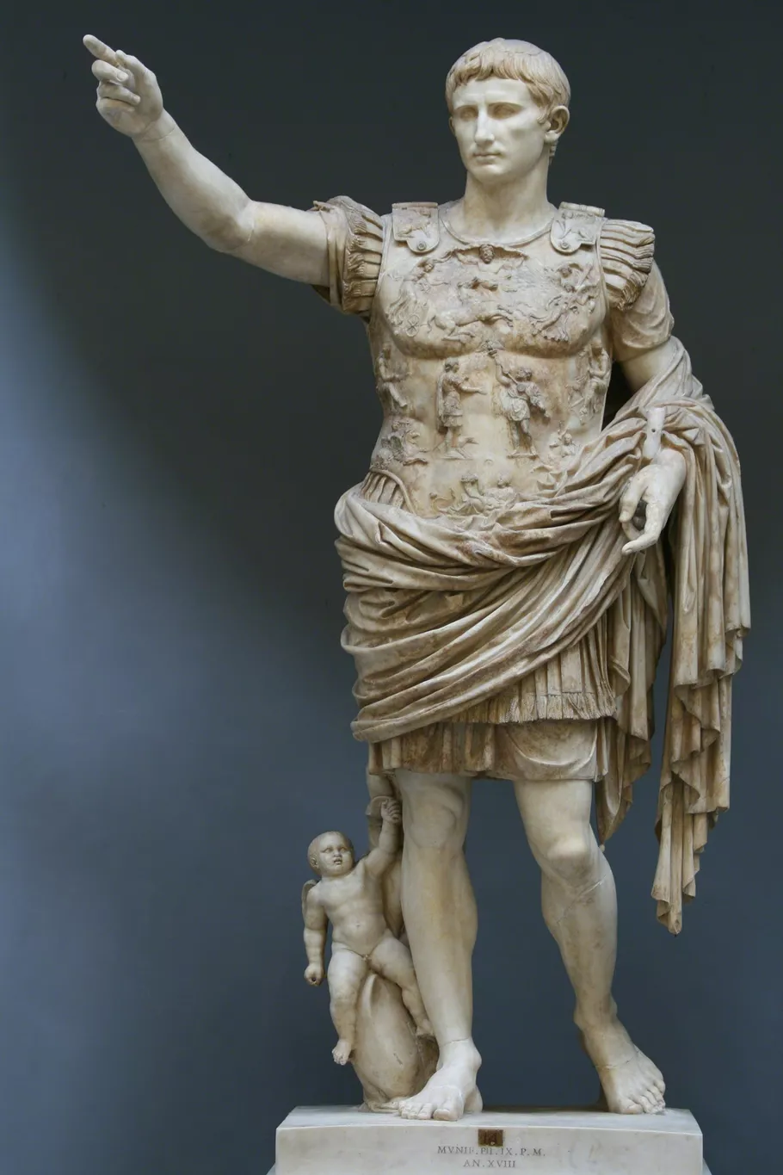
PART A — Previous Review Progress
Work Done Till RMS Review-1
Studied the fundamentals and scope of Iconography.
Conducted a systematic literature review of existing Iconography research.
Identified major research trends, methodologies, strengths and limitations.
Performed comparative analysis of existing research papers.
Developed an initial taxonomy for:
Iconography applications
Cultural and religious Iconography
Identified the need for structured classification and interdisciplinary research.
Prepared a comparative Excel study of existing surveys and the proposed survey.
Key outcome: Established the research foundation and initial taxonomy for Iconography.
2

Slide 3
Work Done Till RMS Review-2
Explored datasets related to cultural heritage and Iconography.
Investigated multiple dataset sources:
Kaggle
Zenodo
Europeana
Museum repositories
Research datasets
Collected 76 research papers from IEEE, Springer, Elsevier, MDPI, ACM and other sources.
Classified papers into:
Core Iconography
AI + Iconography
Supporting Papers
Identified methods and sub-methods used in Iconography.
Refined the taxonomy using the collected literature.
Identified major research gaps:
Lack of standard cultural-heritage datasets
Limited symbolic interpretation
Weak visual-text integration
Lack of unified evaluation benchmarks
Key outcome: Research foundation was converted into a structured dataset/literature-based research framework, enabling implementation-oriented work.

Slide 4
PART B - From Research Gap to Implementation
Transition from Literature Review to AI-Based Implementation
Research gaps identified in Review-2
Lack of standard datasets for cultural-heritage Iconography
Limited AI-based classification and interpretation
Limited symbolic interpretation approaches
Weak integration of visual and textual information
Absence of unified evaluation benchmarks
Current Research Direction
Indian Traditional Painting Classification using Deep Learning
Objective: To investigate AI-based visual classification approaches for Indian paintings and compare their effectiveness across multiple architectures and pipelines.

Slide 5
Implementation progression
Literature & Taxonomy
Dataset Selection
8-Class Painting Classification
Multiple Model Pipelines
Fine-Tuning & Staged Training
Quantitative + Class-wise Evaluation
5

Slide 6
Dataset & Experimental Setup
Indian Painting Classification Dataset
Target task: 8-class image classification
Dataset focused on Indian traditional paintings.
Same dataset splitting protocol is maintained across experiments.
Data augmentation is used during model training where applicable.
Models are evaluated using both overall and class-wise metrics.
Experimental Evaluation
Overall metrics
Accuracy
Precision
Recall
F1-score
Class-wise metrics
Precision
Recall
F1-score
Support
Additional analysis
Confusion Matrix
Experimental objective
Compare different deep-learning representations and classification strategies under a consistent experimental setup.
6

Slide 7
Models Developed and Evaluated
Six Deep Learning Models for Indian Painting Classification
To investigate different approaches for visual representation learning and classification, six models were developed and evaluated on the 8-class Indian painting dataset.
Model | Approach | Key Idea | Category
ResNet50 | Fine-tuned CNN | Deep residual feature learning with transfer learning | CNN-based
EfficientNet-B0 | CNN | Efficient feature extraction with a strong accuracy–efficiency trade-off | CNN-based
ResNet50 + SVM | Deep Features + Classical ML | ResNet50 feature representation combined with SVM classification | Hybrid
Swin Transformer | Hierarchical Transformer | Window-based self-attention for multi-scale visual representation | Transformer-based
ViT-B/16 | Vision Transformer | Global image representation using self-attention | Transformer-based
DINOv2 | Self-Supervised ViT + Contrastive | Self-supervised visual representation learning without relying solely on supervised pretraining | Self-Supervised

Slide 8
Training and Evaluation Strategy
Common Experimental Setup
All models were evaluated for the 8-class Indian painting classification task.
Transfer learning was used for pretrained deep-learning architectures.
Models were trained on the prepared and preprocessed painting dataset.
Validation performance was monitored during training.
The best-performing model/checkpoint was retained based on validation performance.
Model-Specific Training Approaches
ResNet50
Fine-tuned pretrained CNN.
Adapted learned visual features to the Indian painting dataset.
EfficientNet-B0
Transfer-learning based CNN.
Fine-tuned for the target classification task.

Slide 9
Model-Specific Training Approaches
ResNet50 + SVM
Fine-tuned ResNet50 used as a feature extractor.
Extracted 2048-dimensional deep features.
Features standardized using StandardScaler.
SVM used as the final classifier.
Swin Transformer
Transformer-based hierarchical visual representation.
Fine-tuned for painting classification.
ViT-B/16
Transformer-based global visual representation.
Trained using a staged fine-tuning strategy.
DINOv2
Self-supervised pretrained visual representation.
Used as a feature-learning approach for classification.
Evaluation Metrics
Accuracy | Precision | Recall | F1-score | Support

Slide 10
6-Models Performance Analysis
Model | Accuracy | Precision | Recall | F1-score | Weighted Precision | Weighted Recall | Weighted F1-score | Support (Test samples)
ResNet50 (Fine-tuned CNN) | 87.00% | 85.00% | 84.00% | 84.00% | 88.00% | 87.00% | 87.00% | 144
EfficientNet-B0 | 84.72% | 83.14% | 81.54% | 81.38% | 86.60% | 84.72% | 84.93% | 144
ResNet50 + SVM | 87.50% | 86.90% | 85.54% | 85.56% | 88.16% | 87.50% | 87.37% | 144
Swin Transformer | 83.92% | 83.97% | 83.40% | 83.50% | 83.85% | 83.92% | 83.71% | 143
ViT-B/16 | 86.81% | 87.06% | 82.67% | 84.27% | 88.23% | 86.81% | 87.00% | 144
DINOv2 (Self-Supervised ViT + Contrastive) | 94.41% | 94.45% | 93.74% | 93.94% | 94.61% | 94.41% | 94.38% | 143

Slide 11
8-Class Performance Analysis for DINOv2
Model | Class | Precision | Recall | F1-score | Test Images
DINOv2 (Self-Supervised ViT + Contrastive) | gond painting | 93.33% | 93.33% | 93.33% | 15
 | kalighat painting | 97.37% | 100.00% | 98.67% | 37
 | kangra painting | 100.00% | 92.31% | 96.00% | 13
 | kerala mural | 100.00% | 100.00% | 100.00% | 14
 | madhubani painting | 86.67% | 92.86% | 89.66% | 14
 | mandana art drawing | 90.00% | 85.71% | 87.80% | 21
 | pichwai painting | 100.00% | 85.71% | 92.31% | 14
 | warli painting | 88.24% | 100.00% | 93.75% | 15
 | MACRO AVG (overall) | 94.45% | 93.74% | 93.94% | 143

Slide 12
Comparative Analysis & Current Findings
Findings so far:
Multiple model architectures/pipelines were implemented and evaluated.
Transfer learning provides a strong starting point for Indian painting classification.
Fine-tuning improves adaptation to the target dataset.
Stage-wise training allows controlled investigation of model improvement.
Evaluation using precision, recall and F1-score provides more detailed insight than accuracy alone.
Class-wise analysis reveals differences in classification difficulty among the 8 classes.
Current research direction
Identify the most effective pipeline → analyse errors → refine the approach → establish final experimental results.

Slide 13
PART C — NEXT REVIEW
Finalise the best-performing model/pipeline.
Complete Stage 3 and Stage 4 comparative analysis.
Perform detailed confusion-matrix and error analysis.
Consolidate overall and 8-class-wise performance metrics.
Compare all implemented models systematically.
Finalise the proposed methodology/framework.
Document research findings and limitations.
Prepare the research work report and final experimental documentation.
Identify scope for further improvement/future research.

Slide 14
Conclusion
Summarizes the research work completed on iconography till date
Systematic literature review and comparative analysis were conducted
Structured taxonomies for iconography applications and cultural–religious iconography were developed
Made Excel for ,Comparative study between proposed survey and existing surveys.

Slide 15
Thank you
15

