Slide 1
PREDICTION PRODUCT
AD CAMPAIGN PERFORMANCE

Slide 2
Introduction
An ad campaign is a coordinated series of advertisements with a unified theme or message, designed to achieve a specific marketing goal.
It typically spans various media channels such as television, radio, print, online, and social media.
Ad campaigns are crucial for promoting products, services, or brands and for reaching and engaging potential customers effectively.
The objective of this project is to develop a robust supervised machine learning model designed to accurately forecasts key performance indicators (KPIs) for future product ad campaign.

Slide 3
Introduction
By accomplishing this objective, we plan to furnish them with important experiences that can illuminate key direction, improve asset distribution, and upgrade generally speaking promoting viability.

Slide 4
Dataset Information
Following are the details of my dataset:
Our dataset has 731 entries and 11 columns.
There are three columns with float data types and eight with integer data types.
The dataset has 5 categorical variables namely limit_infor, campaign_type, campaign_level, product_level, resource_amount whose values have been represented by single digit numbers. Here, the target variable is "orders“.
Following are the columns with description:

Slide 5
Column name | Description
limit_infor | limits or restrictions associated with the marketing campaign or product.(0,1)
campaign_type | type of marketing campaign, such as email, social media, print advertising,etc (0,1,2,3,4,5,6)
campaign_level | level or scale of the marketing campaign, for example, national, regional, or local.(0,1)
product_level | level or category of the product being marketed, such as high-end, mid-range, or budget.(1,2,3)
resource_amount | resources (e.g., budget, personnel, or materials) allocated for the marketing campaign.(1,2,3,4,5,6,7,8,9)
email_rate | email delivery rate or open rate.
price | selling price of the product.
discount_rate | discounts or promotional offers associated with the product.
hour_resources | the number of labor hours or human resources dedicated to the marketing campaign or product sales efforts.
campaign_fee | fees or costs associated with running the marketing campaign.
orders | number of orders or sales generated for the product during the marketing campaign.

Slide 6
Exploratory Data Analysis (EDA)
Exploratory Data Analysis (EDA) is a critical process in data science that involves examining and summarizing data sets to uncover patterns, spot anomalies, test hypotheses, and check assumptions with the help of summary statistics and graphical representations.
The dataset had no duplicates and 2 missing values in "price" . Hence, the missing values were filled with mean.
While noticing the relationship of numeric qualities with "orders", the campaign_fee had one exception which was taken out for a cleaner information.The outlier value was 33380.

Slide 7
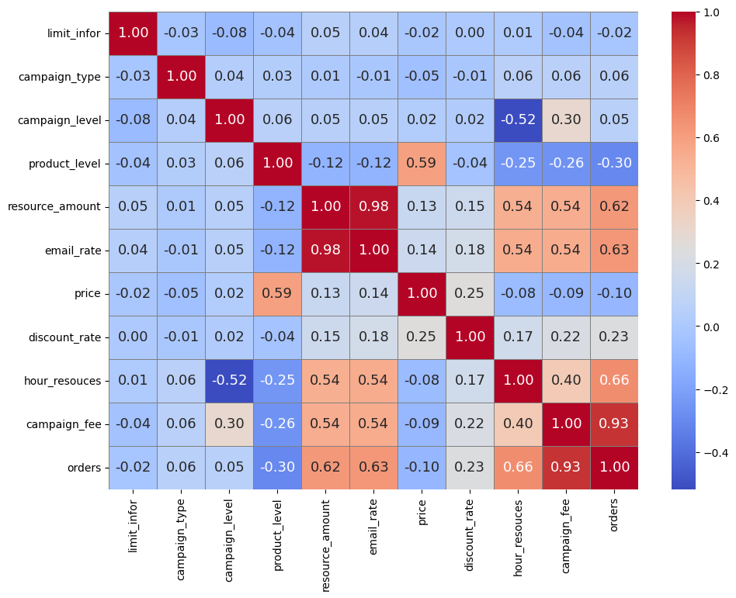

Slide 8
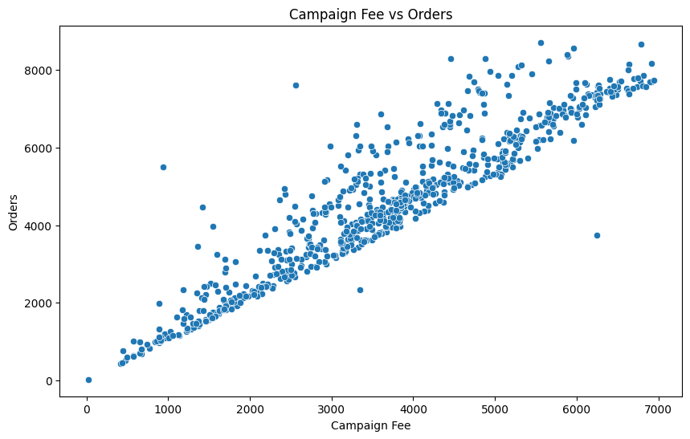

Slide 9
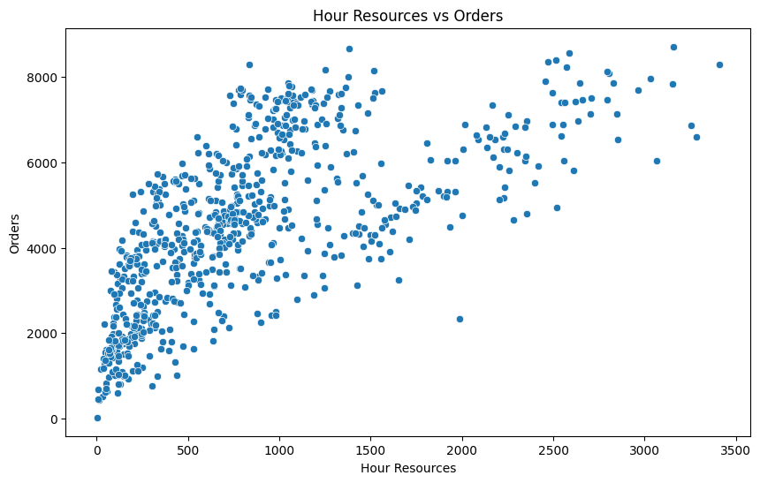

Slide 10
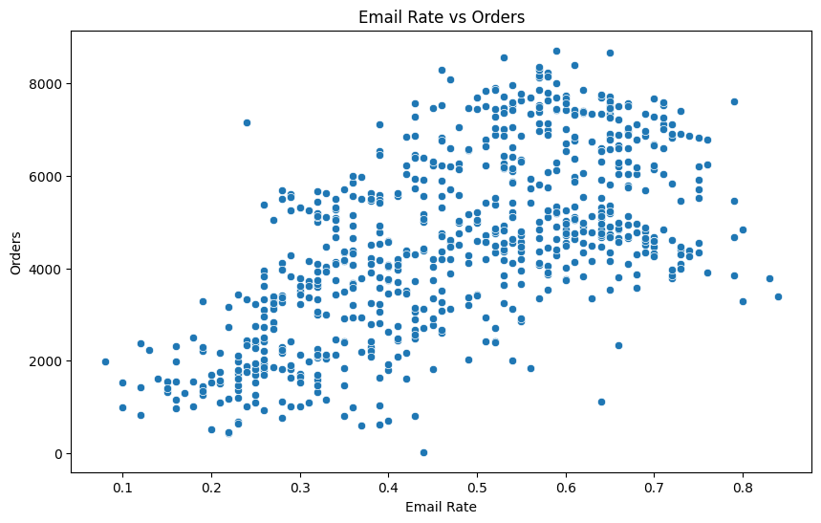

Slide 11
Exploratory Data Analysis (EDA)
I used IQR method to determine and remove the outliers.
While finding out correlation Correlation coefficient revealed that 'discount_rate' (0.23), email_rate' (0.63), 'hour_resouces' (0.66), and 'campaign_fee' (0.93) have positive correlations with 'orders'.
'price' (-0.10) has a weak negative correlation with 'orders'.
I also used MinMaxScaler during preprocessing of data.

Slide 12
Data preparation for model
I splitted the data in two parts: x and y.
X contains all the independent variables, which are the features used to make predictions.
Meanwhile, y represents the dependent variable or target variable, which is the outcome we want to predict.

Slide 13
Train test split
The dataset was parted into preparing and testing sets.
A 80:20 proportion was utilized, with 80% of the information dispensed to preparing and 20% to testing, and the test size set to 0.2.
An irregular condition of 42 was indicated to guarantee the reproducibility of results across various runs

Slide 14
Model Selection
The task of predicting product ad campaign performance is approached as a regression problem. Thus, the following models were employed:
Linear Regression: Ideal for straightforward, linear connections, offering a high degree of interpretability.
Support Vector Machine (SVM): Versatile, catering to both linear and non-linear relationships, though it can be computationally intensive.
Random Forest: Highly effective for intricate, non-linear patterns, providing robust performance, albeit with reduced interpretability and increased computational demands.

Slide 15
Values for all models
MODEL | MAE | MSE | RMSE | R2
Linear Regression | 127.71 | 230943.21 | 480.57 | 0.94
Random Forest Regression | 199.64 | 287138.29 | 535.85 | 0.92
Support Vector Machine | 1633.21 | 3844116.52 | 1960.64 | -0.00

Slide 16
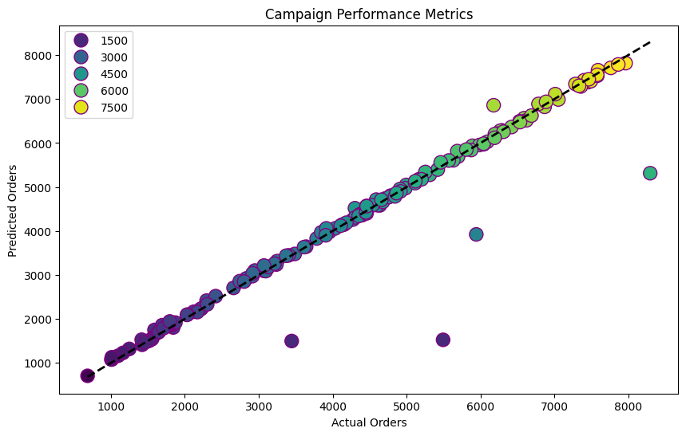

Slide 17
Conclusion
The analysis and predictions deliver crucial insights that can
markedly boost the company's ad campaign performance:
Campaign Fee and Hour Resources: Elevating campaign fees and dedicating more resources positively impact the number of orders. This suggests that investments in these domains are poised to yield substantial returns.
Pricing Strategy: Higher prices tend to diminish the number of orders. Hence, maintaining competitive and minimal prices can lure more customers and enhance sales.

Slide 18
Conclusion
Discount Rates: While elevated discount rates slightly increase the number of orders, their effect is minimal. This implies that concentrating on pricing and resource allocation may be more effective than heavily depending on discounts.
Model Performance: Linear regression surpasses SVM and random forest regression due to the linear relationship between features and the target variable. This underscores the significance of employing a simpler, well-suited model to avert overfitting and ensure precise predictions.
By harnessing these insights, the company can strategically allocate resources, optimize pricing, and fine-tune their ad campaigns to maximize effectiveness and bolster the overall return on investment (ROI).

Slide 19
Thank You!

