Slide 1
Content Recommendation System
Our Team:
Sanket J Shah - AU1841120
Kishan Mehta - AU1841072
Dhruv Sharma - AU1841102
Harsh Patel - AU1841075

Slide 2
Introduction
The internet is growing at an exponential rate, the size and complexities of the websites grows along with it.
An average consumer now prefers on-demand content rather than traditional scheduled streaming method.
58% of the traffic on internet is responsible for the video-based content streaming.
Recommended System collects data from users activities and analyzes it the data to generate customized recommendations.

Slide 3
Problem Statement
In recent years, the information overload problem to find the most relevant products from a massive amount of data has surfaced.
There is no absolute all-working solution for this problem as there can be various aspects that a user might take in consideration.
In various portals, the user is often asked to select few movie which he likes, than the algorithm calculates and recommends movies which lies between both the movies.

Slide 4
Existing body of work
Flickmetrix recommends movies based on their availability on OTT platforms and it takes many inputs from user while searching for movie such as release year and rating.
Date Night app lets you add two movies to the app and it will spit out a line of recommendations that are somewhere between the two choices.
Movie of the Night recommendation works just like Flickmetrix by taking in various time wasting inputs from users but this recommendation system only suggests one movie based on the criteria.

Slide 5
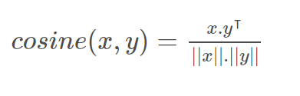
Our Approach
TF-IDF based Cosine Similarity:
The 'term frequency–inverse document frequency(TF-IDF) vectorizer' is used to convert the string input to numeric input so that the calculation becomes efficient.
Cosine similarity is used to calculate the similarity between two vector values. It works by finding the cosine of the θ-angle between both the vectors.
Formula for Cosine similarity for matrices is given as below:

Slide 6
Our Approach
We used the following different combinations of features of a given pair of movies to find the similarity between them:
Movie Tagline + Movie Overview (Movie Description)
Movie Genre + Movie Cast
Movie MetaData (Keywords + Genre + Director + Cast)
We used TF-IDF to convert these string values to numeric values and then build a pairwise similarity matrix.
This matrix contains the similarity index for all the movies in the dataset based on the selected feature combinations.
Finally, we extract the top ‘n’ movies with highest similarity index with respect to the input movie.

Slide 7
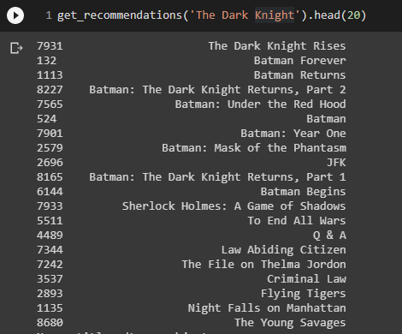
Initial Results
Movie Description(Tagline + Overview)

Slide 8
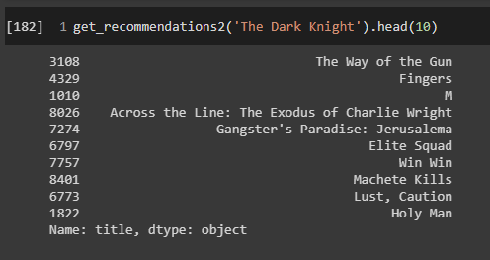
Initial Results
2. Movie Genre + Movie Cast(All cast members)

Slide 9
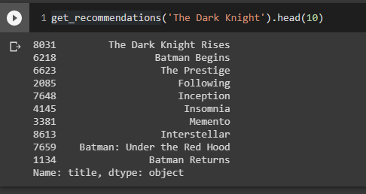
Initial Results
3. Movie MetaData (Keywords + Director + Genre + Cast(top 3 names))

Slide 10
Role of each group member in the project
Work | Report | Coding | Research | Data gathering
Sanket Shah |  | Yes | Yes | Yes
Kishan Mehta | Yes |  | Yes | Yes
Dhruv Sharma | Yes |  | Yes | Yes
Harsh Patel |  | Yes | Yes | Yes

Slide 11
Future Work
Make a hybrid method that can combine the outputs for multiple movie inputs and create a hybrid recommendation list.
Explore the GMM based approach for the movie recommendation problem.
The GMM based approach uses the previous ratings that user has given to the movies and predict the rating that the user would given to the new movie.

Slide 12
References
“Data Mining.” Mining of Massive Datasets, by Anand Rajaraman and Jeffrey David Ullman, Cambridge University Press, Cambridge, 2011, pp. 1–17.
“MovieLens 25M Dataset.” GroupLens, 2 Mar. 2021, grouplens.org/datasets/movielens/25m.
“Mobile Internet Report.” Global Internet Phenomena, 1 Jan. 2020, www.sandvine.com/phenomena#:~:text=This%20edition%20of%20the%20Global,fixed%20and%20mobile%20operators%20worldwide.
Singh, Ramni & Maurya, Sargam & Tripathi, Tanisha & Narula, Tushar & Srivastav, Gaurav. (2020). Movie Recommendation System using Cosine Similarity and KNN. 2249-8958. 10.35940/ijeat.E9666.069520.

Slide 13
Thank You

