Slide 1
Zoo Sanctuary Database
Harshadkumar Patel | N01481887

Slide 2
Agenda
Introduction
Primary Goals
Process
Database Tables
Database Tools and Features
What’s working well and Next steps
Timeline

Slide 3
Introduction
Problem No 1: Assume that donors have the option to earmark their donations for certain type of animals. How can you see the total donated funds for each type of animal?
Problem No 2: Employees must be scheduled for different shifts. How can we schedule different types of employees for different shifts, while making sure employees don’t work more than 40 hours per week period ?

Slide 4
Primary goals
Provide a solution to the real-world problem.

Slide 5
Process

Slide 6
Animal Table
No | Name | Type | Constrain | Extra | Key
1 | AnimalID | Int (11) | Not Null | Auto_Increment | PK
2 | AnimalName | Varchar (50) | Null
3 | Descriptions | Varchar (200) | Null
4 | TypeID | Int (11) | Null |  | FK

Slide 7
Animal Type Table:
No | Name | Type | Constrain | Extra | Key
1 | AnimalTypeID | Int | Not Null | Auto_Increment | PK
2 | Type | Varchar (50) | Not Null

Slide 8
Donation Table
No | Name | Type | Constrain | Extra | Key
1 | DonationID | Int | NOT Null | Auto Increment | PK
2 | Amount | Int | Null
3 | AnimalTypeID | Int | Null |  | FK
5 | DonorID | Int | Null |  | FK

Slide 9
Donor Table
No | Name | Type | Constrain | Extra | Key
1 | DonorID | Int | Not Null | Auto_Increment | Pk
2 | DonorName | Varchar (50) | Null
3 | DOB | Date | Null
4 | Contact | int (15) | Null
5 | Address | Varchar (200) | Null

Slide 10
Employees Table
No | Name | Type | Constrain | Extra | Key
1 | EmployeeID | Int | Not null | Auto_Increment | Pk
2 | EmployeeName | Varchar (50) | Null
3 | Gender | Varchar (10) | Null
4 | DOB | Date | Null
5 | Contact | Int (15) | Null
6 | ResidentialAddress | Varchar (200) | Null

Slide 11
Employee Schedule Table
No | Name | Type | Constrain | Extra | Key
1 | ScheduleID | Int | Not null | Auto_Increment | Pk
2 | EmployeeID | Int | Null |  | Fk
3 | ShiftID | Int | Null |  | Fk
4 | Descriptions | Varchar (200) | Null
5 | HoursWorked | Int | Null

Slide 12
Shift Table
No | Name | Type | Constrain | Extra | Key
1 | ShiftID | Int | Not Null | Auto_Increment | Pk
2 | ShiftType | Varchar (50) | Null

Slide 13
Database tools and features
Normalization of the database using up to 3NF
View to display donations made for all animal with donor and animal information on a single page
Procedure to calculate total donation funds by animal types
1. Trigger
2. Trigger
After delete trigger on donor table to automatically log a deleted data in a separate table.
Before insert trigger on employee schedule to ensure employees cannot work more than 40 hours a week.
1
2
3
4
5
Normalization
View
Procedures

Slide 14
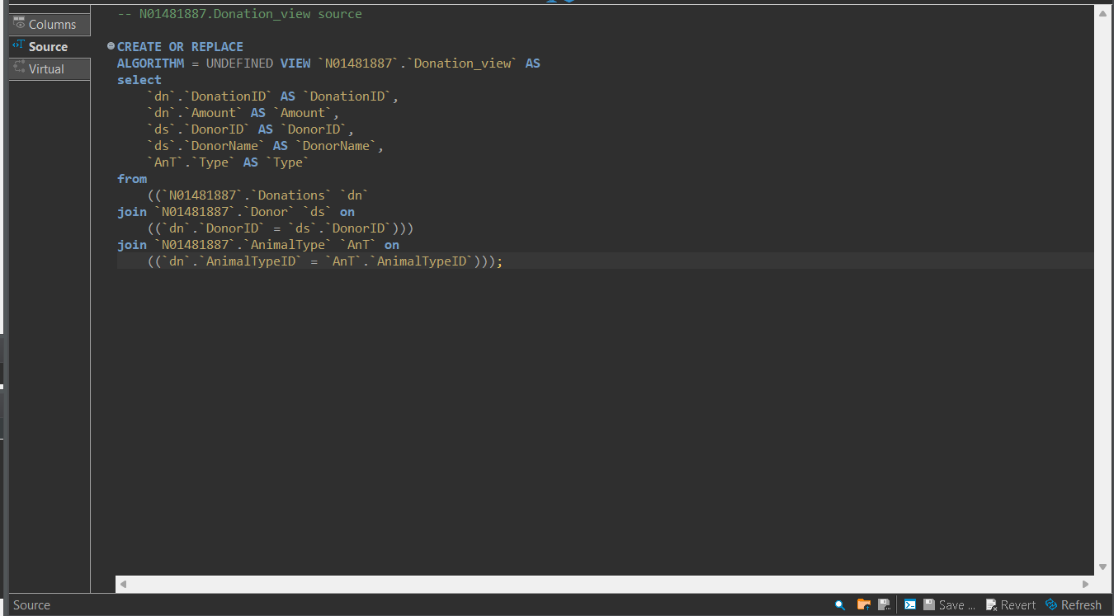
View Query

Slide 15
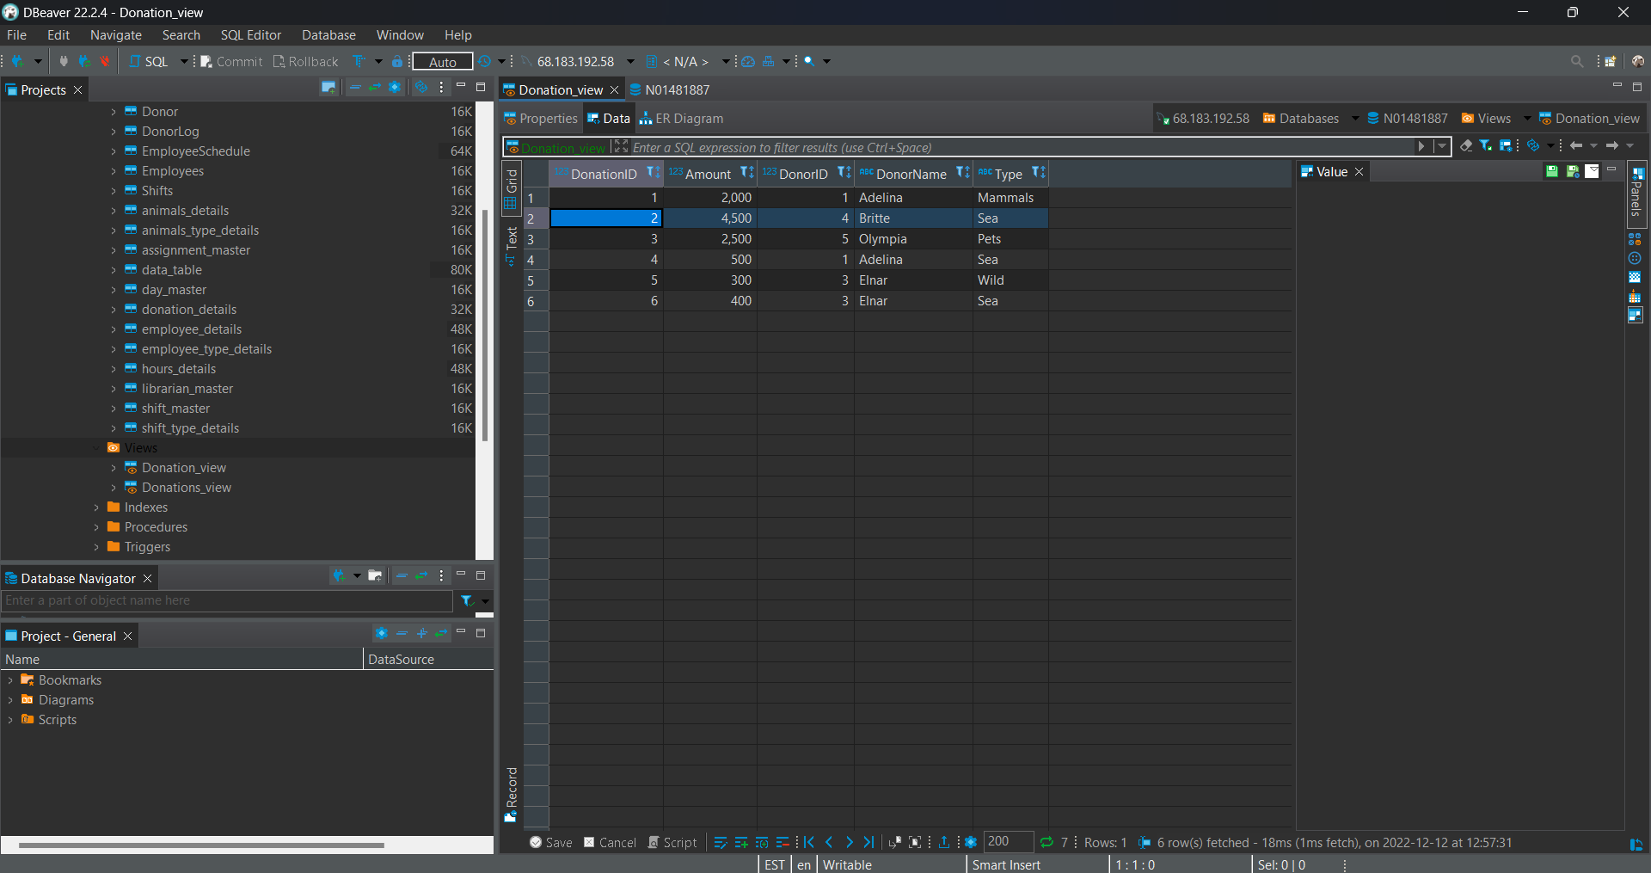
View Output

Slide 16
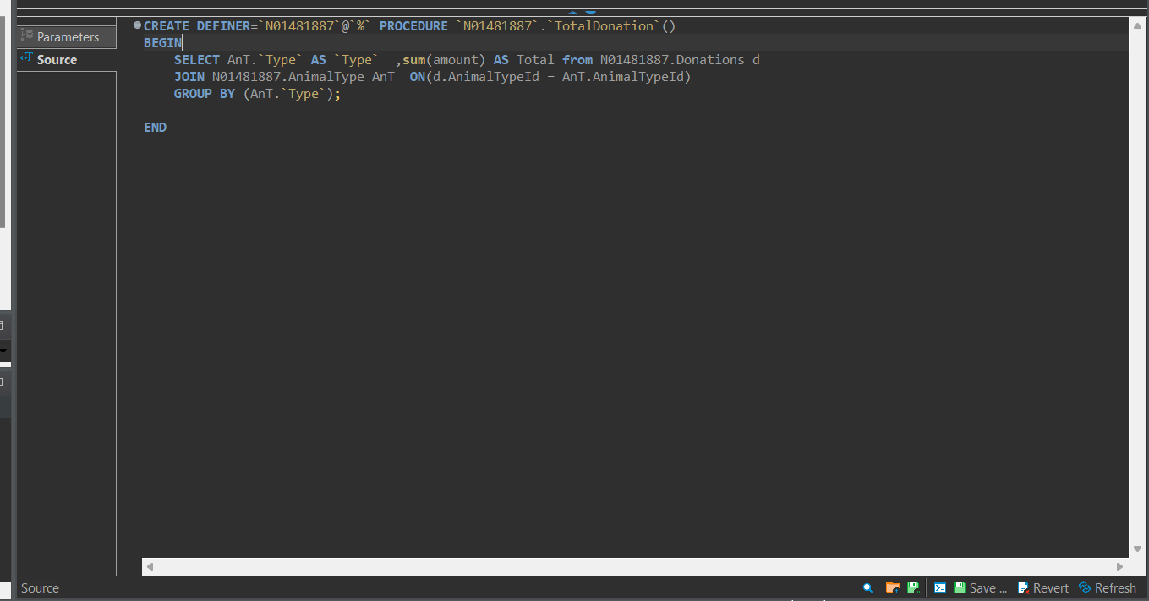
Procedures Query

Slide 17
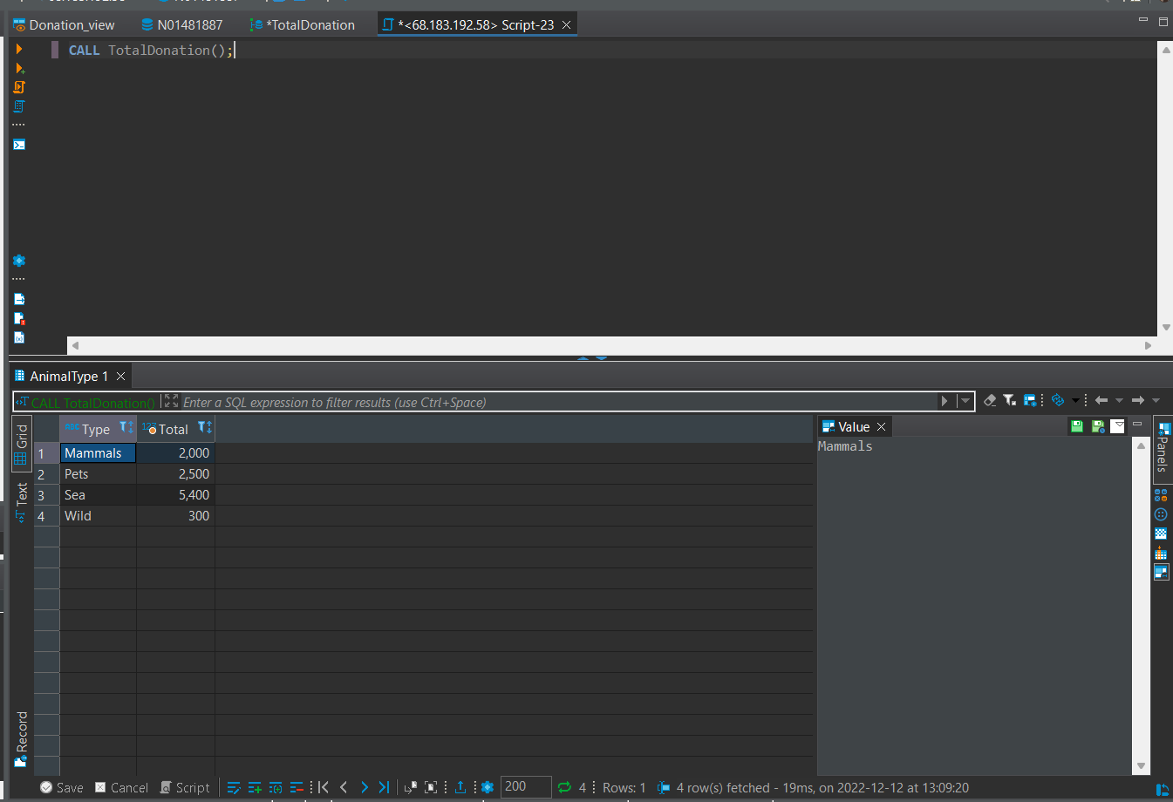
Procedures Output

Slide 18
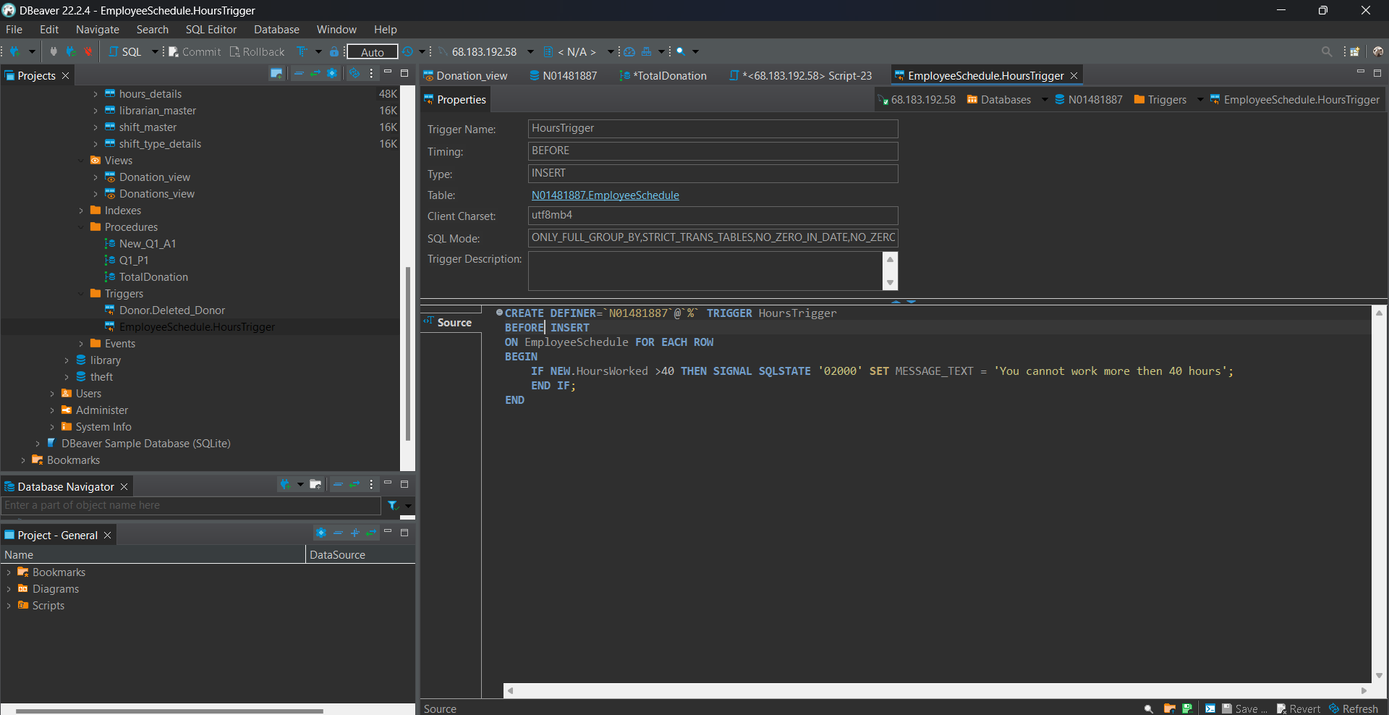
Trigger

Slide 19
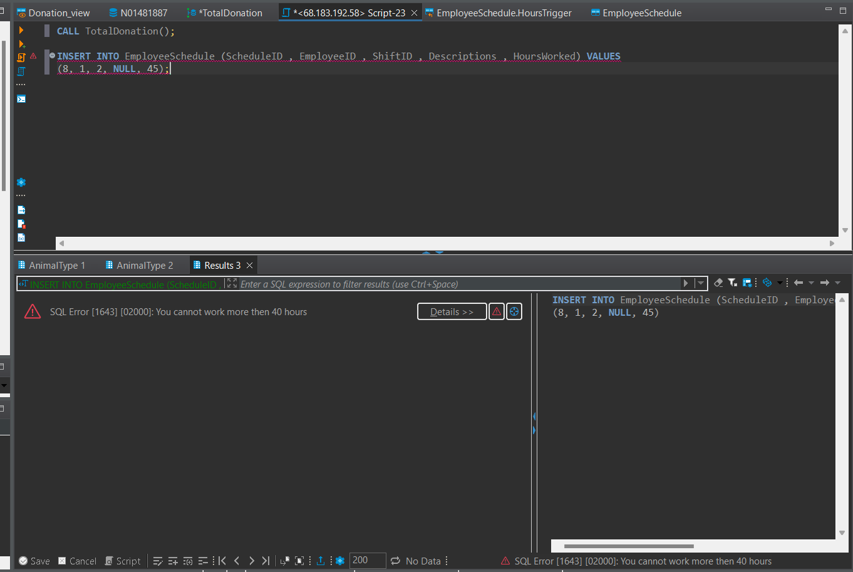
Trigger Output

Slide 20
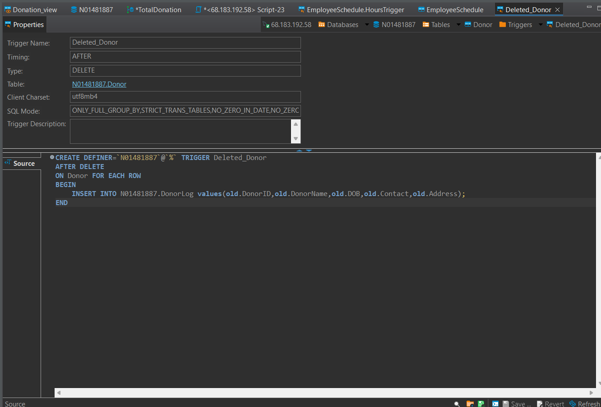
After Delete Trigger

Slide 21
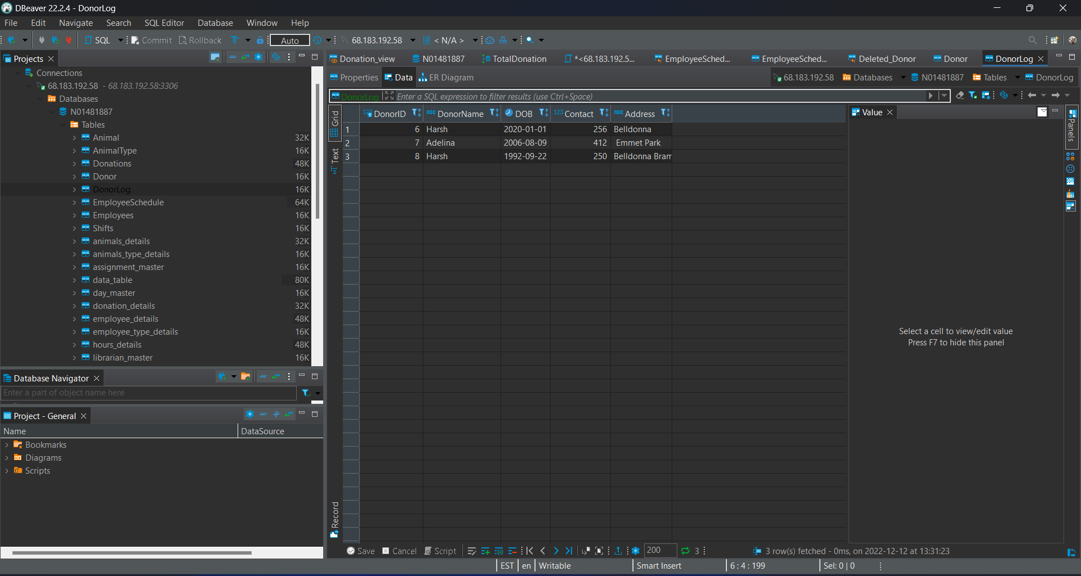
After Delete Trigger Output

Slide 22
What’s working well?
What needs improvement?
Provides effective solution to the problem.
Using procedure, we are able to track total donation for each type of animal.
Using before insert trigger we are ensuring employee do not exceed 40 hours work week policy.
Using after delete trigger to safeguard donor data against accidental deletions.
Need to improve the solution to the problem.
In Current database of employee schedule, I haven't used clock in/clock out. Instead, I directly put hours for the employee. However, I think I can improve later by adding the column Date, Clock-In, Clock-out timestamp.

Slide 23
Timeline
Presentation and final submission
Nov 22, 2022
Proposal Assignment submitted.
Nov 25, 2022
Received feedback on Proposal
Dec 11, 2022
Error and update, Working on to update proposal as per the feedback with real database to reach the solution
Dec 12, 2022
Develop final Assignment and Resubmitted Proposal
Dec 13, 2022

Slide 24
Thank you
Any Question ?

