Slide 1

GLOBAL DEVELOPMENT MEASUREMENT

Slide 2
Cluster Analysis
Group 1
Mr. Harshawardhan Patil
Ms. Chaitra S
Mr. Veera Sai Krishna
Mr. Dinakara Rama Kulala
Mr. Pushpak Dilip Khanke
Mentor Name: Madishetti Rajashekar

Slide 3
Business Problem:
Creating clusters on global development measurement dataset.
Objective: The objective of the analysis is to form
clusters based on the given global development measurement data.

Slide 4
Project Flow
EDA and Visualization
Missing values are present in all the features except
“Country” & “Population Total”. Created different Visualizations like (Boxplot, Distribution plots, bar plots, etc.,) to understand the patterns in the data.
Data Pre-processing
Removed special characters ($, %) before numbers.
Converted few features to numeric datatype from Object type. Used mean/Median imputation techniques to fill NaN values. Dropped 7 columns having maximum null values.
Data Exploration
Dataset shape:
(2704,25)
Deployment
We deployed the model using Streamlit.
Model Performance
Using Elbow Curve to get optimal Clusters in KMeans
Performance is calculated
through Silhouette's Score and distance between means of each cluster.
Model Building
Planning to build models like K-Means Clustering , Hierarchical Clustering and Gaussian Mixture

Slide 5
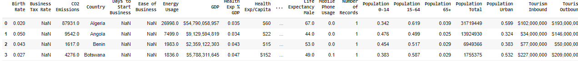
Data set details
Exploratory Data Analysis (EDA)
No. of Rows: 2704 No. of Features: 25
No. of Categorical Features: 1
No. of Continuous Features: 24
Screenshot of the Dataset

Slide 6
What we have done with our data:
Describing data
Removing symbols & convert object into float
Missing values
Dropping column
Duplicate values
Correlation
Distplots
Outliers
Visualizations
EDA Analysis by Using Sweet viz, Auto viz

Slide 7
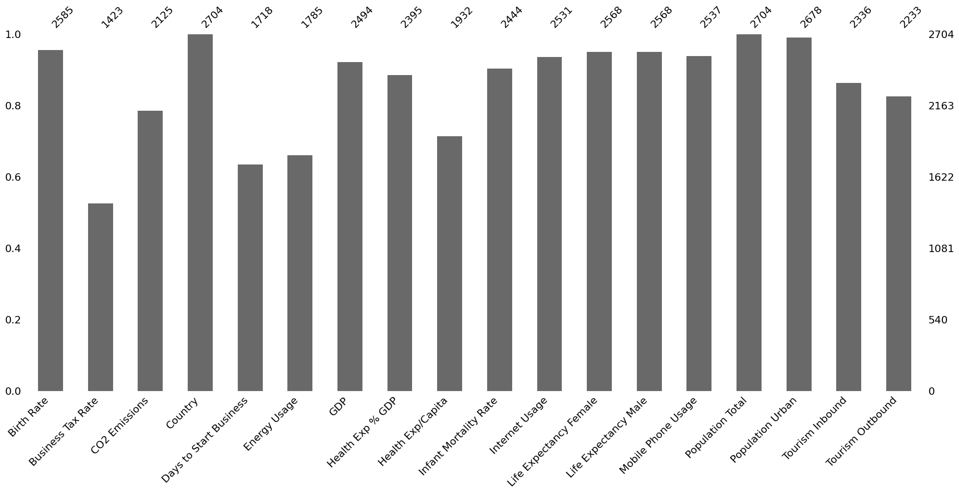
Exploratory Data Analysis (EDA)
Visualizing the Missing values in the dataset

Slide 8
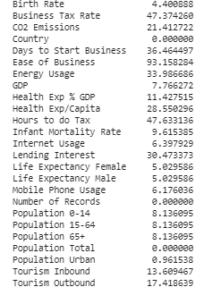
Exploratory Data Analysis (EDA)
Identified null values in the dataset, all the features are having null values except “Country” & “Population Total” features
Feature wise Percentage of Null Values

Slide 9
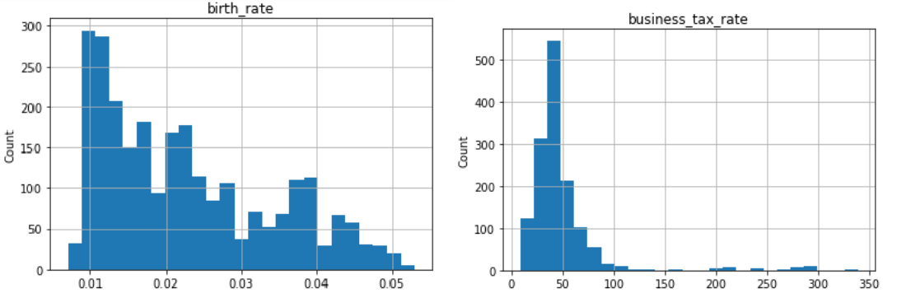
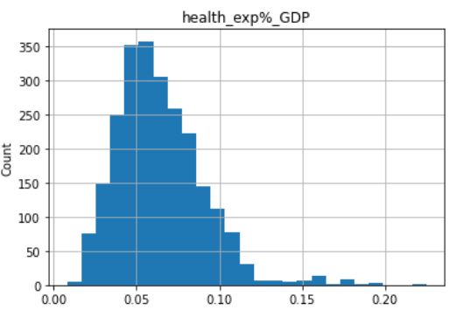
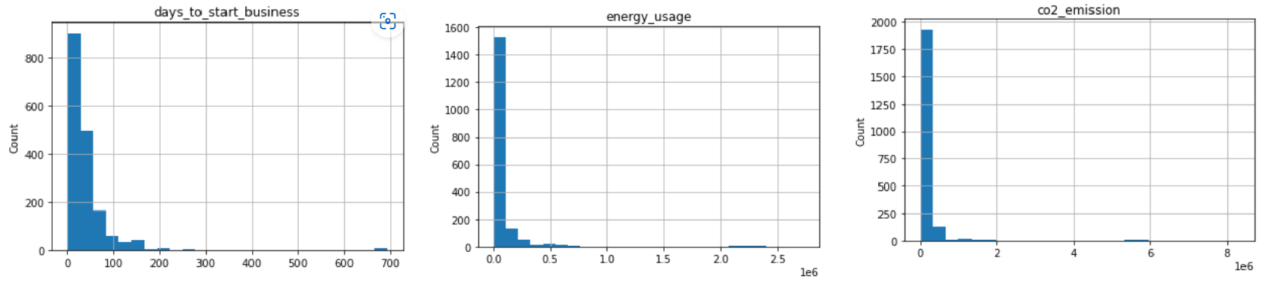
Histograms to visualize the distribution of the data

Slide 10
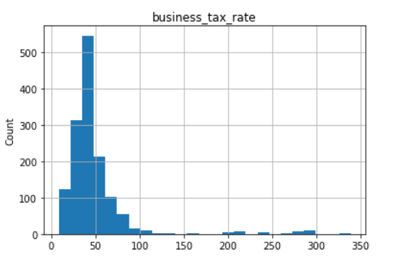
Histograms
Data Distribution: GDP, population_total, co2_emission, days_to_start_business, tourism_inbound, energy_usage, tourism_outbound features are highly skewed.
Range and Spread: By observing the width of the histogram, we can understand the range and spread of the data.
Outliers: Histograms can help identify outliers, which are data points that significantly deviate from the majority of the data.

Slide 11
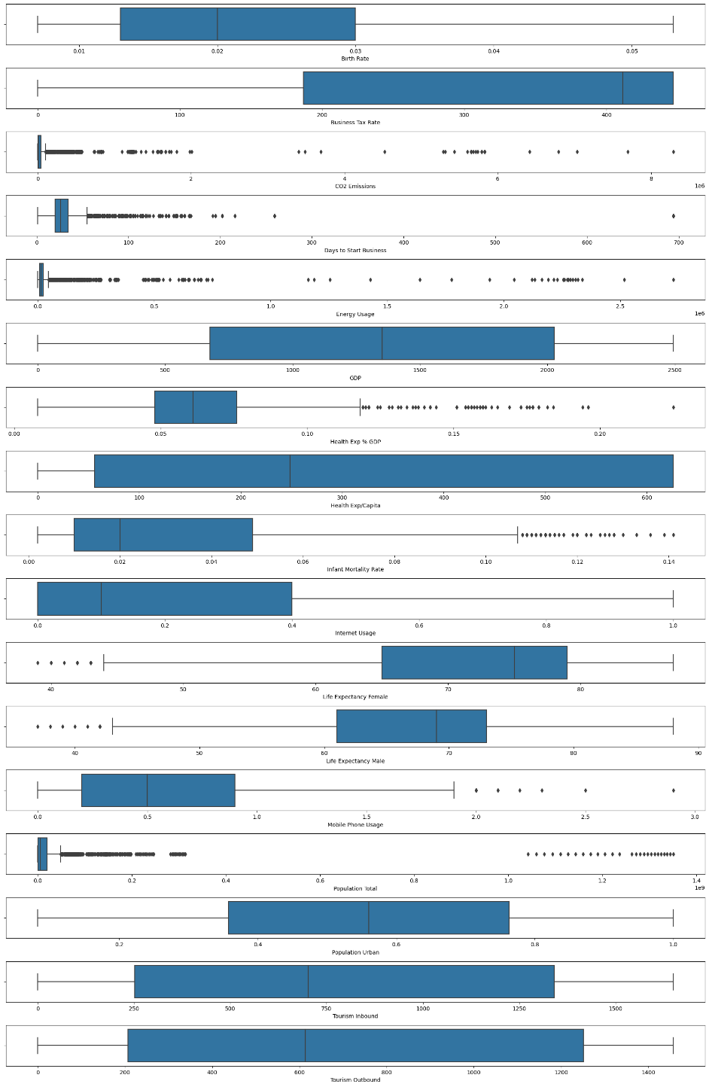
Exploratory Data Analysis (EDA)
Box plot representing that there are
outliers in some of the
columns of the data

Slide 12
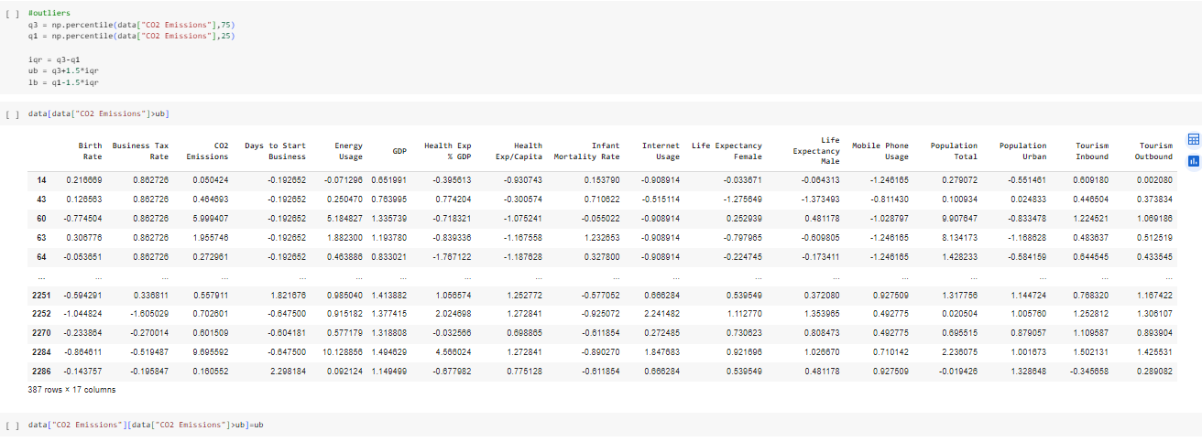
Handling Outliers
In Cluster Analysis, since KMeans Clustering is sensitive to outliers we have handled all the outliers present in the dataset .

Slide 13
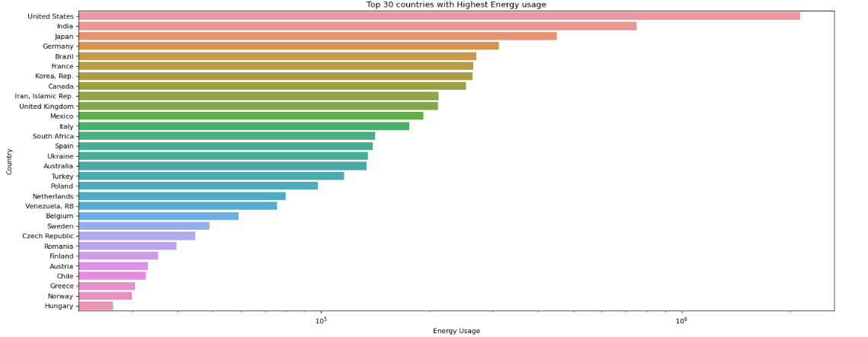
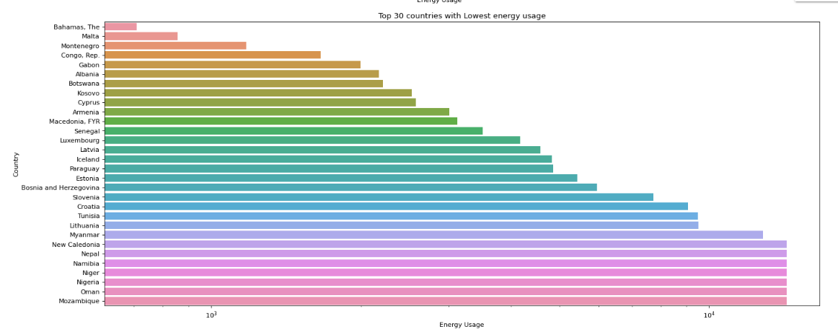
Visualization of Top 30 Countries with Highest Energy Usage
Visualization of Top 30 Countries with Lowest Energy Usage

Slide 14
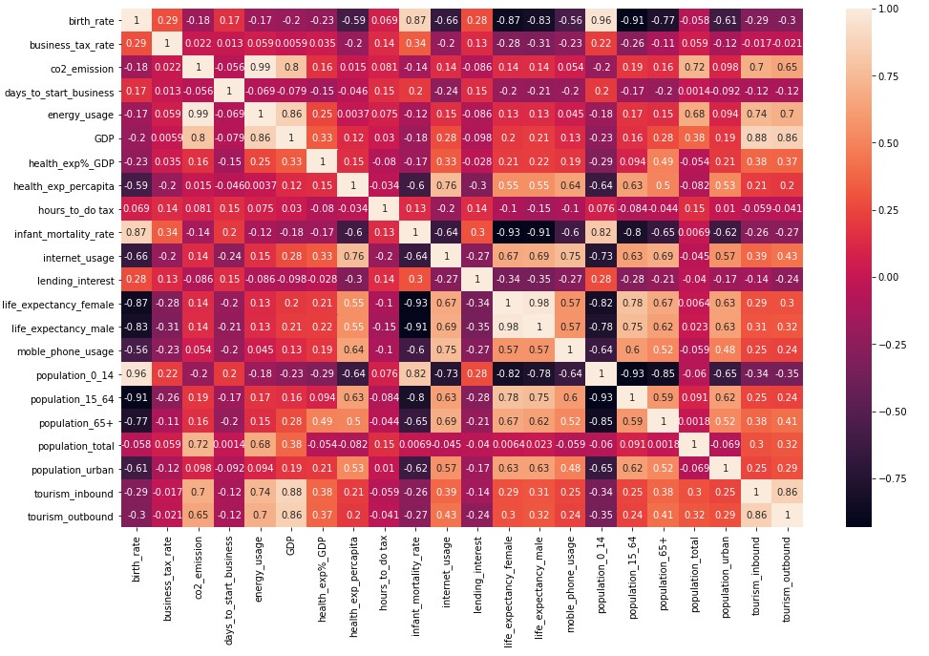
Correlation Heatmap
CO2 Emissions and energy usage are having maximum correlation of 0.99 with each other than any variables.

Slide 15
t-distributed Stochastic Neighbour Embedding
t-Distributed Stochastic Neighbor Embedding is a non-linear dimensionality reduction algorithm used for exploring high-dimensional data.
We have considered t-SNE over PCA as t-SNE is often used for clustering and can help identify groups of similar data points within the data.
The silhouette score for the clusters formed after applying t-SNE is better than the silhouette score for the clusters formed after applying PCA.
The main advantage of t-SNE is the ability to preserve local structure.

Slide 16
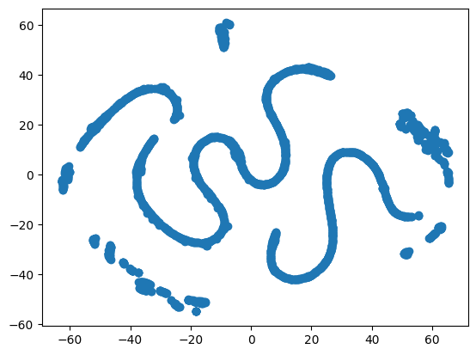
Distribution of data points after applying t-SNE on the dataset
n_components=2

Slide 17
MODEL BUILDING
We have tried to explore 3 Cluster Algorithms:
K-Means Clustering
Hierarchical Clustering
Gaussian Mixture Algorithm
Out of these 3 models we will be considering those models with high silhouette score.

Slide 18
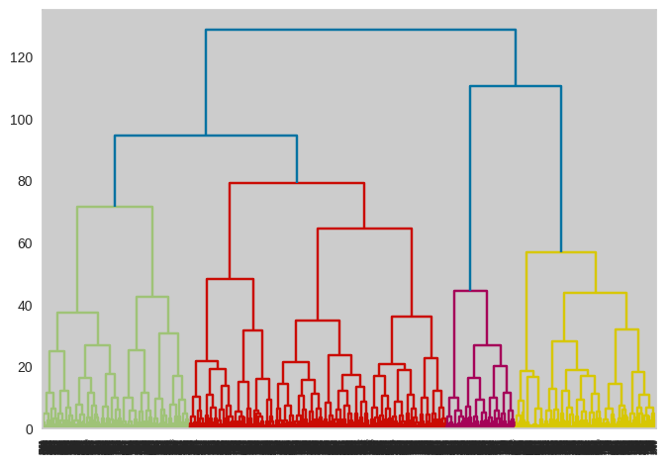
Hierarchical Clustering
In this algorithm we can obtain the optimal number of clusters from the model itself, human intervention not required.
Dendrograms help us in clear visualization, which is practical and easy to understand.
Number of clusters considered= 4

Slide 19
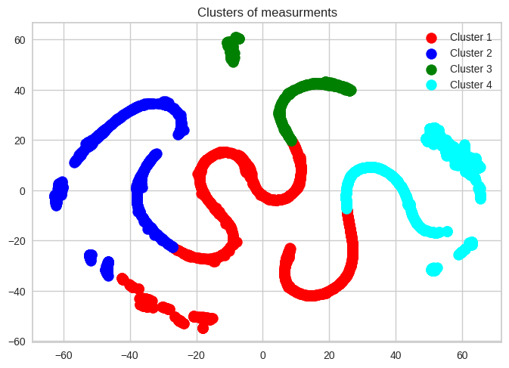

Hierarchical Clustering
Number of clusters considered= 4
Model: Hierarchical Clustering

Slide 20
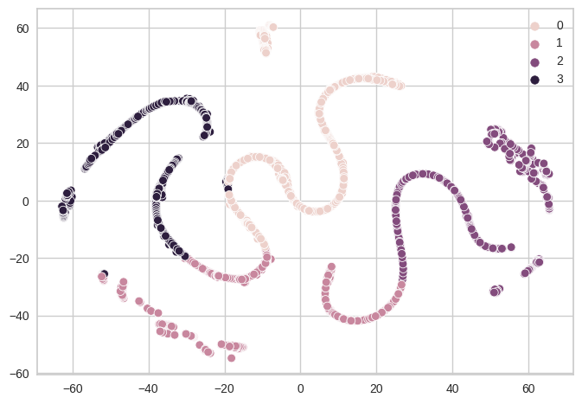

Gaussian Mixture Clustering
The Gaussian Mixture Model (GMM) is a probabilistic model used for clustering and density estimation.
GMM identifies underlying clusters in data, accommodating non-spherical clusters and overlapping patterns
They are best suited for continuous data but can also be used with discrete data.
Number of clusters considered= 4
Model: Gaussian Mixture Clustering

Slide 21
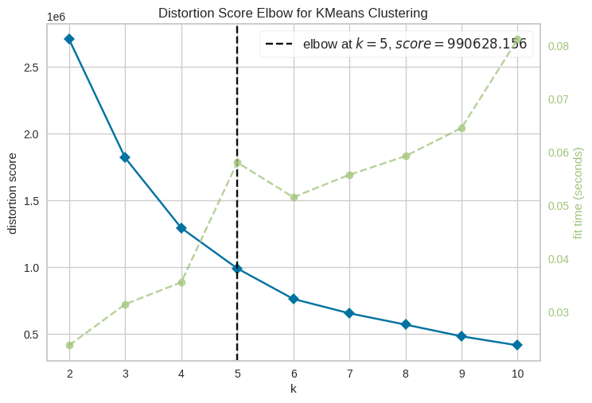
K-Means Clustering
K-means assigns every data point in the dataset to the nearest centroid, meaning that a data point is considered to be in a particular cluster if it is closer to that cluster's centroid than any other centroid.
The goal of K-means clustering is to partition a set of objects into K clusters in such a way that the sum of the squared distances between the objects and their assigned cluster mean is minimized
Optimal number of clusters = 5

Slide 22
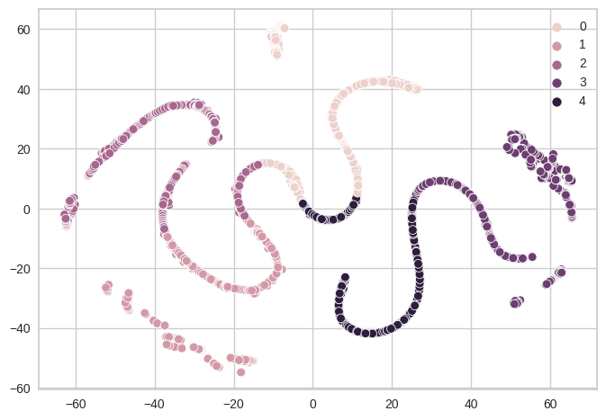


K-Means Clustering
Optimal number of clusters = 5
Model: K-Means Clustering

Slide 23
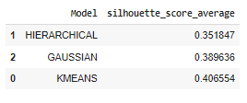
Silhouette Score Comparison
On comparing the silhouette score of all 3 models, KMEANS gives us the highest score with no. of clusters = 5.
Therefore we will be considering KMEANS as our best fit model.

Slide 24
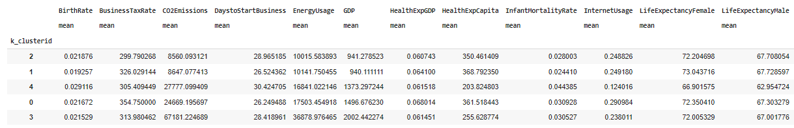
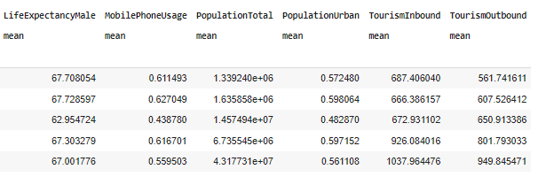
Cluster wise feature means

Slide 25
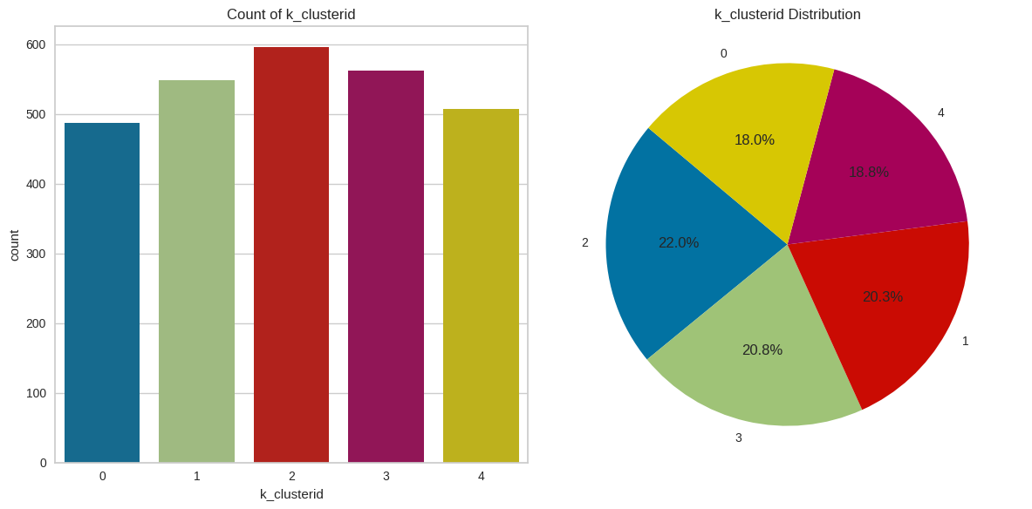
Count plot for Clusters
The bar chart shows distribution of data points among different clusters. It allows us to easily observe the count of data points belonging to each cluster.

Slide 26
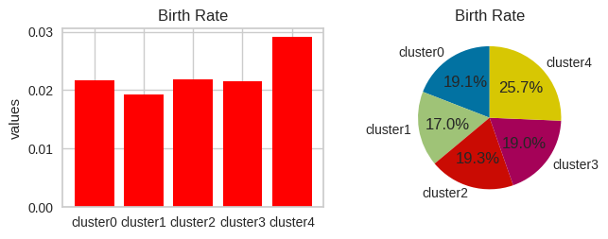
Birth Rate
A high birth rate contributes to population growth. The larger the number of births, the faster the population of the region will increase over time.
Rural areas might experience higher birth rates compared to urban areas where access to education and family planning services is often better.
A low birth rate contributes to an aging population, where a larger proportion of people are elderly. This demographic shift has implications for healthcare, social services, and the labor force

Slide 27
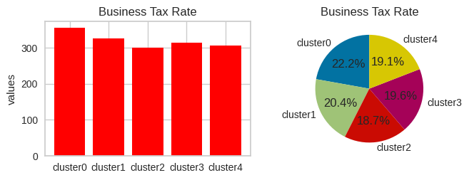
Business Tax Rate
High business tax rates can contribute to economic stability by providing governments with sufficient revenue . This revenue generated from high business tax rates is frequently allocated to infrastructure projects and to fund social welfare programs (healthcare, education, unemployment benefits).
Low business tax rates are often implemented to attract domestic and foreign investment. A favorable tax environment can encourage businesses to invest, expand, and create jobs

Slide 28
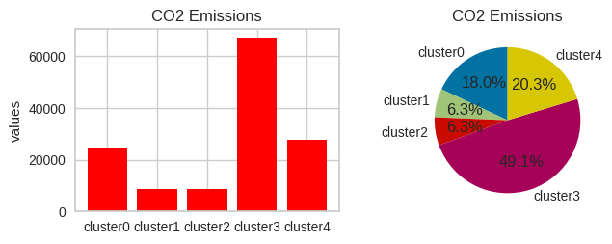
Carbon dioxide Emissions
Countries that have undergone rapid industrialization and experienced substantial economic growth tend to have higher CO2 emissions.
Larger populations often correlate with higher total CO2 emissions.
Countries with low CO2 emissions often prioritize and heavily invest in renewable energy sources such as solar, wind, hydro, and geothermal power.

Slide 29
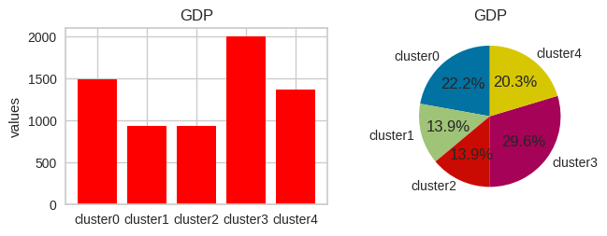
GDP
A high GDP is often associated with economic prosperity and a high standard of living for the population. It suggests that the country is producing a significant amount of goods and services, and there is a higher potential for wealth creation.
Low GDP levels suggest economic challenges and may be indicative of a less developed or struggling economy. This can result in lower living standards and limited opportunities for the population.

Slide 30
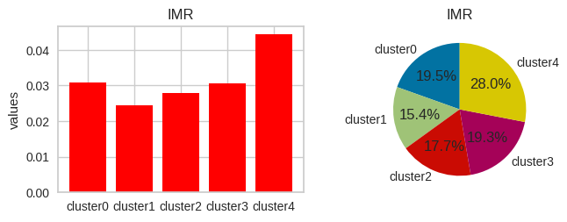
Infant Mortality Rate
High infant mortality rates are often linked to poverty, lack of education, and limited economic opportunities, as these factors impact access to healthcare and nutrition.
Countries with low infant mortality rates generally have well-established healthcare systems with widespread access to quality prenatal and postnatal care.

Slide 31
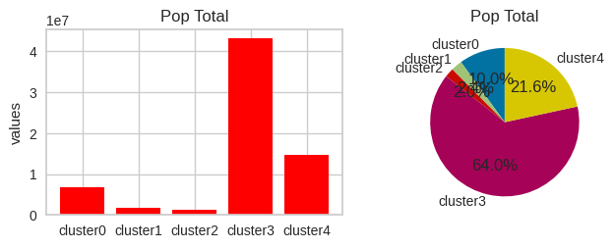
Total Population
High-population countries often have large labor forces, providing a significant workforce that can contribute to economic growth, industrialization, and innovation.
Countries with high populations often exhibit cultural diversity, with a mix of ethnicities, languages, and traditions.
Lower population density can contribute to a higher quality of life, with less congestion, pollution, and competition for resources.

Slide 32
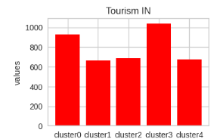
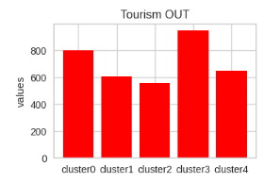
Inbound and Outbound Tourism
Countries with high inbound tourism typically offer a diverse range of attractions, including natural landscapes, historical sites, cultural events, and entertainment options.
A lack of international tourism may lead to missed opportunities for economic growth, job creation, and revenue generation in certain sectors.
Outbound tourism can lead to global business opportunities as citizens explore international markets for trade, investment, and collaboration.
Citizens of countries with low outbound tourism may have limited exposure to global cultures.

Slide 33
These are some of the insights that are obtained with the help of clusters formed using KMEANS Model

Slide 34
Deployment
We have deployed the model using Streamlit

Slide 35
THANK YOU

