Slide 1
Mid Term Presentation on “Student Database Management System”
Submitted To Submitted by Name of CC Name:
Roll no:

Slide 2
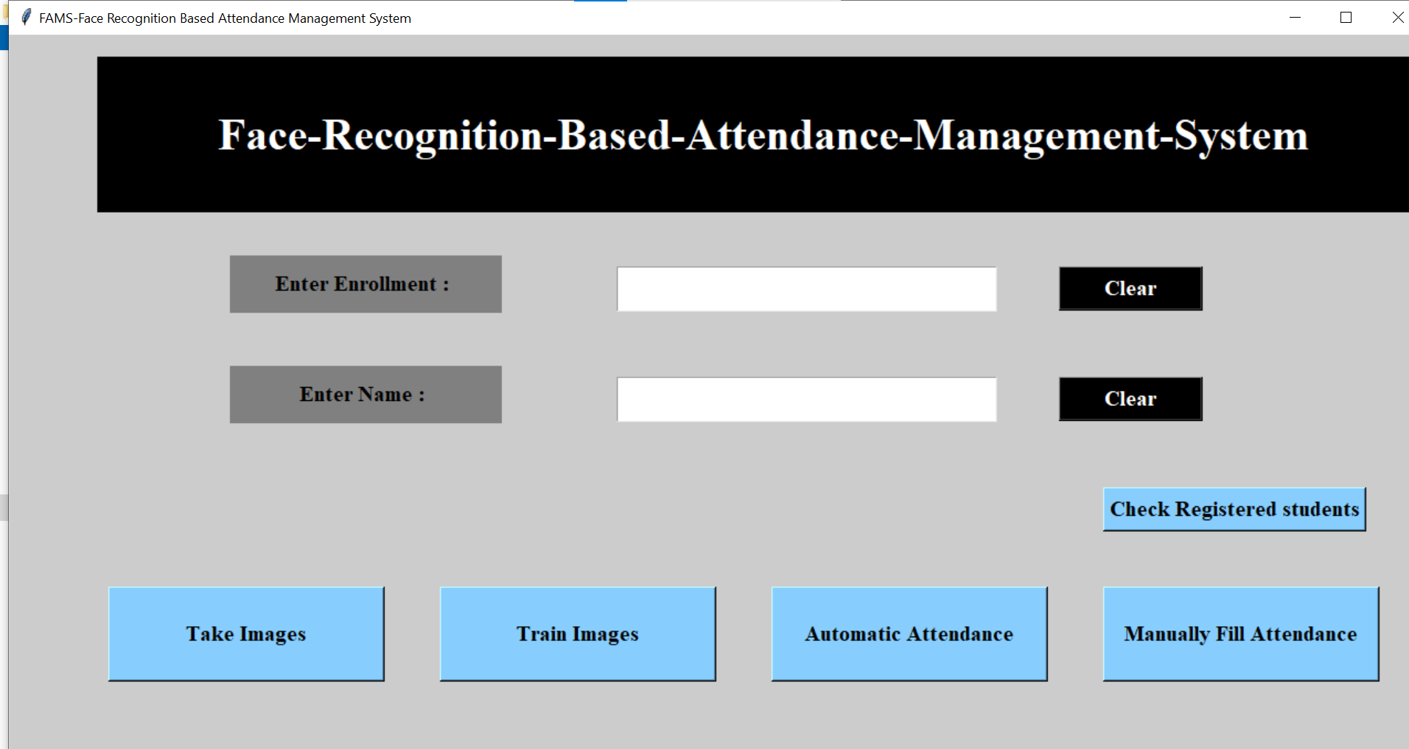
Abstract
The Student Database Management System integrates diverse functionalities tailored to meet the intricate needs of educational institutions. It encompasses student record management, facilitating the seamless storage and retrieval of comprehensive student profiles, including personal deand enrollment status. Moreover, the system orchestrates course administration with precision, enabling administrators to oversee course offerings, faculty assignments, and enrollment processes effortlesslytails, academic records.

Slide 3
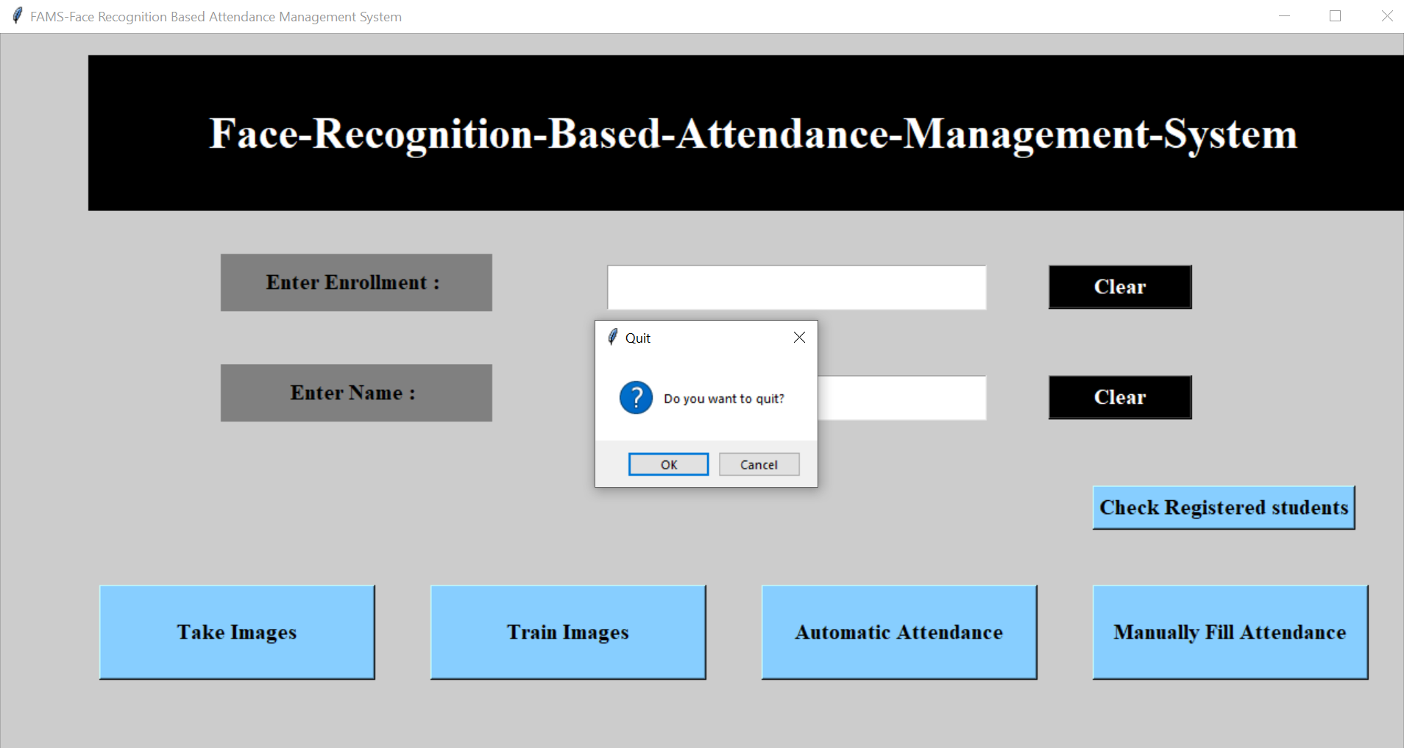
Introduction
The Student Management System can handle all the details about a Student.By automating administrative tasks such as record-keeping, attendance tracking, and grade management, a Student DBMS enhances operational efficiency and frees up valuable time for educators to focus on student engagement and learning outcomes.

Slide 4
Objectives of Project
The Objective can be listed below as:
To provide a proper registration channel / system to the new students.
To maintain all the accounts of the students from enrollment up to the end of the study.
To update the information that is essential to transmit to the users.
To have a centralized control over the records of the students, departments, teachers, staffs , library, etc., and monitor the changes in these records.

Slide 5
Methodology
Methodology in a Student Database Management System (DBMS) outlines the systematic approach and processes employed to design, develop, deploy, and maintain the database system effectively.
It encompasses phases like requirement analysis, database design, implementation, testing, deployment, and maintenance.
Through methodology, stakeholders' needs and system requirements are documented and translated into actionable steps.
Testing within the methodology ensures that the database system functions as intended, with rigorous tests conducted to validate data integrity, performance, security, and compatibility.

Slide 6
Work Done
In a Student Database Management System (DBMS), various tasks and functionalities are carried out to efficiently manage student data and support the operations of educational institutions. Here are some key tasks typically performed within a Student DBMS:
Student registration and enrollment management.
Course scheduling and management.
Attendance tracking and recording.
Grading, GPA calculation, and transcript generation
Personal information management for students and faculty.
Communication tools for announcements and notifications.
Data analysis for insights into academic performance.

Slide 7
Work to be Done
Develop a user-friendly interface for administrators, faculty, and students.
Implement student registration and enrollment functionalities.
Design a course management system for scheduling and enrollment.
Create modules for attendance tracking and recording.
Develop grading and transcript generation functionalities.
Integrate communication tools for announcements and notifications.
Establish data analysis capabilities for academic performance insights.
Ensure robust security measures to protect sensitive student data.
Provide user support and training for system usage.
Regularly update and maintain the system for optimal performance

Slide 8
Timelines
Setting timelines for developing a Student Database Management System (DBMS) involves breaking down the project into manageable tasks and assigning realistic deadlines for each phase. Here's a general timeline for developing a Student DBMS:
Requirement Gathering
System Design
Development
Testing
Deployment
Maintenance and Support

Slide 9
References
OpenCV: Open Source Computer Vision Library - OpenCV is used for image processing and computer vision tasks in Python.
Website: https://opencv.org/
NumPy - NumPy is a fundamental package for scientific computing with Python.
Website: https://numpy.org/
Pillow (PIL Fork) - Pillow is a Python Imaging Library that adds image processing capabilities to Python interpreter.
Website: https://python-pillow.org/
Pandas - Pandas is a fast, powerful, flexible, and easy-to-use open-source data analysis and manipulation tool.
Website: https://pandas.pydata.org/

Slide 10
Thank You
Queries?

