Slide 1



AI-Driven Smart Job Portal
Harsh Nileshbhai Rudani 21BCP183
Academic Mentor: Prof. Amitava Chaudary
Industrial Mentor: Mr. Amit Pandya
Department Of Computer Science And Engineering,
School of Technology, Pandit Deendayal Energy University,
Gandhinagar 382 426

Slide 2
Introduction
Project Focus: This project aims to streamline job searching and hiring by developing an AI-powered Smart Job Portal that connects job seekers (Jumpers) and companies through intelligent automation and real-time applicant tracking.
Technology Stack: The platform is built using Ruby on Rails for backend APIs, React for the company and jumper frontend, and PostgreSQL for data management. Axios handles client-server API communication, while Apache is used as the hosting and reverse proxy server.
AI-Powered Matching: AI algorithms (planned in future scope) will assist in job recommendations, skill-language matching, and filtering applicant profiles based on relevance to job descriptions.
Modular Workflow: The portal is divided into three sections: Jumper (job seeker), Company (job provider), and Admin (monitoring & control). Each role has a tailored interface with unique features such as shift tracking, application filtering, document validation, and resume preview.

Slide 3
Manual and Generic Job Matching: Most traditional portals lack intelligent filtering and personalized suggestions, causing job seekers to waste time on irrelevant roles and companies to receive unsuitable applications.
Problem Statement
The traditional job portals like Naukri, Monster, and Indeed lack intelligent automation, resulting in inefficient job matching, poor document verification, and slow applicant tracking. This creates frustration for job seekers who struggle to find relevant opportunities and for employers who waste time filtering unqualified candidates. There is a need for a unified platform that streamlines the hiring process through AI-driven recommendations, verified applicant profiles, and real-time hiring tools.
Poor Document Verification Workflow: There is no robust system for validating essential documents like CVs, certificates, or references. This leads to low hiring accuracy, fake profiles, and trust issues for employers
Inefficient Application Tracking: Without centralized dashboards or real-time status tracking, applicants struggle to track job status, and companies face delays in hiring decisions due to manual sorting.

Slide 4





Objectives
Ensure Trust & Transparency
Implement first-time document verification for Jumpers to establish authenticity and build trust between candidates and companies
Personalized Job Matching
Use AI to recommend jobs based on user profile, location, and language/skill inputs, improving candidate-job alignment.
Scalable Architecture
Design modular components and RESTful APIs with future support for multilingual UIs, resume parsing, and intelligent analytics.
Streamlined Employer Workflow
Enable Companies to create and manage temporary/permanent jobs, track applicants, review documents, and generate shift-based invoices.
Real-time Status & Feedback
Empower users with real-time application tracking, resume status, and toast-based feedback for every interaction.

Slide 5



Methodology
Backend Architecture & API Layer
Built using Ruby on Rails, the backend delivers secure RESTful APIs to manage user roles, jobs, applications, shifts, and documents. It supports real-time validations, authentication via JWT, and scalable API routing.
Frontend & Intelligence Layer
Developed in ReactJS, the frontend offers role-based dashboards for Jumpers and Companies. Dynamic UI elements like language sliders, map-based job directions, and real-time modals enhance user experience. The architecture is AI-ready for future job-candidate matching modules.
Testing & Deployment
Used tools like Postman to validate performance. The app was deployed on Apache Web Server with PostgreSQL as the database. Real-world scenarios were simulated to ensure reliability and responsiveness.

Slide 6
Tools and Technology
Category | Tools / Frameworks
Frontend Development | ReactJS, Tailwind CSS
Backend Development | Ruby on Rails (RESTful APIs)
Database | PostgreSQL
WebServer | Apache HTTP Server
UI/UX Design | Figma (High-Fidelity Prototypes)
Authentication | JWT (JSON Web Token), Google OAuth
API Testing | Postman
Version Control | Git, GitHub
Cloud Storage | Cloudinary (for document uploads)
Deployment Platform | Cloud-based (Ubuntu Server with HTTPS)
AI Integration Ready | Architecture designed for NLP-based resume parsing and job matching

Slide 7
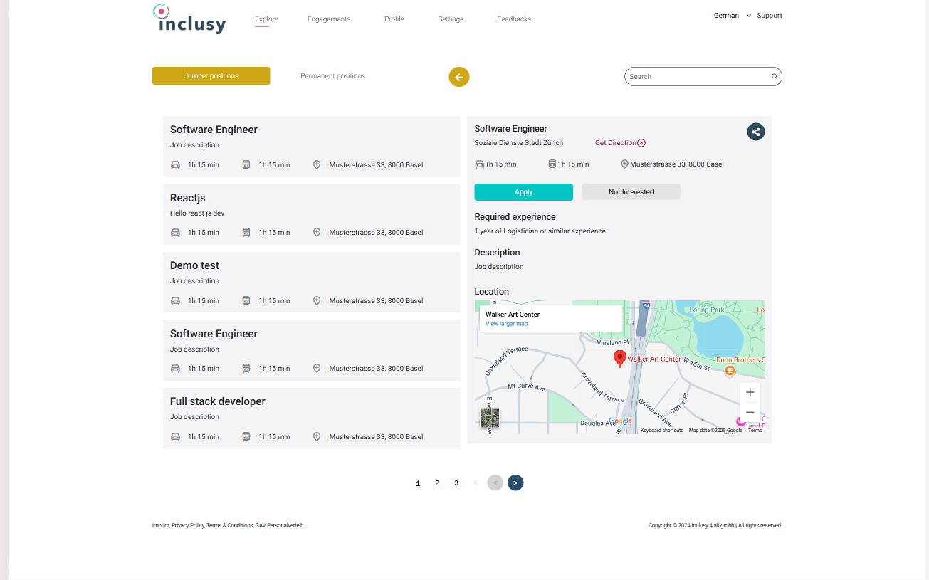
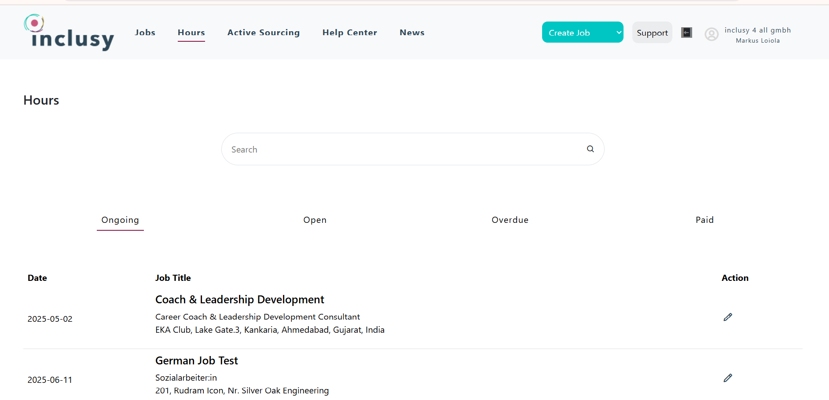
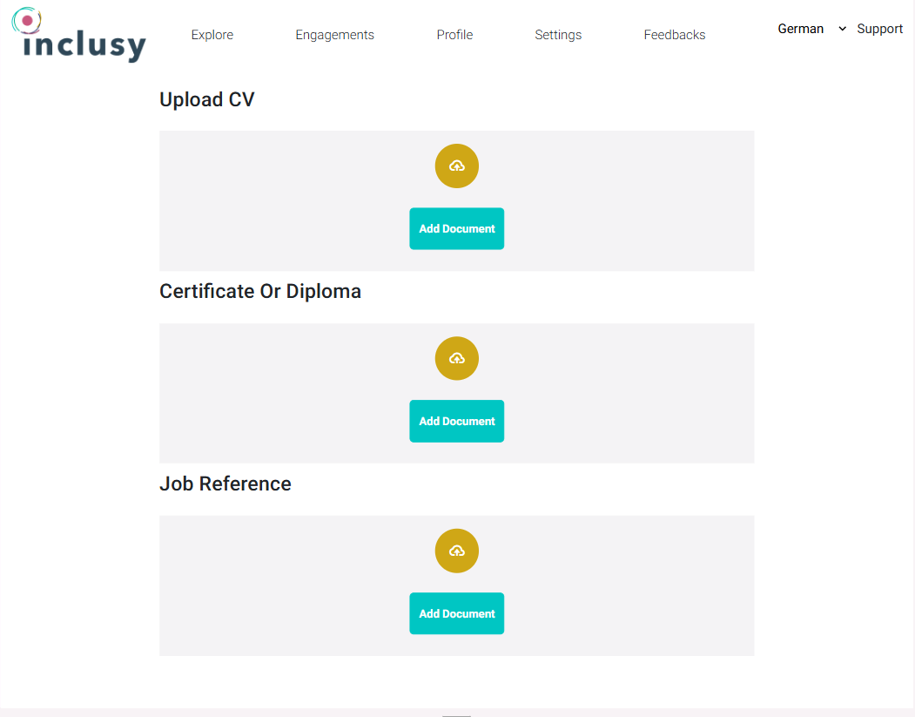
Results
Company
Jumper(Job Seeker)

Slide 8


Conclusion
Key Outcomes
Technical Learnings
Successfully developed a modular, scalable AI-Driven Job Portal (Inclusy) that caters to Jumpers, Companies, and Admins.
Implemented features such as smart job matching, real-time application tracking, and document verification.
Delivered a responsive UI, aligned with Figma prototypes and backed by secure RESTful APIs.
Gained practical experience in full-stack development using ReactJS and Ruby on Rails.
Enhanced understanding of API integration, state management, and real-world system architecture.
Learned to work in an Agile environment, applying rapid prototyping and feedback-driven improvement..

Slide 9
Research Outcomes
AI-Powered Resume Matching
Integrate NLP algorithms to semantically analyze resumes and job descriptions, improving candidate-job relevance and match accuracy.
Mobile Application
Develop a cross-platform mobile app (using React Native or Flutter) to increase accessibility and allow users to apply, track, and receive notifications on the go.
Real-time Chat System
Implement chat functionality between Jumpers and Companies using WebSockets or Firebase, enabling direct communication and interview scheduling.
Multilingual & Global Support
Add support for regional languages and localization, enabling broader adoption across diverse geographies and workforce segments.

Slide 10
References
Aspireedge Technologies – https://www.aspireedge.com
React Documentation – https://reactjs.org/docs
Ruby on Rails Guides – https://guides.rubyonrails.org
PostgreSQL Documentation – https://www.postgresql.org/docs/
Figma Inclusy Design System – https://www.figma.com/design/yKkPQgcn1XP5TcRnNwdQSs/new-inclusy-2
MDN Web Docs – https://developer.mozilla.org

Slide 11

Thank you very much!
PRESENTED BY HARSH NILESHBHAI RUDANI

