Slide 1


NEXT GEN EMPLOYABILITY PROGRAM
CREATING A FUTURE-READY WORKFORCE
Student Name :
Harsh Ajay Shendge
Student ID : STU67971757657fe1737955159(AICTE STUD ID)
College Name :
Vasantdada Patil Pratishtan’s College of Engineering and Visual Arts

Slide 2
CAPSTONE PROJECT SHOWCASE
Project Title
Recipe Sharing Platform With React and ExpressJS Framework
Abstract | Problem Statement | Project Overview | Proposed Solution | Technology Used | Modelling & Results | Conclusion | Q&A

Slide 3
Abstract
This Recipe Generator is a web application built using the MERN stack (MongoDB, Express, React, Node.js) that allows users to discover and generate personalized recipes based on available ingredients.
1
The frontend, developed using React, provides a dynamic user interface where users can input ingredients, and the app generates recipe suggestions based on stored data and predefined algorithms
2
3
The backend is powered by Node.js and Express, handling API requests and interacting with MongoDB to store user preferences and recipe data.
4
The application leverages a RESTful API for seamless communication between the frontend and backend, ensuring a smooth user experience. Additionally, users can save their favorite recipes and customize them for future use.

Slide 4


Problem Statement
The Recipe Sharing Platform allows users to create,share and manage various recipes, with real-time updates across all views.You’ll Gain experience With User authentication,document management,and implementing collabaorative,real-time features through MongoDB,Express.js,Reactjs, Nodejs.

Slide 5

Project Overview
The Recipe Generator aims to provide users with personalized recipe suggestions based on the ingredients they have at hand. This web application, developed using the MERN stack (MongoDB, Express, React, Node.js), allows users to input a list of ingredients and generate recipes that match their available items. The goal is to simplify meal planning and reduce food waste by offering creative recipe ideas using ingredients already on hand.
User Input (Frontend - React)
Recipe Generation (Backend - Node.js/Express)
Recipe Storage (MongoDB)
User Authentication
Responsive UI (React)

Slide 6
Proposed Solution
The system will allow users to input available ingredients, process the data on the server side, and return recipe suggestions that match or come close to the ingredients list. The application will also offer additional features like saving favorite recipes, meal history tracking, and user authentication for a personalized experience. Users can input ingredients they have available. Recipes are filtered and ranked based on relevance and available ingredients. User preferences, search history, and favorite recipes are stored for personalized suggestions. Users can register and log in to save their favorite recipes or to keep track of their meal history. The user interface is responsive and mobile-friendly, ensuring a smooth experience across devices.

Slide 7
Technology used
MongoDB: NoSQL database for storing recipes, user data, and preferences.
Express.js: Server framework to handle API requests and interact with the database.
React.js: Frontend framework to create an interactive and dynamic user interface.
Node.js: JavaScript runtime for backend services.

Slide 8
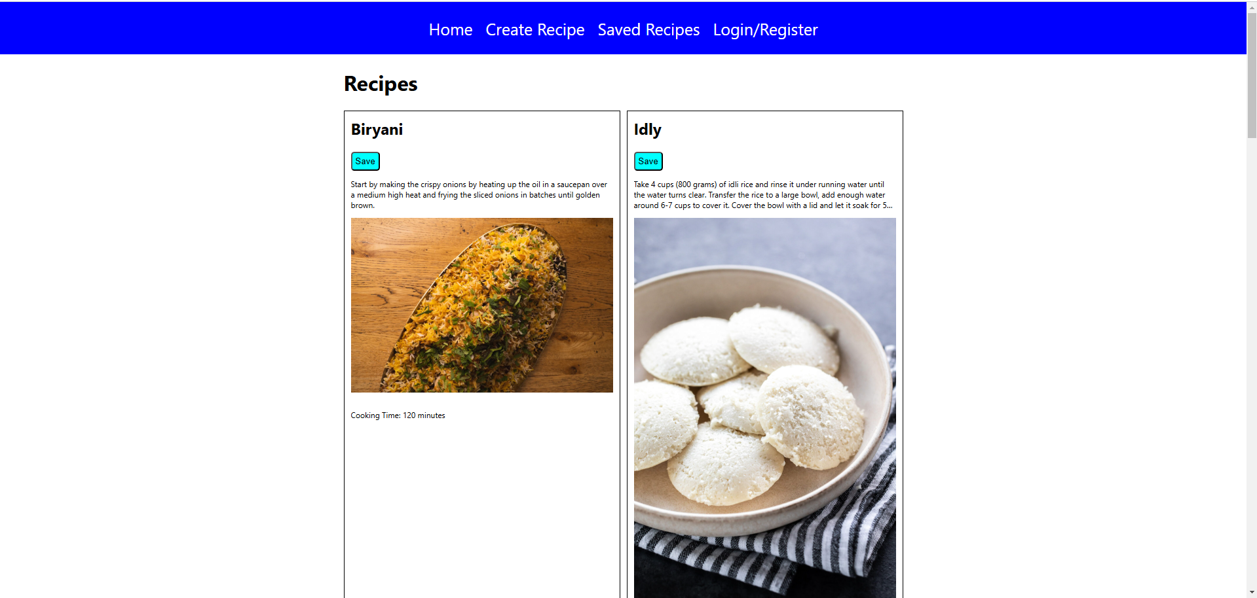
Modelling & Result

Slide 9
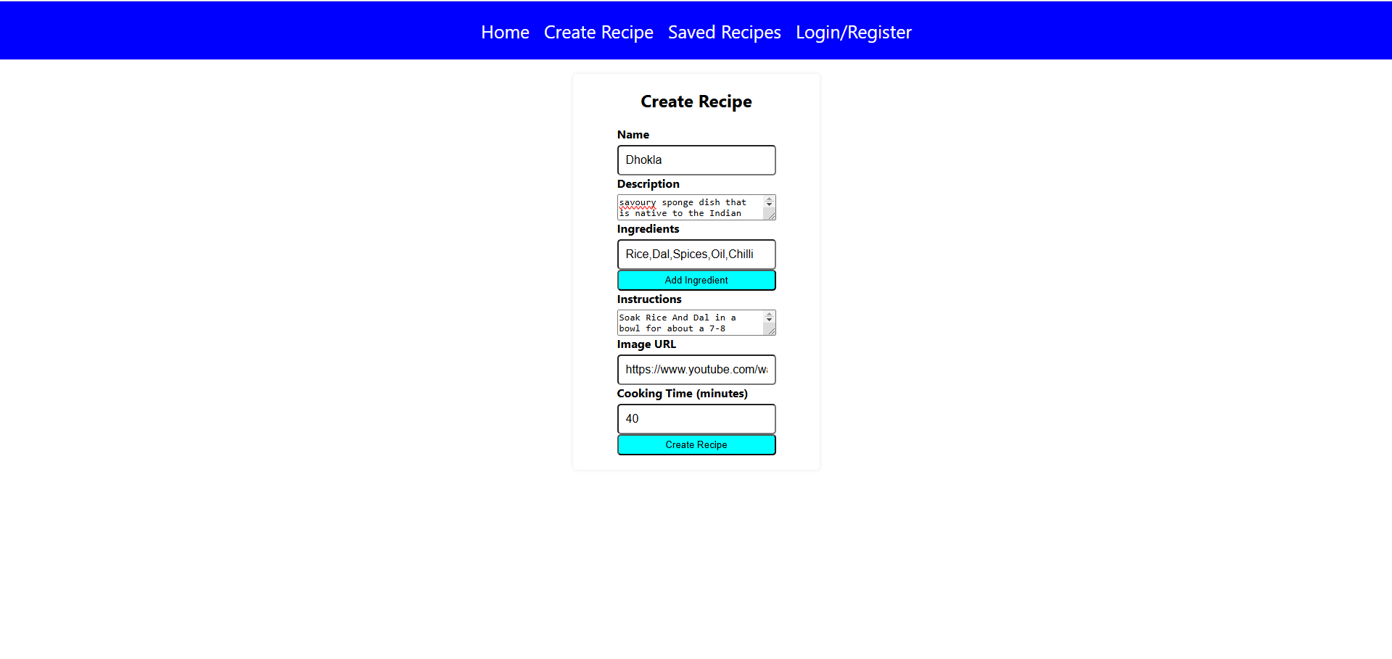
Modelling & Result

Slide 10

Conclusion
The recipe-sharing and generation app built with the MERN stack is a robust and interactive platform that allows users to create, share, and discover new recipes effortlessly. By leveraging MongoDB for efficient data storage, Express.js for seamless backend operations, React for a dynamic user interface, and Node.js for scalable server-side logic, your application ensures a smooth user experience. With features like user authentication, recipe generation, and sharing capabilities, it offers a modern solution for food enthusiasts. This project showcases expertise in full-stack development, demonstrating ability to build functional and user-friendly applications

Slide 11


Notes:
Thank You !!

