Slide 1
Education - An Online Learning Platform Application
Harsh Sharma
Yogita
Archana
GLA University
Computer Science and Engineering
Date :- 29-04-2024

Slide 2
Introduction
The purpose of our Online Learning Platform is to provide a versatile and user-friendly digital environment where individuals from diverse backgrounds can engage in learning activities according to their needs and interests.
Through our platform, learners can access a vast repository of educational resources, ranging from structured courses taught by experts to interactive tutorials and informative content curated from various sources.

Slide 3
Objectives
The objective of an online learning platform is to provide accessible, flexible, and effective educational opportunities through digital means. Here are some key objectives:
Accessibility: Make education available to anyone with an internet connection, breaking down geographical barriers and allowing learners from diverse backgrounds to access quality education.
Flexibility: Enable learners to study at their own pace and convenience, accommodating different learning styles and schedules. This flexibility is particularly beneficial for working professionals, students with busy schedules, or individuals with other commitments.
Engagement: Foster active learning through interactive content, multimedia resources, and engaging activities that stimulate curiosity and promote deeper understanding of the subject matter.
Personalization: Tailor learning experiences to individual needs, preferences, and skill levels through adaptive learning algorithms, personalized recommendations, and customizable learning paths.
Skill Development: Equip learners with practical skills, knowledge, and competencies that are relevant to their personal, academic, or professional goals, thereby enhancing employability and career advancement opportunities.

Slide 4
Problem Statement
Traditional education systems face challenges such as limited accessibility, outdated teaching methods, and the need for continuous upskilling.
Our Online Learning Platform aims to address these issues by providing a modern, accessible, and personalized learning experience that empowers learners to overcome geographical and financial barriers, adapt to technological advancements, and pursue lifelong learning opportunities.
Conversation
Limited Community Engagement
Lack of Interactive Features
User Interface Complexity

Slide 5
Literature Review
Effectiveness of Online Learning Platforms :
Studies compare the learning outcomes of online courses to traditional classroom-based learning, often finding comparable or even superior results in certain contexts.Meta-analyses examine factors influencing the effectiveness of online learning, including instructional design, learner characteristics, and technological affordances.
Technological Features:
Studies evaluate the usability and effectiveness of specific features within online learning platforms, such as discussion forums, multimedia content, interactive simulations, and assessment tools. Research investigates the role of learning analytics, artificial intelligence, and machine learning algorithms in providing personalized learning experiences and actionable insights for instructors.
User Experience and Design:
User experience (UX) design principles are explored to enhance usability, accessibility, and engagement within online learning platforms.Research examines the impact of interface design, navigation structures, and multimedia content on learner satisfaction and retention.
Instructor and Learner Perspectives:
Studies investigate instructors' attitudes, experiences, and challenges in designing and facilitating online courses, including workload management, communication strategies, and technology integration.Learners' perceptions of online learning platforms are explored, including their satisfaction with course materials, interaction with peers and instructors, and overall learning experience.ts in the same domain

Slide 6
Methodology
Frontend-
Html (Hypertext Markup Language): HTML provides the structure and layout of your web pages, allowing you to organize content effectively and create a cohesive user interface.
Css (Cascading Style Sheets): CSS enables you to customize the visual appearance of your website, including aspects such as colors, fonts, layouts, and responsive design for different devices.
Javascript: JavaScript adds interactivity and functionality to your web pages, allowing you to create dynamic elements, handle user interactions, and implement features such as form validation and animations.
Framework-
Bootstrap: Bootstrap is a front-end framework that provides pre-designed templates, components, and utilities to streamline the development process. It helps you create responsive and mobile-friendly layouts with minimal effort.
Backend-
PHP (Hypertext Preprocessor): PHP is a server-side scripting language that allows you to add dynamic content and functionality to your website. With PHP, you can interact with databases, process form data, authenticate users, and perform various server-side tasks.

Slide 7
System Architcture
The system architecture for an online learning platform typically involves several components working together to deliver a seamless learning experience. Here's a high-level overview of the architecture.
Frontend
Client Application
Backend :- Authentication Service, Chat Service, Community service, Notification Service
Database Layer
Infrastructure and Deployment

Slide 8
Implementation
Project Initiation
Role Discussion and Distribution
Infrastructure Setup
Design and Planning
Development Phase
Final Deployment

Slide 9
Features
User Registration and Profiles: Allow users to create accounts, manage their profiles, track progress, and access personalized recommendations.
Course Catalog: Provide a searchable database of courses, organized by topic, level, and format, with detailed descriptions and user ratings.
Interactive Learning Materials: Offer a variety of multimedia content such as video lectures, interactive quizzes, readings, and assignments to engage learners.
Mobile Compatibility: Ensure compatibility with mobile devices, allowing users to access courses anytime, anywhere, and on any device.
Feedback and Ratings: Allow users to leave feedback and ratings for courses, helping others make informed decisions.
Profile Customization: Allow users to customize their profiles with profile pictures, bios, and other personal information.

Slide 10
Results
By the end of the project, we have been achieved the following
User-Engagement: Monitoring how frequently users interact with the platform and how long they spend per session can indicate engagement levels.
User Feedback: Gathering feedback from users through ratings and reviews can provide insights into their satisfaction levels and areas for improvement.
Technical Performance: Website performance such as page load times and server response times can ensure a smooth and seamless user experience.

Slide 11
Challenges Faced
Technical Complexity
User Experience Optimization
Monetization Strategy
Regulatory Compliance

Slide 12
Future scope
"In the future, our Online Learning Platform aims to expand its course offerings while implementing advanced algorithms for personalized learning experiences.
Additionally, opportunities in corporate training, community building, and accessibility improvements will be pursued to ensure the platform remains inclusive and impactful." Furthermore, the platform will evolve to support lifelong learning initiatives, providing resources and support for continuous skill development and personal growth. Embracing emerging trends such as gamification, social learning, and mobile-first design will ensure that the platform remains innovative and engaging for users across diverse demographics and learning preferences. By embracing these strategies, our Online Learning Platform will continue to adapt and thrive in the ever-evolving landscape of online education."

Slide 13
Conclusion
In conclusion , Our Online Learning Platform project has been a journey of innovation and dedication towards empowering learners with accessible and inclusive educational opportunities. We have created a dynamic environment where learners can thrive, explore, and grow, leveraging technology to redefine the boundaries of learning. By focusing on aspects such as user authentication , responsive design , our platform aims to provide comprehensive and user-friendly experience for all learners and tutors seeking a reliable learning and teaching solution.

Slide 14
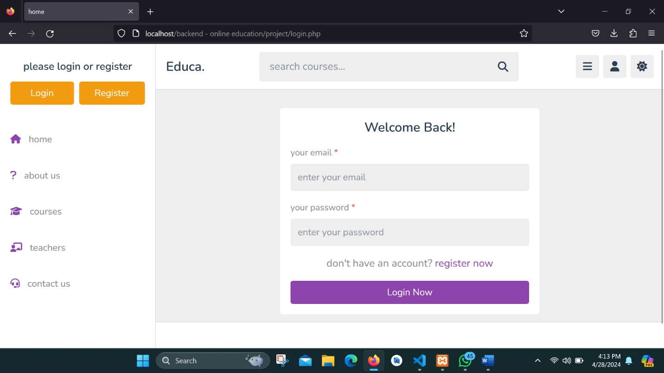
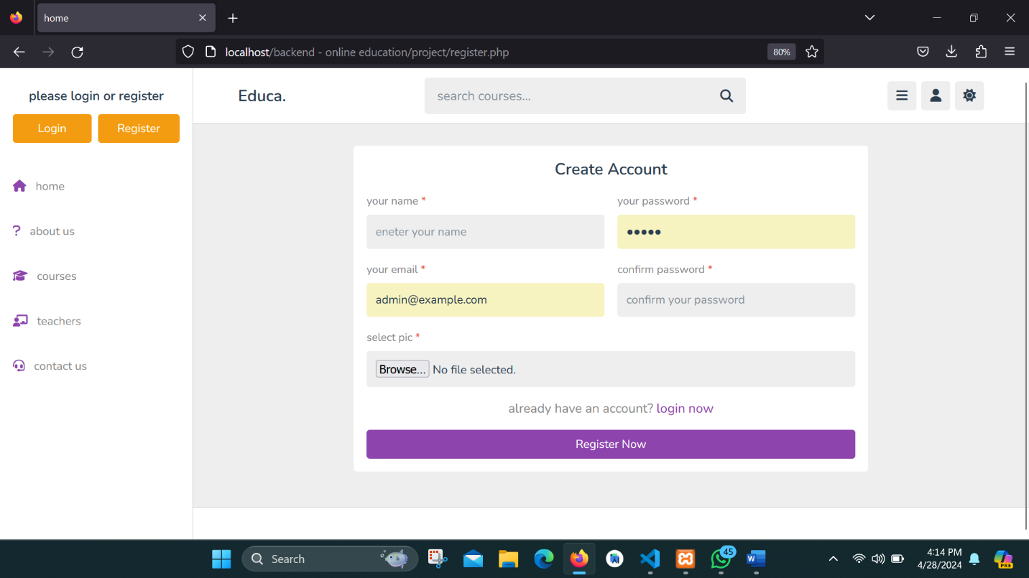
working website

Slide 15
Q&A
Questions
Thank You

