Slide 1
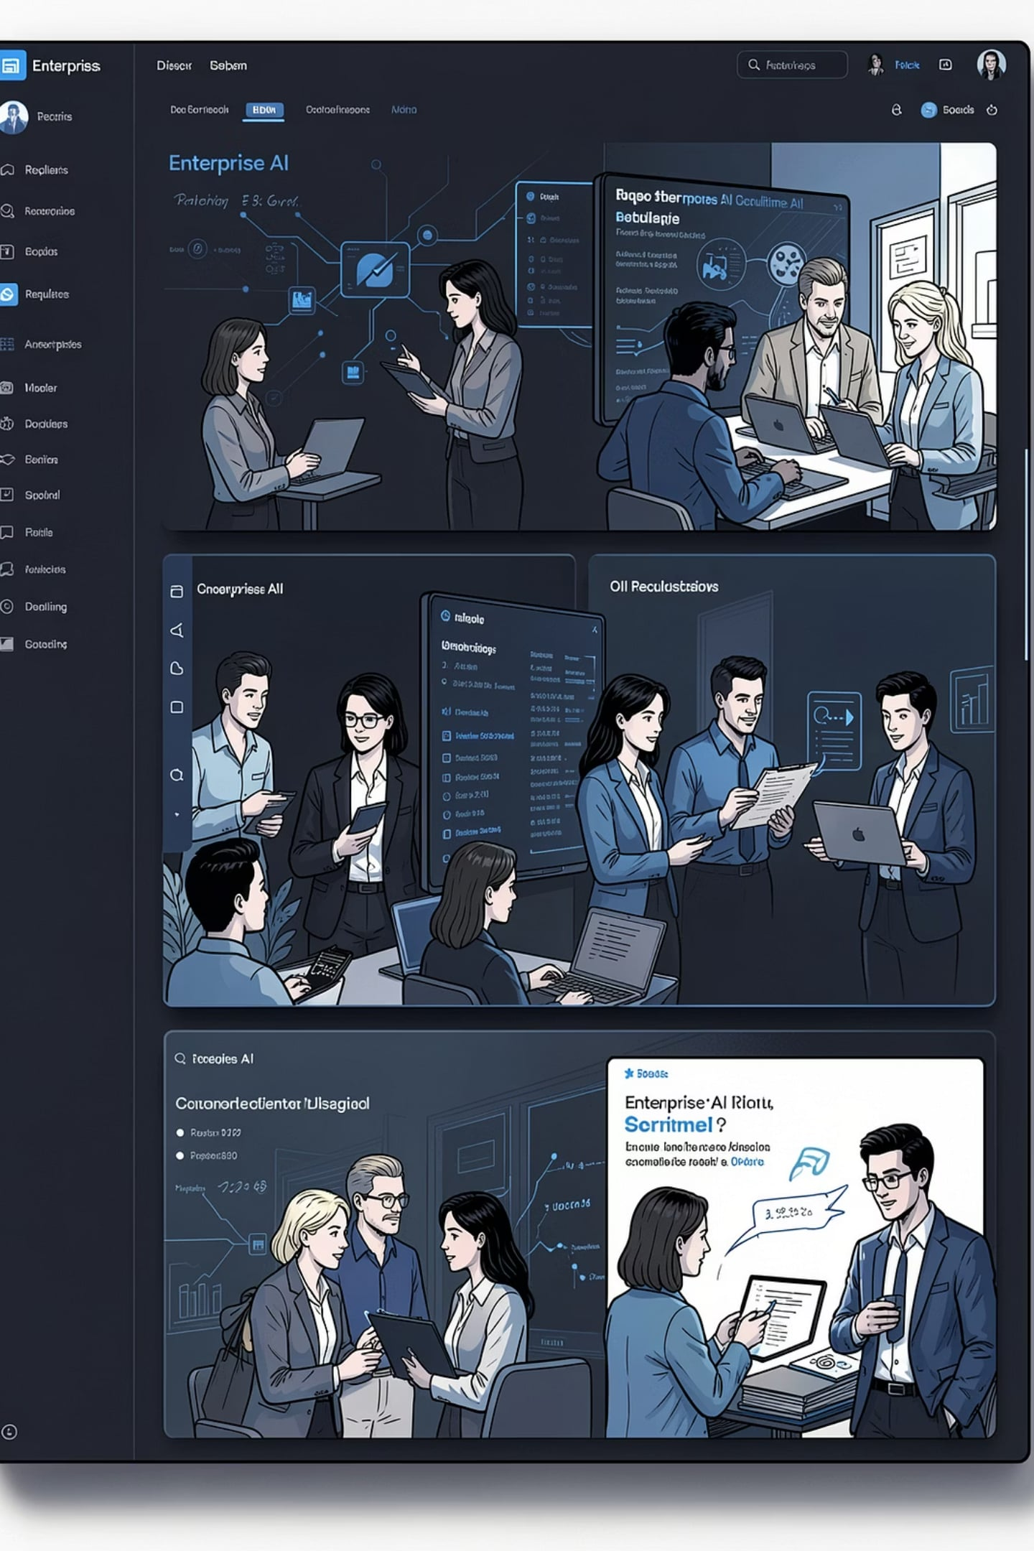

TalentSphere
The Enterprise AI Talent Acquisition Platform
"One Platform. Every Talent Source. AI That Recruits With You."
Enterprise Product Proposal

Slide 2
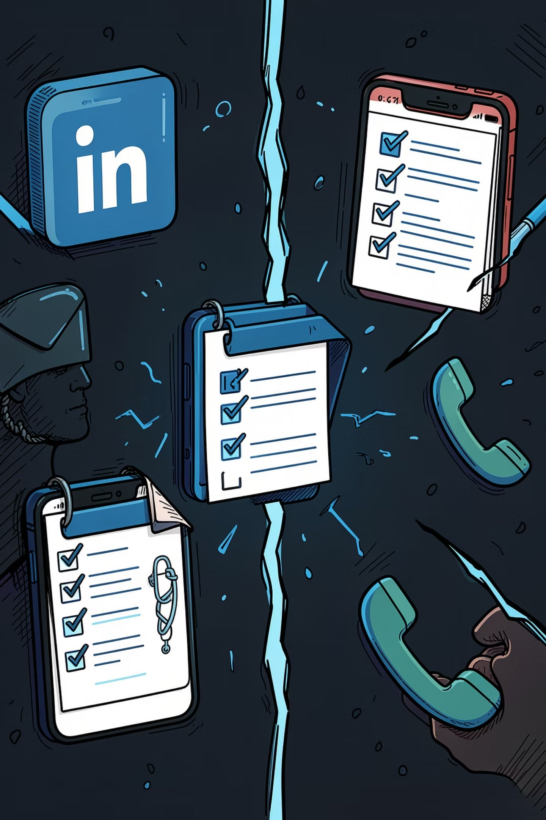
Recruitment Today is Fragmented
Organizations rely on many disconnected channels — job boards, multiple ATS, spreadsheets, email, phone and messaging — creating operational drag and visibility gaps.
1
2
Common Sources
Operational Challenges
LinkedIn Recruiter • Naukri • JobDiva • Internal ATS • Email • Excel • Phone • WhatsApp
Multiple subscriptions, manual sourcing, duplicate records, slow cycles, poor visibility, high cost-per-hire.
3
Key Message
Recruiters spend more time managing tools than hiring talent.

Slide 3
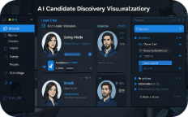
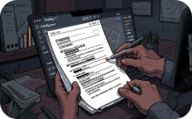

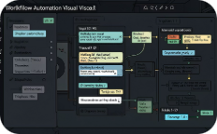
Introducing TalentSphere
TalentSphere unifies recruitment into a single intelligent workspace — combining AI discovery, orchestration, and enterprise-grade integrations to replace fragmented workflows.
AI Candidate Discovery
Resume Intelligence
AI Voice Screening
Workflow Automation
Find the best-fit talent across internal and external sources using semantic search and contextual ranking.
Automated extraction, normalization, and skills mapping to reduce manual parsing.
Asynchronous voice assessments with structured scoring to accelerate shortlisting.
Orchestrate screening, interview scheduling, and HRMS handoffs with minimal manual steps.
One platform replacing fragmented recruitment workflows.

Slide 4
Unified Recruitment Ecosystem
Complete hiring lifecycle under a single login and dashboard — from job creation to HRMS handoff and executive analytics.
Hiring Management
Job Intelligence
Talent Intelligence
Job orchestration, approvals, and role templates.
Smart JD generation and skill modeling.
Cross-source candidate graph and semantic search.
Candidate Engagement
Hiring Operations
Executive Intelligence
Multi-channel outreach, voice screening, and scheduling.
Workflows, SLAs, and process automation.
Dashboards for pipeline, cost, and time-to-hire.
Integrations
Security & Governance
ATS, job boards, HRMS, SSO, and security connectors.
Enterprise IAM, audit logs, and compliance controls.
Single Login. Single Dashboard. Complete Hiring Lifecycle.

Slide 5
60 Specialized AI Agents Working Together
Domain-specific agents collaborate under a central Orchestrator to automate tasks while preserving human control.
Talent Discovery Agent
Resume Intelligence Agent
Semantic sourcing across external and internal pools.
Extracts, normalizes, and enriches candidate profiles.
Voice Screening Agent
Recruiter Copilot
Structured voice assessments with scoring and transcripts.
Contextual suggestions, message drafting, and candidate prioritization.
Executive Dashboard Agent
Platform Governance Agent
Board-ready metrics and alerts for hiring health.
Policy enforcement, audit trails, and data residency controls.
AI doesn't replace recruiters — it becomes their digital workforce.

Slide 6
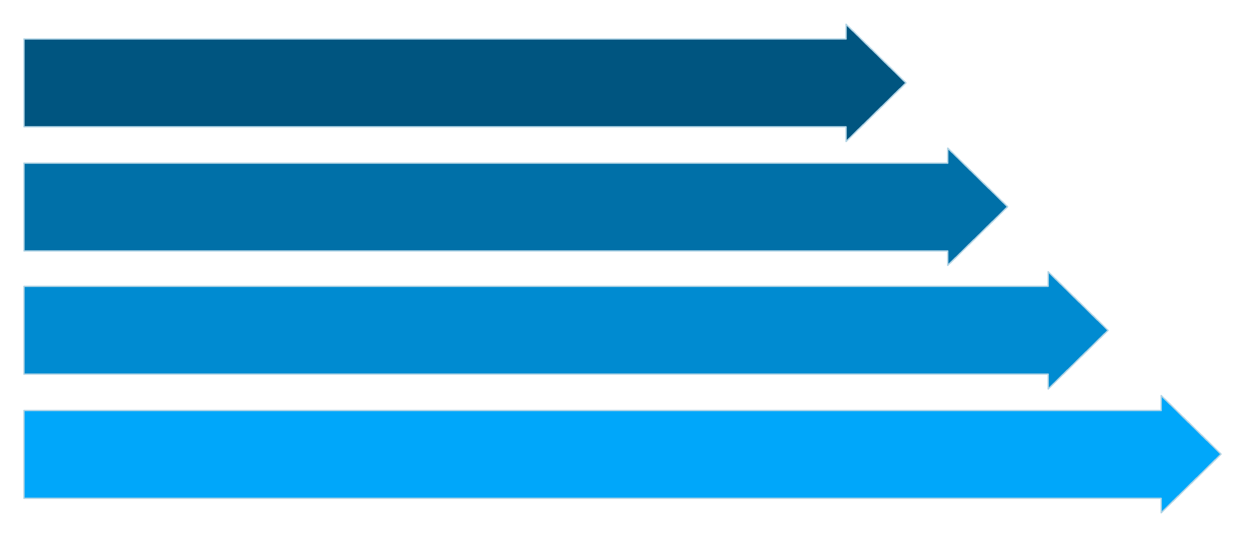
Request & Brief
Talent Discovery
Screen & Rank
Hire & Handoff
Every stage is AI-assisted; humans retain decision authority. The workflow shortens time-to-hire while improving candidate quality and auditability.

Slide 7
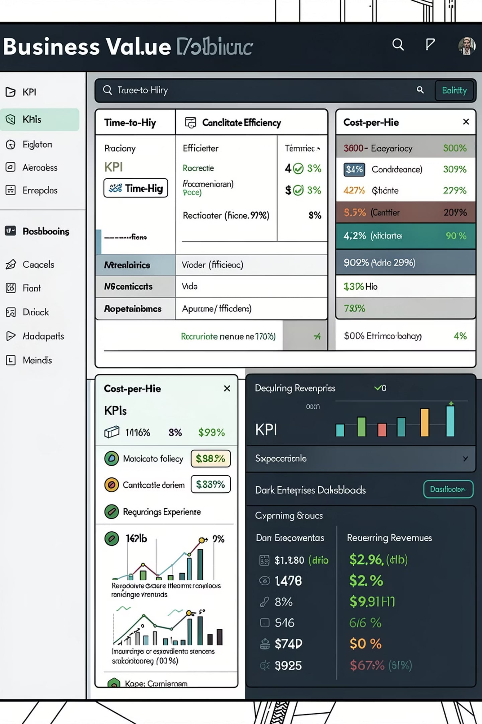
Business Impact
For Customers
For the Company
Faster candidate discovery and better shortlist quality
Reduced manual sourcing and duplicated effort
Higher recruiter productivity and better candidate experience
Unified operations with improved hiring visibility
Enterprise-grade governance and compliance
Recurring SaaS revenue and enterprise licensing
AI usage-based credits and monetizable marketplace
Professional services for onboarding and integrations
High customer retention via platform lock-in and integrations

Slide 8
Why Should We Build TalentSphere?
Strategic Benefits for Our Company
Strategic Benefits
Customer Benefits
Expand from HRMS into a complete Talent Acquisition Platform
Create a high-value enterprise SaaS product with recurring subscription revenue
Cross-sell TalentSphere with our existing HRMS and future HR products
Differentiate our company through AI-powered recruitment automation
Build a scalable platform that can evolve with customer needs
One platform instead of multiple recruitment tools
AI-assisted candidate sourcing and screening
Faster hiring with standardized workflows
Better recruiter productivity
Centralized analytics and hiring visibility
Long-Term Vision
TalentSphere is not intended to replace every recruitment platform. Instead, it becomes the intelligent orchestration layer that connects candidates, recruiters, hiring managers, enterprise systems, and AI agents into one unified recruitment experience.
TalentSphere positions our company to move beyond building HR software and toward building an enterprise AI platform for Talent Acquisition.

Slide 9
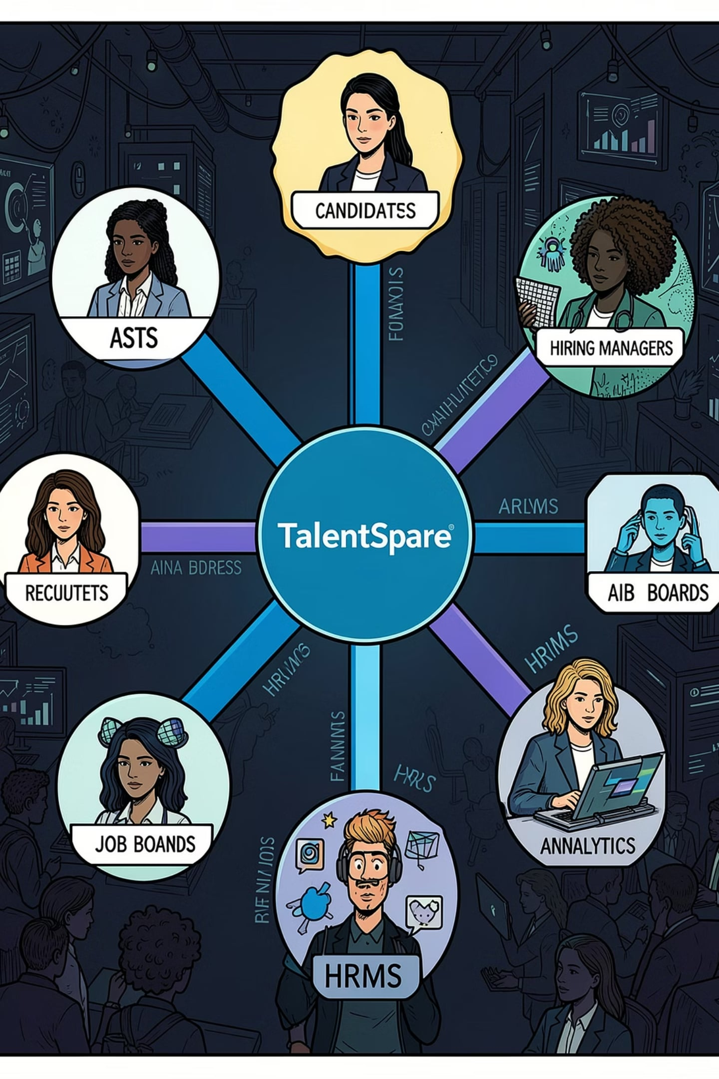
Why Will Customers Choose TalentSphere?
TalentSphere becomes the single intelligent workspace by integrating existing tools, powering AI-assisted screening, and centralizing operations for scale and governance.
Recruitment Agencies
Manage end-to-end hiring, reduce manual effort, and speed delivery to clients.
Enterprise HR Teams
Standardize workflows, improve collaboration, and enable data-driven hiring decisions.
Business Leaders
Lower operational complexity, retain existing tools, and get centralized analytics.
One Platform. Unified Hiring. AI-Assisted Decisions. Enterprise Scale.

Slide 10
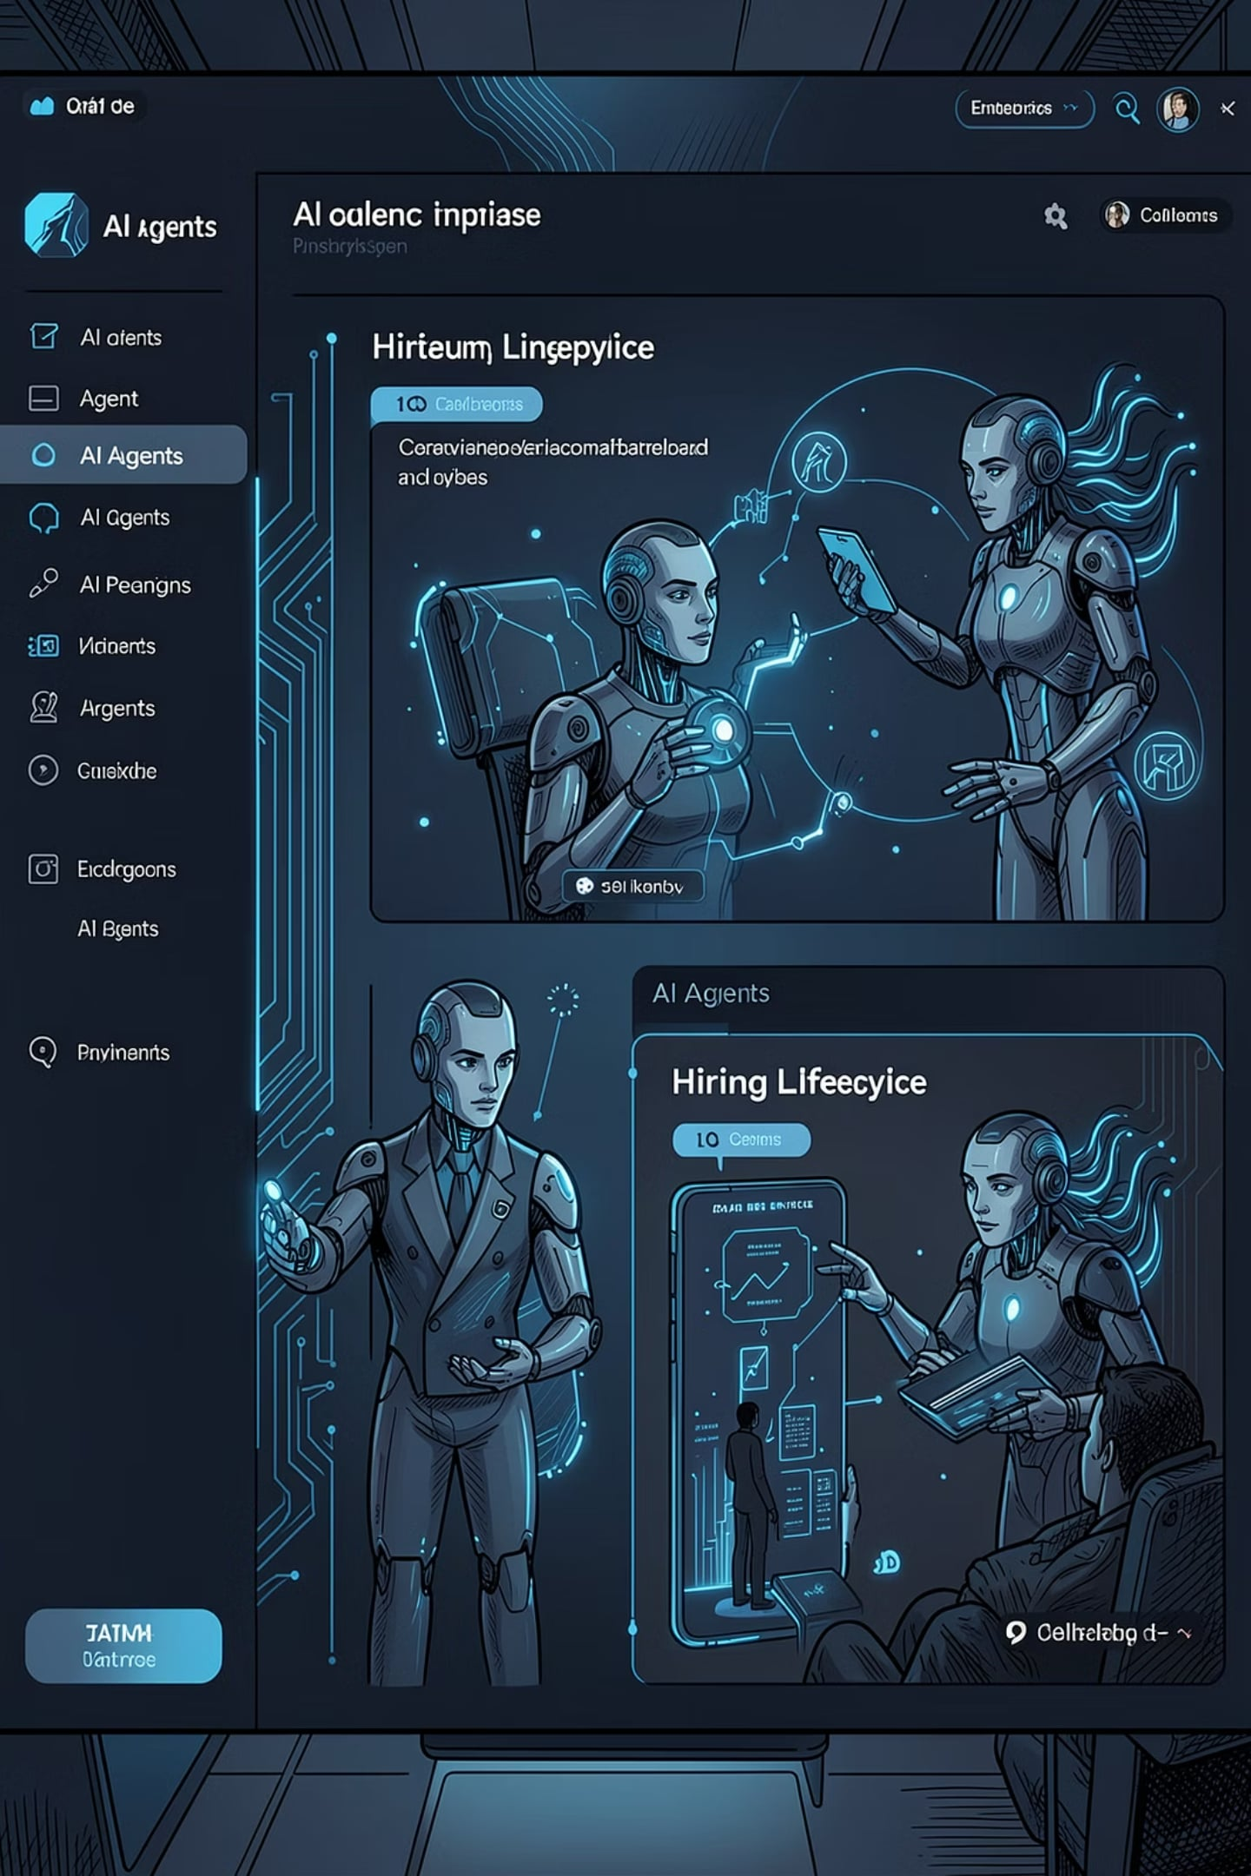
The Future of Enterprise Hiring
TalentSphere will be the intelligent operating layer for talent acquisition — a modular, scalable platform that combines AI agents, enterprise workflows, and unified operations.
Enterprise-ready Architecture
Practical Roadmap
Phased deployments, measurable KPIs, and low-friction integrations.
Secure, auditable, and built for complex orgs.
AI-driven Productivity
Scalable Growth
Digital workforce supporting recruiters — not replacing them.
Modular product and monetization that scale from agencies to global enterprises.
"From Hiring Software to an AI Workforce for Recruitment."

Slide 11
Thank You
TalentSphere
AI-Powered Talent Acquisition Platform
Vision Statement
Reimagine enterprise hiring by combining AI, intelligent automation, and human expertise into one unified recruitment platform.
Key Takeaways
Unified Talent Acquisition Platform
60 Specialized AI Agents
Enterprise-Ready & Scalable
AI-Assisted, Human-Controlled Hiring
Complements Existing HRMS Ecosystem
Strong Long-Term SaaS Revenue Potential
Discussion Points
Is this aligned with our company's long-term product vision?
Which modules should be prioritized for Phase 1?
What strategic integrations should be considered?
How can we validate this idea with potential enterprise customers?
Closing Quote
"The future of hiring isn't more recruiters or more tools—it's intelligent AI working alongside recruiters on a single unified platform."
Thank You
Questions & Discussion

