Slide 1
Review-1 on CloudSentinel AI
Murikipudi Harshith 2310030334
Under the Guidance of
P. Lalitha Kumari
Professor
Computer Science and Engineering Department
KL Hyderabad Off Campus, Aziz Nagar ,Hyderabad
TELUGU YESHWANTH RAJ 2310030310
PULUMAMIDI ABHILASH REDDY 2310030314
BAGIREDDY SHASHANK REDDY 2310030347

Slide 2
Overview
Introduction
Literature Review
Problem Statement
Objectives of the Project
Proposed Methodology/Architecture/Algorithm/Technique/etc
Current Progress
References

Slide 3
Introduction
Cloud computing has become the backbone of modern applications due to its scalability, flexibility, and cost-effectiveness.
Misconfigured cloud resources remain one of the leading causes of security breaches, unauthorized access, and data exposure.
Existing cloud security solutions primarily identify individual misconfigurations but often lack contextual analysis and attack path visualization.
Understanding relationships between cloud resources is essential for accurately assessing security risks and prioritizing remediation efforts.
CloudSentinel AI proposes a knowledge graph and attack graph-based framework to analyze cloud environments and identify potential attack paths.
The framework leverages Explainable AI (XAI) to generate context-aware risk assessments and actionable security recommendations.
Notes:
Cloud adoption has grown rapidly, but with that growth comes increased security complexity. A single misconfigured IAM role or publicly accessible storage bucket can expose critical assets. Existing tools detect these issues individually, but they often don't explain how an attacker could combine them to compromise the environment. Our work, CloudSentinel AI, addresses this challenge by using knowledge graphs, attack graphs, and Explainable AI to provide context-aware risk analysis and practical remediation recommendations.

Slide 4
Literature Review
Existing Work | Approach | Limitation
AWS Security Hub | Detects cloud security findings and compliance violations. | No attack path analysis or contextual risk assessment.
Amazon Inspector | Performs vulnerability assessment for EC2, ECR, and Lambda. | Focuses on vulnerabilities rather than cloud resource relationships.
Prowler | Open-source AWS security and compliance assessment tool. | Reports misconfigurations individually without attack path correlation.
ScoutSuite | Multi-cloud security auditing and posture assessment. | Limited contextual analysis and no explainable AI recommendations.
Research on Knowledge Graph-Based Cloud Security | Models relationships among cloud resources using graph structures. | Limited integration with attack graph generation and AI-driven remediation.
Research Gap:
Current cloud security solutions effectively detect misconfigurations and vulnerabilities but lack integrated knowledge graph modeling, attack path analysis, context-aware risk scoring, and explainable AI-based remediation. CloudSentinel AI addresses these limitations through a unified intelligent security assessment framework.
Notes:
Several commercial and open-source cloud security tools are available today. AWS Security Hub, Amazon Inspector, Prowler, and ScoutSuite are widely used for identifying security issues and compliance violations. However, these tools primarily report individual findings and do not analyze how multiple misconfigurations can be chained together to form an attack path. Recent research has explored knowledge graphs for cloud security, but comprehensive frameworks that combine knowledge graphs, attack graph analysis, context-aware risk assessment, and Explainable AI remain limited. This research aims to bridge that gap.

Slide 5
Problem Statement
Modern cloud environments consist of numerous interconnected services such as IAM, EC2, S3, Lambda, and databases, making security management increasingly complex.
Security misconfigurations, excessive permissions, and insecure network settings can be exploited together to create multi-stage attack paths leading to critical data compromise.
Existing Cloud Security Posture Management (CSPM) tools primarily identify individual security issues but provide limited insight into the relationships between cloud resources and potential attack chains.
Security teams often face alert overload and lack effective prioritization of risks based on exploitability and business impact.
There is a need for an intelligent framework that combines knowledge graph modeling, attack path analysis, context-aware risk assessment, and Explainable AI to provide actionable security recommendations.
Problem Statement:
CloudSentinel AI addresses this challenge by transforming isolated cloud security findings into context-aware, explainable, and prioritized security intelligence.
Notes:
As cloud environments continue to grow, the number of interconnected resources also increases. A single misconfiguration may not seem critical on its own, but when combined with other weaknesses, it can create an attack path that allows an attacker to reach sensitive assets. Current CSPM solutions are effective at identifying individual issues, but they often lack contextual analysis and do not explain how these issues relate to one another. CloudSentinel AI is designed to bridge this gap by integrating knowledge graphs, attack graph analysis, context-aware risk scoring, and Explainable AI to help security teams understand, prioritize, and remediate cloud security risks more effectively.

Slide 6
Objectives of the Project
Develop an intelligent framework to automatically identify cloud security misconfigurations across AWS resources.
Construct a Knowledge Graph to model relationships between cloud resources for enhanced security analysis.
Generate Attack Graphs to identify potential attack paths, privilege escalation opportunities, and lateral movement.
Perform Context-Aware Risk Assessment by prioritizing security findings based on exploitability, resource relationships, and business impact.
Leverage Explainable AI (XAI) to provide transparent risk explanations and actionable remediation recommendations for security teams.
Notes:
The primary objective of this research is to develop an intelligent cloud security framework that goes beyond traditional misconfiguration detection. The framework models cloud resources as a knowledge graph, derives attack graphs to identify possible attack paths, assesses risks based on contextual relationships, and uses Explainable AI to generate understandable recommendations. Finally, the framework is evaluated in an AWS environment to validate its effectiveness.

Slide 7
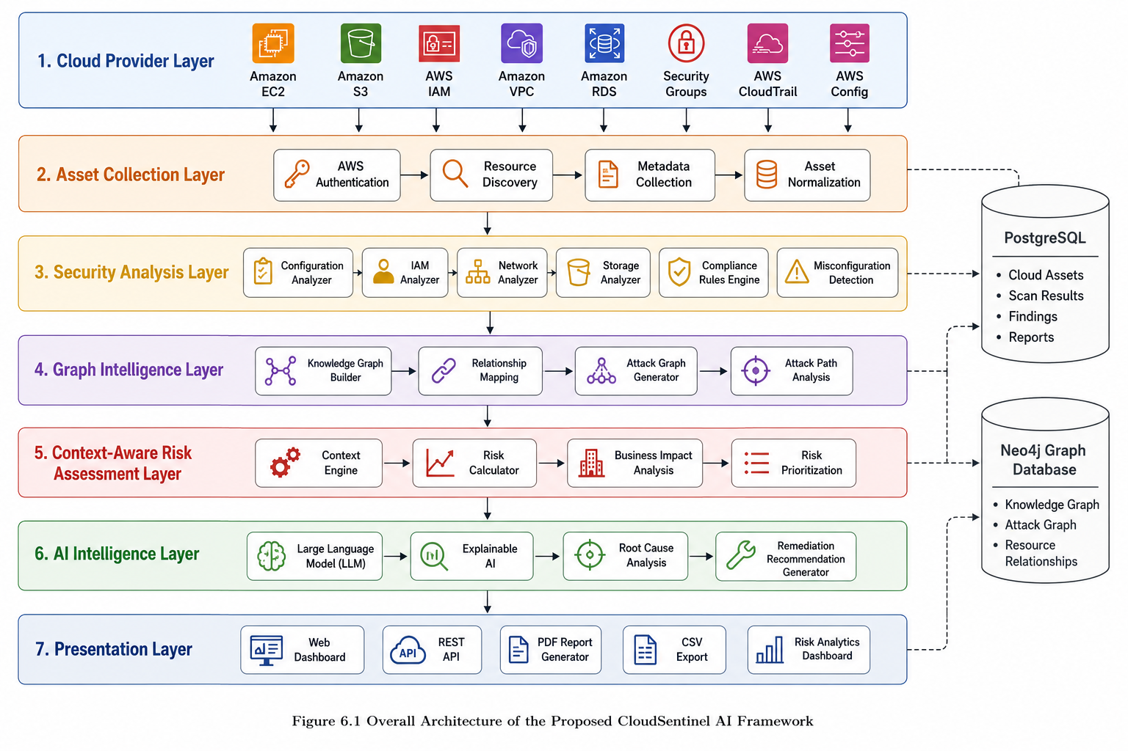
Proposed Methodology/Architecture/Algorithm/Technique/etc
Workflow
AWS Cloud Resources
↓
Cloud Asset Collection
↓
Security Configuration Analysis
↓
Knowledge Graph Construction
↓
Attack Graph Generation
↓
Context-Aware Risk Assessment
↓
Explainable AI Engine
↓
Security Dashboard & Reports
Notes:
This slide presents the overall methodology of CloudSentinel AI. The framework begins by collecting cloud asset and configuration data from AWS services. The collected information is analyzed to detect security misconfigurations and compliance issues. Next, a Knowledge Graph is constructed to model relationships among cloud resources. Using this graph, the framework generates Attack Graphs to identify possible attack paths, privilege escalation opportunities, and lateral movement. A context-aware risk assessment engine then prioritizes findings based on exploitability and business impact. Finally, an Explainable AI module generates clear remediation recommendations, and the results are presented through an interactive dashboard and security reports

Slide 8
References
Amazon Web Services. AWS Well-Architected Framework, 2024. https://docs.aws.amazon.com/wellarchitected/
Center for Internet Security (CIS). CIS Amazon Web Services Foundations Benchmark v3.0, 2024. https://www.cisecurity.org/benchmark/amazon_web_services
National Institute of Standards and Technology (NIST). Cybersecurity Framework (CSF) 2.0, 2024. https://www.nist.gov/cyberframework
Neo4j Inc. Neo4j Graph Database Documentation. https://neo4j.com/docs/
Stuart Russell, Peter Norvig. Artificial Intelligence: A Modern Approach (4th Edition). Pearson, 2021. https://aima.cs.berkeley.edu/
AWS Security Best Practices Documentation. https://docs.aws.amazon.com/security/
Prowler – Open Source Cloud Security Tool. https://github.com/prowler-cloud/prowler
Notes:
These references include international security standards, AWS best practices, graph database documentation, artificial intelligence resources, and recent cloud security literature. They provide the theoretical and technical foundation for the proposed CloudSentinel AI framework.

Slide 9
Thank you and Any Queries

