Slide 1

Advancing Trust and Explainability in Artificial Intelligence Systems
by
Under guidance of
Harsh Vardhan Singh Chauhan
2022BCD0044
Dr. Jeena Thomas

Slide 2
Content
Introduction
Literature Survey
Problem Statement
Objective
Proposed Architecture
Dataset
References

Slide 3
Introduction
AI Models as Black Boxes – Large models like transformers lack transparency, making decisions hard to interpret
Trust & Transparency – Explainability ensures users and stakeholders can trust AI predictions. (healthcare, finance etc.)
Challenges – Trade-off between accuracy and interpretability; scaling explainability to large models is difficult.

Slide 4
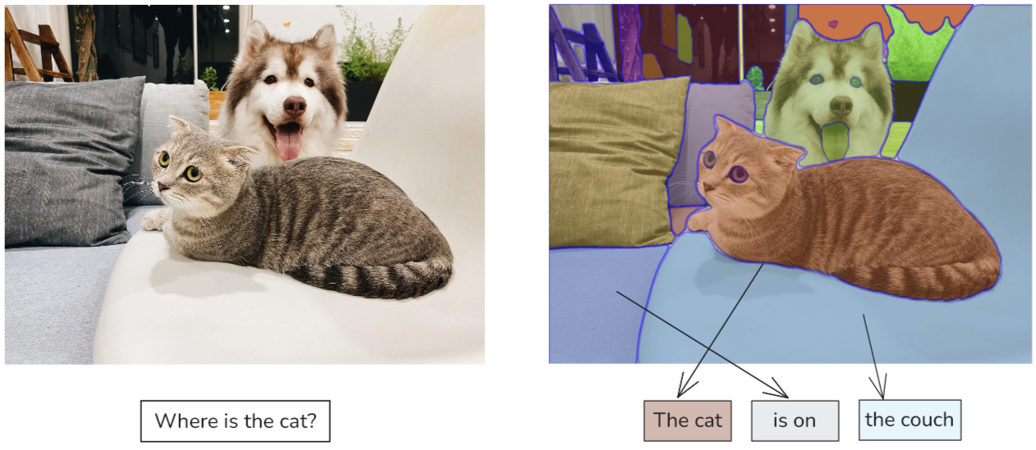
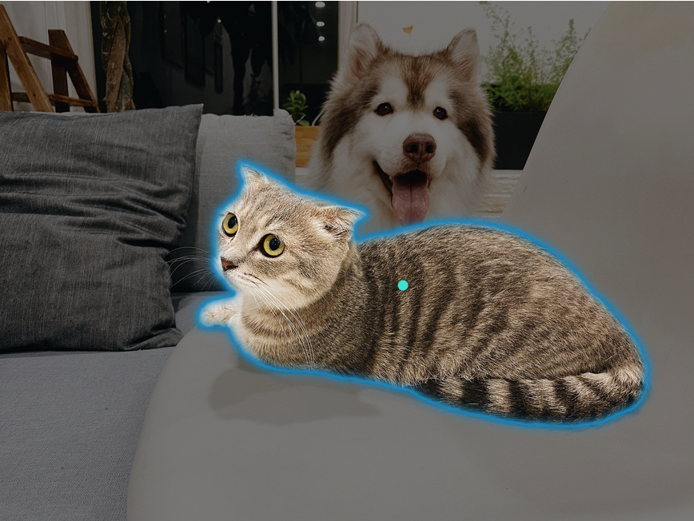
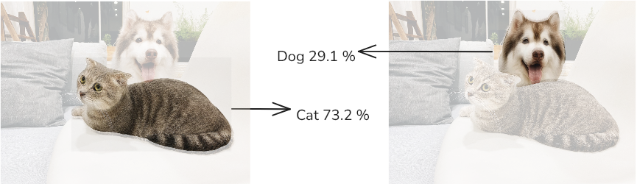
Introduction
VQA
Segmentation
Classification

Slide 5
Literature Survey
Ref No | Method | Category | Dataset | Model | Task | Approach
1 | Grad CAM | Common Attribution | ImageNet, PASCAL VOC, COCO, VQA | VGG-16, ResNet, GoogleNet, AlexNet | Classification, Captioning, VQA | Gradient based activation mapping
2 | Integrated Gradients | Common Attribution | ImageNet | GoogleNet | Classification | Axiomatic attribution
3 | ViT Shapley | Common Attribution | ImageNette, MURA, Oxford IIIT-Pets | Vision Transformers | Classification | Shapley value estimation for feature importance
4 | LRP | Common Attribution | CIFAR-10, ImageNet, MIT Places | CNNs | Classification | Taylor expansion for feature attribution

Slide 6
Literature Survey
Ref No | Method | Category | Dataset | Model | Task | Approach
5 | Raw Attention | Attention based | Crop Satellite Data | LSTM-RNN, MS-ResNet, TempCNN | Classification, | Raw self-attention for time-series
6 | Attention Rollout & Flow | Attention based | Subject-verb agreement Dataset | BERT | Sentiment analysis | Graph-based quantification of attention flow in transformers
7 | Grad-SAM | Attention based | Stanford Sentiment Tree, AgNews, IMDB, MultiRC | BERT based models | Sentiment Analysis | Uses gradient with self-attention for activation maps
8 | Beyond Attention | Attention based | ImageNet, Movie Review, ERASER | BERT, Vision Transformer | NLP & Vision Tasks | Combines attention and propagation

Slide 7
Literature Survey
Ref No | Method | Category | Dataset | Model | Task | Approach
9 | Vision DiffMask | Pruning based | CIFAR-10, ImageNet | LSTM-RNN, MS-ResNet, TempCNN | Classification | Differentiable patch masking for hidden layer activations
10 | X-Pruner | Pruning based | CIFAR-10, ILSVRC-12 | BERT, Swin Transformer | Classification | Differentiable masks for unit contribution, layer-wise pruning
11 | EViT | Pruning based | ImageNet, JFT-300M | Transformers | Classification | Identifies and fuses inattentive tokens
12 | IA-Red2 | Pruning based | ImageNet, Kinetics-400 | Vision Transformers | Classification | Policy based dropout

Slide 8
Literature Survey
Ref No | Method | Category | Dataset | Model | Task | Approach
13 | ViT-CX | Inherently Explainable | ImageNette, MURA | Vision Transformers | Classification | Causal explanation using feature maps and clustering masks
14 | ViT-NeT | Inherently Explainable | CUB-200-2011, Stanford Cars, Stanford Dogs | Vision Transformers | Classification | Neural tree-based decoder
15 | R-Cut | Inherently Explainable | ImageNet, LRN | Vision Transformers | Classification | Relationship-weighted explanation and token cutting
16 | eX-ViT | Inherently Explainable | PASCAL VOC 2012, MS COCO 2014 | Vision Transformers | Weakly Supervised Segmentation | Explainable Multi-Head Attention & Attribute-guided Explainer

Slide 9
Literature Survey
Ref No | Method | Category | Dataset | Model | Task | Approach
17 | CLIP | Joint Embedding Space | MS-COCO, Visual Genome, YFCC100M, WIT (self-made) | Resnet, ViT, CBOW, Transformer | Contrastive training | Minimize cosine similarity between matching pairs of encoded image and text
18 | SHAP-CAT | Inherently Explainable | BCI, IHC4BC-ER, IHC4BC-PR | Resnet50, ViT, DenseNet | Cancer grading | Combining various discriminative task vector to SHAP
19 | Grounding DINO | Inherently Explainable | MSCOCO, LVIS, ODinW | Swin Transformer, Swin Transformer | Object Detection | Multiple cross attention between image and text. Decoder layer with self and cross attn.

Slide 10
Literature Survey
Ref No | Method | Category | Dataset | Model | Task | Approach
20 | ICEv2 | ViT Xai | ImageNet, ILSVRC, Pascal VOC | RobustViT, DeiT-S, DeiT-T | Segmentation | Adversarial Norm for separation of background
21 | 3VL | Gradient Based | MS-COCO, VL-CheckList, ImageNet | FLAN-T5, OpenAI Clip, ALIGN, VALSE, COLA | Image captioning | Contrastive loss for each layer of text tree. Patches of image matched with tokens. Token removal
22 | Segment Anything | Prompt based segmentation | SA-1B | SAM | Image segmentation | Prompt encoder combined with encoded image.

Slide 11
Problem Statement
Limited Scope – Most explainability methods focus only on vision classification, ignoring multi-modal understanding
Lack of Multi-Modal Explainability – Current approaches fail to link textual components with specific image regions in vision-language models.
Novel Mechanism – No central approach is present that explains different pipelines of multimodal system.

Slide 12
Objectives
Develop a Novel Explainability Framework – Design an approach that works for both CNNs and Transformer-based models.
Enable Multi-Modal Interpretation – Provide insights into text-image correlations for tasks like VQA and image captioning.
Go Beyond Classification – Extend explainability to segmentation, and multi-modal reasoning tasks.

Slide 13
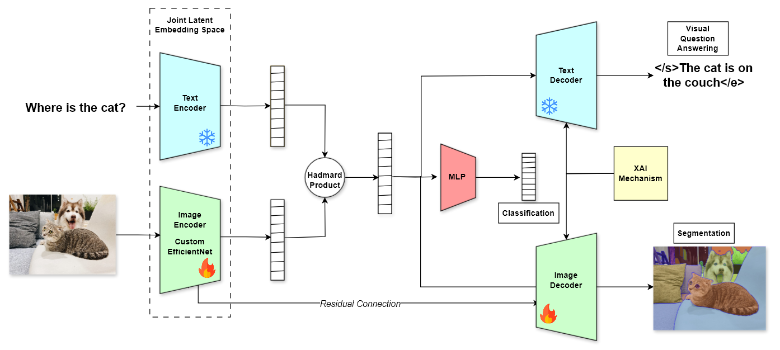
Proposed Architecture

Slide 14
Dataset
Sr no | Name | Number of Images | Task | Classes | Number of Annotations | Modality
1 | ImageNet | ~ 14 Million | Classification | 1000 | 14M image-level labels | RGB
2 | MS COCO | ~ 330 K | Detection, Segmentation, Captioning | 80 | ~2.5M instance + 5 captions per image | RGB + Text
3 | Pascal VOC | ~11 K | Classification, Detection, Segmentation | 20 | ~27K object annotations | RGB
4 | Open Images v6 | ~9M | Detection, Segmentation | 600 | 16M boxes, 2.8M masks, labels | RGB
5 | Visual Genome | ~108K | Scene Graphs, Captioning, QA | 1,600+ | 5.4M region descriptions, relationships | RGB + Text

Slide 15
Dataset
Sr no | Name | Number of Images | Task | Classes | Number of Annotations | Modality
6 | VQA v2 | ~204K | Visual Question Answering | - | 1.1M questions with answers | RGB + Text
7 | GQA | 113K | VQA (Graph-based) | - | 22M reasoning questions | RGB + Text
8 | Flickr30k Entities | ~31K | Captioning, Phrase Grounding | - | 275K phrases linked to boxes | RGB + Text
9 | NoCaps | ~166K | Image Captioning (open vocab) | - | Natural language captions | RGB + Text
10 | TextVQA | ~28K | VQA (Text in Images) | - | 45K questions | RGB + Text (OCR)

Slide 16
Dataset
Sr no | Name | Number of Images | Task | Classes | Number of Annotations | Modality
11 | CLEVR | 100K | VQA (Synthetic) | - | 1M questions | Synthetic + Text
12 | MS-COCO Captions | ~123K | Image Captioning | - | 5 captions/image (~600K total) | RGB + Text
13 | Conceptual Captions | ~3.3M | Large-scale Captioning | - | 3.3M captions | RGB + Text
14 | SBU Captions | ~1M | Image Captioning | - | 1M captions | RGB + Text

Slide 17
Future Work
Investigate State-of-the-Art Methods – Conduct a comprehensive study of existing explainability techniques across modalities and tasks to identify limitations and inform the design of improved solutions.
Pipeline Implementation & Evaluation – Carry out experiments with proposed architecture and make necessary modifications
Literature Survey Expansion – Continue tracking the ongoing research related to XAI for multimodality.

Slide 18
References
Selvaraju, R.R., Cogswell, M., Das, A., Vedantam, R., Parikh, D. and Batra, D., 2017. Grad-cam: Visual explanations from deep networks via gradient-based localization. In Proceedings of the IEEE international conference on computer vision (pp. 618-626)
Sundararajan, M., Taly, A. and Yan, Q., 2017, July. Axiomatic attribution for deep networks. In International conference on machine learning (pp. 3319-3328). PMLR.
Covert, I., Kim, C. and Lee, S.I., 2022. Learning to estimate shapley values with vision transformers. arXiv preprint arXiv:2206.05282.
Binder, A., Montavon, G., Lapuschkin, S., Müller, K.R. and Samek, W., 2016. Layer-wise relevance propagation for neural networks with local renormalization layers. In Artificial Neural Networks and Machine Learning–ICANN 2016: 25th International Conference on Artificial Neural Networks, Barcelona, Spain, September 6-9, 2016, Proceedings, Part II 25 (pp. 63-71). Springer International Publishing.
Rußwurm, M. and Körner, M., 2020. Self-attention for raw optical satellite time series classification. ISPRS journal of photogrammetry and remote sensing, 169, pp.421-435
Abnar, S. and Zuidema, W., 2022. Quantifying attention flow in transformers. arXiv 2020. arXiv preprint arXiv:2005.00928, 10.

Slide 19
References
Barkan, O., Hauon, E., Caciularu, A., Katz, O., Malkiel, I., Armstrong, O. and Koenigstein, N., 2021, October. Grad-sam: Explaining transformers via gradient self-attention maps. In Proceedings of the 30th ACM International Conference on Information & Knowledge Management (pp. 2882-2887)
Chefer, H., Gur, S. and Wolf, L., 2021. Transformer interpretability beyond attention visualization. In Proceedings of the IEEE/CVF conference on computer vision and pattern recognition (pp. 782-791).
Nalmpantis, A., Panagiotopoulos, A., Gkountouras, J., Papakostas, K. and Aziz, W., 2023. Vision diffmask: Faithful interpretation of vision transformers with differentiable patch masking. In Proceedings of the IEEE/CVF Conference on Computer Vision and Pattern Recognition (pp. 3756-3763).
Yu, L. and Xiang, W., 2023. X-pruner: explainable pruning for vision transformers. In Proceedings of the IEEE/CVF conference on computer vision and pattern recognition (pp. 24355-24363).
Liang, Y., Ge, C., Tong, Z., Song, Y., Wang, J. and Xie, P., 2022. Not all patches are what you need: Expediting vision transformers via token reorganizations. arXiv preprint arXiv:2202.07800.

Slide 20
References
Pan, B., Panda, R., Jiang, Y., Wang, Z., Feris, R. and Oliva, A., 2021. IA-RED $^ 2$: Interpretability-aware redundancy reduction for vision transformers. Advances in neural information processing systems, 34, pp.24898-24911.
Xie, W., Li, X.H., Cao, C.C. and Zhang, N.L., 2022. Vit-cx: Causal explanation of vision transformers. arXiv preprint arXiv:2211.03064.
Kim, S., Nam, J. and Ko, B.C., 2022, June. Vit-net: Interpretable vision transformers with neural tree decoder. In International conference on machine learning (pp. 11162-11172). PMLR.
Niu, Y., Ding, M., Ge, M., Karlsson, R., Zhang, Y., Carballo, A. and Takeda, K., 2024. R-cut: Enhancing explainability in vision transformers with relationship weighted out and cut. Sensors, 24(9), p.2695.
Yu, L., Xiang, W., Fang, J., Chen, Y.P.P. and Chi, L., 2023. ex-vit: A novel explainable vision transformer for weakly supervised semantic segmentation. Pattern Recognition, 142, p.109666

Slide 21
References
Hafner, M., Katsantoni, M., Köster, T., Marks, J., Mukherjee, J., Staiger, D., Ule, J. and Zavolan, M., 2021. CLIP and complementary methods. Nature Reviews Methods Primers, 1(1), p.20.
Wang, J., Mao, Y., Guan, N. and Xue, C.J., 2024. SHAP-CAT: A interpretable multi-modal framework enhancing WSI classification via virtual staining and shapley-value-based multimodal fusion. arXiv preprint arXiv:2410.01408.
Liu, S., Zeng, Z., Ren, T., Li, F., Zhang, H., Yang, J., Jiang, Q., Li, C., Yang, J., Su, H. and Zhu, J., 2024, September. Grounding dino: Marrying dino with grounded pre-training for open-set object detection. In European Conference on Computer Vision (pp. 38-55). Cham: Springer Nature Switzerland.
Choi, H., Jin, S. and Han, K., 2024. ICEv2: Interpretability, Comprehensiveness, and Explainability in Vision Transformer. International Journal of Computer Vision, pp.1-18.

Slide 22
References
Yellinek, N., Karlinsky, L. and Giryes, R., 2025. 3VL: Using Trees to Improve Vision-Language Models’ Interpretability. IEEE Transactions on Image Processing.
Kirillov, A., Mintun, E., Ravi, N., Mao, H., Rolland, C., Gustafson, L., Xiao, T., Whitehead, S., Berg, A.C., Lo, W.Y. and Dollár, P., 2023. Segment anything. In Proceedings of the IEEE/CVF international conference on computer vision (pp. 4015-4026).

Slide 23
Thanks

