Slide 1

Student Registration CST499
Alex Johnson
Prof. Echouemi
09/26/2022

Slide 2



SRS
The Software Requirement Specification document provides an outline for the student registration website requirements.
Functions: A user can register an account that saves their information.
User will be able to log into the website using the saved information.
There will be capabilities to enroll in classes and show a list of available classes.
The user will be able to view their information once logged in.

Slide 3
SRS Cont.
Features of the registration site.
Course search: There is a database in with users can search for specific course through a search bar.
Users will have to register for an account and the information is saved for logging in.
Enroll: There is a selection of courses available. The user has the option to pick the course and have an enrollment option. It will show slots available.

Slide 4




UML
Unified Modeling language is the standard modeling language of a group of diagrams that help in development.
I will present three types. Class, sequence, and use case.

Slide 5

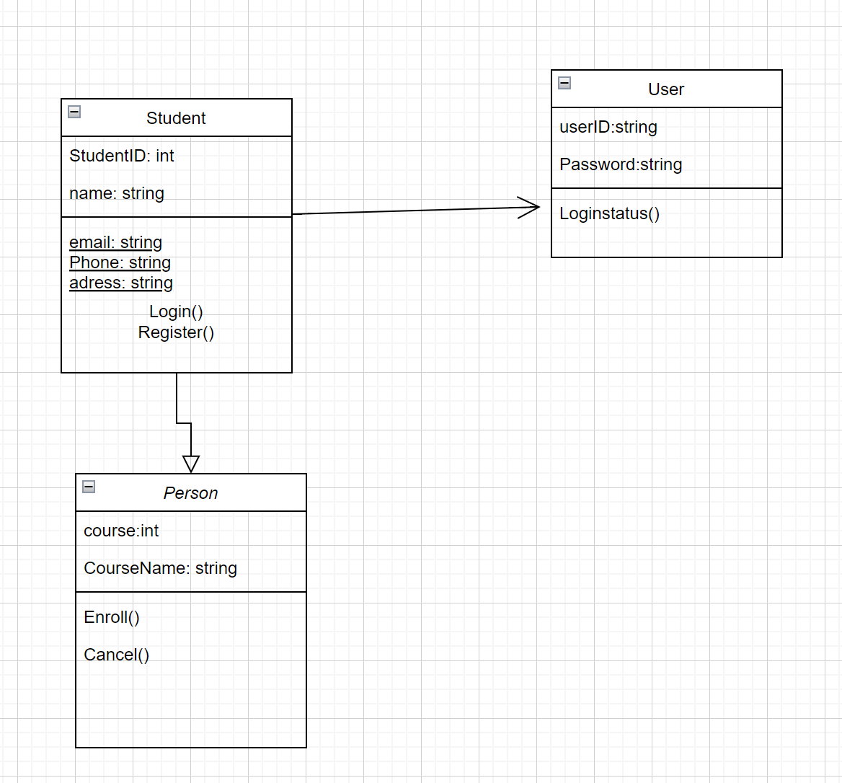
Class
CLASS: this shows the structure of the system by showing classes, attributes, methods and relationships among objects.

Slide 6
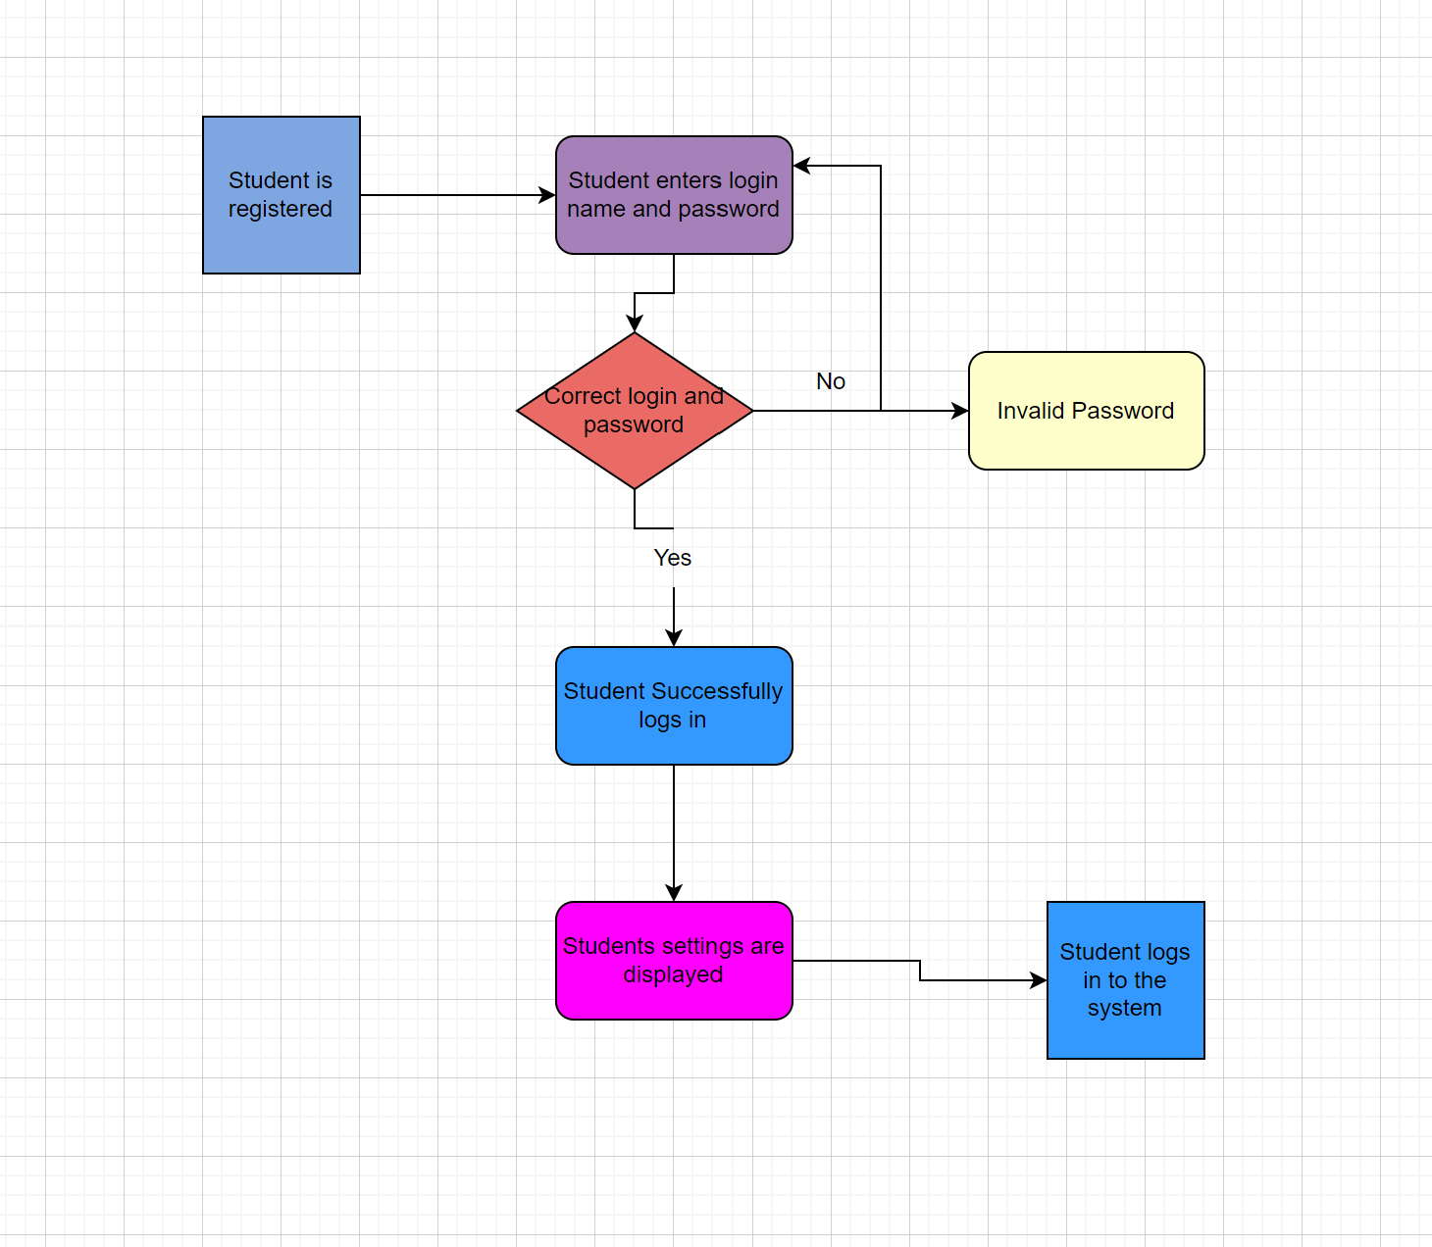
Sequence
This diagram shows the sequence of interactions for classes over time.

Slide 7
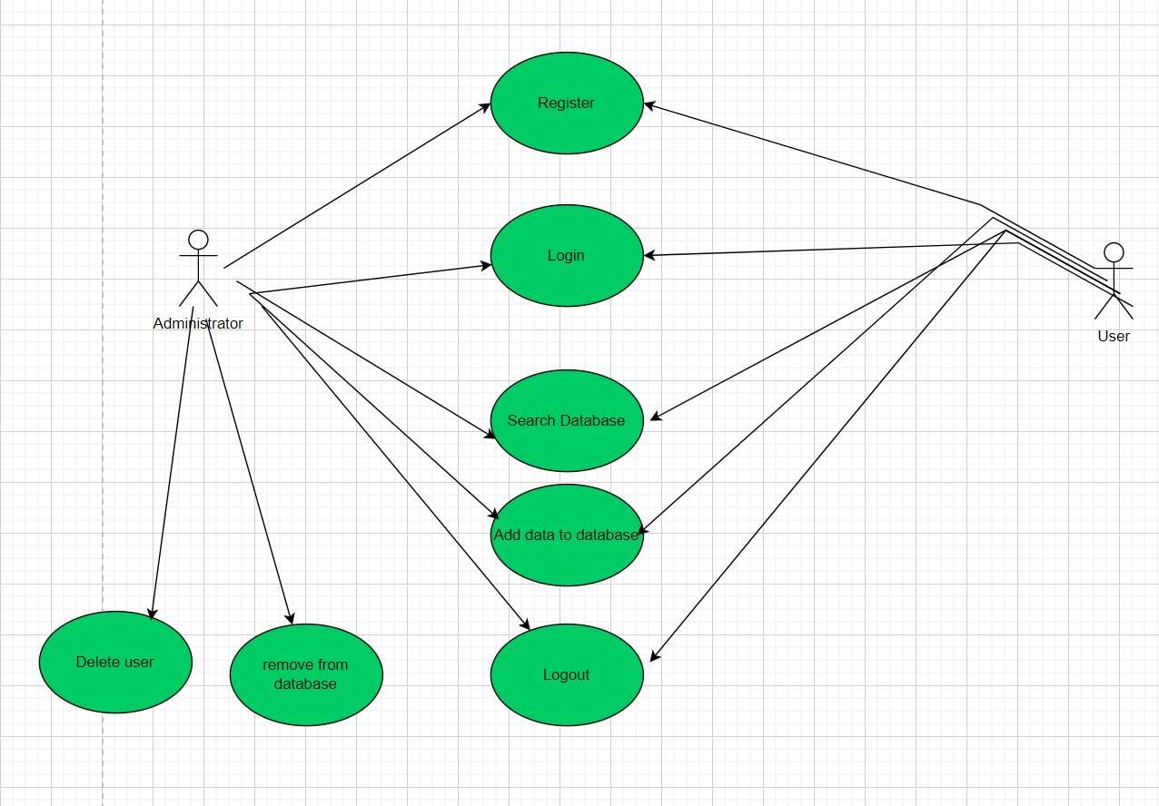
USE CASE
Use case is a type of behavior diagram that uses actors and use cases.

Slide 8

THE USER INTERFACE
The different interfaces of the registration page are login, course registration, and profile page.

Slide 9
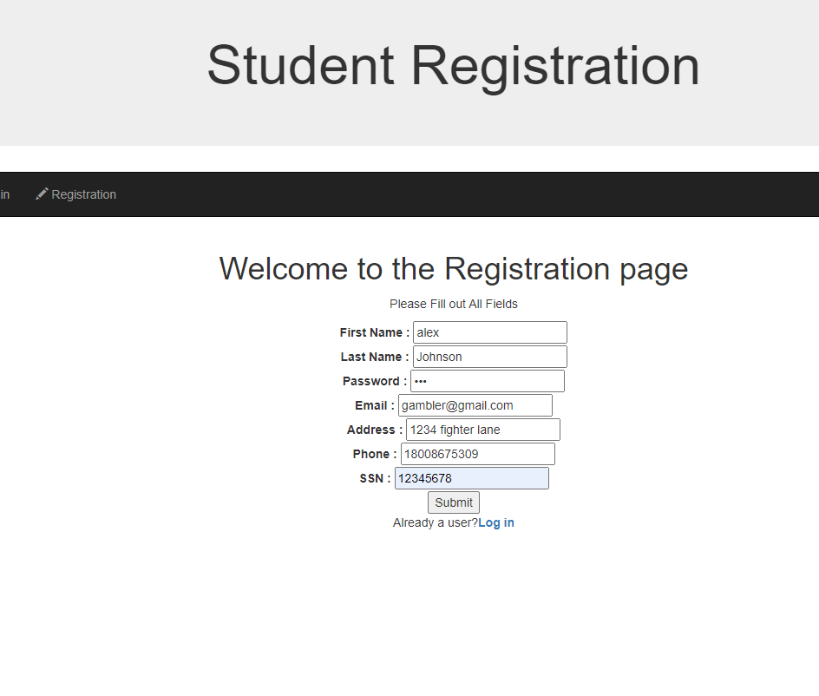
Registration
This page is where the users can provide inputs on their information that is stored on MYSQL database table.

Slide 10
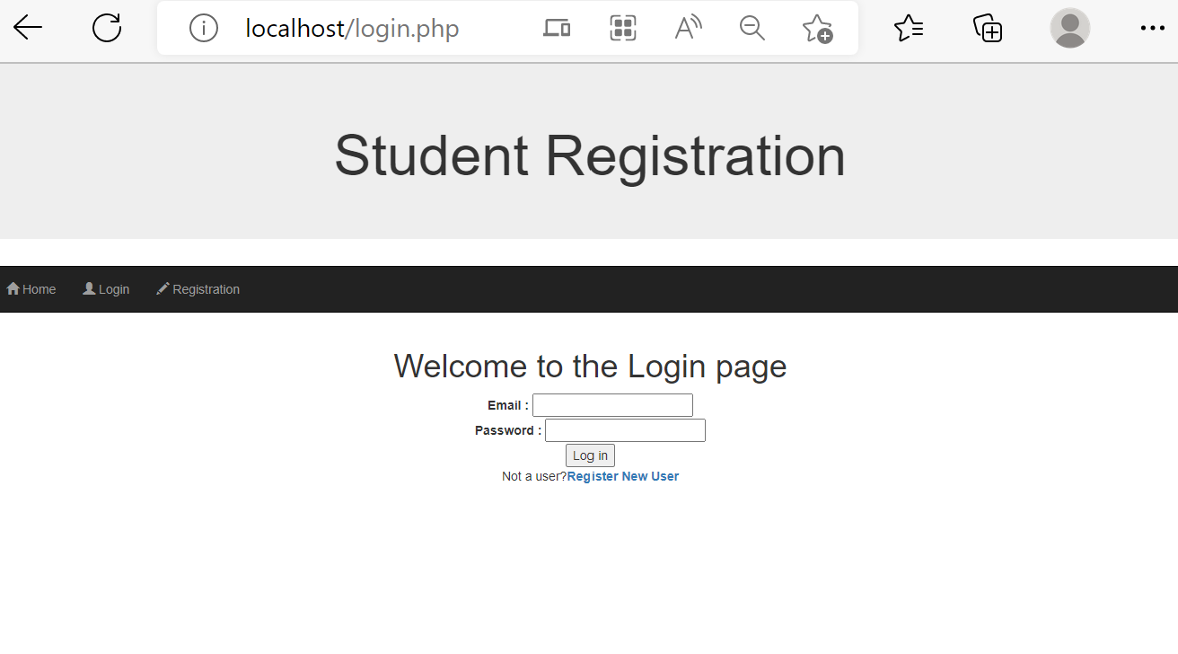
Login
This page is where the user can enter their login information that is saved from the database.

Slide 11
Course Enroll
The enroll page has a dropdown feature where user can see available courses and enroll at the same time.

Slide 12
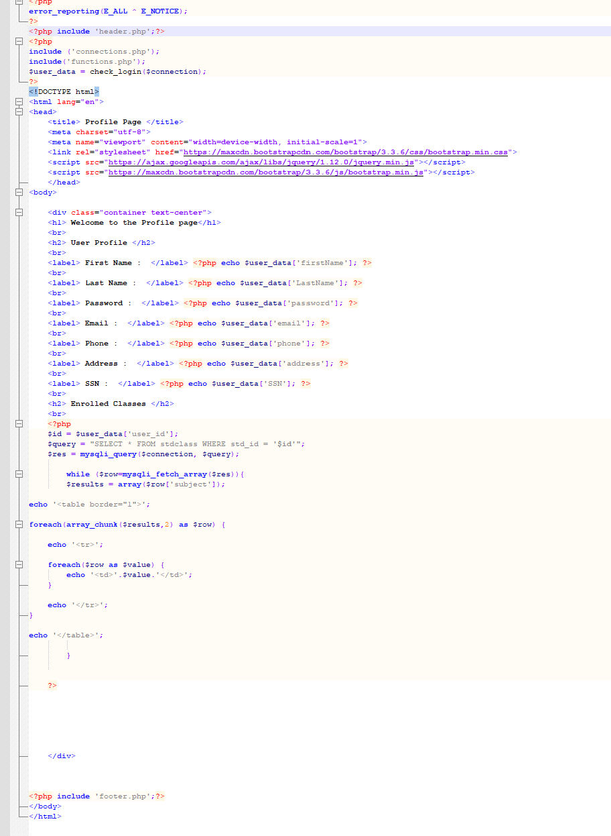
User Profile
The profile page displays the user’s personal information as well as their enrolled classes.

Slide 13
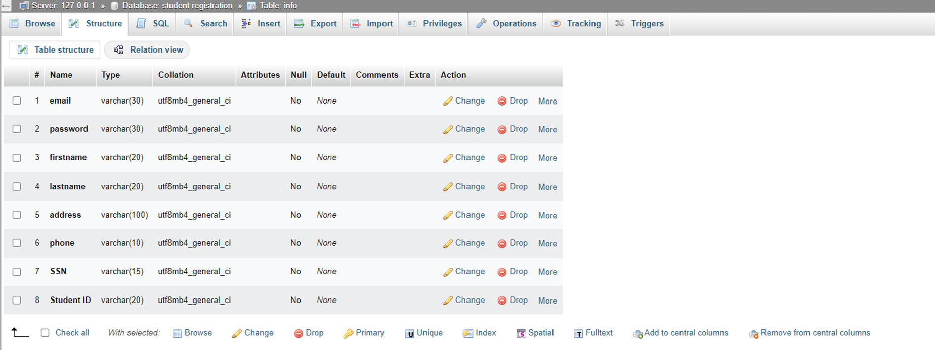
MYSQL DATABASE
This database was created to store the user information inside multiple tables.
Add transitions, animations, and motion.
Save to OneDrive, to get to your presentations from your computer, tablet, or phone.
Open the Design Ideas pane for instant slide makeovers.
When we have design ideas, we’ll show them to you right there.

Slide 14
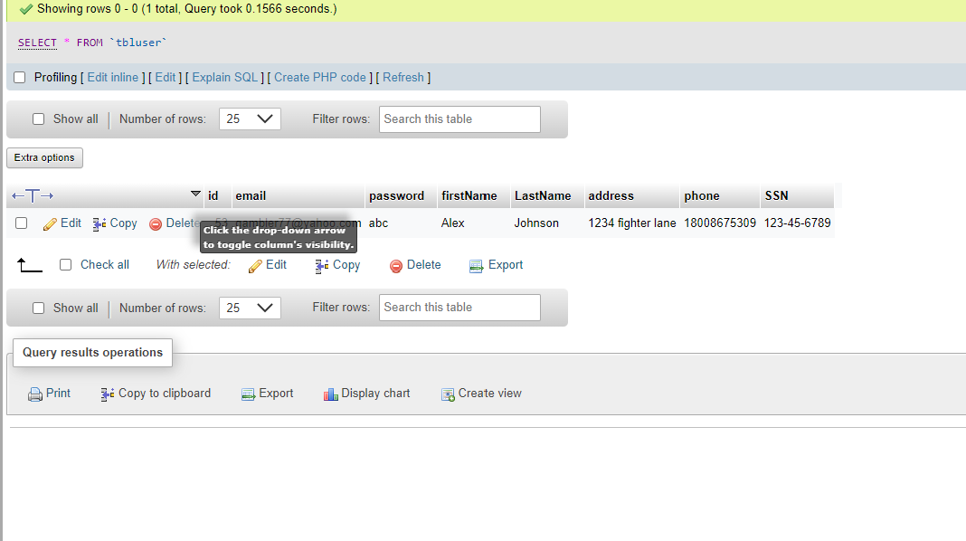
MSQL TABLE

Slide 15
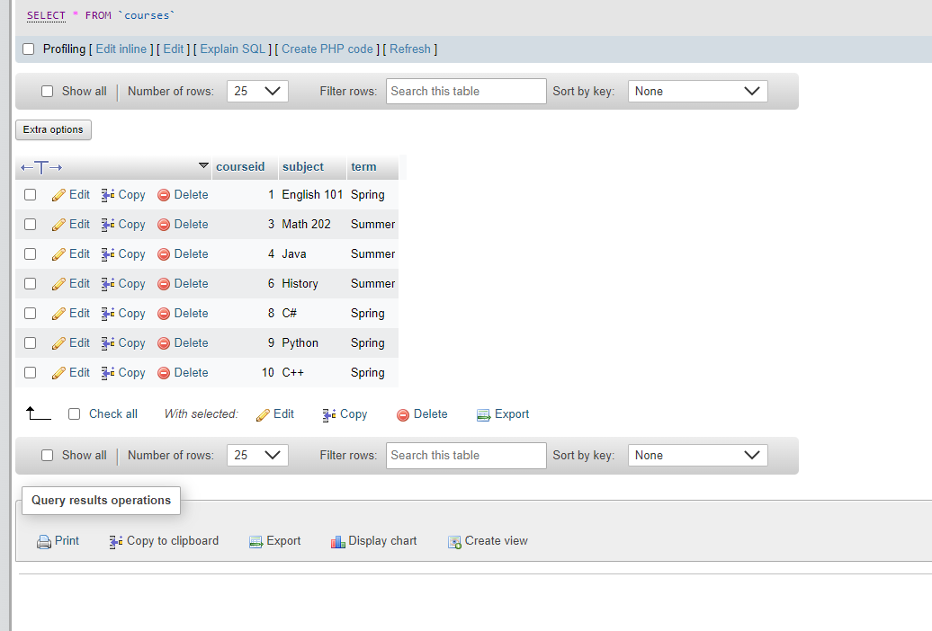
MsQL Courses

Slide 16
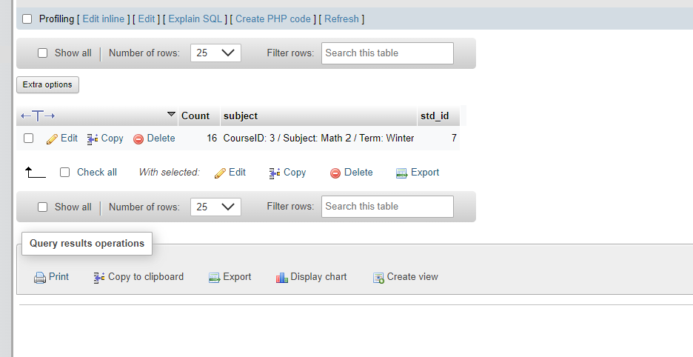
MySQL class

Slide 17
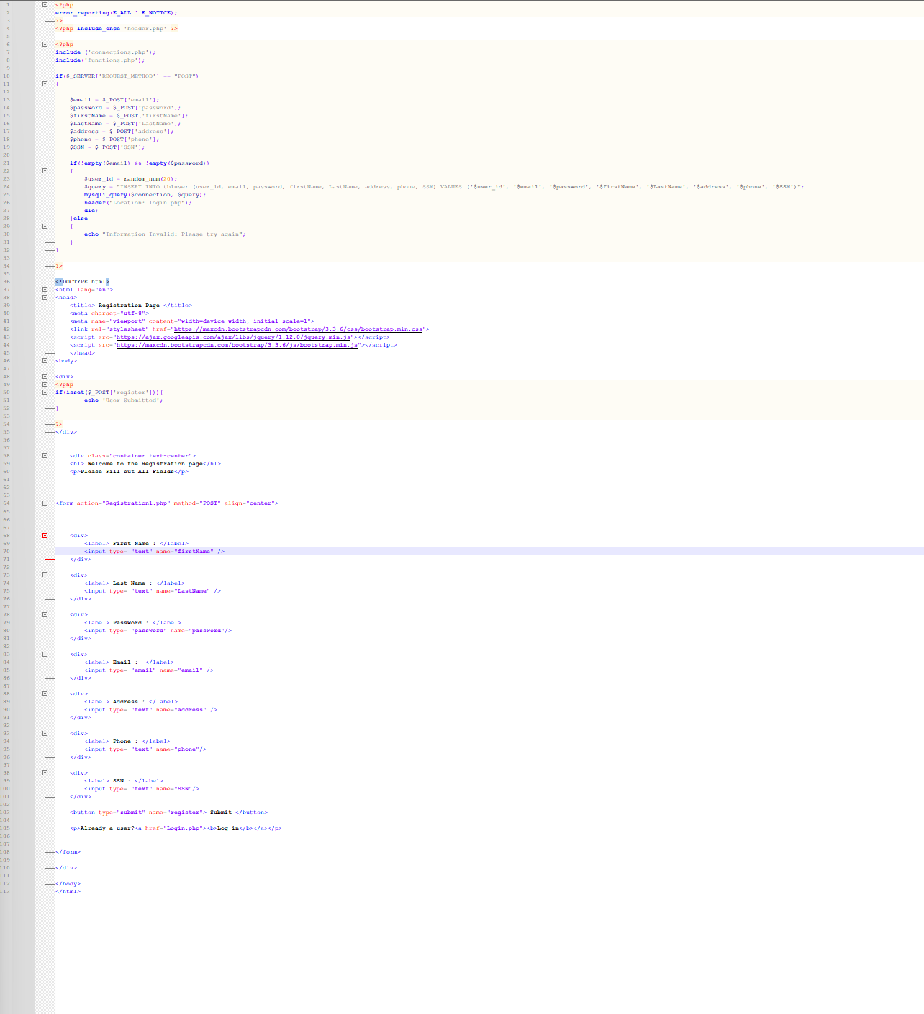
Registration Code

Slide 18
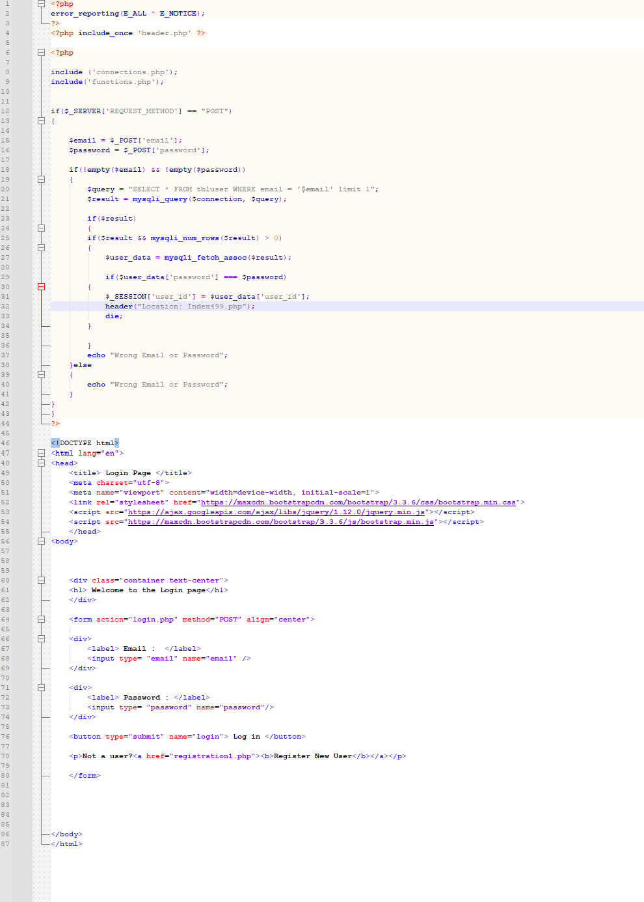
Login Code

Slide 19
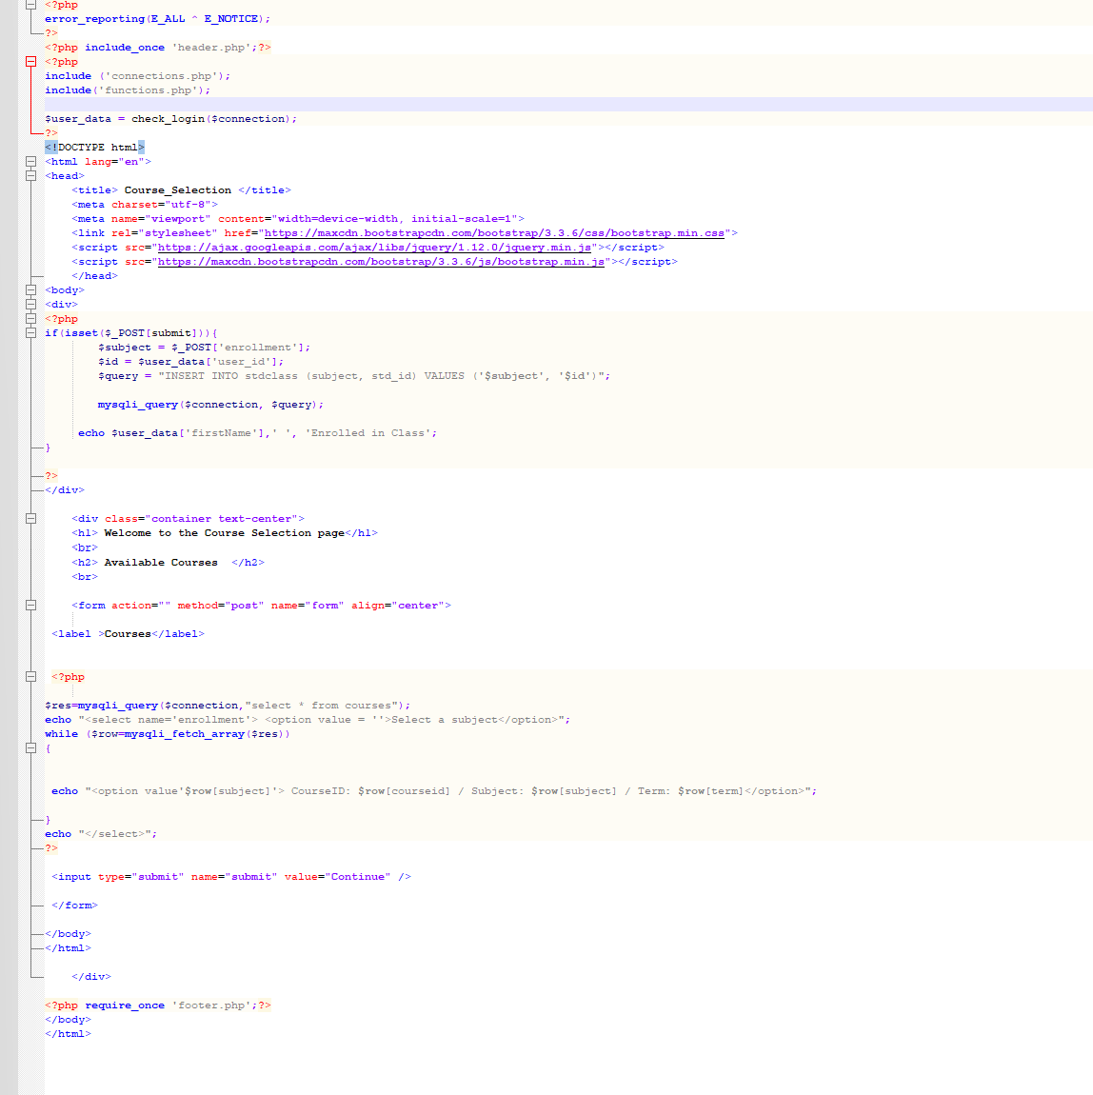
Course Selection Code

Slide 20
Conclusion
I provided key aspects of the SRS document.
Showcased the UML design model.
Explained the landing, login, and enrollment pages.
Explained the MySql Database and class registration.
Discussed the PHP code.

Slide 21


Thank You
Alex Johnson
Harshtime77 (github.com)

Slide 22
References
Tsui, F., Karam, O., & Bernal, B. (2018). Essentials of software engineering (4th ed.). Jones & Bartlett Learning.
Spillner, A., Linz, T., & Schaefer, H. (2014). Software testing foundations: A study guide for the certified tester exam (4th ed.). Ro
cky Nook.
randomtutorial. (2017, October 2). How to create a Github account (Links to an external site.) [Video]. YouTube. https://youtu.be/f_XsJIHSLRg

