Slide 1





PROJECT EXPLANATION & IMPLEMENTATION
Solar-Based RO Drinking Water Initiative
Solar energy
Clean drinking water for school children
Implementation & Project Delivery Overview
10 Government Schools | Banaskatha District, Gujarat
Safe water
Schools
DigiGaon Foundation
Notes:
This deck explains the Solar-Based RO Drinking Water Initiative: what will be installed in 10 government schools in Banaskatha District, how it will be delivered on the ground, who is responsible, how it is monitored, and how it keeps working after handover.

Slide 2









THE CONTEXT
Why This Project Is Needed
CHALLENGE ON THE GROUND
WHAT IT LEADS TO
Groundwater contamination
Water unsafe to drink untreated
High TDS · Fluoride · Microbial contamination
Fluoride exposure raises fluorosis risk
Dependence on untreated sources
Waterborne disease risk
Unsafe handpumps and untreated water in many schools
High incidence reported among school children
Inconsistent electricity supply
Conventional RO cannot run reliably
Power deficit in the region
Grid-dependent purification stops when power fails
Low awareness
Unsafe habits continue
Water safety and hygiene practices
Clean water alone is not enough without awareness
The project response: solar-powered RO purification that treats water on site, using renewable energy instead of unreliable grid power.
Solar-Based RO Drinking Water Initiative · DigiGaon Foundation
2
Notes:
Walk left to right: each challenge on the ground and the consequence it creates for the school. The last row explains why a conventional grid-powered RO is not enough, and why this project uses solar power.

Slide 3







THE PROJECT IN ONE VIEW
Project at a Glance
10
~3,000
140
55,000+
Government schools
Students (approx.)
Teachers
Community members in surrounding areas
Location: Banaskatha District, Gujarat
[School names: to be added once selection is finalised]
WHAT THE PROJECT INCLUDES
Solar-powered RO purification
Renewable Energy –Powered Water Facility
Hygiene & sanitation awareness
12-month maintenance & water-quality testing
Solar-Based RO Drinking Water Initiative · DigiGaon Foundation
3
Notes:
Four numbers describe the reach: 10 government schools, around 3,000 students, 140 teachers and more than 55,000 people in the surrounding communities. The bottom row lists the four things the project delivers.

Slide 4






THE PHYSICAL INTERVENTION
What Will Actually Be Installed
Solar panels
Battery / power system
RO purification
UV / filtration
Safe water storage
Water cooler
Students & school community
SYSTEM COMPONENTS
3.5 KW
5 batteries
Inverter
250 LPH
Rooftop off-grid solar PV system
Battery storage at each site
Inverter & stabilizer
Water purification system
RO + UV
Fittings
200–250 L
× 10 schools
With carbon & sediment filtration
Storage, racking, wiring & plumbing
Solar-powered water cooler
One Solar RO system + cooler per school
Solar-Based RO Drinking Water Initiative · DigiGaon Foundation
4
Notes:
Top row: how the system works, from sunlight to a child drinking clean water. Bottom grid: the specified components. Only specifications stated in the project document are shown.

Slide 5





HOW THE PROJECT IS DELIVERED
The Six-Step Implementation Journey
1
2
3
4
5
6
School Identification
Baseline & Water Assessment
Procurement & Planning
Installation
Training & Awareness
Monitoring, Maintenance & Handover
Transparent selection using local data
Infrastructure, students & water quality recorded
Equipment, vendors & site plans
Solar, RO & cooler installed and tested
Staff, caretakers & community
12-month support; ownership to schools
PREPARE
Month 1–2
BUILD & TRAIN
Month 2–3
OPERATE & SUSTAIN
Month 3–12
From planning to functioning water infrastructure — each step feeds the next.
Solar-Based RO Drinking Water Initiative · DigiGaon Foundation
5
Notes:
This is the backbone of the project. Steps 1 to 3 prepare the ground, steps 4 and 5 put the system in place and train people to use it, and step 6 keeps it working through 12 months of support before full ownership rests with the school.

Slide 6
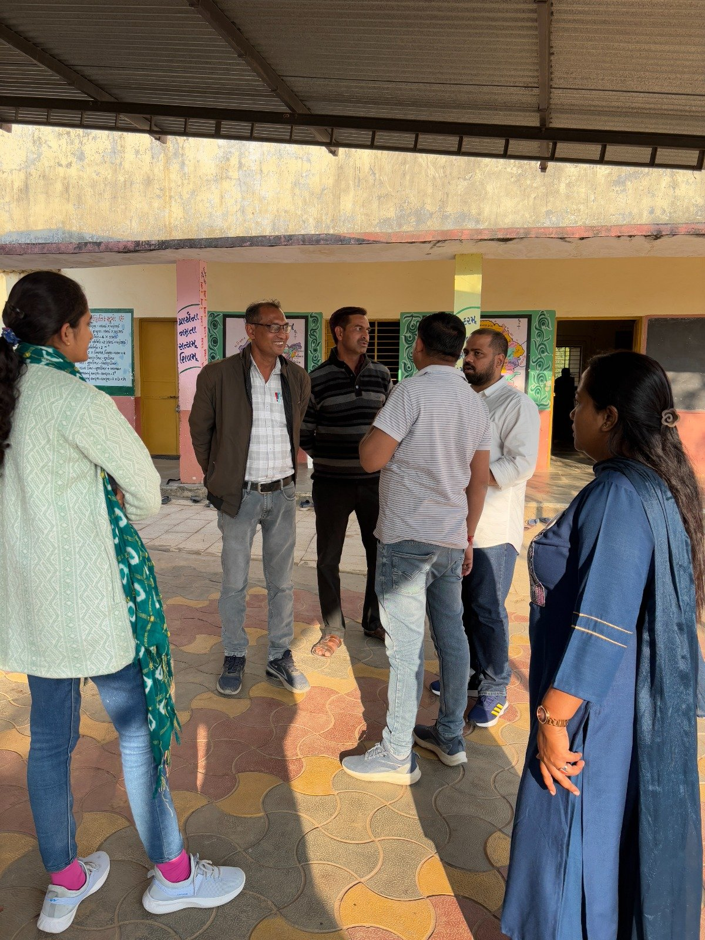


STEPS 1 & 2
School Selection & Baseline Assessment
Step 1 · School Selection
Step 2 · Baseline Data Collected
SITE VISIT
Transparent selection
Local data collection
Community needs assessment
School infrastructure status
PRIORITY GIVEN TO SCHOOLS WITH
Highest student density
Poorest water quality
Student strength / attendance
Water quality
Community commitment to sustainability
Existing infrastructure (space, roof, plumbing)
Existing water source
Solar-Based RO Drinking Water Initiative · DigiGaon Foundation
6
Notes:
Step 1 explains how schools are chosen: transparently, using local data and a community needs assessment, against four criteria. Step 2 records the starting point at each school, during site visits, so that later changes can be measured.

Slide 7
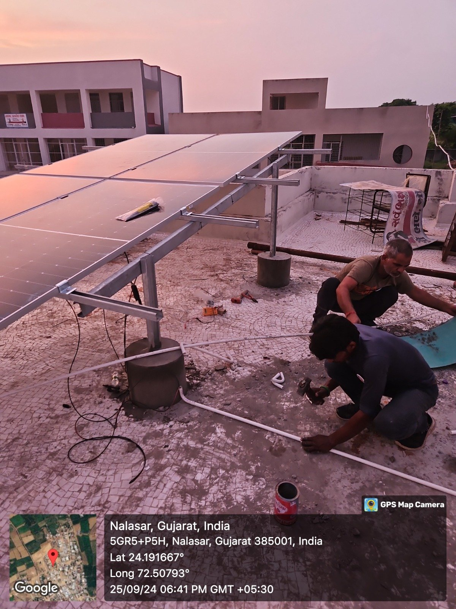

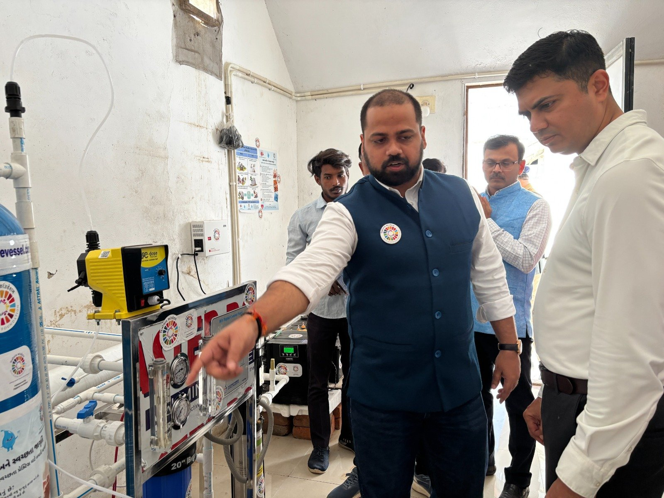
STEPS 3 & 4
From Procurement to a Working System
PLANNING & PROCUREMENT
ON-SITE INSTALLATION
INSTALLATION
Off-site preparation
At each of the 10 schools
1 Procurement
3
4
5
Equipment & materials sourced
Site preparation
Solar installation
RO installation
Rooftop & location readied
Panels, battery & inverter
Purifier, storage & cooler
2 Vendor coordination
6
7
8
Supply & installation aligned with vendors
Plumbing & electrical
System testing
Quality & safety check
TESTING
Wiring, pipes & connections
Full system run & checked
Verified before use
Result: a tested, verified and functioning system at each school, ready for training and handover.
Solar-Based RO Drinking Water Initiative · DigiGaon Foundation
7
Notes:
Left: what happens before anyone goes on site — sourcing equipment and aligning vendors. Right: the on-site sequence at each school, ending with testing and a quality and safety check before the system is used. The two frames on the right are for installation and testing photographs.

Slide 8
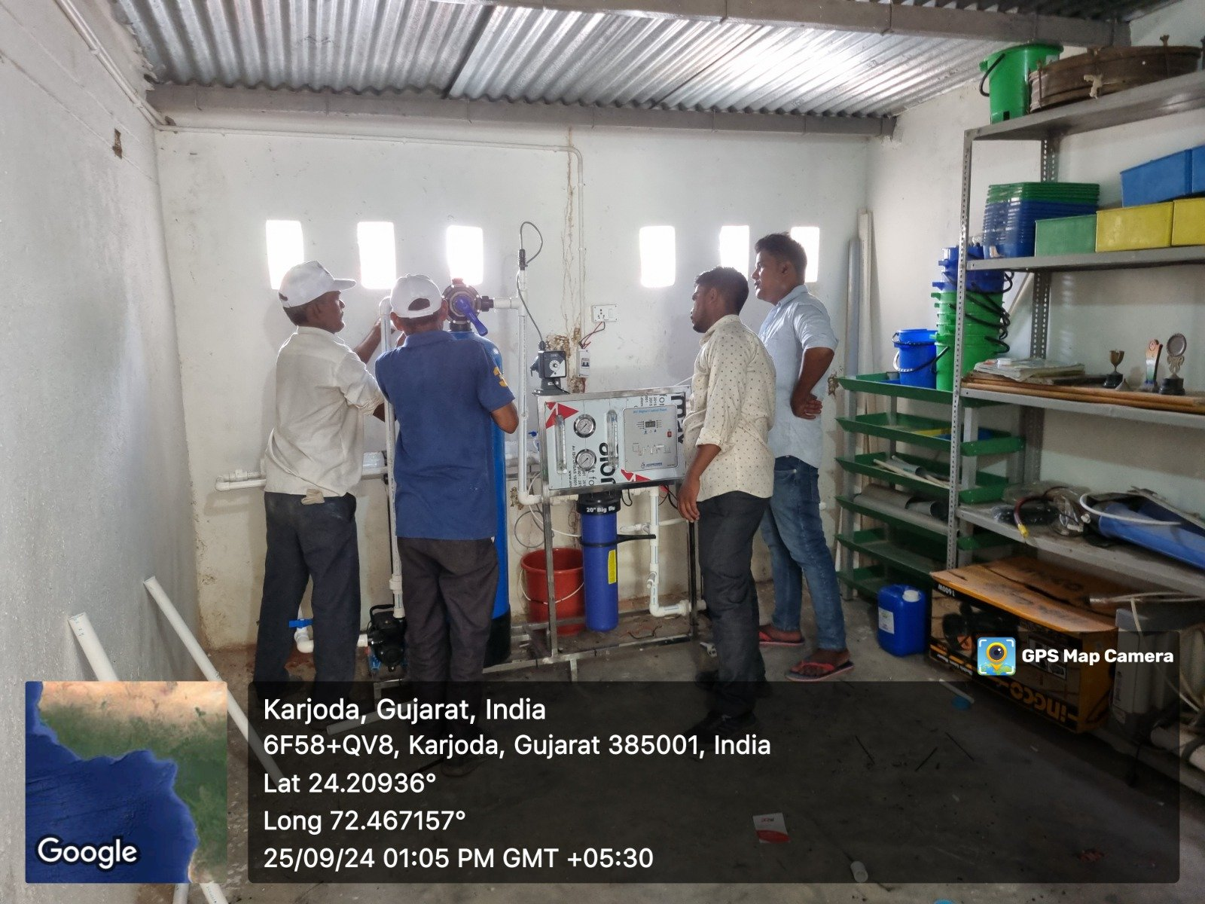



STEP 5
Training & Community Awareness
TRAINING
WHO IS TRAINED
Teachers & school staff
Local personnel / caretakers
WHAT IS COVERED
RO operation & upkeep
Water safety practices
Hygiene & sanitation awareness
COMMUNITY LOOP
Staff and local caretakers trained on the installed system: operation, upkeep and water safety.
Awareness programmes in schools & communities
Feedback: surveys & group discussions
Solar-Based RO Drinking Water Initiative · DigiGaon Foundation
8
Notes:
Once the system is installed, the people who will run it are trained: teachers, school staff and local caretakers. Awareness sessions cover water safety, hygiene and sanitation, and community feedback is collected. The photo frame is for an image of a training or awareness session.

Slide 9



ROLES & RESPONSIBILITIES
Who Delivers the Project
Project Manager
Overall coordination, timelines, reporting & field visits
Technical Coordinator
Water & Sanitation Program Officer
Project Supervisor
Admin & Finance Executive
Installation, vendors, testing, technical issues & handover
Water testing, hygiene awareness, training & maintenance coordination
School & community coordination, feedback, data collection & local issues
Procurement, payments, records, financial documentation & compliance
Solar-Based RO Drinking Water Initiative · DigiGaon Foundation
9
Notes:
One Project Manager holds overall coordination. Four roles report in: technical delivery, water and sanitation, field supervision with schools and communities, and administration and finance.

Slide 10


WHEN IT HAPPENS
Project Timeline: Month 1 to Month 12
M1
M2
M3
M4
M5
M6
M7
M8
M9
M10
M11
M12
Preparation
Month 1–2
School selection · Baseline assessment · Stakeholder consultation · Procurement planning
Installation
Month 2–3
Solar RO installation · Staff training · Awareness activities
Initial Operations
Month 3–4
Monitoring · Troubleshooting · Impact assessment · Documentation · Optimization
Sustained Operations
Month 4–12
Regular maintenance · Impact evaluation · Community engagement
Evaluation
Milestones
Mid-term review
Final evaluation & impact report
Solar-Based RO Drinking Water Initiative · DigiGaon Foundation
10
Notes:
Read the timeline top to bottom. Preparation happens in months 1 to 2, installation and training in months 2 to 3, initial operations in months 3 to 4, and sustained operations with regular maintenance run from month 4 to month 12. A mid-term review in month 6 and a final evaluation in month 12 measure progress and outcomes.

Slide 11







HOW MONITORING WORKS
Actively Monitored, Not Installed and Forgotten
1
WHAT IS CHECKED ON THE GROUND
Baseline
Field visits (PM & Tech. Coordinator)
8
2
Mid-course correction
Installation verification
Geo-tagged photos & videos per milestone
7
Continuous monitoring cycle
3
System functionality checks
Feedback
Daily / weekly activity logs
Water quality checks
6
4
Monthly reports
Photo / video evidence
Surveys & focus group feedback
5
Dashboard issue flagging & resolution
Functional & hygiene checklists
Solar-Based RO Drinking Water Initiative · DigiGaon Foundation
11
Notes:
Monitoring runs as a cycle. It starts from the baseline, verifies the installation, and then keeps going through activity logs, photo and video evidence, checklists, monthly reports and feedback. Any issue leads to corrective action, and the cycle repeats. The right panel lists what is physically checked on the ground.

Slide 12







DOCUMENTATION
Reporting & Documentation
WHAT IS CAPTURED
WHAT IS PRODUCED
Project Documentation & Reports
+
+
Project dashboard (milestones & issues)
Baseline & beneficiary data
Installation records
Date-stamped photos & videos
Monthly progress reports
=
Quarterly reports
Financial documentation
Success stories & case studies
+
+
Attendance & activity logs
Beneficiary feedback
Financial records
Impact assessment report
Final project dossier
Solar-Based RO Drinking Water Initiative · DigiGaon Foundation
12
Notes:
Everything gathered in the field — baseline data, installation records, photos and videos, training logs, feedback and financial records — is compiled into regular monthly and quarterly reports, case studies, an impact assessment and a final project dossier.

Slide 13
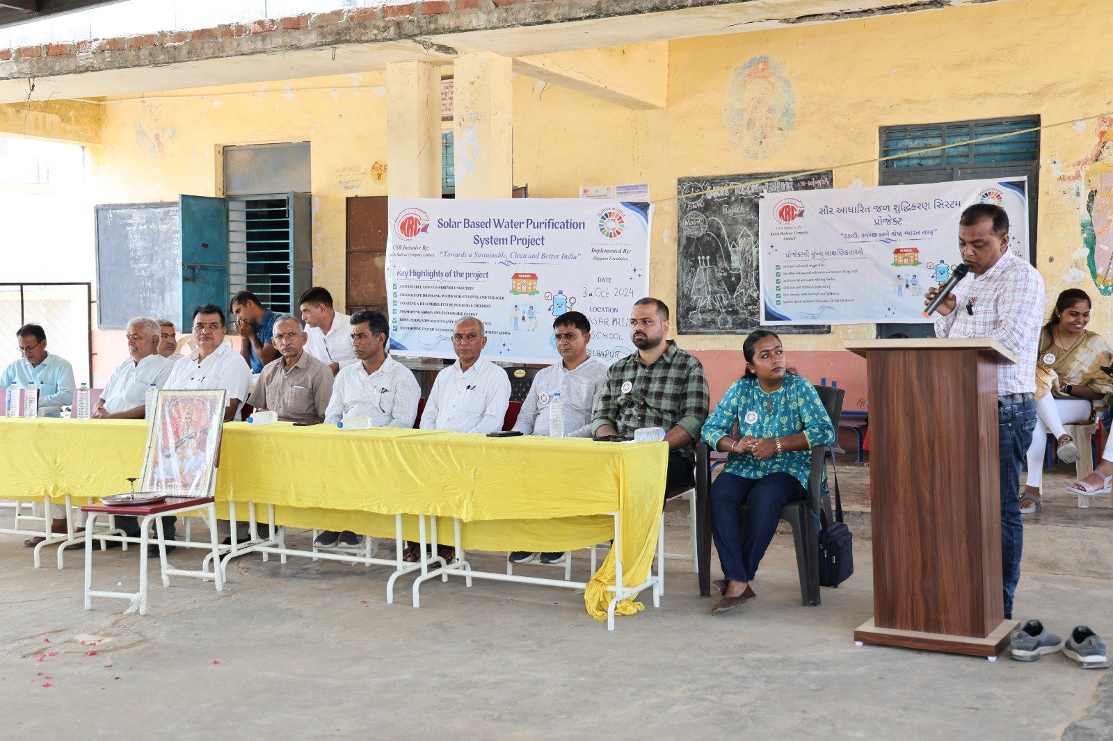
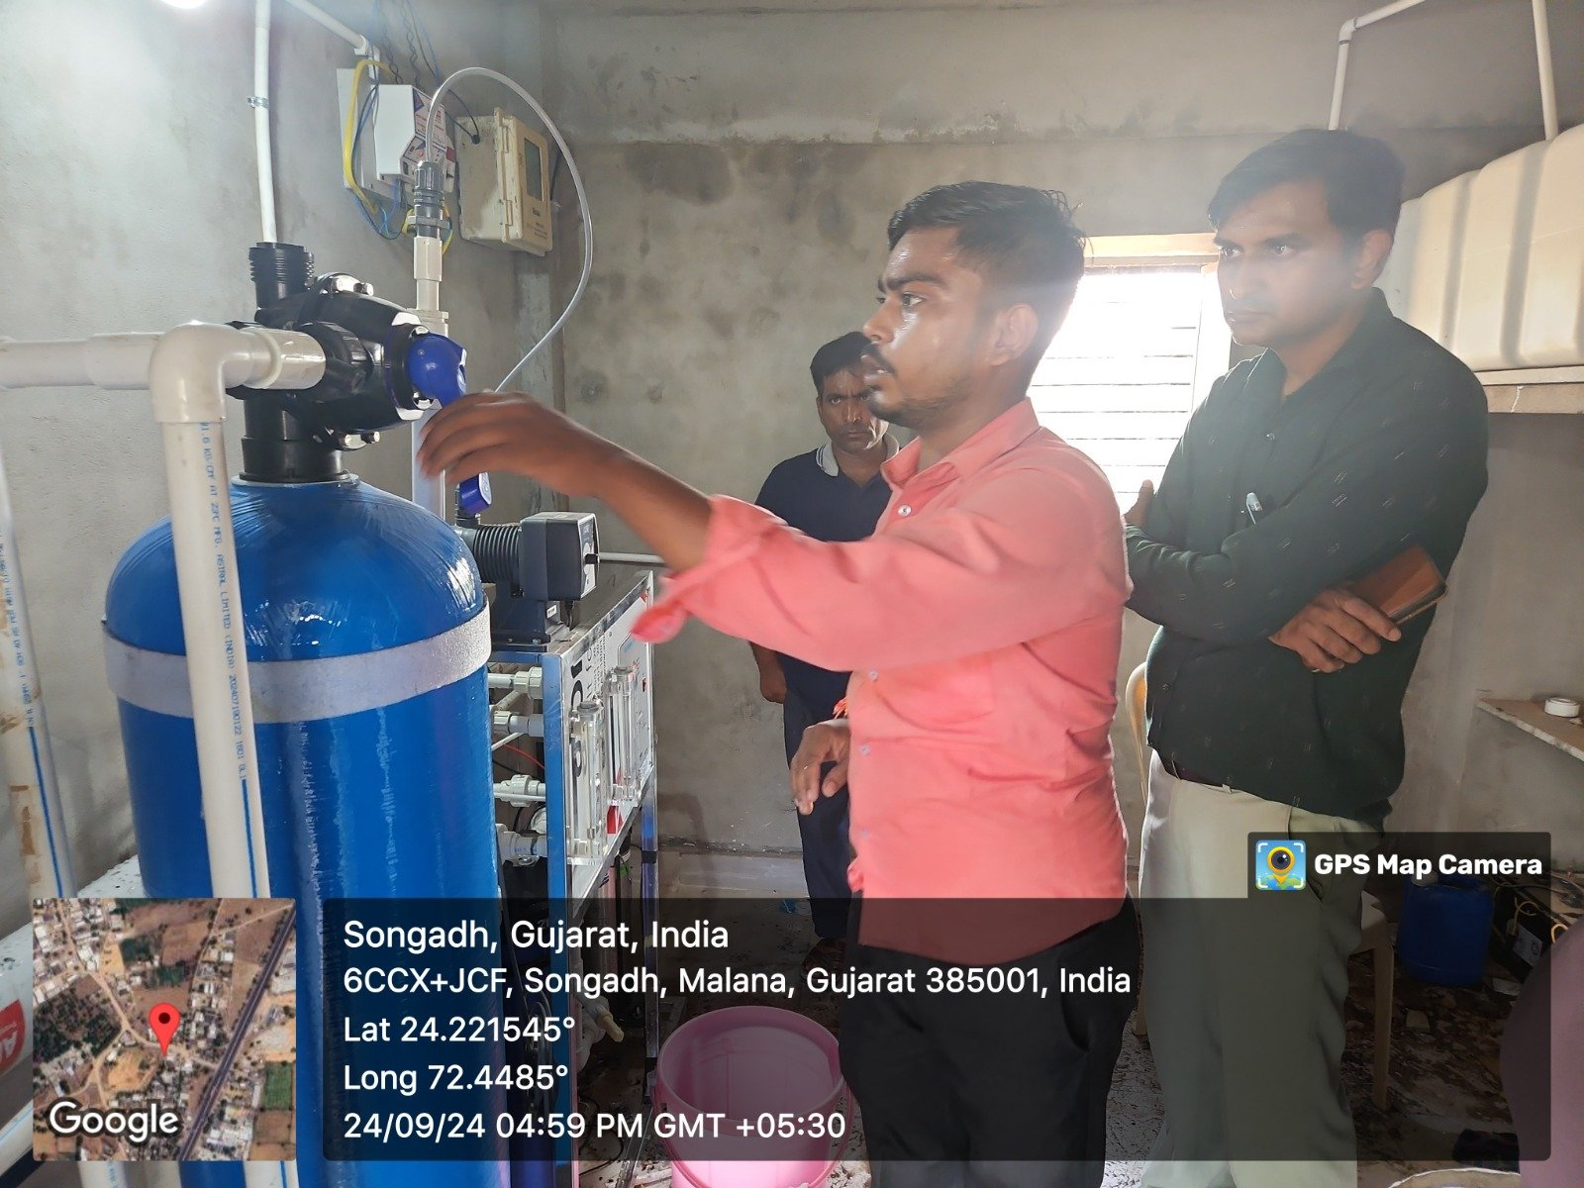
SUSTAINABILITY
What Happens After Installation
Installation
Ownership
Capacity Building
Maintenance
Long-Term Use
System installed, tested & verified at each school
Hardware handed over to school authorities
With documentation & training
Teachers & local staff trained to operate and maintain
12-month maintenance support
12-month water-quality testing
Local technicians for check-ups & repairs
Periodic visits & usage monitoring
Community-led minor upkeep
Hardware life of 15–20 years
END STATE
INAUGURATION
MAINTENANCE
The school owns and operates the system, backed by trained staff, local technicians and an engaged community.
Solar-Based RO Drinking Water Initiative · DigiGaon Foundation
13
Notes:
This slide answers what happens after the installers leave. The school owns the system, trained staff and local personnel run it, 12 months of maintenance and water-quality testing support its operation, and periodic visits, usage monitoring and community involvement keep it in use. The two photo frames are for the inauguration or handover and for maintenance visits.

Slide 14
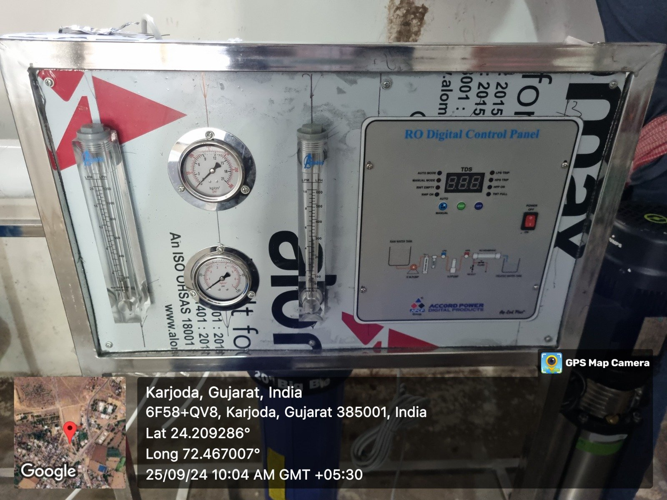
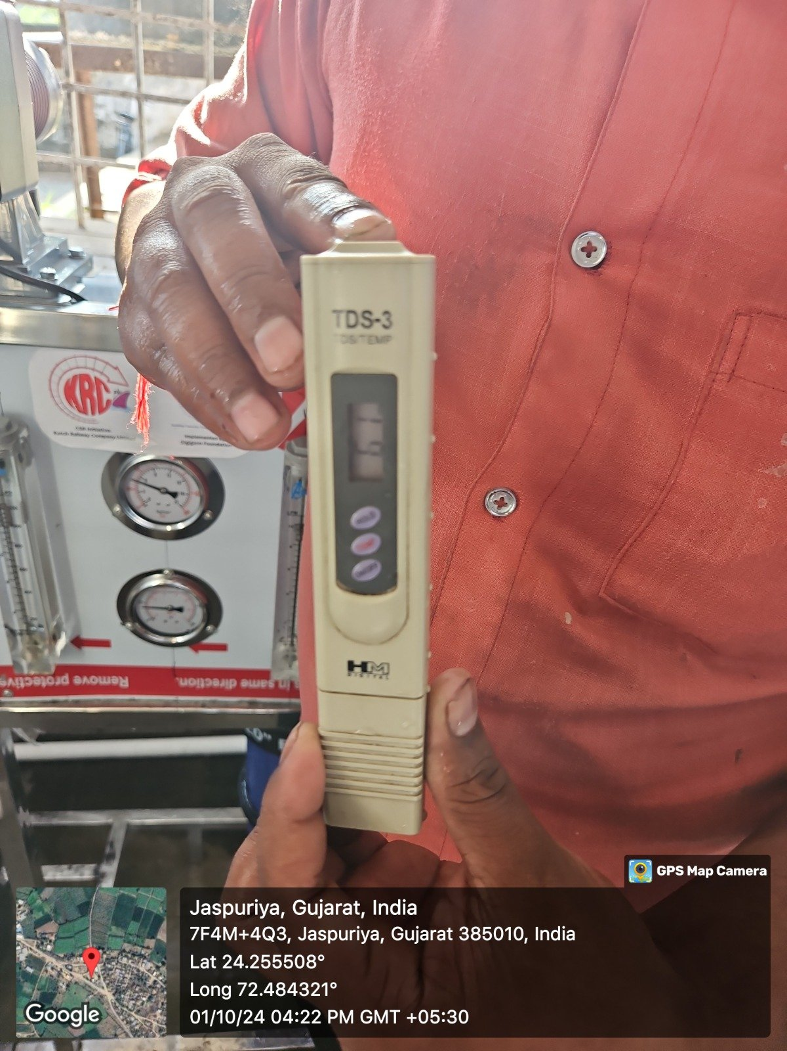
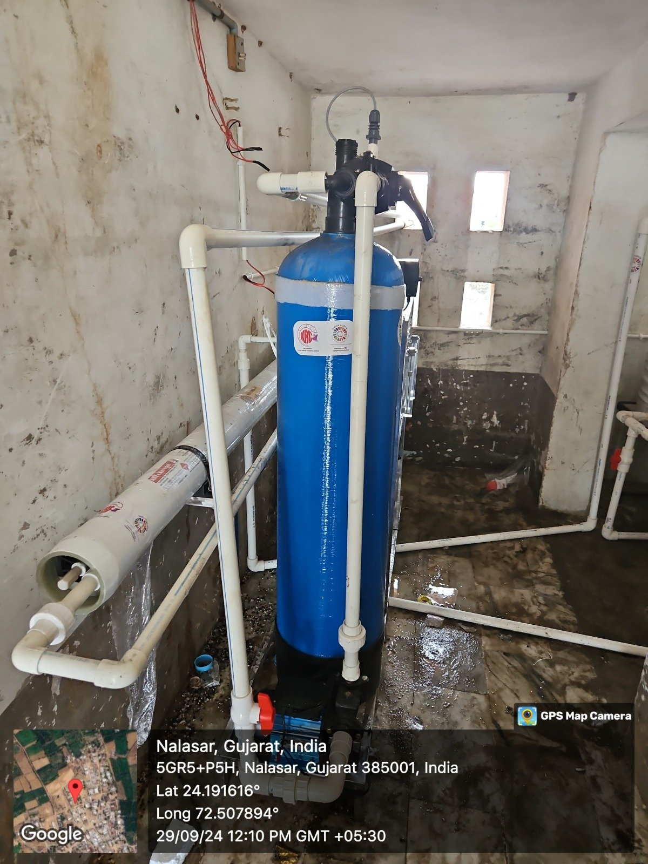
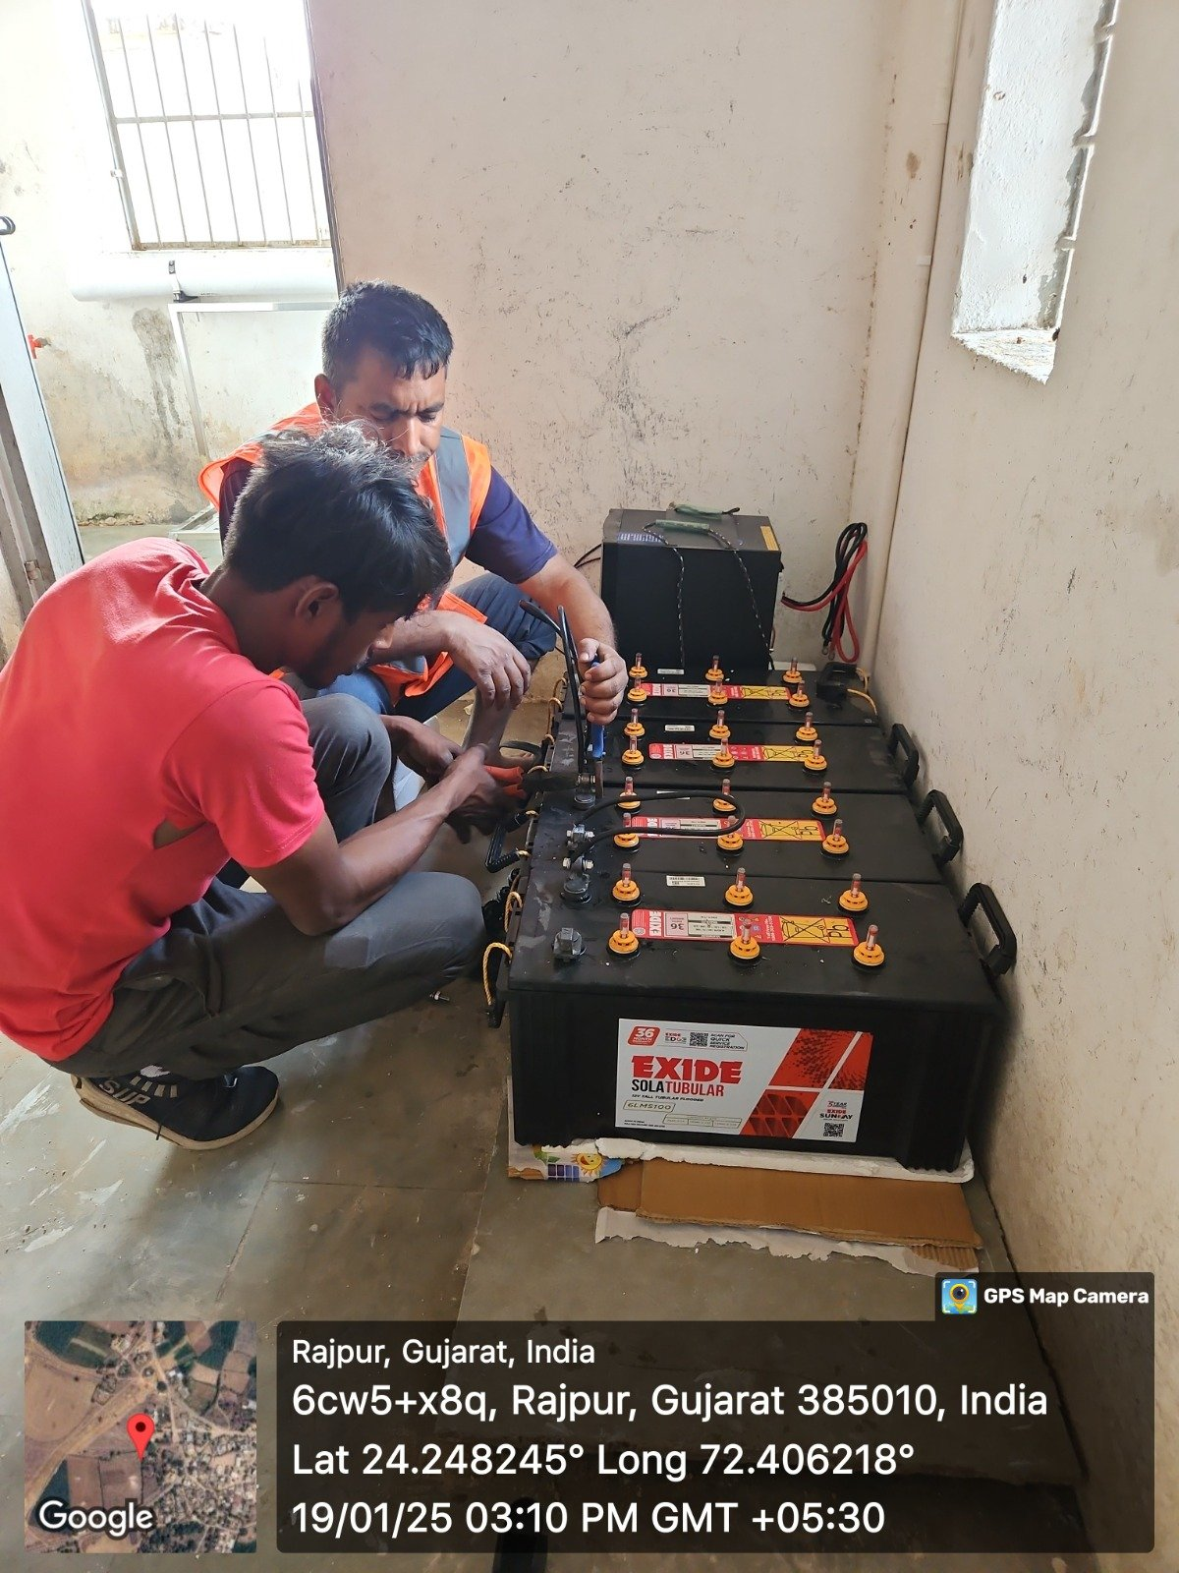
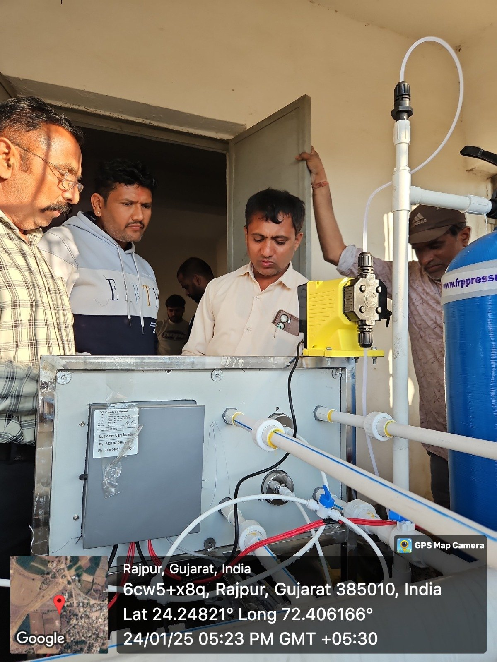
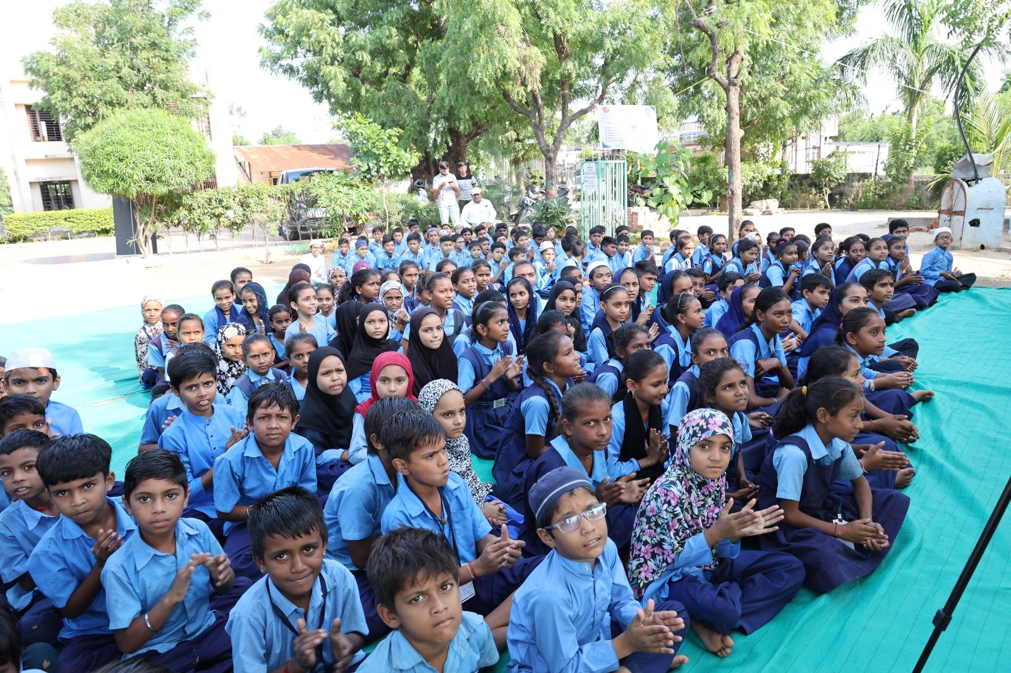

OUTCOMES & FIELD EXPERIENCE
Expected Impact & Past Projects
A · EXPECTED IMPACT
B · PAST PROJECTS & FIELD EXPERIENCE
Health
Safe drinking water · Fewer cases of fluorosis, diarrhoea & waterborne illness · Better hygiene · Improved attendance
Community
Community ownership & involvement · Capacity building · Jobs for local technicians & trainers
Environment
Renewable solar energy · Low operational costs · Long-lasting, sustainable infrastructure
Measured by: baseline vs. endline data, surveys, on-site inspections and observation of hygiene practices
Solar-Based RO Drinking Water Initiative · DigiGaon Foundation
14
Notes:
Left: the outcomes the project expects in health, community and environment. Right: photographs from DigiGaon Foundation's previous field work.

