Slide 1

Ecommerce Furniture
Submitted By:
2210991642: Harshita
2210991645: Harshul
2210990982: Yashnoor Kaur
2210992028: Parth Goyal
Submitted To: Faculty Coordinator:
Mr. Rajesh Ms. Meenakshi

Slide 2
Ecommerce Furniture
Submitted By:
2210991642: Harshita
2210991645: Harshul
2210990982: Yashnoor Kaur
2210992028: Parth Goyal
Submitted To: Faculty Coordinator:
Mr. Rajesh Ms. Meenakshi

Slide 3
Introduction
BETTER ECOMMERCE EXPERIENCE
Users struggle to:
Find products that match their interior style
Navigate clunky websites with poor UI/UX
Filter through hundreds of irrelevant results
Many platforms lack:
Easy to Understand UI/UX.
Smart filters/ categories.

Slide 4
Technology Backbone of DecorMahal
Frontend:
React.js – Component-based architecture
CSS – Modern UI with soft themes and responsiveness
Apollo– Simple management and fetching of the data with GraphQL Query.
Backend:
Node.js + Express.js – RESTful APIs and scalable architecture.
Sequelize ORM + MySQL – Structured relational database.
GraphQL - Integrated GraphQL API endpoints for optimal data fetching .
Auth & Routing:
JWT Authentication
React Router (Private Routes)
Tools:
Git & GitHub (Team Collaboration)
Postman (API Testing)

Slide 5
Project Journey
📌 Phase 1: Planning & Ideation
Planning what to use?
Deciding MVP features: product listing, filters, cart, login/signup
🔧 Phase 2: Backend Setup
Database schema design
Sequelize model creation
Routes for products, auth, cart
GraphQL integeration
🎨 Phase 3: Frontend Development
Component structure: Navbar, Products etc.
Private routing (e.g. Cart only for logged-in users)
Split login/signup for each role i.e. ADMIN, EMPLOYEE and CUSTOMER.

Slide 6
Project Journey
🛍️ Phase 4: Core Features
Product filtering/sorting
Cart functionality (add/remove/update)
Authentication with JWT
3 roles ADMIN, CUSTOMER and EMPLOYEE
ADMIN can manage employees and see the total progress of everything.
CUSTOMER can login and buy product of their choice.
EMPLOYEE can manage products and dispatch the order to their respective customers.
Responsive design.

Slide 7
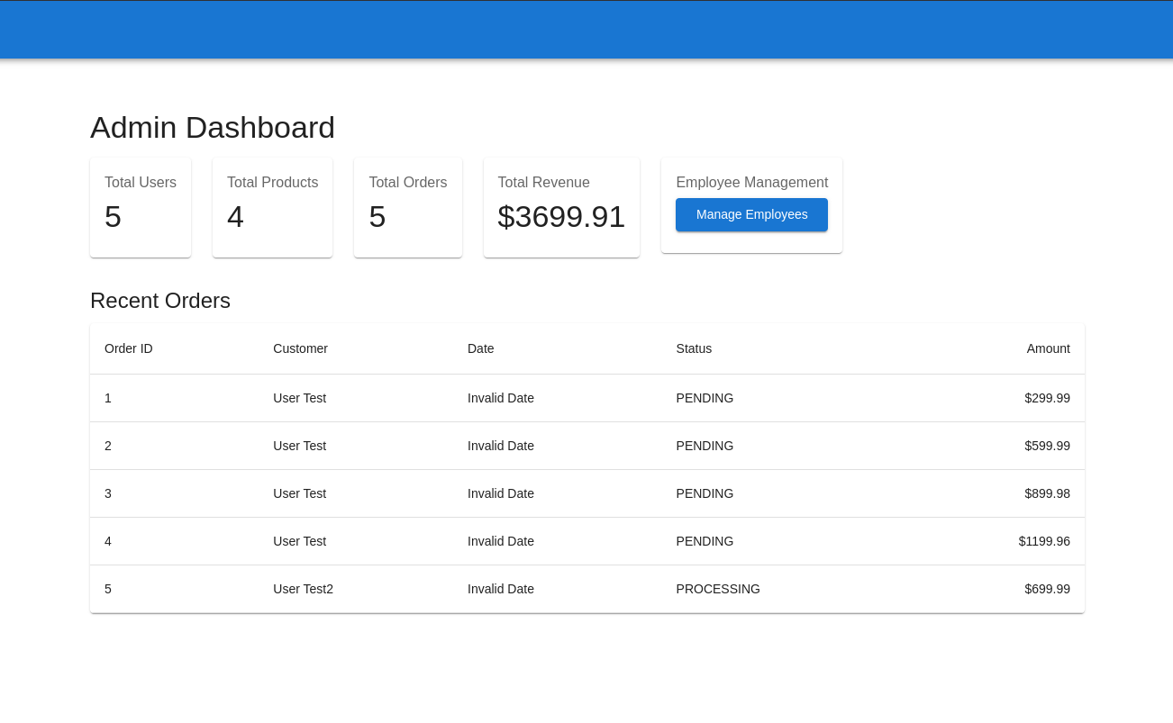
Frontend Architecture
Structure:
Reusable components: Navbar, Footer.
Pages: Home, Login, Signup, Cart
State Management: React Hooks
Responsive Design: Using custom CSS with media queries

Slide 8
What Went Wrong & What We Learned
Switching from MongoDB to Sequelize — understanding relational models
Understanding GraphQL.
Handling async behavior and kept the states in sync.
JWT storage and auth flow with React Router
Responsive design for multiple devices
Understanding to maintain a clean projecture database

Slide 9
Final Thoughts
THANKS

