Slide 1

LENDING CLUB CASE STUDY SUBMISSION
Group Members:
Harshul Agarwal
Mikhil Varshney

Slide 2
Case Study Objectives
Identification of Loan Applicant traits that tend to ‘default’ paying back
Understand the ‘Driving Factors’ or ‘Driver Variables’ behind Loan Default phenomena
Loan Lending Organizations may choose to utilize this knowledge for its portfolio and risk assessment of new loan applicants

Slide 3
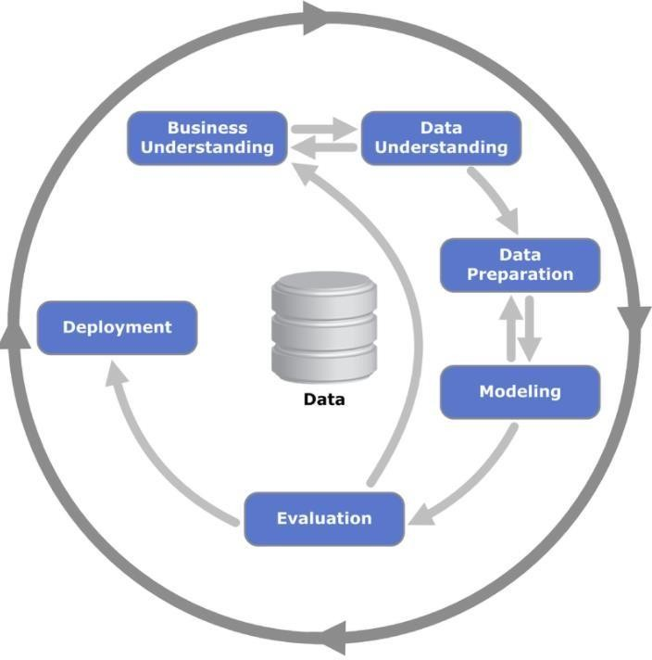
Problem solving methodology using CRISP-DM
Data Cleaning
(Imputed the NA values for all the driver variables
Understanding Dataset
(Data Cleaning)
Data Preparation
Exploratory Data Analysis
(Performed Univariate,
Univariate Segmented & Multivariate analysis

Slide 4
Data Cleaning Steps
Delete columns: Delete unnecessary columns.
Remove outliers: Remove high and low values that would disproportionately affect the results of your analysis.
Missing values: Treat missing values with appropriate approach.
Duplicate data: Remove identical rows, remove rows where some columns are identical.
Filter rows: Filter by segment, filter by date period to get only the rows relevant to the analysis.

Slide 5
Analysis
The essence of the whole project is to analyze and understand how consumer attributes and loan attributes are influencing the tendency of defaulting.
We performed data cleaning and preparation on the Loan dataset:
Imputed the NA values for all the variables
Created two new columns:
Profit and Loss column
Ratio of funded amount and annual income
During univariate analysis we have created:
Histograms and Bar charts to check out the distribution of all the driver variables
Box plots to detect the Outliers
Performed the Multivariate analysis to understand how different variables interact with each other.

Slide 6
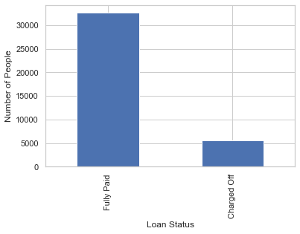
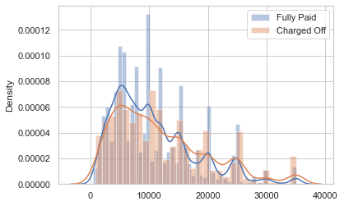
Loan Status Analysis
Observations :
More people who borrow loan with amount lower around 13000 are able to fully pay their loan.
People applying for more amount tend to default more.
Observations :
1. More than 30000 people have fully paid
2. 5000 people are Charged Off

Slide 7
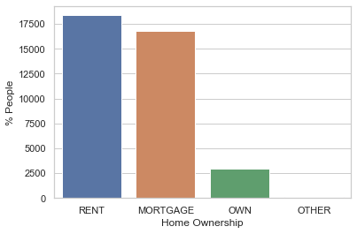
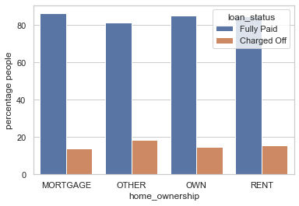
Loan Status by Home Ownership
Observation:
Applicants having there home rented or on mortgage have almost equal tendency to default the loan.

Slide 8
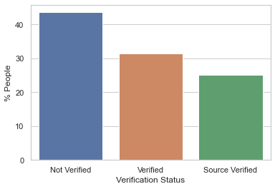
Univariate Analysis of Verification Status
Observations:
For majority of loans approved, the income of borrower was unverified by LC.

Slide 9
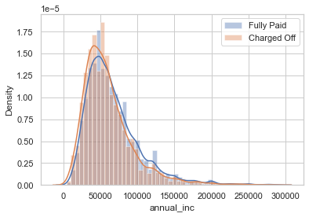
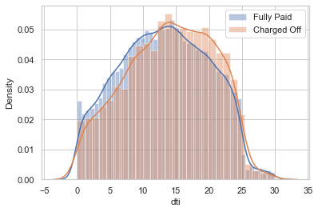
Income Analysis for the loan applicants
Observations:
1. People having lower annual income (less than around 60000) have defaulted their loan more and the default rate decreases at high annual income level.
Observations:
People having lower debt to income ratio tend to fully pay their loan and vice versa.

Slide 10
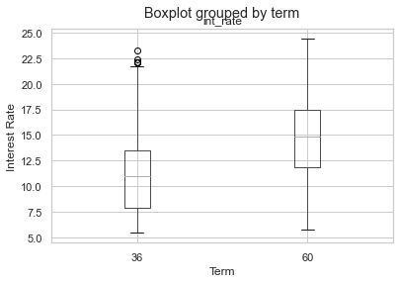
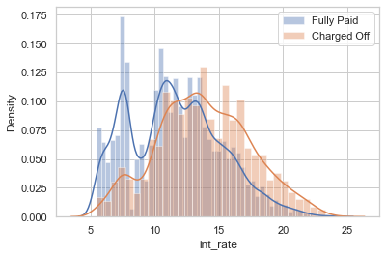
Loan Term Analysis
Observations:
1.The interest rates are higher for 60 month term.
2. More no of defaulters for the loan having higher rate of interest (around 12% interest rate)

Slide 11
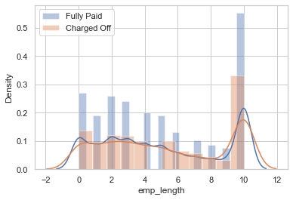
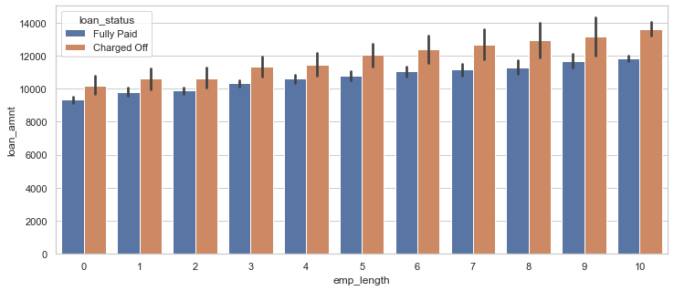
Loan Applicants work Experience Analysis
Observations:
Majority of employees applying for the loan have more than 10 years of experience
Tendency of person to default the loan with 10 years of experience is slightly less .So company need to be careful when granting loan.
Observations:
1.People having more experience take loan for higher amount.
2. Loans having higher loan amount tend to be charged off more.

Slide 12
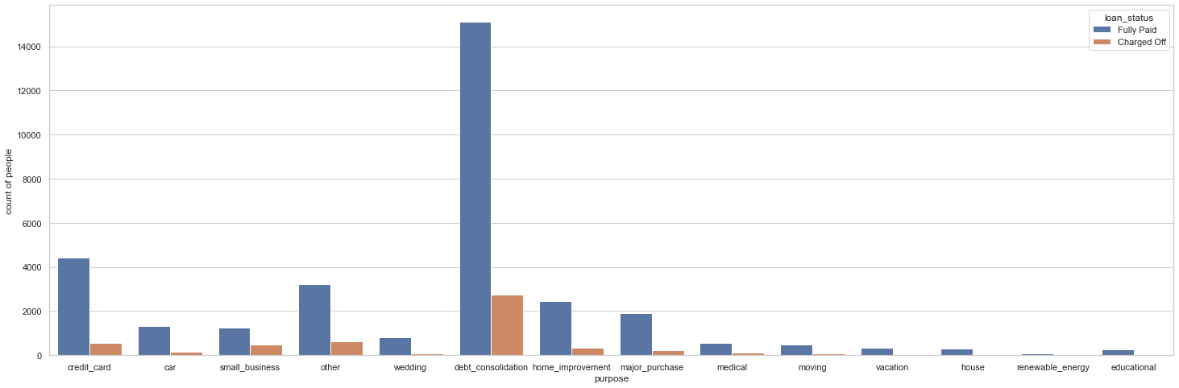
Purpose for applying Loan Analysis
Observation:
Most of the loans are granted were for debt consolidation.

Slide 13
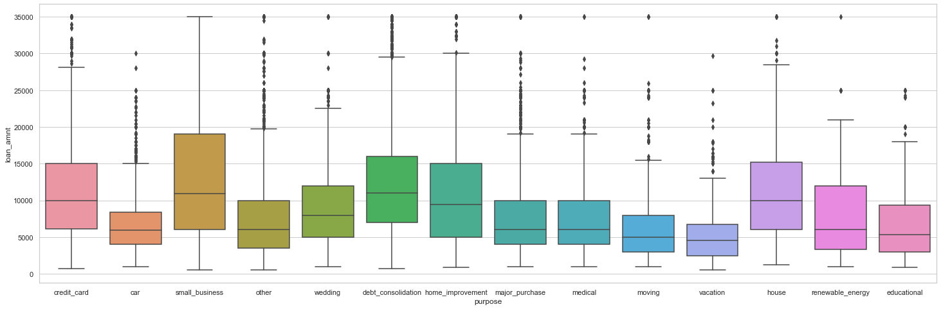
Amount of Loan applied for purpose
Observations:
Small Businesses have been the riskiest category. As large amount of loan is required for it.

Slide 14
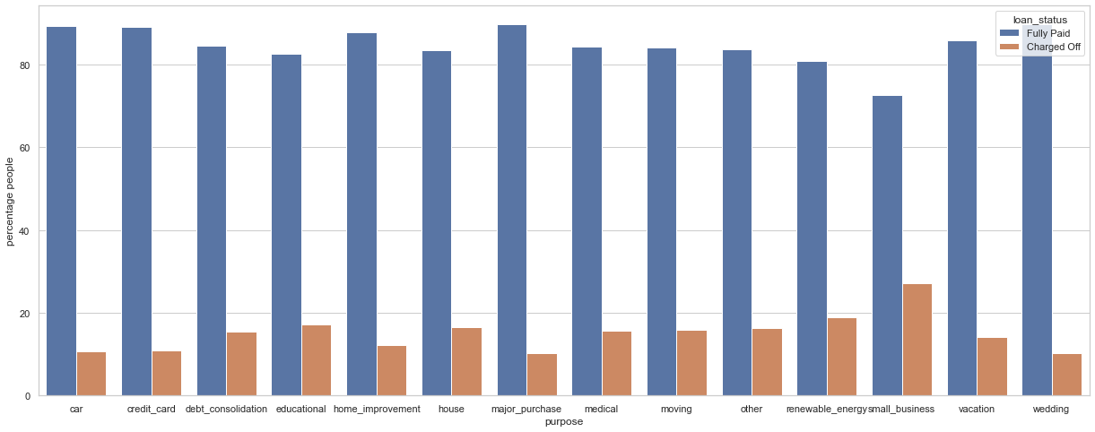
Loan Status , Purpose Vs Percentage of People
Observations:
People who take loan for small business-related purpose are most defaulters.

Slide 15
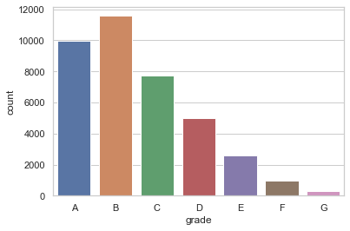
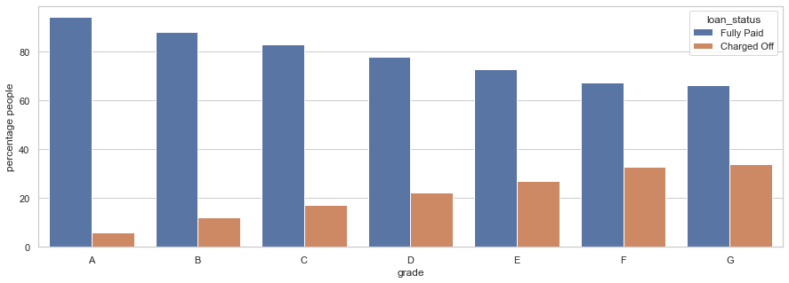
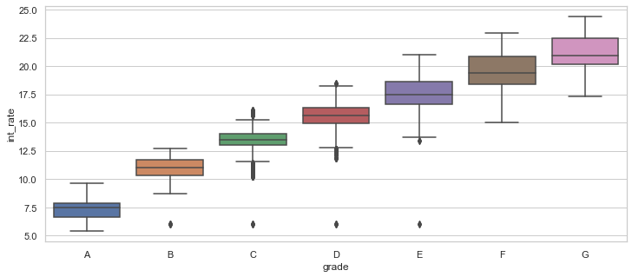
Loan Grade Analysis
Observation:
Most of the loans are applied by people of A and B grade category.
Most of the loans of grade of A and B people are fully paid.
These loans have a low interest rate.
Which depicts, higher interest rate have higher tendency to default the loan.

Slide 16
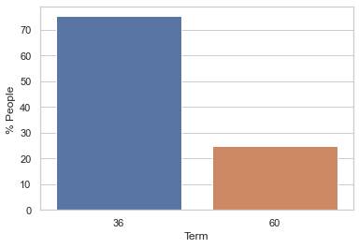
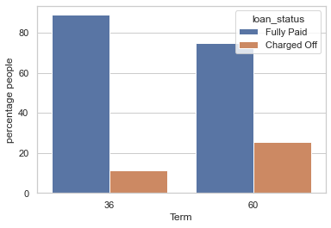
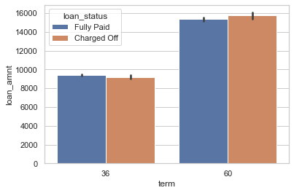
Loan Status vs Loan Tenure
Observations:
Most of the loans granted were of 36 months.
Higher percentage of defaulters who take 60 months term loan (more than 20%).
The average loan amount is similar for both the terms for both charged off and fully paid status.
The average loan amount is higher for the 60-month term.

Slide 17
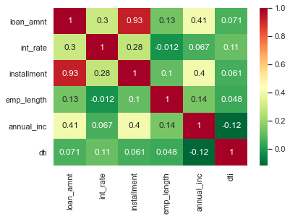
Correlation Heat-Map
Loan amount is highly correlated to installment amount.
Loan amount is 40% positively correlated to annual income of the people.
Annual income is negatively correlated with DTI.

