Slide 1
Assignment-Discussion POS Tagging Using HMM
Harshvardhan Ahirwar (200050051)
Advait Padhye (200100014)
Sohom Mandal (200050136)
…
07/09/2022

Slide 2
Problem Statement
Given a sequence of words, produce the POS tag sequence
Technique to be used: HMM-Viterbi
Use Universal Tag Set (12 in number)
5-fold cross validation
TAGS :- ^, . , ADJ, ADP, ADV, CONJ, DET, NOUN, NUM, PRT, PRON, VERB, X, END

Slide 3
Overall performance
Net Accuracy reported: 95.6%
Net Precision reported: 92.6%
Net Recall: 91.9%
Net F1 score: 92.2%
Net F2 score: 92.04%
Net F half score: 92.4%
Per POS performance is detailed in the next slide……

Slide 4
Per POS performance
 | . | ADJ | ADP | ADV | CONJ | DET | NOUN | NUM | PRT | PRON | VERB | X
Precision | 0.98 | 0.91 | 0.95 | 0.90 | 0.99 | 0.96 | 0.96 | 0.97 | 0.96 | 0.90 | 0.97 | 0.75
Recall | 0.99 | 0.91 | 0.96 | 0.89 | 0.99 | 0.98 | 0.95 | 0.91 | 0.98 | 0.90 | 0.95 | 0.52
F1 score | 0.99 | 0.91 | 0.96 | 0.90 | 0.99 | 0.97 | 0.95 | 0.94 | 0.97 | 0.90 | 0.96 | 0.61
F2 score | 0.99 | 0.91 | 0.96 | 0.89 | 0.99 | 0.98 | 0.95 | 0.92 | 0.97 | 0.90 | 0.95 | 0.55
F half score | 0.98 | 0.91 | 0.95 | 0.90 | 0.99 | 0.97 | 0.96 | 0.95 | 0.96 | 0.90 | 0.96 | 0.69

Slide 5
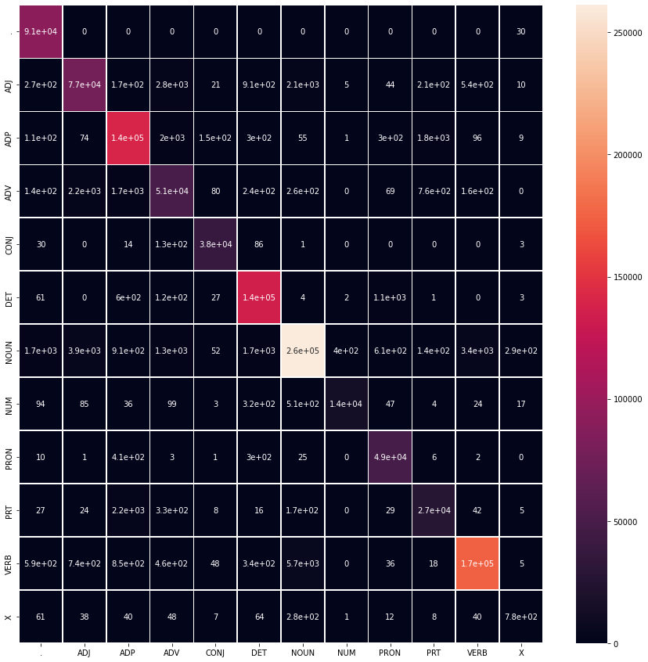
Confusion Matrix

Slide 6
Interpretation of confusion (error analysis)
Q) Which tag is confused the most among the 12 tags?
Ans) The tag that is confused with the most is the X (Others) tag, which is being confused with the NOUN tag. We can infer this from the per POS performance that is mentioned in the previous slide.
Q) What is the reason behind the above?
Ans) The X tag is mostly used when there is a spelling error in the word, and these can easily be classified as NOUN, as the classifier can think of it as an unseen noun.

Slide 7
Other notable mistakes in tagging
Took all the tags which are confused with some other tag more than 3% of the times.
ADJ and ADV :- Both represent modifiers for NOUN/PRON and VERB respectively. Whenever an unseen modifier comes before the modified entity, it is likely to get both ADJ and ADV tag. Since our algorithm only looks one word ahead, it is not able to capture the essence of the whole phrase which contains this modifier. Hence there might be confusions in this region.
NUM as NOUN :- Unseen NUM tagged words often occur in places where a NOUN is possible, and since in general, a transition to NOUN would have a higher probability when compared to transition to NUM, they get tagged as NOUN instead of NUM.

Slide 8
PRT as ADP :- Particles are function words, and they do not satisfy definitions of other tags for function words like ADP, CONJ, etc. So, the places where ADP and PRT occur will be very similar in the sentence structure. But since ADP is about 5 times more common than PRT, the transition probabilities to ADP will be higher. Hence, for unknown words, the probability of getting a tag of ADP will be higher than getting a tag of PRT.
X :- This tag is mostly used for words which are not of English origin, and are being used for adding flavour to the language. Since they do not have a specific meaning and occur almost everywhere throughout the sentence, they are being confused with a lot of tags, namely ‘.’, ADV, DET, NOUN, VERB. All of them might have produced enough transition probabilities from different parts of the sentence to be used as a tag over X. NOUN is special case as any unseen X word can be easily mistaken as some new NOUN.

Slide 9
ADV as ADP :- ADP and ADV both occur near VERB in the structure of a sentence. Hence, the transition probabilities may lead to confusion between the two tags for an unseen word.
VERB as NOUN :- It has been observed that quite often the words which are inherently tagged as NOUN, are also used as VERB in normal sentences. For eg. - “catch” “They went to play catch.” - Here “catch” is a noun. “Ram will catch the ball.” - But here “catch” is a verb. So, there is an inherent confusion within words that are nouns by nature but are being used as verbs. Since they have a higher emission for NOUN, they get tagged as NOUN over the tag VERB, and this contributes to the confusion.

Slide 10
Data Processing Info (Pre-processing)
Lower Casing
Tokenization of sentences
Delimiters(notably ^ and END) added to the sentences for ensuring the correctness of the algorithm
Removed empty sentences from the corpus

Slide 11
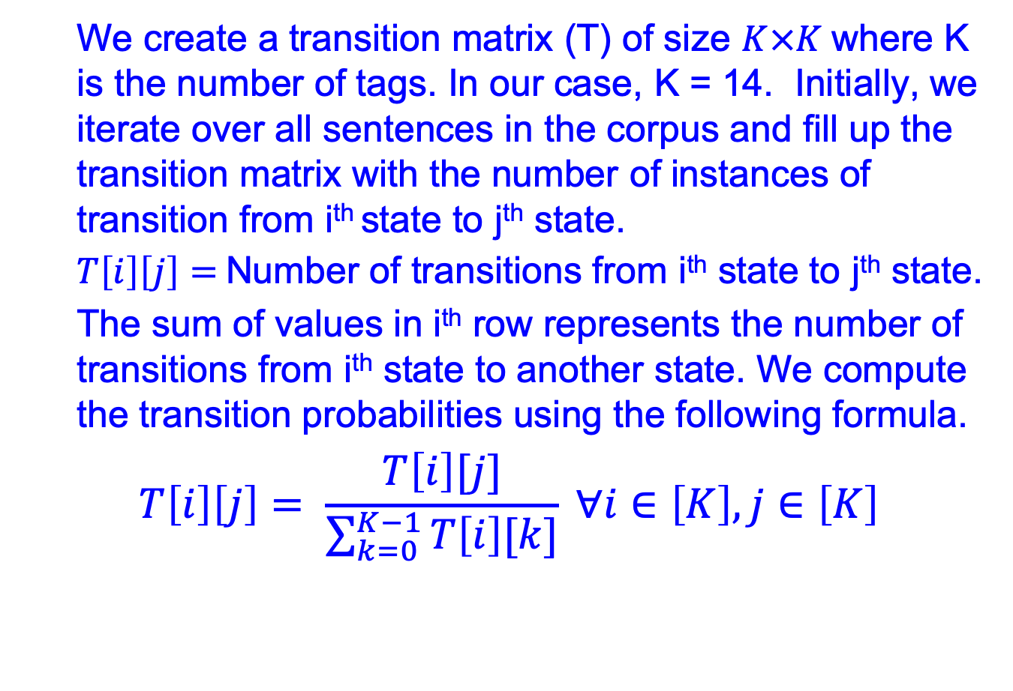
Transition Probabilities
We create a transition matrix (T) of size $K×K$where K is the number of tags. In our case, K = 14. Initially, we iterate over all sentences in the corpus and fill up the transition matrix with the number of instances of transition from i^{th} state to j^{th} state.
$T\left[i\right]\left[j\right]=$Number of transitions from i^{th} state to j^{th} state.
The sum of values in i^{th} row represents the number of transitions from i^{th} state to another state. We compute the transition probabilities using the following formula.
$$T\left[i\right]\left[j\right]= \frac{T\left[i\right][j]}{\sum_{k=0}^{K−1}{T\left[i\right][k]}} ∀i∈\left[K\right], j∈\left[K\right]$$

Slide 12
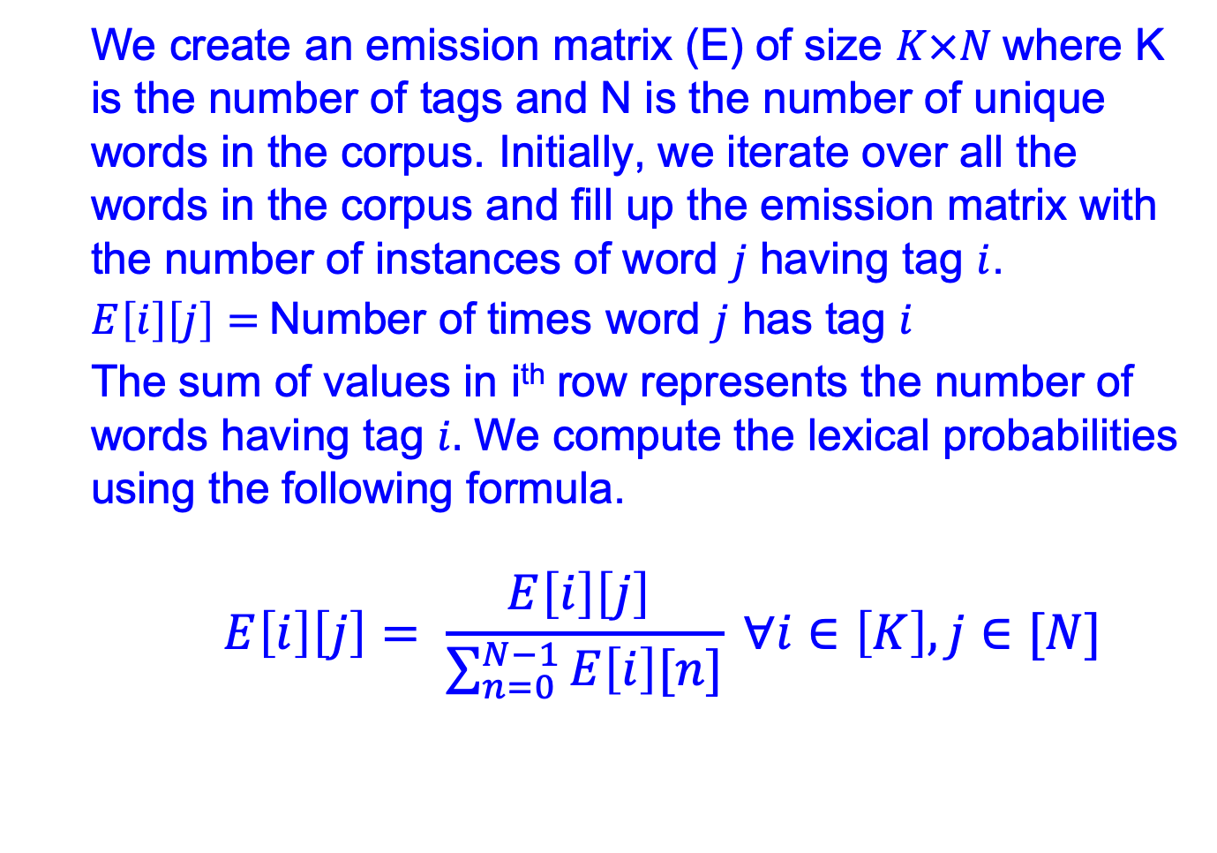
Lexical Probabilities
We create an emission matrix (E) of size $K×N$where K is the number of tags and N is the number of unique words in the corpus. Initially, we iterate over all the words in the corpus and fill up the emission matrix with the number of instances of word $j$ having tag $i$.
$E\left[i\right]\left[j\right]=$Number of times word $j$ has tag $i$
The sum of values in i^{th} row represents the number of words having tag $i.$ We compute the lexical probabilities using the following formula.
$$E\left[i\right]\left[j\right]= \frac{E\left[i\right]\left[j\right] }{\sum_{n=0}^{N−1}{E\left[i\right][n]}} ∀i∈\left[K\right], j∈[N]$$

Slide 13
Implementation of Viterbi Algorithm
Preprocess the input into lowercase letters.
At every iteration, we will maintain 12 paths ( ‘A’ vector ), each corresponding to respective maximum probability paths for each tag.
‘B’ matrix corresponds to cumulative probabilities of transitioning from each of the 12 tags to each of the 12 tags given the word in the context.
We performed Laplace Smoothing for handling words which aren’t in the corpus.
At the end of each iteration, we retain a path for each tag which ends in the highest sequence probability.
When we encounter the last word in the sentence, we just consider the transition probability to ‘END’ tag, and select the maximum probability path out of the 12 options.

Slide 14
Unknown Word Handling
We tried assigning a constant emission probability to every unseen word for every tag. This gave fairly good results.
Then we used Laplace Smoothing to handle zero probabilities in case of unseen words. So, the emission probability for an unseen word(w) given a tag(t) is given by ( 1 / ( n + k ) ),
where n : Total number of words assigned to ‘t’,
k : Total number of unique words in the corpus.
We also smoothened the transition table for taking into account the unseen transitions.
This produce great results with accuracy of 95.6%

