Slide 1
Assignment-Discussion Vector Based POS Tagging
Harshvardhan Ahirwar (200050051)
Advait Padhye (200100014)
Sohom Mandal (200050136)
…
12/10/2022

Slide 2
Problem Statement
Given a sequence of words, produce the POS tag sequence
Technique to be used: HMM-Viterbi-vector
Use Universal Tag Set (12 in number)
5-fold cross validation
TAGS :- ^, . , ADJ, ADP, ADV, CONJ, DET, NOUN, NUM, PRT, PRON, VERB, X, END

Slide 3
Overall performance
 | Accuracy | Precision | Recall | F1-score | F0.5-score | F2-score
HMM-Viterbi-Symbolic | 95.6 | 92.6 | 91.9 | 92.2 | 92.4 | 92.04
HMM-Viterbi-Vector | 96.2 | 93.5 | 92.4 | 92.9 | 93.2 | 92.6
FFNN-BP | 90.0 | 83.0 | 82.2 | 82.5 | 82.3 | 82.8

Slide 4
Per POS Performance (HMM-Viterbi-Symbolic)
 | . | ADJ | ADP | ADV | CONJ | DET | NOUN | NUM | PRT | PORN | VERB | X
Precision | 0.98 | 0.91 | 0.95 | 0.90 | 0.99 | 0.96 | 0.96 | 0.97 | 0.96 | 0.90 | 0.97 | 0.75
Recall | 0.99 | 0.91 | 0.96 | 0.89 | 0.99 | 0.98 | 0.95 | 0.91 | 0.98 | 0.90 | 0.95 | 0.52
F1 score | 0.99 | 0.91 | 0.96 | 0.90 | 0.99 | 0.97 | 0.95 | 0.94 | 0.97 | 0.90 | 0.96 | 0.61
F2 score | 0.99 | 0.91 | 0.96 | 0.89 | 0.99 | 0.98 | 0.95 | 0.92 | 0.97 | 0.90 | 0.95 | 0.55
F half score | 0.98 | 0.91 | 0.95 | 0.90 | 0.99 | 0.97 | 0.96 | 0.95 | 0.96 | 0.90 | 0.96 | 0.69

Slide 5
Per POS performance (HMM-Viterbi-Vector)
 | . | ADJ | ADP | ADV | CONJ | DET | NOUN | NUM | PRT | PORN | VERB | X
Precision | 0.99 | 0.92 | 0.96 | 0.90 | 0.99 | 0.98 | 0.97 | 0.97 | 0.97 | 0.90 | 0.98 | 0.70
Recall | 0.99 | 0.92 | 0.97 | 0.90 | 0.99 | 0.99 | 0.96 | 0.92 | 0.99 | 0.90 | 0.96 | 0.59
F1 score | 0.99 | 0.92 | 0.96 | 0.90 | 0.99 | 0.98 | 0.96 | 0.94 | 0.98 | 0.91 | 0.97 | 0.64
F2 score | 0.99 | 0.92 | 0.97 | 0.89 | 0.99 | 0.98 | 0.95 | 0.92 | 0.97 | 0.90 | 0.95 | 0.55
F half score | 0.98 | 0.91 | 0.95 | 0.90 | 0.99 | 0.97 | 0.96 | 0.95 | 0.96 | 0.90 | 0.96 | 0.69

Slide 6
Per POS performance (FFNN)
 | . | ADJ | ADP | ADV | CONJ | DET | NOUN | NUM | PRT | PORN | VERB | X
Precision | 0.92 | 0.68 | 0.96 | 0.88 | 0.99 | 0.94 | 0.87 | 0.90 | 0.98 | 0.90 | 0.92 | 0.01
Recall | 0.99 | 0.72 | 0.97 | 0.81 | 0.99 | 0.99 | 0.86 | 0.77 | 0.97 | 0.90 | 0.87 | 0.001
F1 score | 0.96 | 0.70 | 0.97 | 0.84 | 0.99 | 0.96 | 0.87 | 0.83 | 0.98 | 0.90 | 0.89 | 0.002
F2 score | 0.94 | 0.69 | 0.96 | 0.86 | 0.99 | 0.94 | 0.87 | 0.87 | 0.98 | 0.90 | 0.91 | 0.004
F half score | 0.98 | 0.71 | 0.97 | 0.82 | 0.99 | 0.98 | 0.86 | 0.79 | 0.97 | 0.90 | 0.88 | 0.002

Slide 7
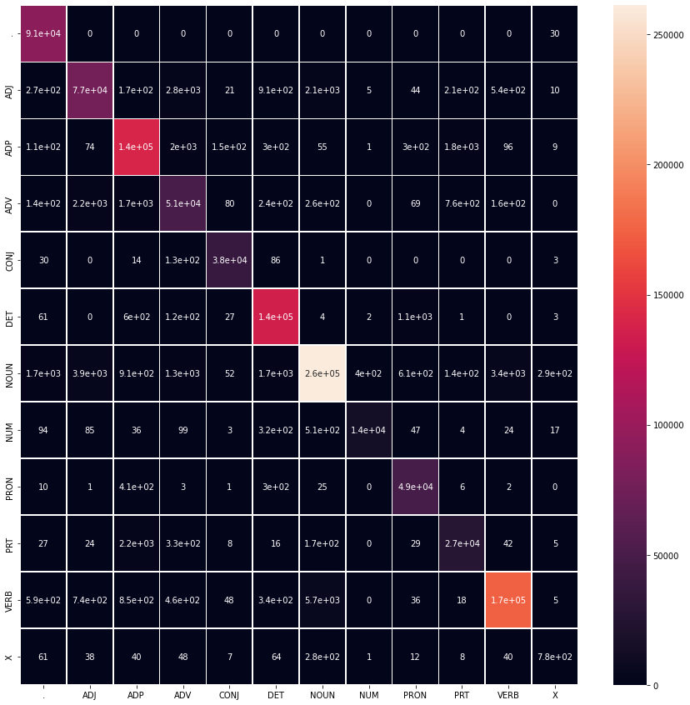
Confusion Matrix (HMM-Viterbi-Symbolic)

Slide 8

Confusion Matrix (HMM-Viterbi-Vector)

Slide 9
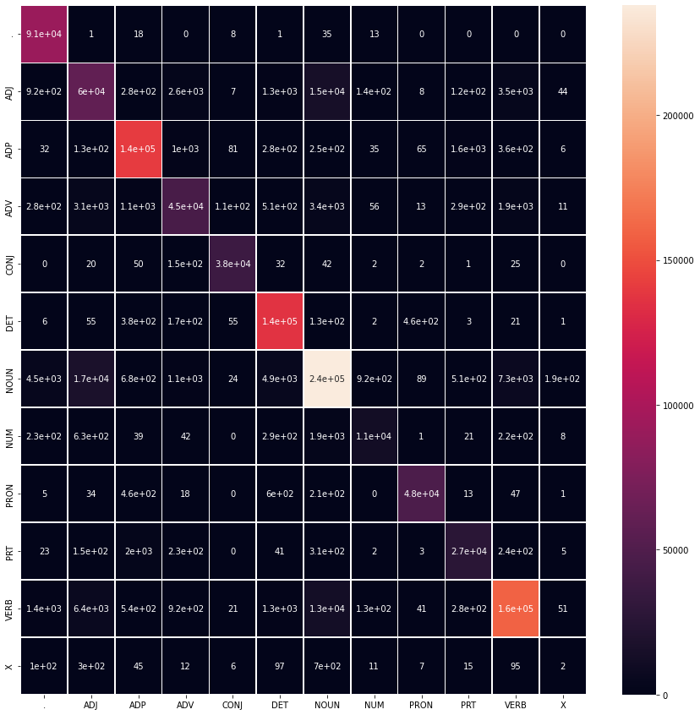
Confusion Matrix (FFNN-BP)

Slide 10
Data Processing Info (Pre-processing)
Lower Casing
Tokenization of sentences
Delimiters(notably ^ and END) added to the sentences for ensuring the correctness of the algorithm
Removed empty sentences from the corpus
Computed word vectors for all the words present in the training corpus

Slide 11
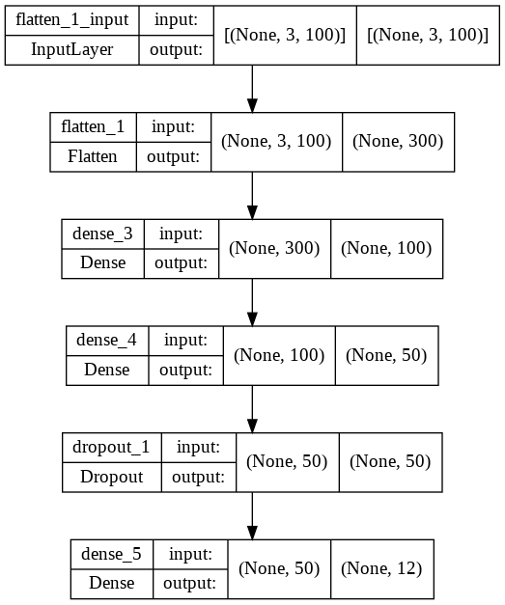
FFNN Architecture

Slide 12
FFNN Architecture (cont.)
We tried experimenting with different architectures and ended up with two hidden layers of dimensions 100 and 50 respectively with ReLU activations and a Dropout Layer. The final output layer utilized Softmax activation in order to perform multi-class classification (POS Tagging)
We have implemented this FFNN architecture using the Tensorflow library.
There are three hyperparameters for the FFNN model
Number of epochs = 5, 10
Window Size = 1, 2
Embedding Dimension = 50, 100, 300
After trying out various values for the hyperparameters, we concluded that the most optimal model is obtained by setting window-size to 1 and embedding dimension to 100 while training the model for 10 epochs.

Slide 13
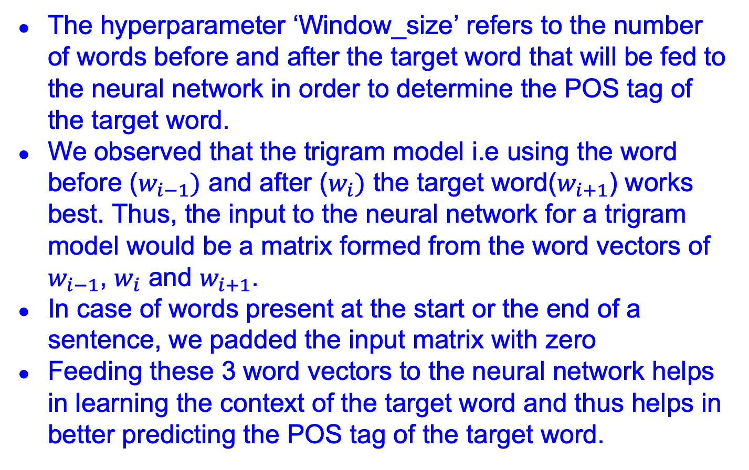
Trigram Model
The hyperparameter ‘Window_size’ refers to the number of words before and after the target word that will be fed to the neural network in order to determine the POS tag of the target word.
We observed that the trigram model i.e using the word before ($w_{i−1})$ and after ($w_{i})$ the target word($w_{i+1}$) works best. Thus, the input to the neural network for a trigram model would be a matrix formed from the word vectors of $w_{i−1}$, $w_{i}$ and $w_{i+1}$.
In case of words present at the start or the end of a sentence, we padded the input matrix with zero
Feeding these 3 word vectors to the neural network helps in learning the context of the target word and thus helps in better predicting the POS tag of the target word.

Slide 14
Word Vectors
For producing word vectors, we used the Word2Vec model present in Gensim library in Python. These word vectors are trained on Google-news-dataset-300
We also used Gensim library to train the Word2Vec model over the Brown Corpus with embedding dimension equal to 100.
These word vectors were used for unknown word handling in HMM-Viterbi-Vector model and for training the Feed Forward Neural Network.
In addition, these vectors can be used to find similar words for a given word by computing cosine similarity between their word vectors.

Slide 15
Unknown Word Handling (FFNN-BP)
Similar to HMM-Viterbi-Vector, we first check whether the unknown word is present in the Google-news-dataset-300.
If the unknown word is present in the Google Dataset then we find the most similar word to the unknown word which is present in the training corpus by computing cosine similarity between Word2Vec vectors. Finally, we feed the word vector of the similar word to the FFNN.
However, if the unknown word is not present in the Google Dataset, then we assign a random vector sampled from uniform distribution.

Slide 16
Unknown Word Handling (HMM-Viterbi-Vector)
Previously in HMM-Viterbi-Symbolic, we implemented Laplace Smoothing for unknown word handling.
In HMM-Viterbi-Vector, we first check whether the unknown word is present in the Google-news-dataset-300.
If the unknown word is present in the dataset then we find the most similar word to the unknown word which is present in the training corpus by computing cosine similarity between Word2Vec vectors. Finally, we use the emission probabilities of the similar word for the unknown word.
However, if the unknown word is not present in the Google dataset, then we resort to Laplace Smoothing.

Slide 17
Unknown Word Handling (HMM-Viterbi-Symbolic)
We tried assigning a constant emission probability to every unseen word for every tag. This gave fairly good results.
Then we used Laplace Smoothing to handle zero probabilities in case of unseen words. So, the emission probability for an unseen word(w) given a tag(t) is given by ( 1 / ( n + k ) ),
where n : Total number of words assigned to ‘t’,
k : Total number of unique words in the corpus.
We also smoothened the transition table for taking into account the unseen transitions.
This produce great results with accuracy of 95.6%

Slide 18
Implementation of Viterbi Algorithm
Preprocess the input into lowercase letters.
At every iteration, we will maintain 12 paths ( ‘A’ vector ), each corresponding to respective maximum probability paths for each tag.
‘B’ matrix corresponds to cumulative probabilities of transitioning from each of the 12 tags to each of the 12 tags given the word in the context.
We performed Laplace Smoothing for handling words which aren’t in the corpus.
At the end of each iteration, we retain a path for each tag which ends in the highest sequence probability.
When we encounter the last word in the sentence, we just consider the transition probability to ‘END’ tag, and select the maximum probability path out of the 12 options.

Slide 19
Overall Performance Comparison
HMM-Viterbi-Vector model outperforms HMM-Viterbi-Symbolic in almost every domain.
A major reason behind HMM-Viterbi-Vector performing better than HMM-Viterbi-Symbolic is that unknown word handling has been improved in HMM-Viterbi-Vector.
On the other hand, FFNN-BP performs the worst amongst all models. A possible reason behind it could be that the architecture is too simple to perform POS tagging. We will try adding more hidden layers to see if we can obtain better results.
An improvement over the neural model for POS tagging could be by using RNNs or Bi-LSTMs.

Slide 20
Per POS Performance Comparison
The performance of HMM-Viterbi-Vector is better than that of HMM-Viterbi-Symbolic particularly for ADV, NOUN, VERB, X tags.
The performance of FFNN-BP model falls for ADJ, ADV, NOUN and VERB tags. However, FFNN-BP performs slightly better than HMM-Viterbi-Vector for ADP tag.
The performance of FFNN-BP is extremely bad for X tags. This is because FFNN-BP very rarely assigns an X tag to a word. A possible reasons behind this behavior could be due to very few examples of X tags in the Brown corpus (1386 examples out of total 1161192 examples) and poor unknown word handling.

Slide 21
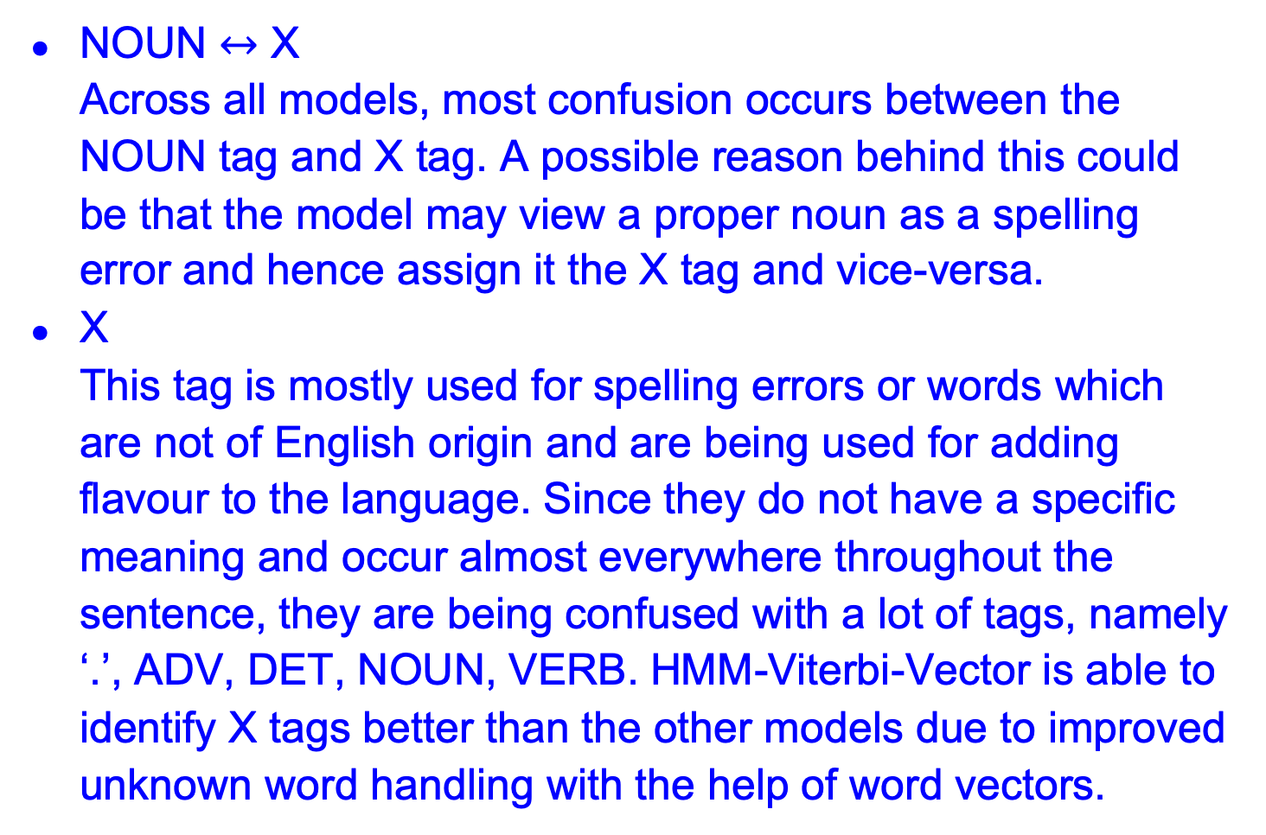
Most Confused Tags
NOUN $↔$ X Across all models, most confusion occurs between the NOUN tag and X tag. A possible reason behind this could be that the model may view a proper noun as a spelling error and hence assign it the X tag and vice-versa.
X This tag is mostly used for spelling errors or words which are not of English origin and are being used for adding flavour to the language. Since they do not have a specific meaning and occur almost everywhere throughout the sentence, they are being confused with a lot of tags, namely ‘.’, ADV, DET, NOUN, VERB. HMM-Viterbi-Vector is able to identify X tags better than the other models due to improved unknown word handling with the help of word vectors.

Slide 22
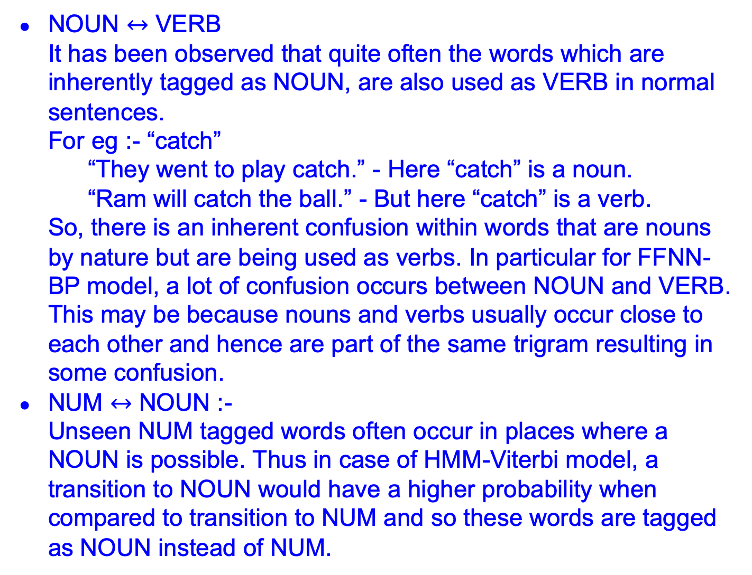
NOUN $↔$ VERB It has been observed that quite often the words which are inherently tagged as NOUN, are also used as VERB in normal sentences. For eg :- “catch” “They went to play catch.” - Here “catch” is a noun. “Ram will catch the ball.” - But here “catch” is a verb. So, there is an inherent confusion within words that are nouns by nature but are being used as verbs. In particular for FFNN-BP model, a lot of confusion occurs between NOUN and VERB. This may be because nouns and verbs usually occur close to each other and hence are part of the same trigram resulting in some confusion.
NUM $↔$ NOUN :- Unseen NUM tagged words often occur in places where a NOUN is possible. Thus in case of HMM-Viterbi model, a transition to NOUN would have a higher probability when compared to transition to NUM and so these words are tagged as NOUN instead of NUM.

Slide 23
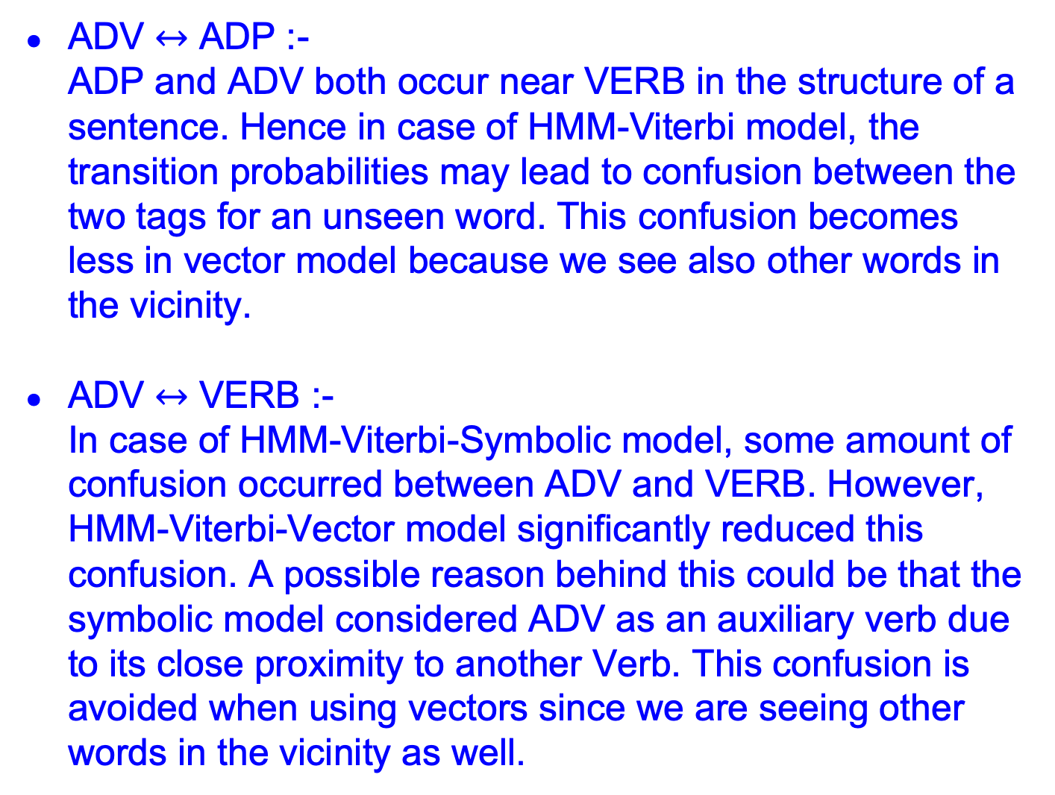
ADV $↔$ ADP :- ADP and ADV both occur near VERB in the structure of a sentence. Hence in case of HMM-Viterbi model, the transition probabilities may lead to confusion between the two tags for an unseen word. This confusion becomes less in vector model because we see also other words in the vicinity.
ADV $↔$ VERB :- In case of HMM-Viterbi-Symbolic model, some amount of confusion occurred between ADV and VERB. However, HMM-Viterbi-Vector model significantly reduced this confusion. A possible reason behind this could be that the symbolic model considered ADV as an auxiliary verb due to its close proximity to another Verb. This confusion is avoided when using vectors since we are seeing other words in the vicinity as well.

Slide 24
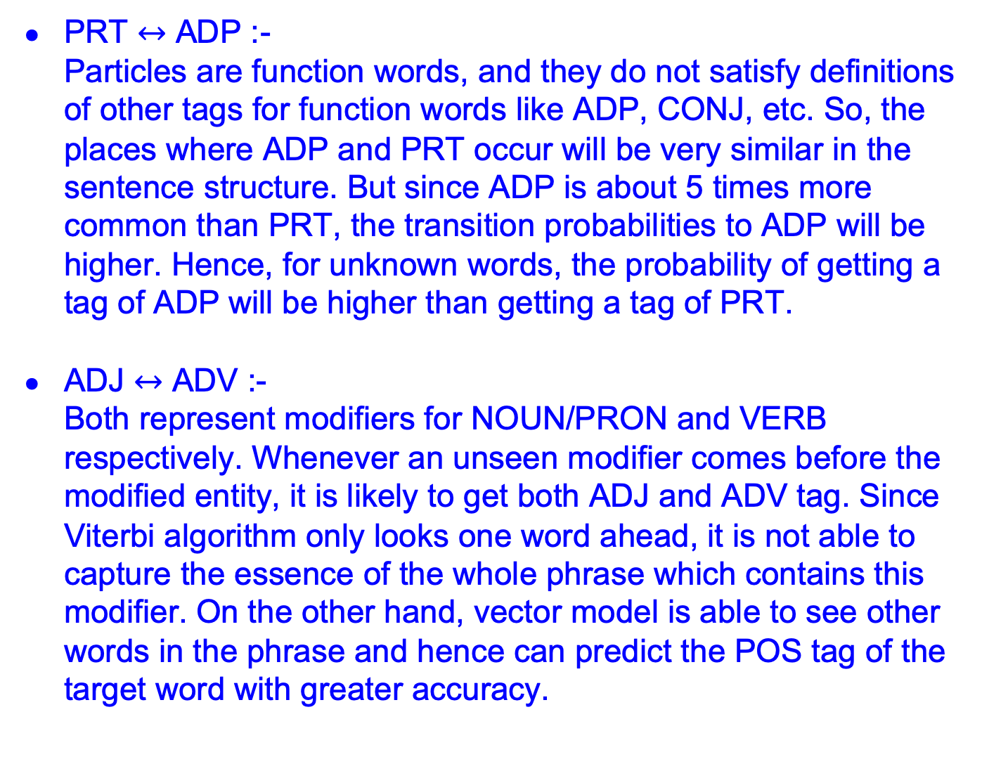
PRT $↔$ ADP :- Particles are function words, and they do not satisfy definitions of other tags for function words like ADP, CONJ, etc. So, the places where ADP and PRT occur will be very similar in the sentence structure. But since ADP is about 5 times more common than PRT, the transition probabilities to ADP will be higher. Hence, for unknown words, the probability of getting a tag of ADP will be higher than getting a tag of PRT.
ADJ $↔$ ADV :- Both represent modifiers for NOUN/PRON and VERB respectively. Whenever an unseen modifier comes before the modified entity, it is likely to get both ADJ and ADV tag. Since Viterbi algorithm only looks one word ahead, it is not able to capture the essence of the whole phrase which contains this modifier. On the other hand, vector model is able to see other words in the phrase and hence can predict the POS tag of the target word with greater accuracy.

Slide 25
Error Analysis Per POS tag
ADV:- Confused with NOUN NOUN and VERB occur together very frequently, and ADV and VERB also occur together in a sentence. Hence due to this proximity, ADV gets tagged as NOUN
CONJ:- Least confused out of all It is the easiest to identify a CONJ based on its position. It occurs between separate clauses, so if the context on both the sides of the word is different then it indicates toward a CONJ
DET:- Confused as PRON Both occur before NOUN, hence they get confused easily by the neural network.
ADP:- Confused with PRT ADP and PRT occur in similar positions around other words. Any modifier that is not ADP,ADJ,ADV is tagged as PRT

Slide 26
NOUN:- Confused with ADJ NOUN and NOUN words occur together frequently, and ADJ has to occur before NOUN. So, due to similar relative positions, they get confused with each other.
PRON:- Confused with DET Both of them occur in similar positions around other words. Take the case of possessive pronouns and determiners- “It is his, not mine” In this sentence we can interchange his and mine, and it would still have meaning. “His” is a pronoun and “mine” is a determiner.
PRT:- Confused with ADP Both occur in similar contexts around other words, hence they get confused while tagging.

Slide 27
Problems with FFNN-BP Model
One issue we faced during training our model was that the Gensim model which we were using to generate word vectors wasn’t generating word vectors for certain words. Upon further inspection, we found out that these words were rarely found in the dataset and hence this may be the reason behind Gensim not generating any word vectors for these words.
One of the reasons that we suspect is responsible for the poor performance of FFNN-BP Model as compared to the Hidden Markov Models is that the FFNN-BP Model isn’t able to handle X tags properly.
Since words that are assigned X tags are quite rare, the Gensim model may not have generated any word vectors for these words thus making these words “unknown”.
Moreover, since these words are rare, there won’t be any corresponding word vectors in the Google dataset as well. Thus, we have to use random vectors to assign a POS tag to these words.

Slide 28
Possible Solutions
One possible solution to this problem is to use clustering.
We could generate 12 representative vectors for each POS tag that is the mean of all word vectors of that particular POS tag.
We could then pass these representative vectors into the model and store the POS tag as well as the probability value that model assigns to this POS tag. Finally, we see which POS tag has the maximum probability amongst all the tags and then assign that POS tag to the word.
Another solution could be to instead use k-Nearest Neighbors. Currently, for unknown word handling, we are only considering the word vector that is the closest to the word vector of the given input word. For better results, we could instead consider the k nearest neighbors of the given input word and assign the majority POS tag of these k words. Here, k is another hyperparameter.

