Slide 1


Library management system prepared by : harsh bipinkumar vaghela enroll : 21002170110204 branch : ce oopj

Slide 2
Introduction
Core Features:
Book Management: Add, update, search, and delete books in the library catalog.
Student Management: Register new students and manage their records.
Transaction Handling: Efficiently manage book check-ins and check-outs
Benefits:
Organized Resource Management: Simplifies tracking and organization of books and materials.
Error Reduction: Minimizes manual errors through automation.
Enhanced User Experience: Provides a seamless and user-friendly interface for library staff and patrons.
Technology Used:
Java: Utilizes Java’s object-oriented programming capabilities for a scalable and maintainable system.
Purpose:
Efficiency: Automates routine tasks to save time and reduce administrative overhead.
Scalability: Designed to handle libraries of various sizes, from small collections to large inventories.
Modernization: Enhances traditional library management practices with technology-driven solutions.

Slide 3
objective
Automate Library Operations:
Develop a system to automate routine tasks such as book check-ins, check-outs, and record maintenance, reducing manual workload and errors.
Efficient Book Management:
Provide functionalities for adding, updating, searching, and deleting book records to ensure accurate and up-to-date information.
Streamline Student Management:
Enable easy registration and management of student records, including tracking borrowed books and maintaining student details.
Enhance Search Capabilities:
Implement robust search features that allow users to find books by title, author, or serial number quickly and accurately.
Improve Transaction Handling:
Facilitate efficient management of book transactions, including checking out and returning books, and updating availability status.
Ensure Data Integrity:
Maintain accurate and consistent data through reliable record-keeping and automated updates.
Provide a User-Friendly Interface:
Design an intuitive and easy-to-use interface for library staff and students, enhancing overall user experience.

Slide 4
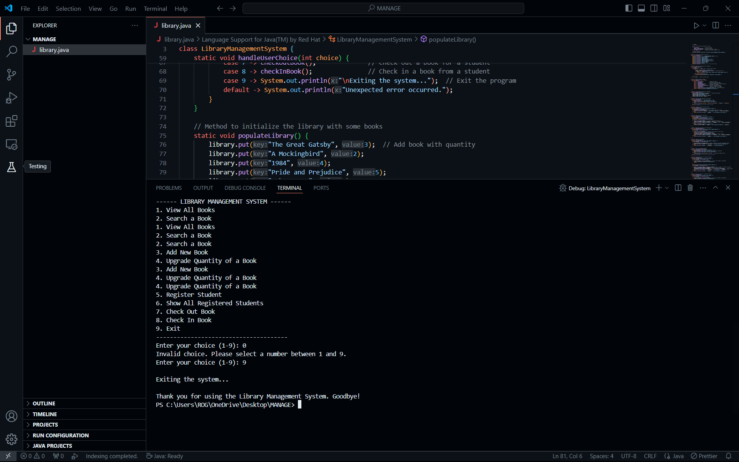

Slide 5
Engaging the library
Add New Book: This feature allows users to input details for a new book, including title, author, ISBN, and quantity. The system updates the database with this new book information, ensuring that it becomes part of the library's collection.
Check-In: When books are returned, this feature updates the book’s status and reverts its quantity in the system, reflecting the book's availability for future borrowing.
Check-Out: This feature handles the process of borrowing books. It updates the book's status to show it is checked out and reduces its available quantity. It also tracks which user has borrowed the book.
Search Books: Users can search for books using criteria such as title, author, or ISBN. The system retrieves and displays relevant details from the database, making it easy to find specific books.
Show Books: This feature displays a comprehensive list of all books in the system. It provides details on each book, giving users a complete view of the available collection.
Register Student: This functionality allows new students to be added to the system. It captures essential student details and creates a profile, enabling them to borrow books.
Show All Students: A list of all registered students is displayed through this feature. It provides details about each student, including their borrowing status and other relevant information.
Upgrade Quantity of Book: This feature allows the system to update the quantity of a specific book, adjusting the available stock as needed to reflect new additions or corrections.
Exit: The exit feature provides a safe way to close the system. It ensures that all data is saved properly and that the system shuts down without issues.

Slide 6
THANK YOU 😊

