Slide 1
Fronthaul Load Management in Open RAN
Uncertainty-aware, deadline-feasible budget allocation on a shared 7-2x fronthaul link
B.Tech. Project — mid-term evaluation
Student: <name> | Supervisor: <name> | Department of <dept>
Deliverables today: working simulator + 7 controllers + trained quantile forecaster + reproducible experiments (5 scenarios x 5 seeds) + tests + this deck, all generated from the repository.
BTP mid-evaluation | Fronthaul load management | 1
Notes:
Opening (60-90 s): Good morning. My BTP is on fronthaul load management in Open RAN. In a 7-2x split, several radio units share one Ethernet fronthaul link that is deliberately over-subscribed to exploit statistical multiplexing. The distributed unit must decide how much of that link each cell may use in the next control interval, before it knows the traffic that will actually arrive, and the traffic is bursty. I built a slot-level simulator of this problem, implemented five baseline controllers including an oracle, and propose an allocation rule that uses a quantile forecast of each cell's deadline-feasible rate and a newsvendor-style KKT rule that equalises the weighted probability that the marginal bit is needed. On five test scenarios the rule reduces priority-weighted deadline violations by 10-50% against the point-forecast controller and beats the deadline-aware reactive baseline on every seed, but it is only a tie with the simplest proportional baseline under flash crowds, and online calibration did not help. Everything I show is produced by the code in the repository.

Slide 2
Why fronthaul load management?
1 Motivation
• O-RAN 7-2x split: O-RU does low-PHY; the fronthaul carries frequency-domain IQ per PRB, layer, symbol
  – Load-dependent: 3,387 FH bits per scheduled PRB-layer-slot (BFP-9, 8% eCPRI/Eth. overhead)
  – One 100 MHz / 4-layer cell peaks at 7.4 Gbit/s
• Shared aggregation links are over-subscribed on purpose (statistical multiplexing)
  – Default scenario: 8 cells, 25GE link, aggregate peak = 2.4x usable capacity
• When bursts coincide, some cell's IQ must be deferred or dropped; low-latency cells have ~2 ms of slack
• Load management = deciding, every control interval, how much link each cell may use — before the traffic is known
  – Bad decisions → deadline violations (lost IQ / HARQ failures) or wasted link capacity
O-RU 1
LL
O-RU 2
LL
O-DU
scheduler +
budget controller
FH
switch
O-RU 3
eMBB
shared 25GE
(bottleneck)
O-RU 4
eMBB
…
BTP mid-evaluation | Fronthaul load management | 2
Notes:
The 7-2x split moves the low-PHY into the radio unit; the fronthaul then carries frequency-domain IQ samples per PRB, per layer, per symbol. Its bit rate is huge but, unlike 8, it depends on how many PRBs are actually scheduled, so an operator can over-subscribe a shared link. Our default: 8 cells of 100 MHz, 4 layers, BFP-9, whose summed peak is 2.4x the usable 25GE capacity. The price of over-subscription is that during coincident bursts someone has to back off, and the delay budget of the low-latency cells is only a couple of milliseconds. So the question is how to split the link.

Slide 3
System model and operating constraints
2 System model
• Time: NR slots of 0.5 ms (30 kHz SCS). Data: bits. Capacity: bits/slot
• Cells: 3 low-latency (deadline 4 slots = 2 ms, priority 3) + 5 eMBB (20 slots = 10 ms, priority 1)
• Demand mapping: FH bits = user bits / SE_i(t) × IQ bits per PRB-layer (SE differs per cell and drifts)
• Per-cell DU queue, FIFO, age-tracked; bits older than D_i are dropped = deadline violation
• Shared link: Σ_i r_i ≤ C_u = 0.97 × 25 Gbit/s (3% reserved for C/M/S-plane); r_i ≤ per-cell peak
• Controller: every T = 20 slots (10 ms) sets budgets r_i, fixed for the interval; sees state τ = 2 slots old
• DU scheduler: serves each queue up to r_i per slot within the budget; link never queues (budgets enforce this)
• Why decide in advance? Budgets are a reservation held for T slots and telemetry is delayed → the next
  – interval's arrivals are unknown at decision time; the ~10 ms control interval matches real DU/switch reconfiguration
observe state
(τ = 2 slots old)
decide budgets r_i
Σ r_i ≤ C_u
hold for T = 20 slots (10 ms)
DU serves queue_i ≤ r_i per slot
arrivals unknown at decision time
bits older than D_i → dropped
(violation accounting per class)
Sources: O-RAN WG4 CUS-Plane spec (7-2x sections, BFP, T2a windows); Larsen et al., IEEE COMST 2019 (load-dependent bit rate, ~8% Ethernet overhead); Pérez et al. 2018/2019 (packet-switched aggregation).
BTP mid-evaluation | Fronthaul load management | 3
Notes:
Everything is in slots of 0.5 ms. Arrivals are user bits per cell per slot; the DU converts them to PRBs using the cell's spectral efficiency and each PRB-layer costs a fixed number of fronthaul bits, so fronthaul demand is application demand divided by spectral efficiency times the IQ constant — the two are not interchangeable. Bits wait in a per-cell DU queue; a bit that waits longer than its class deadline is discarded and counted as a violation. The controller sets per-cell budgets in bits per slot that must sum to the usable link capacity, holds them for T=20 slots, and observes the state with a 2-slot telemetry delay. The DU scheduler then serves each queue FIFO up to its budget in every slot. The controller does not see the future, and neither do any of the practical baselines.

Slide 4
Focused literature review → the opportunity
3 Literature
• A. Fronthaul itself (primary sources)
  – O-RAN WG4 CUS-Plane spec (7-2x, BFP, T2a windows) • Larsen et al., IEEE COMST 2019: bit rate varies with load for splits ≤ 7-2
  – Pérez et al., JOCN 2018 / IEEE Access 2019 (packet-switched eCPRI aggregation) • Wang & Zhou, IEEE Commun. Lett. 2017 (multiplexing gain)
  – Lagén et al., IEEE Commun. Mag. 2022: shared 7-2x link, reactive per-slot compression control — closest fronthaul work, no forecasting
• B. Predictive / anticipatory capacity allocation
  – Bega et al., DeepCog (INFOCOM 2019 / JSAC 2020), AZTEC (INFOCOM 2020): DL capacity forecasts → slice allocation; fixed cost ratio
  – Predictive DBA for PON fronthaul (Mikaeil et al. 2018; Zhang et al. 2019); Kavehmadavani et al., TWC 2023: LSTM point forecasts + FH constraint
  – Typical treatment of uncertainty: a fixed safety margin on a point forecast; no per-cell deadline feasibility
• C. Uncertainty-aware forecasting / conformal methods
  – Cohen et al., IEEE WCL 2023 (conformal URLLC pre-allocation, single stream) • Gibbs & Candès, NeurIPS 2021 (ACI)
  – Kasuluru et al. 2024 [preprint]: probabilistic PRB-load forecasts, percentile chosen globally, not from a coupled allocation
• Gap: no work turns a predictive DISTRIBUTION of deadline-feasible demand into per-cell FH budgets under one hard link constraint, and tests it against strong reactive + point-forecast baselines
BTP mid-evaluation | Fronthaul load management | 4
Notes:
Three groups of work. First the primary sources for the fronthaul model. Second, predictive or anticipatory allocation: these papers forecast load, mostly with LSTMs or similar, then plan with the point forecast; uncertainty is handled by a fixed margin if at all. Third, uncertainty-aware forecasting and conformal/quantile methods, which so far have been applied to slicing or to cloud resources rather than to a shared fronthaul with per-class deadlines. The gap I address is the middle: the allocation rule that turns a predictive distribution into deadline-feasible budgets under one hard link constraint, compared fairly against strong reactive and point-forecast controllers. Full list with DOIs is in docs/fhlm/literature_review.md.

Slide 5
Problem formulation and evaluation objective
4 Formulation
• Decision each epoch k: budgets r ∈ {0 ≤ r_i ≤ cap_i, Σ r_i ≤ C_u}, held for slots kT … (k+1)T−1
• Primary metric (fixed before tuning): priority-weighted deadline-violation ratio
  – V_w = Σ_i p_i · violated_bits_i / Σ_i p_i · arrived_bits_i (p_LL = 3, p_eMBB = 1)
  – Supporting: per-class violation ratio, link utilisation, mean/p99 DU queueing delay, Jain fairness of service ratio, decision time
• Deadline-feasible rate r*(a, D): smallest constant rate that serves arrivals a_1..a_H with no bit waiting > D slots
  – r*(a, D) = max over windows [s, e] of Σ_{t=s..e} a_t / (e − s + 1 + D) — network-calculus bound, exact for FIFO
  – Demand of a cell for the next interval = backlog-clearing rate + r* of the unseen arrivals
• Why forecasting matters: r* of the NEXT interval is not observable; LL r* ≈ peak 4-slot burst rate (hard to predict)
• Why not point forecasts: r* is right-skewed (bursts) → the median under-reserves, a fixed margin over-reserves everywhere
BTP mid-evaluation | Fronthaul load management | 5
Notes:
The controller chooses budgets on the simplex defined by the link capacity and per-cell caps. Our primary metric, fixed before any tuning, is the priority-weighted deadline-violation ratio: violated bits weighted by class priority over arrived bits weighted the same way. The key modelling step is the deadline-feasible rate r*: for a sequence of arrivals and a deadline D, r* is the smallest constant service rate under which no bit waits longer than D. It is a max over windows of the window sum divided by window length plus D — the network-calculus view of a deadline. For eMBB with D=20 it is close to the horizon mean; for LL with D=4 it is essentially the peak 4-slot burst rate, which is much harder to predict. Forecasting r* rather than volume is what makes the forecast deadline-aware.

Slide 6
Baseline controllers (implemented; tuned on validation seeds)
5 Baselines
Controller | Budget rule | Information | Tuned
Static equal share | C_u / N per cell (caps redistributed) | none | —
Reactive proportional | backlog/T + (1+m)·EWMA; proportional split; leftover redistributed | history | m, EWMA window
Deadline-aware reactive (strong) | backlog-slack rate + (1+m)·r*(last horizon); priority weights; water-fill | history, D_i, p_i | m, #horizons
Point forecast + water-fill (ablation) | same as above with GBM MEDIAN forecast of r* | history, D_i, p_i, model | m
Oracle water-fill (reference) | true r* of the next horizon; same water-fill as above (perfect point forecast, not a bound on other rules) | future arrivals | —
• Validation tuning (seeds 2000-2003, scenarios moderate/high; test seeds untouched):
  – reactive_prop → {'margin': 0.0, 'ewma_window': 20} | queue_aware → {'margin': 0.0, 'num_horizons': 1} | point_forecast → {'margin': 0.0} | proposed_cal → {'gamma': 0.005}
  – Finding: every safety margin > 0 was worse on validation — inflating a point estimate hurts when the shortage is split proportionally (over-claimers get more)
• All controllers: identical traces, identical delayed observations, unused capacity always redistributed
BTP mid-evaluation | Fronthaul load management | 6
Notes:
Five references. Static equal share ignores everything. Reactive proportional is the classic: backlog plus an EWMA of recent demand, split proportionally, leftover redistributed. The deadline-aware reactive controller has the same deadline knowledge as our method: it uses the deadline-feasible rate of the last observed horizon as a persistence forecast, backlog slack, and priority weights. The point-forecast controller is the ablation: identical to the proposed method but uses the GBM median instead of the distribution. The oracle knows the actual next-horizon arrivals and removes forecast error from the water-fill family; it is a reference for the forecast, not a bound on other rules — in fact the KKT rule beats it at short intervals. It also bounds what interval-level allocation could achieve. All margins and windows were chosen on validation seeds; the tuned values are margin zero everywhere, meaning inflating a point estimate does not help under a proportional split.

Slide 7
Proposed method: quantile forecast of r* + KKT budget rule
6 Proposed
• 1. Forecaster: K = 6 quantiles (5, 25, 50, 75, 90, 95%) of r*_i for the next horizon
  – One HistGradientBoostingRegressor(loss='quantile') per level; 28 features from past slots only (lag means, EWMAs, last slots, past r*, SE, deadline, cell id)
  – Target normalised by the cell's fixed peak → no statistics fitted on data; trained on TRAIN seeds only
• 2. Allocator: separable concave program under the forecast distribution F_i
  – max Σ_i w_i · E[min(B_i + r*_i, r_i)] s.t. Σ r_i ≤ C_u, 0 ≤ r_i ≤ cap_i
  – KKT: r_i(λ) = clip(B_i + F_i⁻¹(1 − λ / w_i), 0, cap_i), λ from bisection on Σ r_i(λ) = C_u (λ = 0 if slack → headroom spread)
  – Meaning: every cell is cut at the same weighted tail probability w_i·P(marginal bit needed) = λ
  – → wide forecast or high weight ⇒ larger margin; confident forecast ⇒ ≈ median; backlog funded first (F_i(x<0) = 0)
• Optional: per-cell ACI offset δ_i on the quantile level (Gibbs & Candès 2021) as an online fallback — tested as ablation
• Cost: O(N·K + N·60) per epoch; feasibility by construction (Prop. 1-3 in docs/fhlm/method.md)
history (past slots)
queue, HoL age, SE
quantile GBM → q_i(α), α ∈ {.05 … .95}
(predictive CDF F_i of r*_i)
KKT rule
r_i = B_i + F_i⁻¹(1 − λ/w_i)
bisection on λ: Σ r_i = C_u
budgets r_i, held T slots
DU scheduler serves ≤ r_i
Adapted: quantile GBM, ACI, water-filling.
Candidate contribution: r* as forecast target + KKT rule over the forecast CDF under the link constraint, evaluated vs strong baselines.
BTP mid-evaluation | Fronthaul load management | 7
Notes:
Two components. The forecaster predicts six quantiles of each cell's next-horizon deadline-feasible rate with one gradient-boosted model per quantile, from 28 features built only from the observed past. The allocator then solves a separable concave program: maximise the weighted expected served demand, where the expectation is taken under the forecast distribution. The KKT conditions say each cell gets its backlog rate plus the inverse CDF at 1 minus lambda over its weight, and lambda is the single multiplier found by bisection so that the budgets sum to capacity. So all cells are cut at the same weighted tail probability: a cell whose forecast is wide or whose weight is high automatically receives a larger margin above its median; a confident cell gets almost exactly its median. Point forecasts are the degenerate case, which is why the median water-fill is the fair comparator. The rule is closed-form apart from a scalar bisection, feasibility is guaranteed by construction.

Slide 8
Architecture and what has been implemented
7 Implementation
config.py
units, 7-2x FH constants, cells, link
traffic.py
synthetic arrivals: Gamma + Pareto ON/OFF + regimes + SE drift
demand.py
deadline-feasible rate r*, backlog slack rate
simulator.py
slot loop, FIFO age queues, drops, metrics
controllers.py
5 baselines incl. oracle, water-fill
forecast.py
features, quantile GBM, window quantiles, CompiledGBM
proposed.py
KKT allocator + ACI offsets
scenarios.py
train/val/test seeds, 5 scenarios
train.py
train on TRAIN seeds, validate on VAL
run_experiments.py
tune / main / sweep / demo; raw JSON per run
make_figures.py
all figures from CSV
tests/test_fhlm.py
13 tests (capacity, queues, accounting, leakage, KKT …)
• Pipeline: traffic → simulator ↔ controller (observation τ old → budgets) → metrics/raw JSON → figures → slides
• Data flow for ML: TRAIN seeds → features/targets → 6 GBMs (~12 s CPU) → VAL coverage check → frozen model → TEST
• Python 3, numpy/pandas/scikit-learn/matplotlib only; full reproduction ≈ 6 min on a 4-core laptop
BTP mid-evaluation | Fronthaul load management | 8
Notes:
The package fhlm has about 1,700 lines. config holds the units and the 7-2x constants; traffic generates the synthetic arrivals; demand implements r*; simulator is the slot loop with queues and accounting; controllers hold the five baselines; forecast the feature pipeline, quantile GBM and a compiled vectorised inference path; proposed the KKT allocator; scenarios the seed splits; train, run_experiments, make_figures and make_slides reproduce everything in this deck. Thirteen tests cover capacity compliance, non-negative queues, bit accounting, zero load, overload, reproducibility, r* tightness, KKT properties, the no-future-leakage contract and compiled-vs-sklearn equality.

Slide 9
Experimental setup (synthetic traffic, labelled as such)
8 Experiments
Scenario | Mean FH load / C_u | Traffic family | Used for tuning?
low | 0.50 | nominal | no
moderate | 0.65 | nominal | yes (validation seeds)
high | 0.80 | nominal | yes (validation seeds)
overload_bursts | 0.80 | flash crowds: ×1.8 regimes, 15% of the time (offered load > C_u) | no
shift (held-out) | 0.80 | ON rate ×1.5, ON duration ×1.5, Pareto α_on = 1.2 — never in training/tuning | no
• Traffic (synthetic): Gamma smooth part + Pareto ON/OFF bursts (α_on 1.5) + log-normal regimes (~1 s) + SE drift
• Seeds: train 1000-1015 (loads 0.5-0.95) | validation 2000-2003 | test 3000-3004 — disjoint
• Per run: 20,000 slots = 10 s after 1,000-slot warm-up; T = 20 slots, τ = 2 slots; 8 methods × 5 scenarios × 5 seeds = 200 runs
• Identical traces and identical delayed observations for every controller; forecaster frozen before test
• Note: absolute violation ratios are high by design (heavy-tailed bursts at 0.8 mean load); relative, paired differences are the evidence
BTP mid-evaluation | Fronthaul load management | 9
Notes:
Traffic is synthetic: a smooth Gamma component plus a Pareto-distributed ON/OFF bursty component per cell, slow log-normal regime changes about every second, and spectral-efficiency drift. Five scenarios differ in mean load and burstiness; 'shift' uses heavier and longer bursts than anything in training and is the held-out condition. Every method sees the same trace, seed by seed, so we can compare pairwise. Train, validation and test seeds are disjoint ranges. Absolute violation ratios are high because the traffic is deliberately heavy-tailed at 80% mean load; the comparison between methods is the result.

Slide 10
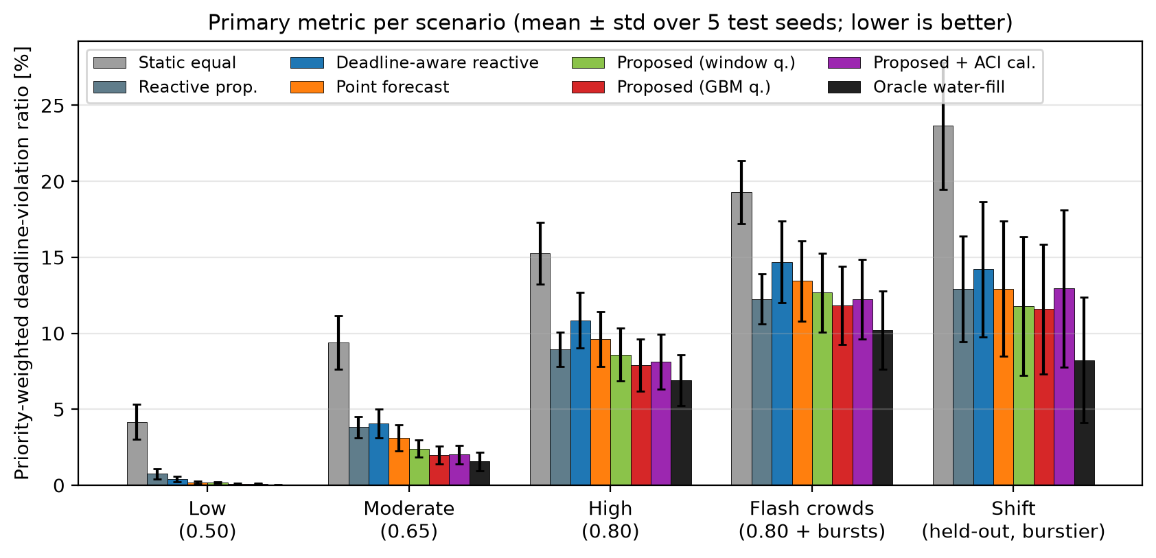
Results: primary metric per scenario (5 test seeds, mean ± std)
9 Results
• Proposed = best implementable method in 5/5 scenarios
  – vs point forecast (same model, median only): −18% (high), −10% (shift)
  – vs deadline-aware reactive: −27% (high), −18% (shift)
  – vs reactive proportional: −12% (high) but only −3% under flash crowds (3/5 seeds) → tie
• Gap to oracle at high load: 7.9% vs 6.9%
• Std across seeds is large (burst timing) → paired per-seed comparison next
BTP mid-evaluation | Fronthaul load management | 10
Notes:
Bars are the priority-weighted violation ratio; lower is better; black is the oracle. The proposed rule (red) is the best implementable method in every scenario. Against the point-forecast controller, which has the same model and the same information, it reduces the metric by 18% at high load and 10% under the held-out shift. Against the deadline-aware reactive baseline by 27% and 18%. Against the plain proportional controller the margin is 12% at high load but only 3% under flash crowds, where it wins 3 of 5 seeds — a tie. The std bars are large because seeds differ in burst timing; the paired analysis on the next slide is the correct reading.

Slide 11
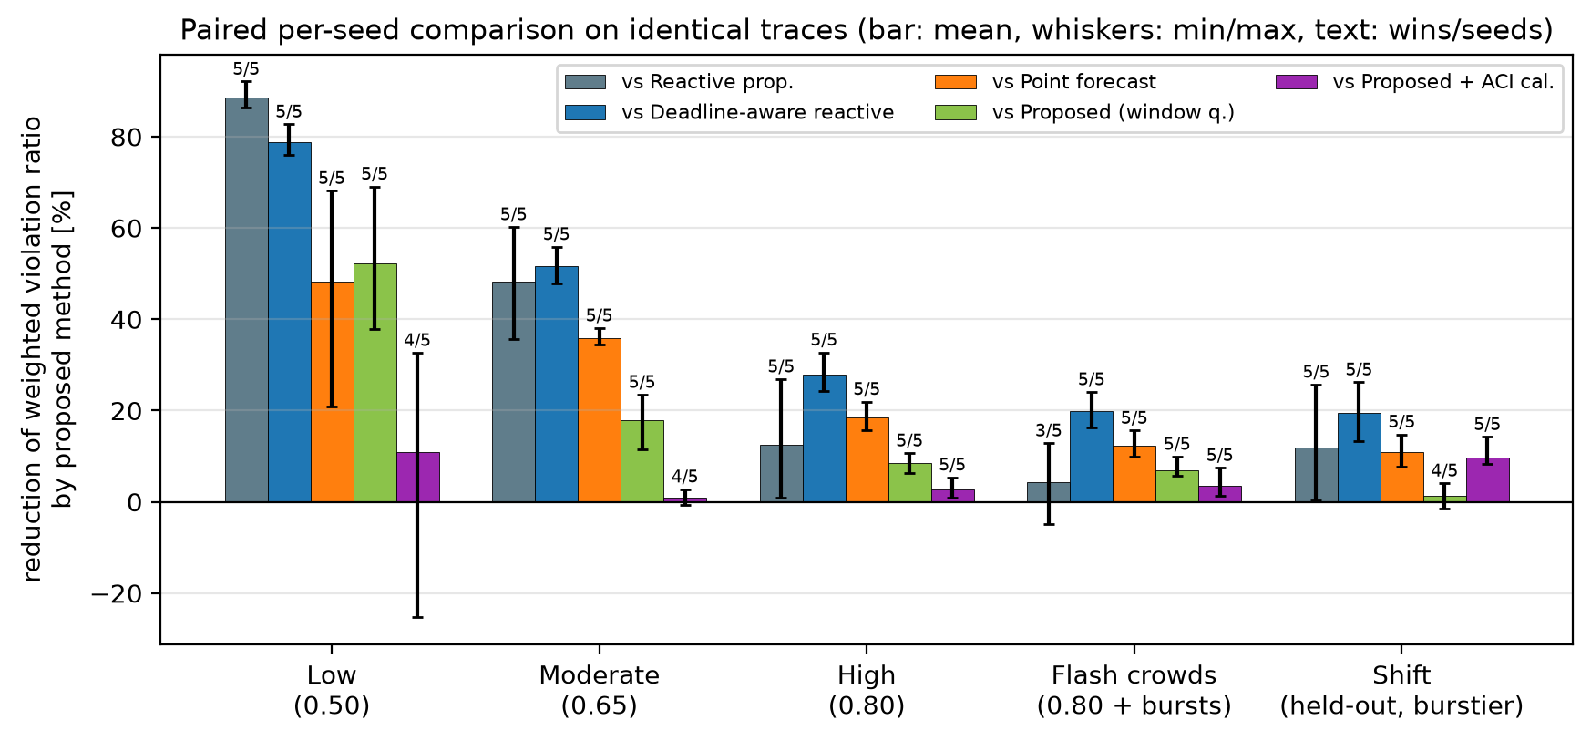
Results: paired per-seed comparison on identical traces
9 Results
• Wins 5/5 seeds vs point forecast and vs deadline-aware reactive in every scenario
• vs reactive proportional: 5/5 in four scenarios; 3/5 under flash crowds (no claim there)
• ML ablation (same rule, window quantiles instead of GBM):
  – GBM adds 2–51% ; smallest under held-out shift (2%) → the rule, not the model, carries most of the gain
• ACI calibration: no gain in-distribution, harmful under shift (over-reserves LL, starves eMBB) → negative result
• No significance test claimed with 5 seeds; win counts and min/max are reported instead
BTP mid-evaluation | Fronthaul load management | 11
Notes:
Each bar is the mean relative reduction of the primary metric by the proposed method against one baseline, computed seed by seed on the very same trace; whiskers are min and max over seeds and the text is how many of the five seeds the proposed method won. Against point forecast and the deadline-aware reactive controller it wins every seed in every scenario. Against the plain proportional controller it wins all seeds except under flash crowds. The green bars are the ML ablation: the same rule fed with empirical window quantiles instead of the GBM; the ML forecaster adds 5-50% in nominal traffic but almost nothing under the held-out shift, where the trained model is out of distribution. Purple: ACI calibration gives no benefit and is harmful under shift.

Slide 12
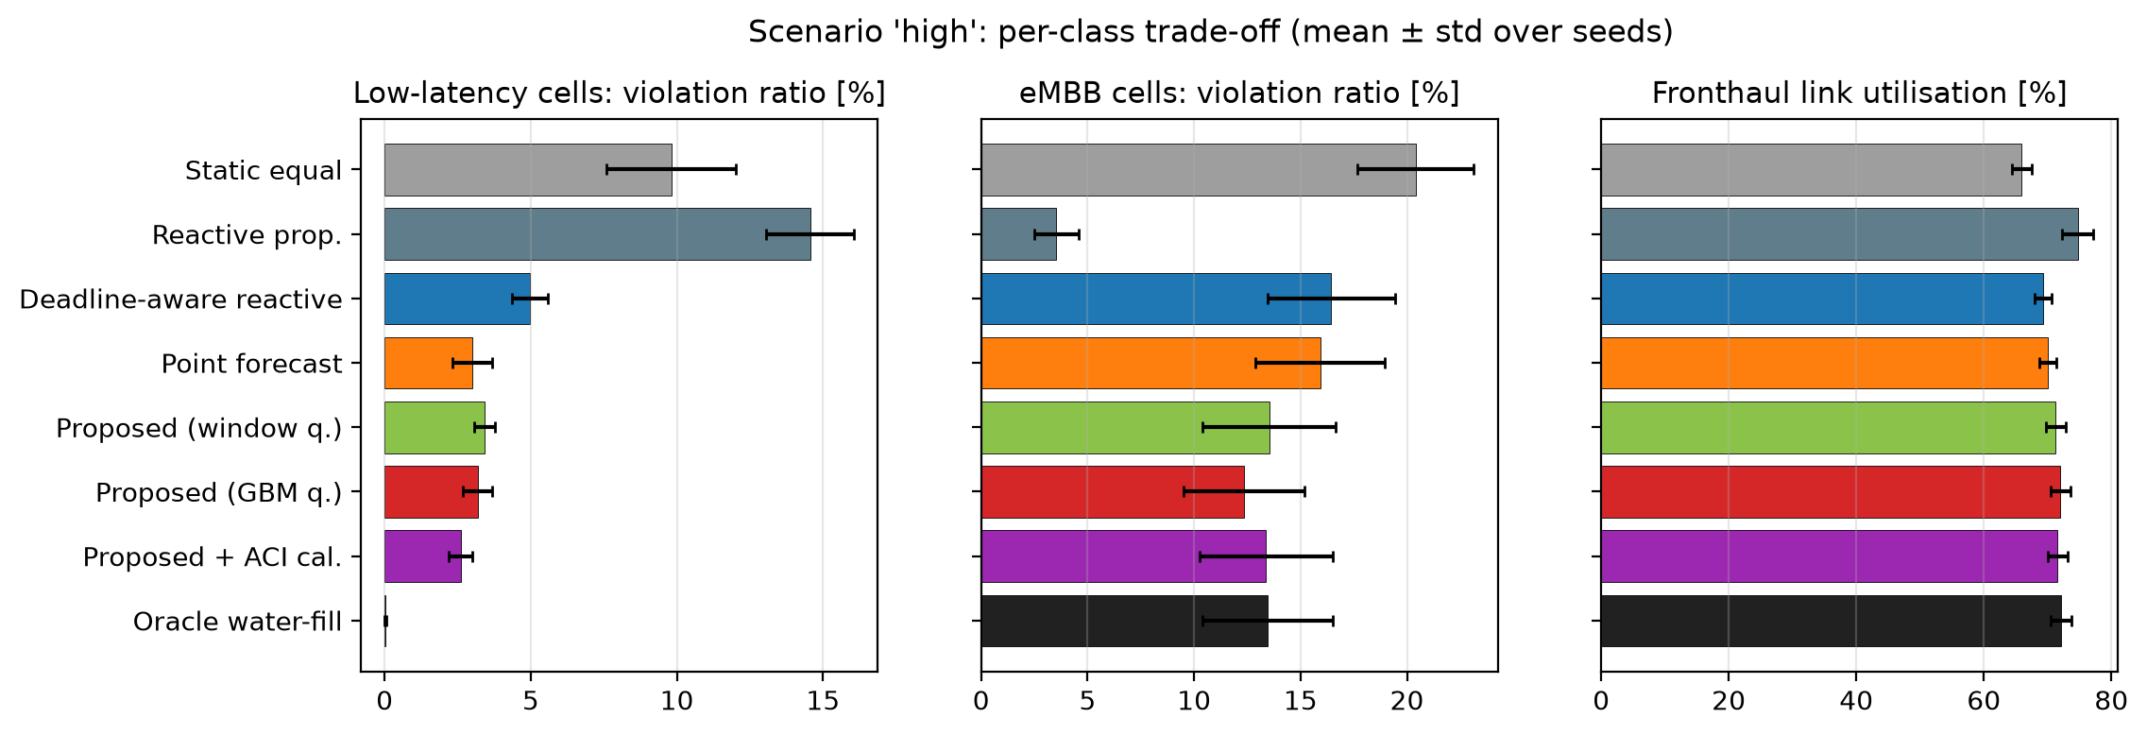
Where the gain comes from: per-class trade-off (high load)
9 Results
• Reactive proportional: LL 14.6% vs proposed 3.2% — deadline-unaware controllers sacrifice LL
• Within the deadline-aware family, proposed has the lowest eMBB loss (12.3% vs 15.9% point forecast) and highest utilisation (72.0%)
• Oracle still loses 13.4% eMBB at 0.80 load: 10-ms fixed budgets cannot track heavy-tailed bursts → control interval matters
BTP mid-evaluation | Fronthaul load management | 12
Notes:
Left: low-latency violations; middle: eMBB; right: link utilisation. The proportional controller keeps eMBB almost clean but lets low-latency cells lose 15% of their bits — the deadline-unaware failure mode. The deadline-aware family (blue, orange, red, black) protects the LL cells at the price of eMBB. Within that family the proposed rule has the lowest eMBB loss and the highest utilisation, because it reserves margin only where the forecast is uncertain instead of everywhere. The oracle shows that even perfect knowledge of the next interval leaves 13% eMBB loss at this load: budgets fixed for 10 ms cannot follow heavy-tailed bursts, so a shorter interval — next slide — is the other lever.

Slide 13
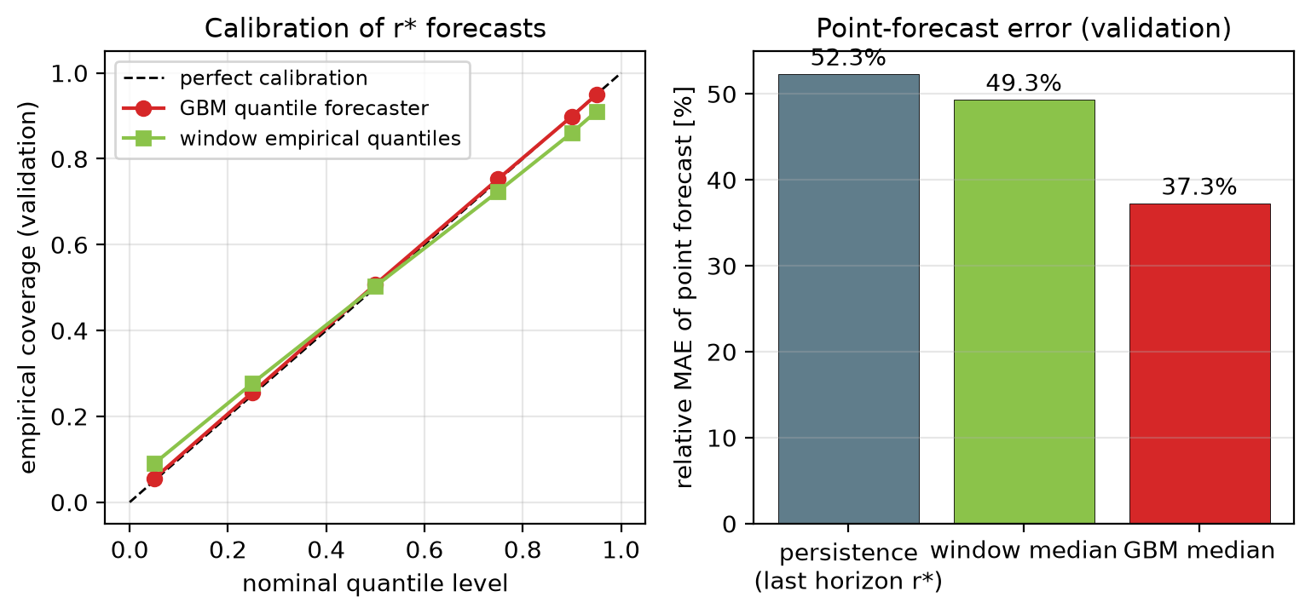
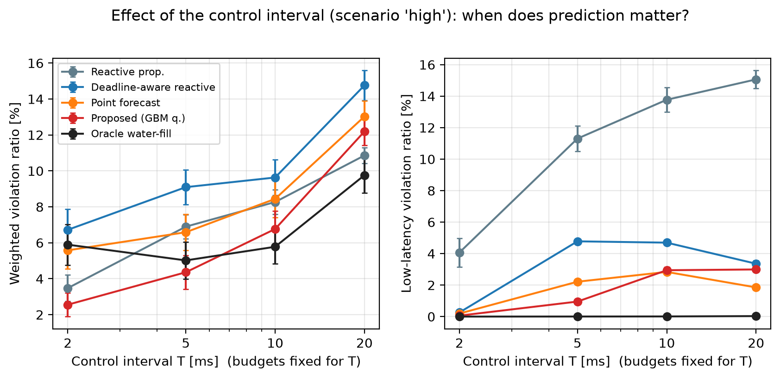
Ablations: forecast quality and control interval
10 Ablation
• Validation coverage at nominal 5/50/95%: 5.6% / 50.7% / 94.9% ; median rel. MAE 37% vs persistence 52% , window 49%
• Interval sweep (scenario high, 3 seeds), reduction by proposed vs deadline-aware reactive / vs reactive proportional / vs oracle water-fill:
  – T=2 ms: +62% / +27% / +57% | T=5 ms: +52% / +37% / +13% | T=10 ms: +30% / +18% / -17% | T=20 ms: +17% / -12% / -25%
• At T = 2 ms the KKT rule even beats the oracle water-fill (perfect point forecast, proportional shortage split) → the allocation RULE, not only the forecast, drives the gain
• At T = 20 ms (budgets held 5× the LL deadline) the deadline-aware family over-reserves the LL peak rate and reactive proportional wins on the weighted metric → known failure regime; a bound on how long a reservation should be held
BTP mid-evaluation | Fronthaul load management | 13
Notes:
Left: the GBM quantiles are well calibrated on validation data — empirical coverage matches nominal levels within one point — and its median error is lower than persistence and window medians. Right: the control-interval sweep on the high scenario, forecasters retrained per interval. Two honest findings. At 2 ms the proposed rule is far ahead of every reactive controller and even of the oracle-informed water-fill, which has a perfect point forecast: so the allocation rule itself, not only the forecast, is doing work. At 20 ms — five times the low-latency deadline — reserving the LL peak rate for the whole interval over-reserves, and the deadline-unaware proportional controller becomes better on the weighted metric. So the method is appropriate when the control interval is at most a few multiples of the shortest deadline; our default of 10 ms is inside that regime.

Slide 14
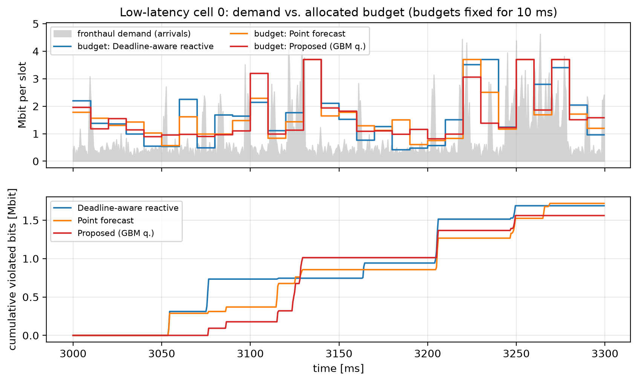
One trace: budgets vs. demand of a low-latency cell (300 ms)
9 Results
BTP mid-evaluation | Fronthaul load management | 14
Notes:
Top: fronthaul demand of a low-latency cell in grey and the budget each controller gave it. The reactive controller reacts one interval late to each burst; the point forecast tracks the median; the proposed rule raises the budget when the predictive distribution is wide and lets it sit near the median when it is confident. Bottom: cumulative violated bits — the proposed rule has the fewest on this window. This is the demo I can run live: python -m fhlm.run_experiments demo, then make_figures.

Slide 15
Limitations and honest status
11 Limitations
• Synthetic traffic only (Gamma + Pareto ON/OFF + regimes); no real O-RU traces → no real-world validation claimed
• Gains are relative to interval-level controllers; the oracle itself is interval-level — a slot-level optimum is lower
• Not a universal win: tie with reactive proportional under flash crowds; GBM adds ≈0-2% over window quantiles under held-out shift
• ACI online calibration did not help (negative result); the robust fallback is currently the window-quantile variant
• 5 test seeds → win counts and min/max reported, no significance test
• Simplified link: budget-enforced pipe, no switch packet queueing, one traffic class per cell, no HARQ/RLC feedback
• Decision time ≈ 3.4 ms per 10-ms epoch in Python (vectorised tree evaluation); reactive baselines ≈ 0.1 ms
• Propositions in docs are feasibility / equal-tail-probability / backlog-first — no stability or optimality-in-the-loop claims
BTP mid-evaluation | Fronthaul load management | 15
Notes:
Be explicit about what this is not. Traffic is synthetic; no real fronthaul traces were available, so there is no real-world validation. The oracle is only interval-level; a slot-level optimum would be lower. The gain over the simplest proportional controller vanishes under flash crowds, and the ML forecaster adds little under the held-out shift. ACI calibration did not help. Five seeds do not allow a significance claim. The fronthaul link is modelled as a budget-enforced pipe: no packet-level queueing in the switch, one class per cell, no HARQ feedback loop. Decision time is Python-level: about 3 ms per 10 ms epoch, fine for simulation, not a claim about real-time deployment.

Slide 16
Status and remaining work toward the final evaluation
12 Plan
Implemented and validated
Planned (not yet done)
• Slot-level 7-2x shared-link simulator with deadlines, priorities, telemetry delay, accounting (13 tests)
• Synthetic heavy-tailed traffic generator with regimes, flash crowds, SE drift
• 5 baselines (static, proportional, deadline-aware reactive, point forecast, oracle), tuned on validation seeds
• Quantile-GBM forecaster of r* (calibrated on validation), vectorised inference
• KKT allocation rule with feasibility proof; ACI variant; window-quantile variant
• 200-run main comparison, paired analysis, interval sweep, demo, all figures, this deck — reproducible
• Real or public traffic traces (e.g. per-cell PRB utilisation datasets) → re-validate the forecaster
• Skill-weighted blend of GBM and window quantiles as a principled fallback (replace ACI)
• Second control lever: per-cell BFP compression / modulation compression under the same rule
• Switch-level packet queue and T2a window model instead of a budget-enforced pipe
• Ablation on the target: r* vs interval volume; more seeds; sensitivity to τ and priorities
• Cost model: does the 3 ms Python decision fit a real DU? (C++/numba port, or longer epochs)
BTP mid-evaluation | Fronthaul load management | 16
Notes:
Left column is done and verified by tests and experiments; right column is what I propose to do next, in priority order: replace or complement the synthetic traffic with public traces; make the rule cheaper and robust by mixing window quantiles and GBM by recent forecast skill; add a switch queue and a second lever such as compression ratio; more seeds; and an ablation on the deadline-feasible target itself.

Slide 17
Backup: primary metric [%], mean ± std over 5 test seeds
Backup
Method | Low 0.50 | Moderate 0.65 | High 0.80 | Flash crowds | Shift (held-out)
Static equal share | 4.16 ± 1.15 | 9.38 ± 1.77 | 15.27 ± 2.02 | 19.30 ± 2.07 | 23.65 ± 4.18
Reactive proportional (EWMA) | 0.75 ± 0.34 | 3.81 ± 0.71 | 8.94 ± 1.15 | 12.25 ± 1.65 | 12.92 ± 3.47
Deadline-aware reactive (persistence r*) | 0.39 ± 0.18 | 4.07 ± 0.95 | 10.86 ± 1.84 | 14.70 ± 2.67 | 14.21 ± 4.44
Point forecast (GBM median) | 0.18 ± 0.10 | 3.11 ± 0.87 | 9.63 ± 1.82 | 13.44 ± 2.65 | 12.93 ± 4.45
Proposed rule, window quantiles (no ML) | 0.17 ± 0.04 | 2.41 ± 0.56 | 8.60 ± 1.74 | 12.67 ± 2.59 | 11.80 ± 4.56
Proposed (GBM quantiles + KKT) | 0.08 ± 0.04 | 2.00 ± 0.59 | 7.89 ± 1.71 | 11.82 ± 2.56 | 11.59 ± 4.27
Proposed + ACI calibration | 0.09 ± 0.02 | 2.02 ± 0.61 | 8.12 ± 1.80 | 12.24 ± 2.62 | 12.95 ± 5.17
Oracle water-fill (true r*, reference) | 0.01 ± 0.01 | 1.56 ± 0.60 | 6.90 ± 1.68 | 10.21 ± 2.57 | 8.23 ± 4.14
Source: results/fhlm/main_runs.csv (200 runs). Paired per-seed statistics: results/fhlm/main_paired.csv.
BTP mid-evaluation | Fronthaul load management | 17
Notes:
Table of the primary metric per scenario and method, produced from results/fhlm/main_runs.csv.

Slide 18
Backup: derivation of the KKT budget rule
Backup
• Objective: J(r) = Σ_i w_i E_{F_i}[ min(B_i + X_i, r_i) ], X_i ~ F_i (forecast CDF of r*_i)
• d/dr_i E[min(B_i + X_i, r_i)] = P(B_i + X_i > r_i) = 1 − F_i(r_i − B_i) → J concave, separable
• Lagrangian: L = J − λ(Σ r_i − C_u) + Σ μ_i r_i − Σ ν_i (r_i − cap_i)
• Stationarity for an interior r_i: w_i (1 − F_i(r_i − B_i)) = λ ⇒ r_i = B_i + F_i⁻¹(1 − λ / w_i)
• Clip at 0 and cap_i (μ_i, ν_i ≥ 0); Σ_i r_i(λ) is non-increasing in λ ⇒ unique λ* by bisection (60 steps)
• Prop. 1 (feasibility): output always satisfies caps and Σ r_i ≤ C_u — verified by test_kkt_allocation_properties
• Prop. 2 (equal weighted tail): at the optimum all interior cells share w_i·P(marginal bit needed) = λ*
• Prop. 3 (backlog first): F_i(x) = 0 for x < 0 ⇒ marginal value below B_i is w_i ⇒ backlog of any cell with λ* < w_i is fully funded
• Degenerate F_i (point forecast) ⇒ priority-ordered fill = the point-forecast water-fill baseline
• F_i⁻¹: piecewise-linear through the 6 forecast quantiles, linear extrapolation above 0.95; monotone by sorting
BTP mid-evaluation | Fronthaul load management | 18
Notes:
Derivation for questions. The objective is concave and separable; the Lagrangian derivative in r_i is w_i times one minus F_i at r_i minus B_i minus lambda; setting it to zero gives the inverse-CDF form. Because F_i is zero below zero, the derivative equals w_i there — backlog is always funded before any uncertain demand of a lower-weight cell. The sum of r_i(lambda) is non-increasing in lambda, so bisection finds the unique lambda at which the link is exactly full.

Slide 19
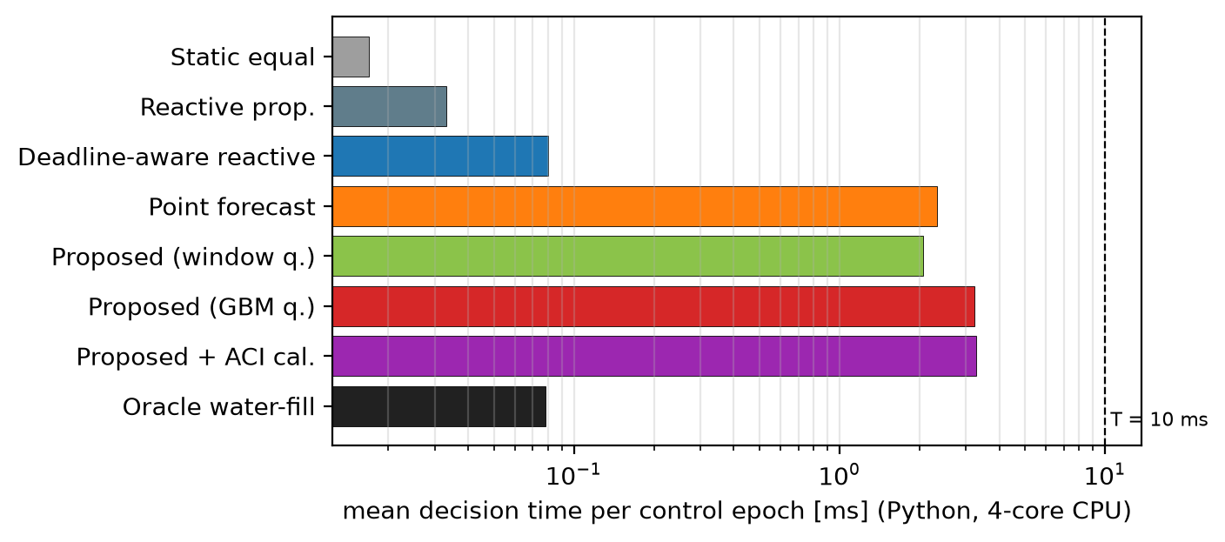
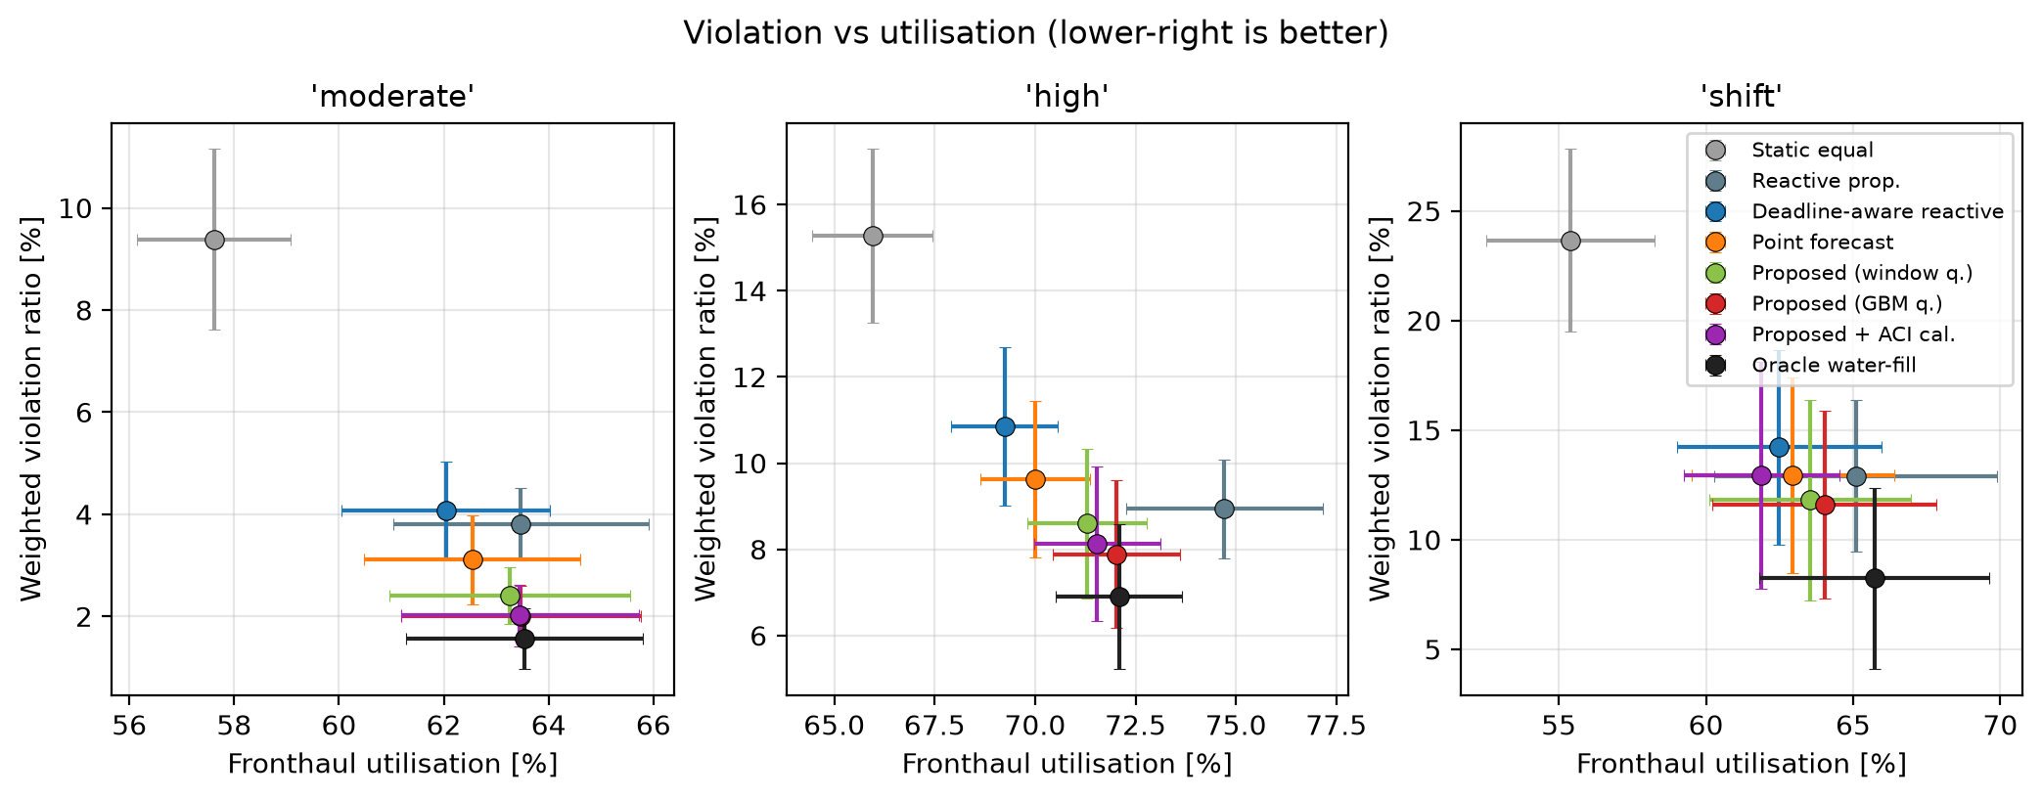
Backup: decision overhead and utilisation trade-off
Backup
Decision times are Python on a 4-core CPU inside the simulator (feature construction + 1,800 trees via vectorised traversal + bisection). The rule itself is < 0.1 ms.
BTP mid-evaluation | Fronthaul load management | 19
Notes:
Left: mean decision time per control epoch per method. Right: violation versus utilisation per scenario.

Slide 20
Backup: references
Backup
• O-RAN WG4, Control, User and Synchronization Plane Specification (O-RAN.WG4.CUS.0) [standard] — 7-2x, BFP compression (Annex A.1), T2a windows. 3GPP TR 38.801 [standard]; IEEE 802.1CM-2018 [standard].
• L. M. P. Larsen, A. Checko, H. L. Christiansen, 'A Survey of the Functional Splits Proposed for 5G Mobile Crosshaul Networks', IEEE COMST 21(1), 2019. DOI 10.1109/COMST.2018.2868805 [peer-reviewed]
• G. O. Pérez, J. A. Hernández, D. Larrabeiti, 'Fronthaul Network Modeling and Dimensioning Meeting Ultra-Low Latency Requirements for 5G', JOCN 10(6), 2018. DOI 10.1364/JOCN.10.000573; IEEE Access 2019, DOI 10.1109/ACCESS.2019.2923020 [peer-reviewed]
• L. Wang, S. Zhou, 'On the Fronthaul Statistical Multiplexing Gain', IEEE Commun. Lett. 21(5), 2017. DOI 10.1109/LCOMM.2017.2653120 [peer-reviewed]
• S. Lagén, X. Gelabert, A. Hansson, M. Requena, L. Giupponi, 'Fronthaul Compression Control for Shared Fronthaul Access Networks', IEEE Commun. Mag. 2022. DOI 10.1109/MCOM.001.2100959 [peer-reviewed]
• D. Bega, M. Gramaglia, M. Fiore, A. Banchs, X. Costa-Pérez, 'DeepCog', IEEE INFOCOM 2019, DOI 10.1109/INFOCOM.2019.8737488; 'AZTEC', IEEE INFOCOM 2020, DOI 10.1109/INFOCOM41043.2020.9155299 [peer-reviewed]
• F. Kavehmadavani, V.-D. Nguyen, T. X. Vu, S. Chatzinotas, 'Intelligent Traffic Steering in Beyond 5G Open RAN Based on LSTM Traffic Prediction', IEEE TWC 2023. DOI 10.1109/TWC.2023.3254903 [peer-reviewed]
• K. M. Cohen, S. Park, O. Simeone, P. Popovski, S. Shamai, 'Guaranteed Dynamic Scheduling of URLLC Traffic via Conformal Prediction', IEEE WCL 2023 [peer-reviewed]; I. Gibbs, E. Candès, 'Adaptive Conformal Inference Under Distribution Shift', NeurIPS 2021 [peer-reviewed]
• V. Kasuluru, L. Blanco, C. J. Vaca-Rubio, E. Zeydan, 'On the Impact of PRB Load Uncertainty Forecasting for Sustainable Open RAN', arXiv:2407.14400, 2024 [preprint]
• W. Willinger et al., IEEE/ACM ToN 1997 (heavy-tailed ON/OFF sources); Hadley & Whitin 1963 (constrained multi-item newsvendor); Le Boudec & Thiran, Network Calculus, 2001. Full list: docs/fhlm/literature_review.md
BTP mid-evaluation | Fronthaul load management | 20
Notes:
Full list with DOIs/links in docs/fhlm/literature_review.md.

