Slide 1
Part A: Making the Fronthaul Lighter and the DU Faster
Structure-aware IQ compression, RMT-guided warm-start complex inversion,
and a fused C/AVX-512 RZF precoder kernel for O-RAN 7-2x
Mayank Yadav Harshvardhan Choudhary
B.Tech. Project — Final Evaluation, November 2026

Slide 2
Why Part A?
Two bottlenecks of a 5G/6G O-RAN cell
1. The fronthaul is huge
• Raw 64-antenna cell: ≈ 15.4 Gbit/s
• DU-side precoding over 100 MHz, 64 streams: 118 Gbit/s
• O-RAN BFP only shortens numbers: ≈ 4×
→ need compression that exploits channel structure
2. The DU has 0.5 ms per slot
• RZF precoder per PRB: G = HHᴴ + αI, W = Hᴴ G⁻¹
• 273 PRBs × complex K×K inverse every slot
• numpy + LAPACK: 3.2 ms for K = 16 → misses the slot 6×
→ need fast, accurate complex inversion
Our answer: compress the data with its own structure, and invert the complex channel
matrices with an RMT-guided method running on hand-optimised kernels.
Part A attacks both bottlenecks: fewer bits on the link, and a precoder that fits in the slot.
Fronthaul Load Management in O-RAN | Part A | M. Yadav & H. Choudhary
2

Slide 3
Our Part A contributions at a glance
CSEE & RAS-BFP
13–16× compression
vs ≈ 4× for O-RAN BFP
3–6× faster than SVD
ACAFS
Rank-adaptive functional split
55–75 % bandwidth cut
at high SNR
RMT-WS inversion
Complex Hermitian Grams
6 GEMMs vs > 10 for
Neumann-type methods
Warm-start tracking
2.7× fewer GEMMs, 30× lower
loss at pedestrian speed;
never diverges at 120 km/h
Fused C/AVX-512 kernel
Whole RZF precoder
10–15× faster than numpy+LAPACK
fits the 0.5 ms slot
RU-side precoding
−72 % fronthaul
at 99.7 % of exact
RZF sum-rate
From compression theory to a slot-feasible precoder: a complete DU-side toolchain.
Fronthaul Load Management in O-RAN | Part A | M. Yadav & H. Choudhary
3

Slide 4
Structure-aware IQ compression
Y = H ⊙ X + W ∈ ℂ^(M×N), M = 64 antennas, N = 1200 subcarriers, 3GPP TDL-A
CSEE — delay-domain sparse encoder
1. IFFT along subcarriers → delay domain
2. Keep top-K taps (channel is sparse in delay)
3. Per-antenna BFP, FFT back at the receiver
Theorem 1: NMSE ≤ σ²_tail/σ²_Y + (Δ²/12)·K/(MN σ²_Y)
Complexity O(MN log N)
RAS-BFP — randomised sketch + QR
1. SRHT sketch Z = ΩY ∈ ℂ^(r×N)
2. Thin QR of Zᴴ, project L = YQ
3. Send BFP(L), BFP(Q); Y ≈ LQᴴ
Theorem 2: ‖Y − LQᴴ‖² ≤ (1+ε)‖Y − Y_r‖² w.h.p.
Theorem 4: optimal rank r* = ⌊√(B/(b(M+N)))⌉, O(rMN)
Both encoders come with provable error bounds and lower complexity than SVD.
Fronthaul Load Management in O-RAN | Part A | M. Yadav & H. Choudhary
4

Slide 5
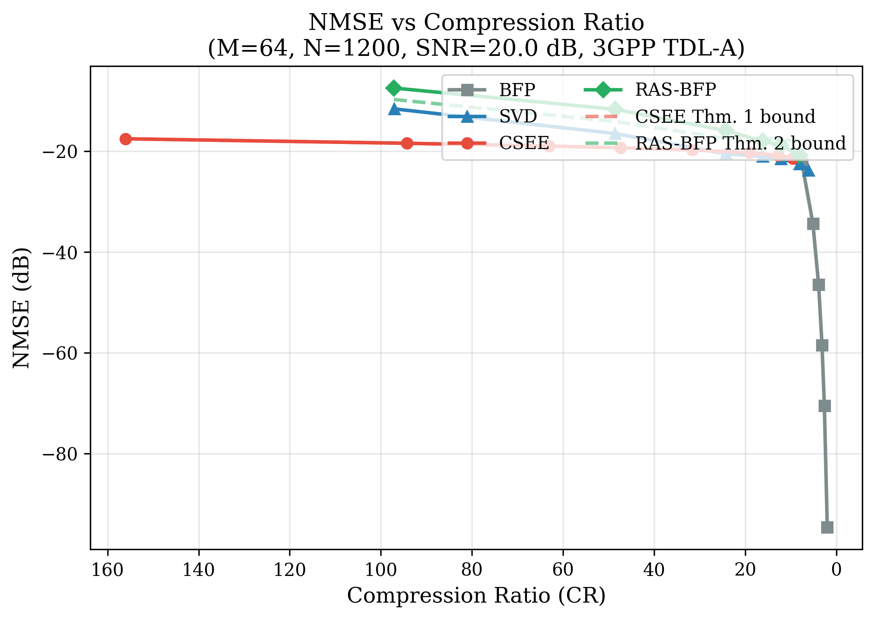
Compression: 4× more than the O-RAN standard
M = 64, N = 1200, SNR 20 dB, TDL-A
Method | Compression | Encode time
O-RAN BFP (b = 8) | 3.9× | 3.1 ms
Truncated SVD (r = 12) | 16.2× | 18–30 ms
CSEE (ours) | 12.7× | 5.2 ms
RAS-BFP (ours) | 16.2× | 7.2 ms
• 13–16× compression at ≈ −20 dB NMSE
• RAS-BFP: SVD-level compression, 3–4× faster
• CSEE: 4–6× faster than SVD; ≈ 63× at the K = 60 knee
• Stable NMSE across SNR −5 to 30 dB
RAS-BFP matches SVD compression at a fraction of its encode time.
Fronthaul Load Management in O-RAN | Part A | M. Yadav & H. Choudhary
5

Slide 6
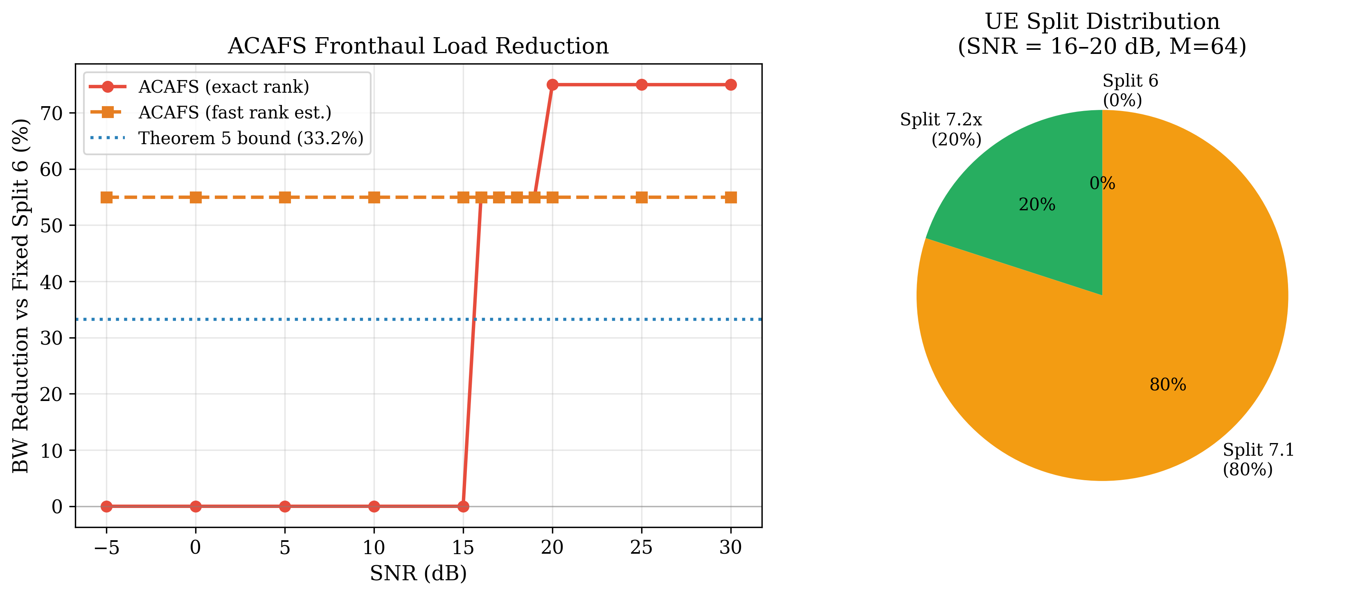
ACAFS: rank-adaptive functional split
Per-UE rank fraction r/M picks the O-RAN split on the fly
Rank fraction r/M | Split
< 0.15 | 7.2x
0.15 – 0.55 | 7.1
≥ 0.55 | 6
• Theorem 5: closed-form bandwidth saving vs a fixed Split 6
• ≈ 33 % saving for uniformly spread ranks
• 55–75 % saving at high SNR (rank collapse)
• Decision per UE, from the rank the encoder already computes
The split adapts to the channel instead of being fixed at deployment.
Fronthaul Load Management in O-RAN | Part A | M. Yadav & H. Choudhary
6

Slide 7
The real DU workload: complex RZF precoding
We built the full complex-valued pipeline, not a toy benchmark
Realistic complex channels (cmatinv/)
• 3GPP TR 38.901 UMa NLOS path loss + shadowing
(near-far user powers)
• TDL-A 23-tap profile over 100 MHz
• Per-user angular-spread spatial correlation
• Rician line-of-sight option
• Clarke/Jakes aging ρ = J₀(2π f_D T): 3–120 km/h
• M = 64/128 antennas, K = 8/16/32 layers,
273 PRBs, 30 kHz slots, 3.5 GHz
Per PRB, every 0.5 ms slot
G = HHᴴ + αI ∈ ℂ^(K×K) (complex Hermitian)
W = Hᴴ G⁻¹ ∈ ℂ^(M×K)
× 273 PRBs inside one slot
Our question:
Can the whole complex precoder run inside
the slot on a CPU DU — and can inversion
exploit the channel's statistics?
Fronthaul Load Management in O-RAN | Part A | M. Yadav & H. Choudhary
7

Slide 8
RMT-WS: random-matrix-guided warm-start inversion
Our complex inversion method
• Equilibrate Ĝ = D^(−½) G D^(−½) — removes the near-far spread
• Eigensolve-free spectral interval from Marchenko–Pastur + moment match:
  – v = ‖Ĝ‖²_F / K − 1, [a, b] = 1 + v/s̄ ∓ 2√v (only K² work)
• Cold start: Chebyshev polynomial on [a, b], then Newton–Schulz
  – X ← X(2I − ĜX): quadratic convergence, pure GEMMs
• Tracking: next slot starts from the previous inverse
• Residual certificate ‖(I − ĜX)z‖/‖z‖ picks the Newton steps per PRB
  – or falls back to a cold start — always safe
Why it fits the DU
✔ Adapts to correlated and
near-far channels automatically
✔ No eigen-decomposition
✔ Only matrix multiplies:
GPU / NPU / tensor-core friendly
✔ Cost adapts to user speed
✔ Built-in accuracy certificate
Random-matrix theory gives the inverse a head start; the certificate keeps it safe.
Fronthaul Load Management in O-RAN | Part A | M. Yadav & H. Choudhary
8

Slide 9
Cold-start inversion: fewer GEMMs
Complex GEMMs (K³ MACs) needed for ≤ 1 % RZF sum-rate loss
Method | 64/16 | 128/16 | 64/32
Neumann (Wu / Prabhu) | > 8 | > 8 | > 8
Joint Newton–Neumann (Shao) | > 10 | > 10 | > 10
Newton–Schulz, classical init | > 10 | > 10 | > 10
Block conjugate gradient | 7 | 5 | 12
Gauss–Seidel | 6 | 4 | > 12
Cheb-MP + Newton–Schulz (ours) | 6 | 5 | 9
• Beats every Neumann / Newton-type scheme in every configuration
• Best of all methods at heavy load (K/M = 0.5): 9 vs 12 GEMMs
Our initialisation converges in 6 GEMMs where classical series need more than 10.
Fronthaul Load Management in O-RAN | Part A | M. Yadav & H. Choudhary
9

Slide 10
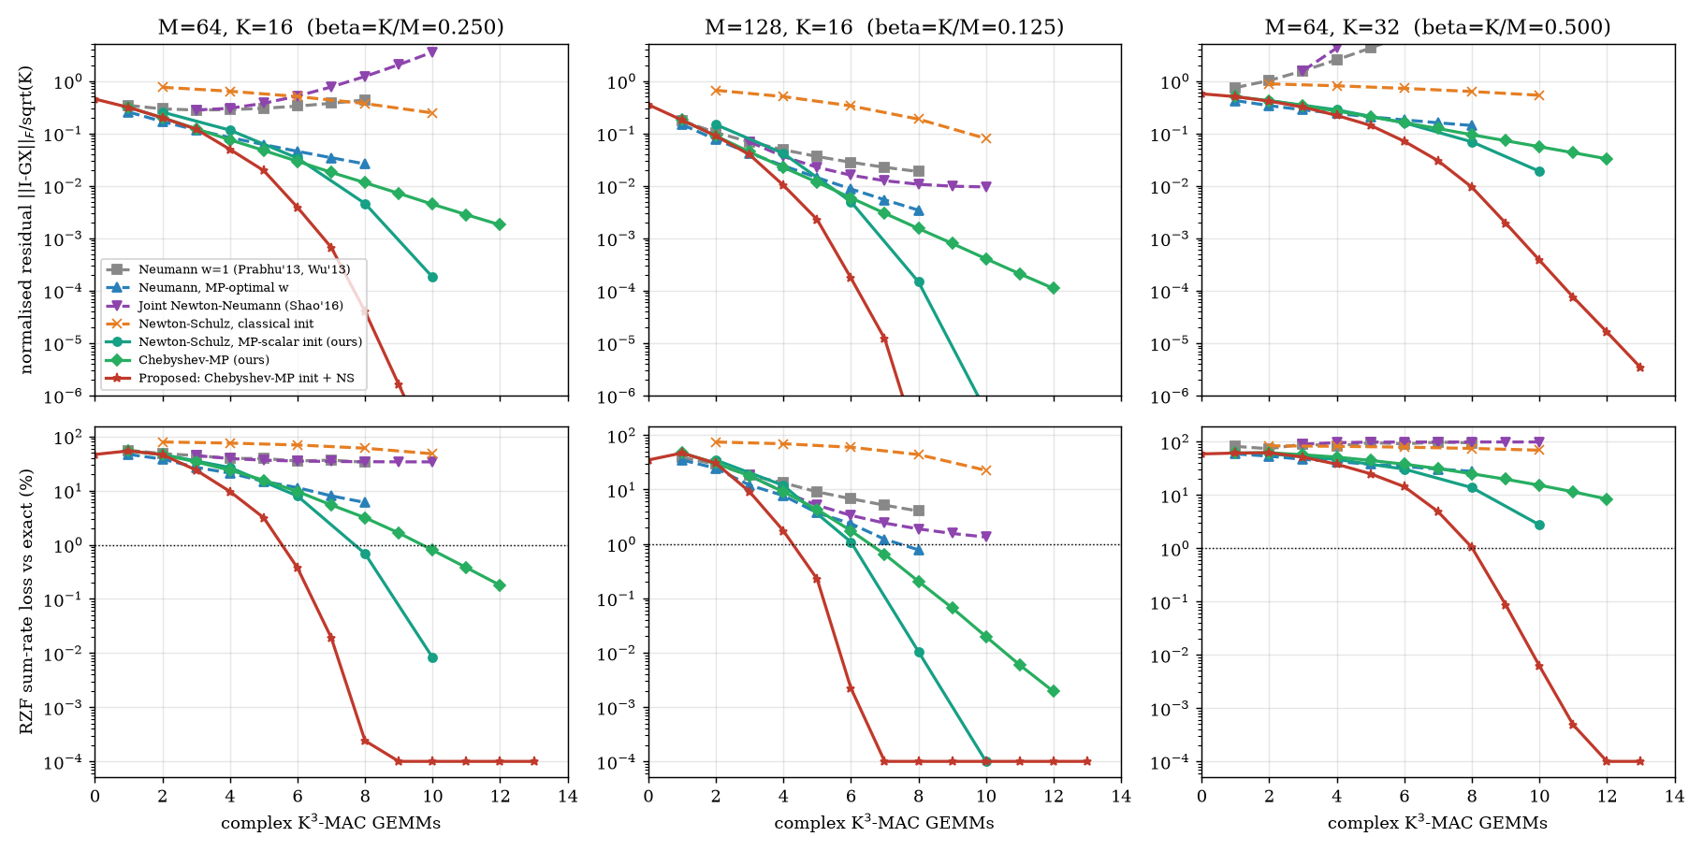
Cold start: residual and sum-rate loss vs GEMM budget
Red curve (ours) reaches 1 % loss first in every antenna/user configuration.
Fronthaul Load Management in O-RAN | Part A | M. Yadav & H. Choudhary
10

Slide 11
Warm-start tracking across user speeds
K = 16, M = 64, sum-rate loss vs exact RZF / GEMMs per slot per PRB
Speed | Warm Gauss–Seidel ×4 | Warm CG ×4 | RMT-WS (ours)
3 km/h | 0.009 % / 4 | 0.013 % / 5 | 0.006 % / 2.25
30 km/h | 0.63 % / 4 | 0.96 % / 5 | 0.43 % / 5.2
120 km/h | 2.9 % / 4 | 5.5 % / 5 | 0.12 % / 6.25
• 3 km/h: 2.7× fewer GEMMs and 30× lower loss than a cold start
• 30 km/h: lowest loss of all warm-started methods
• 120 km/h: 24× lower loss than warm Gauss–Seidel
• Fixed 1- or 2-step warm starts diverge at 120 km/h — RMT-WS never does
One method, every speed: cheap when users are slow, safe when they are fast.
Fronthaul Load Management in O-RAN | Part A | M. Yadav & H. Choudhary
11

Slide 12
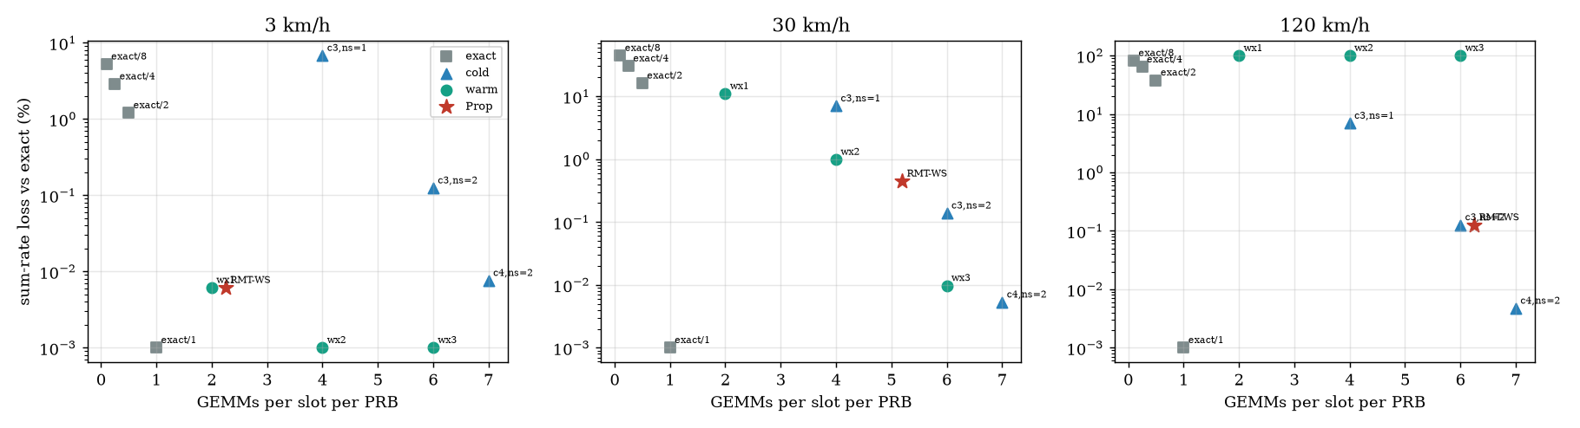
Tracking: accuracy vs cost at 3, 30 and 120 km/h
RMT-WS (red star) sits at the low-cost, low-loss corner at every speed.
Fronthaul Load Management in O-RAN | Part A | M. Yadav & H. Choudhary
12

Slide 13
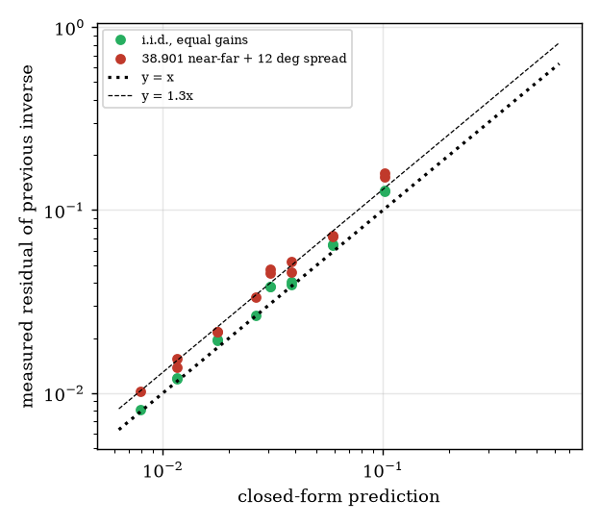
A closed-form speed law and a safety certificate
Doppler-to-warm-start law
r₀ ≈ c · 2√(K/(M−K)) · √(1−ρ), 1−ρ ≈ (π f_D T)²
• r₀ grows linearly with speed (measured slope 1.00)
• Predicts the Newton steps needed: ⌈log₂(ln ε / ln r₀)⌉
• Warm start valid up to ≈ 39 km/h (64/16),
60 km/h (K = 8), 23 km/h (K = 32)
Certified safety
• Tail bound P(r̂² ≤ (1−d) r²) ≤ exp(−p d² s / 2)
• Audit of 480 PRB cases, 3–120 km/h:
0 accepted-but-non-contractive cases at r̂ ≤ 0.3
A design rule: the DU knows in advance up to which speed the warm start pays off.
Fronthaul Load Management in O-RAN | Part A | M. Yadav & H. Choudhary
13

Slide 14
Robust at low precision
GEMM operands rounded to b mantissa bits, wide accumulate (tensor-core / NPU style)
Setting | Direct Gauss–Jordan | Cheb + 3 Newton (ours)
8 mantissa bits | 0.88 % | 0.15 %
6 mantissa bits | 5.1 % | 1.4 %
Ill-cond., 10 bits | 1.2 % | 0.49 %
• Sum-rate loss vs float64 exact
• 6× lower loss at 8 bits, 3.6× at 6 bits
• Newton iteration self-corrects rounding errors
• Tracker at 8 bits: 0.70 % vs 0.54 % at full precision (30 km/h)
Our method is ready for low-precision accelerators where direct inversion degrades.
Fronthaul Load Management in O-RAN | Part A | M. Yadav & H. Choudhary
14

Slide 15
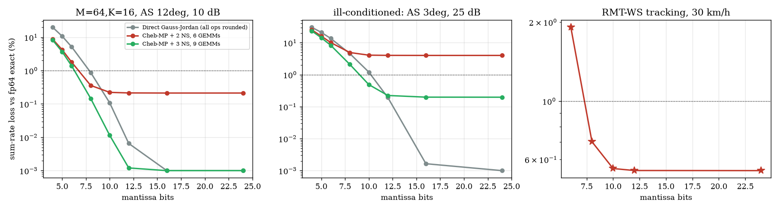
Low precision: loss vs mantissa bits
Newton refinement keeps the loss low where direct inversion degrades.
Fronthaul Load Management in O-RAN | Part A | M. Yadav & H. Choudhary
15

Slide 16
Kernel programming: a fused complex RZF precoder in C
kernels/cmat_kernels.c — batched complex64, AVX-512, OpenMP; Python binding cmatinv/fastkernels.py
• One pass per PRB: load H once → Gram → inverse → Wᵀ + power scaling
  – everything stack / L1-resident, no DRAM intermediates
• Hermitian symmetry: Gram on the lower triangle only
• Split re/im planes so complex arithmetic vectorises
• In-place Gauss–Jordan sweep: K rank-1 updates, no sqrt/divide chains
  – inverse 6.4k → 2.9k cycles per PRB (K = 16)
• Register-blocked W = Hᴴ X: 0.81 → 0.42 ms per slot
• AVX-512 code generation: 1.3–1.5× single thread, 2× on 4 threads
• Fused Newton step returns the exact residual for free
// inner loop of the sweep inverse
for (int i = 0; i < K; i++) {
if (i == k) continue;
float fr = ckr[i]*piv, fi = cki[i]*piv;
float *ar = xr + i*K, *ai = xi + i*K;
#pragma omp simd
for (int j = 0; j < K; j++) {
ar[j] -= fr*rkr[j] - fi*rki[j];
ai[j] -= fr*rki[j] + fi*rkr[j];
}
ar[k] = -fr; ai[k] = -fi;
}
gcc -O3 -march=native -fopenmp
-mprefer-vector-width=512
Fronthaul Load Management in O-RAN | Part A | M. Yadav & H. Choudhary
16

Slide 17
Kernel results: the whole precoder now fits in the slot
273 PRBs, complex64, 4-core AVX-512 Xeon, median of 40 runs
K, M | numpy+LAPACK | Our kernel | Speed-up
8, 64 | 1.08 ms | 0.070 ms | 15×
16, 64 | 3.21 ms | 0.226 ms | 14×
32, 64 | 12.2 ms | 0.97 ms | 12.5×
16, 128 | 4.71 ms | 0.41 ms | 11.6×
32, 128 | 16.3 ms | 1.60 ms | 10×
• K = 8, 16 (M = 64) and K = 16, M = 128 fit a 0.5 ms slot
• Near-linear thread scaling: 0.92 → 0.45 → 0.23 ms
• Accuracy: sum-rate loss < 10⁻⁵ % vs float64
10–15× faster: from 6× over the slot budget to under half of it.
Fronthaul Load Management in O-RAN | Part A | M. Yadav & H. Choudhary
17

Slide 18
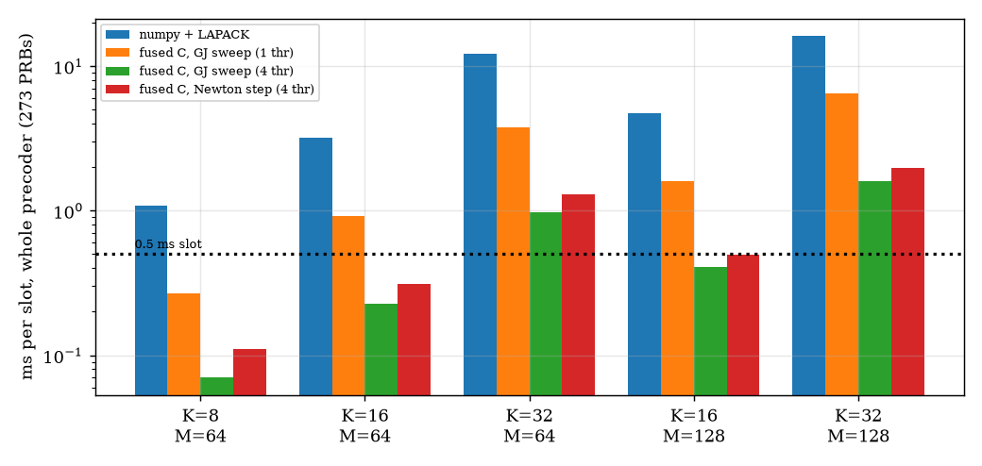
Whole-precoder time per slot (273 PRBs)
Our fused kernels (green, red) run under the 0.5 ms line for K ≤ 16; numpy+LAPACK never does.
Fronthaul Load Management in O-RAN | Part A | M. Yadav & H. Choudhary
18

Slide 19
Where should precoding run? A 72 % fronthaul saving
100 MHz, M = 64, K = 16, BFP-9 IQ
Architecture | Fronthaul | Sum-rate vs exact
DU precodes, sends 64 streams | 118.4 Gbit/s | 100 %
RU precodes, 16 layers + 8-bit weights | 32.8 Gbit/s (−72 %) | 99.7 %
RU precodes, 16 layers + 6-bit weights | 32.0 Gbit/s (−73 %) | 96.7 %
• Mobility requires refreshing the weights every slot
  – every 4 slots: only 70 % of the rate at 30 km/h
• Per-slot weights are exactly what our fast kernel delivers
• RU-side precoding cuts the link load by 3.6×
Fast per-slot precoding unlocks a 72 % lighter fronthaul at 99.7 % of the rate.
Fronthaul Load Management in O-RAN | Part A | M. Yadav & H. Choudhary
19

Slide 20
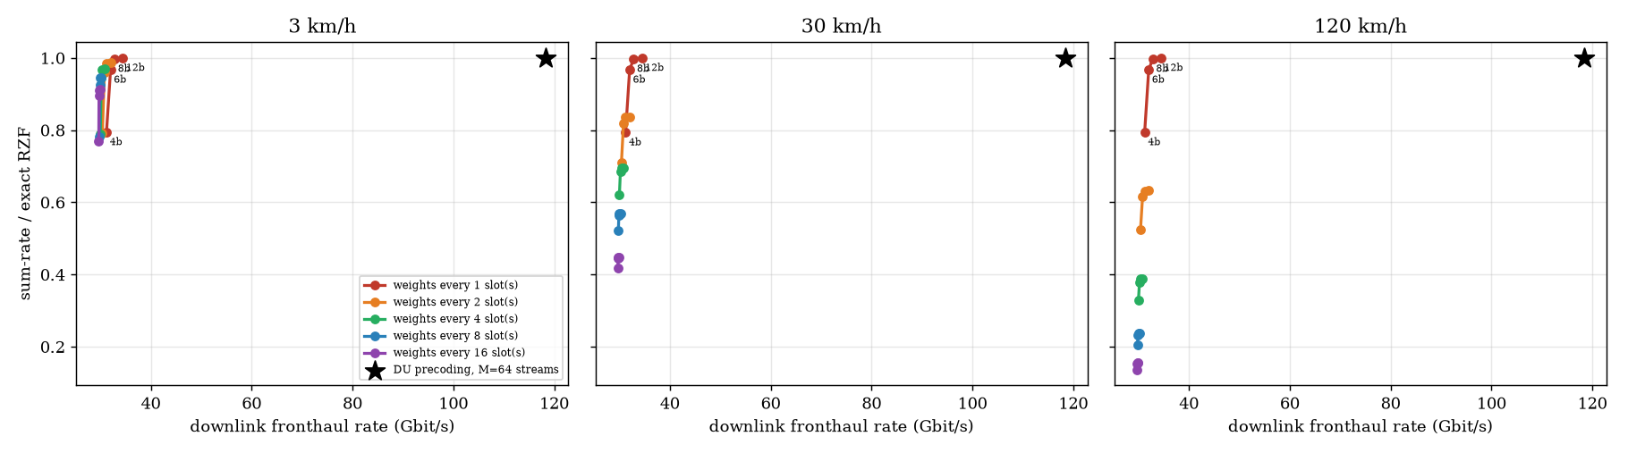
Fronthaul rate and sum-rate by architecture
RU-side precoding with per-slot weights: −72 % fronthaul at 99.7 % rate.
Fronthaul Load Management in O-RAN | Part A | M. Yadav & H. Choudhary
20

Slide 21
Part A summary
Contribution | Headline result
CSEE / RAS-BFP compression | 13–16× vs ≈ 4× for O-RAN BFP; 3–6× faster than SVD; provable error bounds
ACAFS adaptive split | 55–75 % bandwidth saving at high SNR
RMT-WS cold start | 6 GEMMs vs > 10 for Neumann / Newton-type; best at K/M = 0.5
RMT-WS tracking | 2.7× fewer GEMMs, 30× lower loss at 3 km/h; safe up to 120 km/h
Speed law + certificate | Closed-form warm-start envelope; 0 unsafe decisions in 480 cases
Low precision | 6× lower loss than direct inversion at 8 bits
Fused C/AVX-512 precoder | 10–15× faster than numpy+LAPACK; K ≤ 16 fits the 0.5 ms slot
RU-side precoding | −72 % fronthaul at 99.7 % of exact sum-rate
Part A delivers a lighter link and a slot-feasible precoder — the foundation for Part B.
Fronthaul Load Management in O-RAN | Part A | M. Yadav & H. Choudhary
21

Slide 22
Next: taking RMT-WS to GPU and tensor cores
• RMT-WS is pure matrix multiplication — the native operation of GPUs, NPUs and tensor cores
• K = 16 Gram matrices match a 16 × 16 tensor-core tile exactly
• Our low-precision results show the method keeps its accuracy at 8 bits
• Plan: CUDA port of the fused precoder; benchmark against cuBLAS / cuSOLVER batched
• Near-RT RIC deployment of ACAFS as an xApp
• Compression width as a per-cell knob for the Part B allocation rule
Thank you — questions?
Fronthaul Load Management in O-RAN | Part A | M. Yadav & H. Choudhary
22

