Slide 1
Fronthaul Load Management in 5G C-RAN / O-RAN
Compression, rank-adaptive split selection and capacity-constrained allocation
B.Tech. Project — mid-term evaluation
September 2026
Evidence: Python/numpy simulation on 3GPP TR 38.901 TDL-A channels (no hardware, no field traces)
Legend used on every slide: [repo] present in the repository before this iteration [new] implemented and validated in this iteration [prelim] preliminary [future] planned
Notes:
Good morning. My project is about managing the load on the fronthaul link of a 5G centralised / open RAN.
In one sentence: the radio unit produces far more I/Q data than the link can carry, and I study how to compress it,
how many streams to send, and how to share a link between several radio units — and I build a simulator to test that.
Everything I show is simulation in Python on standard 3GPP channel models; I will be explicit about what existed before,
what I implemented in this iteration, and what is still preliminary. The colour tags on each slide mark that.

Slide 2
Why fronthaul load is the bottleneck
O-RAN split 7.2x carries frequency-domain I/Q per antenna, per subcarrier, per OFDM symbol
Uplink I/Q rate per radio unit (RU)
R_raw = 2 · M · N · b · (14 symbols / 1 ms)
M = 64 antennas, N = 1200 subcarriers (15 kHz, 18 MHz), b = 16 bit
→ 2.46 Mbit per symbol = 34.4 Gbps per RU
→ 8 RUs on one link: 275 Gbps
Three levers, one budget
Compress the I/Q (how many bits, which structure to exploit)
Send fewer streams / move the functional split (rank-adaptive)
Share the link across RUs so the sum stays under capacity
What 'load management' means in this project
Per OFDM symbol and per RU, choose an encoder operating point (and stream count) such that
Σ_k rate_k ≤ link capacity
while minimising the distortion of the transported matrices.
Not modelled (and not claimed):
MAC scheduling, HARQ, latency/jitter, hardware timing, real traces
Problem: several RUs, one fronthaul link, a fixed bit budget per symbol — decide bits, structure and streams per RU.
BTP mid-evaluation · Fronthaul load management in 5G C-RAN/O-RAN · Motivation
2
Notes:
The numbers: with 64 antennas and 1200 subcarriers at 16-bit I/Q, one radio unit produces 2.46 megabit per OFDM symbol,
which is 34 gigabit per second. Eight radio units on one link would need 275 gigabit per second. That is the load.
There are three levers: compression, sending fewer spatial streams (which is what a functional split decision does),
and sharing the link across radio units. My project touches all three, and the third one — the allocation — is what I added in this iteration.
I want to be clear about scope: this is a physical-layer, single-symbol model. No scheduler, no latency, no hardware.

Slide 3
Starting point, audit and objectives for this iteration
What the repository actually contained on 17 Sep 2026 and what I set out to do
Component | Found in repository | Verified problem | Now
Experiment scripts Exp1-4, notebook, figures, report | [repo] present | import a package src/ that was never committed → nothing runnable; figures irreproducible | [new] src/ reconstructed, 42 tests
SVD baseline timing (Exp2) | [repo] figure | full N×N SVD timed (~1.7 s); economy SVD is 13 ms → '4-6x faster than SVD' unsupported | [fix] economy SVD
ACAFS split model (Exp3) | [repo] figure | 'saving vs split 6' with split 6 as most expensive — inverted vs 3GPP TR 38.801; 'fast rank' curve = exact rank + random ±1 | [fix] model + real estimator
NMSE vs SNR (Exp4) | [repo] figure | NMSE vs noisy Y saturates at −SNR; text claimed 'stable across SNR' | [fix] two references
CSEE input assumption | [repo] docs | delay sparsity only holds for unmodulated symbols; real data symbols whiten it | [new] data vs reference symbols
Shared-capacity allocation | absent | the 'load management' decision itself did not exist | [new] allocator + Exp5
Matrix-inversion benchmark | [repo] complete | NumPy engine used ReLU, model uses GELU; overstated docstring | [fix] + re-run
Priority order followed: (1) make it run and correct, (2) credible baselines, (3) one well-evaluated improvement — the allocator.
BTP mid-evaluation · Fronthaul load management in 5G C-RAN/O-RAN · Scope
3
Notes:
Before adding anything I audited the repository. The most important finding: all the fronthaul experiment scripts and the notebook
import a package called src that was never committed, so none of the compression or split results could be reproduced.
I also found four modelling problems in the committed figures: the SVD baseline was timed with a full N-by-N SVD, which made it look
a hundred times slower than it is; the functional-split model had the bandwidth ordering inverted; the 'fast rank estimate' curve
was the exact rank plus random noise; and the NMSE interpretation was wrong. My objectives for this iteration were therefore:
reconstruct and test the simulator, fix the baselines, and add the one missing piece that the project title promises —
allocation under a shared capacity. The full audit is in docs/audit.md.

Slide 4
Research context and the gap this project addresses
Verified sources only; full list with links in docs/research_review.md (search cutoff 17 Sep 2026)
Direction | Representative work | What it assumes / measures | Relation to this project
Standardised I/Q compression | O-RAN WG4 CUS Annex A [5]; Silva et al., JCIS 2022 [6] | per-PRB BFP / block scaling / μ-law, 4-bit exponent; SQNR vs iqWidth, single RU | our BFP baseline reproduces this bit accounting; their per-PRB method selection ≈ our per-RU menu, but no capacity constraint
Fronthaul survey / functional splits | Park et al., IEEE SPM 2014 [1]; Larsen et al., COMST 2019 [3]; 3GPP TR 38.801 Annex A [4] | quantize-and-forward theory; UL bit-rate per split: Opt.6 ≈ 5.6 Gb/s ≪ Opt.7b 54–86 ≪ Opt.8 157 Gb/s | source of the split-ordering correction in ACAFS; motivates rank-adaptive stream count
Shared fronthaul, centralised control | Lagén et al., IEEE ComMag 2021/2022 [7][9]; IEEE TMC 2023 [8] | several cells on one FH link; DL modulation compression + MAC scheduling; ns-3 throughput | template for Exp5 (per-cell operating point, common capacity); ours is UL I/Q with NMSE, no MAC
Structured compression of channel / received matrices | Wen et al., WCL 2018 (CsiNet) [15]; Qiao–Jiang–Yu, ICC 2023 / TWC 2024 [13][14]; Rahmani et al., arXiv 2025 [10] | delay-domain sparsity of H; learned dimension-reduction matrices from local CSI; O-RAN BFP under TDL, BLER | explains why CSEE works only on reference symbols; low-rank sketch = our RAS-BFP; BLER is the metric we still lack
Closest single-link prior art | Aswathylakshmi–Ganti, WCNC 2022 [22]; Li et al., IEEE Access 2019 [24]; Kanno et al., VTC 2023 [25] | 64-ant. TDL-A delay-domain low rank via blind deconvolution; bit-width vs load/SINR on one eCPRI link; SVD streams + bits per stream at one AP | CSEE's structure, but data symbols removed first — hence CSEE needs reference symbols; allocator extends [24][25] to many RUs
Learning-based split orchestration | Murti et al., EuCNC 2022 [16]; IEEE TNSM 2024 [17] | DQN / D3QN over minutes-scale demand traces; cost model from testbed; up to 59–69 % cost saving vs static | justifies adaptive split as a topic; RL not warranted here because our rate model is closed-form per symbol
Numerical foundations | Halko–Martinsson–Tropp, SIAM Rev. 2011 [19]; Tropp 2011 [20]; Shoham–Gersho 1988 [21] | randomised range finder + Frobenius bound; SRHT subspace embedding; λ-sweep / convex-hull bit allocation | RAS-BFP algorithm and Thm-2 bound; allocator = Shoham–Gersho on RU menus (no algorithmic novelty claimed)
Gap addressed: prior art adapts bits or streams on one link [22][24][25]; here a closed-form per-symbol predictor drives allocation across RUs sharing one link, with a metric separating signal loss from removed noise.
BTP mid-evaluation · Fronthaul load management in 5G C-RAN/O-RAN · Research context
4
Notes:
Research context, verified against primary sources with a cutoff of 17 September 2026; the full table with access levels is in docs/research_review.md.
Row one: the O-RAN specification and Silva et al. define the block floating point baseline I implement — twelve-RE blocks, a four-bit shared exponent. Silva et al. select the compression method per PRB; I select an operating point per RU under a shared budget.
Row two: the surveys and 3GPP TR 38.801 give the bit-rate ordering of the splits; this is the source of the correction to the ACAFS model.
Row three is the closest work: Lagén and co-authors control compression for several cells sharing one fronthaul link, but for downlink modulation compression with a full ns-3 simulator. My Exp5 is the uplink I/Q analogue with an analytical predictor instead of a system-level simulator.
Row four: CsiNet shows that channel matrices are sparse in the delay domain — that is why CSEE works on reference symbols and, as I will show, not on data symbols. Qiao, Jiang and Yu learn dimension-reduction matrices for cell-free uplink; RAS-BFP does the same reduction with a randomised sketch and no training.
Row five: Murti et al. use deep RL for split orchestration because their cost model is only measurable, not closed-form. Mine is closed-form per symbol, so a rule on the estimated rank is the right tool for now.
Row six is the closest prior art, found in a second search pass: Aswathylakshmi and Ganti compress a 64-antenna TDL-A uplink through the same delay-domain low rank as CSEE, but they first separate the data symbols by blind deconvolution — which is precisely why my CSEE without that step needs reference symbols. Li et al. adapt the bit-width to load and SINR on a single eCPRI link; Kanno et al. allocate bits per SVD stream at one access point. My allocator generalises that to several RUs sharing one link with heterogeneous operating points.
Row seven: the numerical foundations — HMT for the randomised range finder and its bound, Shoham–Gersho for the allocation algorithm. I claim no novelty in these algorithms.

Slide 5
System model
[new]
3GPP TR 38.901 TDL-A uplink, one OFDM symbol per RU
RU 1 (SNR 0 dB)
Y_k → encoder(a_k)
shared
fronthaul
Σ R_k ≤ C
DU
decoders → Ŷ_k
controller:
ACAFS (streams)
allocator (bits)
uses predicted D_k(a)
Y_k = H_k · diag(x_k) + W_k ∈ ℂ^{M×N}
H_k = Σ_l a_l e_lᵀ : 23 TDL-A taps at delays τ_l (100 ns RMS), a_l ~ CN(0, P_l R), R_ij = 0.7^|i−j|
⇒ rank(H) ≤ 23 (spatial low rank) and IFFT over subcarriers is concentrated on few delay bins
x_k: data symbols (random QPSK per subcarrier) or reference symbols (known, de-rotated → H + W′)
W ~ CN(0, σ²), σ² = 10^(−SNR/10), E|H|² = 1
Metrics the model can measure honestly
NMSE (dB) = 10 log₁₀ ‖Y − Ŷ‖²_F / ‖Y‖²_F — vs transported Y, and vs noiseless H
Compression ratio = 2·M·N·16 / bits used (exact accounting incl. exponents, headers)
Encode time: numpy medians — relative comparison only
Allocation: utilisation, dropped cells, |predicted − measured| NMSE, decision time
RU 2 (SNR 10 dB)
Y_k → encoder(a_k)
RU 3 (SNR 20 dB)
Y_k → encoder(a_k)
RU 4 (SNR 30 dB)
Y_k → encoder(a_k)
rate R_k(a_k)
BTP mid-evaluation · Fronthaul load management in 5G C-RAN/O-RAN · Technical approach
5
Notes:
The system: K radio units, each with a 64-by-1200 received matrix per OFDM symbol, one shared link to the DU.
The channel is 3GPP TDL-A: 23 taps, so the channel matrix has rank at most 23, and it is sparse along the delay axis after an IFFT.
The transmitted symbols matter: on a data symbol every subcarrier carries a random QPSK symbol; on a reference symbol the RU knows the sequence and can remove it.
I will show that this distinction decides which compression structure survives.
The metric is NMSE. I report it against the noisy transported matrix, which is what the link sees, and against the noiseless channel, which tells you what signal was actually lost.
I do not call anything 'latency' or 'BLER' because the simulator does not model those.

Slide 6
Formulation and the predictor that makes it cheap
[new]
Multiple-choice knapsack per scheduling interval
Decision
a_k ∈ menu (e.g. CSEE (K, b), BFP b) for each RU k
Rate R_k(a): exact bit count · Distortion D_k(a) = ‖Y_k − Ŷ_k‖²/‖Y_k‖²
minimise Σ_k D_k(a_k) [or max_k D_k(a_k)]
subject to Σ_k R_k(a_k) ≤ C_link
Solver: greedy marginal gain on each RU's lower convex hull of (R, D) points — Lagrangian optimum up to one fractional step; overload → drop least-useful RUs.
Measured: ≈1 ms allocation + ≈27 ms predictions for 8 RUs × 66 options (Python).
Proposition 1 (CSEE rate-distortion predictor)
Y_d = IFFT_N(Y) row-wise; S = top-K delay bins by Σ_m |Y_d[m,n]|²
NMSE = ( T_S + E_q ) / ‖Y_d‖²_F
T_S = Σ_{n∉S} ‖Y_d[:,n]‖² — discarded tail, exact (Parseval)
E_q = Σ_blocks n_b Δ_b²/6 (estimate) or n_b Δ_b²/2 (worst case, true bound), Δ_b = 2^{e_b} from BFP block exponents
Noise-aware form: subtract the noise expected in the tail, charge noise in kept bins, divide by signal energy — uses the RU's σ² estimate
Cost: one IFFT per RU for the whole menu (nested top-K supports).
Measured |predicted − measured| ≤ 0.5 dB for CSEE in Exp5 (BFP predictor: ≤ 1.3 dB).
Theorem 2 (RAS-BFP reference bound, from HMT 2011 Thm 10.5, Gaussian sketch, p ≥ 2)
E‖Y − Ŷ_r‖²_F ≤ (4 + 2r/(p−1)) · Σ_{i>r} σ_i²
BTP mid-evaluation · Fronthaul load management in 5G C-RAN/O-RAN · Technical approach
6
Notes:
The allocation is a multiple-choice knapsack: each RU picks one operating point from a menu; each point has an exactly known rate and a distortion.
We minimise total distortion subject to the sum of rates fitting the link. I solve it with the standard greedy marginal-gain rule on the convex hull
of each RU's rate-distortion points, which is the Lagrangian-relaxation optimum up to one fractional upgrade.
The key enabler is Proposition 1: for CSEE the distortion can be predicted without encoding. The tail term is exact by Parseval;
the quantisation term comes from the BFP block exponents. Because top-K supports are nested, a whole menu costs one IFFT per RU.
Measured prediction error is below half a dB. For RAS-BFP I adapt the Halko–Martinsson–Tropp bound; it is a reference for Gaussian sketches — I use SRHT and check it empirically.

Slide 7
Encoders: two baselines, two proposed
[new]
All quantise with O-RAN-style block floating point (12-RE blocks, 4-bit exponent)
Encoder | Structure exploited | Payload | Complexity | Analysis
BFP (O-RAN WG4) | dynamic range only | 2bMN + 4·M·N/12 | O(MN) | quantisation-noise model
Truncated SVD | spatial low rank | BFP(U_rΣ_r) + BFP(V_r) | O(MN·min(M,N)) (economy) | Eckart–Young floor
CSEE (proposed) | delay-domain sparsity, shared support across antennas | BFP(Y_d[:,S]) + K·⌈log₂N⌉ | O(MN log N) | Prop. 1 (exact tail)
RAS-BFP (proposed) | spatial low rank via randomised range finder: SRHT sketch → QR → Y Q → small SVD | same shape as SVD at rank r | O(MN(r+p)) | Thm. 2 (HMT-type)
• Which structure survives modulation? Y = H·diag(x) + W
• Spatial rank: rank(H·diag(x)) = rank(H) because diag(x) is invertible → SVD and RAS-BFP work on data and reference symbols.
• Delay sparsity: IFFT(H·diag(x)) = IFFT(H) ⊛ IFFT(x); random QPSK x is white → the convolution spreads energy over all N bins → CSEE only works on reference symbols (H + W′).
• This was not visible in the original documents because the original simulation used an unmodulated (constant) symbol.
BTP mid-evaluation · Fronthaul load management in 5G C-RAN/O-RAN · Technical approach
7
Notes:
Four encoders. BFP is the O-RAN baseline: a shared exponent per block of 12 resource elements and b-bit mantissas. Truncated SVD is the strong low-rank baseline, now with the economy SVD.
CSEE takes an IFFT over subcarriers, keeps the K delay bins with most energy summed over antennas — one support set signalled once — and BFP-quantises them.
RAS-BFP replaces the SVD with a randomised range finder: sketch the antenna dimension, QR, project, then a tiny SVD to get exactly rank r, so the payload shape is identical to the SVD baseline and the comparison is fair.
The important observation is at the bottom: multiplying by a diagonal of unit-modulus symbols does not change rank but does destroy delay sparsity. That decides where each encoder is applicable.

Slide 8
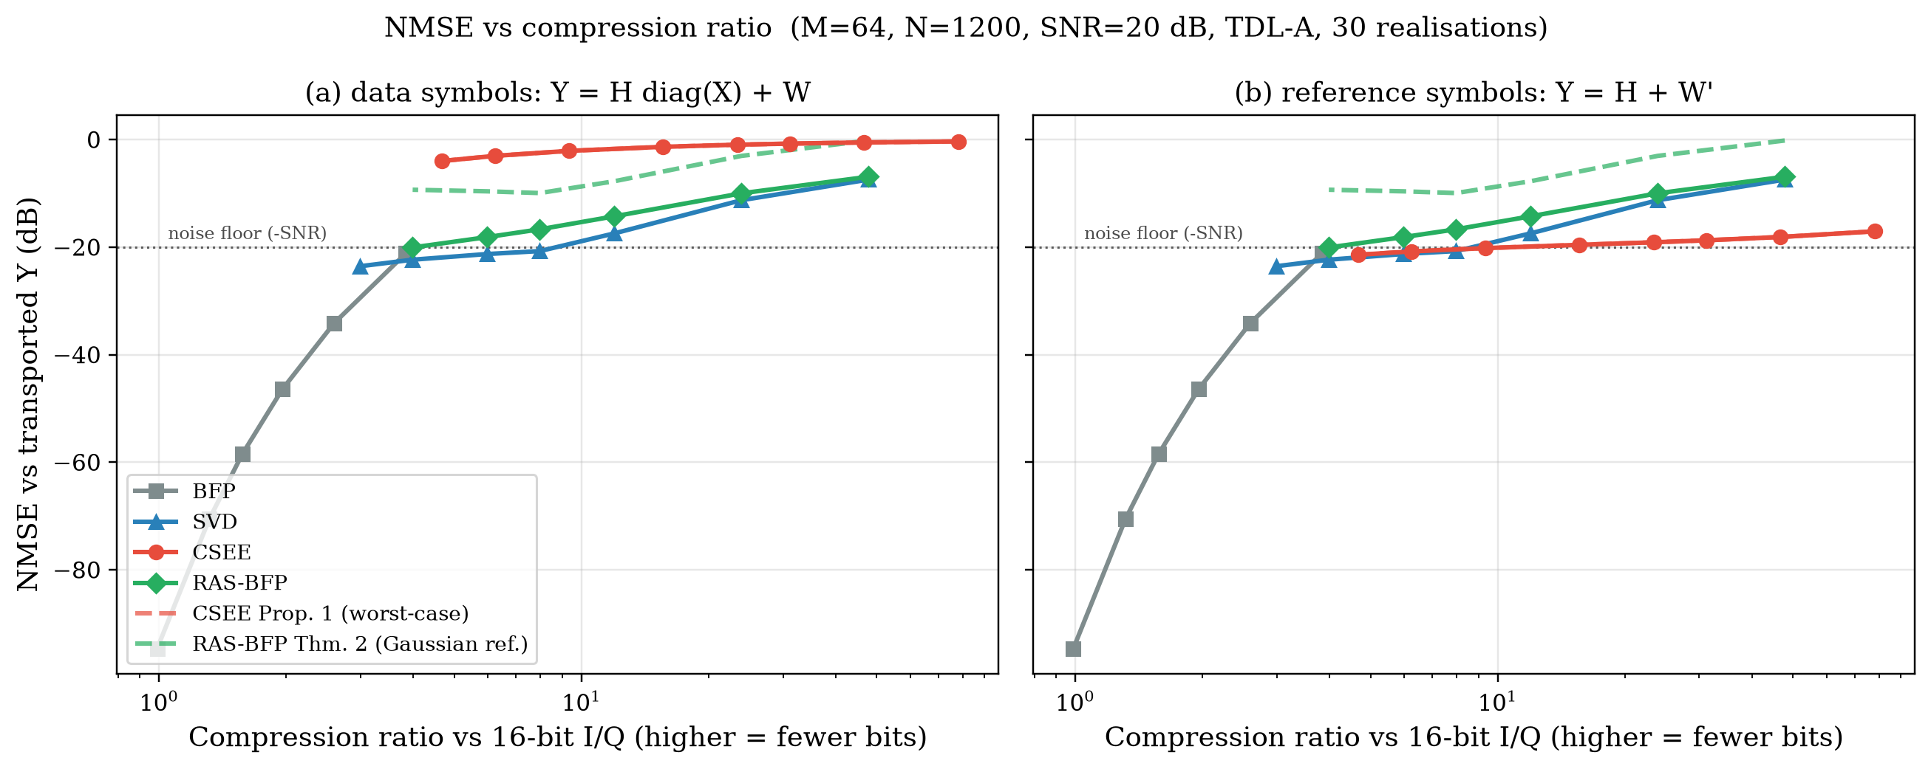
Result 1 — rate-distortion frontier (Exp1)
[new]
M=64, N=1200, SNR 20 dB, 30 channel realisations; bits b=10 for SVD/CSEE/RAS-BFP
Operating point | CR | data | reference
BFP b=8 | 2.0x | -46.4 dB | -46.4 dB
SVD r=12 | 8.0x | -20.7 dB | -20.7 dB
RAS-BFP r=12 | 8.0x | -16.7 dB | -16.7 dB
CSEE K=120 | 15.6x | -1.3 dB | -19.6 dB
• Workload: TDL-A, SNR 20 dB; metric: NMSE vs transported Y
• CSEE reaches −17 to −21 dB at 6–78x CR on reference symbols but ≈0 dB on data symbols.
• RAS-BFP is 1–4 dB worse than SVD at equal payload; Thm-2 bound 6–10 dB above (valid, loose).
• All truncating encoders sit at the −20 dB noise floor of this metric at 20 dB SNR.
CSEE is a reference-symbol (CSI) compressor, not a general I/Q compressor; spatial low-rank methods work on both symbol types.
BTP mid-evaluation · Fronthaul load management in 5G C-RAN/O-RAN · Evidence
8
Notes:
Left panel: data symbols, right: reference symbols. Same channels, same encoders.
BFP is the grey curve: 2x compression at 8 bits for minus 46 dB — very accurate, very little compression.
SVD and RAS-BFP overlap in both panels because spatial rank does not care about modulation. RAS-BFP costs one to four dB for the same payload.
CSEE — the red curve — is the story: on reference symbols it gives minus 20 dB at 16x, on data symbols it gives essentially zero dB. It only works when the delay domain is sparse.
Also note everything clusters at minus 20 dB, which is the noise floor of this metric at 20 dB SNR: the encoders discard noise and this metric counts that as error. The next slides handle that.
Dashed lines are the analytical predictions: Prop. 1 coincides with the CSEE curve; the HMT-type bound for RAS-BFP is above the curve by 6 to 10 dB — valid but loose, as expected for a Gaussian-sketch bound applied to SRHT.

Slide 9
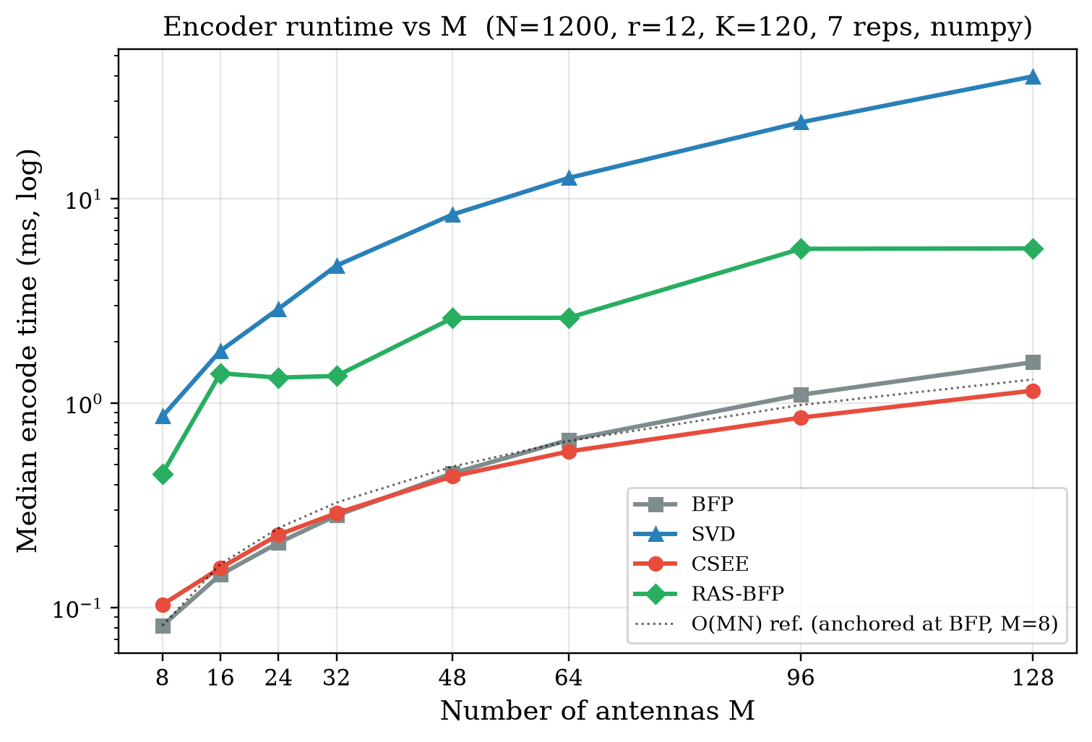
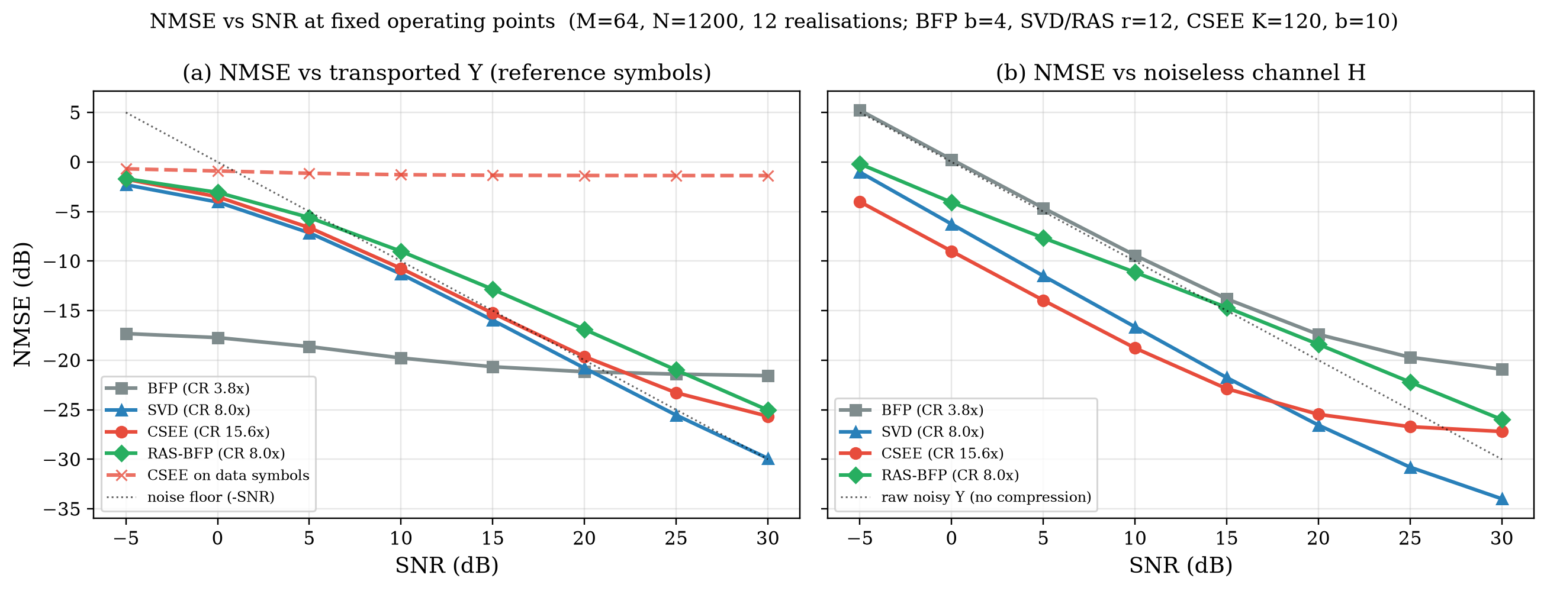
Results 2–3 — encode cost and two NMSE references
[new]
Exp2: numpy medians of 7, N=1200 · Exp4: reference symbols, CR≈8x operating points, 12 realisations
M=64: BFP 0.66 ms · CSEE 0.58 ms · RAS-BFP 2.6 ms · SVD 12.6 ms
RAS-BFP ≈ 5x faster than economy SVD at M=64, 7x at M=128 (was reported as ~100x with a full SVD)
(a) vs Y: truncating encoders track −SNR. (b) vs H: at 0 dB SNR CSEE gives -9 dB and SVD -6 dB where the raw noisy matrix is at 0 dB — they denoise.
At 30 dB: SVD -34, CSEE -27, RAS-BFP -26, BFP b=4 -21 dB. CSEE on data symbols (dashed): ≈ −1 dB everywhere.
The earlier claim 'stable across SNR' was an artefact of the metric; against the noiseless channel the encoders act as denoisers at low SNR.
BTP mid-evaluation · Fronthaul load management in 5G C-RAN/O-RAN · Evidence
9
Notes:
Left: encode time versus number of antennas. With the economy SVD the baseline is 13 ms at 64 antennas; RAS-BFP is 2.6 ms, CSEE and BFP under one millisecond.
So the honest speed-up of RAS-BFP over SVD is about five times, not a hundred. These are Python numbers; I only claim the ordering and the scaling.
Right: NMSE against SNR for fixed operating points. Panel (a) is against the transported noisy matrix: the curves follow the minus-SNR line because discarded noise is counted as error.
Panel (b) is against the noiseless channel: at 0 dB SNR the raw matrix is at 0 dB, but CSEE at K=120 is at minus 9 dB — it removes noise.
The dashed CSEE-on-data curve stays at minus one dB across all SNRs, confirming the applicability limit.

Slide 10
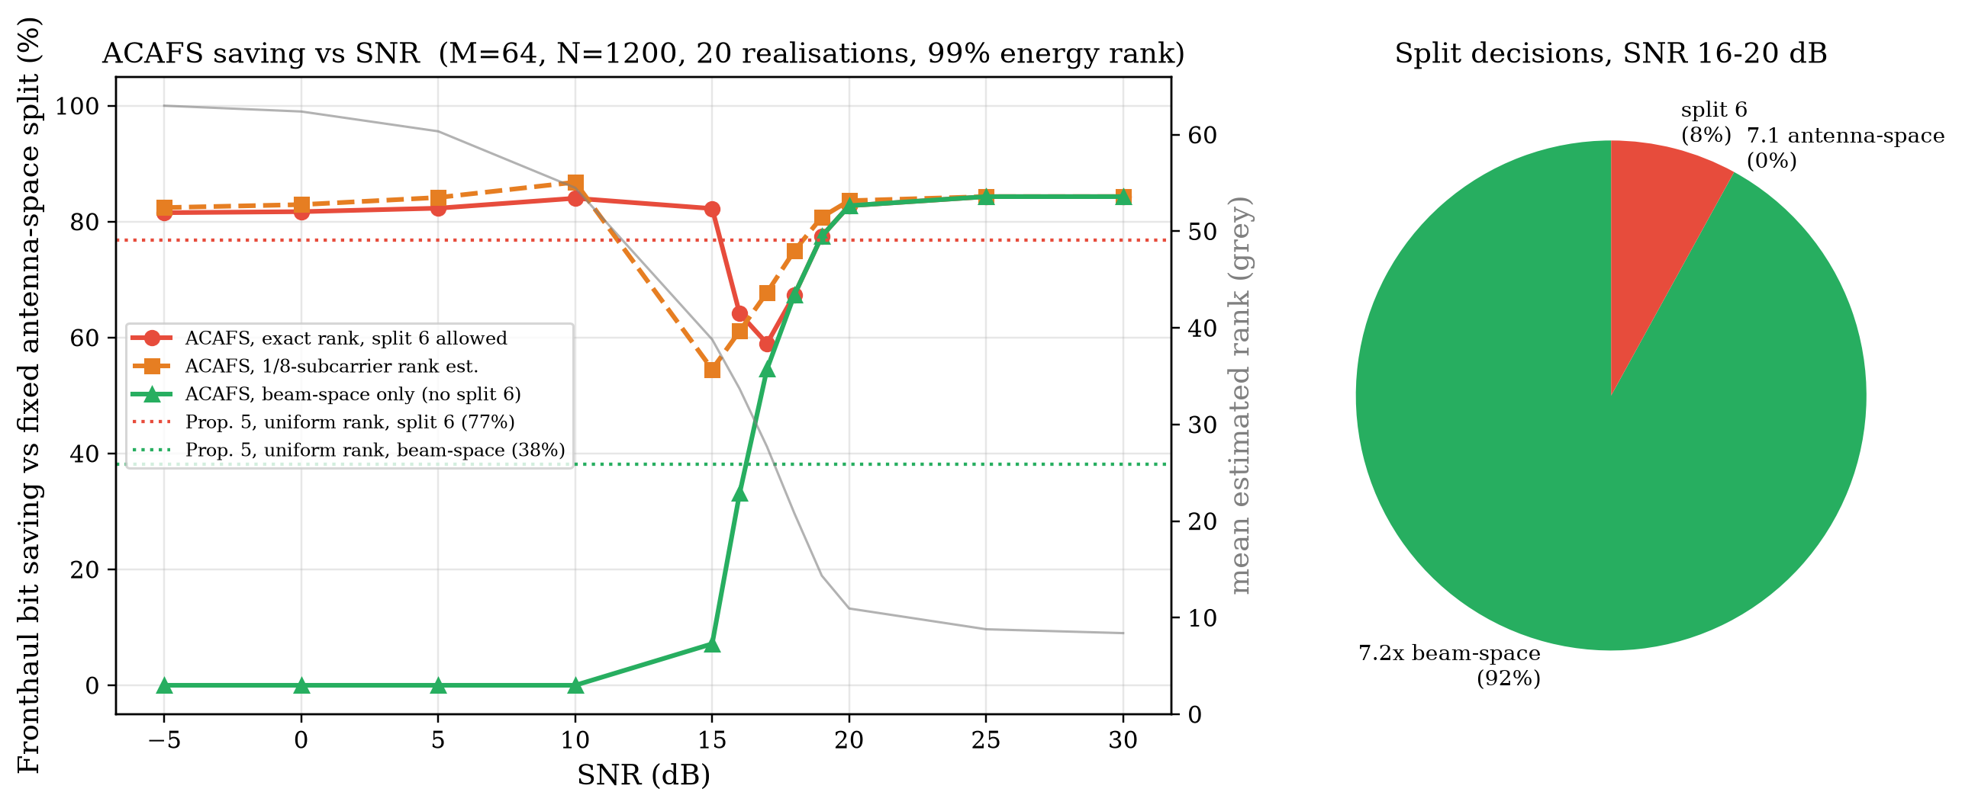
Result 4 — rank-adaptive split selection (ACAFS, Exp3)
[fix]
M=64, N=1200, 20 realisations per SNR; rank = 99 % energy of Y Yᴴ eigenvalues
• Corrected bandwidth model (3GPP TR 38.801 / O-RAN)
• antenna-space 7.1/7.2x-A: 2MNb (reference)
• beam-space 7.2x-B: 2rNb + weights/14
• split 6 (MAC-PHY): r·N·η, η = 6 bit/RE → ≈20x cheaper, needs full UL PHY in the RU
• Rule: r/M < τ_high → beam-space with max(r, ⌈τ_low M⌉) streams; else split 6 if RU compute allows, else antenna-space.
• Beam-space only: 0 % below 15 dB → 83 % at 20 dB (mean rank 11).
• Fast estimator (1/8 subcarriers): 36 % less time, but under-estimates rank by up to 10 at 10–17 dB → τ_low floor is the guard.
• Prop. 5 (uniform rank): 38 % beam-space, 77 % with split 6 — a prediction, not a bound.
The original 'saving vs split 6' figure had the split ordering inverted; the corrected model shows saving is driven by rank collapse at high SNR and by whether the RU may host split 6.
BTP mid-evaluation · Fronthaul load management in 5G C-RAN/O-RAN · Evidence
10
Notes:
ACAFS decides how many spatial streams to send based on the estimated rank of the received matrix.
First the correction: in 3GPP terms, split 6 carries decoded transport blocks and is the cheapest option on the fronthaul; the I/Q splits are the expensive ones.
The original figure reported savings 'versus split 6' as if split 6 were the most expensive; I inverted that back and report savings versus the fixed antenna-space split.
The result: with beam-space only, the saving is zero below 15 dB because the noise fills all 64 dimensions, and rises to about 83 percent at 20 dB where the rank collapses to about 10.
Allowing split 6 gives a large saving at any SNR in this model — but that option costs RU compute, which is exactly what the matrix-inversion benchmark quantifies.
The orange curve is a real fast estimator now — a random eighth of the subcarriers — and it is biased low in the transition region; the stream floor protects against that.

Slide 11
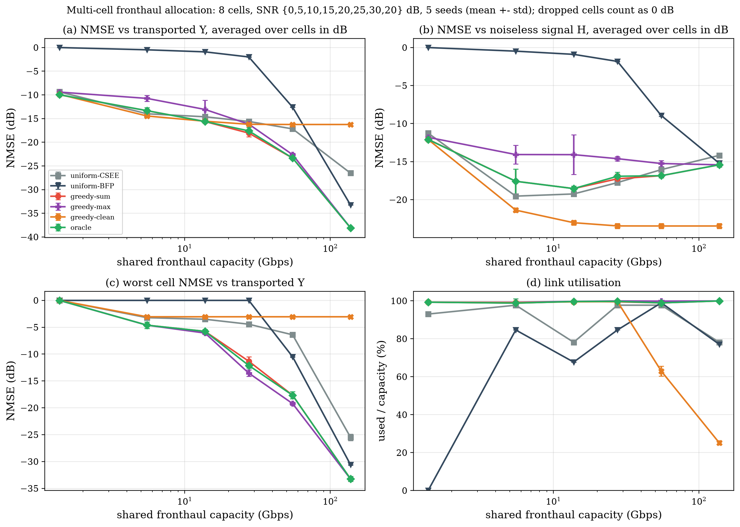
Result 5 — shared-capacity allocation, 8 RUs (Exp5)
[new]
SNR per RU {0,5,10,15,20,25,30,20} dB · menu 11 K × 6 b = 66 CSEE points · 5 seeds · reference symbols
• Policies
• uniform-CSEE / uniform-BFP: one operating point for all RUs (today's static config)
• greedy-sum / greedy-max: proposed, decisions from Prop. 1 predictions only
• greedy-clean: proposed, noise-aware objective (signal distortion)
• oracle: greedy on measured NMSE — encodes every option (ablation)
• What the panels show
• (a) vs Y: greedy within 0.5 dB of the oracle at every capacity; 2.5 dB better than uniform at 27.5 Gbps, 6.2 dB at 55 Gbps; uniform-BFP cannot fit below 55 Gbps (drops RUs)
• (b) vs H: greedy-sum wastes bits on noise in low-SNR RUs; noise-aware objective is 6.2 dB better at 27.5 Gbps
• (c) min-max objective: worst RU up to 2.2 dB better (27.5 Gbps) at a 0.7–2.6 dB cost in the mean
• (d) noise-aware uses only 25 % at 138 Gbps — more bits stop helping the signal
Prediction-driven allocation matches an encode-everything oracle; the objective matters — optimise signal distortion, not fidelity to noise.
BTP mid-evaluation · Fronthaul load management in 5G C-RAN/O-RAN · Evidence
11
Notes:
This is the load-management experiment. Eight radio units with SNRs from 0 to 30 dB share one link; capacity is swept from 0.5 % to 50 % of the raw load.
Each radio unit gets one CSEE operating point. The controller uses only the Proposition-1 predictions; afterwards every RU is actually encoded and the true NMSE measured.
Panel (a): the greedy allocator (red) sits on top of the oracle (green) that encodes every option — the predictor is good enough. It beats uniform allocation by up to eleven dB, and the O-RAN-style uniform BFP cannot even fit until 55 gigabit.
Panel (b) is the honest part. Against the noiseless channel, minimising fidelity to the noisy matrix spends bits reproducing noise in the 0 and 5 dB cells — at 14 and 27 gigabit it is worse than uniform.
That negative result led to the noise-aware objective, orange: it uses the RU's noise variance in Proposition 1, gains four to eight dB on the signal, and at high capacity it stops using the link once more bits do not help — panel (d).
Error bars are one standard deviation over five seeds; they are small because the channel statistics are stationary.

Slide 12
Supporting result — compute cost of a split decision
[repo]
MMSE-type processing needs matrix inverses per PRB group; timings on a 4-core CPU, float32, held-out matrices
n | LAPACK LU (numpy.linalg.inv) | classic Newton–Schulz | InverseNet-NS (17 params, learned) | InverseNet-Ultra (learned) | InverseNet-MLP
10 | 0.00581 ms · err 4.8e-08 | 0.0423 ms · err 9.3e-08 | 0.114 ms · err 4.0e-02 | 0.0383 ms · err 1.7e-01 | 0.0501 ms · err 3.6e-01
100 | 0.138 ms · err 4.8e-08 | 0.403 ms · err 2.2e-07 | 0.328 ms · err 4.0e-04 | 0.397 ms · err 1.1e-06 | n/a
500 | 5.86 ms · err 4.8e-08 | 18.1 ms · err 3.6e-07 | 117 ms · err 7.4e-03 | 17.9 ms · err 1.3e-06 | n/a
• LAPACK LU is fastest and float32-exact at every size; a 100×100 inverse (≈0.14 ms) fits a 500 µs slot per PRB group on one core, a 500×500 one (≈6 ms) does not.
• Learned unrolled Newton–Schulz (17 parameters) generalises to 4e-4 error at n=100 (4e-2 at n=10, 7e-3 at n=500) but is slower than LU; direct-regression MLP fails (0.36 error at n=10). Ultra reaches ≈1e-6 at n=100/500 but 0.17 at n=10 and never beats LU medians.
• Fixed this iteration: the NumPy inference engine used ReLU while the trained model uses GELU (now identical, tested); overstated docstring corrected; benchmark re-run (n=500 with 20 held-out matrices).
• Role in the project: an RU-compute constraint for the split-6 option in ACAFS — connecting the two halves is [future] work.
BTP mid-evaluation · Fronthaul load management in 5G C-RAN/O-RAN · Evidence
12
Notes:
This benchmark existed in the repository and I kept it because it answers a question the split decision raises: if the RU has to run the uplink PHY for split 6, what does the equaliser's matrix inversion cost?
LAPACK LU is the reference: a 100-by-100 inverse in 0.14 ms fits a slot; 500-by-500 does not. The learned unrolled Newton–Schulz is interesting because it has 17 parameters and generalises, but it is not faster on a CPU.
I fixed one bug — the NumPy engine used the wrong activation — and toned down a docstring that claimed float32 precision and LU-beating speed, which the numbers do not support.
Wiring this into ACAFS as a compute constraint is future work.

Slide 13
Contributions, limitations and plan to final evaluation
• Completed
[new] • Runnable, tested simulator for channel → encoders → split → allocation (was missing)
[fix] • Corrected baselines and models (economy SVD, split ordering, real rank estimator, two NMSE references)
[new] • Prop. 1 predictor within 0.5 dB; Thm. 2 reference bound checked
[new] • Multi-cell allocator with static baselines, oracle and objective ablations, 5 seeds
[new] • Finding: delay-domain compression is CSI-only; spatial low rank is modulation-invariant
[repo] • Compute benchmark, bug-fixed and re-run
• Limitations
• Single symbol; no scheduler, HARQ, latency, multi-slot dynamics
• CSEE valid on reference symbols only → Exp5 covers reference-symbol traffic
• Python timings: ordering and scaling only
• Thm. 2 proven for Gaussian sketch; SRHT checked empirically
• Split-6 rate model coarse (η = 6 bit/RE); σ² assumed known in the noise-aware ablation
• No real traces; only TDL-A
• No novelty claimed for any single encoder; the contribution is the validated system and its findings
• Next (to final evaluation)
[future] • Slot-level simulation mixing data + reference symbols; mixed CSEE/RAS-BFP/BFP menu (needs RAS-BFP predictor)
[future] • Joint ACAFS + allocator under one capacity with the compute benchmark as RU constraint
[future] • Sensitivity to σ² estimation error and rank bias
[future] • Learned predictor only where no analytical one exists, judged against the analytical one
[future] • C/SIMD timing of BFP, CSEE, RAS-BFP
BTP mid-evaluation · Fronthaul load management in 5G C-RAN/O-RAN · Closing
13
Notes:
To summarise. Completed: a simulator that runs and is tested; corrected baselines; an analytical predictor that is accurate enough to drive decisions; a multi-cell allocator with proper baselines and ablations; and one clear finding about which compression structure survives modulation.
Limitations I want to state myself: single-symbol model, CSEE only on reference symbols, Python timings, and the RAS-BFP bound is a Gaussian reference.
I am not claiming novelty for any encoder — the encoders adapt known techniques; the contribution is the validated system and the findings that came out of making it correct.
Next: slot-level simulation with mixed symbol types, joining the split decision with the allocator under one capacity, and only then consider a learned component where an analytical predictor does not exist.

Slide 14
References (1/2) — verified sources, see docs/research_review.md
[1] S.-H. Park, O. Simeone, O. Sahin, S. Shamai, "Fronthaul compression for cloud radio access networks," IEEE Signal Process. Mag., vol. 31, no. 6, 2014. doi:10.1109/MSP.2014.2330031 (abstract)
[2] M. Peng, C. Wang, V. Lau, H. V. Poor, "Fronthaul-constrained cloud radio access networks: Insights and challenges," IEEE Wireless Commun., vol. 22, no. 2, 2015. (full text, author copy)
[3] L. M. P. Larsen, A. Checko, H. L. Christiansen, "A survey of the functional splits proposed for 5G mobile crosshaul networks," IEEE Commun. Surveys Tuts., vol. 21, no. 1, 2019. (full text)
[4] 3GPP TR 38.801 (Rel-14), "Study on new radio access technology: Radio access architecture and interfaces," §11.1.2, Annex A Tables A-1/A-2.
[5] O-RAN Alliance WG4, "Control, User and Synchronization Plane Specification," O-RAN.WG4.TS.CUS.0-R004-v19.00, Annex A (compression methods). (annex listing; BFP details cross-checked with [6])
[6] M. D. L. Silva, L. Ramalho, I. Almeida, E. Medeiros, M. Berg, A. Klautau, "A new O-RAN compression approach for improved performance on uplink signals," J. Commun. Inf. Syst., vol. 37, no. 1, pp. 30–41, 2022. doi:10.14209/jcis.2022.3 (full text)
[7] S. Lagén, L. Giupponi, A. Hansson, X. Gelabert, "Modulation compression in next generation RAN: Air interface and fronthaul trade-offs," IEEE Commun. Mag., vol. 59, no. 1, 2021. doi:10.1109/MCOM.001.2000453 (full text)
[8] S. Lagén, X. Gelabert, L. Giupponi, A. Hansson, "Fronthaul-aware scheduling strategies for dynamic modulation compression in next generation RANs," IEEE Trans. Mobile Comput., vol. 22, no. 5, pp. 2725–2740, 2023. (abstract)
[9] S. Lagén, X. Gelabert, A. Hansson, M. Requena, L. Giupponi, "Fronthaul compression control for shared fronthaul access networks," IEEE Commun. Mag., vol. 60, no. 6, 2022. doi:10.1109/MCOM.001.2100959 (full text)
[10] M. Rahmani et al., "Exploring O-RAN compression techniques in decentralized distributed MIMO systems: Reducing fronthaul load," arXiv:2507.04997, 2025. (preprint, full text)
[11] "Hardware implementation for O-RAN block floating point compression and decompression methods in 5G base station," Proc. ATC 2024. doi:10.1109/ATC63255.2024.10908174 (abstract)
[12] S. Yagi et al., "Deep learning-based nonlinear quantizer for fronthaul compression," Proc. OECC/PSC 2022. (abstract)
[13] R. Qiao, T. Jiang, W. Yu, "Learning-based fronthaul compression for uplink cloud radio access networks," Proc. IEEE ICC 2023, pp. 5928–5933. (abstract)
[14] R. Qiao, T. Jiang, W. Yu, "Meta-learning-based fronthaul compression for cloud radio access networks," arXiv:2403.09004, 2024; IEEE Trans. Wireless Commun., vol. 23, no. 9, 2024. (abstract)
[15] C.-K. Wen, W.-T. Shih, S. Jin, "Deep learning for massive MIMO CSI feedback," IEEE Wireless Commun. Lett., vol. 7, no. 5, pp. 748–751, 2018. (full text)
BTP mid-evaluation · Fronthaul load management in 5G C-RAN/O-RAN · References
14
Notes:
Reference list. Every entry was checked against a primary page (publisher, arXiv record, or standards body) on 17 Sep 2026. Entries marked '(abstract)' were not read in full and are cited only for what their abstracts state.

Slide 15
References (2/2) — verified sources, see docs/research_review.md
[16] F. W. Murti, S. Ali, G. Iosifidis, M. Latva-aho, "Learning-based orchestration for dynamic functional split and resource allocation in vRANs," Proc. EuCNC/6G Summit 2022. (full text)
[17] F. W. Murti, S. Ali, G. Iosifidis, M. Latva-aho, "Deep reinforcement learning for orchestrating cost-aware reconfigurations of vRANs," IEEE Trans. Netw. Service Manag., vol. 21, no. 1, pp. 200–216, 2024. doi:10.1109/TNSM.2023.3292713 (full text)
[18] F. W. Murti, S. Ali, M. Latva-aho, "Constrained deep reinforcement based functional split optimization in virtualized RANs," arXiv:2106.00011, 2021. (abstract)
[19] N. Halko, P.-G. Martinsson, J. A. Tropp, "Finding structure with randomness," SIAM Rev., vol. 53, no. 2, pp. 217–288, 2011. doi:10.1137/090771806 (full text)
[20] J. A. Tropp, "Improved analysis of the subsampled randomized Hadamard transform," Adv. Adapt. Data Anal., vol. 3, no. 1–2, pp. 115–126, 2011. (full text, preprint)
[21] Y. Shoham, A. Gersho, "Efficient bit allocation for an arbitrary set of quantizers," IEEE Trans. Acoust., Speech, Signal Process., vol. 36, no. 9, pp. 1445–1453, 1988. doi:10.1109/29.90373 (abstract)
[22] Aswathylakshmi P, R. K. Ganti, "Fronthaul compression for uplink massive MIMO using matrix decomposition," Proc. IEEE WCNC 2022, pp. 2524–2529. doi:10.1109/WCNC51071.2022.9771783 (full text)
[23] F. Wiffen, W. H. Chin, A. Doufexi, "Distributed dimension reduction for distributed massive MIMO C-RAN with finite fronthaul capacity," Proc. Asilomar 2021, pp. 1228–1236. doi:10.1109/IEEECONF53345.2021.9723180 (full text)
[24] L. Li et al., "Enabling flexible link capacity for eCPRI-based fronthaul with load-adaptive quantization resolution," IEEE Access, vol. 7, pp. 102174–102185, 2019. doi:10.1109/ACCESS.2019.2930214 (full text)
[25] I. Kanno et al., "Adaptive bit allocation for SVD based hybrid processing of uplink cell-free massive MIMO under limited fronthaul capacity," Proc. IEEE VTC2023-Spring. doi:10.1109/VTC2023-Spring57618.2023.10201009 (abstract)
[26] L. Liu, R. Zhang, "Optimized uplink transmission in multi-antenna C-RAN with spatial compression and forward," IEEE Trans. Signal Process., vol. 63, no. 19, pp. 5083–5095, 2015. (abstract)
[27] A. Martínez Alba, W. Kellerer, "Dynamic functional split adaptation in next-generation radio access networks," IEEE Trans. Netw. Service Manag., vol. 19, no. 3, pp. 3239–3263, 2022. (abstract)
[28] L. Wang, S. Zhou, "On the fronthaul statistical multiplexing gain," IEEE Commun. Lett., vol. 21, no. 5, pp. 1099–1102, 2017. (abstract)
[29] 3GPP TR 38.901 V19.4.0, "Study on channel model for frequencies from 0.5 to 100 GHz," cl. 7.7.2–7.7.5 (TDL-A, delay scaling, correlation extension).
BTP mid-evaluation · Fronthaul load management in 5G C-RAN/O-RAN · References
15
Notes:
Reference list. Every entry was checked against a primary page (publisher, arXiv record, or standards body) on 17 Sep 2026. Entries marked '(abstract)' were not read in full and are cited only for what their abstracts state.

Slide 16
Backup — audit: verified problems in original material
• src/ absent from every commit and branch; Exp1-4 + notebook import it → nothing ran
• Exp2 SVD baseline: committed figure ~1.7 s at M=64 vs 13 ms economy SVD; O(MN) reference line plotted in seconds on a ms axis
• Exp3: 'fast rank est.' = exact rank + Uniform{−1,0,1}; 'Theorem 5 bound' below the simulated curve → not a bound
• ACAFS: split 6 treated as the most expensive split; TR 38.801 ordering is R_6 ≪ R_7.2x-beam ≤ R_7.x-antenna
• Exp4: 'stable across SNR' claimed while the figure shows NMSE ≈ −SNR
• CSEE input: constant pilot ⇒ delay sparsity; with random QPSK per subcarrier CSEE gives ≈ −0.5 dB
• CR reference 32-bit components ⇒ all CRs inflated 2x (BFP b=8: 3.9x quoted vs 2.0x against 16-bit)
• Docs: 'Theorems 1-5' without statements/proofs; '100 MHz at 15 kHz' with N=1200 (=18 MHz); TWC/JSAC target; AVX-512/CUDA/USRP roadmap
• matinv_bench: ReLU vs GELU in the NumPy engine; docstring claiming 1e-7 error and LU-beating latency
• Original figures/tables preserved in results/original_snapshot/ for comparison
BTP mid-evaluation · Fronthaul load management in 5G C-RAN/O-RAN · Backup
16
Notes:
Backup slide with the full list of verified problems, in case the committee asks what exactly was wrong with the earlier figures.

Slide 17
Backup — Proposition 1 and the noise-aware variant
• Setup: Y ∈ ℂ^{M×N}; Y_d = IFFT_N(Y) row-wise (numpy: Y = FFT(Y_d), ‖Y‖²_F = N‖Y_d‖²_F). Encoder keeps columns S (|S|=K) and BFP-quantises them: Ŷ_d = Q(Y_d[:,S]) on S, 0 elsewhere. Decoder: Ŷ = FFT(Ŷ_d).
• ‖Y − Ŷ‖²_F = N‖Y_d − Ŷ_d‖²_F = N( Σ_{n∉S}‖Y_d[:,n]‖² + ‖Y_d[:,S] − Q(Y_d[:,S])‖²_F ) = N(T_S + E_q).
• NMSE = N(T_S + E_q) / (N‖Y_d‖²) = (T_S + E_q)/‖Y_d‖²_F. T_S is exact; E_q depends on the quantiser.
• BFP block with exponent e_b, step Δ_b = 2^{e_b}: per real component |error| ≤ Δ_b/2 (deterministic) and Var ≈ Δ_b²/12 (high-rate model). Complex sample: ≤ Δ_b²/2 worst case, ≈ Δ_b²/6 expected. Summing over the n_b non-zero samples of each block gives E_q^{wc} (bound) and E_q^{est} (estimate). Zero samples quantise exactly.
• Top-K supports are nested in K, so one sort of the N bin energies gives T_S for all K; block maxima per K give Δ_b for all b as a shift of log₂(2^{b−1}−1). Whole 66-point menu ≈ one encoder pass.
• Noise-aware form (RU knows σ²): white noise has total delay-domain energy Mσ² spread evenly over N bins. Signal distortion ≈ [max(T_S − Mσ²(N−K)/N, 0) + Mσ²K/N + E_q] / (‖Y_d‖² − Mσ²). Measured within 0.1 dB at 20 dB SNR and ≈1.7 dB at 0 dB SNR.
• Why it matters: with the plain form the allocator upgrades low-SNR RUs to reproduce noise; with the noise-aware form the marginal gain of extra bits goes to zero once the tail is noise, so capacity is released.
BTP mid-evaluation · Fronthaul load management in 5G C-RAN/O-RAN · Backup
17
Notes:
Derivation of Proposition 1 for a technical question. The key point is that the tail term is an identity, only the quantisation term is modelled.

Slide 18
Backup — RAS-BFP algorithm and Theorem 2
• 1. Sketch antennas: Z = Ω Y ∈ ℂ^{(r+p)×N}, Ω = √(M/(r+p)) · S · H_M · D (SRHT: random signs D, Walsh–Hadamard H_M via fast transform, row sampler S) or Gaussian.
• 2. Thin QR: Zᴴ = Q R, Q ∈ ℂ^{N×(r+p)} spans an approximate dominant right singular subspace of Y.
• 3. Project: L = Y Q (M×(r+p)); small SVD of L; keep rank r: L_r = U_rΣ_r, Q_r = Q V_r. Ŷ = L_r Q_rᴴ (HMT Alg. 4.1 + 5.1).
• 4. Transmit BFP(L_r) and BFP(Q_r) — identical payload shape to truncated SVD at rank r ⇒ equal CR, fair comparison.
• Cost: O(MN log M) sketch (SRHT) or O(MN(r+p)) (Gaussian) + O(N(r+p)²) QR + O(MN(r+p)) projection, vs O(MN·min(M,N)) for the SVD.
• Theorem 2 (HMT 2011, Thm 10.5, Gaussian Ω, p ≥ 2): E‖Y − YQQᴴ‖²_F ≤ (1 + r/(p−1)) Σ_{i>r}σ_i². Truncation adds at most an Eckart–Young term (‖Y − Q[QᴴY]_r‖ ≤ ‖Y − QQᴴY‖ + ‖Y − Y_r‖), so E‖Y − Ŷ‖²_F ≤ (4 + 2r/(p−1)) Σ_{i>r}σ_i². Quantisation is on top.
• Caveats: proven for Gaussian sketches; SRHT (Tropp 2011) needs larger oversampling for a proof — with p = 4 the bound holds empirically with 6–10 dB slack in Exp1. For p < 2 the code returns ∞ rather than a made-up bound. SRHT falls back to Gaussian when M is not a power of two or r+p ≥ M.
BTP mid-evaluation · Fronthaul load management in 5G C-RAN/O-RAN · Backup
18
Notes:
Backup for the randomised encoder. If asked why not just the SVD: cost. If asked whether the bound is tight: no, and it is stated for Gaussian sketches; the plot shows the slack.

Slide 19
Backup — ACAFS bandwidth model and allocator
• Bits per OFDM symbol per RU (M=64, N=1200, b=16, η=6, T_c=14)
• antenna-space: 2MNb = 2 457 600
• beam-space, r streams: 2rNb + 2Mrb/T_c (r=10: 385 463; r=32: 1 233 481)
• split 6, r layers: rNη (r=10: 72 000; r=64: 460 800)
• rule: ρ = r/M; ρ < τ_high=0.55 → beam-space with max(r, ⌈0.15·M⌉=10) streams; else split 6 if allowed, else antenna-space
• Prop. 5 = mean over r∈{1..M} of the per-rank saving under the rule (a prediction; simulated saving can exceed it when ranks concentrate low)
• greedy_allocate(rates, dist, C, objective)
• for each RU: keep only (R, D) points on the lower convex hull (dominated / non-convex points never help)
• start every RU at its cheapest point; if Σ R > C: drop RUs with the largest predicted D at that point until it fits (they gain least from transport)
• repeat: among feasible next-hull upgrades pick argmax ΔD/ΔR (sum) or the RU with current max D (max); stop when none fits
• guarantee: Lagrangian-relaxation optimum up to one fractional upgrade (standard for multiple-choice knapsack greedy on convex hulls)
• uniform_allocate: best single point that fits for all RUs — the static-configuration baseline
• tests: capacity respected, greedy ≥ uniform on its objective, low load → best point, overload → drops, zero-traffic RU, invalid inputs
BTP mid-evaluation · Fronthaul load management in 5G C-RAN/O-RAN · Backup
19
Notes:
Numbers behind the split model and pseudo-code of the allocator, for questions on either.

Slide 20
Backup — reproducibility: commands and outputs
• pip install -r requirements.txt (numpy, scipy, pandas, matplotlib, tqdm, pytest; torch only for matinv_bench)
• python -m pytest tests -q → 42 passed (~1 s)
• python experiments/exp1_nmse_vs_cr.py → results/figures/exp1_*.png|pdf, results/data/exp1_nmse_vs_cr.json (~10 s)
• python experiments/exp2_complexity.py → exp2_* (~2 s)
• python experiments/exp3_acafs_gain.py → exp3_* (~3 s)
• python experiments/exp4_snr_sweep.py → exp4_* (~5 s)
• python experiments/exp5_fronthaul_allocation.py → exp5_allocation.png, exp5_allocation_runs.csv (every run), exp5_allocation_summary.csv (~8 s)
• jupyter nbconvert --execute --inplace notebooks/mid_evaluation_demo.ipynb (from notebooks/)
• python -m matinv_bench.generate_dataset --dims 10 100 --num-samples 1000; python -m matinv_bench.benchmark --dims 10 100
• Every results/data file records generation time, Python/numpy version, host and CPU count; results/logs/ has the console output of the runs shown here.
• Host used for the numbers in this deck: 4-core x86_64, Python 3.12, numpy 2.x, no GPU.
BTP mid-evaluation · Fronthaul load management in 5G C-RAN/O-RAN · Backup
20
Notes:
If the live demo fails, these are the saved outputs and how they were produced.

