Slide 1
Part B: Sharing One Fronthaul Link Well
Deadline-feasible, uncertainty-aware budget allocation across O-RAN 7-2x cells:
the KKT newsvendor rule, a Bayesian Transformer forecaster, and the back-pressure newsvendor
Mayank Yadav Harshvardhan Choudhary
B.Tech. Project — Final Evaluation, November 2026
Notes:
Part B is about sharing one fronthaul link between several cells. Part A made the data smaller; Part B decides who may send how much when the link is too small for everyone's peak.

Slide 2
Part B at a glance
Three steps, each building on the previous one
B1 KKT newsvendor rule
Forecast r* as a range (GBM)
Split the link at equal weighted risk
Best of 12 controllers, 2 families
NCC 2027 submission
Extended study
MDP view + Markov-fluid theory
3rd traffic family (Markov)
CEM policy & predictive MaxWeight
beat the KKT rule in 9/10
B2 Bayesian Transformer
LCQT: patch + cross-cell attention
Bayesian mixture, differentiable KKT
Best KKT variant, small gain
→ the gap is structural
B3 Back-pressure newsvendor
Back-pressure base + KKT margins
Contains both strongest baselines
Beats them in 10/10 scenarios
of 3 traffic families
Keep the structure, learn only what is uncertain — then fix the structure where it is wrong.
Fronthaul Load Management in O-RAN | Part B | M. Yadav & H. Choudhary
2
Notes:
Give the audience the map. B1 is the main method and the NCC paper. The extended study found two stronger controllers. B2 tried a better forecaster (Transformer) and showed the gap is structural. B3 changed the decision structure and now beats both strongest baselines in all 10 scenarios.

Slide 3
The problem: one link, eight cells, decide in advance
• 8 cells: 3 low-latency (LL, deadline 2 ms, weight 3) + 5 eMBB (10 ms, weight 1)
• One 25GE link, 3 % for control → C = 12.125 Mbit per 0.5 ms slot
• Aggregate cell peak = 2.44 × C (statistical multiplexing)
• Every T = 10 ms: per-cell budgets r_i, held for the interval
• Telemetry is τ = 1 ms old; the future is never seen
• Bits waiting longer than their deadline are dropped = violations
Why decide in advance?
• Near-RT RIC / E2 loop ≥ 10 ms
• Switch shaping not changed per slot
• DU schedulers cannot coordinate
inside the sub-ms pipeline
⇒ commit for T + τ without seeing traffic
Question
Given a forecast range of each cell's need,
how should the link be split?
Someone must lose data when bursts coincide; the controller decides who.
Fronthaul Load Management in O-RAN | Part B | M. Yadav & H. Choudhary
3
Notes:
8 cells share one 25GE link. Their total peak is 2.44 times the link on purpose (statistical multiplexing). Every 10 ms a coordinator sets per-cell budgets held for the interval, on telemetry that is 1 ms old. Why not every slot: near-RT RIC/E2 loops are at least 10 ms, switch shaping is not reconfigured per slot, and DU schedulers cannot consult each other within a slot.

Slide 4
System model
Fronthaul load follows scheduled resource blocks, not user bits
Cost of one PRB-layer per slot (Part A enters here)
β(b) = (12·2·b + 8) · 14 · 1.08
β(9) = 3,387 bits; BFP-6: 0.68×, BFP-12: 1.32×, BFP-14: 1.54×
Cell peak = 273 PRBs × 4 layers × β ≈ 7.4 Gbit/s
Primary metric (fixed before tuning)
Priority-weighted violation ratio
V_w = Σ w_i · violated_i / Σ w_i · arrived_i
= (3·LL dropped + eMBB dropped)
/ (3·LL arrived + eMBB arrived)
Lower is better.
Also reported: per-class violations, unweighted ratio,
utilisation, delay, Jain fairness, decision time.
Fronthaul demand and decision
d_i(t) = ⌈a_i(t) / η_i(t)⌉ · β (user bits ÷ spectral eff.)
Σ_i r_i ≤ C, 0 ≤ r_i ≤ cap_i
FIFO DU queue per cell; drop after D_i slots
Two cells with the same user traffic can differ 2–3× in fronthaul load.
Fronthaul Load Management in O-RAN | Part B | M. Yadav & H. Choudhary
4
Notes:
beta is the cost of one PRB-layer per slot. It is where Part A enters: the BFP mantissa width b. With BFP-9 it is 3387 bits. Demand of a cell = user bits / spectral efficiency x beta. The link never queues because budgets add up to at most C; congestion shows up as DU queueing and drops. The score V_w was fixed before any tuning.

Slide 5
B1: The KKT Newsvendor Rule
Forecast the right quantity, as a range, and split at equal risk
Notes:
Section 1: the main method of the NCC paper.

Slide 6
Key idea 1: forecast the deadline-feasible rate r*
Smallest constant rate at which no bit misses its deadline
r*(a, D) = max over windows [s, e] of Σ_{t=s..e} a_t / (e − s + 1 + D) (network-calculus service curve; tight in tests)
• Long deadline → r* ≈ mean rate
• Short deadline → r* ≈ peak burst rate
• Example: burst of 8, mean 1
  – D = 1 slot → r* = 4; D = 7 slots → r* = 1
• 2 ms class: r* is 2–3× the mean and right-skewed
Demand of every deadline-aware controller
need_i = B_i + r*_i
B_i = backlog_i / slack_i (what is already queued)
r*_i = what has not arrived yet
Controllers differ only in how they
estimate r*_i and split a shortage.
A single number is a poor basis for reserving a skewed quantity ⇒ forecast a range.
Fronthaul Load Management in O-RAN | Part B | M. Yadav & H. Choudhary
6
Notes:
r* is the smallest constant rate at which no bit misses its deadline. Long deadline: close to the mean. Short deadline: close to the peak burst rate. Example: one burst of 8 units, average 1. With D = 1 slot, r* = 8/2 = 4. With D = 7, r* = 8/8 = 1. For the 2 ms cells r* is often 2-3x the mean and skewed, which is why one predicted number is a poor basis for a reservation.

Slide 7
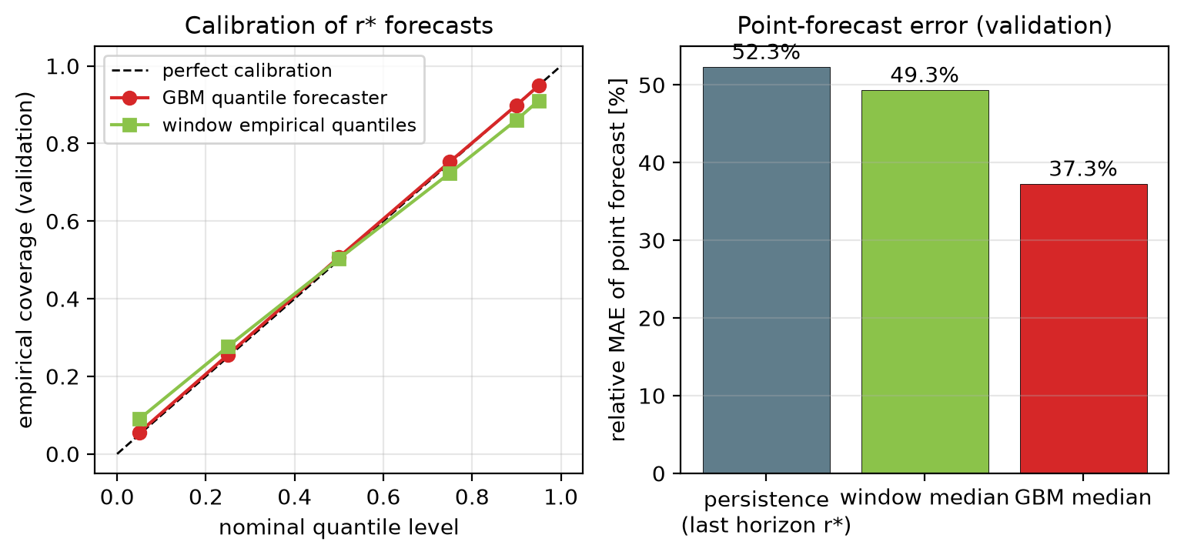
Key idea 2: a quantile forecaster
Six gradient-boosted tree models, one per quantile level
• Target: y_i = r*(next horizon) / cell peak
• 28 features, past only: horizon means, EWMAs, last 4 slots, r* of last 3 horizons, spectral eff., D/H, cell id
• 6 models (α = 5/25/50/75/90/95 %), 300 trees, 15 leaves
• 101k rows, 12 s training on CPU
• Seeds: train 1000–1015, val 2000–2003, test 3000–3019
Validation | GBM | Baseline
Coverage at 5 / 50 / 95 % | 5.6 / 50.7 / 94.9 | —
Median rel. error | 37 % | 52 % (persist.)
Pinball loss | 0.0224 | 0.0293 (window)
Well calibrated, cheap and CPU-only.
Fronthaul Load Management in O-RAN | Part B | M. Yadav & H. Choudhary
7
Notes:
Target: r* of the coming horizon normalised by the cell peak. 28 features from the past only. One HistGradientBoosting quantile model per level 5/25/50/75/90/95 %, 300 trees, 15 leaves, 12 s on a CPU. Seeds are disjoint: train 1000-1015, validation 2000-2003, test 3000-3019. Calibration within a point.

Slide 8
Key idea 3: the KKT (constrained newsvendor) rule
Objective for one interval (forecast distribution F_i of r*_i)
max_r Σ_i w_i · E[ min(B_i + r*_i, r_i) ] s.t. Σ_i r_i ≤ C, 0 ≤ r_i ≤ cap_i
Concave; slope = w_i · P(the next bit of budget is needed)
Closed-form solution
r_i(λ) = clip( B_i + F_i⁻¹(1 − λ / w_i), 0, cap_i )
• one price λ for all cells, 60-step bisection
• λ = 0 if the link is not full
• tens of μs for 8 cells
Toy example (C = 10, λ = 0.6)
LL (w = 3): level 1 − 0.6/3 = 0.8 → 80 % quantile
eMBB (w = 1): level 1 − 0.6 = 0.4 → 40 % quantile
Wide forecast or high priority → more margin;
confident forecast → about its median.
Every cell is cut at the same weighted risk: margins are derived, not tuned.
Fronthaul Load Management in O-RAN | Part B | M. Yadav & H. Choudhary
8
Notes:
Maximise the expected weighted served need under the forecast. It is separable and concave, so the KKT conditions give the global optimum in closed form. One number lambda (a price of capacity) is found by bisection so budgets sum to C. Toy: lambda = 0.6, LL cell funded to its 80 % quantile (1 - 0.6/3), eMBB to its 40 % quantile. Say: every cell is cut at the same weighted risk; margins are derived, not tuned.

Slide 9
Properties and the control loop
Proposition | In plain words
1 Feasibility | Whatever the forecast, budgets fit the caps and Σ r_i ≤ C: the link is never overloaded
2 Equal weighted risk | w_i (1 − F_i(r_i − B_i)) = λ for every cell; a point forecast reduces it to a priority fill
3 Backlog first | Queued bits are funded before uncertain demand of equal or lower weight
4 Miscalibration | Forecast off by ε (Kolmogorov) ⇒ loss ≤ 2 ε w_max C: linear, so it degrades gently
Control loop (every 10 ms)
Delayed state
(1 ms old)
28 features
per cell
6 GBM quantiles
of r*
KKT rule
bisection on λ
Budgets r_i
held 10 ms
DU queues,
drops after D
Properties of one interval — no closed-loop optimality claim.
Fronthaul Load Management in O-RAN | Part B | M. Yadav & H. Choudhary
9
Notes:
Four propositions, all for one interval: feasibility, equal weighted tail probability, backlog first, and a linear miscalibration bound. No closed-loop optimality or stability claim. Walk the loop left to right.

Slide 10
Baselines and evaluation protocol
All baselines tuned on validation seeds; identical traces for every controller
Controller | Estimate of r* | Split
Static equal | none | C / N
Reactive proportional | EWMA, no deadlines | proportional
MaxWeight | priority × queue | max-weight
Deadline-aware reactive | last observed r* | water-fill
Point forecast | GBM median | water-fill
Fixed global quantile | GBM, level 0.75 | water-fill
Proposed (window) | last 30 intervals, no ML | KKT
Proposed | GBM quantiles | KKT
Oracle / Oracle + KKT | true r* | WF / KKT
Family S (synthetic, bursty)
Gamma + Pareto ON/OFF bursts
low 0.50, moderate 0.65, high 0.80,
flash crowds, held-out shift
Family G (3GPP only)
TR 38.901 UMa, TS 38.214 CQI
FTP Model 3 (eMBB), XR video (LL)
Demand = PRB scheduler output
20 test seeds × 10 s, paired bootstrap CIs, Holm-corrected Wilcoxon tests.
Fronthaul Load Management in O-RAN | Part B | M. Yadav & H. Choudhary
10
Notes:
The point forecast is the key ablation: same model, one number. The fixed global quantile checks that 'just use a quantile' is not the trick. Margin 0 was best for every baseline. Family S is bursty synthetic with a held-out shift; Family G is built only from 3GPP models. 20 test seeds, paired bootstrap and Holm-corrected Wilcoxon tests.

Slide 11
B1 result, Family S: V_w [%] (mean of 20 test seeds)
Method | low | mod. | high | flash | shift
Static equal | 4.45 | 9.65 | 15.46 | 19.15 | 22.31
Reactive proportional | 0.83 | 4.11 | 9.20 | 12.27 | 11.70
MaxWeight | 0.90 | 4.85 | 11.54 | 15.24 | 12.31
Deadline-aware reactive | 0.52 | 4.24 | 11.03 | 14.51 | 12.56
Point forecast | 0.27 | 3.23 | 9.70 | 13.33 | 11.30
Fixed global quantile | 0.34 | 4.35 | 11.76 | 15.09 | 12.85
Window quantiles (no ML) | 0.25 | 2.57 | 8.72 | 12.67 | 10.22
Proposed (GBM + KKT) | 0.15 | 2.15 | 8.00 | 11.76 | 10.04
Oracle water-fill | 0.07 | 1.62 | 6.89 | 10.16 | 6.69
Paired vs proposed
vs point forecast: −11 to −43 %
vs fixed quantile: −22 to −54 %
vs deadline-aware: −19 to −70 %
vs MaxWeight: −18 to −83 %
all 20/20 seeds, p < 0.01
Weak: vs reactive prop. under
flash crowds only −4 %
(16/20, p = 0.03)
Best implementable controller in all five scenarios.
Fronthaul Load Management in O-RAN | Part B | M. Yadav & H. Choudhary
11
Notes:
The proposed rule is the best implementable controller in all five scenarios. The std across seeds is mostly shared burst timing, so read the paired comparison. Against the point forecast: -11 to -43 %, every seed. Weak spot: only -4 % against reactive proportional under flash crowds (16/20, p = 0.03).

Slide 12
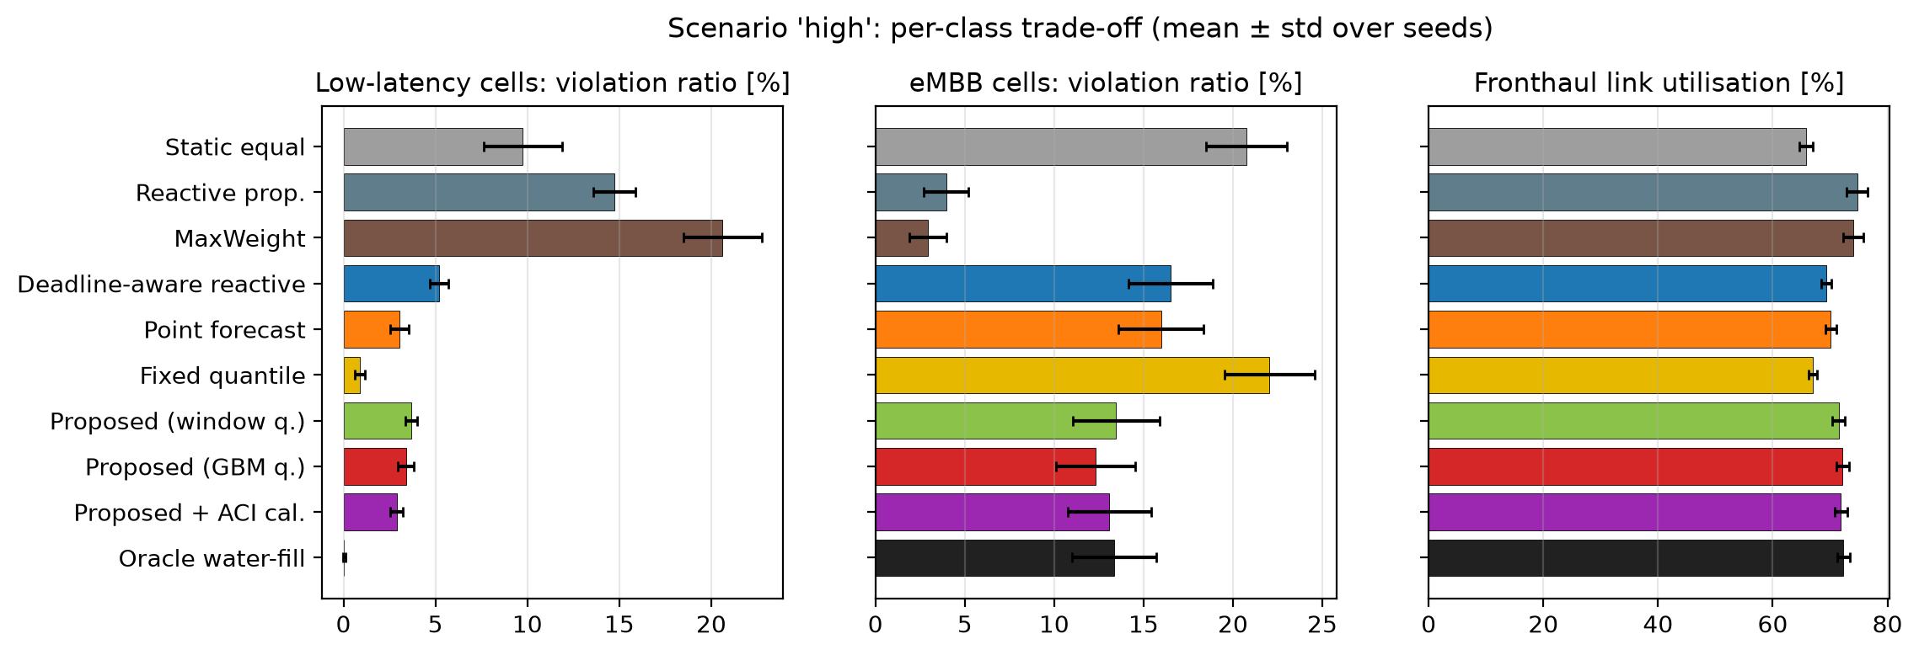
Where the gain comes from (scenario high)
• Unaware controllers starve LL (14.7 %, 20.6 %); aware ones pay with eMBB
• Proposed: lowest eMBB loss (12.3 %) and highest utilisation (72.2 %) in the deadline-aware family
Margin only where the forecast is wide.
Fronthaul Load Management in O-RAN | Part B | M. Yadav & H. Choudhary
12
Notes:
Deadline-unaware controllers sacrifice the LL cells. Every deadline-aware controller protects LL and pays with eMBB. Among them the proposed rule loses the least eMBB and uses the link most, because it adds margin only where the forecast is wide. One global level wastes a third of the allocation.

Slide 13
Ablations: what carries the gain?
Ablation (same everything else) | Effect of the proposed choice | Reading
Range vs single number (median) | −11 % to −43 %, 20/20 seeds | Representing uncertainty matters
Per-cell KKT level vs one global level | −22 % to −54 % | Level must be set per cell by the link
GBM vs window quantiles (no ML) | −7 % to −37 %; only −2 % under shift | Most of the gain is the rule
Online ACI calibration on/off | 1–9 % worse; 10 % worse under shift | Per-stream correction does not transfer
Family G (3GPP) reproduces it
High load: 8.01 % — −11 % vs point forecast, −31 % vs deadline-aware, −50 % vs reactive prop., 20/20 seeds;
also best under the unweighted ratio. Oracle + KKT gap: 24–40 % of the remaining loss at high load is forecast error.
ML is useful, not necessary: the r* target and the KKT split do most of the work.
Fronthaul Load Management in O-RAN | Part B | M. Yadav & H. Choudhary
13
Notes:
Range vs number matters; the per-cell level matters; ML helps on nominal traffic but only 2 % under shift, so most of the gain is the rule. Online ACI calibration hurt, because in a coupled split LL misses are caused by the shortage split, not by forecast bias.

Slide 14
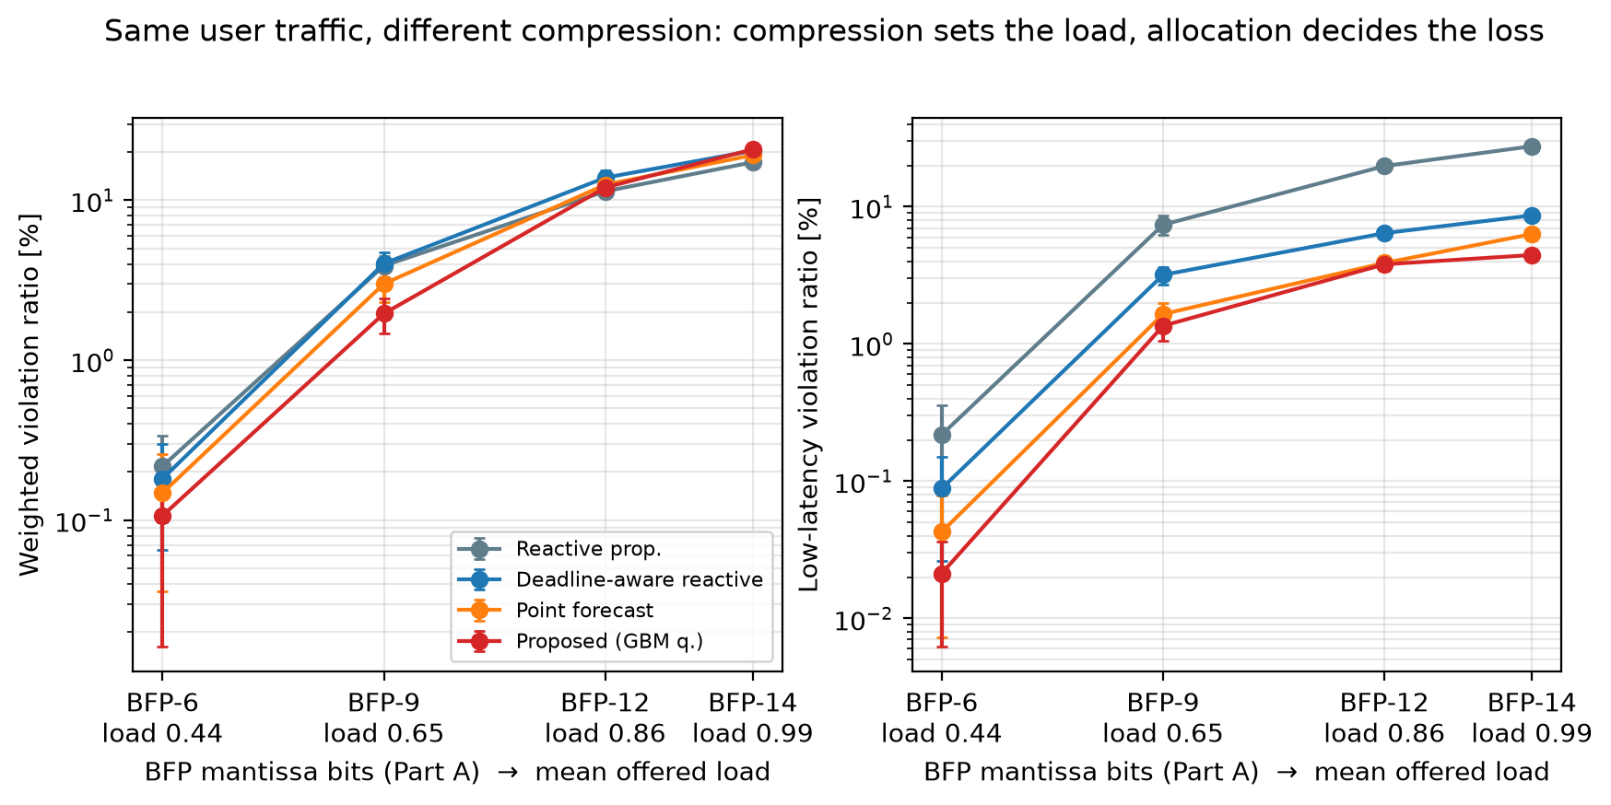
Honest caveats and operating regime
LL weight (S high) | 1 | 2 | 3 | 5
Reactive prop. | 6.55 | 8.13 | 9.20 | 10.56
Proposed | 6.58 | 8.35 | 8.00 | 6.93
Interval T | 2 ms | 5 ms | 10 ms | 20 ms
Reactive prop. | 3.91 | 7.42 | 8.91 | 11.80
Proposed | 3.07 | 5.07 | 7.71 | 13.15
• Needs an LL weight ≥ 2–3 (priority trade)
• Loses at T = 20 ms; near tie at τ = 5 ms
• Sweeps use 10 seeds (hence 7.71 vs 8.00)
Part A × B: BFP 6/9/12/14 bits → load 0.44/0.65/0.86/0.99.
Allocation matters at 0.5–0.8; at ≈ 1.0 nothing helps.
Compression sets the regime; allocation decides the loss inside it.
Fronthaul Load Management in O-RAN | Part B | M. Yadav & H. Choudhary
14
Notes:
Say these before you are asked. The gain is a priority trade: with every bit equal, proportional loses fewer bits in Family S. The rule wins for intervals up to a few times the shortest deadline and fresh telemetry. Compression sets the load regime; allocation matters between 0.5 and 0.8 load.

Slide 15
Extended Study
Theory, a third traffic family, and stronger controllers
Notes:
This was added after the NCC submission for the 11-page manuscript.

Slide 16
Extended study: stronger controllers exist
• Real problem: a POMDP — intractable
• Three approximation families:
  – one-step stochastic program (KKT rule)
  – Lyapunov drift: predictive MaxWeight
  – policy search: CEM, 3 parameters
• Family M: Markov-modulated traffic
• Theory: r* linked to effective bandwidth;
  – bounds valid but 25–100× loose
V_w [%] | KKT (GBM) | Pred. MW | CEM
S moderate | 2.15 | 1.62 | 1.77
S high | 8.00 | 6.15 | 6.57
S flash | 11.76 | 9.69 | 10.20
G high | 8.01 | 11.36 | 7.17
M high | 4.94 | 4.79 | 3.93
M shift | 5.52 | 4.80 | 4.17
λ diagnostic: link full ~100 % of intervals; λ* ≥ w_eMBB in 50–58 %
→ eMBB already at its lowest quantile; re-tuning the weight gains 1–4 %
CEM best in 6/10, predictive MaxWeight in 3/10: the gap is structural, not a constant.
Fronthaul Load Management in O-RAN | Part B | M. Yadav & H. Choudhary
16
Notes:
The real problem is an intractable POMDP. Three approximation families were implemented: one-step stochastic programs (our KKT rule), Lyapunov drift (predictive MaxWeight), and direct policy search (CEM). Theory: r* linked to effective bandwidth; bounds valid but 25-100x conservative, which argues for learning. Result: the KKT rule wins the NCC comparison set, but CEM and predictive MaxWeight beat it in 9/10 scenarios.

Slide 17
B2: A Bayesian Transformer Forecaster
Can a better forecaster close the gap? (Family S)
Notes:
Part B2 asks whether the gap to CEM and predictive MaxWeight is forecast error. Answer: mostly not.

Slide 18
LCQT: link-aware cross-cell quantile Transformer
A drop-in replacement for the GBM forecaster
Patch tokens
16 patches × 22 slots
+ r*, mean, max
Temporal encoder
2 layers, d = 48,
4 heads
FiLM
deadline D/H,
priority p
Cross-cell attn.
over the 8 cells
on the link
Non-crossing head
6 quantiles
q_k = q_k−1 + softplus
Bayesian mixture
3 seeds × 8 dropout
→ mixture F̂_i
Differentiable KKT layer (DF-LCQT)
Forward: bisection for λ*; backward: implicit gradient
∂λ*/∂q = − (∂g/∂q) / (∂g/∂λ), g = Σ r_i − C
Loss = Σ p_i (D_i+1)(B_i + r*_i − r_i)⁺ + β · pinball
Contexts logged closed-loop, one DAgger round
 | LCQT
Parameters | 63 k (44 k without cross-cell)
Training | 40 epochs, early stop on validation
Time | ≈ 6 min, 4-core CPU
Data | same seeds and target as GBM
Each block is prior art; we found no paper that combines them for a shared link.
Fronthaul Load Management in O-RAN | Part B | M. Yadav & H. Choudhary
18
Notes:
Built on PatchTST (patches), iTransformer (attention across variates), TFT (multi-quantile output), MC dropout and deep ensembles, and decision-focused learning. Our modifications: deadline-aware patch tokens carrying r* of each patch; FiLM on deadline and priority so one network serves both classes; cross-cell attention over the 8 cells sharing the link; non-crossing quantile head; a Bayesian mixture layer; and a differentiable KKT layer. Each block is prior art; we found no paper combining them. 63k parameters, about 6 minutes of CPU training.

Slide 19
B2 forecast quality
Same validation rows for every model; shift = held-out test (out of distribution)
Model | Pinball | Pinball LL | 90 % cov. | 90 % width | Shift 90 % cov. | Shift LL q95 cov.
GBM (B1) | 0.0224 | 0.0259 | 0.894 | 1.51 | — | —
LCQT | 0.0214 | 0.0251 | 0.902 | 1.36 | 0.795 | 0.855
LCQT + MC dropout (16) | 0.0214 | 0.0251 | 0.911 | 1.41 | 0.802 | 0.870
Deep ensemble (3) | 0.0212 | 0.0248 | 0.912 | 1.37 | 0.806 | 0.864
Ensemble × MC (3×8) | 0.0213 | 0.0249 | 0.919 | 1.40 | 0.808 | 0.873
DF-LCQT (decision-focused) | 0.0224 | 0.0273 | 0.907 | 1.38 | 0.830 | 0.822
• Transformer: pinball −4.5 %, 90 % interval −8 % at higher coverage than GBM
• Cross-cell layer and priority-weighted loss: no forecast gain (equal within noise)
• Bayesian layer improves calibration under shift (LL q95: 0.855 → 0.873) but cannot remove under-coverage
A better forecast — but only modestly better.
Fronthaul Load Management in O-RAN | Part B | M. Yadav & H. Choudhary
19
Notes:
The Transformer cuts pinball loss by 4.5 % and the 90 % interval width by 8 % at higher coverage than GBM. Cross-cell layer and priority weighting do not improve the forecast. The Bayesian layer moves coverage towards nominal under shift but cannot remove under-coverage there. DF-LCQT gives up accuracy on purpose.

Slide 20
B2 closed loop: V_w [%] on Family S (20 test seeds)
Controller | low | mod. | high | flash | shift
GBM + KKT (B1) | 0.15 | 2.15 | 8.00 | 11.76 | 10.04
LCQT median + water-fill | 0.25 | 3.14 | 9.76 | 13.47 | 11.51
LCQT + KKT | 0.13 | 2.05 | 7.91 | 11.81 | 10.06
Bayesian LCQT + KKT | 0.12 | 2.02 | 7.89 | 11.78 | 10.02
DF-LCQT + KKT | 0.18 | 2.26 | 7.93 | 11.62 | 10.15
CEM policy | 0.13 | 1.77 | 6.57 | 10.20 | 9.73
Predictive MaxWeight | 0.14 | 1.62 | 6.15 | 9.69 | 10.25
Oracle + KKT | 0.05 | 0.88 | 4.77 | 8.10 | 5.84
Bayesian vs GBM | Change | Wins
low | −20.8 % | 20/20
moderate | −6.1 % | 20/20
high | −1.4 % | 20/20
flash | +0.2 % (n.s.) | 9/20
shift | −0.2 % (n.s.) | 14/20
• Patch Transformer: the main gain
• Bayesian mixture: small, consistent
• Cross-cell, priority loss: no gain
• DF-LCQT: −1.2 % flash, +14 % low
Best KKT variant, but CEM / predictive MaxWeight stay 14–28 % better: the gap is structural.
Fronthaul Load Management in O-RAN | Part B | M. Yadav & H. Choudhary
20
Notes:
The Bayesian LCQT is the best KKT-rule variant and improves the proposed method on every seed at low to high load (-20.8 / -6.1 / -1.4 %). Flash and shift are not significant. The gains are small at high load, while CEM and predictive MaxWeight are still 14-28 % better: the gap is structural.

Slide 21
B2: honest assessment
What improved
• Bayesian LCQT beats GBM + KKT on every seed
at low–high load; never loses significantly
• Best calibration under shift
• LCQT alone is cheaper per decision
than GBM (2.7 vs 3.5 ms)
• Differentiable KKT layer works and is
unit-tested (matches numpy to 1e-6)
What did not
• Gains small at high load (−1.4 %)
• Decision-focused gain on validation did not
transfer to test at low/moderate load
• Bayesian layer: 17–21 ms in Python
(> the 10 ms interval) — needs compiling
• Family S only
Next: keep the forecaster, change the decision structure (B3).
Fronthaul Load Management in O-RAN | Part B | M. Yadav & H. Choudhary
21
Notes:
What improved: every seed at low to high load, best calibration under shift, cheaper per decision than GBM (2.7 vs 3.5 ms) without the Bayesian layer, and a working, unit-tested differentiable KKT layer. What did not: small gains at high load, the decision-focused validation gain did not transfer, the Bayesian layer costs 17-21 ms in Python, and only Family S was run. Next step: keep the forecaster, change the decision structure — that is B3.

Slide 22
B3: The Back-Pressure Newsvendor
One policy class that contains both strongest baselines
Notes:
Part B3 changes the decision rule, not the forecaster.

Slide 23
Why the KKT rule loses to back-pressure (S high)
Controller | V_w | LL viol. | eMBB viol. | Util.
KKT rule (GBM) | 8.00 | 3.4 | 12.3 | 72.2
CEM class-level | 6.57 | 6.0 | 7.1 | 74.7
Pred. MaxWeight (CEM-tuned) | 5.98 | 6.0 | 5.9 | 75.5
BPN v1 | 5.23 | 5.5 | 4.9 | 76.1
BPN v2 | 5.32 | 5.8 | 4.8 | 76.1
Oracle + KKT | 4.77 | 0.1 | 9.2 | 74.8
Diagnosis
A budget is a per-cell cap:
reserved-but-unused capacity
is lost.
KKT over-protects LL and
starves eMBB.
Back-pressure wastes less but
ignores deadlines and
uncertainty.
Idea: fill the base in back-pressure order, then spend the leftover on newsvendor margins.
Fronthaul Load Management in O-RAN | Part B | M. Yadav & H. Choudhary
23
Notes:
A budget is a per-cell cap. Capacity reserved for a 2 ms cell's upper quantile and not used is lost. The KKT rule over-protects LL (3.4 %), starves eMBB (12.3 %) and uses the link least (72.2 %). Back-pressure fills in queue order with median demands and wastes less, but ignores deadlines and uncertainty. Idea: fill the base in back-pressure order, then spend the leftover on newsvendor margins.

Slide 24
BPN: back-pressure base + KKT margins
8 parameters, learned by CEM on training seeds only
Stage 1 — base, in back-pressure order
b_i = a · Q_i/T + (1 − a) · B_i (drain rate vs deadline backlog)
d_i = b_i + (1 + μ) · F̂_i⁻¹(p⁰_class)
Shortage ∝ v_class · (π_i / π̄)^η, π_i = Q_i + ℓ·H·median_i
η = 0: class-weighted water-fill; η = η_max: strict back-pressure
Learned | η | a | (p⁰_LL, p⁰_eMBB)
S (bursty) | 6 (greedy) | 0.98 | (0.41, 0.45)
G (3GPP) | 0 | 0.31 | (0.94, 0.73)
M (Markov) | 0 | 0.34 | (0.84, 0.31)
The search recovers the regime map
Short bursts (S) → back-pressure
Long bursts (FTP files, XR frames) → reservation
Stage 2 — leftover by the KKT rule
r_i = max( r_i⁽¹⁾, b_i + F̂_i⁻¹(1 − λ/ω_class) ), Σ r_i = C
Contains predictive MaxWeight and the CEM class-level policy exactly (unit-tested).
Baselines re-tuned with the same CEM search: equal tuning effort.
One policy class, both strongest baselines inside it: the search can only match or beat them.
Fronthaul Load Management in O-RAN | Part B | M. Yadav & H. Choudhary
24
Notes:
Stage 1: base demand mixes MaxWeight's drain rate with the deadline-aware backlog rate (a), plus a class base quantile. Shortage shared by a pressure score raised to eta: eta = 0 is class-weighted water-fill (reservation), large eta is strict back-pressure order. Stage 2: leftover capacity by the KKT rule. With the right parameters it becomes exactly predictive MaxWeight or the CEM class-level policy (unit-tested). Equal search effort for the baselines. The learned eta recovers the regime map.

Slide 25
B3 result, Family S: V_w [%] (20 test seeds)
Forecaster | Controller | low | moderate | high | flash | shift
GBM | KKT rule (B1) | 0.15 | 2.15 | 8.00 | 11.76 | 10.04
GBM | Pred. MaxWeight (CEM-tuned) | 0.16 | 1.66 | 5.98 | 9.36 | 10.46
GBM | CEM class-level (re-searched) | 0.13 | 1.73 | 6.58 | 10.23 | 9.76
GBM | BPN v1 (6 param.) | 0.10 | 1.21 | 5.23 | 8.58 | 9.23
GBM | BPN v2 (8 param.) | 0.10 | 1.21 | 5.32 | 8.70 | 9.26
LCQT | BPN v2 | 0.08 | 1.16 | 5.25 | 8.59 | 9.24
Bayesian LCQT | BPN v1 | 0.08 | 1.11 | 5.05 | 8.34 | 8.92
Bayesian LCQT | BPN v2 | 0.07 | 1.12 | 5.21 | 8.55 | 9.12
— | Oracle + KKT (true r*) | 0.05 | 0.88 | 4.77 | 8.10 | 5.84
Same forecaster: BPN beats both baselines everywhere; within 6–10 % of the oracle at high load.
Fronthaul Load Management in O-RAN | Part B | M. Yadav & H. Choudhary
25
Notes:
With the same forecaster, BPN beats both strongest baselines in every scenario. At high load it is within 6-10 % of the oracle-informed KKT rule. The Transformer from B2 now pays off more. Note: on Family S, BPN v1 is slightly better than v2 at high load (5.23 vs 5.32); v2 is the version that also works on Family G.

Slide 26
B3 generalisation: Families G (3GPP) and M (Markov)
V_w [%], GBM forecaster
Controller | G moderate | G high | M moderate | M high | M shift
KKT rule (B1) | 5.08 | 8.01 | 0.92 | 4.94 | 5.52
Pred. MaxWeight (CEM-tuned) | 6.75 | 10.02 | 1.61 | 4.82 | 4.82
CEM class-level (re-searched) | 4.51 | 7.05 | 0.94 | 3.94 | 4.22
BPN v1 | 5.67 | 8.92 | 0.63 | 3.71 | 3.72
BPN v2 | 4.24 | 6.81 | 0.68 | 3.62 | 3.82
Oracle + KKT | 3.47 | 6.06 | 0.03 | 1.84 | 2.31
• BPN v1 lost on G: strict back-pressure cannot represent reservation, which wins on long FTP bursts
• v2 contains the reservation policy and fixes it
• Training cost (BPN v2 / best baseline): S 0.0387 / 0.0436, G 0.0527 / 0.0555, M 0.0196 / 0.0226
v2 is the version that generalises across all three families.
Fronthaul Load Management in O-RAN | Part B | M. Yadav & H. Choudhary
26
Notes:
BPN v1 lost on Family G because its stage 1 is always strict back-pressure, so it cannot represent reservation, which wins on long 3GPP bursts. v2 contains the reservation policy and fixes it. Training costs (BPN v2 vs best baseline): S 0.0387/0.0436, G 0.0527/0.0555, M 0.0196/0.0226.

Slide 27
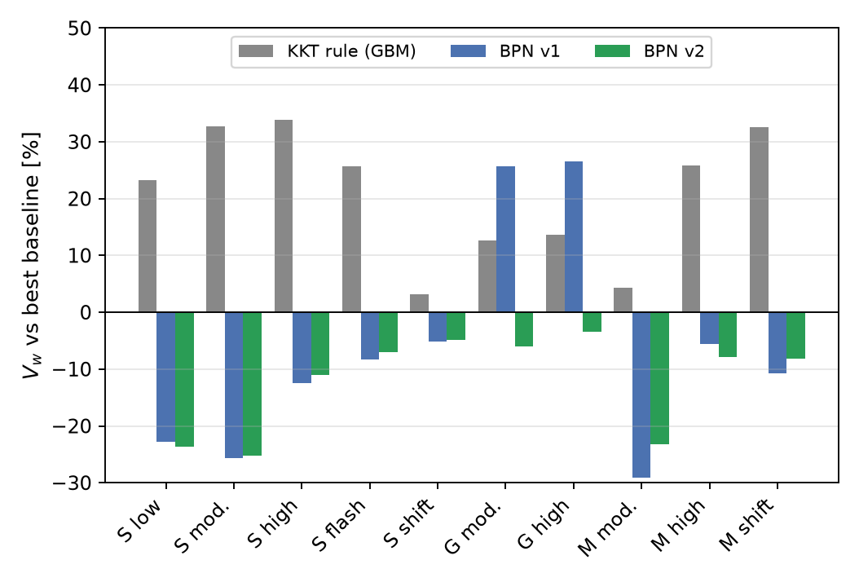
BPN v2 vs the best baseline in each scenario
Scenario | vs best baseline | Wins
S low | −23.7 % | 15/20
S moderate | −25.3 % | 20/20
S high | −11.0 % | 20/20
S flash | −7.0 % | 20/20
S shift | −4.8 % | 20/20
G moderate | −5.9 % | 20/20
G high | −3.4 % | 19/20
M moderate | −23.3 % | 20/20
M high | −7.9 % | 20/20
M shift | −8.2 % | 20/20
10/10 scenarios, 3 families, all p ≤ 0.024 (Holm–Wilcoxon).
Fronthaul Load Management in O-RAN | Part B | M. Yadav & H. Choudhary
27
Notes:
Best baseline means the better of predictive MaxWeight and CEM class-level, each in its best tuning. BPN v2 wins all 10 scenarios across 3 families on paired tests, all p <= 0.024. The grey bars show how far behind the original KKT rule was.

Slide 28
B3: what is now claimable, and what is still needed
Claimable
• Beats both strongest baselines, each in
its best tuning, in 10/10 scenarios
• Equal search effort, training seeds only;
baselines are special cases of the policy
• Learned η explains when to reserve and
when to back-pressure: interpretable
• 2.2–3.5 ms per decision (Python)
(Bayesian forecaster: ≈ 20 ms)
Still needed
• Real per-cell PRB / fronthaul traces
• Deep-RL xApp (PPO) baseline; Lyapunov
drift-plus-penalty with deadline queues
• BPN over T, τ and load (only T = 10 ms,
τ = 1 ms so far)
• Policy learned per family; transfer untested
• No optimality proof for the hybrid
A controller that beats the strongest baselines — with its limits stated.
Fronthaul Load Management in O-RAN | Part B | M. Yadav & H. Choudhary
28
Notes:
Claimable: beats both strongest baselines in their best tuning in all 10 scenarios, with equal search effort on training seeds only; the learned exponent is interpretable; 2.2-3.5 ms per decision in Python. Still needed: real traces, a deep-RL (PPO) baseline and drift-plus-penalty, sensitivity over T, tau and load, transfer between families, and there is no optimality proof for the hybrid.

Slide 29
Part B summary
Step | Headline result
B1 KKT newsvendor rule | Best of 12 controllers in all scenarios of 2 families: −11 to −43 % vs forecast median, every seed
Ablations | Most of the gain is the r* target + KKT split; ML useful, not necessary; ACI calibration hurt
Caveats | Needs LL weight ≥ 2–3; T ≤ a few × the shortest deadline; allocation matters at load 0.5–0.8
Extended study | r* linked to effective bandwidth; CEM and pred. MaxWeight beat the KKT rule in 9/10: structural gap
B2 Bayesian Transformer | Best KKT variant (−21 / −6 / −1.4 % at low / moderate / high); confirms the gap is structural
B3 Back-pressure newsvendor | Beats both strongest baselines in 10/10 scenarios of 3 families (−3 to −25 %)
Keep the structure, learn only what is uncertain — and let the search pick the structure.
Fronthaul Load Management in O-RAN | Part B | M. Yadav & H. Choudhary
29
Notes:
Read the table top to bottom: it is the story of Part B. Then the take-away.

Slide 30
Limitations and future work
What we do not claim
• No real-world validation (3 simulated families)
• Simplified link: budget-enforced pipe, no switch
queue, no HARQ, downlink only
• No closed-loop optimality or stability proof
• KKT rule: only −4 % vs proportional in flash crowds
• B2 on Family S only; Bayesian layer too slow
in Python for a 10 ms interval
• BPN learned per family, at T = 10 ms, τ = 1 ms
Next
• Measured per-cell PRB traces
• PPO xApp baseline; BPN sweeps over T, τ, load
• Cross-family transfer of the learned policy
• Compiled O-DU implementation (C++ / batched)
• Coupled calibration (adjust λ)
• Compression width as a per-cell knob
inside the allocation rule (Part A + B)
Thank you — questions?
Fronthaul Load Management in O-RAN | Part B | M. Yadav & H. Choudhary
30
Notes:
Say the limits calmly. Then future work and thank the audience.

