Slide 1
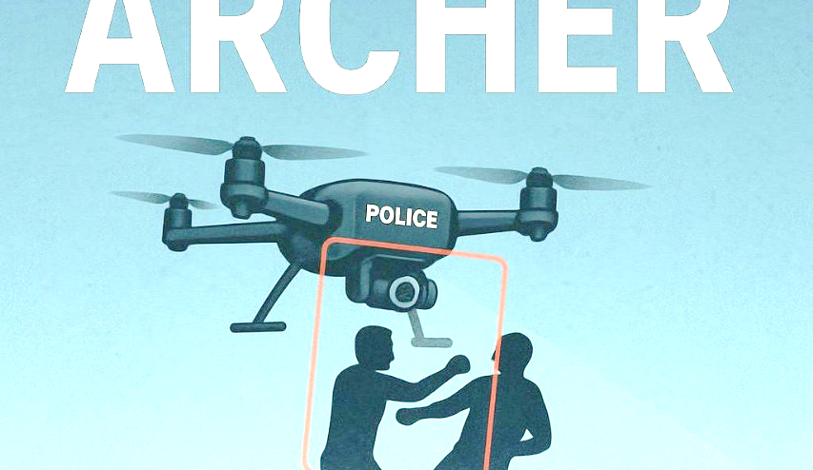
Active Response & Control Hub for Emergency Reconnaissance -:
ARCHER➵
Team – Flag Smashers

Slide 2
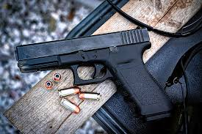
ARCHER
ISSUES
CHALLENGES
Delayed police response
No immediate on-ground intervention
Underreported or unnoticed crimes
Human surveillance limitations
Inefficient emergency call handling
High crime in unmonitored zones
Next

Slide 3
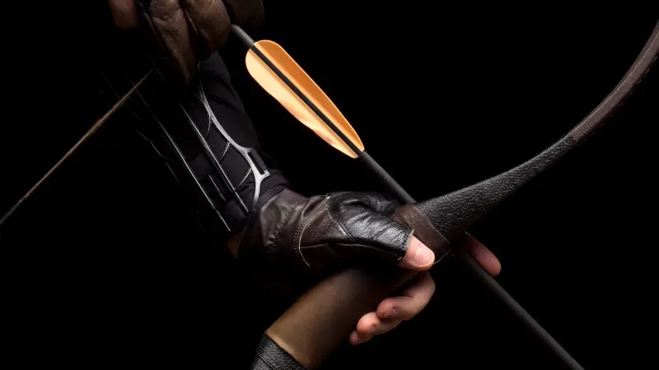

ARCHER?
(Active Response & Control Hub for Emergency Reconnaissance)
Is an AI-powered drone and rover system that detects threats through human motion analysis and responds instantly with non-lethal force, providing rapid intervention before police arrive.
Bullseye in Every Shot

Slide 4


Tech Stack :-
Flight Controller
Transmitter Receiver
Electronic Speed Controllers
Motor Driver
BLDC Motors
Arduino
Raspberry Pi 4
Web Cam
Open CV2
YOLO V8L
ESP32 CAM
And Lots of more interesting stuff…….

Slide 5
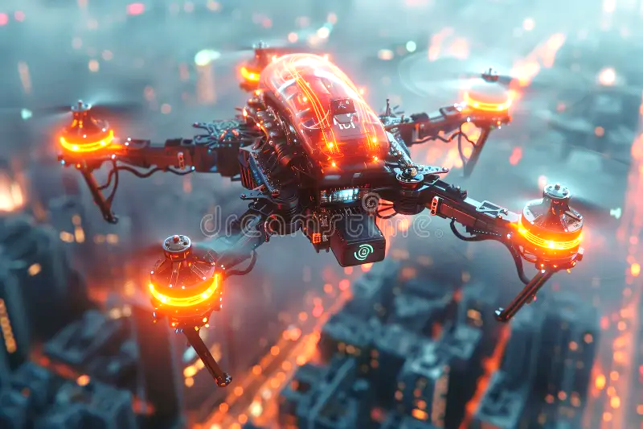
ARCHER
APPLICATIONS
Working of ARCHER:
1- A semiautonomous drone monitors over a radius of police station zone. 2- A operator at the police station keeps an eye on the visuals of drones through FPV mode (First Person View). 3- When the drone detects any crime or threats based on body movements of humans like punching, running, stabbing etc with the help of artificial intelligence, it sends alerts on the operator’s screen. 4- Operator than confirms the visual as a possible threat and then notifies another operator. 5- Operator 2 then deploys a semiautonomous rover which then travels to the GPS coordinates of the drone and locks on the suspect.
6- Then operator has options to ask the suspect to kneel down and surrender or shoot him with Taser or Pepper spray knocking him down until police arrives at the location.
7-The drone will charge on the roof of the zonal police station while the rover will have its own charging station on every 200-300 meters in the city to reach the crime location as quick as possible.
Next

Slide 6
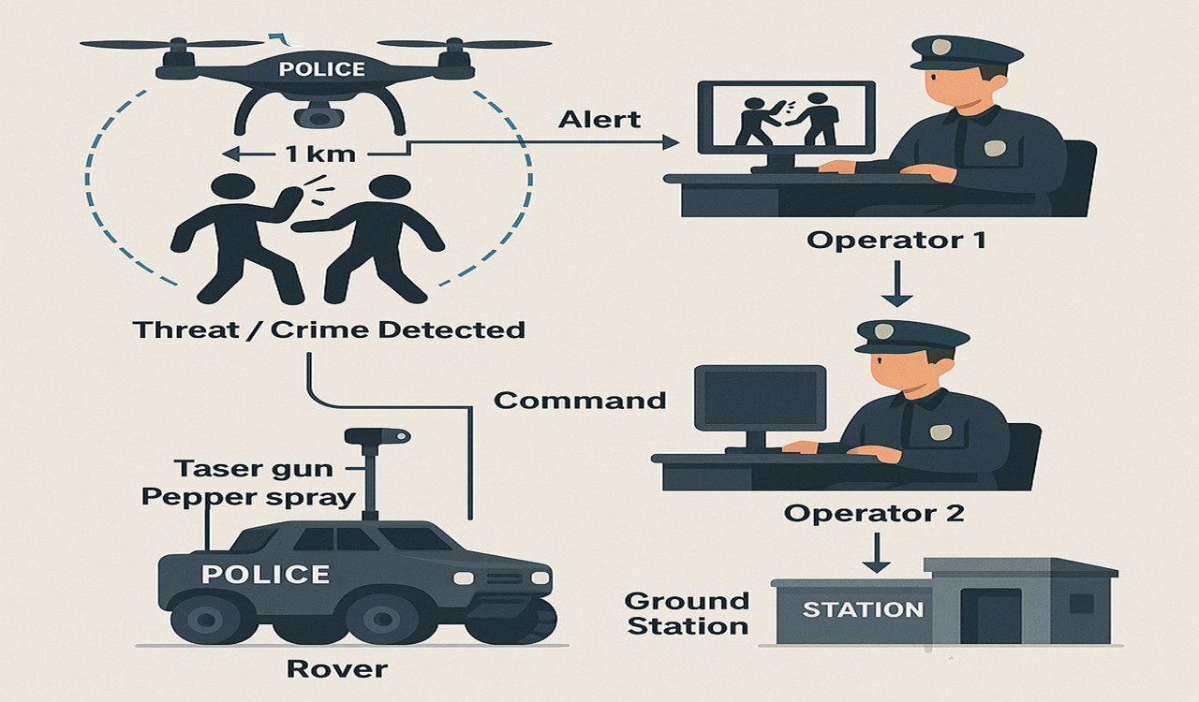

Slide 7
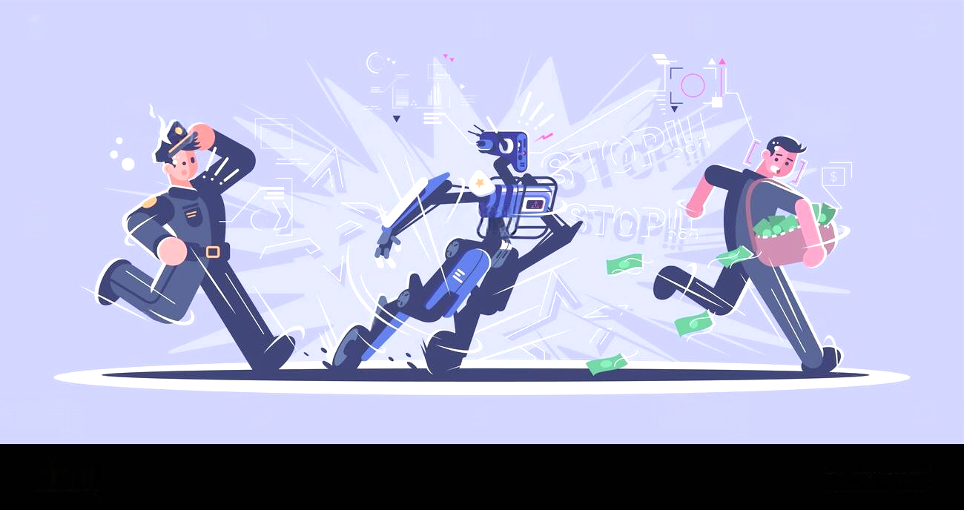
Solution and Benefits-:
Faster response time than traditional police dispatch
Crime deterrence through visible AI patrols
Reduced risk to human officers during initial response
24/7 autonomous monitoring with minimal manpower
Autonomous rover deployment from ground stations every 300m
Non-lethal threat engagement (taser, pepper spray)
Two-operator control system for safety and decision-making
Immediate help for victims before police arrive
Supports police, doesn’t replace—a true force multiplier

Slide 8

BY-:
Harshvardhan Bajpai
Dhairya Gupta
Rohit Kumar Pandit
Ujjwal Kumar

