Slide 1
X
We are introducing you
DivyaGPT
the Innovative A.I

Slide 2
AI-Generated/Traditional Note
With smooth animations to enhance your story
Traditional note- taking
Traditional note taking system take longer times for the delivery of the same and also it is bit complicated to understand
Traditional Note taking Methodology
AI
UP
DOWN
AI-Generated notes
AI generated notes are easier to understand and delivered quickly and it also contain content visualization and important questions.
T
Future of Note Generation

Slide 3
I
Improve everyday
The app uses natural language processing to understand user queries and provide accurate and relevant responses.
Improve everyday
F
Fast responding
Our model also poses the feature of fast responding as well.
Fast responding
In
Integrations
Connect your model across different platforms and boost productivity and referenced based learnings.
Integrations
F
Flowchart and Image generation
Flowcharts and Image generation using generative pretrained transformer help to understand topics in an precise way possible.
Flowchart and Image generation
D
DocTalk Conversation
The app can do conversation with the notes and documents in a click and with high accuracy.
DocTalk Conversation
S
SummerizedNotes
Lets users quickly summerize the learnings and references taught in class.

Slide 4
Generative AI made for Educators.
Summery Generation
Notes + Image Generation
Flowcharts
Learning Maps Generation

Slide 5
AI conversation with seamless collaboration
With smart automation and top-notch security, it's the perfect solution for teams looking to work smarter.
1
Seamless Integration
2
Top-notch Security
3
With smart automation and top-notch security, it's the perfect solution for teams looking to work smarter.
Smart Automation

Slide 6
Beta version
IS
Releasing Soon!

Slide 7
Tech Stack
GPT .(Generative pre – trained transformer)
m
f
Natural language processing(NLTK)
Python (Lemitization,stop world removable)
a
h
PDF converter
API’s
b

Slide 8
Future Aspects
E
Efficient & skillable neural schemas.
Custom problem solving
C
Scalable & self deployed architect forces(R&D)
S

Slide 9
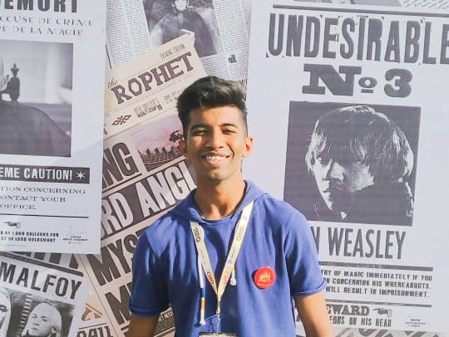
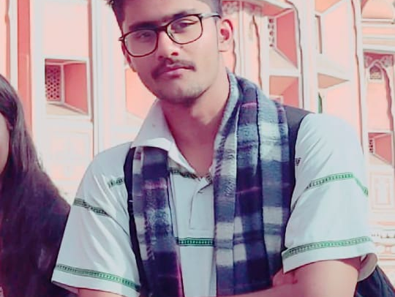
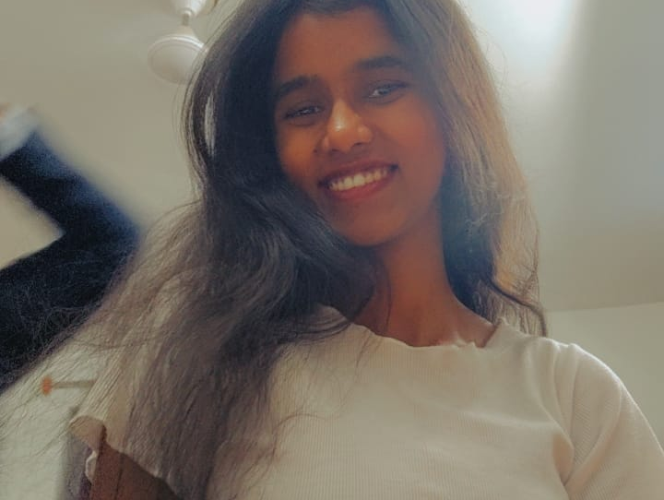
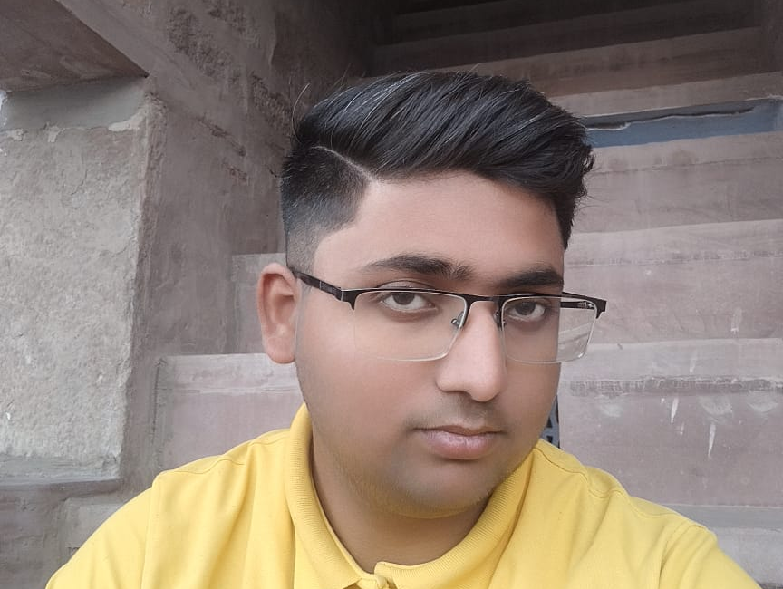
Our great team
With smooth animations to enhance your story
Harshvardhan purohit
Profession or something
Marketing
Prateek vyas
Profession or something
Devloper
Divya Kumari
Profession or something
Influancer
Yazdaan Ahmed
Profession or something
Graphic desgiiner

