Slide 1
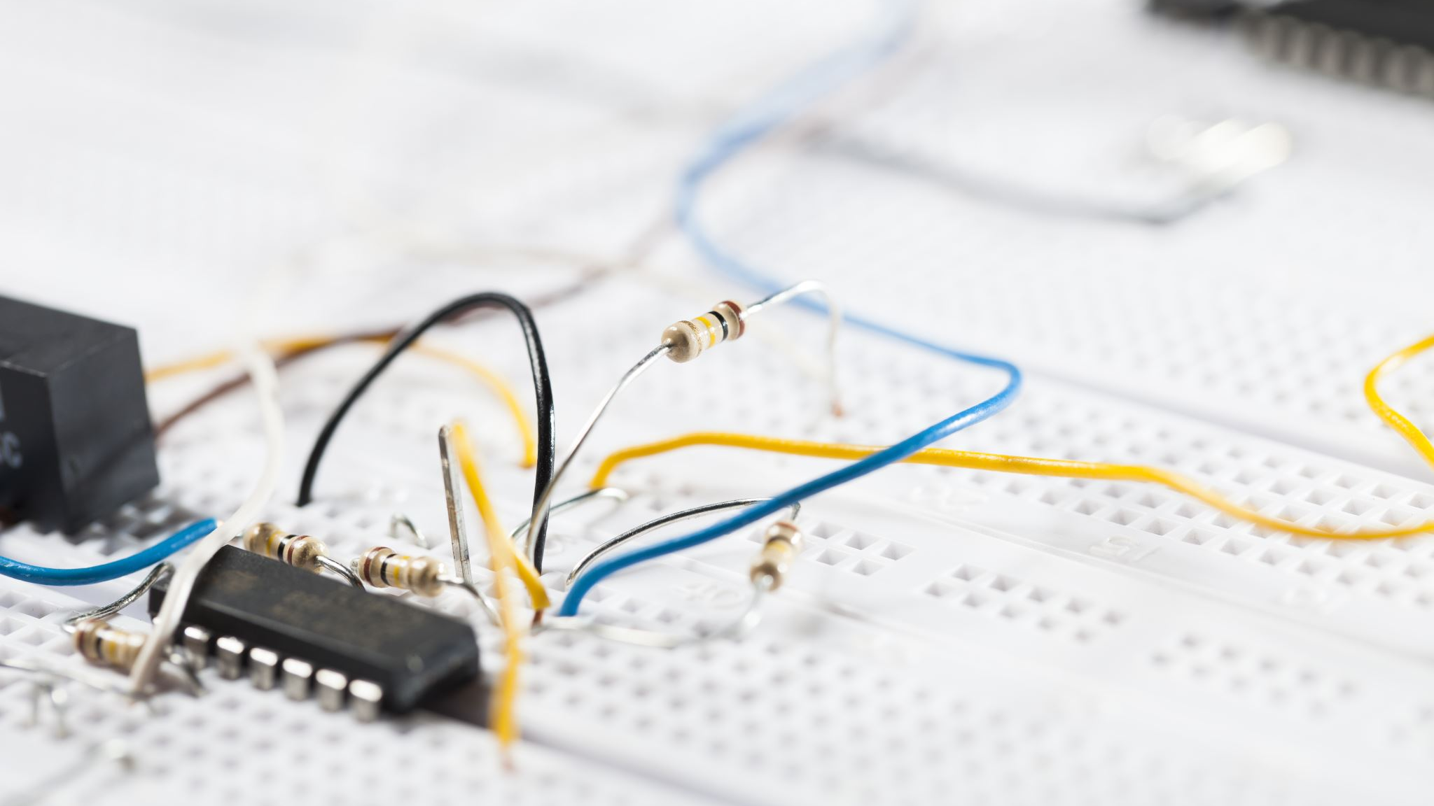
Internet of Things Stepper motor
-Harshvardhan Gaikwad 4947

Slide 2
Introduction
Stepper motor is a motor that converts electrical pulse signals into corresponding angular displacement.
A stepper motor, also known as step motor or stepping motor, that divides a full rotation into a number of equal steps.
Each time a pulse signal is an input, the motor rotates by an angle and its output angular displacement is proportional to the number of input pulses, and the speed is proportional to the pulse frequency.

Slide 3
Types
Permanent magnet stepper
Variable reluctance stepper
Hybrid synchronous stepper

Slide 4
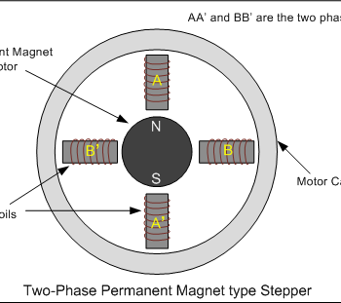
Permanent magnet stepper
The rotor and stator poles of a
permanent magnet stepper are
not teethed. Instead the rotor
have alternative north and south
poles parallel to the axis of the
rotor shaft.

Slide 5
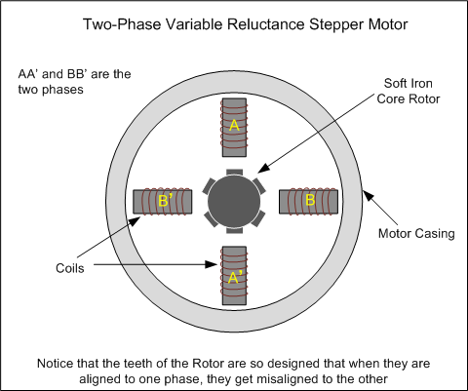
Variable reluctance stepper
The variable reluctance stepper has a toothed non-magnetic soft iron rotor. When the stator coil is energized the rotor moves to have a minimum gap between the stator and its teeth.

Slide 6
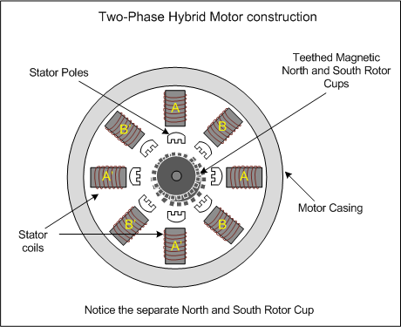
Hybrid synchronous stepper
A hybrid stepper is a combination of both permanent magnet and the variable reluctance. It has a magnetic teethed rotor which better guides magnetic flux to preferred location in the air gap.

Slide 7
Types of Wiring
There are two basic winding arrangements for the electromagnetic coils in a two phase stepper motor:
Bipolar
Unipolar.

Slide 8
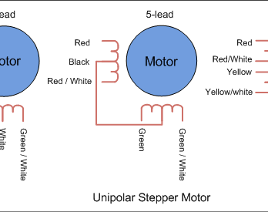
Unipolar
Unipolar Stepper motor
In unipolar step motor there are two winding per phase. The two winding to a pole may have one lead common i.e. centre tapped.
In the designs where the common of two poles are separate but centre tapped, motor have six leads.
If the centre taps of the two poles are internally short, the motor has five leads.
Eight lead unipolar facilitates both series and parallel connection whereas five lead and six lead motors have series connection of stator coils.
These are also called bifilar motors.

Slide 9
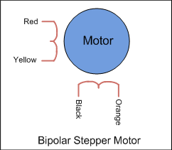
Bipolar
Bipolar Stepper Motor
In bipolar stepper there is single winding per pole. The direction of current need to be changed by the driving circuit so the driving circuit of the bipolar stepper becomes complex. These are also called unifilar motors. They are further divided into 3 types as:
Wave Drive: In wave drive stepping mode only one phase is energized at a time.
Full Drive: In full drive, two phases are energized at a time.
Half drive: In half drive, alternately one and two phases are energized. This increases the resolution of the motor.

Slide 10
Advantages Of Stepper motor
Flexibility :Stepper motors offer flexibility in application for a wide range of applications because the design of the stepper motor provides a constant holding torque without the need for the motor to be powered.
Very Reliable : Stepper Motors are very reliable since there are no contact brushes in the motor. Therefore, the life of the motor is simply dependent on the life of the shaft bearing.
Longer Life : Many of the moving parts are frictionless, so it is considered that Stepper Motor offer a longer life when considering that the bearings are essentially the only part that will wear-out.
Greater Torque :The torque of a stepper motor of that of the same size of a servo motor, at lower speeds is greater than that of a servo motor.

Slide 11
Disadvantages Of Stepper motor
Low Efficiency :Some of the top Stepper Motor disadvantages are in that the motors provide a low efficiency. The Stepper Motor draws substantial power (remembering holding torque) regardless of load.
The Torque Declines Rapidly with Speed :The torque of a Stepper Motor declines rapidly with speed as torque is the inverse of speed.
Very Noisy :When the load is exceeded, synchronization will be broken, and vibration and noise will be emitted when working at high speed.
No feedback :Compared to servo motors, stepper motors have no integral feedback for the position.

Slide 12
Application of Stepper motor
Basically, it can be used in situations involving positioning, such as
ATM machines
Inkjet printers
Plotters
Spraying equipment
Medical instruments and equipment
Precision instruments,
Industrial control systems, etc.

Slide 13
Thank you..
- Harshvardhan Gaikwad

