Slide 1


Slide 2
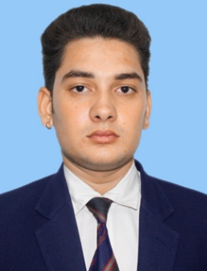
Arunesh Dwivedi
Background:
Selected Experience:
Arunesh Dwivedi is an experienced patent professional.
He holds a Bachelor’s degree in Mechanical Engineering.
He has more than 1.5 years of work experience in providing various patent related services. He is experienced in patent databases like Derwent Innovation, Orbit Intelligence, Patseer, along with other free and national patent databases like Espacenet, Google Patents etc.
He specializes in domains like Automobiles (Hybrid vehicle, Autonomous vehicles & Electric vehicles) and Engines (Internal and External Combustion engines), Motors, Pumps etc.
Worked on Patentability and Knockout searches in Mechanical and Automotive applications such as Engine valves, Pumps, Filters, Exhaust gas treatment, Electric vehicles, Hybrid vehicles etc.
Worked on Invalidity searches in the domain like wind turbines, Air Purifier, Medical Equipment, Compressors, Vehicle exhaust systems etc.
Performed FTO searches in the domain of hybrid vehicles, electric vehicles, Vehicle Airbags, Vehicle Tires, Vehicle seating, Vehicle Brakes, Medical devices, Surgical instruments, Stroller etc.
Worked on Patent landscape analysis in the domain of Automobile Safety, Steering wheel with air bag.
Worked on Portfolio Management in the domain Vehicle seating.
Conducted SOA searches on NDT Method for rope testing.
Conducted Design Searches on Design Invalidity like Medical Devices etc..
Conducted Trademark Searches.
Prepared Claim charts of Invalidity Searches.
Performed assignee searches in the field of Automobile Applications.
Functional Expertise:
Technical Expertise:
Invalidation searches
Freedom to Operate Searches
Patentability / Novelty
SOA Searches (State of Art)
Design Searches
Trademark Searches
Landscape Analysis
Portfolio Management
Automobiles
IC Engines
Tires
Power Generation
Refrigeration
3D Printing
Heavy machinery
Manufacturing Process

