Slide 1
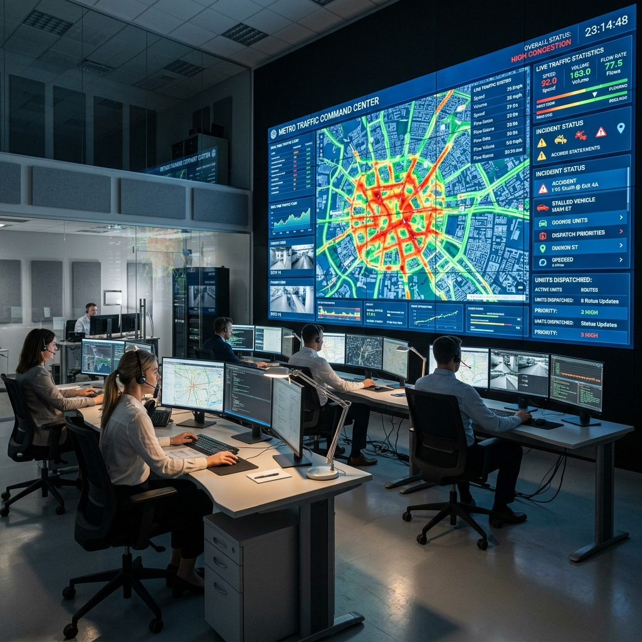
FLIPKART GRIDLOCK HACKATHON 2.0
ParkFlow AI
Intelligent Parking Congestion Management ML Traffic Predictions meets Smart Dispatch Operations.
Developed by: Harshwardhan Bhaskar Team: HB Technologies (Solo Participant)

Slide 2
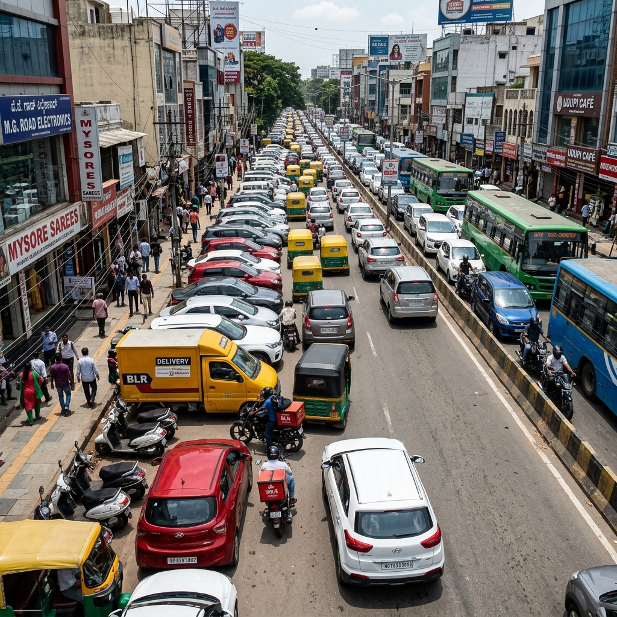
PARKFLOW AI
The Gridlock Challenge: Reactive Enforcement
Urban Congestion Bottlenecks: Illegal parking in dense corridors block lanes, reducing road capacity by up to 65% and creating severe cascading traffic gridlocks.
Blind Random Patrols: Municipal enforcement squads and tow-trucks patrol randomly, relying on guesswork rather than priority or traffic sensitivity data.
Resource Disconnection: Highly accurate predictive traffic modeling exists, but is completely disconnected from real-time municipal dispatcher platforms.

Slide 3
PARKFLOW AI
ParkFlow AI: End-to-End Predictive Dispatch
1. Predictive ML Engine Combines LightGBM, XGBoost, and CatBoost ensemble. Dynamically forecasts spatiotemporal traffic demand for any geohash coordinate based on cyclic time parameters.
2. Bottleneck Engine Custom formulas evaluate congestion drag (CDI) caused by double-parked vehicles and compute dynamic targeted enforcement priority (TEP) scores for dispatch.
3. Actionable UI Dashboard Interactive Leaflet mapping, auto-ranked priority dispatch list for enforcement officers, and an instant What-If congestion clearing simulator.

Slide 4
PARKFLOW AI
Phase 1 ML Architecture: Blended Ensemble
Blended Regressor Ensemble: Built a powerful blend of LightGBM, XGBoost, and CatBoost. Blending optimized weights to achieve robust spatiotemporal generalizability.
Cyclic Temporal Features: Encoded continuous time boundaries. Applied sine/cosine transformations on hour of day and day of week to preserve continuous temporal patterns.
Spatial Feature Clustering: Decoded 9-character spatial geohashes to precise latitude/longitude coordinates and grouped coordinates using K-Means clustering (K=15) to map regional densities.
Target Baseline Encoding: Computed out-of-fold historical baseline demand per geohash/temporal bucket to provide baseline benchmarks without introducing data leakage.

Slide 5
PARKFLOW AI
Congestion Impact Formulas & Economic Loss
Congestion Drag Index (CDI) CDI = predicted_demand / remaining_capacity * Where remaining_capacity decreases by 7% per double-parked vehicle (up to a max reduction of 65%). * Highlights road corridors that are approaching severe traffic saturation.
Enforcement Priority (TEP) TEP = violation_count * CDI * Ranks active hotspots by both physical violations and the road's congestion index. * Enables dispatchers to target tow-trucks to corridors where they will relieve the most traffic drag.
Economic Loss (Rupees) Loss = delay_minutes * affected_vehicles * hourly_rate * Estimates financial commuter drain. * Assumes ₹300 per hour commuter time-value and 400 affected vehicles per hour. Translates physical traffic blockages into clear, understandable economic figures (₹).

Slide 6
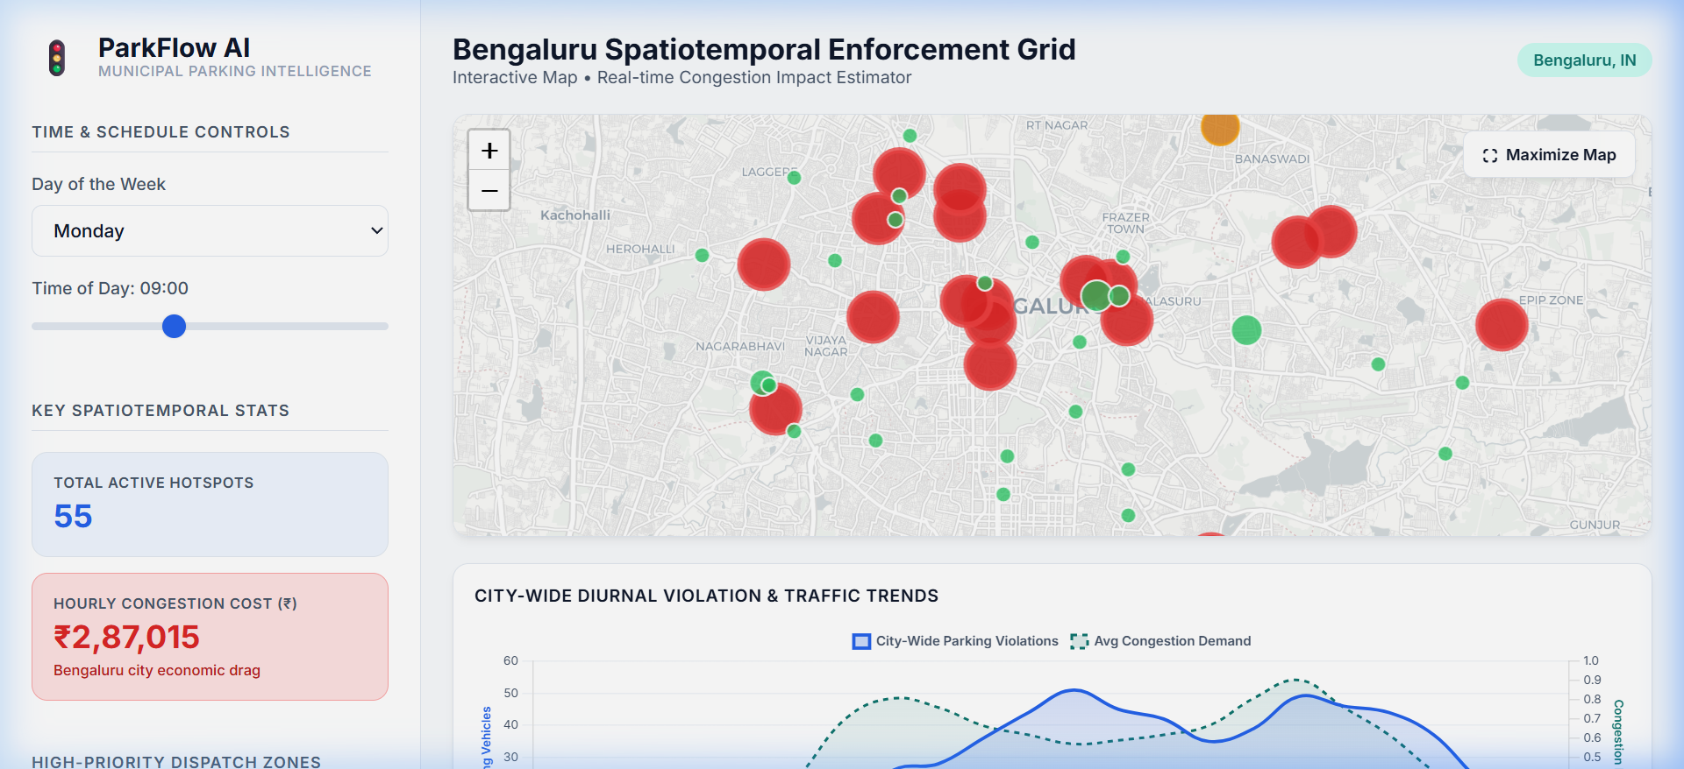
PARKFLOW AI
Operational Dashboard: Map & Priority Dispatch
Dynamic Leaflet Mapping: Renders coordinates in Bengaluru. Color-coded markers (Red = High Congestion, Yellow = Moderate, Green = Low) reveal spatial parking hotspot clusters.
Auto-Ranked Dispatch: Left sidebar lists hotspots in descending order of their TEP score, showing officers exactly where to deploy for maximum congestion relief.
Diurnal Analytics Chart: Displays city-wide traffic demand patterns to schedule patrol rosters efficiently.

Slide 7
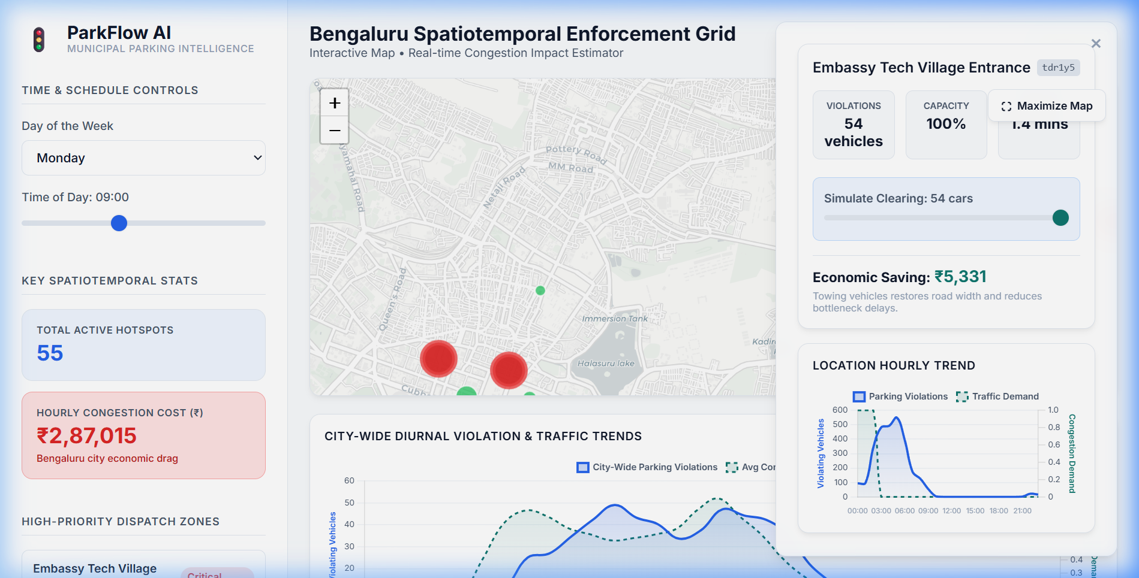
PARKFLOW AI
What-If Congestion Simulator
Simulate Vehicle Clearing: Allows operators to slide from 0 to maximum parked vehicles to simulate active traffic enforcement actions.
Instant Financial Feedback: Recalculates in real-time the capacity restored, delay minutes saved, and the total commuter economic savings (₹) achieved.
Corridor Demand Analytics: Includes detailed Chart.js visual showing the selected location's violation history alongside the city average demand curve.

Slide 8
PARKFLOW AI
Business Value & Future Scaling Roadmap
Commuter Travel Savings: Reduces travel delays, carbon emissions, and fuel burn in dense urban bottlenecks by maximizing road capacity.
Enforcement Cost Relief: Allows municipalities to maximize tow-truck ROI. deploys squads to high-impact priority grids instead of blind random patrols.
IoT & Smart City Sensors: Plan to integrate low-cost geomagnetic road sensors that report occupancy, automating violation logging without manual entry.
Edge-AI CCTV Camera Feeds: Roadmap to integrate virtual no-parking boxes on city CCTV cameras, running YOLOv8 model for real-time automated vehicle counts.

