Slide 1
A Project Presentation On
P146 - Mushroom Classification
Mushroom.csv

Slide 2
Project No :- P146
Group No :- 1
1 . Shweta Shrivastava
2. Soham Jondhale
3.Akash
4.Vishal Chavan
5.Harshwardhan Murkute

Slide 3
Objective
To classify whether a mushroom is poisonous or edible
Introduction
This dataset includes descriptions of samples corresponding to 23 species of gilled mushrooms in the Agaricus and Lepiota Family Mushroom drawn from The Audubon Society Field Guide to North American Mushrooms (1981)

Slide 4
Project Architecture / Project Flow
Get A Data Source / Csv file
Intinial Analysis (EDA) / visualization
Feature Engineering
Model Building / Model Compiling
Model Deployment

Slide 5
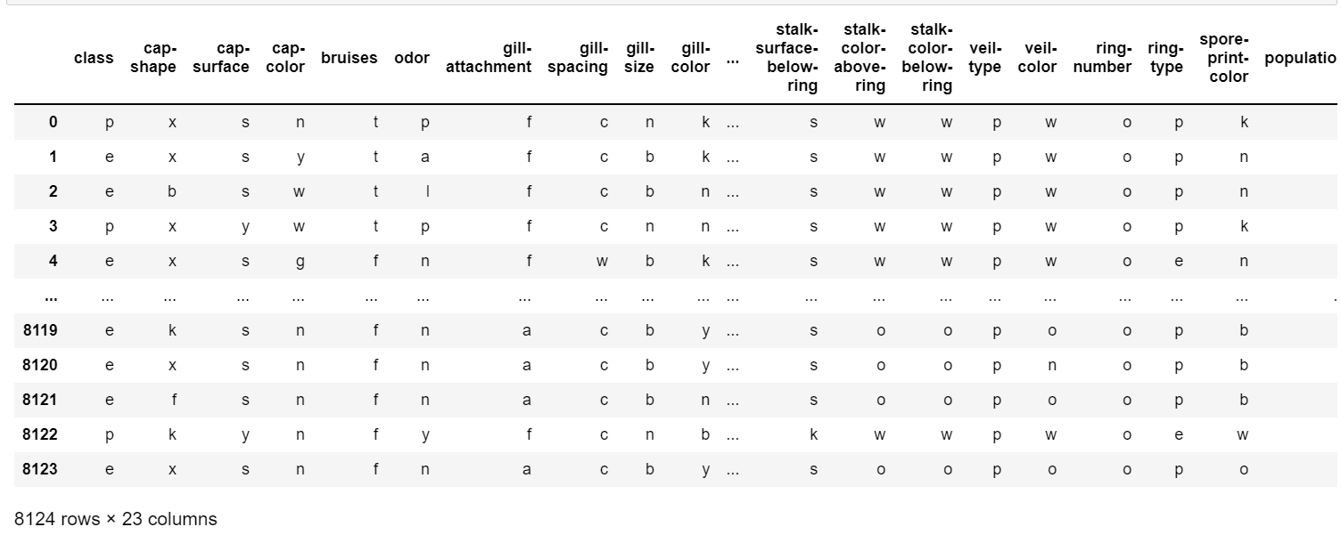
Import Dataset
Dataset of Mushroom

Slide 6
Description of Some attribute
Attribute Information: (classes: edible=e, poisonous=p)
cap-shape: bell=b,conical=c,convex=x,flat=f, knobbed=k,sunken=s
cap-surface: fibrous=f,grooves=g,scaly=y,smooth=s
cap-color: brown=n,buff=b,cinnamon=c,gray=g,green=r,pink=p,purple=u,red=e,white=w,yellow=y
bruises: bruises=t,no=f
odor: almond=a,anise=l,creosote=c,fishy=y,foul=f,musty=m,none=n,pungent=p,spicy=s
gill-spacing: close=c,crowded=w,distant=d
gill-size: broad=b,narrow=n
gill-color: black=k,brown=n,buff=b,chocolate=h,gray=g, green=r,orange=o,pink=p,purple=u,red=e,white=w,yellow=y
stalk-shape: enlarging=e,tapering=t
stalk-root: bulbous=b,club=c,cup=u,equal=e,rhizomorphs=z,rooted=r,missing=?
stalk-surface-above-ring: fibrous=f,scaly=y,silky=k,smooth=s
stalk-surface-below-ring: fibrous=f,scaly=y,silky=k,smooth=s
stalk-color-above-ring: brown=n,buff=b,cinnamon=c,gray=g,orange=o,pink=p,red=e,white=w,yellow=y

Slide 7
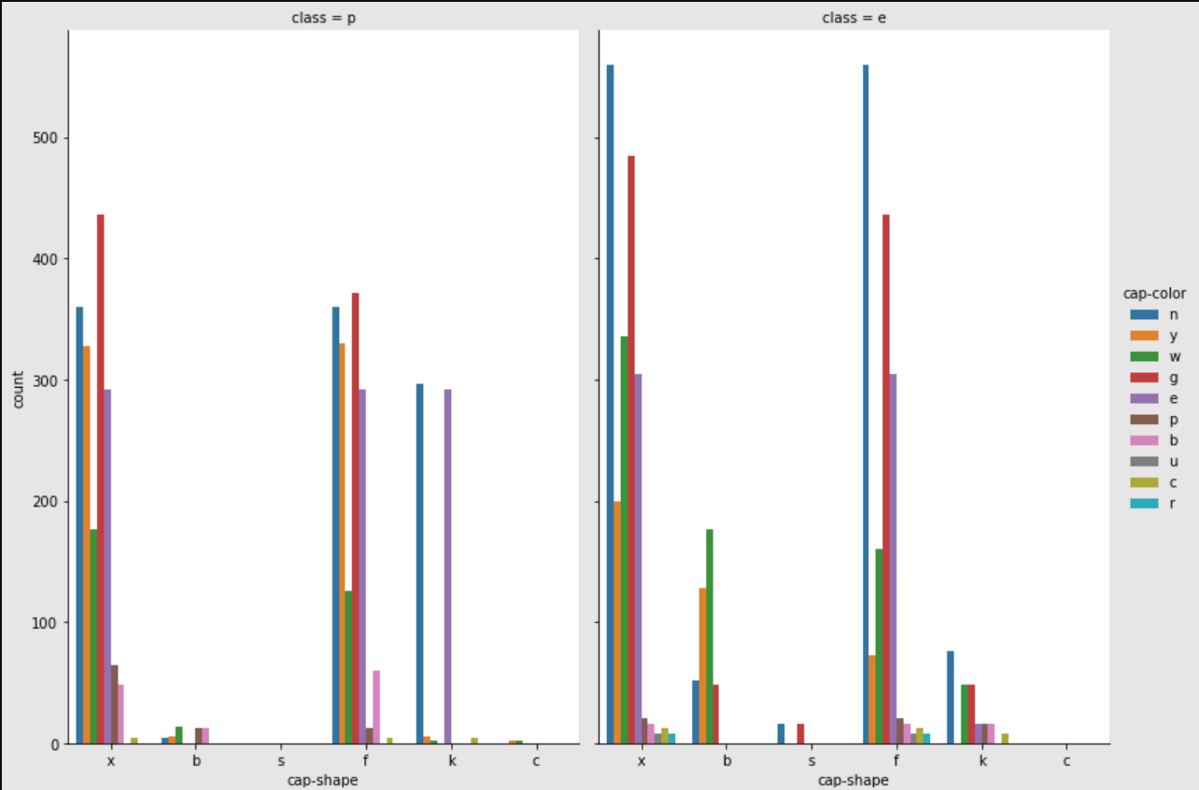
Using plotly library
import matplotlib.pyplot as plt
import plotly.express as px
Visualizing Part
From CountPlot, we can say that ##1: Green Color(g) & Convex Shape(x) are Poisonous Mushroom ##2: Brown color(n) & Flat Shape(f) / Convex Shape(x) are Edible Mushroom

Slide 8
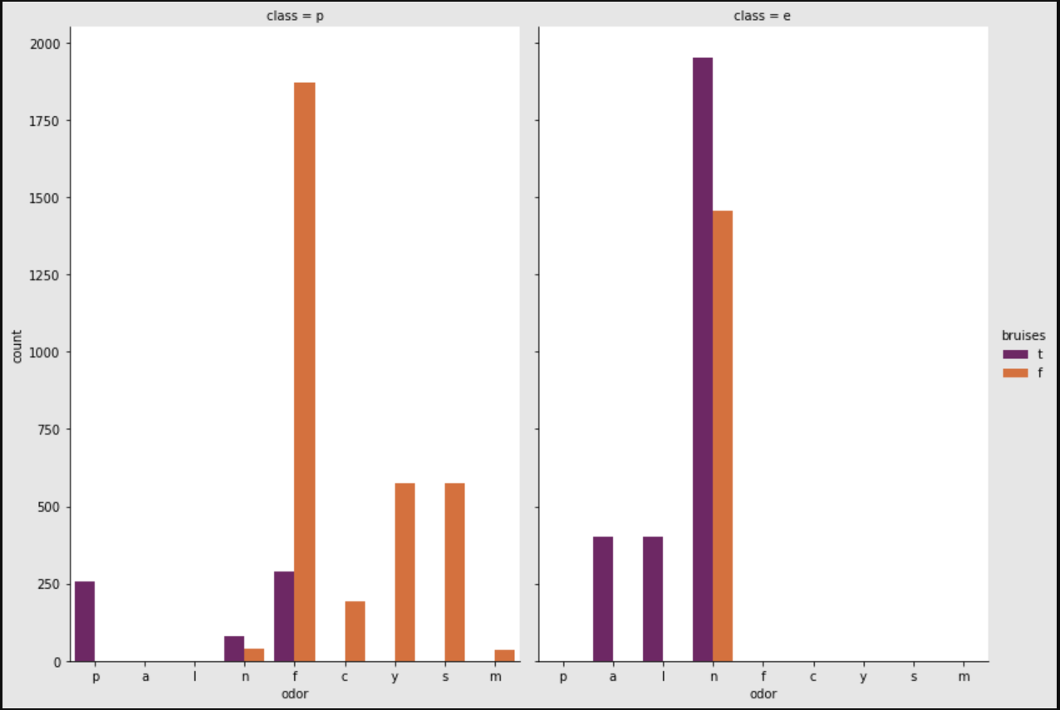
Visualization : Catplot
From above CatPlot we can say that ##1: Tapering Stalk Shape(t) with Missing Stock Root(m) are Poisonous Mushroom. ##2: Tapering Stalk Shape(t) with Bulbous Stock Root(b) are Edible Mushrooms.

Slide 9
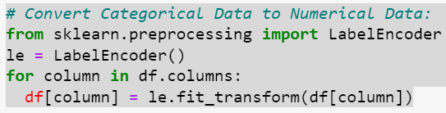
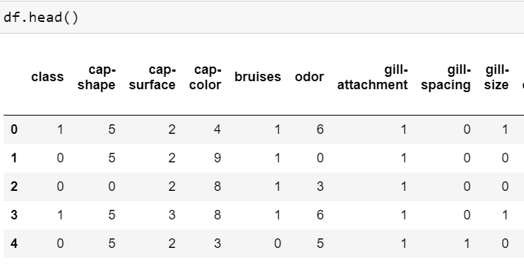
Data Preprocessing

Slide 10
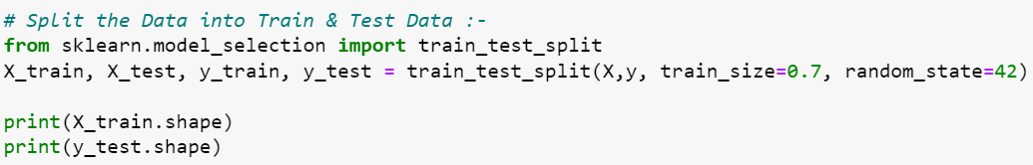

we have split columns into Train & Test data

Slide 11
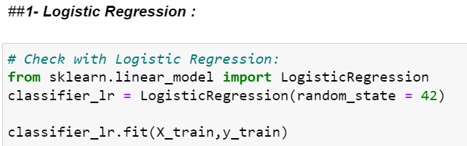

We Use serval Model to Classify the mushroom.csv file
Logistic regression
Random Forest method
Decision Tree Classifier
KNeighbors Classifier
Support Vector Classifier
Neural Network Model
Logistic regression

Slide 12
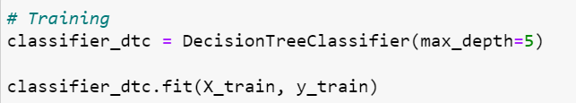
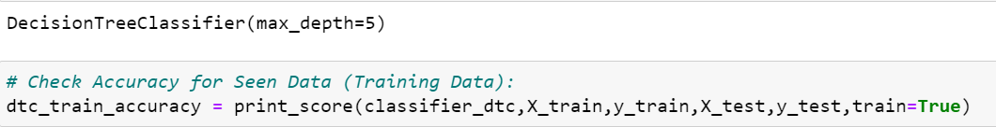

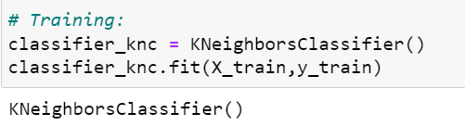

Decision Tree Classifier
KNeighbors Classifier

Slide 13

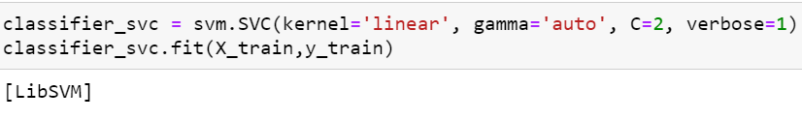



Support Vector Classifier
Neural Network Model

Slide 14
Model Deployment on Web Server
For model deployment ,we have implemented data on streamlit with the help of model .
1 . Logistic regression
SVM
Random Forest
1.Create .py file for streamlit containing all visualization tasks (Import dataset,Name of Stock, Describe
& Plots/Graphs)
2.Open the command prompt
3.Run pip install streamlit
streamlit run filename.py
4.New window will open containing streamlit data.

Slide 15
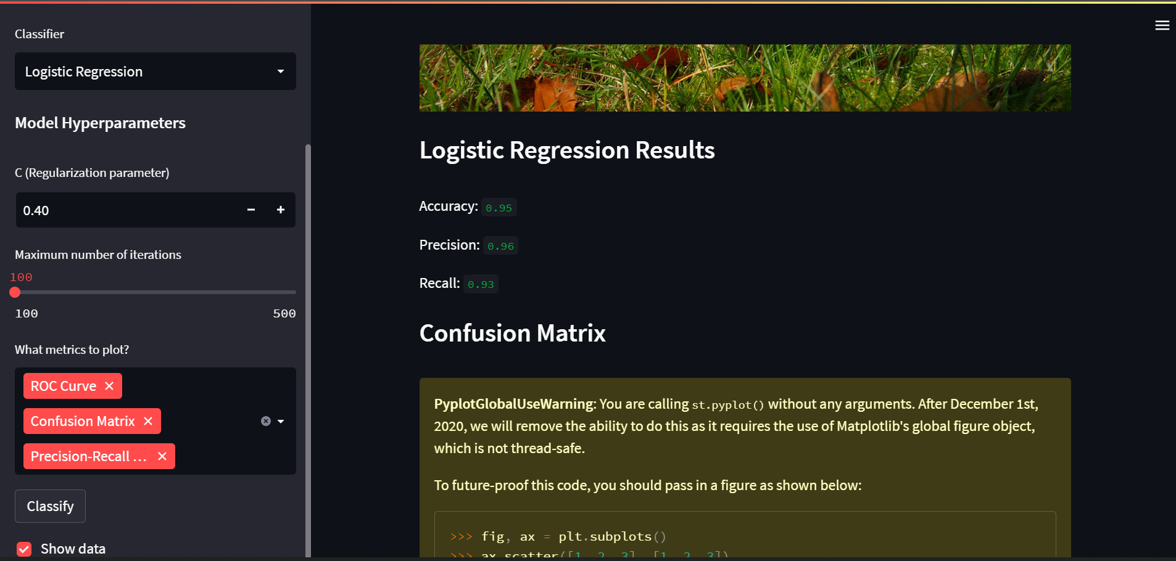
Deployment On streamlit

Slide 16
Team Member GitHub Links
Soham Jondhale : https://github.com/sohamjondhale
Vishal Chavan : https://github.com/vishalchavan5
Akash salve : https://github.com/Akki9295
Shweta Shrivastava : https://github.com/shwetashriwastava
Harshwardhan Murkute : https://github.com/HarshwardhanMurkute

Slide 17
Conclusion
We concluded that after applying Logistic regression , Random Forest,
SVM model on Mushroom.csv file, favorable result has shown its show accuracy of that models.
THANK YOU !

