Slide 1

Grower: Entrepreneurs Social Media Platform
Vishwakarma Institute of Technology , Pune
Department of Information Technology
Guide :Prof. Dr. Deepali Joshi
Students Names :
1. Pratik Mandalkar ,TY-IT-B, 25
2. Pratik Mane, TY-IT-B, 26
3. Netra Mohekar, TY-IT-B, 28
4. Pranav Patel, TY-IT-B, 45 5. Harshwardhan Patil, TY-IT-B, 50

Slide 2
Content
Introduction
Motivation
Literature Review
Problem Statement
Proposed Methodology
Tools/Technology Used
Project Flow Diagram

Slide 3
Introduction
“Grower: Entrepreneurs Social Media Platform” is a full-stack web application designed to empower entrepreneurs by creating a dedicated ecosystem for networking, innovation, and funding. This platform leverages cutting-edge technologies to bridge the gap between visionary entrepreneurs and venture capital.

Slide 4
Motivation
Entrepreneurial Challenges: Entrepreneurs often face barriers in accessing capital and expert advice due to fragmented networks.
Industry Gap: While many social platforms exist, none specifically cater to the unique needs of entrepreneurs and investors.
Our Vision: To create an interactive, engaging, and secure platform that not only facilitates idea sharing but also accelerates the process of connecting with potential investors.

Slide 5
Literature Review
Identified Gaps:
Limited AI assistance for content creation.
Lack of a cohesive, dedicated community that bridges the gap between idea generation and funding.
Inadequate tools for tailored networking based on user interests and industry trends.

Slide 6
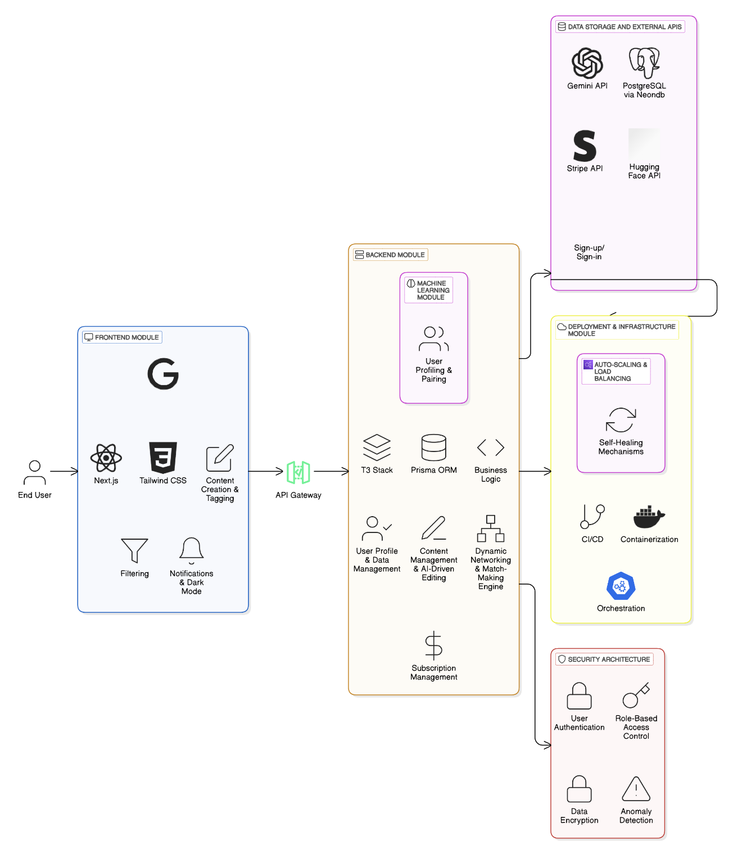
Proposed Methodology

Slide 7








Technology Stack
FRONTEND
BACKEND

Slide 8
Thank You

