Slide 1
SingleStore: Distributed SQL for the Real-Time Enterprise
ISM 6562 — Midterm Part 4 | Alpha Developers

Slide 2
AGENDA
What We'll Cover?
What is SingleStore?
Who built it — and who uses it
Distributed architecture & sharding
CAP Theorem positioning
HTAP: OLTP + OLAP in one system
Pros & cons
SingleStore in TechRetail
Q&A

Slide 3

What is SingleStore?
Distributed relational database for real-time data and analytics
Supports both OLTP + OLAP in one engine (HTAP)
MySQL compatible — works with existing tools
Dual storage engine:
Rowstore → fast transactions & lookups
Columnstore → high-performance analytics
Eliminates need for separate transactional and analytics systems

Slide 4
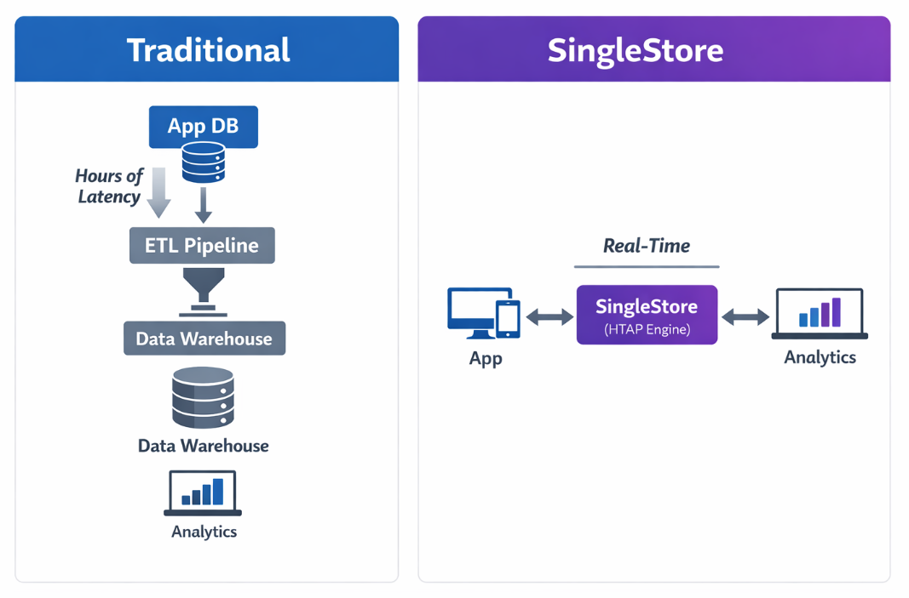

Slide 5
Who Built It — Who Uses It
Company | Use Case
Uber | Real-time analytics on ride events
Palo Alto Networks | Live threat detection
Nasdaq | Financial market surveillance
Comcast | Customer analytics at scale
Founded in 2011 as MemSQL
Founders:
Nikita Shamgunov (ex-Microsoft SQL Server)
Eric Frenkiel (ex-Facebook infrastructure)
Rebranded in 2021 → SingleStore
Headquarters: San Francisco, CA
Funding: $300M+ (Series F)

Slide 6
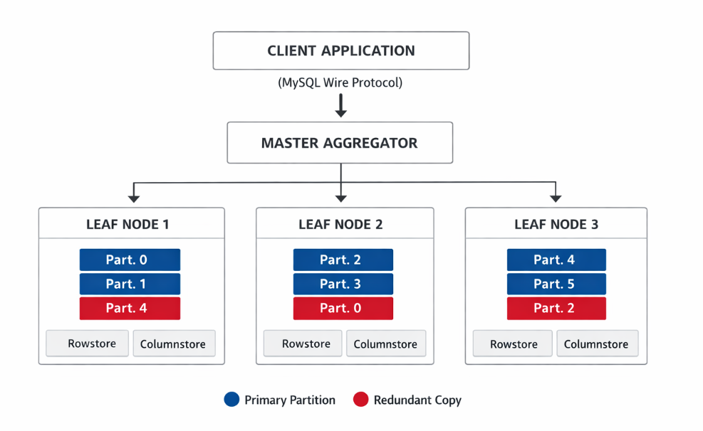
How SingleStore Distributes Data
Core Architecture
Hybrid Storage Engine (custom):
Rowstore (RAM): fast writes & point queries (OLTP)
Columnstore (Disk): fast analytical scans (OLAP)
Distributed Processing:
Queries are parallelized across nodes
Uses Two-Phase Commit (2PC) for consistency
Durability & Availability:
Synchronous replication
Each write is confirmed only after redundancy

Slide 7
CAP Theorem — SingleStore as CP
SingleStore in CAP
SingleStore = CP (Consistency + Partition Tolerance)
Guarantees strong consistency → always reads the latest data
Uses synchronous replication → writes confirmed only after replicas respond
During network failures → rejects writes (avoids stale data)
Not configurable → consistency level is fixed

Slide 8
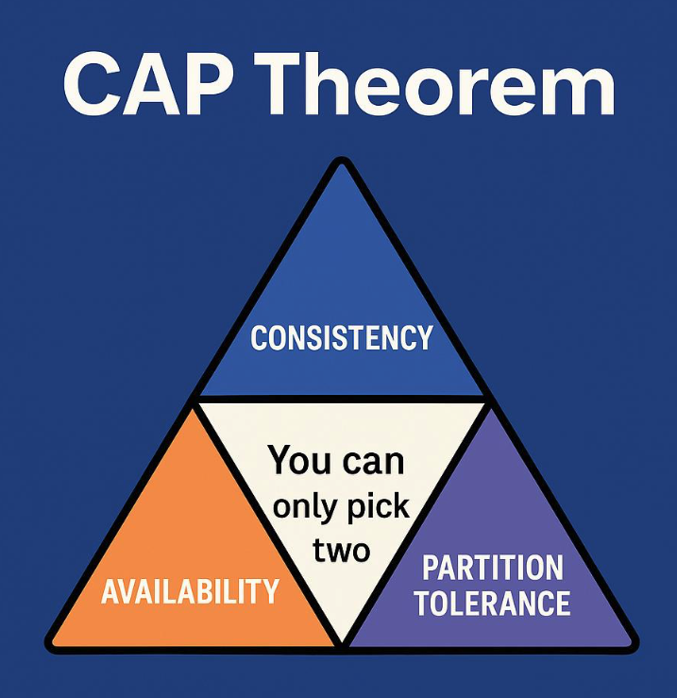
CAP Theorem — SingleStore as CP
System | CAP | Behavior During Partition | Configurable
PostgreSQL | CP | Rejects requests | ❌ No
Cassandra | AP | Continues (may return stale data) | ✅ Yes
SingleStore | CP | Rejects writes (ensures consistency) | ❌ No

Slide 9
Scaling Model — Automatic vs Manual Sharding
How SingleStore Scales
Automatic Sharding (Hash-Based Partitioning)
Define a shard key (e.g., customer_id)
System hashes each row → assigns it to a partition
Ensures even distribution across nodes
Unit of Distribution
→ Partition (default: 8 × number of leaf nodes)
Auto-Rebalancing
→ Add a node → partitions are redistributed automatically (no downtime)
Query Behavior
✅ Single-partition queries (using shard key) → very fast
⚠️ Cross-partition queries → require data movement (slower)

Slide 10
Aspect | Manual Sharding (Part 2) | SingleStore (Automatic)
Sharding strategy | Geographic (SE / NE) | Hash-based (shard key)
Scaling | Manual (create new shard) | Add node → auto-scale
ETL impact | Requires changes | No changes needed
Query complexity | UNION across shards | Handled automatically
Rebalancing | Manual | Automatic

Slide 11
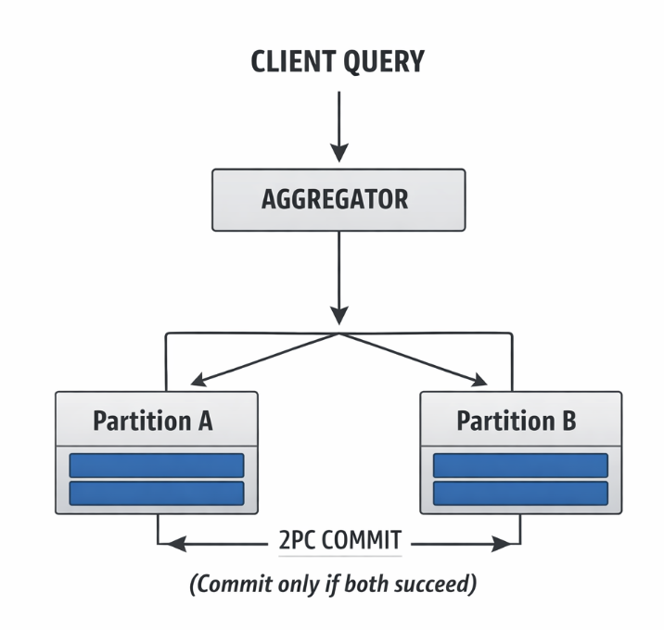
SQL Compatibility & Transactions
SQL Compatibility
MySQL wire-compatible → supports full SQL (JOINs, CTEs, window functions, subqueries, stored procedures)
Migration:
MySQL → no code changes ✅
PostgreSQL → driver change required (minor SQL adjustments)
Limitations:
❌ No SERIALIZABLE isolation (cluster-wide)
❌ No DDL inside transactions
❌ No DEFERRABLE constraints
⚠️ Cross-partition queries → broadcast join (slower at scale)

Slide 12
Would SingleStore Replace TechRetail's Architecture?
Current Architecture (Parts 1-3)
[Cassandra Cluster] ← High-velocity order writes.
[PG Shard SE] + [PG Shard NE] ← Reference data (customers, products).
[PG Warehouse DB] ← Star schema analytics.
[ETL Service (cron)] ← Connects all of the above.
Status: 4 separate systems + ETL latency + manual SE/NE sharding.
With SingleStore
[SingleStore Cluster]
Rowstore: Replaces Cassandra (ingestion) + PG Shards (reference data).
Columnstore: Replaces PG Warehouse (analytics, no ETL needed).
Auto hash partitioning: Replaces manual SE/NE sharding.
Status: 1 unified system, zero ETL, automatic sharding, real-time analytics.

Slide 13
Would SingleStore Replace TechRetail's Architecture?
Aspect | PG Shards | Cassandra | SingleStore
Primary Role | OLTP | Ingestion | HTAP
CAP | CP | AP | CP
Consistency | Strong | Eventual | Strong
Sharding | Manual | Auto | Auto
SQL Support | Full SQL | No JOINs | Full SQL
ETL Needed | Yes | Yes | ❌ No
Analytics | Slow | Poor | Fast
Write Speed | Medium | Very Fast | Fast
Cost | Free | Free | Expensive
HA | Primary-standby | Leaderless | Sync

Slide 14
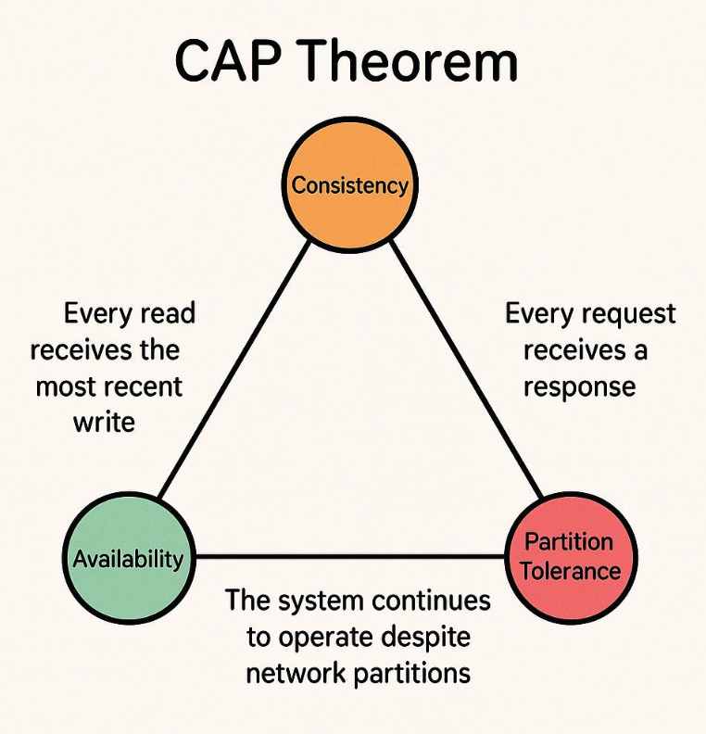
Conclusion — When Should You Use SingleStore?
Avoid SingleStore When:
Cost is a constraint → Open-source options (e.g., CockroachDB, YugabyteDB) may be more suitable
You need always-available writes (AP model) → e.g., Cassandra during network partitions
Hardware limitations → In-memory rowstore requires strong infrastructure
Pure OLTP workload → Simpler databases can handle this more efficiently
Need SERIALIZABLE isolation (distributed) → Not supported cluster-wide

