Slide 1
SIT BACK AND
ENJOY THE CV

Slide 2
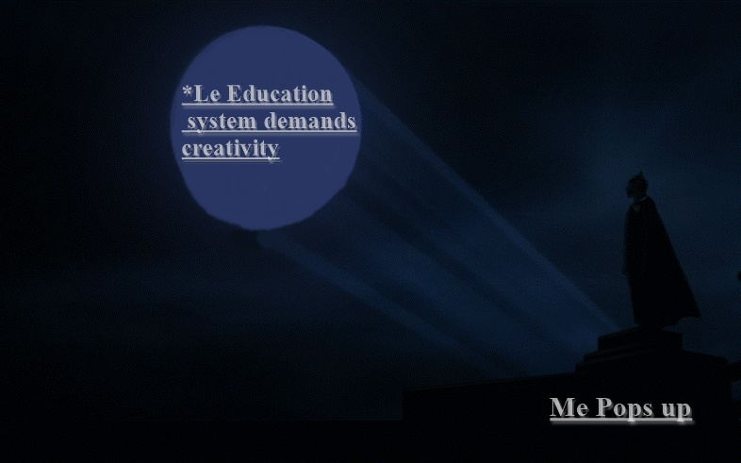

Slide 3
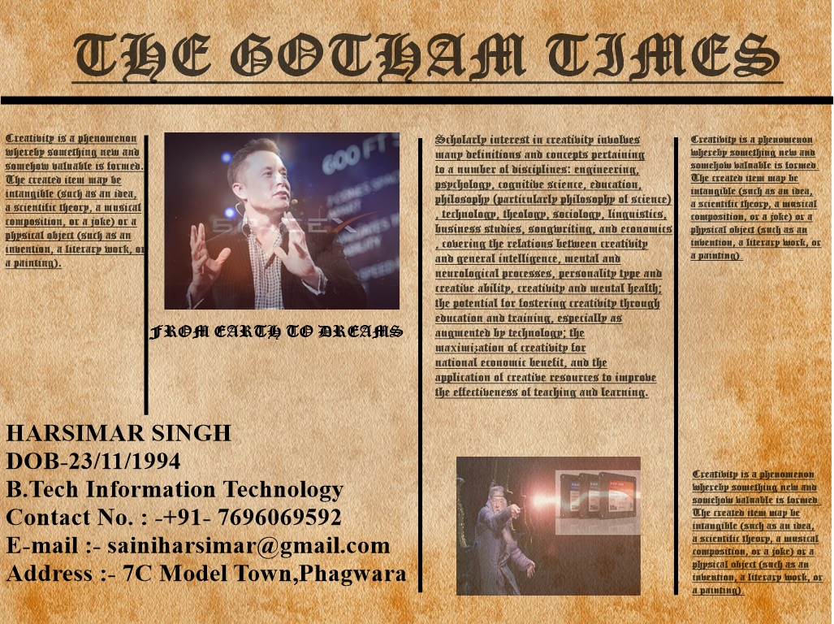

Slide 4
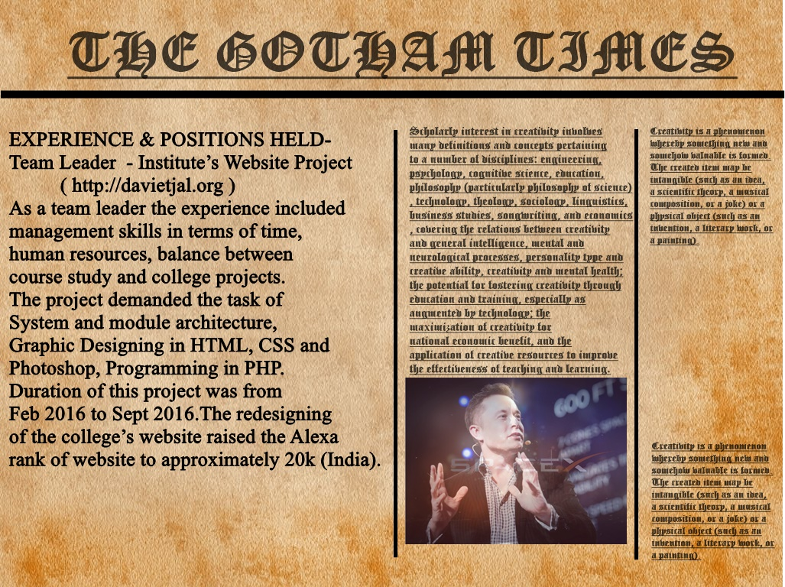

Slide 5
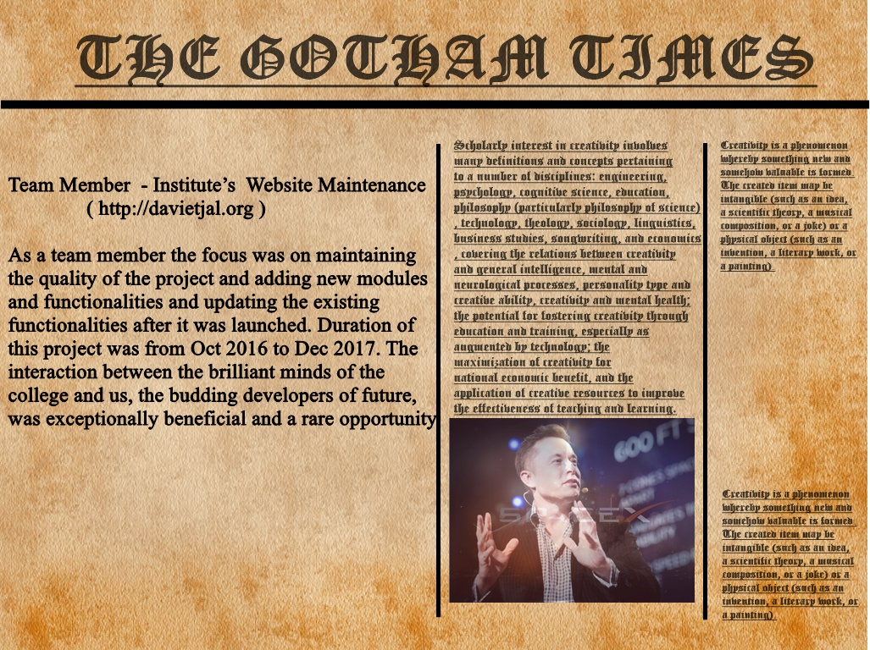

Slide 6
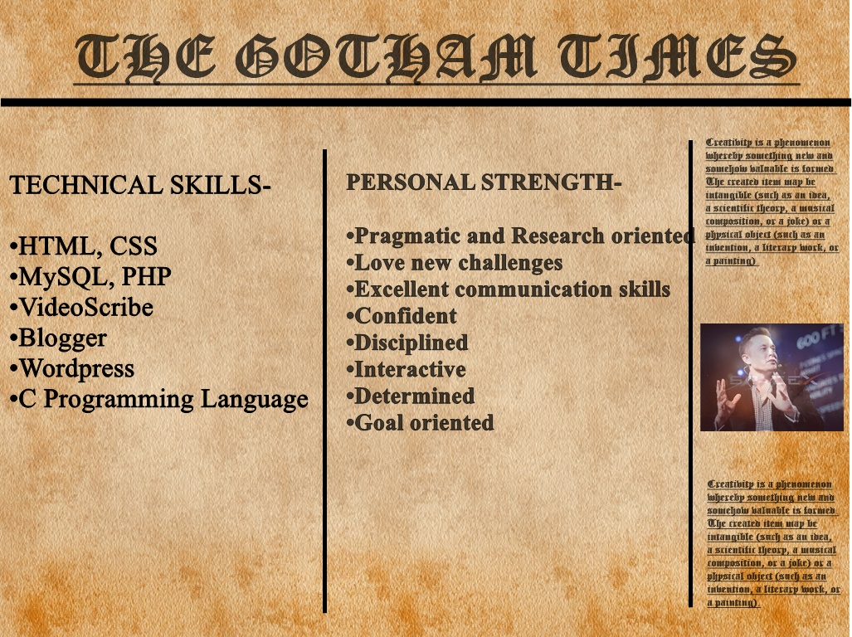

Slide 7

THE GOTHAM TIMES
GATE RANK – 5912 / 96878
HOBBIES -
• Acquiring new skills
• Reading
Public Speaking
Art and painting
Workout

Slide 8
