Slide 1
Database for a Financial Services company
By Harsimran Singh

Slide 2
What? Why? How?

Slide 3
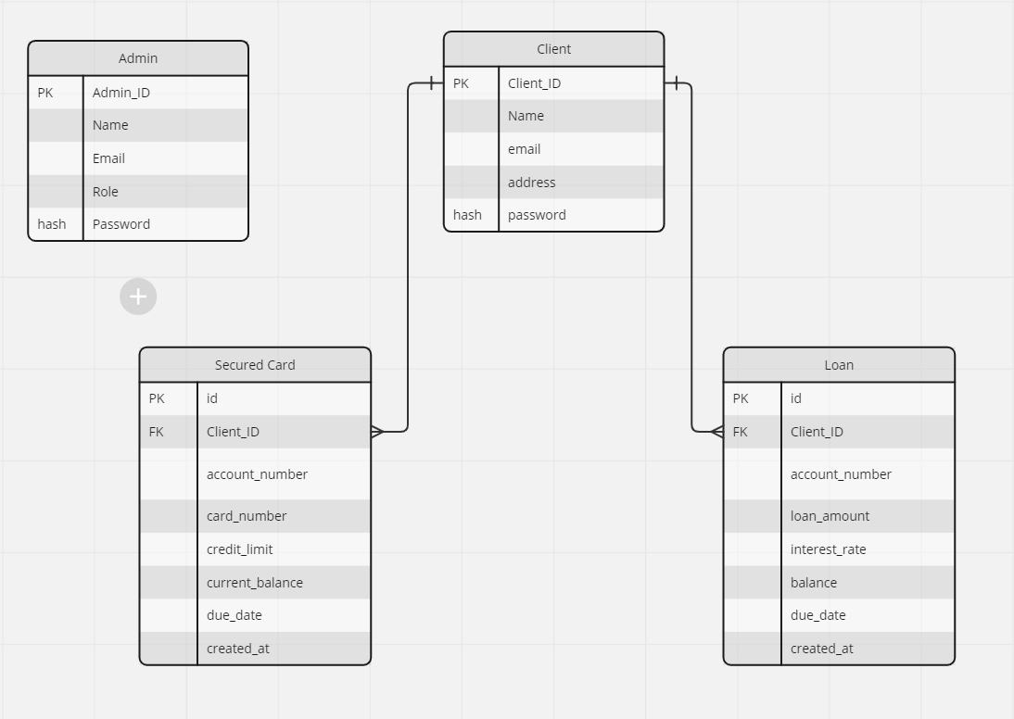
The ER Diagram

Slide 4
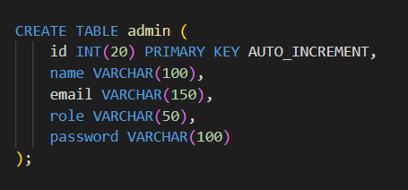
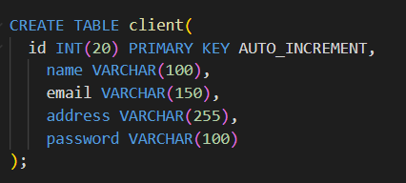
User Tables
Admin User Table
Client User Table
Notes:
CREATE TABLE admin (
id INT(20) PRIMARY KEY AUTO_INCREMENT,
name VARCHAR(100),
email VARCHAR(150),
role VARCHAR(50),
password VARCHAR(100)
);
CREATE TABLE client(
id INT(20) PRIMARY KEY AUTO_INCREMENT,
name VARCHAR(100),
email VARCHAR(150),
address VARCHAR(255),
password VARCHAR(100)
);

Slide 5
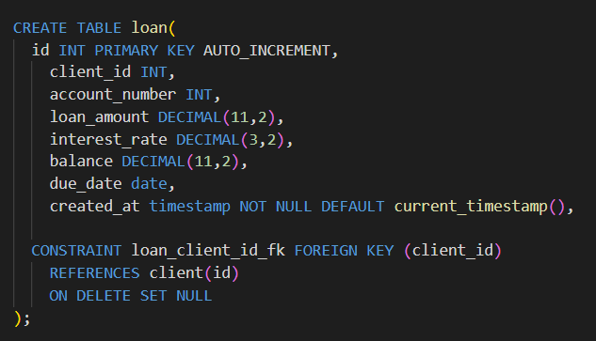
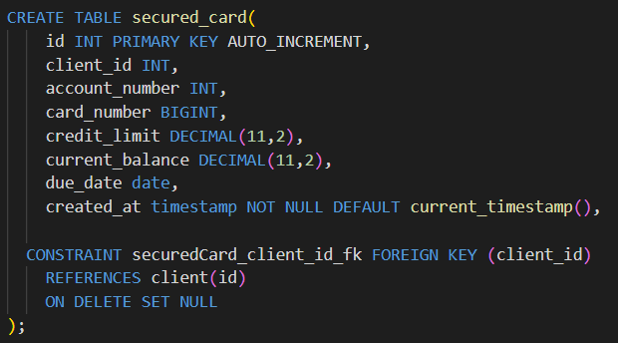
Account Tables
Loan Card
Secured Account
Notes:
CREATE TABLE admin (
id INT(20) PRIMARY KEY AUTO_INCREMENT,
name VARCHAR(100),
email VARCHAR(150),
role VARCHAR(50),
password VARCHAR(100)
);
CREATE TABLE client(
id INT(20) PRIMARY KEY AUTO_INCREMENT,
name VARCHAR(100),
email VARCHAR(150),
address VARCHAR(255),
password VARCHAR(100)
);

Slide 6
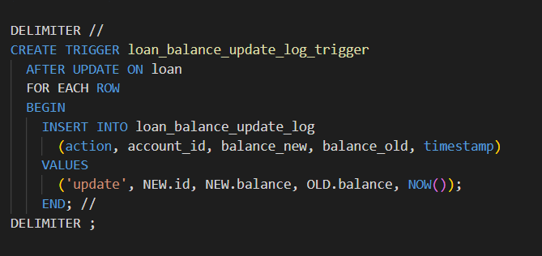
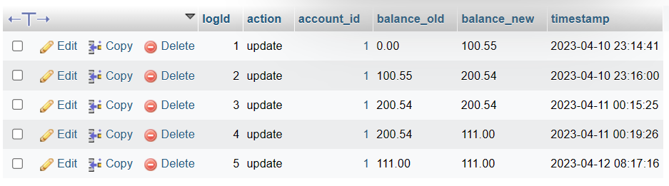
Triggers
The Loan Balance Update log trigger
Notes:
CREATE TABLE loan_balance_update_log (
logId INT PRIMARY KEY AUTO_INCREMENT,
action VARCHAR(255),
account_id INT,
balance_old VARCHAR(255),
balance_new VARCHAR(255),
timestamp TIMESTAMP,
CONSTRAINT loan_log_id_fk FOREIGN KEY (account_id)
REFERENCES loan(id)
ON DELETE SET NULL
);

Slide 7
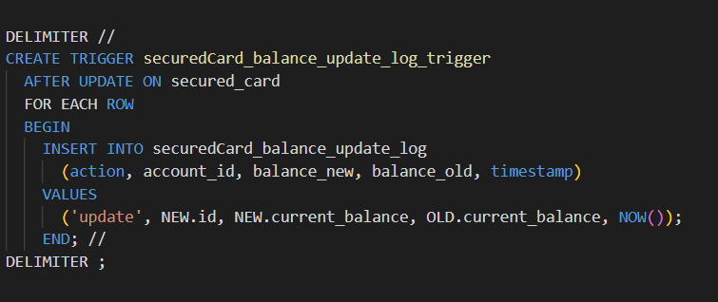
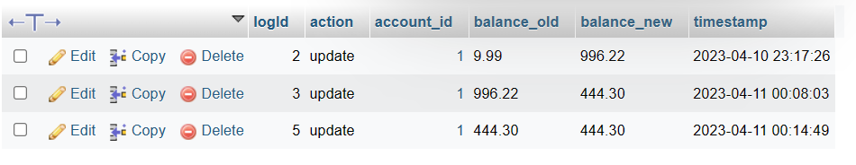
Triggers
The Secured Card Balance Update log trigger
Notes:
CREATE TABLE securedCard_balance_update_log (
logId INT PRIMARY KEY AUTO_INCREMENT,
action VARCHAR(255),
account_id INT,
balance_old VARCHAR(255),
balance_new VARCHAR(255),
timestamp TIMESTAMP,
CONSTRAINT securedCard_log_id_fk FOREIGN KEY (account_id)
REFERENCES secured_card(id)
ON DELETE SET NULL
);

Slide 8
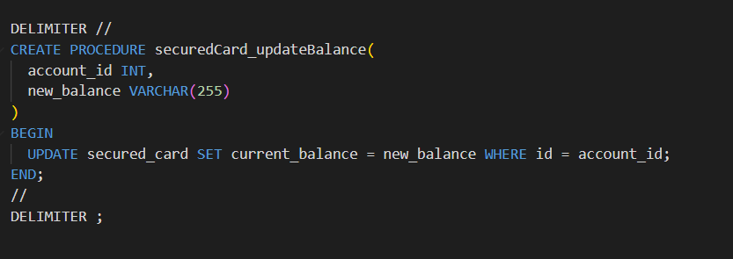
Procedures
For Updating balance of a secured card account

Slide 9
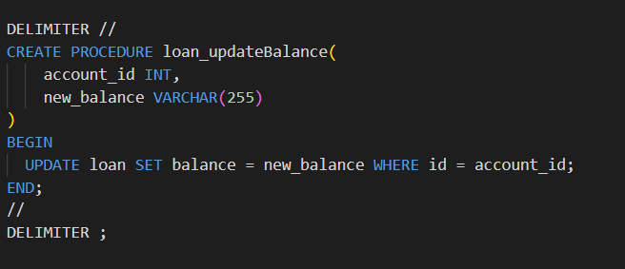
Procedures
For Updating balance of a loan account

Slide 10
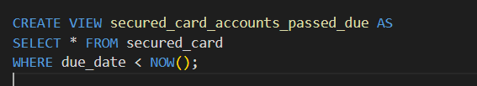
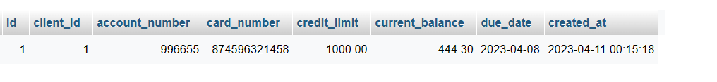
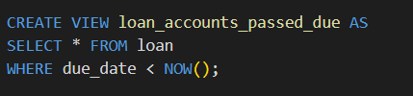
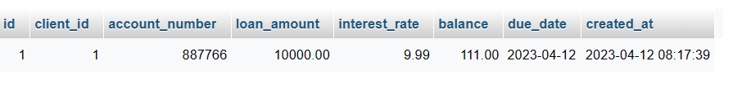
Views
For showing accounts that passed their due date

Slide 11

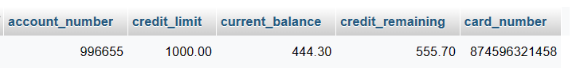
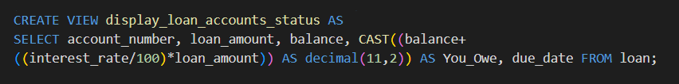

Views
For showing accounts with their pending

Slide 12
The Today Problem?

Slide 13
Thank You!
By Harsimran Singh

