Slide 1

Section - E | G5
Strategic Procurement Analysis: Optimizing Spend Efficiency & Reducing Risk
Public Administration & Government Finance
TEAM MEMBERS:
S.Harsith Priyan - 2401010398
Asad Ali - 2401010108
Himani Pinjani - 2401020115
Bhumi Rastogi - 2401010129
Joshit Dutta - 2401010203
Siddhant Giri - 2401010455

Slide 2
Sector Context:
Context & Problem Statement
Public procurement involves managing billions of taxpayer dollars. The City of Chicago allocates funds across 45+ departments and thousands of vendors. Inefficiencies here lead to wasted public funds and operational delays.
Problem Statement:
"Is the City’s procurement spending efficient and stable, or are there hidden risks in vendor concentration, approval bottlenecks, and contract volatility?"
Objective:
To build a dynamic dashboard that transforms raw contract data into actionable intelligence, specifically identifying spending concentration, administrative delays, and financial risks.

Slide 3
Data Engineering
(Source to Sink)
Source
(The "Extract")
Data Cleaning (Key Actions)
Data Dictionary
(The "Governance")
  Name: City of Chicago Administration & Finance Data (Public Ledger).
  Size: 10,000 Rows, 20 Columns (Raw).
  Time Period: 1990 – 2026 (Projected).
  Standardization: Unified inconsistent vendor names (uppercase) for accurate grouping.
  Imputation: Filled missing Start/End dates to enable timeline analysis.
  Feature Engineering: Created Approval_Delay_Days and Contract_Duration to measure operational efficiency.
  Created a comprehensive Data Dictionary to track the transformation pipeline.
  Documented data types, mapped raw columns to cleaned features, and recorded every "Issue Found" against its specific "Cleaning Action Taken" to ensure data integrity and reproducibility.

Slide 4
KPI & Metrics Framework
Primary KPIs :
Why These KPIs?
  Total Spend: $31.56 Billion (Measures Financial Scale).
  Avg Approval Delay: 1180 Days (Measures Administrative Efficiency).
  Negative Mods: 80 (Measures Negative ).
  % High Value Contracts: 10.9% (Measures Portfolio Complexity).
We chose a mix of Financial (Spend), Operational (Delay), and Risk (Concentration) metrics to provide a holistic "Health Check" of the procurement system, rather than just looking at costs.

Slide 5


Observation 1
(The Whale)
Observation 3
(The Bottleneck)
Spending is highly concentrated. The Department of Finance and Aviation alone account for over 35% of the total budget.
The average contract takes 805 days (>2 years) to be fully approved, indicating a severe administrative lag.
Key Insights
Observation 2
(Vendor Monopoly)
Observation 4
(Volatility)
The top 5 vendors control nearly 30% of the entire city spend. The largest single vendor (Blue Cross Blue Shield) takes ~15% of the total pie.
25% of contracts are "Depends Upon Requirements" (Blanket Contracts), meaning the city has indefinite financial commitments without fixed caps.

Slide 6

Advanced Analysis
Risk Segmentation:
Pareto Analysis:
  We segmented contracts by "Risk Flags": High Value, Negative Modifications, and Zero Awards.
  Finding: While only 0.8% of contracts have Negative Modifications, these represent specific failures in planning that incur penalties or scope reductions.
  80/20 Rule Confirmed: A small fraction of "Large" contracts drives the vast majority of spending.
  Insight: Operational focus should shift from the thousands of "Small" contracts to the few "Large" ones to maximize impact.

Slide 7
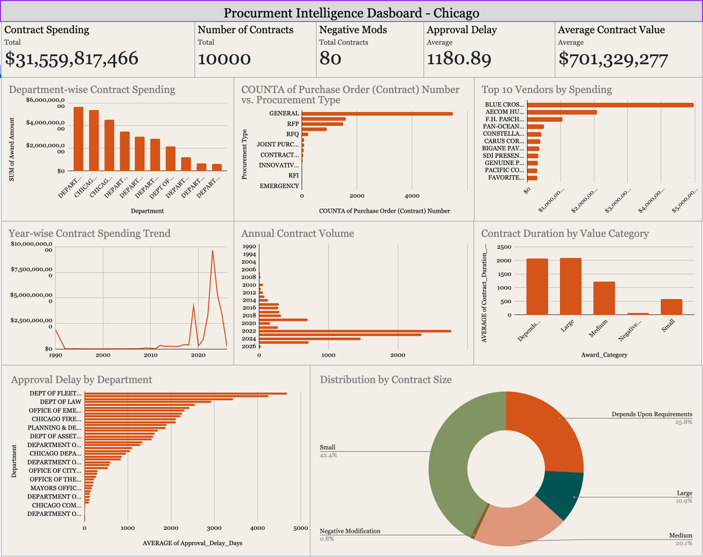
Dashboard Walkthrough
Executive View (Top Row):
  Immediate visibility into Total Spend ($31.5B) and Critical Flags (Approval Delay).
Operational View (Charts):
  Slicer Interactivity: Allows the user to drill down by Department (e.g., selecting "Transportation" instantly filters vendor lists and trends).
  Trend Analysis: The "Yearly Spending Trend" chart helps officials forecast future budget needs based on historical spikes.

Slide 8
Recommendations
Diversify the Vendor Ecosystem:
Action: Break down "Mega-Contracts" (like the $4B+ healthcare spend) into smaller bundles to encourage bidding from mid-sized vendors and reduce the "Too Big to Fail" risk.
01.
Implement "Express Lane" Approvals:
Action: The 805-day average delay is critical. Create a fast-track approval process for standard, low-value contracts (<$50k) to reduce the backlog.
02.
Cap "Blanket" Contracts:
Action: Limit "Depends Upon Requirements" contracts to a fixed % of the budget (e.g., max 20%) to prevent unchecked spending creep.
03.

Slide 9
Impact & Value
Financial Impact:
Increasing vendor competition by 10% could yield estimated savings of $1.5 Billion (5% of total spend).
Operational Impact:
Reducing approval delay from 800 days to 400 days would save thousands of administrative man-hours annually.
Governance:
Real-time monitoring of "Negative Modifications" allows for early intervention before contracts fail.

Slide 10
Limitations &
Next Steps
Limitations:
  Granularity: The dataset provides contract-level totals but lacks line-item details (we know who got paid, but not exactly which items were bought).
  Historical Gaps: Data pre-2010 has inconsistent fields compared to recent entries.
Next Steps:
  Integrate "Line Item" procurement data for deeper unit-price analysis.
  Automate the data pipeline to refresh the dashboard weekly instead of static CSV uploads.

Slide 11
Thank you very much!
TEAM MEMBERS:
S.Harsith Priyan - 2401010398
Asad Ali - 2401010108
Himani Pinjani - 2401020115
Bhumi Rastogi - 2401010129
Joshit Dutta - 2401010203
Siddhant Giri - 2401010455

