Slide 1
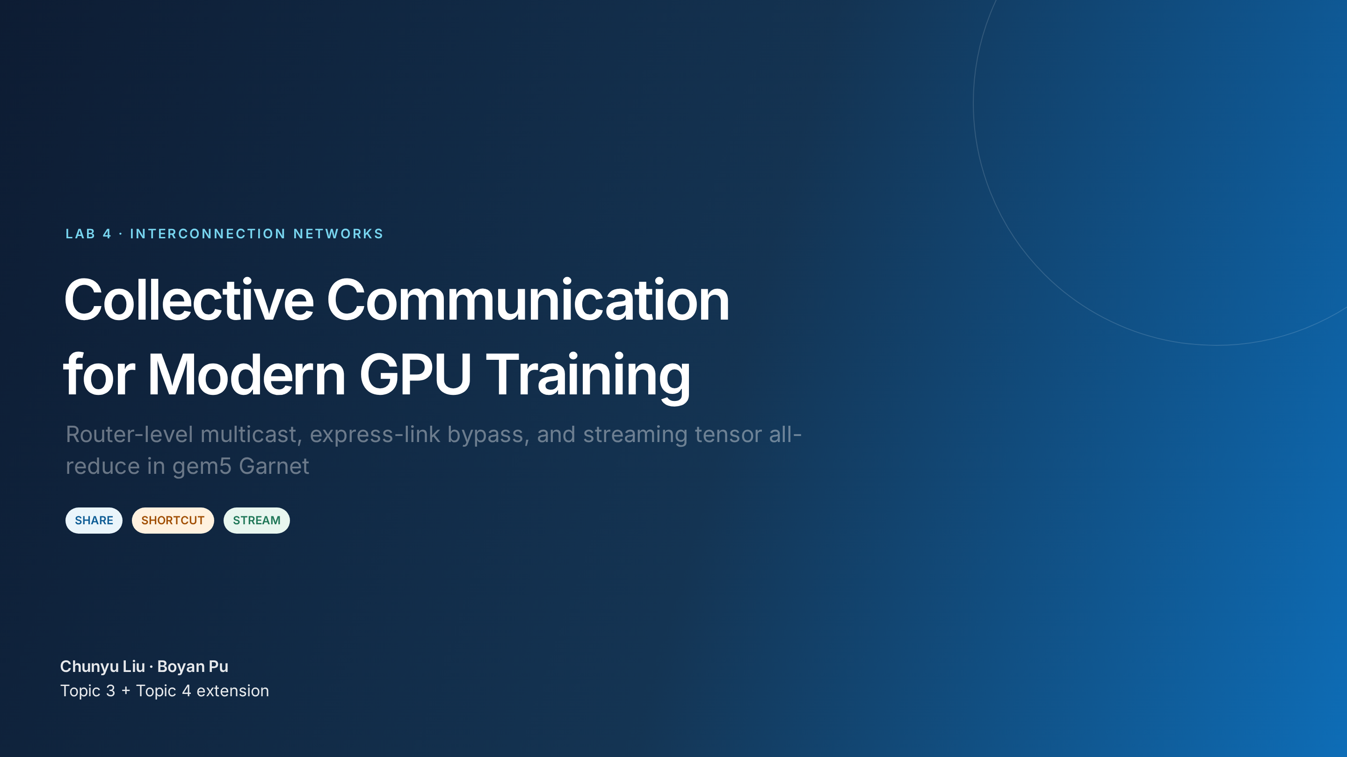
Notes:
Good morning. Our project asks one question: if GPU training repeatedly pays for collective communication, what structure should the NoC expose directly? We built and evaluated three mechanisms in gem5 Garnet: tree multicast, physical bypass links, and streaming tensor all-reduce. Timing: 0:00–0:20.

Slide 2
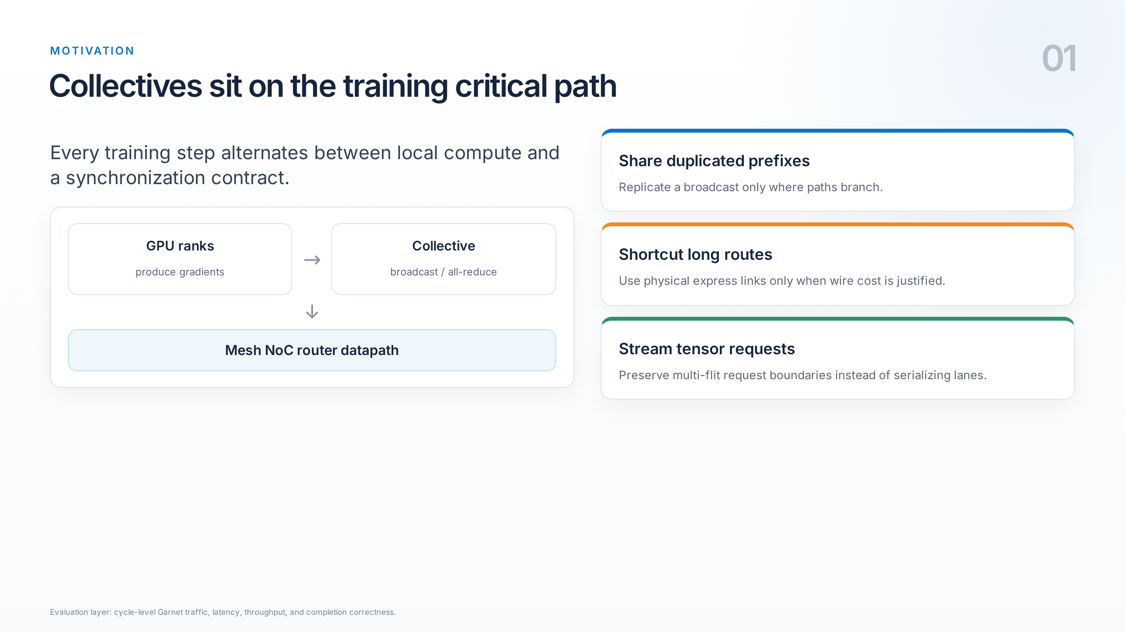
Notes:
The communication phase delays the next training step. We found three different kinds of structure to exploit: shared prefixes in one-to-many traffic, shorter physical routes, and tensor request boundaries. The key point is that these are separate opportunities, so each needs its own baseline and metric. Timing: 0:20–0:55.

Slide 3
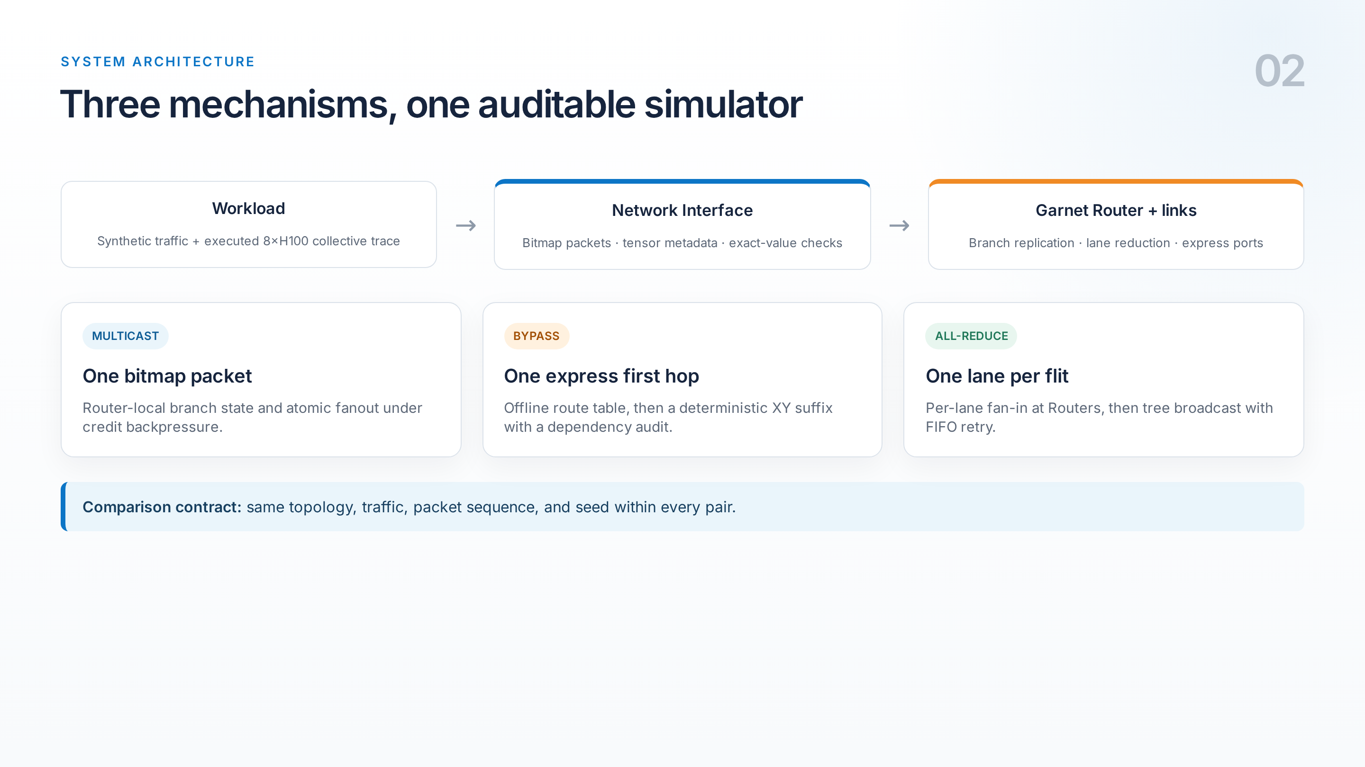
Notes:
The implementation touches the workload, Network Interface, Router, routing logic, and physical topology. The NI creates bitmap or tensor metadata and checks exact delivery. Routers replicate multicast branches or merge tensor lanes. For bypass, the route table chooses at most one express first hop, then uses an audited XY suffix. Every performance comparison is paired with identical workload inputs. Timing: 0:55–1:35.

Slide 4
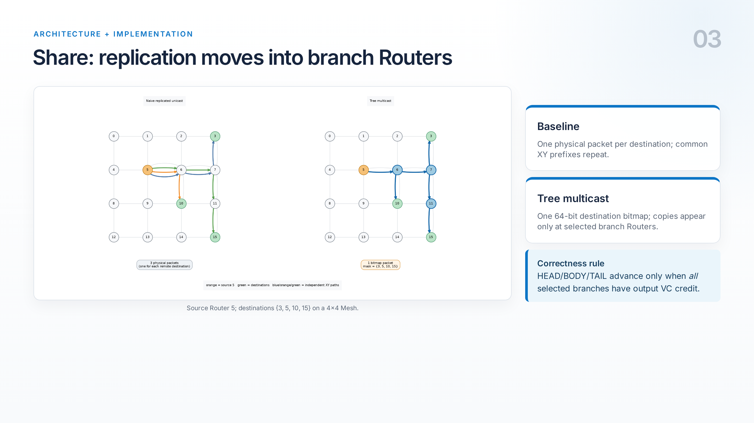
Notes:
The naive baseline sends a complete packet to each destination. Our packet instead carries a destination bitmap. Each Router removes local destinations, computes outgoing branches, and replicates only there. Multi-flit branch state is retained until the tail. To keep copies consistent under backpressure, fanout is atomic: a flit advances only when every selected output has credit. That guarantees correctness, but it also creates a performance trade-off. Timing: 1:35–2:15.

Slide 5
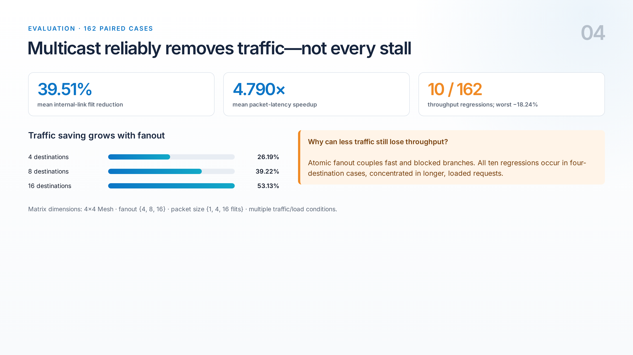
Notes:
Across 162 paired cases, multicast removes 39.51 percent of internal-link flits on average, and the saving rises monotonically with fanout. Latency improves in every pair. Throughput is more nuanced: ten cases regress, all at fanout four. This is not contradictory. The tree performs less total link work, but atomic fanout lets one blocked branch hold the others. So traffic reduction is structural; throughput remains workload dependent. Timing: 2:15–2:55.

Slide 6
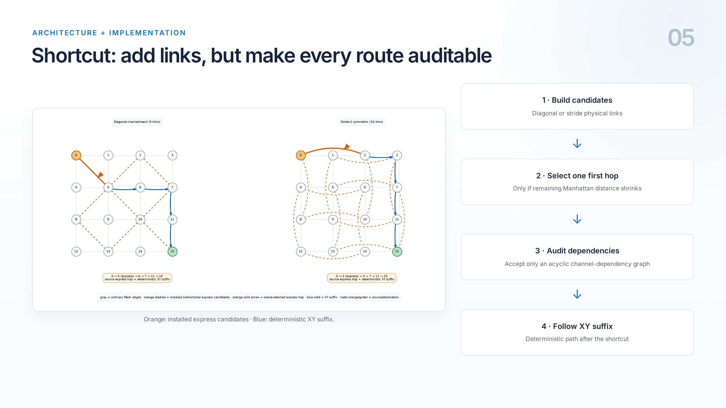
Notes:
Bypass adds physical diagonal or stride links. Before simulation, a route-table builder considers every source-destination pair and records at most one express first hop when it reduces the remaining Manhattan distance. The rest of the route is deterministic XY. We then build the channel-dependency graph and accept only acyclic placements. This makes the shortcut deadlock-safe and auditable, instead of relying on an opaque adaptive choice. Timing: 2:55–3:40.

Slide 7
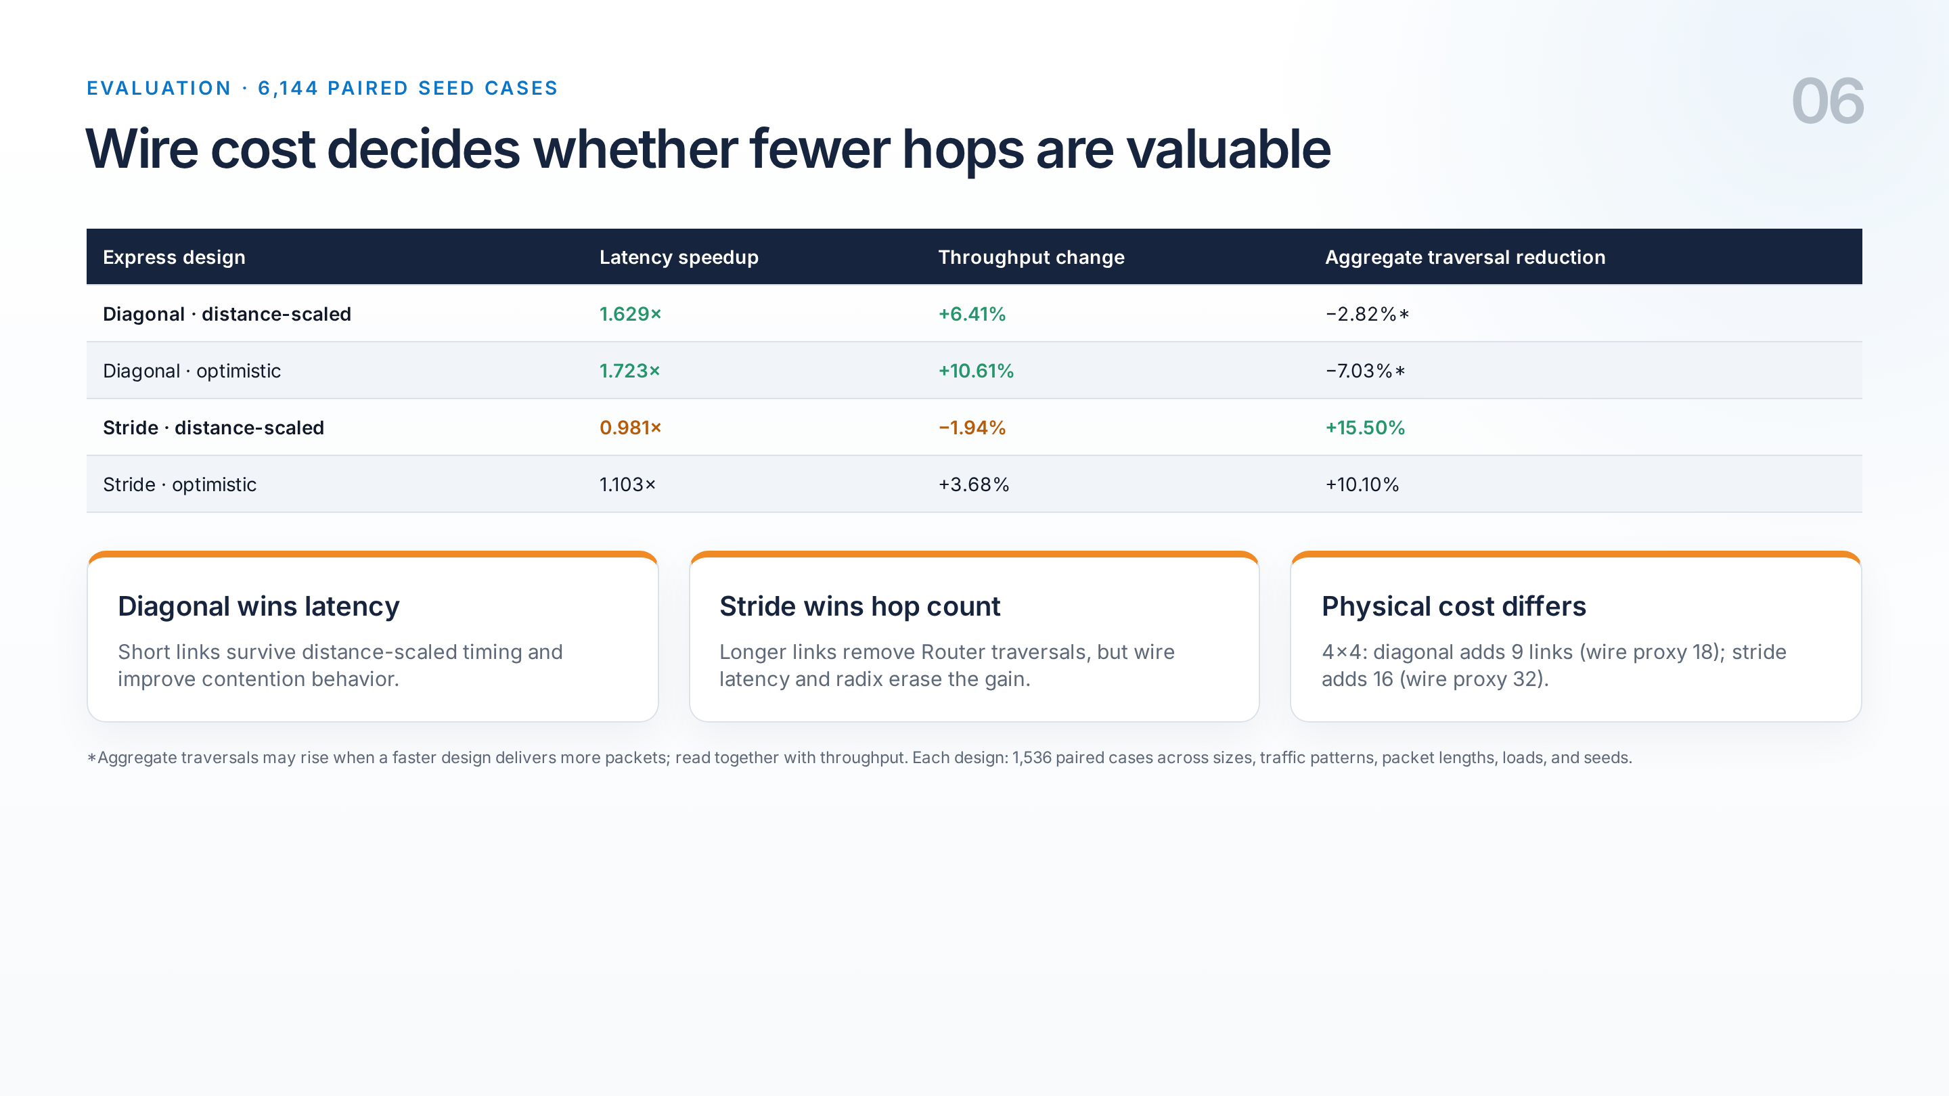
Notes:
The primary bypass sweep contains 1,536 paired cases per design. Distance-scaled diagonal links give the best hardware-oriented result: 1.629 times mean latency speedup and 6.41 percent throughput improvement. Stride links remove more Router traversals, but under distance-scaled wire timing they average a slight slowdown. The lesson is that hop reduction is not enough; wire span, added links, radix, and congestion determine whether the physical shortcut is useful. Timing: 3:40–4:30.

Slide 8
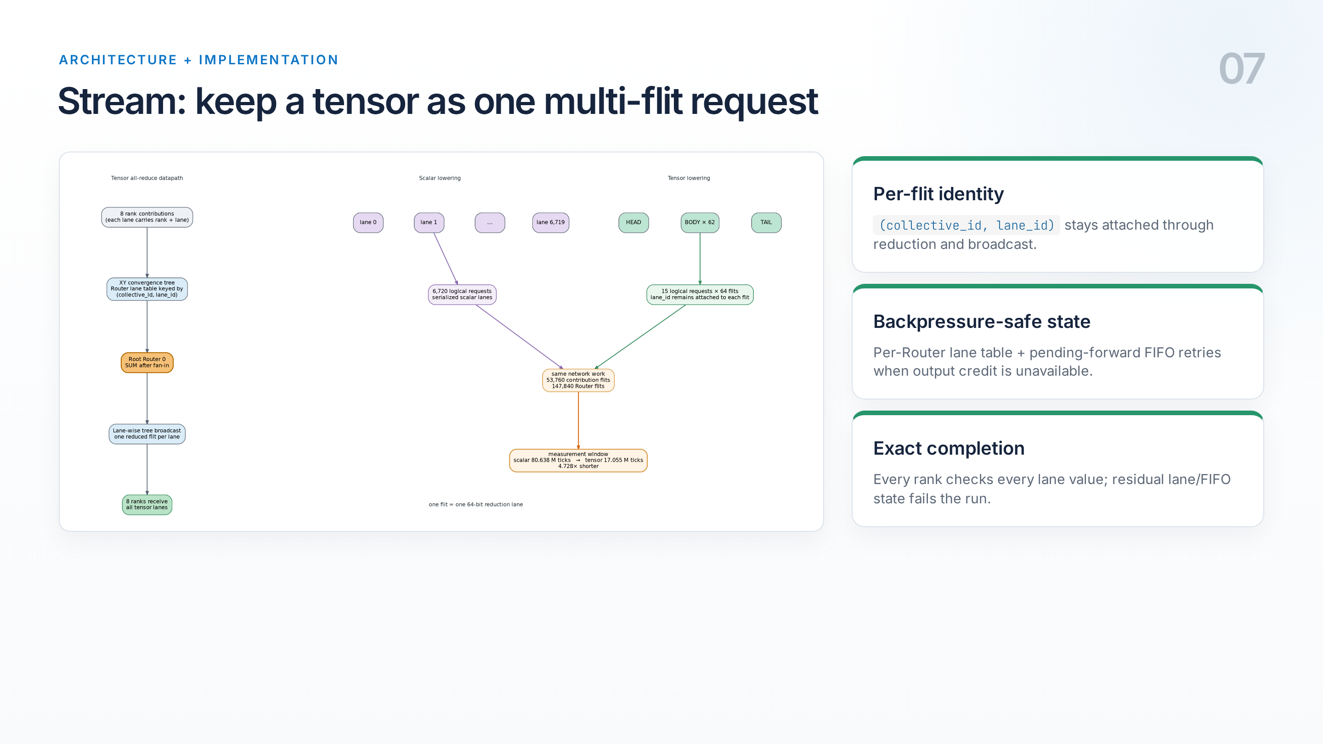
Notes:
Our Topic 4 extension replaces a scalar all-reduce path with a true multi-flit tensor request. Each flit carries a lane ID. Routers key accumulation state by collective and lane, merge contributions on an XY convergence tree, and broadcast the result. If downstream credit is unavailable, a FIFO retains the forward rather than dropping or failing. At completion, every rank checks the exact value of every lane, and we assert that no collective state remains. Timing: 4:30–5:15.

Slide 9
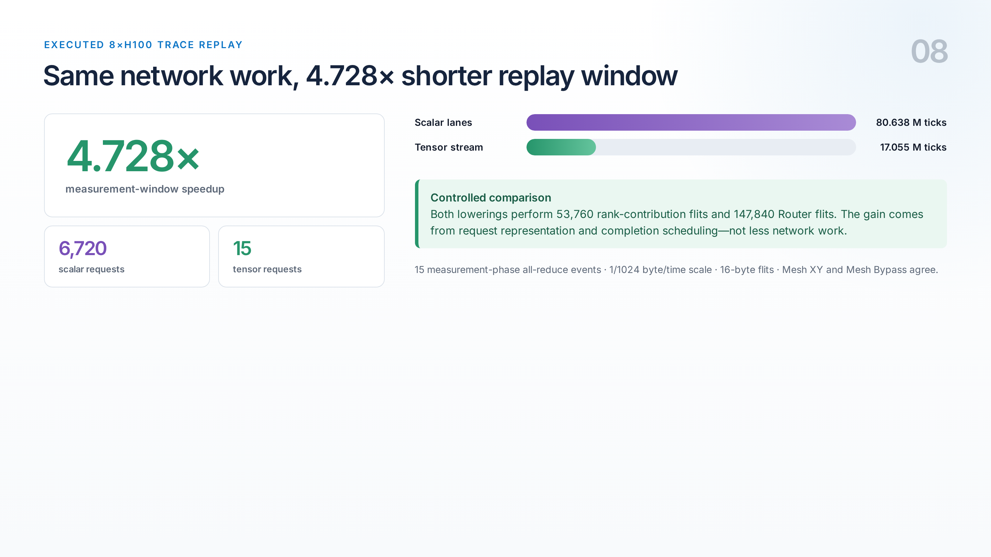
Notes:
We replayed 15 measurement-phase all-reduces from an executed eight-H100 NCCL microbenchmark. The old lowering serializes 6,720 scalar lanes; the new lowering retains 15 multi-flit requests. The replay window falls from 80.638 to 17.055 million ticks, a 4.728 times speedup. Importantly, both execute exactly 53,760 contribution flits and 147,840 Router flits, so this isolates request representation and scheduling rather than claiming less physical traffic. Timing: 5:15–6:00.

Slide 10
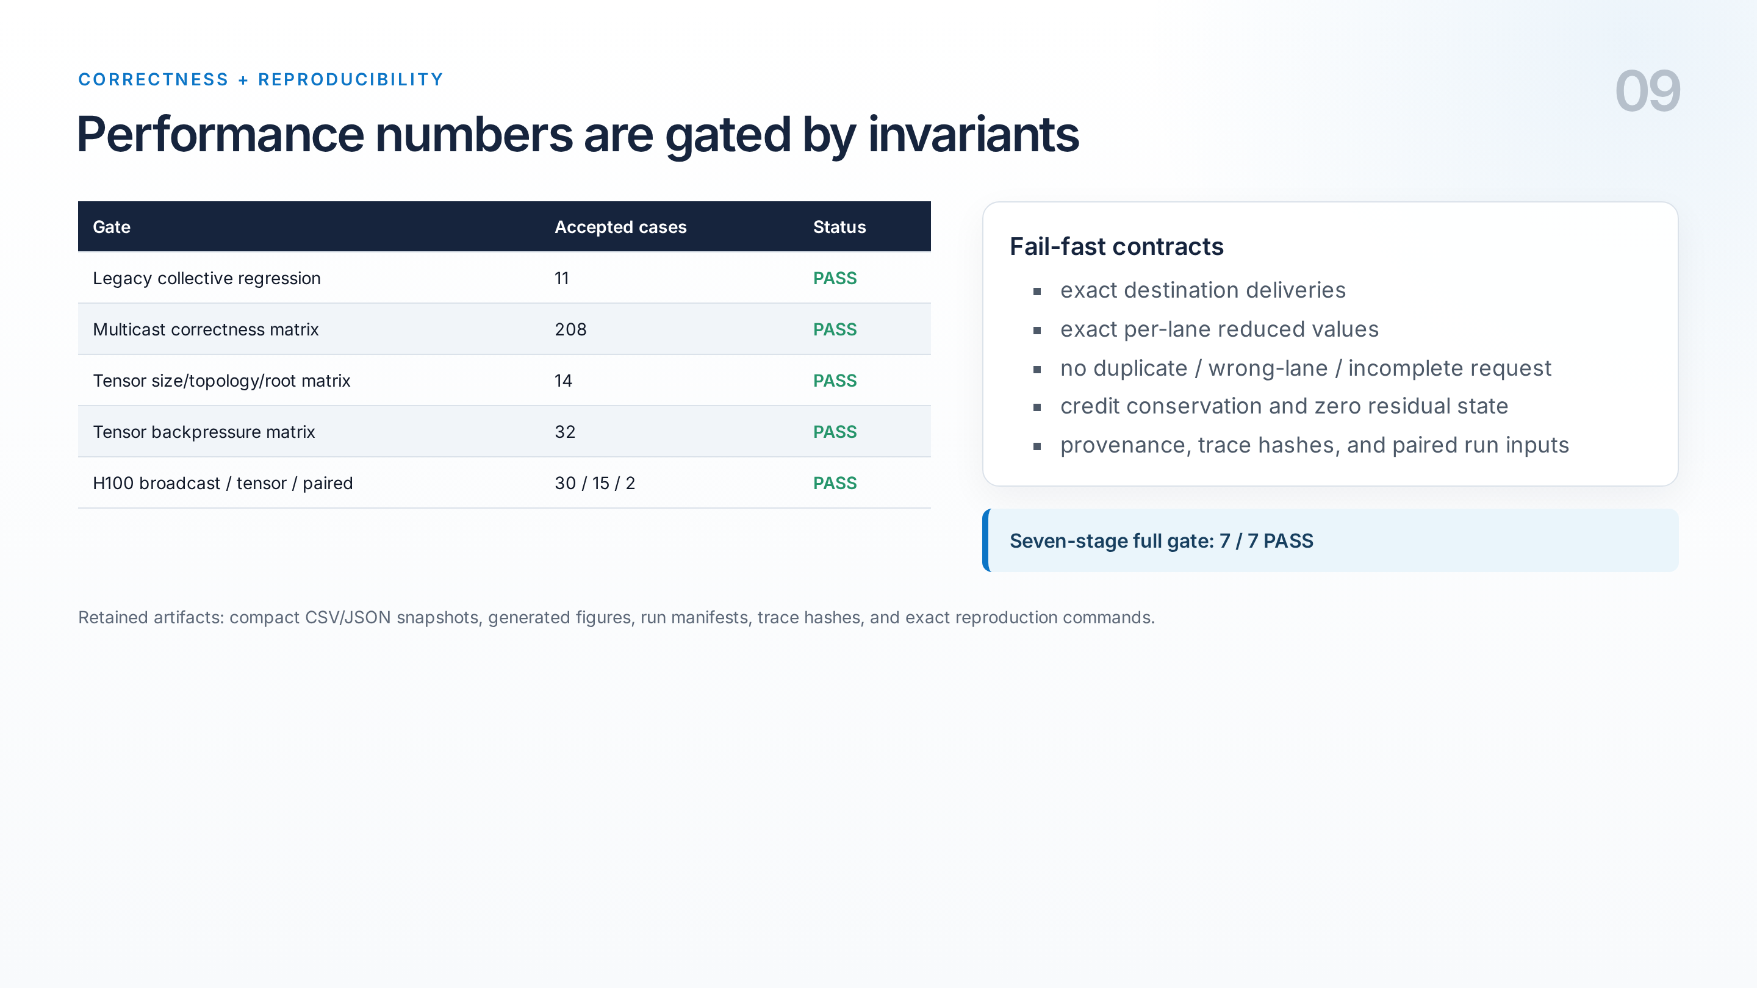
Notes:
Correctness is part of the architecture, not an afterthought. The complete seven-stage gate passes. We test multicast delivery, tensor sizes and roots, one-credit-depth backpressure, exact arithmetic, replay completeness, credit conservation, and zero residual state. The report keeps compact accepted data, manifests, trace hashes, and reproduction commands. This matters because a fast collective with one missing lane is simply wrong. Timing: 6:00–6:35.

Slide 11
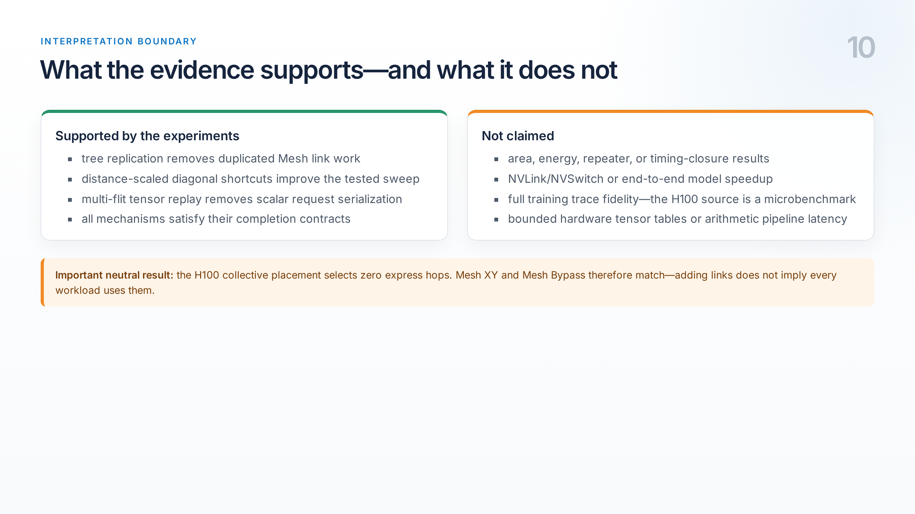
Notes:
We keep the claims narrow. These are cycle-level Garnet results, not silicon area or power, NVLink performance, or end-to-end training speedup. The H100 input is an executed collective microbenchmark scaled by 1 over 1024, not a full model trace. Also, the H100 collective tree selects zero express hops, so the two topology arms match. That neutral result is useful: merely adding links does not help a workload whose routes do not select them. Timing: 6:35–7:05.

Slide 12
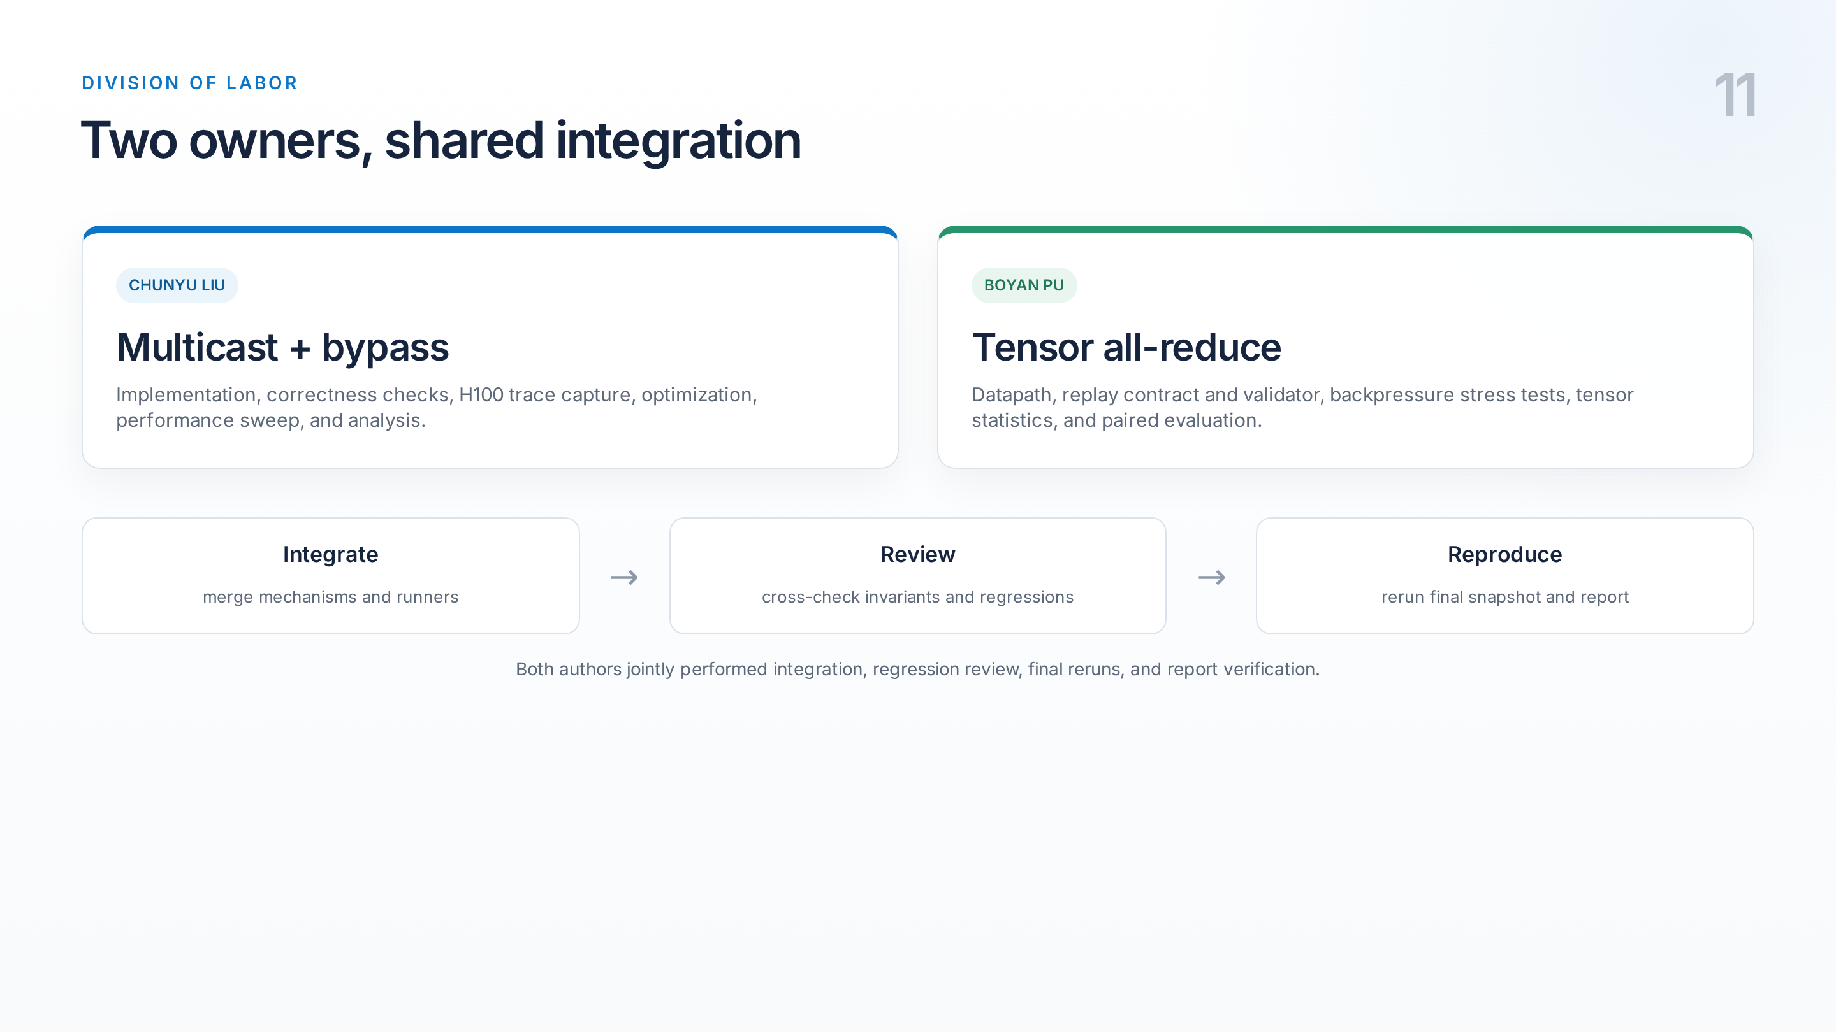
Notes:
Chunyu owned multicast and bypass, including implementation, trace capture, optimization, and evaluation. Boyan owned tensor all-reduce, including the datapath, replay contract, validator, backpressure tests, and statistics. We jointly integrated the branches, reviewed regressions, reran the final artifact snapshot, and verified the report. Timing: 7:05–7:30.

Slide 13
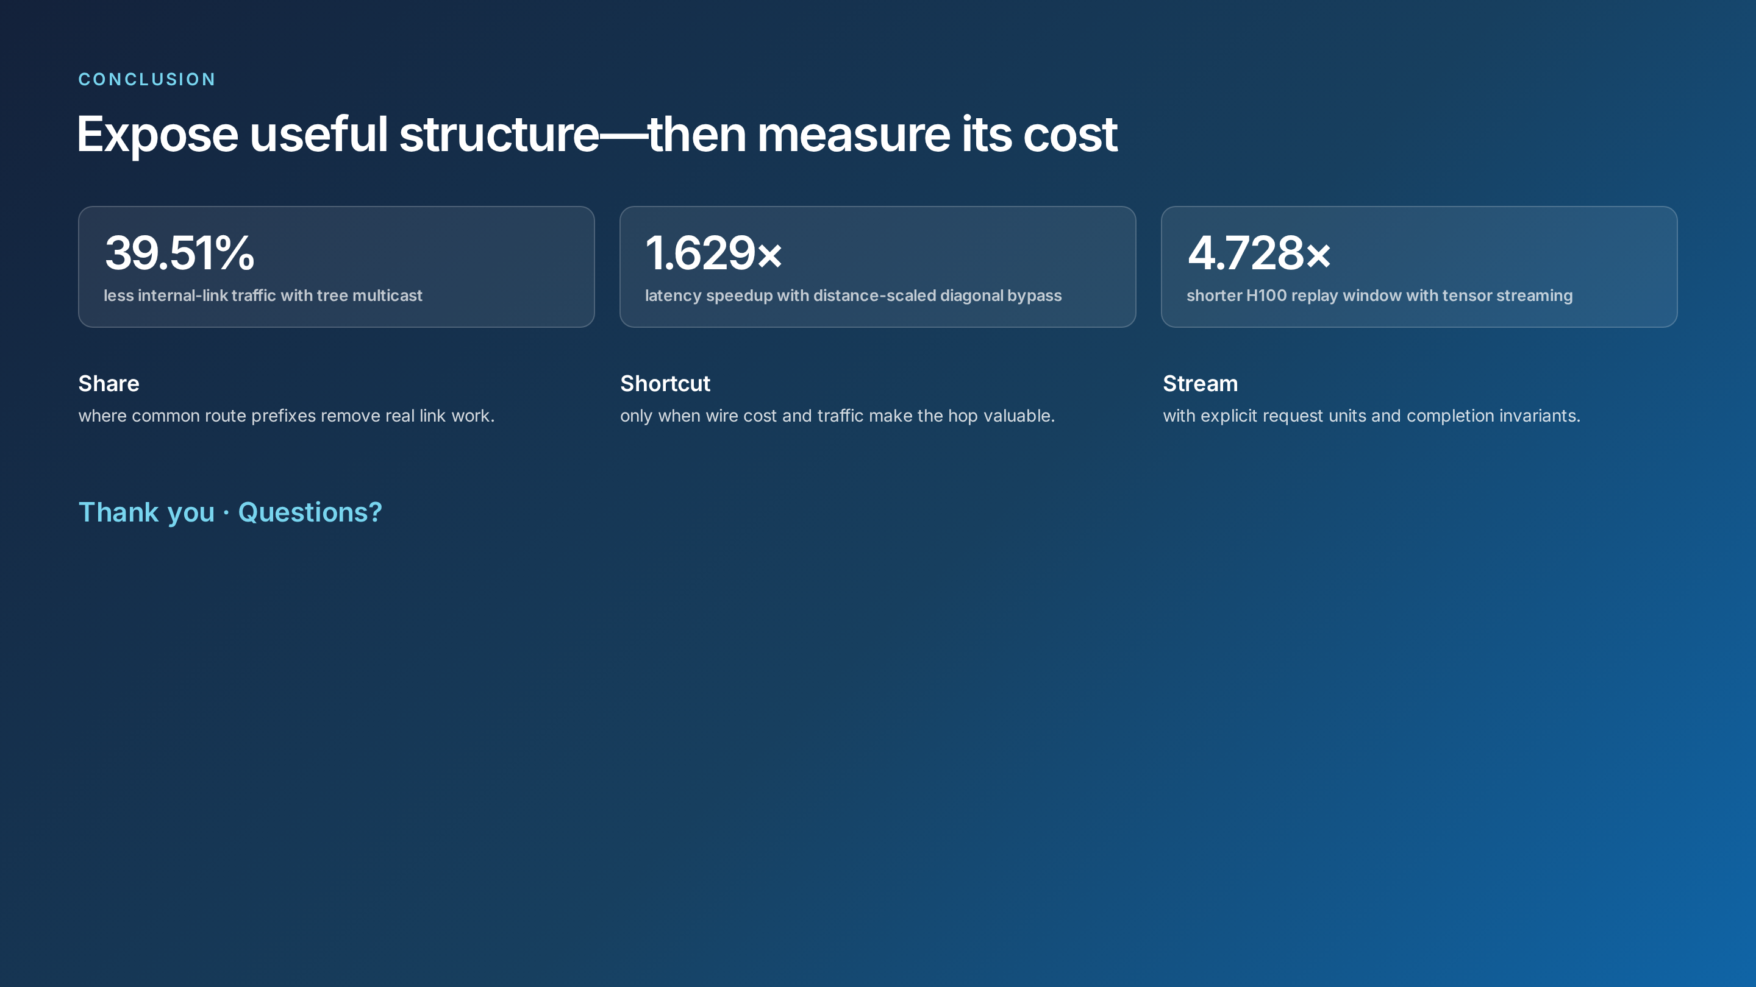
Notes:
To conclude: multicast robustly removes duplicated traffic, bypass helps only when physical cost and route structure align, and tensor streaming removes scalar serialization while preserving identical network work. Our design principle is to expose collective structure where it removes measurable work, but keep cost models, baselines, and completion contracts explicit. Thank you. Timing: 7:30–8:00.

