Slide 1
BIOS3036 Computer Modelling in Science: Applications Cellular Models Part 1
Prof Leah Band
leah.band@nottingham.ac.uk

Slide 2
Spatial models: Summary of topics covered in this module
We will have three sessions on Spatial models:
Cellular models
Diffusion and pollution
Diffusion and patterns
How did the zebra get his stripes?

Slide 3
Spatial models: Cellular Models Today’s Learning Objectives
Understanding what spatial models are and why we use them
Learning one technique for constructing and simulating a spatial model (‘Cellular modelling approach’)
Learning how to programme and analyse a spatial model, and critically evaluate the model

Slide 4
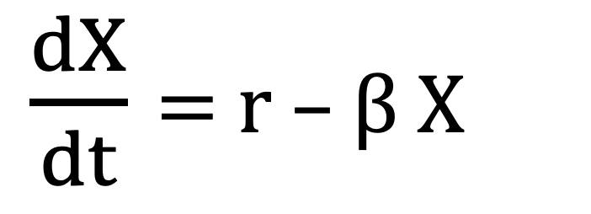
What do we mean by spatial models?
We have previously considered a radioactive leak model
$\frac{dX}{dt}$ = r – β X
X
t
This model predicts ‘X’ at a single point in space
What if we were interested in the level of X at different points in space?
(e.g. relative to the source of a radioactive leak)

Slide 5
Definition of a spatial model
Spatial models are models in which in addition to variation of some property over time, there is also some variation in space. Why create a spatial model?
How could we create a
spatial model?
Notes:
this is radioactive
why create spatial model? – see later slodes
How?

Slide 6
Why create a spatial model?
Single cell models to understand calcium oscillations
Tissue scale models to understand embryonic patterning
Population scale to understand the spread of infectious diseases
Notes:
Single cell pictures from Estrada 2006,
Journal of Cell Science
Ca dynamics over time in a cell
dynamics over time and space

Slide 7
How could we create a spatial model?
We can divide the space into compartments (or cells) and model the system using coupled ODEs for the concentration in each cell.
This approach is called cellular modelling and enables us to simulate reactions and transport that occur between neighbouring cells.

Slide 8
Today’s example model: Embryo development
During development, patterning is required to create and organize different types of cells into an organism.

Slide 9
The Delta-Notch signaling pathway
Delta-Notch a cell-to-cell signaling pathway (often called a juxtacrine signalling pathway) that is present in all animal species and is essential for many patterning processes in embryonic development.
(Lai, Development, 2004.)

Slide 10
Examples of Delta-Notch patterning in development
Bristles on a fly’s wing
(Renaud & Simpson 2001, Dev. Biol.)
Loss of Notch signalling
Drosophila embryo with stained for a neural marker
(Lai, Development, 2004.)
How does a population of nearly identical cells pattern itself so that only a few, regularly spaced cells turn into a certain type?
Notes:
Delta-Notch creates regular patterns during embryo development

Slide 11
Delta-notch – the full network
Like all biological systems, the full notch signalling network is very complex
However, to make a model we can simplify to consider the expression of just two transmembrane proteins: DELTA and NOTCH
(Andersson 2011, Development)

Slide 12
Delta-notch – the key features
D₁
N₂
N₁
D₂
Cell1
Cell2
Delta increases the activity of Notch in the neighbouring cell.
Notch lowers the activity of Delta within the same cell.
These relatively simple reactions can cause isolated cells to exhibit high Delta.
Only cells with high Delta take on different cell fate (e.g. become hair cells) and so these simple reactions can create biological patterns.

Slide 13
Delta-notch in two cells
D₁
N₂
N₁
D₂
Cell1
Cell2
Delta promotes Notch in the neighbouring cell.
Notch inhibits Delta in the same cell

Slide 14
Practical Part 1
Let’s simulate Delta-Notch signaling in two cells.
Please download the instructions for the practical from Moodle.

