Slide 1
Elements of Macroeconomics TA Session 2: Assignment 1
Haruki Shibuya
hshibuy1@jh.edu
Slides on https://github.com/Haruki-Shibuya/TA
09/09/2024

Slide 2
Tips for learning (as a former freshman)
Even smart ones can find it hard to learn effectively at university
Tips:
There is no single ‘perfect’ textbook/material/teacher for university-level learning. Everything has a different focus.
It’s much faster to find other resources when you don’t get it
In such a case, try looking for 3+ renowned textbooks & online resources (e.g., search ‘PPF lecture note’)
Then extract info that is easiest for you/most detailed
I don’t recommend reading the same paragraph 100 times when you don’t get it

Slide 3
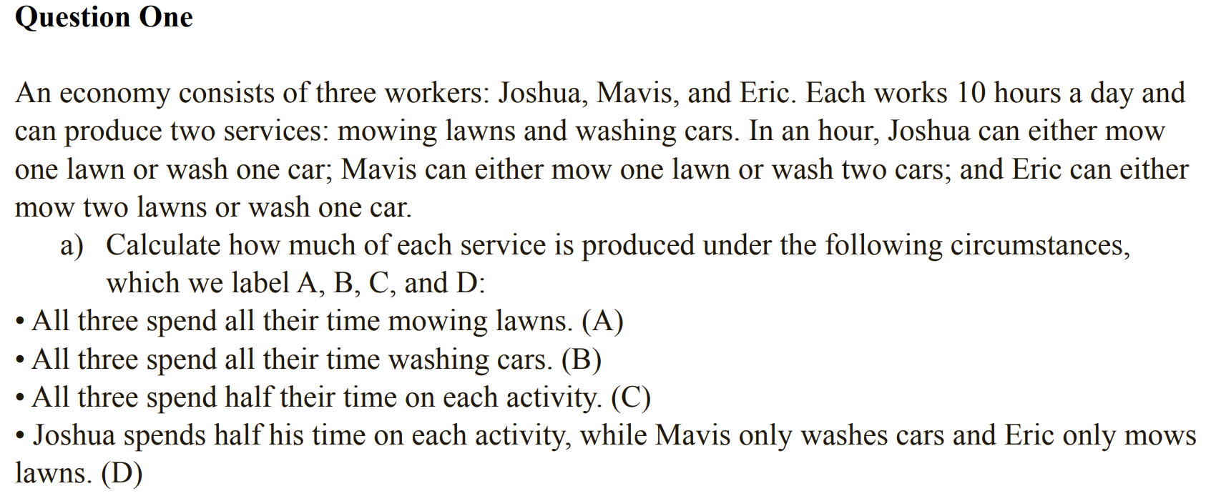
Q1(a)

Slide 4
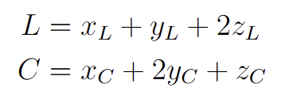
Q1 (a)
Define
L : otal loans mowed, C: total cars washed
x_L, y_L, z_L: hours worked for mowing lawns by Joshua/Mavis/Eric
x_C, y_C, z_C: hours worked for washing cars by Joshua/Mavis/Eric
Then

Slide 5
Q1 (a)
Scenario (A): x_L=y_L=z_L=10, x_C=y_C=z_C=0 ⇒ (L,C)=(40,0)
Scenario (B): x_L=y_L=z_L=0, x_C=y_C=z_C=10 ⇒ (L,C)=(0,40)
Scenario (C): x_L=y_L=z_L=5, x_C=y_C=z_C=5 ⇒ (L,C)=(20,20)
Scenario (B): x_L=x_C=5, y_L=z_C=0, y_C=z_L=10 ⇒ (L,C)=(25,25)

Slide 6
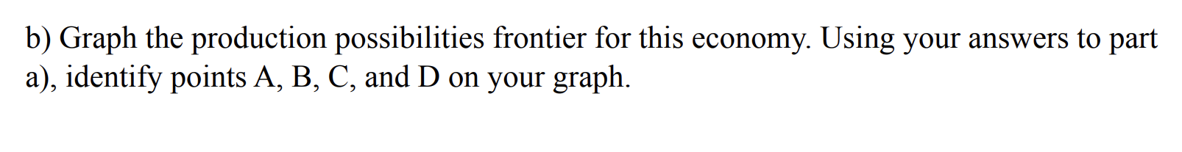
Q1 (b)

Slide 7
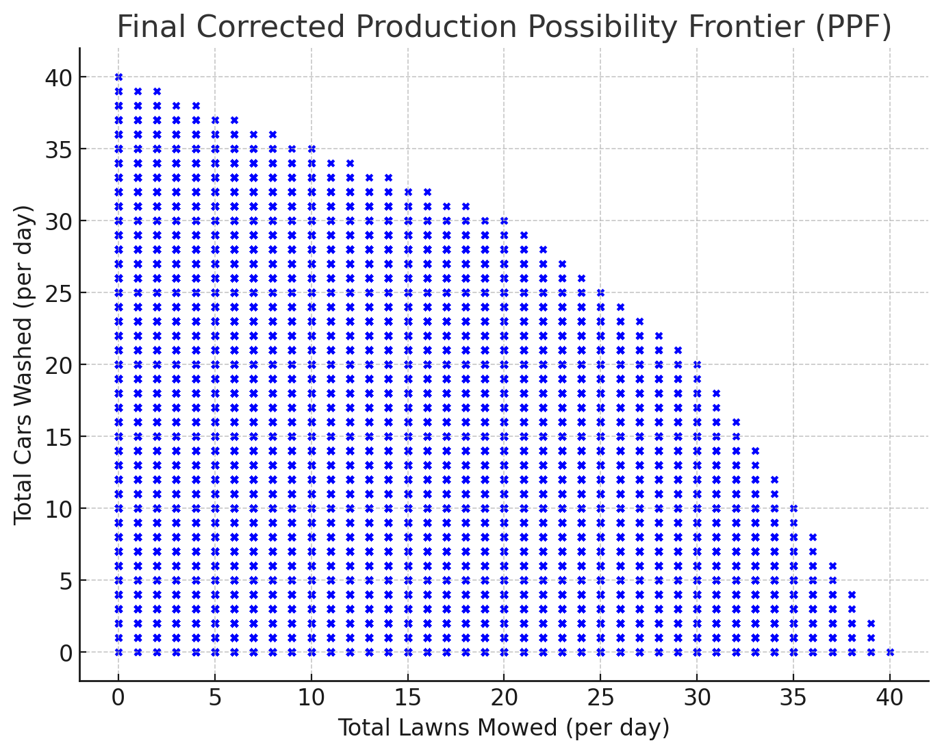
Q1 (b)
The PPF (Production Possibility Frontier) is the set of points (L,C) that shows the maximum possible production of one good (in this case, L or C) given the production of the other, subject to the constraints on resource use.

Slide 8
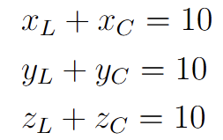
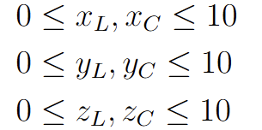
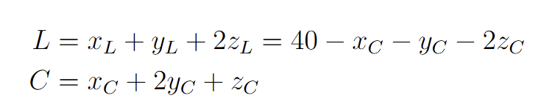
Q1 (b)
Resource constraints:
Eliminate x_L, y_L, z_L using equations to simplify:

Slide 9
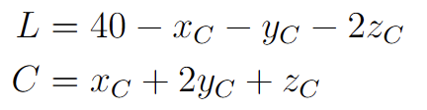
Q1 (b)
We want to derive a relationship between L and C
→Eliminate one of x_C, y_C, z_C
Case (1): Eliminate x_C from
Given any C, maximum L is achieved when y_C=10, z_C=0
L = - C+50
But don’t forget the constraints 0<=x_C<=10

Slide 10


Q1 (b)
We have
We confirmed y_C=10 and z_C=0 on the PPF
Hence 0<=C - 20<=10
i.e., 20<=C<=30
Thus, PPF part (1) is obtained as

Slide 11

Q1 (b)
We want to derive a relationship between L and C
→Eliminate one of x_C, y_C, z_C
Case (2): Eliminate y_C from
Given any C, maximum L is achieved when x_C=0, z_C=0
L = - C/2+40
But don’t forget the constraints 0<=y_C<=10

Slide 12
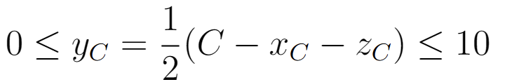
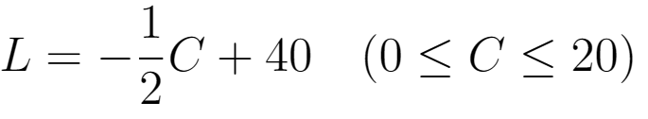
Q1 (b)
We have
We confirmed x_C=0 and z_C=0 on the PPF
Hence 0<=C/2<=10
i.e., 0<=C<=20
Thus, PPF part (1) is obtained as

Slide 13
Q1 (b)
We want to derive a relationship between L and C
→Eliminate one of x_C, y_C, z_C
Case (3): Eliminate z_C from
Given any C, maximum L is achieved when x_C=10, y_C=10
L = - 2C+80
But don’t forget the constraints 0<=z_C<=10

Slide 14
Q1 (b)
We have
We confirmed x_C=10 and y_C=10 on the PPF
Hence 0<=C-30<=10
i.e., 30<=C<=40
Thus, PPF part (1) is obtained as

Slide 15
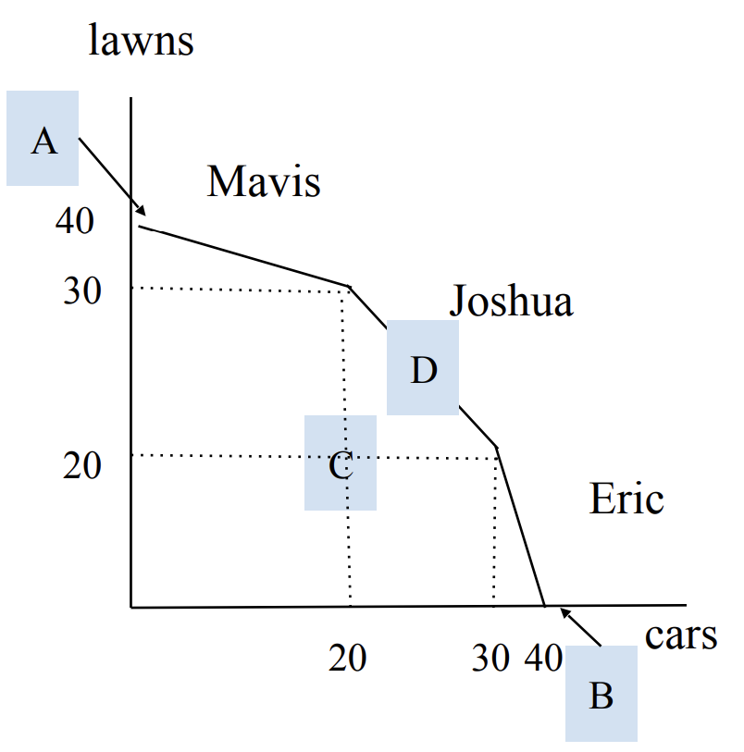
Q1 (b)
PPF & points ABCD:

Slide 16
Q1 (c)
Why is PPF convex (bowed out)?
In other words, why does D on PPF come
northeast of C, where the latter is on line AB?
Because
D: everyone focuses on a task with a
less opportunity cost
C: everyone does both tasks regardless of skills
By focusing on what everyone is good at
we have a more efficient result, hence bowed out.

Slide 17
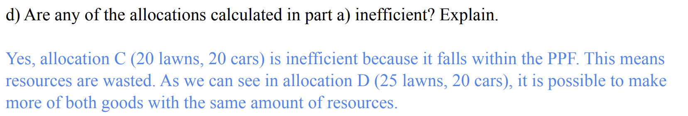
Q1 (d)
Cf., Pareto efficiency

Slide 18
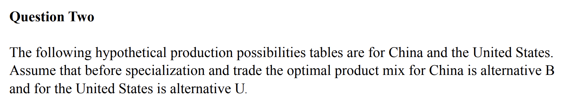
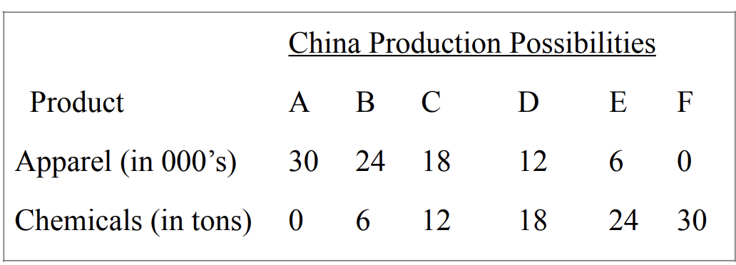
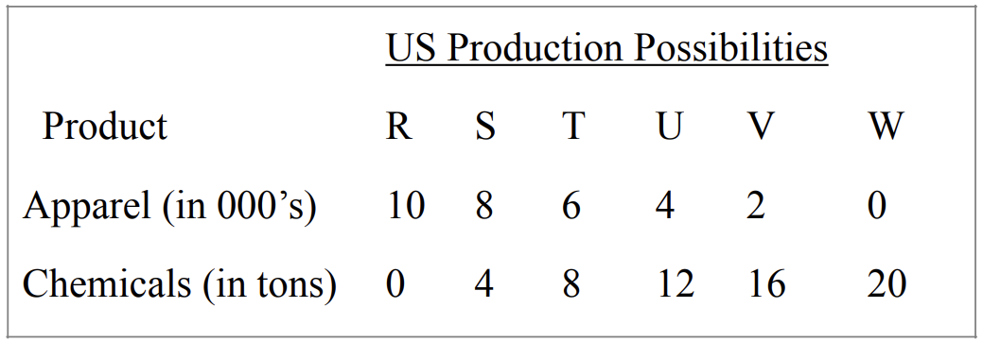
Q2

Slide 19
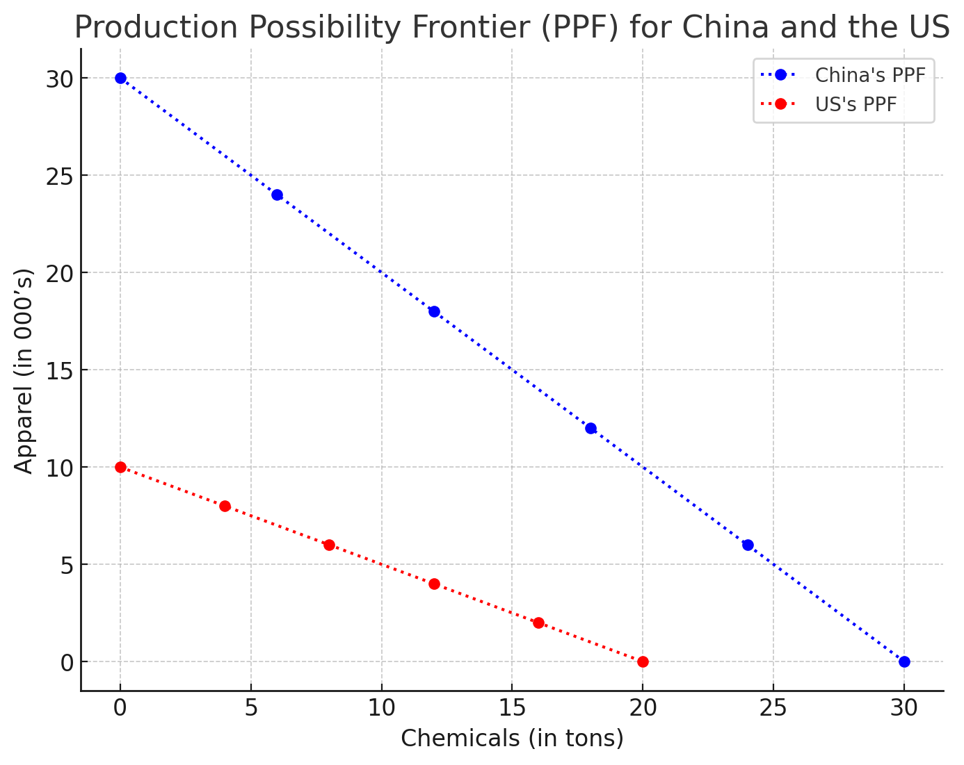
Q2 (a)
China gives up 30 chemicals to
produce 30 apparel
Opportunity cost of producing
1 apparel in terms of chemicals
for China is
OC_{China, A}=30/30=1
B
U

Slide 20
Q2 (a)
US gives up 20 chemicals to
produce 10 apparel. Similarly,
OC_{US, A}=20/10=2
OC_{China, A}<OC_{US, A}
China has comparative advantage in
apparel→US: chemicals, CN: apparel
B
U

Slide 21
Q2 (b)
US: chemicals, China: apparel
Specialization would yield 30 apparel
and 20 chemicals
B and U yield 4+24=28 apparel
and 6+12=18 chemicals
Specialization gives 2 more apparel
and 2 more chemicals than (B,U) in total
B
U

Slide 22
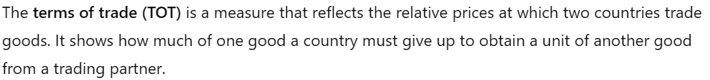
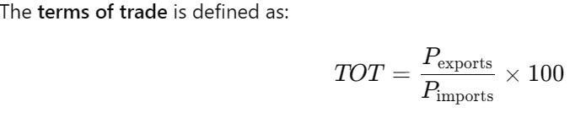
Q2 (c)
We omit 100 hereafter.

Slide 23
Q2 (c)
Remember the specialization US: chemicals, China: apparel
US exports chemicals and imports apparel
OC_{US, A} < TOT_{US} < OC_{China,A} should hold
Why?
TOT_{US}<=OC_{US, A} wouldn’t be good for US
Because in that case US would be better off making apparel by itself
OC_{China, A}<=TOT_{US} wouldn’t be good for China
Because in that case China would be better off making chemicals by itself

Slide 24
Q2 (c)
Hence 1< TOT_{US} < 2
By the same token, ½<TOT_{China}<1

Slide 25
Q2 (d)
US: chemicals, China: apparel
Specialization yields 30 apparel and 20 chemicals
The trade results in
US: (4 apparel, 14 chemicals) and China: (26 apparel, 6 chemicals)
US gets two more chemicals compared to point U
China gets two more apparel compared to point B

Slide 26
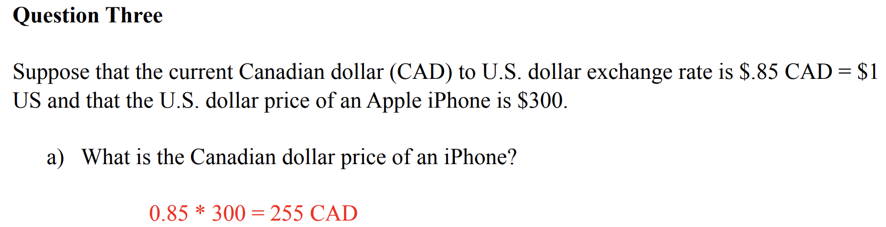
Q3(a)

Slide 27
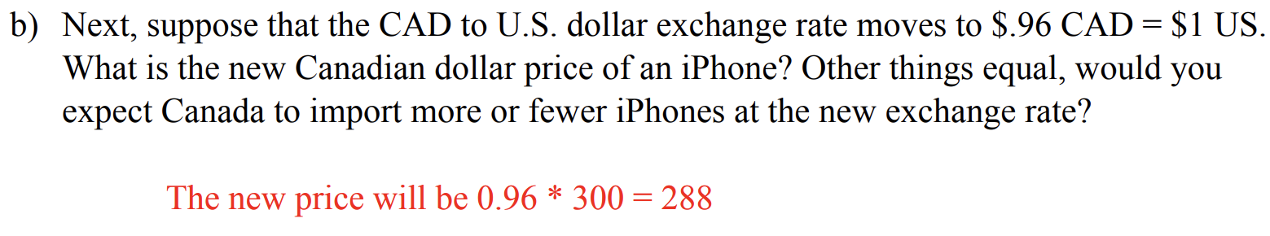
Q3(a)

Slide 28
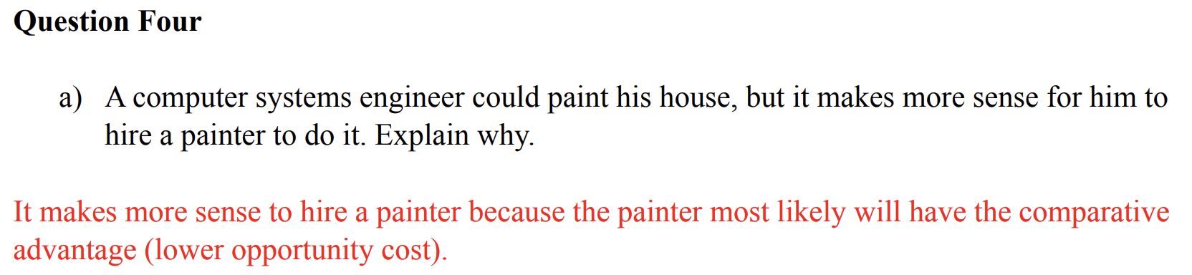
Q4(a)

Slide 29
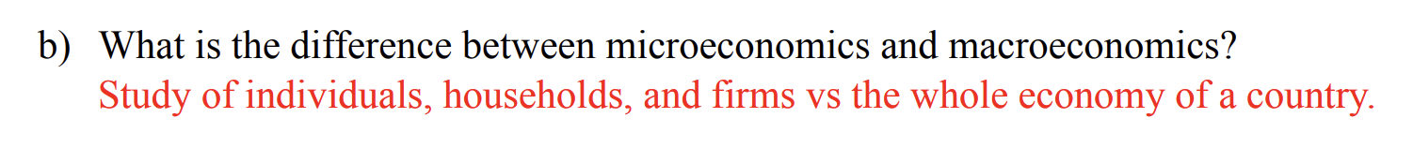
Q4(b)

Slide 30
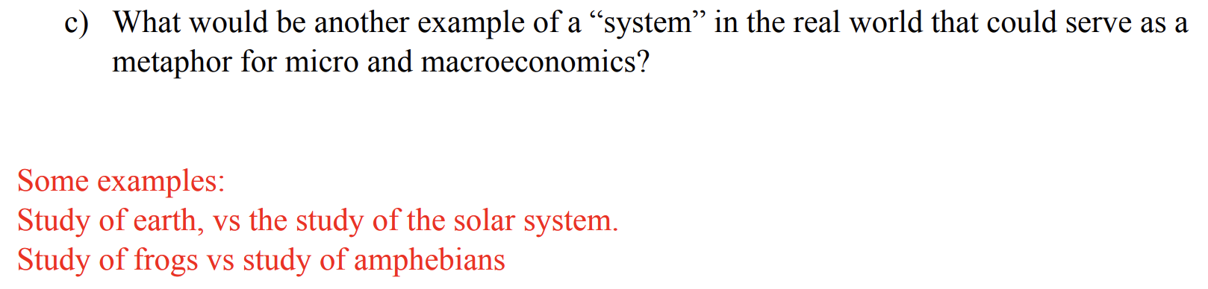
Q4(c)

