Slide 1






G20-MAIT INTRA-COLLEGE HACKATHON 28-29, MARCH 2023
Problem Statement Title: NEW AGE WOMEN SAFETY
Team Name: SHESHIELD
Team Leader Name: AKSHIT SHARMA
Mentor Name: DR.TEJNA KHOSLA

Slide 2
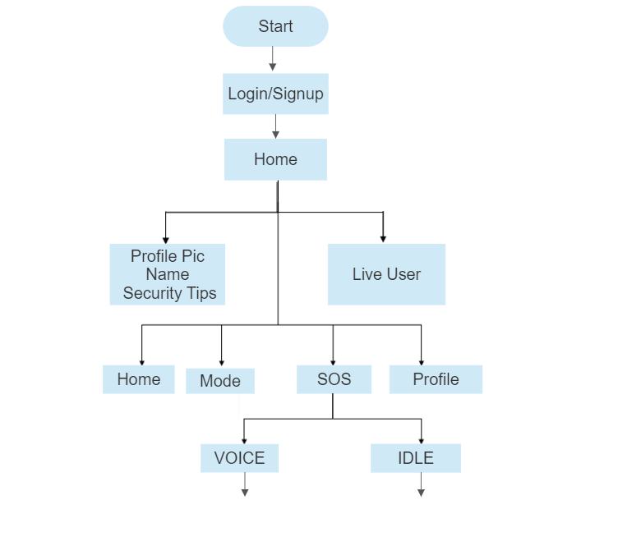
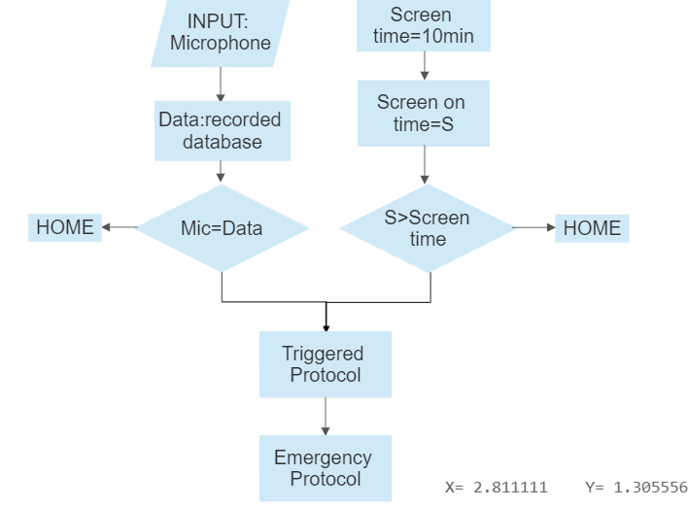

Idea/Approach Details
Flow Chart of our Idea
Our idea/Solution/Prototype here:
Women's security is a major issue in today's world due to the increasing number of crimes against females, causing fear and harassment in educational institutes, workplaces, and homes.
Using available resources to escape unsafe situations effectively reduces the risk of violent crimes. To aid women in distress, an Android app is developed that facilitates easy help and escape, thereby promoting self-protection.
Introducing "SHESHIELD", an Android app designed for safety and emergency purposes, unlike other apps that are only useful in hazardous or emergencies. This app can be used as a precautionary measure for women's protection, and in the event of an emergency, it assists to ensure their safety.
As the name suggests is an application that shields, protects, saves, and guards oneself against danger. The main purpose of creating this program was to provide a safe environment through smartphones. A message is immediately sent to the police, containing the user's geographical location as well as the contact details of a pre-selected list of an emergency contact.
NO
NO
YES
YES

Slide 3
Idea/Approach Details
Our Use Cases here
"SHESHIELD" is an Android application that serves as a valuable tool for personal Security. The system is powered by Artificial Intelligence, which forms the main functionality of the application. By leveraging AI, the system can accurately detect potential threats and provide the necessary help to ensure the safety of the user.
The purpose of this project is to develop a portable women’s safety software tool, which can be helpful in following cases
Assault and harassment in public spaces: Women are often subjected to unwanted attention, catcalling, and even physical assault when walking alone in public spaces. Our app provides user with a panic button and an emergency contact feature that can help her call for help in case of danger in with her accurate location coordinates sent to the law enforcements
Domestic violence: Many women experience domestic violence and are unable to seek help due to fear or lack of resources. Our app works on a dynamic AI which can detect screams or call of help and can trigger an emergency protocol and inform the law enforcement organization
Travel safety: Many women travel alone for work or leisure and may feel vulnerable in unfamiliar places. Our app continuously monitors the route, inside conversation between the user and anyone else inside the transport. Our AI can also detect whether the user is still near the device or not. If she is not near the device, our app will trigger a warring notification alert to check whether the user is fine and no dangerous activities are taking place inside or outside the vehicle.
Our Technology stack here:
Python and Java are popular programming languages used to develop and execute applications. Additionally, the Kivy framework in Python provides a powerful toolkit for building user interfaces and developing cross-platform applications with ease. Combining these technologies can enable developers to create robust and scalable applications that deliver a rich and engaging user experience.
Describe your Dependencies / Show stopper here
Our Dependencies/Show Stopper here:
When dealing with a large dataset, building an AI can present challenges. The sheer size of the data can make it difficult to analyse effectively. Additionally, training an AI model on a large dataset can be a resource-intensive task, requiring significant computational power and time.

Slide 4
Team Member Details
Sr. No. | Name of Team Member | Course (B.Tech/MBA etc.): | Stream (ECE, CSE etc.): | Year | Position in team (Team Leader, Front end Developer, Back end Developer, Full Stack, Data base management etc.)
1 | AKSHIT SHARMA | B.Tech | AI&DS | 1st Year | Team leader , Full Stack Developer
2 | SHASHI KANT SHARMA | B.Tech | AI&DS | 1st Year | Frontend Developer
3 | VINEET GOYAL | B.Tech | AI&DS | 1st Year | Backend Developer
4 | JOYAL JIJO | B.Tech | AI&DS | 1st Year | Backend Developer
5 | PULKIT GARG | B.Tech | AI&DS | 1st Year | Artificial intelligence
6 | VANSH SINGHAL | B.Tech | AI&DS | 1st Year | Artificial intelligence
Team Mentor Details
Sr. No. | Name of Mentor | Department
1 | Ms. Tejna Khosla | Assistant Professor IT

Slide 5
THANKING
YOU

