Slide 1






G20-MAIT INTRA-COLLEGE HACKATHON 28-29, MARCH 2023
Problem Statement Title: NEW AGE WOMEN SAFETY
Team Name: SHESHIELD
Team Leader Name: AKSHIT SHARMA
Mentor Name: MS.TEJNA KHOSLA

Slide 2

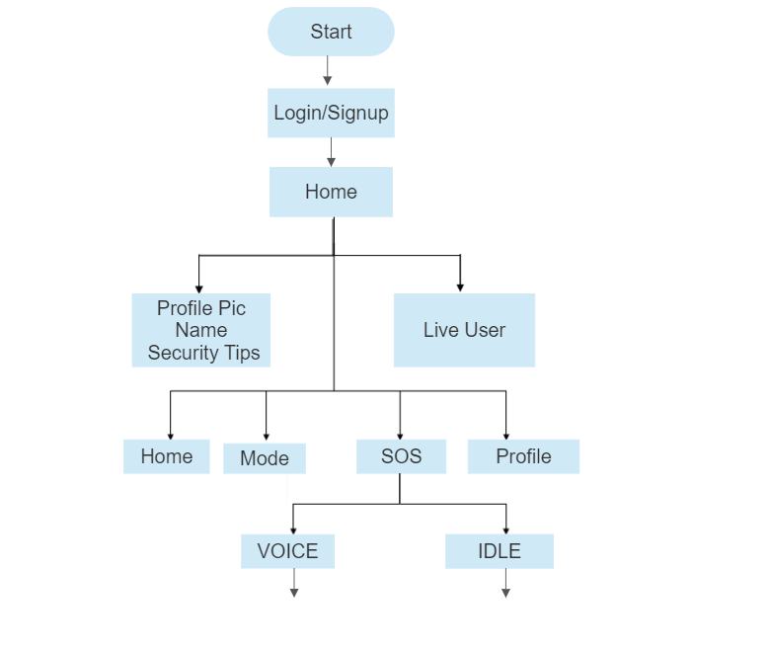
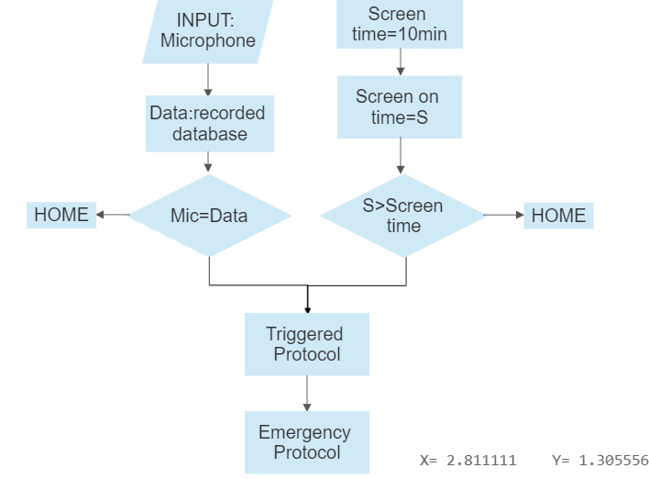

Idea/Approach Details
Flow Chart
Solution
Women's security is a major issue in today's world due to the increasing number of crimes against women, causing fear and harassment in educational institutes, workplaces, and homes.
Introducing "SHESHIELD", an Android app designed for safety and emergency purposes, unlike other apps that are only useful in hazardous or emergencies. This app can be used as a precautionary measure for women's protection, and in the event of an emergency, it assists to ensure their safety.
As the name suggests is an application that shields, protects, saves and guards oneself against danger. The main purpose of creating this program was to provide a safe environment through smartphones. A message is immediately sent to the police, containing the user's geographical location as well as the contact details of a pre-selected list of an emergency contact.
NO
NO
YES
YES

Slide 3
Idea/Approach Details
"SHESHIELD" is an Android application that serves as a valuable tool for personal Security. The system is powered by Artificial Intelligence, which forms the main functionality of the application.
Assault and harassment in public spaces: Women are often subjected to unwanted attention, catcalling, and even physical assault. Our app provides user with a panic button and an emergency contact feature that can help her call for help in case of danger in with her accurate location coordinates sent to the law enforcements
Domestic violence: Many women experience domestic violence and are unable to seek help due to fear or lack of resources. Our app works on a dynamic AI which can detect screams or call of help and can trigger an emergency protocol and inform the law enforcement organization
Travel safety: Our app continuously monitors the route, inside conversation between the user and anyone else inside the transport. Our AI can also detect whether the user is still near the device or not.
TECHNOLOGY STACK
PYTHON
JAVA
ANDROID STUDIO
USE CASES
SHOW STOPPER
If the user becomes inactive due to low device battery, user falls asleep or is unavailable to attend to the warning.
The Lack of data also presents a problem for our AI model.

Slide 4
Team Member Details
Sr. No. | Name of Team Member | Course (B.Tech/MBA etc.): | Stream (ECE, CSE etc.): | Year | Position in team (Team Leader, Front end Developer, Back end Developer, Full Stack, Data base management etc.)
1 | AKSHIT SHARMA | B.Tech | AI&DS | 1st Year | Team leader , Full Stack Developer
2 | SHASHI KANT SHARMA | B.Tech | AI&DS | 1st Year | Frontend Developer
3 | VINEET GOYAL | B.Tech | AI&DS | 1st Year | Backend Developer
4 | JOYAL JIJO | B.Tech | AI&DS | 1st Year | Backend Developer
5 | PULKIT GARG | B.Tech | AI&DS | 1st Year | Artificial intelligence
6 | VANSH SINGHAL | B.Tech | AI&DS | 1st Year | Artificial intelligence
Team Mentor Details
Sr. No. | Name of Mentor | Department
1 | Ms. Tejna Khosla | Assistant Professor IT

Slide 5
THANKING
YOU

