Slide 1
SECURE THE DATA TO PREVENT HACKERS
SECURE DATA HIDING IN IMAGES USING STEGANOGRAPHY
Presented By:
Student Name : ROHIT SINGH CHOUHAN
College Name : AMBALIKA INSTITUTE OF MANAGEMENT & TECHNOLOGY
Department: B.Tech (Computer Science & Engineering)

Slide 2
OUTLINE
○ Problem Statement
○ Technology used
○ Wow factor
○ End users
○ Result
○ Conclusion
○ Git-hub Link
○ Future scope

Slide 3
PROBLEM STATEMENT
Traditional encryption methods make hidden communication obvious.
Steganography conceals messages inside images, allowing secure and undetectable data transmission.

Slide 4
TECHNOLOGY USED
○ Programming Language: Python
○ Libraries: Pillow (PIL)
○ Technique: Least Significant Bit (LSB)
○ Visual Studio Code (IDE)
○ WINDOWS

Slide 5
WOW FACTORS
○ Uses LSB technique for message hiding
○ Message remains invisible to casual observers
○ Supports encryption and decryption using different images

Slide 6
END USERS
○ Cybersecurity professionals
○ Forensic experts
○ Data security enthusiasts
○ Military and Intelligence agencies

Slide 7
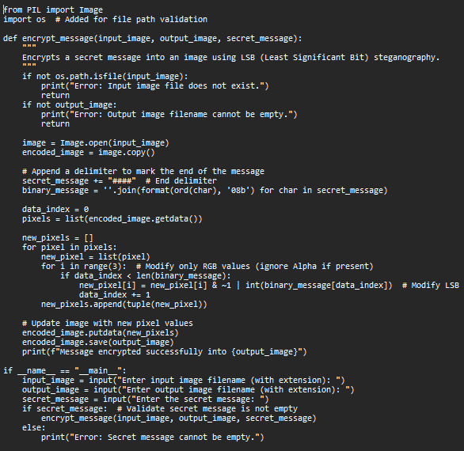
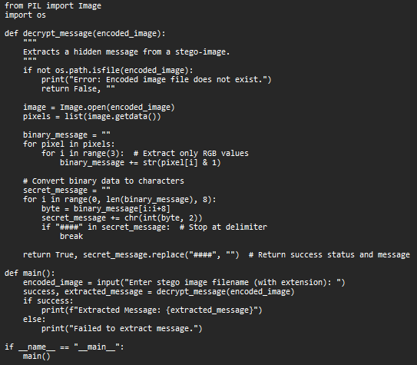

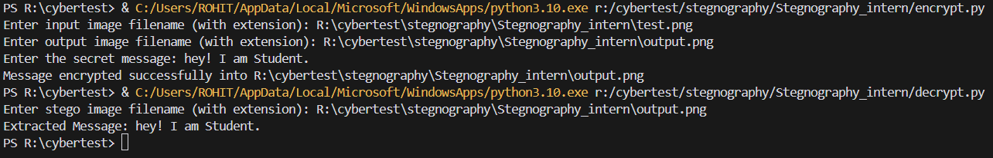
RESULTS
CODE
OUTPUT FILE
Extracted message from encrypted image

Slide 8
CONCLUSION
○ Steganography provides a secure way to hide messages inside images. The LSB technique ensures minimal visual difference while maintaining secrecy.

Slide 9

GITHUB LINK
○ GitHub Repository: https://github.com/HarukiUzumaki/stegnography_internedu.git

Slide 10
THANK YOU

