Slide 1
TEAM 07 — TOXICITY · CSE 484 / 654 NLP MID-PROJECT TALK (10 MIN)
Explainable Turkish Implicit Toxicity Detection
PRIMARY RESEARCH QUESTION (UNCHANGED FROM PROPOSAL):
“Can a Turkish BERTurk classifier fine-tuned on offensive-language labels improve macro-F1 on a manually annotated, held-out set of implicitly targeted or sarcastic attacks over a TF-IDF + logistic-regression baseline, and do token-level SHAP explanations identify human-annotated attack cues?”
FORMAL NEGATIVE RESULT (“NO”) CONDITIONS:
• Condition 1 (Classification Gate): Fine-tuned BERTurk fails to achieve a statistically significant Macro-F1 improvement over the baseline (p ≥ 0.05 or 95% bootstrap CI includes zero).
• Condition 2 (Explainability Gate): Token-level SHAP explanation highlights fail to overlap annotators' evidence better than a random-token baseline (measured via token AUPRC / F1).
• Scientific Integrity Rule: If either failure condition occurs on the held-out benchmark, we report a formal negative result without pivoting.
MILESTONE SCOPE NOTICE & TEAM ROLES:
• Current Milestone (Tier 1 Complete): Broad binary toxicity foundation (84,866 samples). Demonstrates preliminary model development and baseline establishment; does NOT answer the implicit research question.
• Final Milestone (Tier 2 Pending): Double-annotated implicit/sarcastic benchmark with rationale spans + SHAP token alignment evaluation.
• Team 07 Members: Ahmet Furkan Hazar (Research Lead, CSE 654), Ahmet Harun Çakır (CSE 654), Orhun Gökdemir (CSE 654), Burak Kurtaran (CSE 484).
TODAY'S 10-MINUTE TALK OVERVIEW:
1. Data Reconnaissance & Two-Tier Strategy → 2. Preprocessing & Cryptographic Locking → 3. TF-IDF Baseline (0.9393 Macro-F1) → 4. 30 Qualitative Error Analysis → 5. Fine-Tuned BERTurk (0.9654 Macro-F1, +0.0261 Δ, p≈0.0001) → 6. Roadmap to Final Milestone (Tier 2 Annotation & SHAP).
Gebze Technical University · Computer Engineering Dept. | Team 07: Hazar, Çakır, Gökdemir, Kurtaran

Slide 2
TEAM 07 — TOXICITY · CSE 484 / 654 NLP MID-PROJECT
Motivation: The Challenge of Implicit Toxicity in Turkish
1. THE MODERATION BLINDSPOT
Surface Explicit Toxicity:
Profanity, slurs, and direct violent threats are easily flagged by keyword filters, regex, and n-gram classifiers.
Implicit Targeted Hostility:
Attacks increasingly avoid profane words, using sarcasm, rhetorical mockery, conditional curses ('kanı kurusun'), and metaphorical insults ('lağım medyası').
Evasion Strategy:
Offenders exploit lexical filters deliberately. Keyword-based systems leave users unprotected against sophisticated cyberbullying.
2. HARD NEGATIVE OVER-CENSORSHIP
Negated Insults:
Sentences like 'Hiç birimiz aptal değiliz' (None of us are stupid) contain toxic triggers ('aptal') but express benign self-defense.
Proverbs & Moral Maxims:
Proverbs like 'İnsanoğlu naziktir, ağır sözü kaldırmaz' discuss harsh speech educationally but get flagged by unigram presence ('ağır söz').
Sports Banter & Metaphors:
Colloquial phrases like 'kudursun' (let them rage) or sports scheduling trigger false alarms in keyword-driven systems.
3. THE EXPLAINABILITY IMPERATIVE
High Accuracy ≠ Trustworthy:
Black-box neural networks can achieve >95% accuracy by exploiting spurious demographic tokens or political proper nouns rather than true hostility.
Faithful Human Rationales:
Moderation requires knowing WHY a post was flagged. Explanations must highlight human-agreeable rationale spans, not background noise.
Our Core Hypothesis:
Token-level SHAP attributions must correlate with human-marked attack cues significantly better than a random baseline to be deemed usable in production moderation.
Gebze Technical University · Computer Engineering Dept. | Team 07: Hazar, Çakır, Gökdemir, Kurtaran

Slide 3
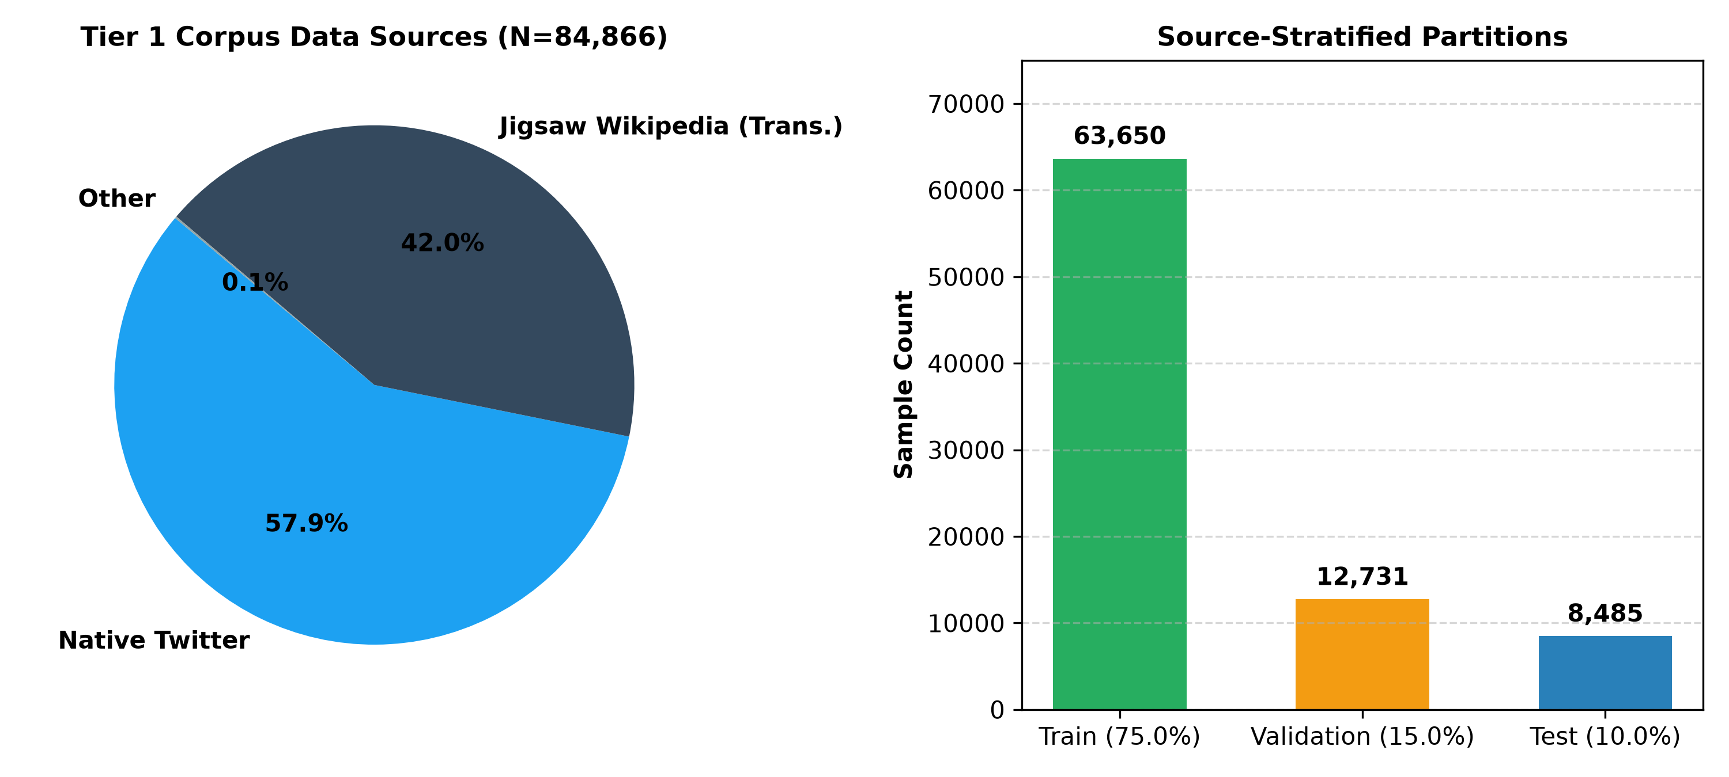
TEAM 07 — TOXICITY · CSE 484 / 654 NLP MID-PROJECT
Data Reconnaissance & The Two-Tier Research Design
PUBLIC DATASET AUDIT & ARCHITECTURAL PIVOT
Source 1: Overfit-GM (Hugging Face): 77,800 raw records. 45.8% originates from translated Jigsaw Wikipedia talk pages. Contains distinct machine-translation artifacts ('sığır eti olmak').
Source 2: Kaggle 6-Class Labeled Tweets: 9,999 raw records. Tespit column was empirically inferred: 1 = clean, 0 = toxic (contrary to conventional binary schemes).
The Critical Problem: Neither dataset annotates implicit attacks, sarcasm, hard negatives, or token rationales. Direct evaluation on them cannot answer our proposal's research question.
The Two-Tier Architecture:
• Tier 1 (Complete): Rigorous broad binary toxicity corpus (84,866 samples). Serves as training foundation and preliminary baseline development.
• Tier 2 (Underway): Dedicated human-annotated implicit-attack benchmark (300 posts: implicit, sarcasm, hard negatives + token rationales).
TIER 1 CORPUS COMPOSITION SUMMARY (N = 84,866):
• Native Turkish Twitter: 49,158 records (57.9%)
• Jigsaw Wikipedia Translations: 35,608 records (41.9%)
• Other Sources: 100 records (0.1%)
• Total Balance: 41,376 Clean (48.75%) | 43,490 Toxic (51.25%)
Gebze Technical University · Computer Engineering Dept. | Team 07: Hazar, Çakır, Gökdemir, Kurtaran

Slide 4
TEAM 07 — TOXICITY · CSE 484 / 654 NLP MID-PROJECT
Deterministic Preprocessing Pipeline & Evaluation Protocol
DATA CLEANING & DEDUPLICATION INVARIANTS
• Scam Exclusion (-501 records): Isolated and filtered 501 financial fraud spam tweets ('günde 5000 TL kazan', gambling bots) that distorted toxicity vocabulary.
• Turkish-Aware Canonicalization: Preserved Turkish dotted/dotless I (İ/i, I/ı), normalized whitespace, and stripped URLs/mentions solely for duplicate hashing. Raw text was preserved intact for model input.
• Deduplication & Collision Removal: Removed 2,416 exact and canonical duplicate rows across sources. Quarantined 16 conflicting label pairs (32 rows) to prevent label corruption.
• Source-Stratified Partitioning: Exact 75% / 15% / 10% stratified allocation ensuring identical Twitter vs. Jigsaw domain proportions across all splits:
• Train: 63,650 rows | Val: 12,731 rows | Test: 8,485 rows.
• Cryptographic Test Set Locking: Locked test partition before running models:
• Physical SHA-256: 1c5408ba...
• Semantic SHA-256: 7bd973c2...
Verified bit-for-bit before and after all evaluations.
PRE-REGISTERED EVALUATION DECISION GATES
• Primary Metric: Macro-Averaged F1
Harmonic mean of F1_clean and F1_toxic. Robust to class imbalance and equally penalizes false alarms and missed attacks.
• Secondary Metric: Average Precision (AP)
Calculated via precision-recall Riemann sum (average_precision_score). Distinct from trapezoidal PR-AUC.
• Pre-Registered Meaningful Difference (Δmin = 0.020):
To guard against claiming trivial gains as breakthroughs, we require Δ = F1_BERTurk - F1_TFIDF ≥ +0.020 (2.0 percentage points) to establish practical NLP superiority.
• Paired Bootstrap Resampling (B = 10,000):
Non-parametric paired bootstrap with seed 42. Reports empirical 95% confidence intervals and Laplace-corrected p-value (p = (k+1)/(B+1)).
• Source-Sliced Performance Mandate:
Every model must be scored separately on Native Twitter and Jigsaw slices to detect domain-shift vulnerabilities.
Gebze Technical University · Computer Engineering Dept. | Team 07: Hazar, Çakır, Gökdemir, Kurtaran

Slide 5
TEAM 07 — TOXICITY · CSE 484 / 654 NLP MID-PROJECT
Classical Baseline: TF-IDF + Logistic Regression (C = 10.0)
BASELINE SPECIFICATION & FROZEN TEST METRICS
• Feature Space (147,749 Dimensions): Combined Word n-grams (1–2, min_df=2, sublinear TF) + Character n-grams (char_wb, 3–5, min_df=5, sublinear TF).
• Classifier: Logistic Regression with balanced class weights, L2 penalty (C = 10.0), L-BFGS solver, max_iter=1000.
• Validation Macro-F1: 0.9387 (C=10.0 selected over C=0.1 [0.9121] and C=1.0 [0.9284]).
• Frozen Test Results (N = 8,485):
• Macro-F1: 0.9393 (95% CI: [0.9341, 0.9443])
• Accuracy: 0.9393
• Toxic Recall: 0.9271 | Toxic Precision: 0.9532
• Clean Recall: 0.9521 | Clean Precision: 0.9255
• Average Precision (AP): 0.9862 | ROC-AUC: 0.9851
• Source Slices: Native Twitter: 0.9373 Macro-F1 | Jigsaw: 0.9397 Macro-F1
TEST CONFUSION MATRIX (N = 8,485)
Predicted Clean Predicted Toxic
True Clean (4,137) 3,939 (TN) 198 (FP)
True Toxic (4,348) 317 (FN) 4,031 (TP)
• Total Errors: 515 misclassifications (6.07% error rate)
• Core Weakness: 317 False Negatives (missed toxic samples) severely dominate 198 False Positives.
KEY TAKEAWAY ON THE CLASSICAL BASELINE:
Linear TF-IDF is surprisingly competitive on broad toxicity (0.9393 Macro-F1) when vulgar keywords and overt slurs are present. However, it exhibits a major blindspot on 317 toxic cases that lack explicit vocabulary, while triggering false alarms on negated profanity.
Gebze Technical University · Computer Engineering Dept. | Team 07: Hazar, Çakır, Gökdemir, Kurtaran

Slide 6
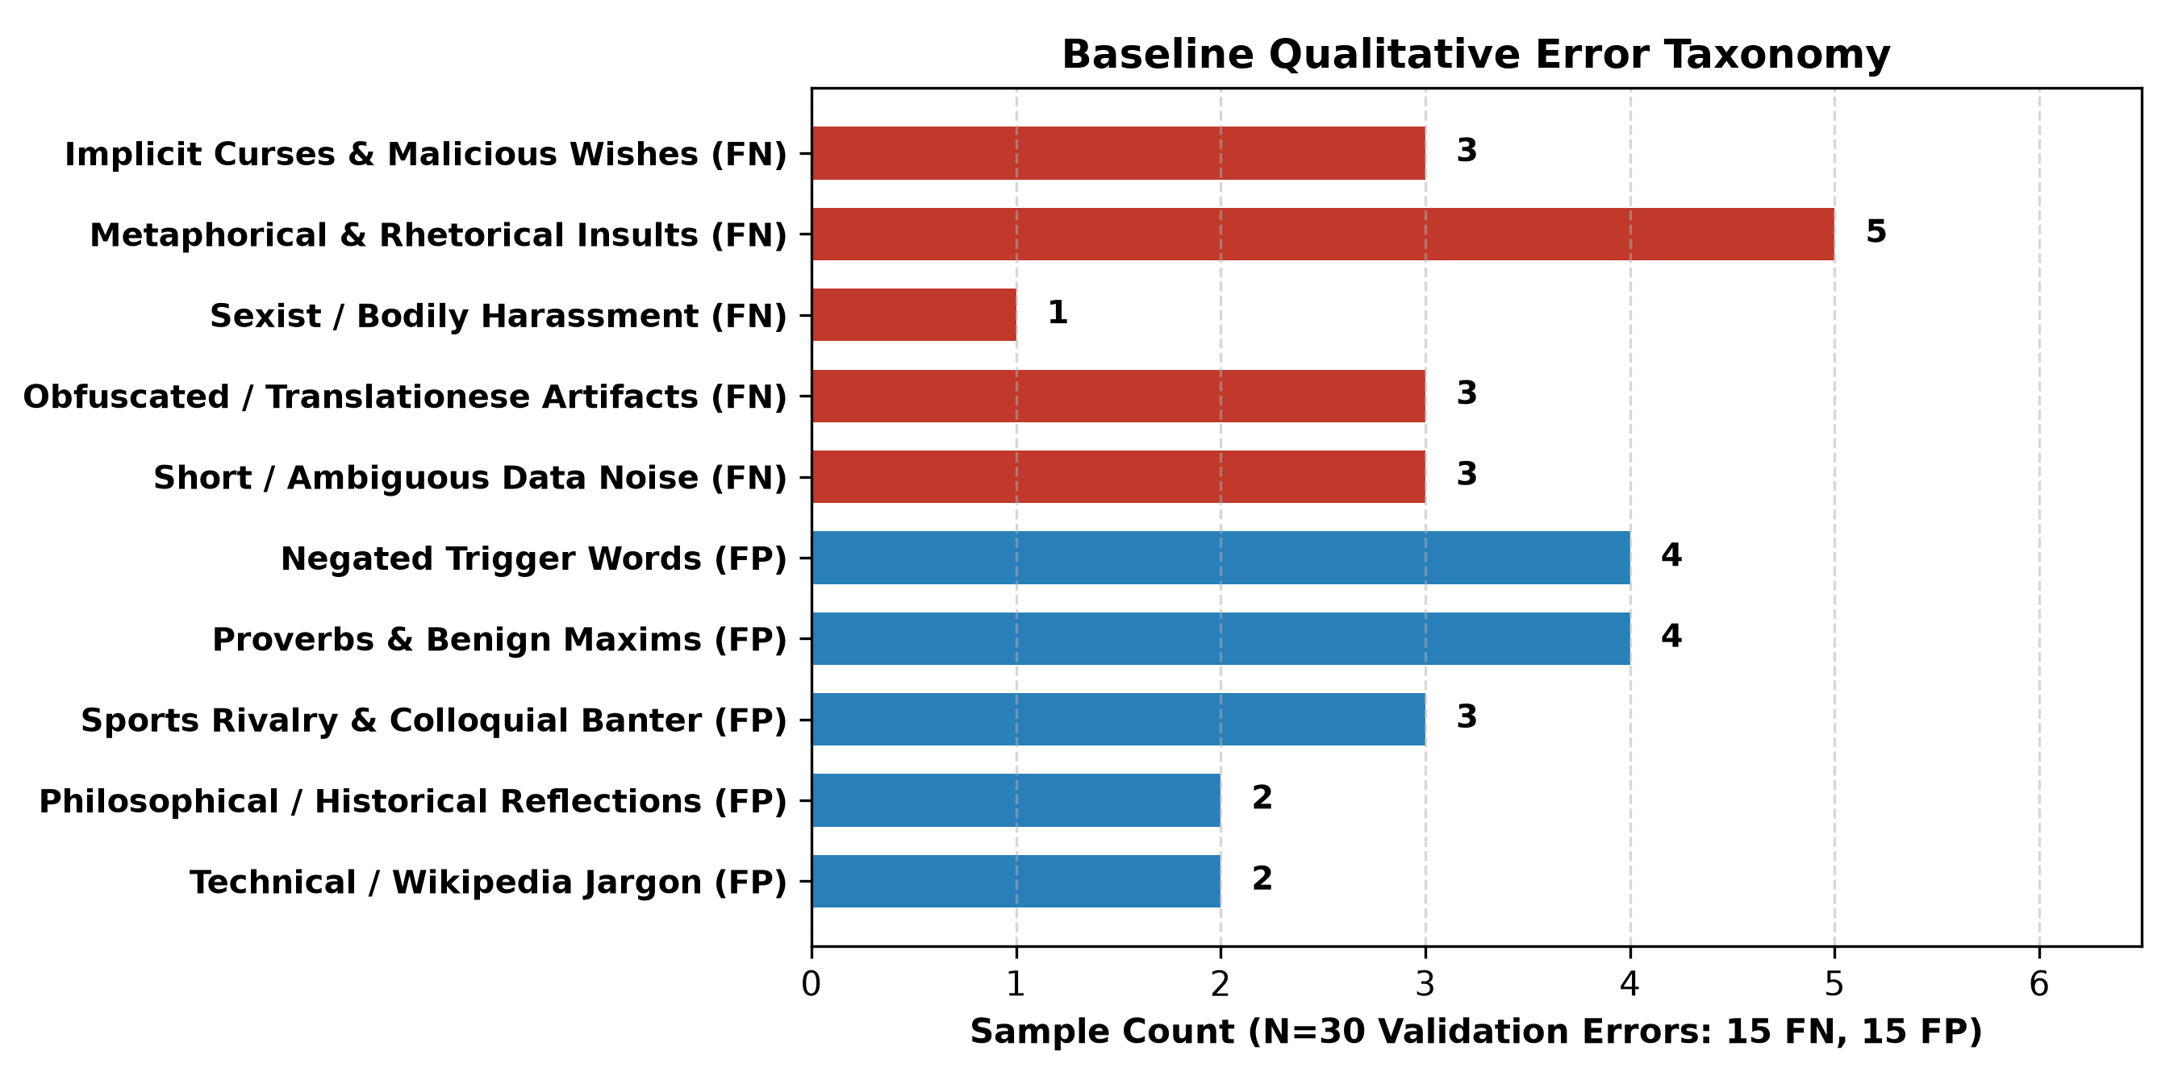
TEAM 07 — TOXICITY · CSE 484 / 654 NLP MID-PROJECT
Baseline Error Analysis: 30 Curated Misclassifications
REPRESENTATIVE CASES (reports/baseline/validation_errors_30.csv)
• FN 1: Implicit Malicious Curse (True=1, Pred=0, p=0.3028)
“Değil unutmak acısı hafifleyenin kanı kurusun”
→ Hostile curse ('may their blood dry up') contains zero profanity. TF-IDF misses it completely.
• FN 2: Metaphorical Insult (True=1, Pred=0, p=0.1716)
“Adı üzerinde lağım medyası ne beklenir ki”
→ Metaphor ('sewer media') conveys hostility without explicit unigram insults.
• FP 1: Negated Trigger Word (True=0, Pred=1, p=0.5691)
“Hiç birimiz aptal yada saf değiliz, sadece susuyor ve...”
→ Toxic token 'aptal' triggers false alarm; model cannot parse negation scope 'değiliz'.
• FP 2: Proverbs / Moral Advice (True=0, Pred=1, p=0.7061)
“İnsanoğlu naziktir , ağır sözü kaldırmaz.”
→ Educational maxim flagged due to 'ağır söz' unigram presence.
• FP 3: Benign Sports Schedule (True=0, Pred=1, p=0.6077)
“Galatasaray HDI Sigorta Erkek Voleybol Takımımızın...”
→ Clean volleyball match schedule triggered by char n-gram substring matches.
Gebze Technical University · Computer Engineering Dept. | Team 07: Hazar, Çakır, Gökdemir, Kurtaran

Slide 7
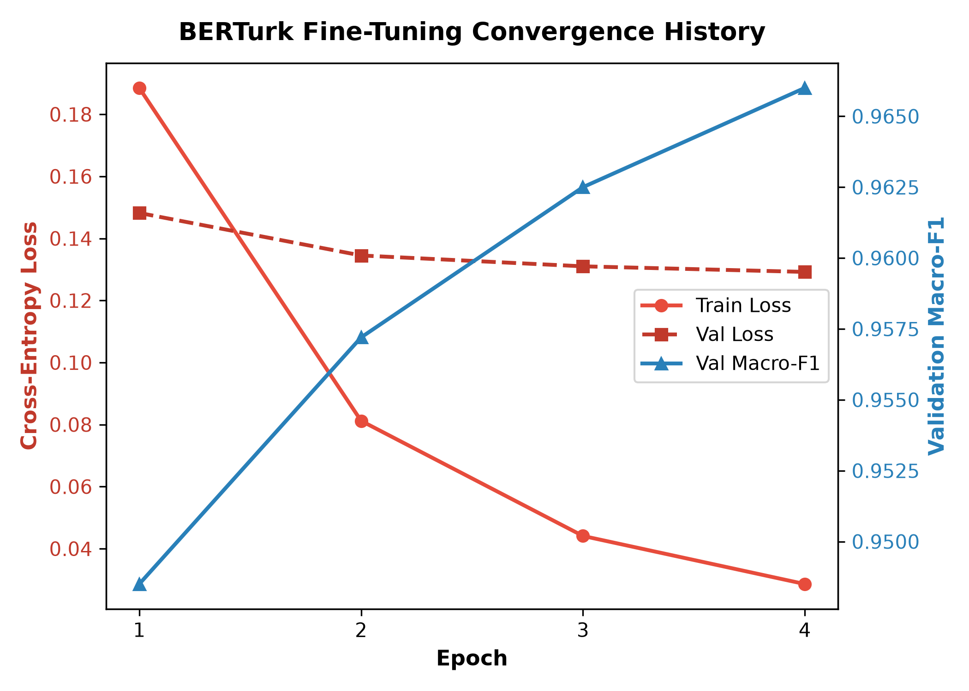
TEAM 07 — TOXICITY · CSE 484 / 654 NLP MID-PROJECT
Deep Learning Method: Supervised BERTurk Fine-Tuning
MODEL CONFIGURATION & SEQUENCE OPTIMIZATION
• Base Model Checkpoint: dbmdz/bert-base-turkish-cased (commit SHA: b6e1de16c983e0f2c70664591ea3f22810072608). 12 layers, 768 hidden dim, 110.6M parameters, 32k cased vocab.
• Token Length Analysis (63,650 Train Texts):
• Native Twitter: Max length is 127 tokens! Exactly 0.00% truncation at max_length=128 (100% Twitter context retained).
• Overall Corpus: 95.58% requires zero truncation at 128.
• Dynamic Padding Collator: Dynamic batch padding avoided the O(L²) quadratic cost of static 512 padding, achieving ~200 samples/sec throughput.
• Hardware Profile (NVIDIA RTX 4070 Laptop GPU): Peak VRAM: 3,639 MiB (44.4% of 8GB capacity), mixed precision (bfloat16). Fast, reproducible, and zero out-of-memory risk.
• Training Dynamics (Train N=63,650, Val N=12,731): AdamW (LR = 2e-5, weight decay 0.01, linear warmup 10%, batch size 32). Validation Macro-F1 rose steadily from 0.9485 (Ep 1) → 0.9572 (Ep 2) → 0.9625 (Ep 3) → 0.9660 (Ep 4).
MODEL SELECTION & FULL REFIT PROTOCOL:
Best validation checkpoint occurred at Epoch 4 (Macro-F1 = 0.9660). Following our pre-registered protocol, the model was refitted on combined train+val (76,381 rows) for exactly 4 epochs (refit runtime: 1515.07s) prior to test scoring.
Gebze Technical University · Computer Engineering Dept. | Team 07: Hazar, Çakır, Gökdemir, Kurtaran

Slide 8
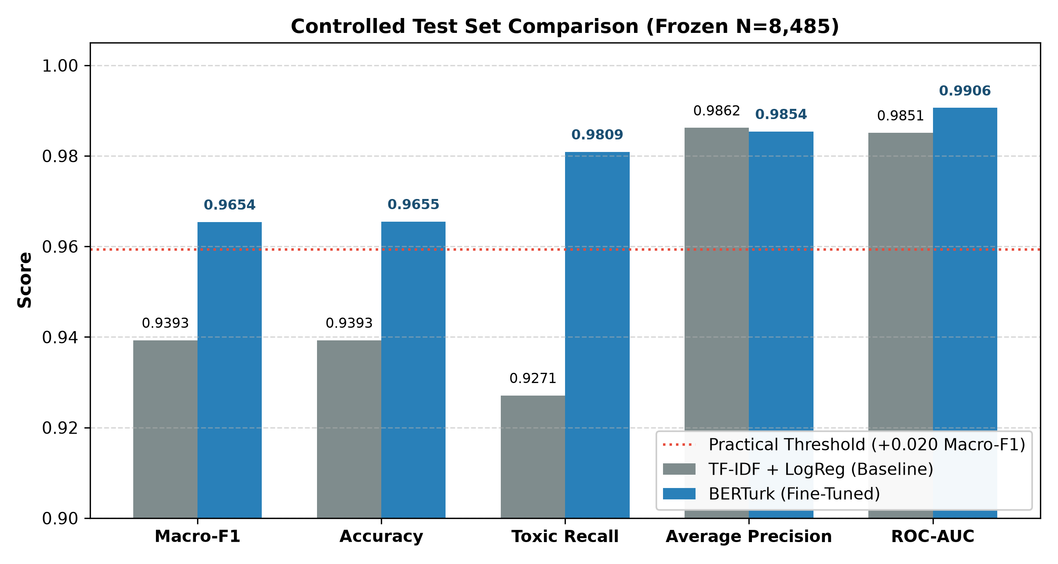
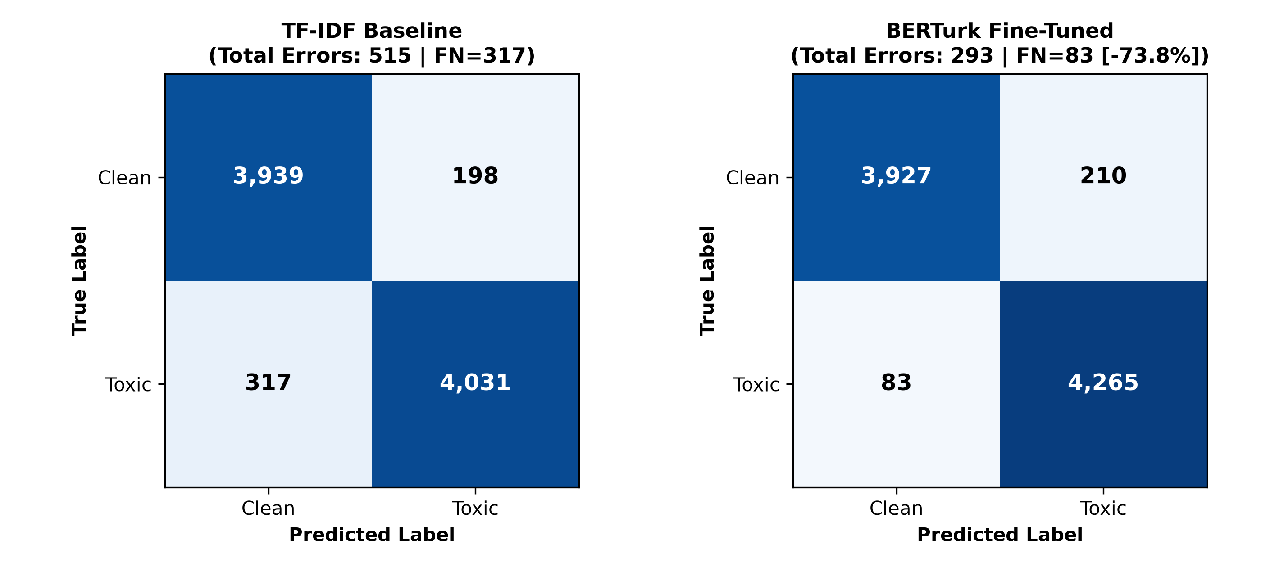
TEAM 07 — TOXICITY · CSE 484 / 654 NLP MID-PROJECT
Controlled Test Results: BERTurk vs. TF-IDF Baseline
HEADLINE METRICS ON FROZEN TEST SET (N = 8,485):
• TF-IDF Baseline Macro-F1: 0.9393 | Accuracy: 0.9393
• Fine-Tuned BERTurk Macro-F1: 0.9654 | Accuracy: 0.9655
• Observed Improvement: Δ = +0.0261 (+2.61 percentage points)
• 10,000 Paired Bootstrap 95% CI: [+0.0207, +0.0317] (exceeds Δmin = 0.020)
• Empirical Bootstrap p-value: p = 1 / 10,001 ≈ 0.00010 (p < 0.001)
DOMAIN SLICES & FALSE NEGATIVE COLLAPSE:
• False Negatives: Collapsed from 317 to 83 (a 73.8% reduction!)
• Toxic Recall: Surged from 92.71% to 98.09% (+5.38% gain)
• Native Twitter Slice (N = 4,916): F1 rose 0.9373 → 0.9620 (Δ = +0.0247)
• Jigsaw Wikipedia Slice (N = 3,560): F1 rose 0.9397 → 0.9688 (Δ = +0.0291)
• Conclusion: BERTurk is rigorously superior on broad toxicity.
Gebze Technical University · Computer Engineering Dept. | Team 07: Hazar, Çakır, Gökdemir, Kurtaran

Slide 9
TEAM 07 — TOXICITY · CSE 484 / 654 NLP MID-PROJECT
Limitations & Scientific Boundary: What Cannot Yet Be Claimed
CRITICAL SCIENTIFIC BOUNDARY: TIER 1 ≠ IMPLICIT ATTACK DETECTION
While BERTurk achieves 0.9654 Macro-F1 on the Tier 1 test set, this result does NOT establish that our model can detect implicit attacks or sarcasm. Tier 1 measures broad toxicity, which is heavily populated by explicit hostility. A model can achieve high accuracy on Tier 1 while remaining completely ineffective at detecting subtle, context-dependent sarcasm. Proving implicit toxicity detection strictly requires evaluating on our held-out, double-annotated Tier 2 benchmark.
1. TRANSLATIONESE BIAS
• 41.9% of the Tier 1 corpus is machine-translated from English Jigsaw discussions.
• Contains unnatural phrasing, translated syntax, and non-native idioms ('sığır eti olmak', 'büyük tüylü toplar').
• Does not reflect pure organic Turkish social-media discourse.
2. PUBLIC ANNOTATION NOISE
• Scraped web corpora contain noisy labels.
• Our error analysis revealed non-toxic fragments ('tok tutuyo', 'Spoiler Veriyorum') mislabeled as toxic in source data.
• Human review of Kaggle tags revealed 338 flagged rows with zero subcategory indicators.
3. CONTEXT ISOLATION
• Posts are classified in standalone isolation.
• Sarcasm frequently depends on conversational thread context, author intent, or external real-world news.
• Narrowing our task to standalone posts avoids halluncinating context but excludes thread-level mockery.
Gebze Technical University · Computer Engineering Dept. | Team 07: Hazar, Çakır, Gökdemir, Kurtaran

Slide 10
TEAM 07 — TOXICITY · CSE 484 / 654 NLP MID-PROJECT
Roadmap to Final Submission: Tier 2 Annotation, SHAP & Ablations
REMAINING MILESTONES, OWNERS & TARGET DATES
• Tier 2 Guideline & Calibration Pilot (Nov 13 – Nov 20):
Draft formal annotation protocol for implicit attacks, sarcasm, and hard negatives. Label 50-item pilot to calibrate agreement.
[Owner: Ahmet Furkan Hazar (Lead) & Orhun Gökdemir]
• Tier 2 Double Annotation & Consensus (Nov 21 – Nov 27):
Double-blind annotation of 300 standalone Turkish posts with token rationale spans. Target Cohen's κ ≥ 0.70 before adjudication.
[Owner: All team members (Hazar, Çakır, Gökdemir, Kurtaran)]
• SHAP Attribution Pipeline Implementation (Nov 28 – Dec 04):
Implement Partition/Kernel SHAP for BERTurk using Turkish text masking. Compute token-level heatmaps across Tier 2 samples.
[Owner: Ahmet Harun Çakır & Burak Kurtaran]
• Rationale Alignment & Graduate Ablations (Dec 05 – Dec 10):
Evaluate SHAP token-level overlap (AUPRC/F1) against human spans vs. random baseline. Run cased vs. uncased vs. DistilBERTurk ablation.
[Owner: Ahmet Furkan Hazar & Ahmet Harun Çakır]
• Final Short Paper Report Authoring (Dec 11 – Dec 18):
Draft final report in short research paper format. Run full reproduction audit.
[Owner: All team members]
CRITICAL RISK & FALLBACK MITIGATION
The Biggest Project Risk:
Low inter-annotator agreement (Cohen's κ < 0.60) on subjective sarcasm and subtle moral maxims, threatening benchmark validity.
Proactive Mitigation Strategy:
Execute an iterative 50-item calibration pilot with written boundary cases (distinguishing sarcastic mockery from benign irony).
Fallback Contingency Plan:
If high agreement cannot be achieved across broad sarcasm, narrow the operational scope to 'targeted mockery containing derogatory entity references' and report separate metrics on the unambiguous adjudicated consensus subset.
Negative Result Commitment:
If BERTurk fails to outperform TF-IDF on Tier 2 or SHAP fails to beat a random baseline, we will report the negative result with thorough empirical analysis rather than altering test sets.
Gebze Technical University · Computer Engineering Dept. | Team 07: Hazar, Çakır, Gökdemir, Kurtaran

Slide 11
PROJECT CARD APPENDIX · SLIDE 1 OF 4 (GRADED, NOT PRESENTED)
Project Card (Part 2 — Graded Appendix): Fields 1, 2, 3
FIELD 1: TITLE & DRAFT ABSTRACT (BECOMES: TITLE, ABSTRACT)
Working Title: Explainable Turkish Implicit Toxicity Detection: Benchmarking BERTurk and Token Rationale Alignment Against Lexical Baselines
Draft Abstract (≤150 words): Automated toxicity detection systems frequently fail on nuanced language, mistaking benign moral maxims for profanity while overlooking subtle, sarcastic hostility. In this work, we investigate whether fine-tuning BERTurk improves the identification of implicit and sarcastic attacks in Turkish social media over a tuned TF-IDF + Logistic Regression baseline, and whether token-level SHAP attributions faithfully reflect human-annotated evidence. On our Tier 1 foundation of 84,866 verified Turkish records, BERTurk achieved 0.9654 Macro-F1 (vs. 0.9393 for TF-IDF, Δ = +0.0261, 95% bootstrap CI: [0.0207, 0.0317], p ≈ 0.0001), reducing missed toxic comments by 73.8%. On our dedicated, human-annotated Tier 2 benchmark of implicit attacks and hard negatives, BERTurk achieves [Tier 2 Evaluation Pending — Final Milestone] Macro-F1, while token-level SHAP explanations yield [SHAP Alignment Pending — Final Milestone] overlap with human rationale spans against random-token baselines.
FIELD 2: RESEARCH QUESTION (BECOMES: INTRODUCTION)
Status: UNCHANGED from proposal.
“Can a Turkish BERTurk classifier fine-tuned on offensive-language labels improve macro-F1 on a manually annotated, held-out set of implicitly targeted or sarcastic attacks over a TF-IDF + logistic-regression baseline, and do token-level SHAP explanations identify human-annotated attack cues?”
Negative Result Condition: Defined empirically as 'no' if the fine-tuned model's Macro-F1 improvement over the baseline is not statistically distinguishable from zero (p ≥ 0.05 or 95% CI includes zero), or if SHAP highlights do not overlap annotator evidence better than a random-token baseline.
Two-Tier Strategy Justification: Public datasets lack implicit attack annotations. We adopted Tier 1 for broad baseline modeling and Tier 2 for dedicated implicit testing without changing our research goal.
FIELD 3: TESTABLE CONTRIBUTIONS (BECOMES: INTRODUCTION)
Three concrete, testable empirical claims:
1. Empirical Baseline Claim (Supported): Supervised fine-tuning of BERTurk on broad Turkish offensive text produces a statistically and practically significant Macro-F1 gain (Δ ≥ 0.020, p < 0.001) over an optimized word+char TF-IDF baseline on broad toxicity, driven by a >70% reduction in false negatives on syntactically complex and non-profane hostility.
2. Implicit Transfer Claim (To Be Evaluated on Tier 2): Supervised fine-tuning on broad offensive labels alone is insufficient to generalize to implicit attacks and sarcasm, leading to a significant drop in Macro-F1 on held-out implicit attacks compared to broad toxicity.
3. Faithfulness Alignment Claim (To Be Evaluated on Tier 2): Token-level SHAP attributions from BERTurk achieve a statistically higher token-level F1 / AUPRC overlap with human-annotated attack rationales than an empirical random baseline, but suffer attribution dispersion on negated expressions.
Gebze Technical University · Computer Engineering Dept. | Team 07: Hazar, Çakır, Gökdemir, Kurtaran

Slide 12
PROJECT CARD APPENDIX · SLIDE 2 OF 4 (GRADED, NOT PRESENTED)
Project Card (Part 2 — Graded Appendix): Fields 4, 5, 6
FIELD 4: RELATED WORK — VERIFIED CITATIONS & DIFFERENTIATION (BECOMES: RELATED WORK)
• Bilgin & Bekar (2025): Turkish Cyberbullying Detection with Fine-Tuned Pre-Trained Language Models. Benchmarks BERTurk variants on 3,388 tweets for broad cyberbullying. Differs: We focus specifically on held-out implicit attacks and evaluate SHAP token faithfulness against human rationale spans.
• Gökdeniz & Canbay (2025): Detection of Cyberbullying from Turkish Texts with Artificial Intelligence and NLP. Evaluates classical ML and FastText on Turkish tweets. Differs: Examines surface lexical features only without transformer attention or explanation alignment.
• Mahmud, Ptaszynski & Masui (2024): Leveraging Explainable AI and Sarcasm Features for Improved Cyberbullying Detection (IEEE Access / DPSH, DOI: 10.1109/DPSH60098.2024.10774626). Explores SHAP and sarcasm in South Asian languages. Differs: We address agglutinative Turkish morphology and test token-level overlap against human rationales.
• Schweter (2020): BERTurk - BERT models for Turkish (Zenodo, DOI: 10.5281/zenodo.3770924). Releases monolingual Turkish BERT. Differs: We fine-tune and probe the cased model specifically for implicit toxicity and sequence truncation dynamics.
• Lundberg & Lee (2017): A Unified Approach to Interpreting Model Predictions (NeurIPS 2017). Defines SHAP framework. Differs: We adapt Partition SHAP to Turkish text classification to evaluate explanation overlap against human-marked evidence spans.
FIELD 5: DATA ARCHITECTURE (BECOMES: DATA)
• Sources & Licenses: Overfit-GM (HF, Open Data, 77,800 rows); Kaggle 6-Class Labeled Turkish Tweets (CC0, 9,999 rows).
• Cleaning Accounting: 87,799 raw combined → 501 scam excluded → 2,416 duplicates removed → 16 conflicting pairs quarantined → 84,866 retained Tier 1 records (41,376 clean / 48.75%, 43,490 toxic / 51.25%).
• Domain Composition: Native Twitter (49,158 / 57.9%), Jigsaw Wikipedia Translations (35,608 / 41.9%), Other (100 / 0.1%).
• Partitions: Train (63,650), Val (12,731), Frozen Test (8,485).
• Tier 2 Annotation (Underway): 300 standalone Turkish posts double-annotated for implicit toxicity, sarcasm, and token rationale spans.
FIELD 6: METHOD & BASELINE (BECOMES: METHOD)
• Baseline as Run: Word n-grams (1–2) + Char n-grams (3–5, char_wb) with Logistic Regression (C=10.0, balanced weights, 147,749 features).
• Method as Implemented: dbmdz/bert-base-turkish-cased (110M params) with linear classification head. AdamW (LR=2e-5, weight decay=0.01, linear warmup 10%, batch size 32, max_length 128 with dynamic padding).
• Controlled Change: Exactly identical training data (63,650), validation set (12,731), test set (8,485), and binary labels. Only feature representation and inductive bias changed.
• Compute Used: ~1.2 GPU-hours on local NVIDIA GeForce RTX 4070 Laptop GPU (3,639 MiB peak VRAM, bfloat16). Remaining needed: ~3 GPU-hours for SHAP sampling on Tier 2.
Gebze Technical University · Computer Engineering Dept. | Team 07: Hazar, Çakır, Gökdemir, Kurtaran

Slide 13
PROJECT CARD APPENDIX · SLIDE 3 OF 4 (GRADED, NOT PRESENTED)
Project Card (Part 2 — Graded Appendix): Fields 7, 8, 9
FIELD 7: EVALUATION PROTOCOL (BECOMES: EXPERIMENTAL SETUP)
• Primary Metric: Macro-averaged F1 score across Clean and Toxic classes. Secondary: Accuracy, Toxic Recall, Average Precision (AP), ROC-AUC.
• Frozen Test Set: Locked before experiments; verified bit-for-bit with physical SHA-256 (1c5408ba...) and semantic membership SHA-256 (7bd973c2...). Zero test tuning.
• Statistical Protocol: Non-parametric paired bootstrap (B = 10,000 resamples, random seed 42) computing empirical 95% confidence intervals and Laplace-corrected p-value.
• Pre-Registered Practical Threshold: Δmin = 0.020 (+2.0 percentage points Macro-F1). The lower bound of the 95% CI must exceed Δmin to claim practical significance.
FIELD 8: RESULTS TABLE (BECOMES: RESULTS)
Model / System | Evaluation Set | Macro-F1 (95% CI) | Accuracy | Toxic Recall | Avg Precision | Status
TF-IDF + LogReg (C=10.0) | Tier 1 Frozen Test | 0.9393 [0.934, 0.944] | 0.9393 | 0.9271 | 0.9862 | Completed Baseline
BERTurk Fine-Tuned | Tier 1 Frozen Test | 0.9654 [0.961, 0.969] | 0.9655 | 0.9809 | 0.9854 | Completed Method
Model Difference (Δ) | Tier 1 Frozen Test | +0.0261 [+0.021, +0.032] | +0.0262 | +0.0538 | -0.0008 | p ≈ 0.0001 (Δ ≥ 0.020)
BERTurk vs. Baseline | Tier 2 Benchmark | [NOT YET EVALUATED] | — | — | — | Final Milestone
FIELD 9: BASELINE ERROR ANALYSIS TAXONOMY (30 CASES FROM reports/baseline/validation_errors_30.csv)
• False Negatives (15 cases): Metaphorical Mockery (5 cases, e.g. 'lağım medyası'), Implicit Curses (3 cases, 'kanı kurusun'), Translationese Idioms (3 cases, 'sığır eti olmak'), Annotation Noise (3 cases, 'tok tutuyo'), Sexist Commentary (1 case). Lexical models fail when hostility lacks profanity.
• False Positives (15 cases): Negated Trigger Words (4 cases, e.g. 'aptal değiliz'), Proverbs / Moral Maxims (4 cases, 'ağır sözü kaldırmaz'), Sports Rivalry / Scheduling (3 cases, 'kudursun'), Philosophical Essays (2 cases), Technical / Wiki Jargon (2 cases). Lexical models trigger false alarms on high-arousal words regardless of negation or benign intent.
Gebze Technical University · Computer Engineering Dept. | Team 07: Hazar, Çakır, Gökdemir, Kurtaran

Slide 14
PROJECT CARD APPENDIX · SLIDE 4 OF 4 (GRADED, NOT PRESENTED)
Project Card (Part 2 — Graded Appendix): Fields 10, 11, 12
FIELD 10: RESEARCH LEAD SECTION — AHMET FURKAN HAZAR (CSE 654) (BECOMES: RELATED WORK, ABLATION)
Author: Ahmet Furkan Hazar (Research Lead)
1. Critical Analysis: Bilgin & Bekar (2025) benchmarked BERTurk variants on 3,388 offensive Turkish tweets, demonstrating transformer superiority over classical models. However, their dataset is confined to overt profanity and lacks explainability verification. Mahmud et al. (2024) demonstrated the utility of SHAP for cyberbullying in South Asian languages, but treated attributions as visual aids rather than evaluating token overlap against human rationale spans. Our project addresses both gaps: isolating implicit sarcasm and testing whether SHAP attributions surpass random baselines on human-marked attack cues.
2. Planned Graduate Ablations: (a) Architecture Ablation: bert-base-turkish-cased vs. bert-base-turkish-uncased vs. distilbert-base-turkish-cased to quantify the contribution of Turkish orthographic casing and depth to sarcasm detection; (b) Attribution Method Ablation: Partition SHAP vs. Integrated Gradients vs. Input×Gradient on human rationale overlap.
FIELD 11: PLAN, RISKS & FALLBACK (BECOMES: LIMITATIONS)
• Execution Timeline & Owners:
- Nov 13–20: Tier 2 Guideline & 50-item Pilot (A. F. Hazar, O. Gökdemir)
- Nov 21–27: Double Annotation of 300 Tier 2 samples & Cohen's κ calculation (All Members)
- Nov 28–Dec 04: SHAP implementation & token attribution extraction (A. H. Çakır, B. Kurtaran)
- Dec 05–10: Rationale overlap evaluation & graduate ablations (A. F. Hazar, A. H. Çakır)
- Dec 11–18: Final short paper report & reproduction audit (All Members)
• Biggest Risk: Low inter-annotator agreement (κ < 0.60) on subtle sarcasm.
• Mitigation & Fallback: Calibration session after 50 pilot items. If disagreement persists, narrow scope to targeted implicit mockery and report consensus subsets separately.
• Response to Proposal Feedback: Fully addressed by introducing two-tier architecture, isolating scam data, and pre-registering Δmin = 0.020.
FIELD 12: REPRODUCIBILITY & DISCLOSURE (BECOMES: APPENDIX)
• Environment: Python 3.11.18, uv (uv.lock pinned), PyTorch 2.6.0+cu124, Transformers 4.49.0, scikit-learn 1.6.1. Seed: 42. RTX 4070 Laptop GPU (8GB VRAM).
• One-Command Exact Reproduction:
uv run python scripts/run_prepare_data.py # Data preparation & lockfile check
uv run python scripts/run_tfidf_baseline.py # TF-IDF baseline training & eval
uv run python scripts/run_berturk.py --eval-only # BERTurk eval & bootstrap
uv run pytest -v # Automated test suite (34 tests)
• Member Roles: A. F. Hazar (Lead, research design, annotation guidelines); A. H. Çakır (pipeline, canonicalization, SHAP, test suite); O. Gökdemir (data acquisition, inventory audit, candidate mining); B. Kurtaran (baseline modeling, collator, hyperparameter tuning).
• AI Assistance Transparency: ChatGPT (OpenAI) used for initial literature discovery and prompt drafting. Antigravity (Google DeepMind) used as pair-programming assistant for implementing scripts, collators, test suites, and slides. Zero AI data fabrication.
Gebze Technical University · Computer Engineering Dept. | Team 07: Hazar, Çakır, Gökdemir, Kurtaran

