Slide 1

Mapper Algorithm implementation for schizophrenia detection using EEG Signals
LAB BASED PROJECT
Presenting by:
Giri Ajay(21116040) , Guttula Harun Shankar(21116041).
Under Supervision of:
Tharun Kumar Reddy , Asst. Professor, Dept of ECE, IIT ROORKEE.

Slide 2
Contents
Introduction
Proposed Methods
Keppler Mapper Algorithm
Feature extraction
Dataset Description
Results
Conclusion
References

Slide 3
Introduction
Neuronal electrical activity of the brain can be visualized using Electroencephalogram (EEG) to inspect and analyze the functional activity of healthy subjects and patients with neurological disorders.
The Kepler Mapping Algorithm is a method used in data science to efficiently and accurately map high-dimensional data onto a lower-dimensional space while preserving its intrinsic structure and relationships. It's particularly useful for tasks like visualization and dimensionality reduction.
Feature extraction methods like adjacency matrix, covariance matrix, and correlation matrix are commonly applied to EEG data to capture relationships between electrodes and identify patterns of connectivity or similarity among brain regions. These matrices condense complex EEG signals into structured representations, facilitating analysis and interpretation of brain activity in research and clinical applications.
Schizophrenia dataset in EEG format provides valuable insights into the neural dynamics of individuals affected by the disorder, offering a window into the aberrant brain activity and potential biomarkers associated with schizophrenia.

Slide 4
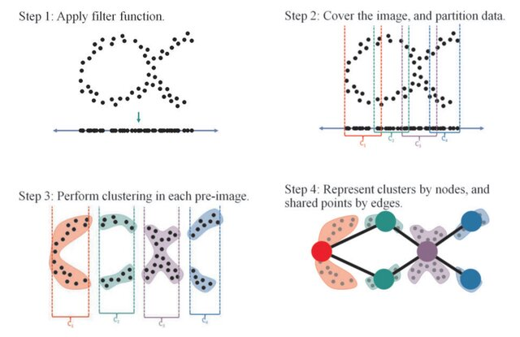
Proposed Methods
Mapper
Mapper is way to construct a graph (or simplicial complex) from data in a way that reveals the some of the topological features of the space. mapper is able to estimate important connectivity aspects of the underlying space of the data so that it can be explored in a visual format. This is an unsupervised method of generating a visual representation of the data.
the Mapper algorithm works by performing a local clustering guided by a projection function.
Fig 1:steps of mapper algorithm implementation

Slide 5
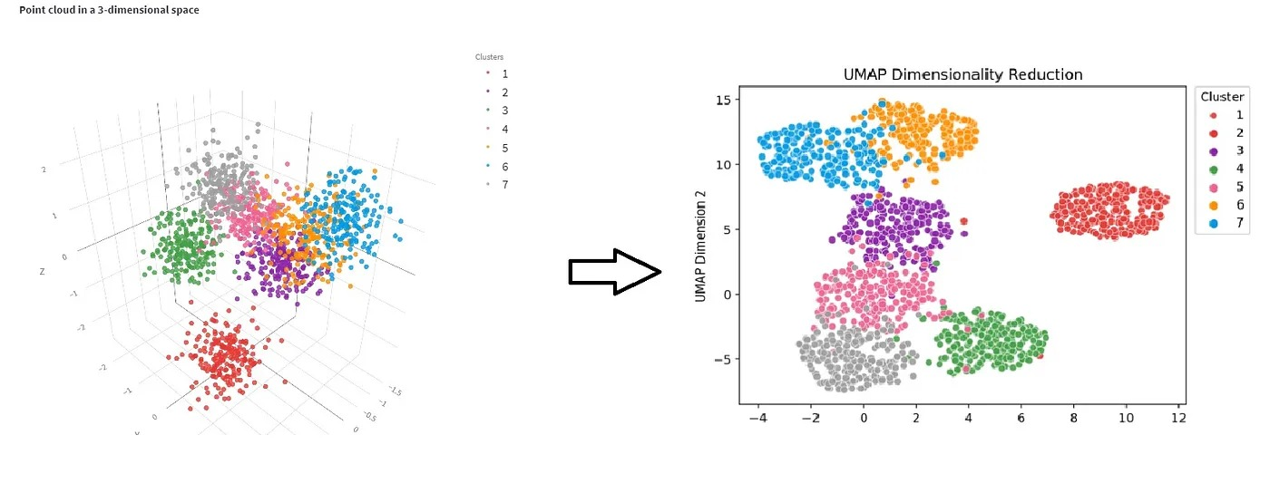
Implementation of Mapper Algorithm
>Dimensionality Reduction is the process of reducing the number of features or variables in a dataset while preserving as much relevant information as possible.
UMAP (Uniform Manifold Approximation and Projection) is a dimensionality reduction technique that uses manifold learning principles to map high-dimensional data into a lower-dimensional space, such as 2D or 3D.
UMAP is based on the concept of constructing a fuzzy topological representation of the high-dimensional data and then optimizing the low-dimensional representation to be as close as possible to this fuzzy topological structure.
Fuzzy Topological Structure:UMAP calculates a fuzzy topological representation of the data by modeling the local and global structure of the high-dimensional graph. It achieves this by optimizing a low-dimensional embedding that preserves the local neighborhood structure of the data.
Fig 2:Visual representation of Umap Dimensionality Reduction

Slide 6
Implementation of Mapper Algorithm
A clustering algorithm is a technique used to partition a dataset into groups, or clusters, where data points within the same cluster are more similar to each other than to those in other clusters. Density-based clustering is a method that identifies clusters based on regions of high data density.
Clusters are dense regions in the data space, separated by regions of the lower density of points. The DBSCAN algorithm is based on this intuitive notion of “clusters” and “noise”. The key idea is that for each point of a cluster, the neighborhood of a given radius has to contain at least a minimum number of points.
Parameters Required For DBSCAN Algorithm:
1)eps: It defines the neighborhood around a data point i.e. if the distance between two points is lower or equal to ‘eps’ then they are considered neighbors.
2)MinPts: Minimum number of neighbors (data points) within eps radius.

Slide 7
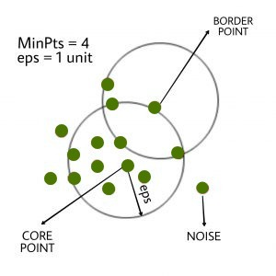
Pseudocode For DBSCAN Clustering Algorithm
DBSCAN(dataset, eps, MinPts){
# cluster index
C = 1
for each unvisited point p in dataset {
mark p as visited
# find neighbors
Neighbors N = find the neighboring points of p
if |N|>=MinPts:
N = N U N'
if p' is not a member of any cluster:
add p' to cluster C }
Fig 3:Classification of points using eps and MinPts

Slide 8
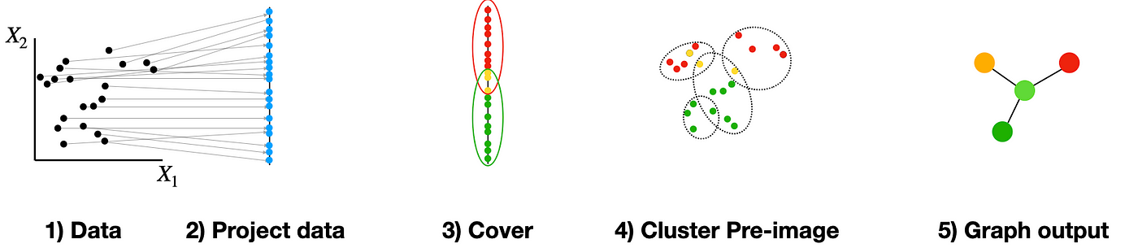
Mapper Algorithm is applied manually in the following steps
Combine the UMAP-transformed data and their cluster labels.
Create a graph representation (Mapper graph) of the data:
For each data point:
Add a node to the graph with the data point's position in the lower-dimensional space.
Connect nodes with edges if the distance between their corresponding data points is less than a specified threshold.
- Plot the Mapper graph to visualize the clusters and their relationships.
Fig 4: Visualization of data across the stages of mapper algorithm implementation

Slide 9
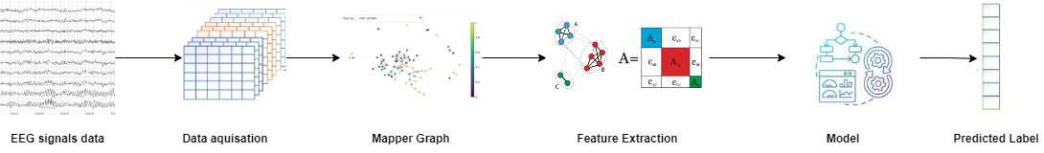
Proposed Framework
X_{cxt}
X_{nxcxT}
G_{Cx3}
Cov_{cxc}
Adj_{cxc}
Cor_{cxc}
Fig 5: Proposed mapper algorithm framework for EEG Signal classification
C= Number of channels
n= Number of trails per subject
T= Time samples per Trail
t= Number of samples for full recording of a subject
To obtain features from the Mapper graphs, adjacency matrix, covariance matrix, and correlation matrix are computed:
>Adjacency Matrix(Adj_{64X64}): The adjacency matrix represents the connections between nodes (features) in the Mapper graph.
>Covariance Matrix(Cov_{64X64}): The covariance matrix quantifies the linear relationship between pairs of features.
>Correlation Matrix(Corr_{64X64}): The correlation matrix measures the strength and direction of the linear relationship between pairs of features.

Slide 10
Dataset Description
Schizophrenia EEG Dataset (40)
Healthy Controls (25)
Schizophrenia controls (15)
EEG data were recorded from 64 scalp sites and 8 external sites.
EEG data were continuously digitized at 1024 Hz and referenced off-line to averaged earlobe electrodes.
After EEG was re-referenced, they were digitally bandpass filtered between 0.5 and 15 Hz.
Dataset: https://www.kaggle.com/datasets/broach/button-tone-sz/data

Slide 11
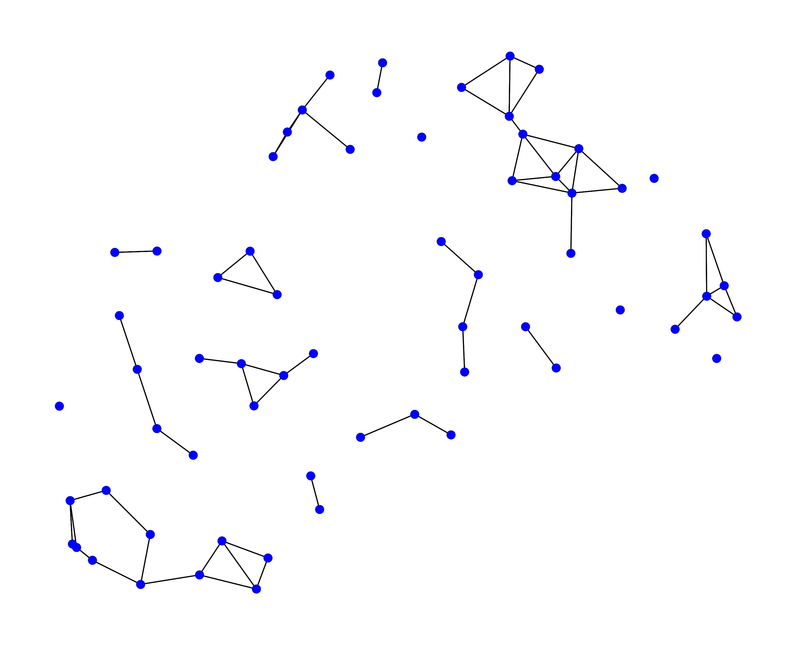
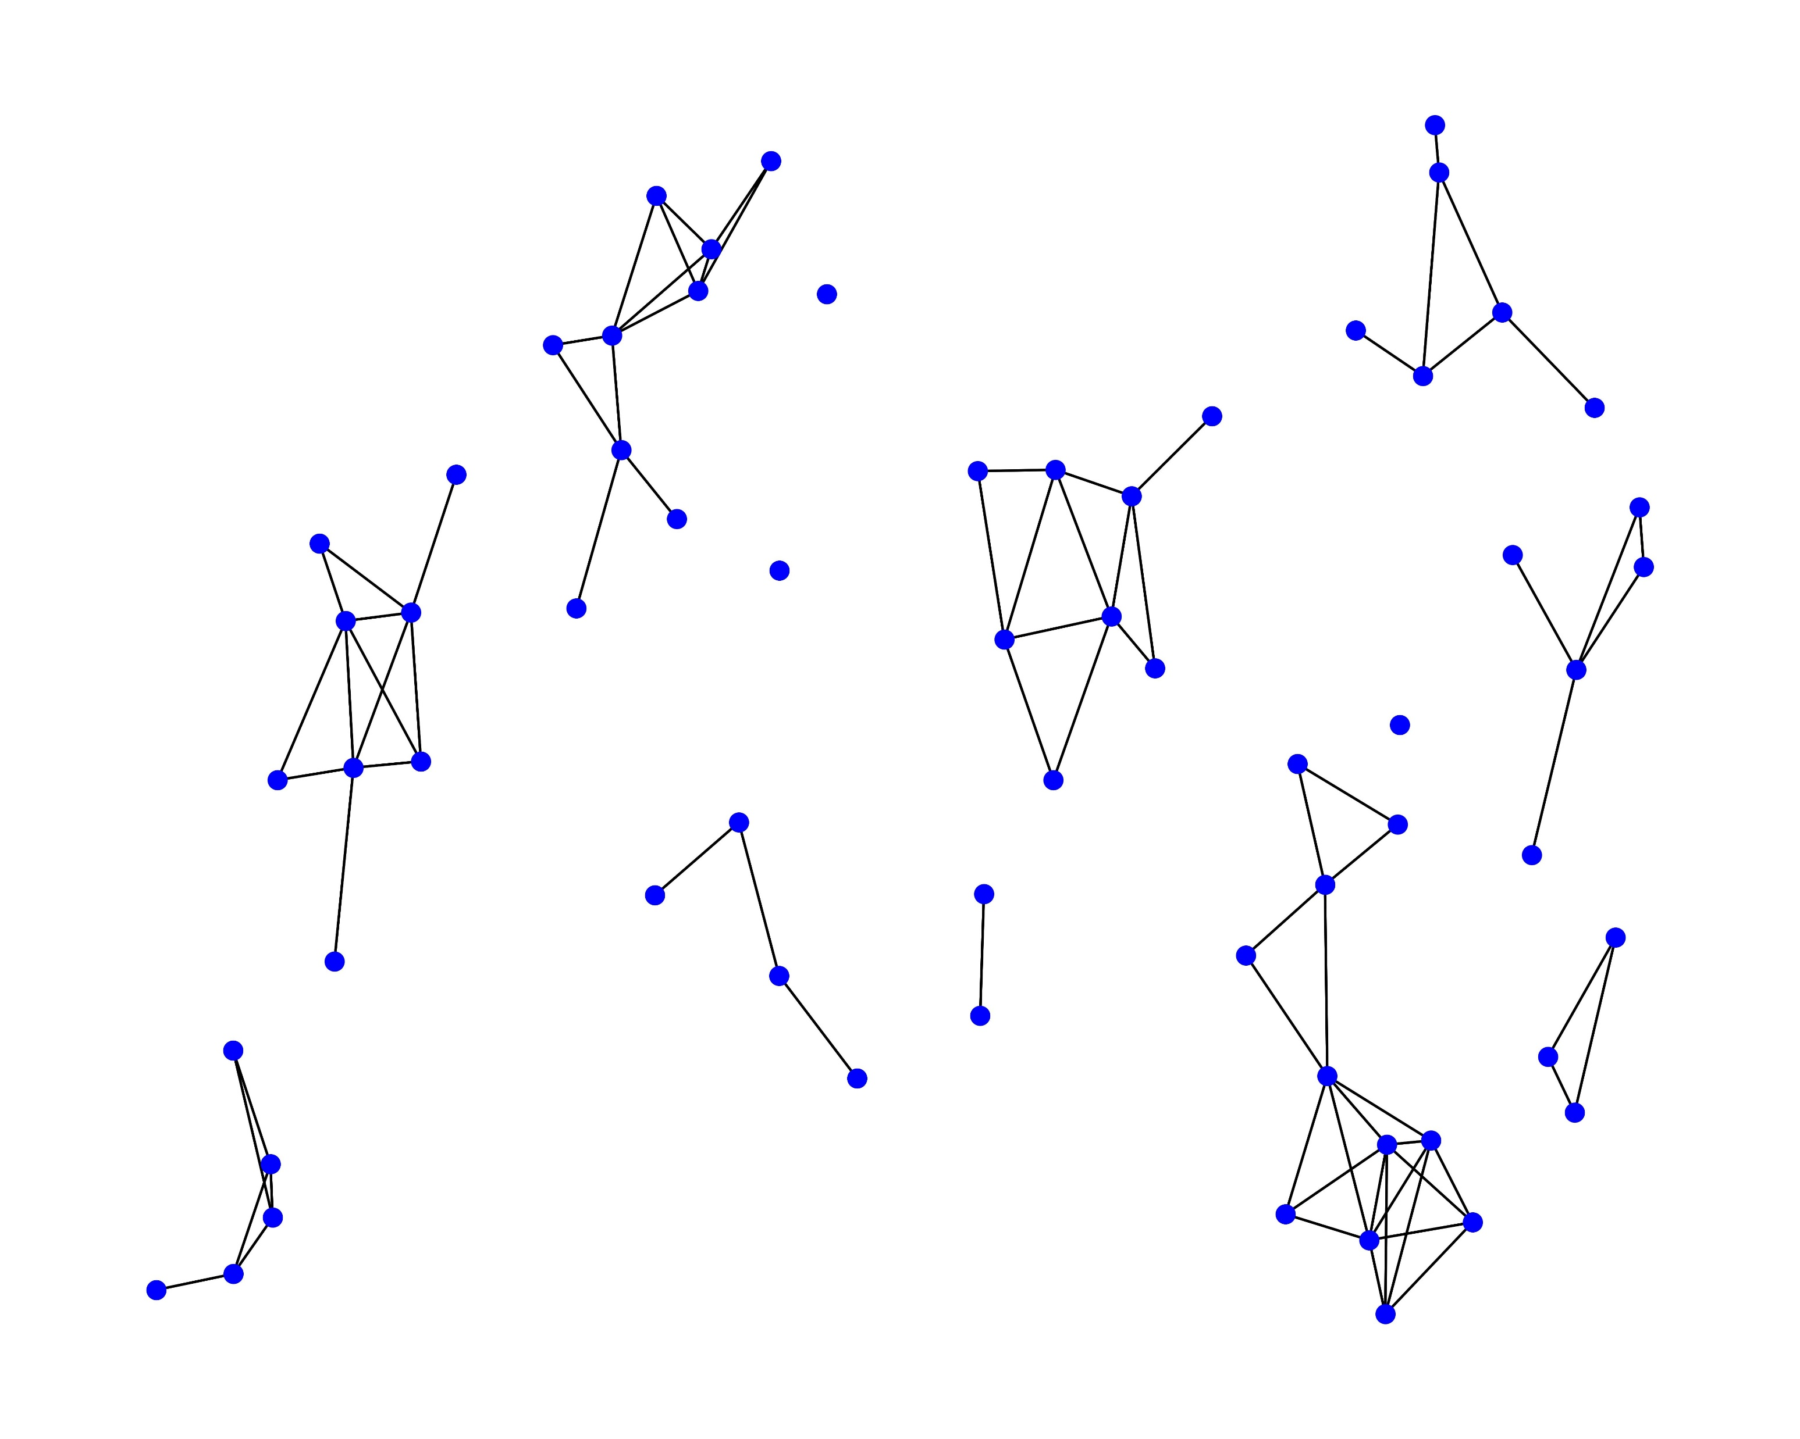
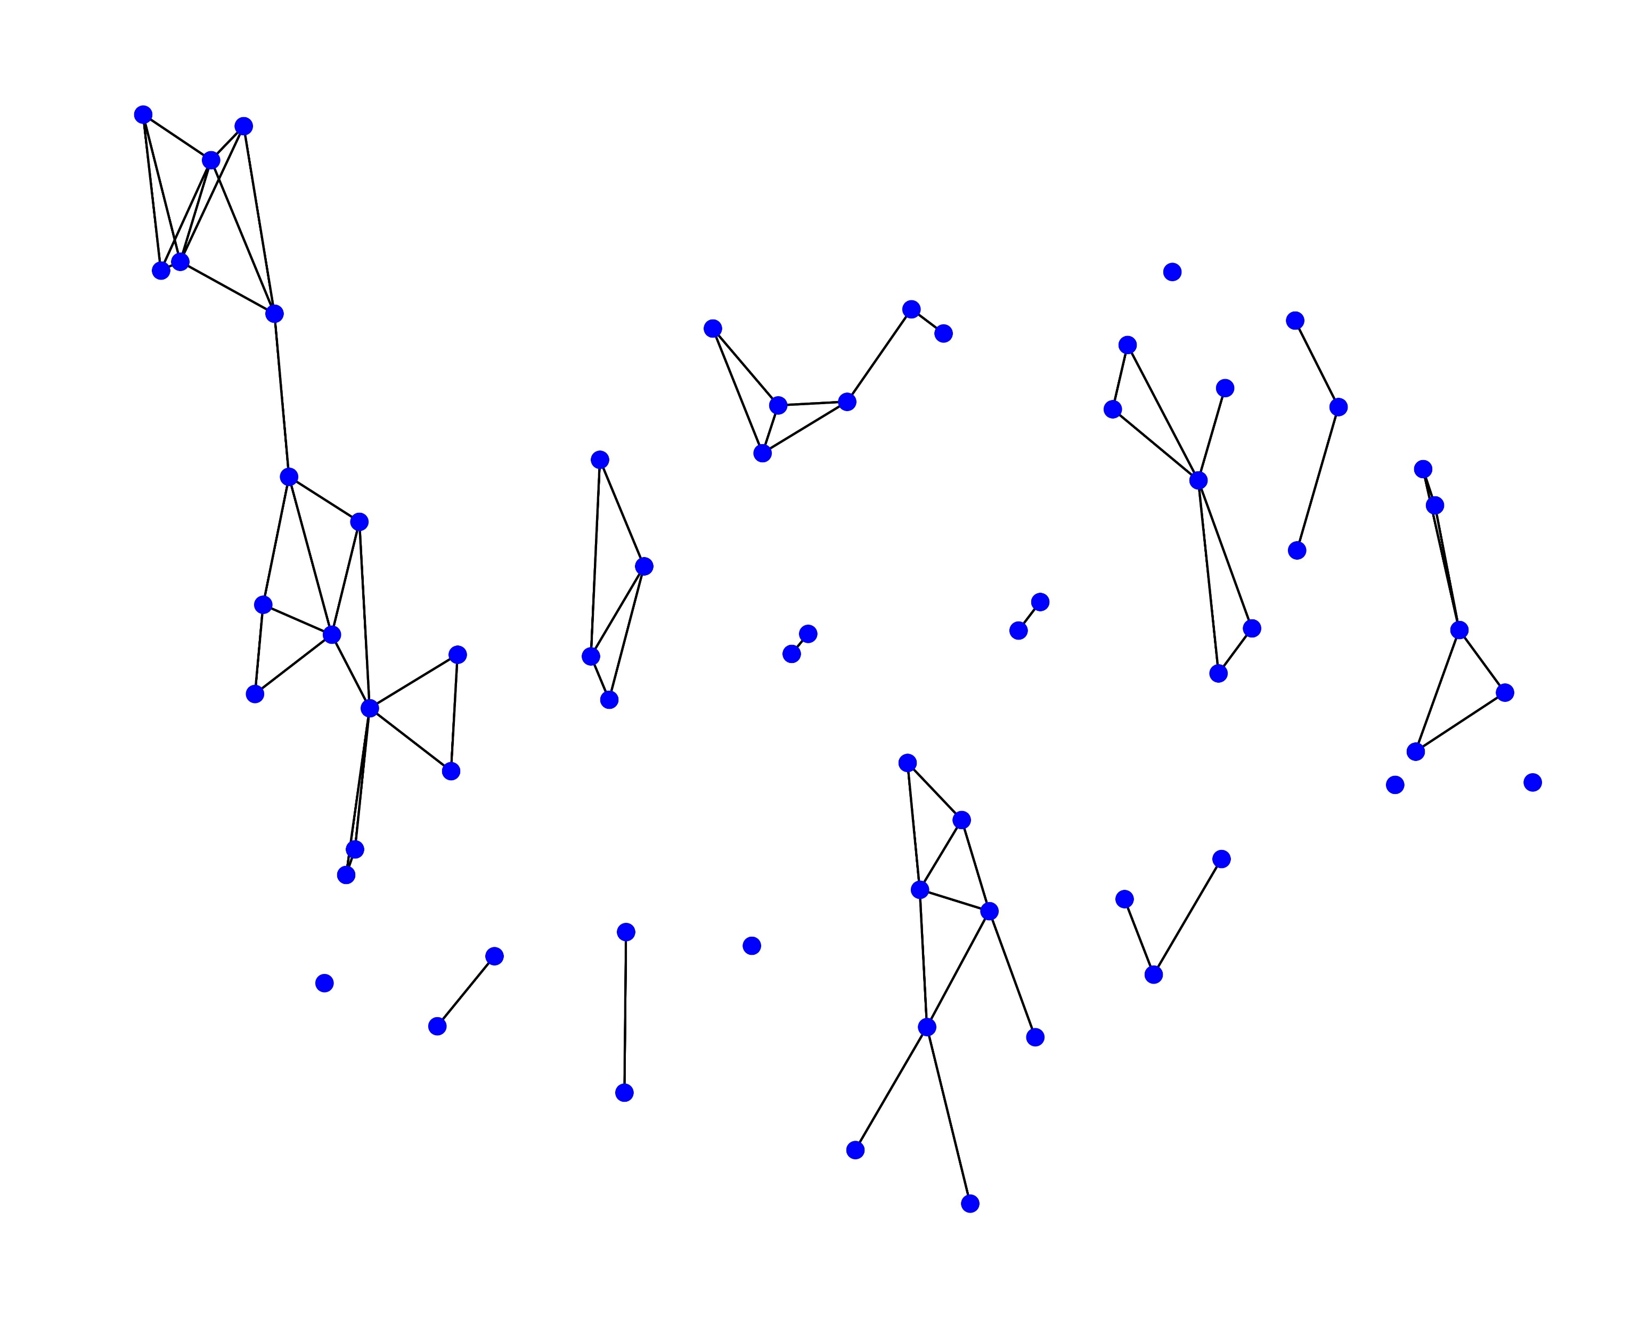
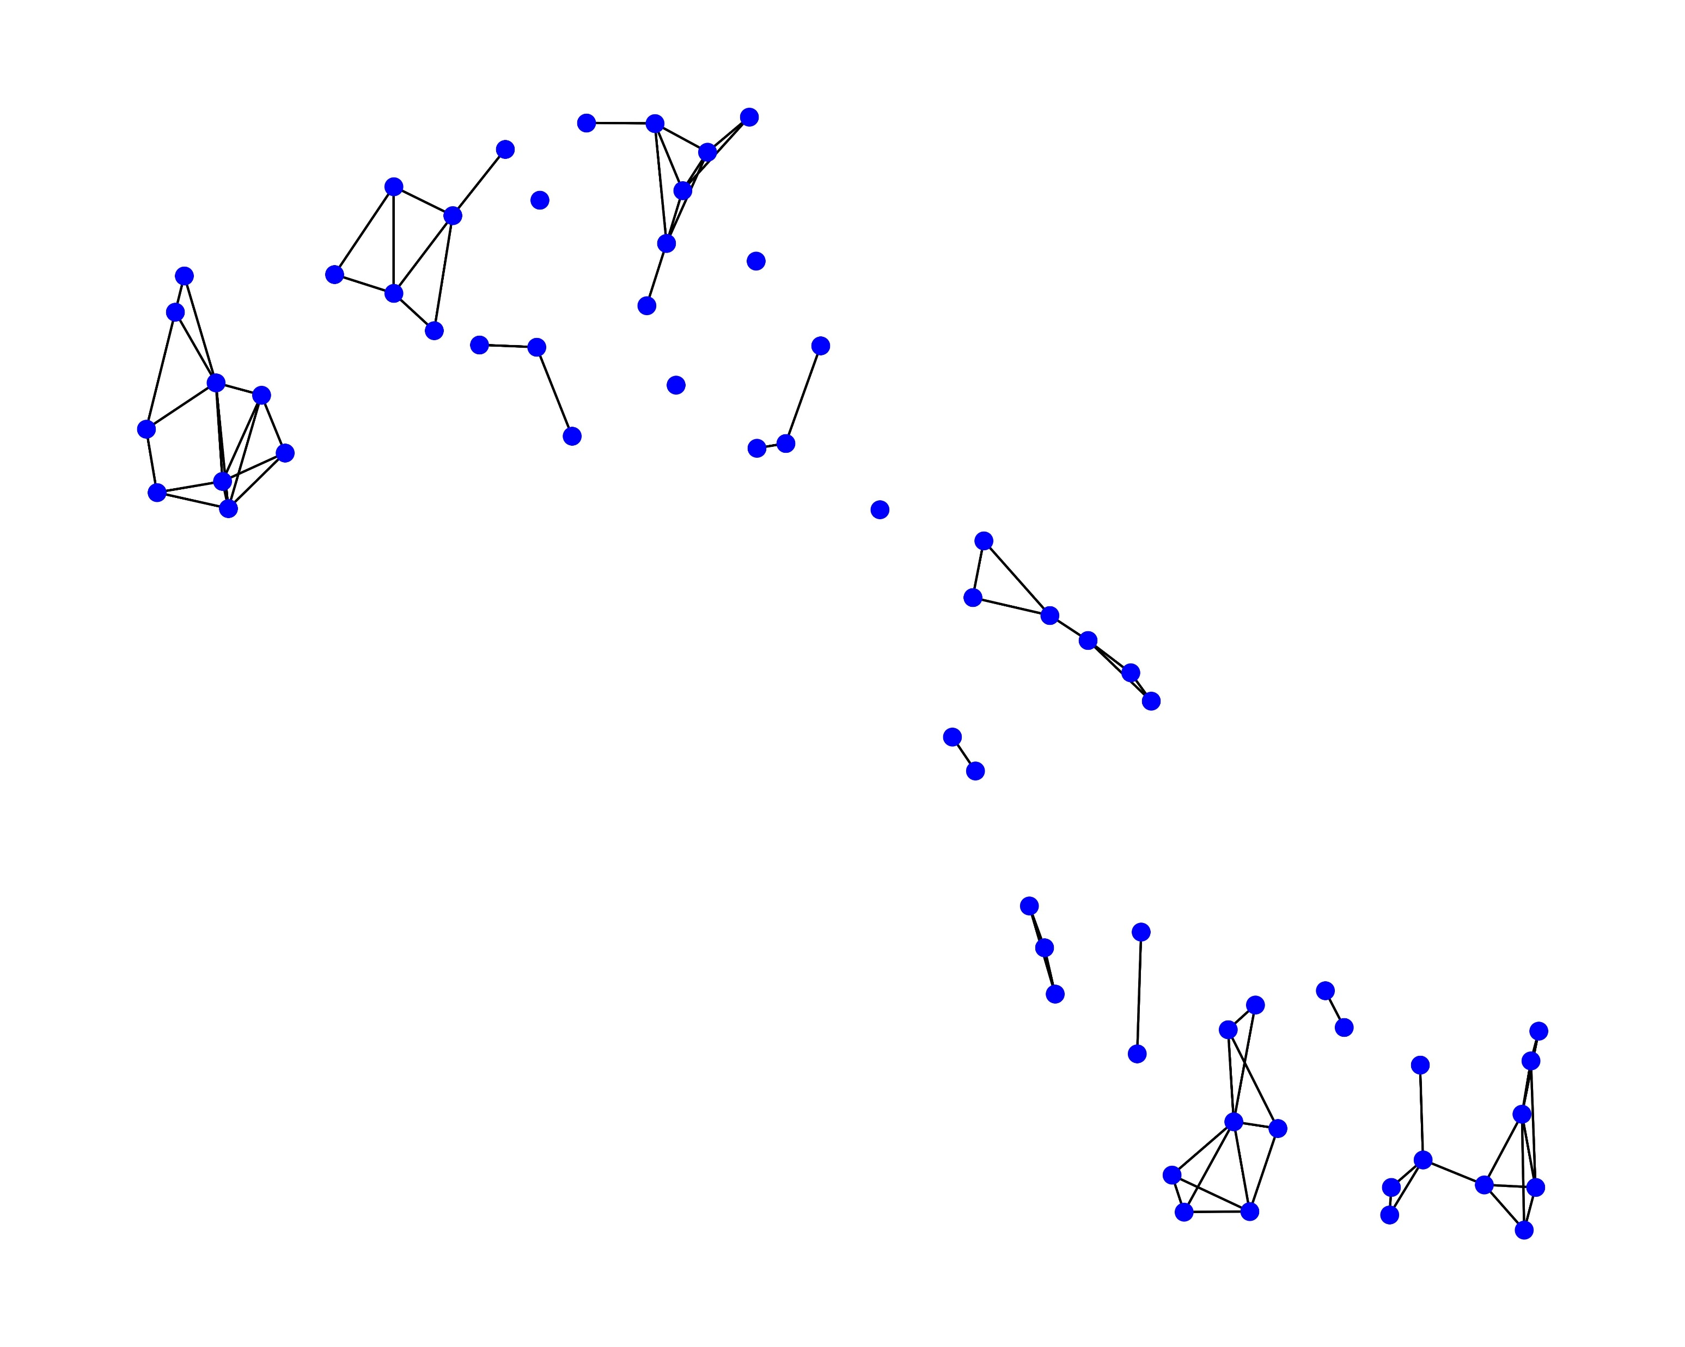
Results:
Figure 5:Mapper graph of healthy subject-i
Figure 6:Mapper graph of healthy subject-ii
Figure 7:Mapper graph of schizophrenia affected subject-i
Figure 8:Mapper graph of schizophrenia affected subject-ii

Slide 12
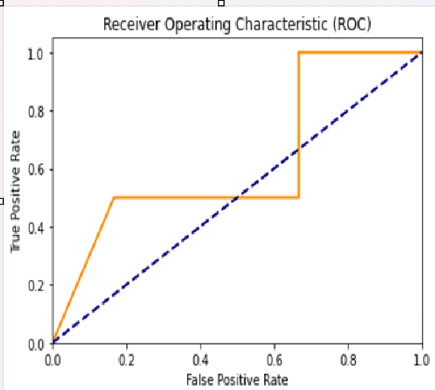
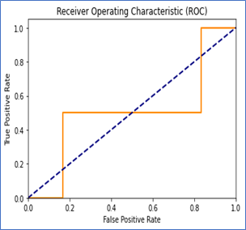
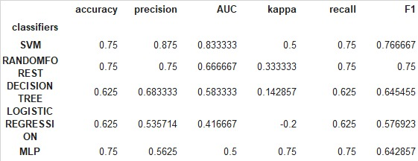
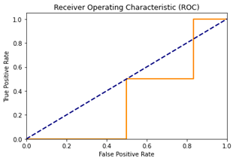
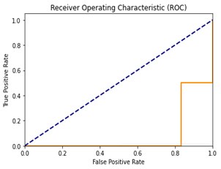
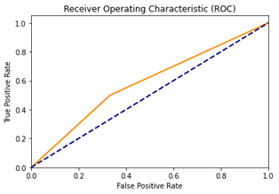
Results
Fig 9: SVM AUC curve
Fig 10: Random Forest AUC curve
Table 1: Classification metric comparison between SVM,
Random Forest, Decision Tree, Logistic Regression and MLP Models
Fig 11: MLP AUC curve
Fig 12: Decision Tree AUC curve
Fig 13: Logistic Regression AUC curve

Slide 13
Conclusion
Our analysis of schizophrenia EEG datasets, utilizing mapper graphs, feature matrices, and machine learning models, has yielded promising results in terms of accuracy and precision. Through thorough parameter tuning, we have enhanced the performance of our models.
These findings suggest the potential of EEG-based approaches in distinguishing between healthy and unhealthy individuals, contributing to the understanding and diagnosis of schizophrenia.
Further research and validation could refine these methods using advanced graph theory techniques for clinical applications, potentially leading to improved detection and management of the disorder.

Slide 14
References
EROGLU, A. and EROGLU, H.U., Topological Data Analysis for Intelligent Systems and Applications.
S. D. Reddy, K. Gaurav and T. K. Reddy, "Schizophrenia and Bipolar Psychosis Classification with rsfMRI Functional Connectivity Feature Fusion technique using Super Learner," 2023 IEEE Silchar Subsection Conference (SILCON), Silchar, India, 2023, pp. 1-6, doi: 10.1109/SILCON59133.2023.10404202.
Xu, X., Drougard, N. and Roy, R.N., 2021. Topological Data Analysis as a New Tool for EEG Processing. Frontiers in Neuroscience, 15, p.761703.
Altındis¸, F., Yılmaz, B., Borisenok, S. and ˙Ic¸ ¨oz, K., 2021. Parameter investigation of topological data analysis for EEG signals. Biomedical Signal Processing and Control, 63, p.102196.
Chazal, F. and Michel, B., 2021. An introduction to topological data analysis: fundamental and practical aspects for data scientists. Frontiers in artificial intelligence, 4, p.108.

Slide 15
Thank you!!!

