Slide 1
Chapter 3: Processes

Slide 2
Outline
Process Concept
Process Scheduling
Operations on Processes
Interprocess Communication
IPC in Shared-Memory Systems
IPC in Message-Passing Systems
Examples of IPC Systems
Communication in Client-Server Systems

Slide 3
Outline
Process Concept
The Process
Process State
Process Control Block
Process Scheduling
Operations on Processes
Interprocess Communication
IPC in Shared-Memory Systems
IPC in Message-Passing Systems
Examples of IPC Systems
Communication in Client-Server Systems

Slide 4
What is a process?

Slide 5
Overview
Process – a program in execution
Also called jobs, tasks
Program – passive ;
Process – active

Slide 6
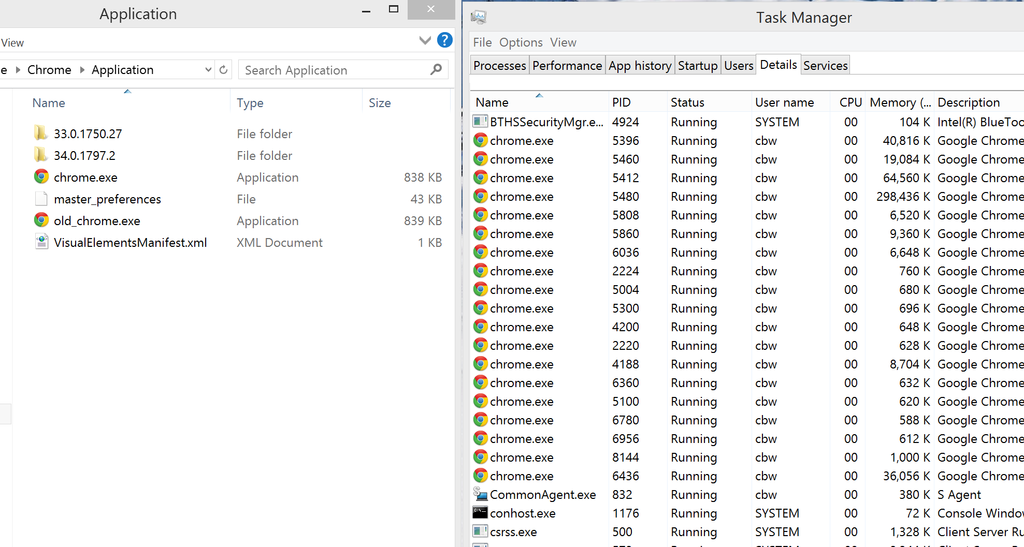
Programs and Processes
(19) Process
The running instantiation of a program, stored in RAM
Program
An executable file in storage
CS 5600 Computer Systems

Slide 7
如何讓Process順利執行呢?
給他需要的資源

Slide 8
Process執行時需要什麼資源呢?

Slide 9
Overview (Cont.)
A process need certain resources:
CPU
CPU registers and PC (Program Counter)
Memory
Text section: program code (fixed size)
Data section: global variable (fixed size)
Stack section: temporary data
Parameter, return address, local variable…
Heap section: memory that are dynamically allocated by calling malloc() and free()
Files, networking, display, keyboard……

Slide 10
本章關注於CPU和記憶體~

Slide 11
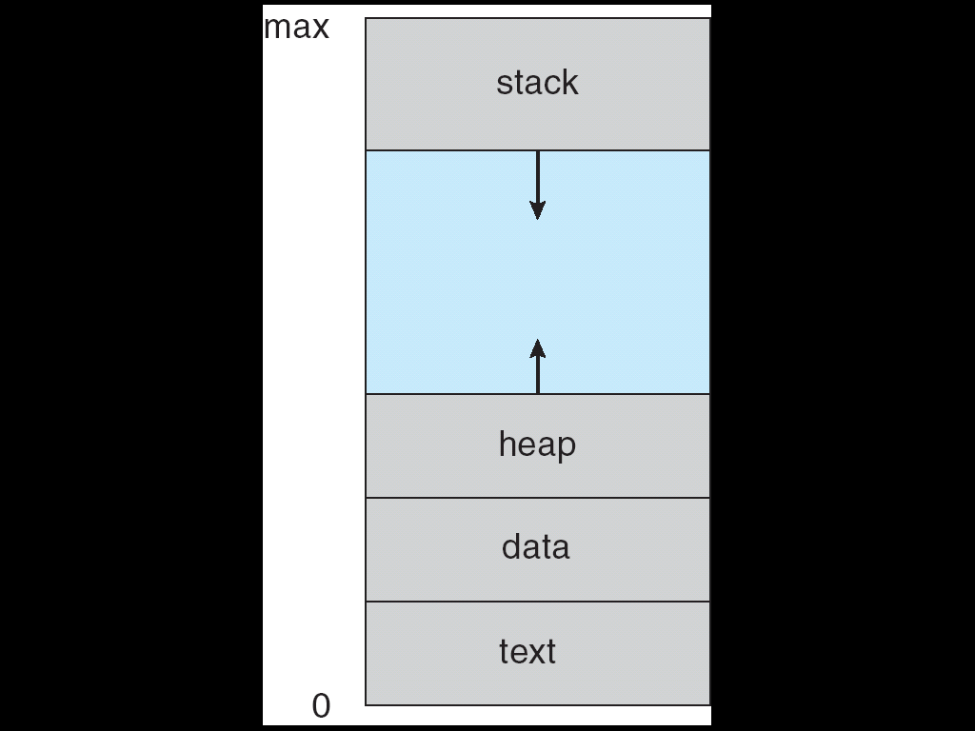
CPU and Memory Used by a Process
CPU
eax=10, ebx=5,…
pc= 0x1000

Slide 12
複習: EIP (or PC)
EIP
1009
1000
mov eax, Y;
1003
add eax, 4;
1006
mov ebx 3;
1009
imul ebx;
100C
mov X, eax;
100F
…
1012
…

Slide 13
為什麼要分為text section, data section, stack section and heap section?

Slide 14
複習:Example: Adding and Subtracting Integers
;AddVariables.asm – Chapter 3 example
.386
.model flat,stdcall
.stack 4096
ExitProcess PROTO, dwExitCode:DWORD
.data
sum DWORD 0
.code
main PROC
mov eax,5
add eax,6
mov sum,eax
INVOKE ExitProcess,0
main ENDP
END main

Slide 15
為什麼使用stack section儲存parameter, return address, local variables?

Slide 16
複習: Stack: Example 1
main()
{
.
.
a = a + 1;
function_1(…);
exit(1);
}
function_1()
{
b = b - 1;
function_2(…);
return;
}
function_2()
{
…
return;
}
stack
ESP
arugment
return address
local variables
ESP
argument
return address
local variables
ESP
argument
return address
local variables

Slide 17
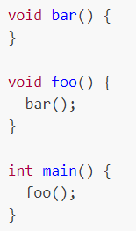
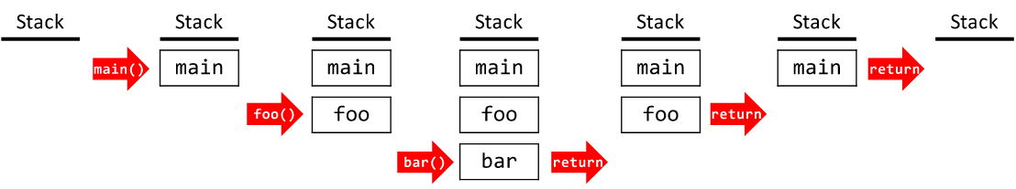
複習: Stack: Example 2
stack frame
https://eecs280staff.github.io/notes/02_ProceduralAbstraction_Testing.html

Slide 18
複習: Stack: Example 3
By the time Sub3 is called, the stack contains three stack frames
stack frame
stack frame
stack frame

Slide 19
Heap section的用途?

Slide 20
Heap
main()
{
.
.
malloc(1024);
……;
b = b - 1;
malloc(2048)
……;
malloc(512);
free(512)
free(2048);
free(1024);
}
heap

Slide 21
為什麼stack and heap sections要動態分配?

Slide 22
Actual Memory Layout of a C Program
As shown in the following slide, in fact
The global data section is divided into initialized data and uninitialized data sections
A separate section is provided for the argc and argv parameters

Slide 23
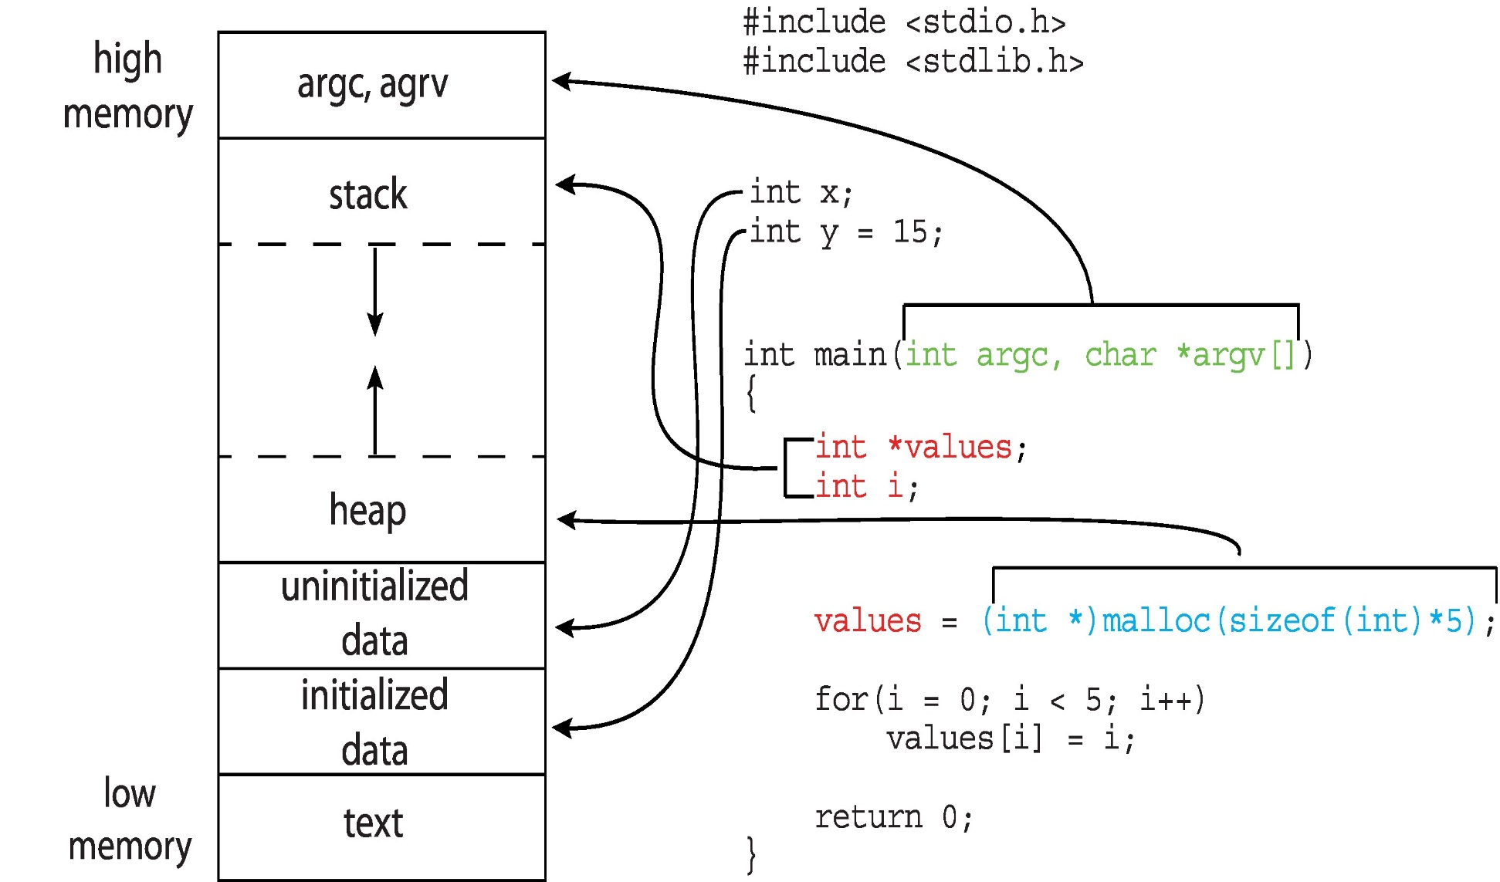
Actual Memory Layout of a C Program

Slide 24
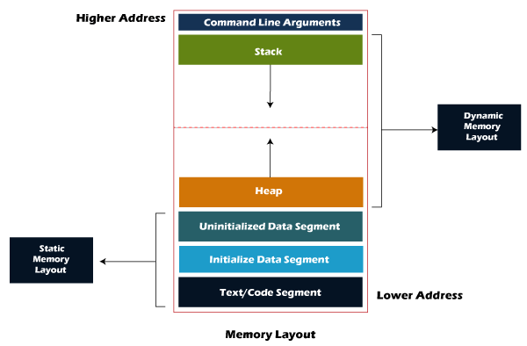
Actual Memory Layout of a Process
https://techaccess.in/2021/05/07/sections-of-a-process/

Slide 25
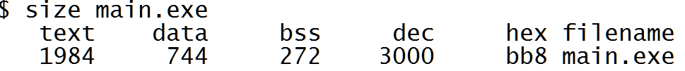
Memory Layout of a C Program
To obtain the size of the segment of a program
size executable-file-name
text: code segment
data: initialized global data
bss (block start by symbol): uninitialized global data
dec and hex: sum of three sections

Slide 26
為什麼沒有stack and heap sections的sizes?

Slide 27
Outline
Process Concept
The Process
Process State
Process Control Block
Process Scheduling
Operations on Processes
Interprocess Communication
IPC in Shared-Memory Systems
IPC in Message-Passing Systems
Examples of IPC Systems
Communication in Client-Server Systems

Slide 28
如何讓Process順利執行呢?
紀錄process的狀態
但是process有哪些狀態呢?

Slide 29
Process State
As a process executes, it changes state
new: The process is being created
running: Instructions are being executed
waiting: The process is waiting for some event to occur
ready: The process is waiting to be assigned to a processor
The process is runable
terminated: The process has finished execution
Only one process can be running on a core
Many processes may be ready or waiting

Slide 30

Diagram of Process State

Slide 31
為什麼要維護process的狀態? 由誰維護的呢?

Slide 32
Outline
Process Concept
The Process
Process State
Process Control Block
Process Scheduling
Operations on Processes
Interprocess Communication
IPC in Shared-Memory Systems
Examples of IPC Systems
Communication in Client-Server Systems

Slide 33
如何讓Process順利執行呢?
紀錄process的所有資訊

Slide 34
由誰紀錄呢?

Slide 35
Process Control Block (PCB) (or Process Descriptor)
For each process, OS maintain a data structure called process control block to keep information with each process
Also called task control block, process descriptor, task descriptor

Slide 36
紀錄哪些資訊呢?

Slide 37
Process Control Block (PCB) (Cont.)
Keep information associated with each process
Process state
Program counter: address of the next instruction
Saved when an interrupt occurs or context switches occurs
CPU registers
Saved when an interrupt or context switches occurs (introduce later)
CPU scheduling information: process priority……
Memory-management information: will be introduced later
Accounting information: CPU time and real time used…..(see following slide)
I/O status information: Open files and devices…

Slide 38
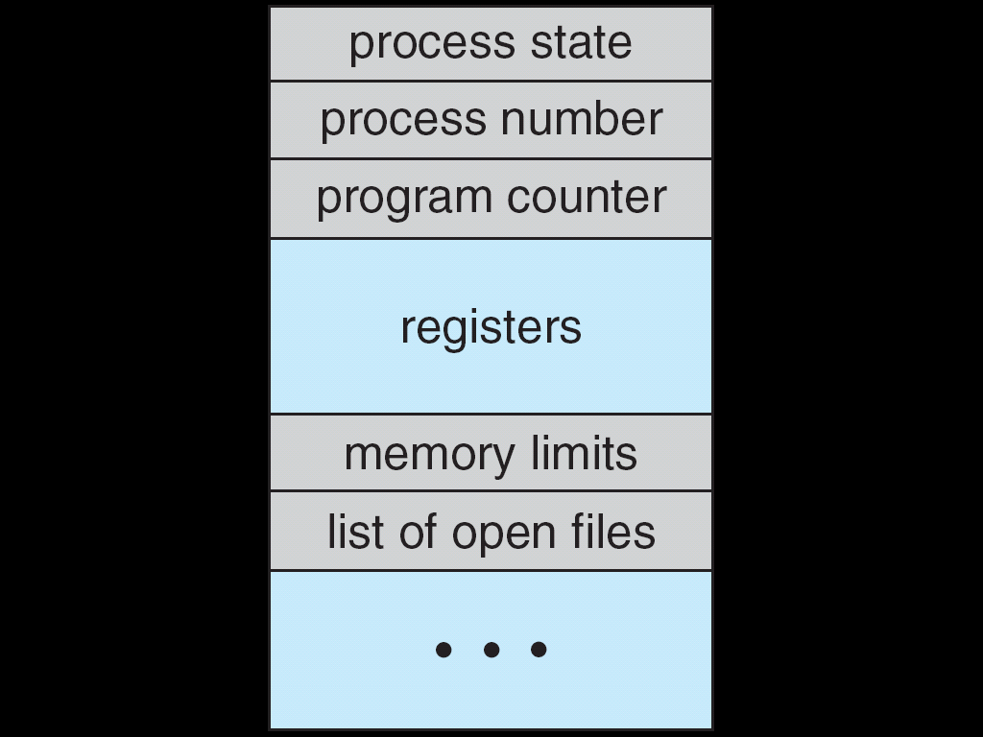
Process Control Block (PCB)

Slide 39
Process Control Block (PCB)
…
out eax, 0x60;
add eax, ebx;
…
…
out eax, 0x30;
add ebx, ebx;
…
…..
P1 PCB
pc = x, eax=y, …..,
OS
P2 PCB
pc = i, eax=j, …..,
OS

Slide 40
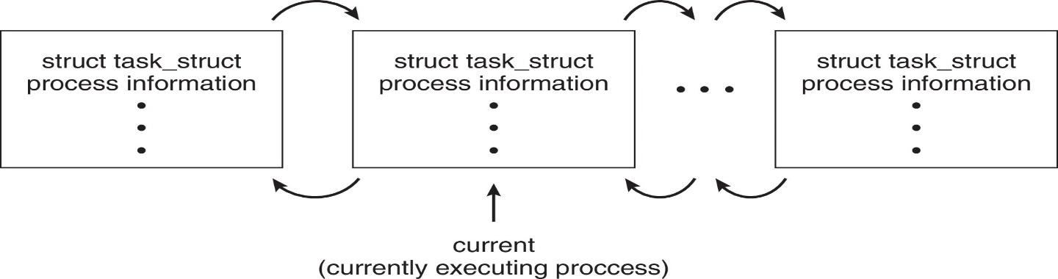
Process Representation in Linux
Represented by the C structure task_struct
pid t_pid; /* process identifier */ long state; /* state of the process */ unsigned int time_slice /* scheduling information */ struct task_struct *parent;/* this process’s parent */ struct list_head children; /* this process’s children */ struct files_struct *files;/* list of open files */ struct mm_struct *mm; /* address space of this process */

Slide 41
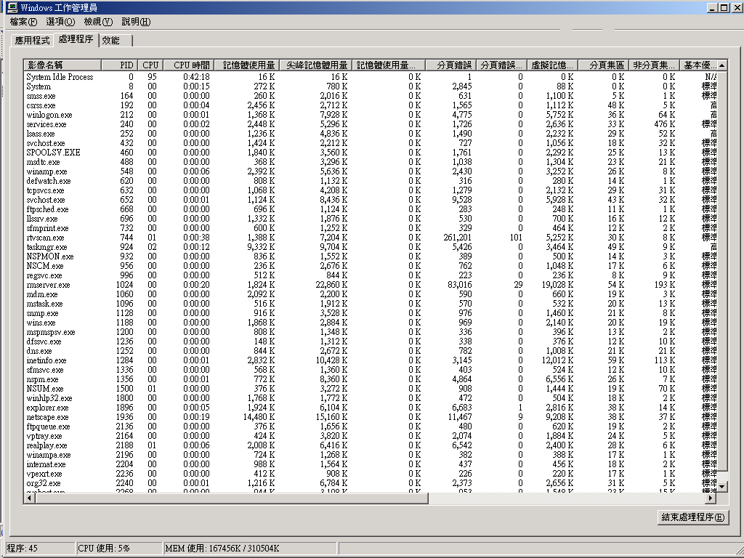
Accounting

Slide 42
Outline
Process Concept
Process Scheduling
Operations on Processes
Inter-Process Communication
IPC in Shared-Memory Systems
Examples of IPC Systems
Communication in Client-Server Systems

Slide 43
Outline
Process Concept
Process Scheduling
CPU Scheduling
Scheduling Queues
Context Switch
Operations on Processes
Interprocess Communication
IPC in Shared-Memory Systems
Examples of IPC Systems
Communication in Client-Server Systems

Slide 44
什麼是CPU Scheduler?
假設有五個ready的processes, CPU cores有兩個!
OS必須選擇兩個ready process執行!
這段選擇的程式就是CPU Scheduler~

Slide 45
CPU Scheduling
CPU Scheduler (or Process Scheduler)
Selects a ready processes for execution on a CPU core
See the following two slides

Slide 46
CPU Scheduler
User
Applications
…
for (;;)
a=a+1;
…
User
Applications
…
for (;;)
a=a+1;
…
Change to execute another application
User Mode
Kernel Mode
CPU_scheduler ()
{
select a ready process to run on a CPU core
}
Hardware

Slide 47
Question: 如何選擇呢?
Shown in Chapter 5

Slide 48
CPU Scheduling (CPU)
CPU scheduler is invoked very frequently
At least once very 100 milliseconds
Why?
But, CPU scheduler cannot be invoked extremely too frequently
Why? (introduced later)

Slide 49
詳細的CPU排程演算法會在第五章介紹!

Slide 50
Outline
Process Concept
Process Scheduling
CPU Scheduling
Scheduling Queues
Context Switch
Operations on Processes
Interprocess Communication
IPC in Shared-Memory Systems
Examples of IPC Systems
Communication in Client-Server Systems

Slide 51
CPU Scheduler需要什麼資料結構？

Slide 52
Scheduling Queues
OS maintains scheduling queues of processes
Ready queue – set of all processes residing in main memory, ready and waiting to execute
A set of wait queues – set of processes waiting for events, e.g., completion of I/O
Processes migrate among the ready queue and various wait queues (see following two slides)

Slide 53
複習: Diagram of Process State

Slide 54
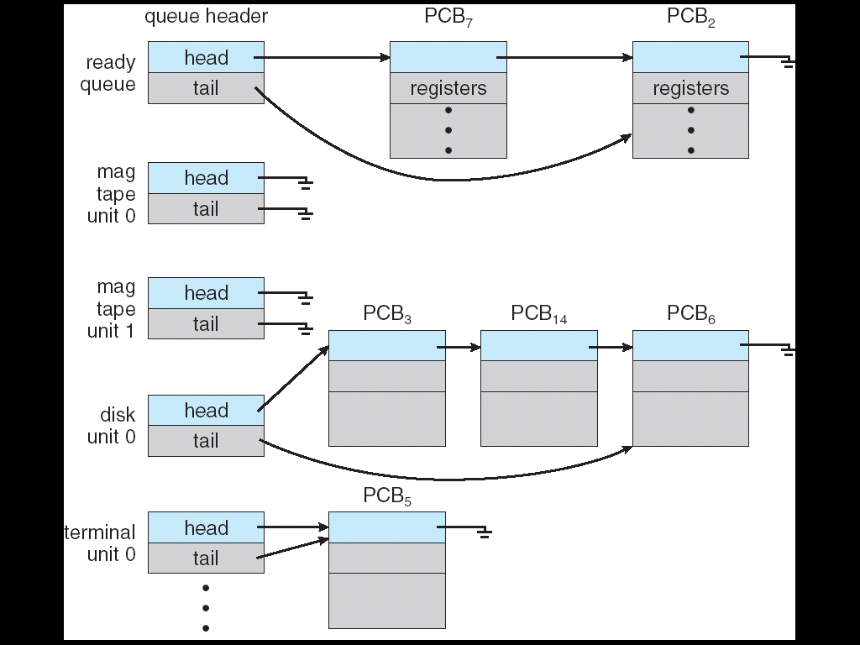
The Ready Queue and Wait Queues
There may be a set of wait queues
NIC
NIC
disk unit 1

Slide 55
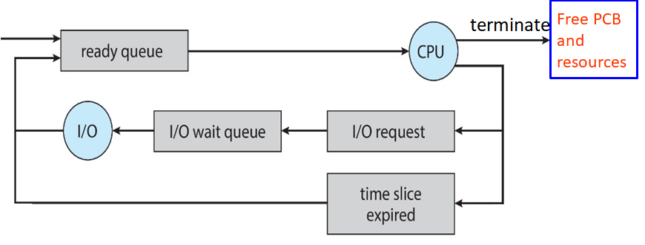
A Simple Queuing-Diagram Representation of Processes
CPU Scheduler
In real system, the diagram is much more complicated.

Slide 56
Outline
Process Concept
Process Scheduling
Scheduling Queues
CPU Scheduling
Context Switch
Operations on Processes
Interprocess Communication
IPC in Shared-Memory Systems
Examples of IPC Systems
Communication in Client-Server Systems

Slide 57
CPU排程演算法會伴隨Context Switch!
什麼是Context Switch?

Slide 58
Context Switch
Context switch: CPU switches from one process to another process
OS must save the state (context) of the old process in its PCB
Then OS must restore the saved state (context) of the new process from PCB

Slide 59
複習： 問題: What is a state?

Slide 60
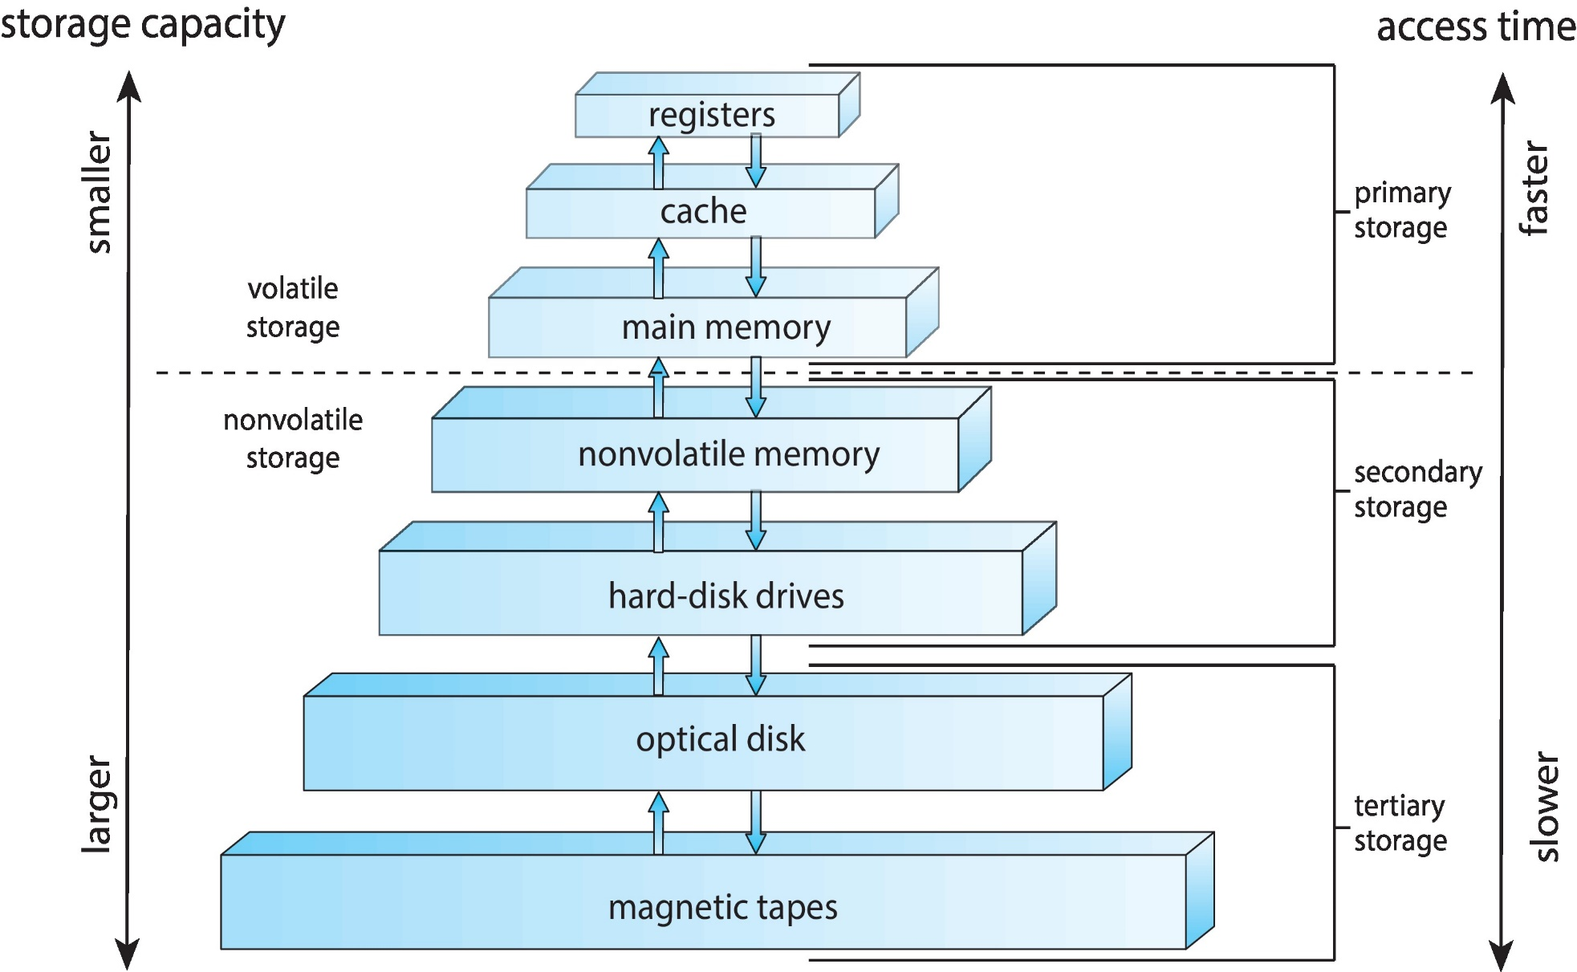
複習：Storage-Device Hierarchy

Slide 61
Context Switch (Cont.)
Context (state):
CPU registers (including Program Counter),
記憶體的內容(Memory areas)
相關變數目前的值~
目前檔案的內容
……
They constitute the environment or context of a process.

Slide 62
簡而言之, context (state)就是程式執行到某一行時的狀態
其狀態會存放在暫存器, 記憶體, 硬體(檔案)…)

Slide 63
因此, 當從P1切換到P2執行時(也就是context switch), 我們必須確保P1的狀態不會被P2破壞
Q: 有可能會被破壞嗎?

Slide 64
複習：暫存器內容被破壞
…
out eax, 0x60;
add eax, ebx;
…
CPU
eax | 59
ebx | 25
eax | 10
ebx | 5
…..
…
add eax, 0x30;
add ebx, eax;
…
OS

Slide 65
Q: 怎麼辦呢?

Slide 66
所以，切換Process時 (Context Switch)，必須要儲存當下Process的state，然後復原接下來要執行的Process的state!

Slide 67
Q: 儲存的state要放在哪裡呢?
Ans: 儲存的state記錄會在PCB當中

Slide 68
Context Switch
P1’s PCB
PC=0x1000
eax=10, ebx=5
ecx =9, edx = 11
etc.
save
context
switch
……
context
switch
process P1
process P1
restore
CPU
eax=6, ebx=9,
ecx=3, edx =32
pc= 0x58000…
CPU
eax=10, ebx=5,
ecx=9, edx =11
pc= 0x1000…
CPU
eax=10, ebx=5,
ecx=9, edx =11
pc= 0x1000…

Slide 69
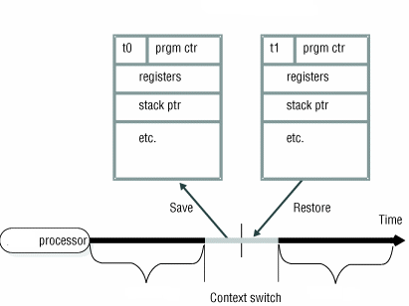
Context Switch
P1’s PCB
P2’s PCB
process P1
process P2

Slide 70
Context Switch 1
…
out eax, 0x60;
add eax, ebx;
…
CPU
context
switch
eax | 59
ebx | 25
eax | 10
ebx | 5
…
out eax, 0x30;
add ebx, ebx;
…
…..
P1 PCB
eax=10; ebx=5;……
P1 PCB
eax=x; ebx=y;……
OS
P2 PCB
eax=59; ebx=25;……
OS

Slide 71
Context Switch 2
…
out eax, 0x60;
add eax, ebx;
…
CPU
context
switch
eax | 10
ebx | 5
eax | 100
ebx | 35
…
out eax, 0x60;
add eax, ebx;
…
…..
P1 PCB
eax=10; ebx=5;……
P1 PCB
eax=x; ebx=y;……
OS
P2 PCB
eax=59; ebx=25;……
P2 PCB
eax=100; ebx=35;……
OS

Slide 72
但是, ISR(Interrupt Service Routine)執行時不需要對ISR做state restore和state save
(see the following two slides)

Slide 73
CPU Dispatch an Interrupt to ISR
…
mov eax, 0x60;
…
P1
CPU
…..
interrupt
OS
CPU dispatch an interrupt to ISR
Interrupt Service
Routine (ISR)

Slide 74
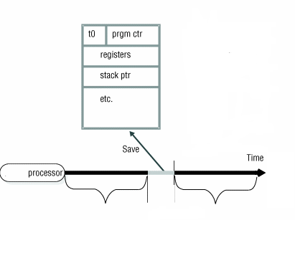
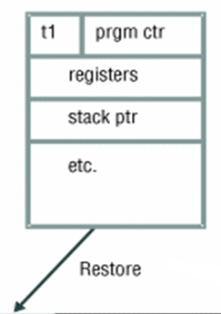
比較：ISR Has no State to Be Saved/Restored
P1’s PCB
P1’s PCB
process P1
ISR

Slide 75
Q: 為什麼不需要對ISR做state restore和state save呢?

Slide 76
Context Switch (Cont.)
Context-switch time is overhead
System does not execute user applications while switching
See the following slide
Q: 有什麼方法可以減少context switch的overhead呢?

Slide 77
複習: Context Switch
P1’s PCB
P2’s PCB
process P1
process P2

Slide 78
Context Switch (Cont.)
Hardware support for reducing context switch overhead
Existence of special instructions
A single instruction to save/load all registers
(See p. 13 in Chapter 5 of Assembly Language)
Sun UltraSPARC provides multiple sets of registers
Content switch ⇨ change to use the current register set

Slide 79
複習：Related Instructions
PUSHFD and POPFD
Push and pop the EFLAGS register
PUSHAD pushes 32-bit general-purpose registers on stack
Order: EAX, ECX, EDX, EBX, ESP, EBP, ESI, EDI
POPAD pops the same registers off stack in reverse order
PUSHA and POPA do the same for 16-bit registers
.data
saveFlags DWORD ?
.code
pushfd ; push flags on stack
pop saveFlags ; copy into a variable
push saveFlags ; push saved flag values
popfd ; copy into a variable

Slide 80
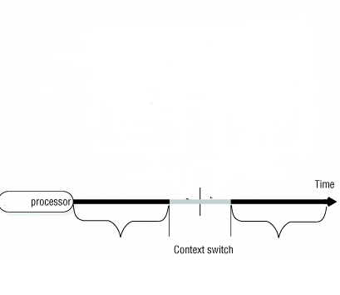
Multiple Sets of Registers
CPU
eax₁=1;
ebx₁=5;
ecx₁=8;
edx₁=6;
……
eax₂=4;
ebx₂=3;
ecx₂=7;
edx₂=8;
……
……
process P1
process P2

Slide 81
Q: 前面只關心CPU內部暫存器的狀態, 當context switch時, 那P1的記憶體內容(變數)和硬碟內容(檔案)也會被P2破壞嗎?
Hint: 怎樣的情形下會被破壞?

Slide 82
Q: 怎樣的情形下會被破壞?
Ans: 有共享的時候~
例如: P1和P2共享記憶體

Slide 83
複習: Multiple Sets of Registers
CPU
eax₁=1;
ebx₁=5;
ecx₁=8;
edx₁=6;
……
eax₂=4;
ebx₂=3;
ecx₂=7;
edx₂=8;
……
……
變成不共享記憶體
process P1
process P2

Slide 84
所以, P1的記憶體(變數)和硬碟(檔案)也會被P2破壞嗎?
Ans: 看是否共享~
記憶體如果共享: 第六章會介紹
檔案如果共享: 這門課上不到了~

Slide 85
此外, 記憶體(變數)和硬碟(檔案)的共享問題必須由應用程式自已解決, OS不處理. Why?
Ans:
和暫存器不同, 變數和檔案不一定會共享~(程式自己才知道)
和暫存器不同, 解決變數和檔案的共享問題比較複雜(有很多不同的解決方案, 應用程式可以依照需求自己選擇)

Slide 86
Outline
Process Concept
Process Scheduling
Operations on Processes
Process creation
Process termination
Interprocess Communication
IPC in Shared-Memory Systems
Examples of IPC Systems
Communication in Client-Server Systems

Slide 87
問題：如何產生(建立) 一個process?
Double Click某一個應用程式(X)
我們是資工系: 我們想知道double click會發生什麼事情?

Slide 88
Q1：誰決定產生(建立) 一個process?
Ans: 應用程式
(例如window檔案總管, shell in Linux……)

Slide 89
Q2：誰負責創建一個process?
OS

Slide 90
Q3：應用程式如何請OS創建一個process?
呼叫system call

Slide 91
所以,當Double Click某一個應用程式，發生了什麼事情呢?
解答: Windows檔案總管(or Shell in Linux)會呼叫某一個system call請OS creates一個process，執行此一應用程式

Slide 92
Process Creation
A process may create several new processes
The creating process is called parent
The new processes are called children of that process
And so on…
Forming a tree of processes

Slide 93
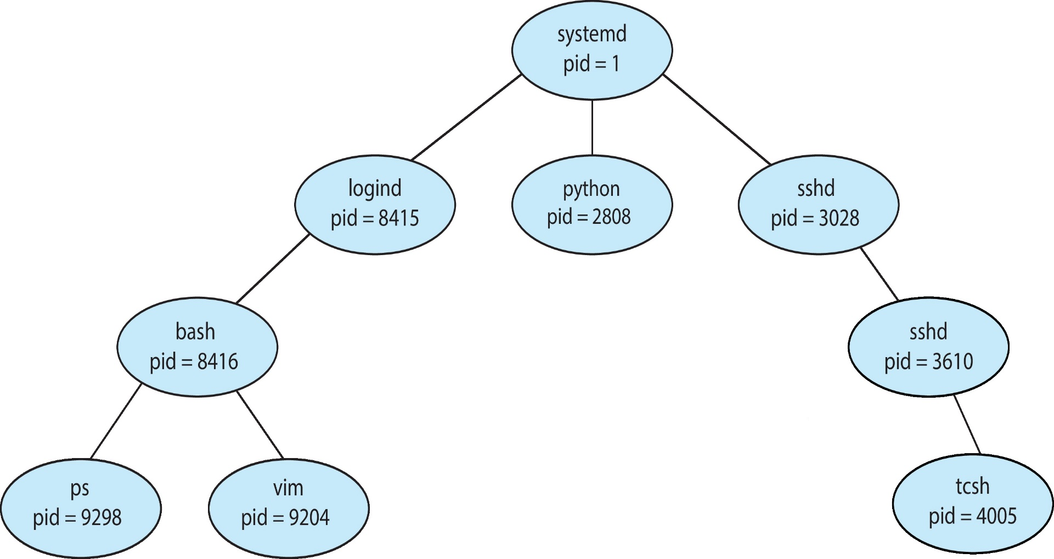
A Tree of Processes in Linux
OS identify processes according to a unique process identifier (or pid)

Slide 94
在Linux, 如何創建一個process?
By fork() system call

Slide 95
The fork() System Call
Memory
Copy from original image
Original image
fork()
New image
NCHU System & Network Lab

Slide 96
在fork()中, child會跟parent執行相同的程式, 但如果child想載入不同的程式執行呢?
By exec() system call

Slide 97
The exec() System Call
Memory
Copy from original image
Original image
fork()
Load another image
New image
exec()
NCHU System & Network Lab

Slide 98
呼叫fork()之後, parent和child就並行執行, 但如果parent想等待child結束再繼續執行呢?
By wait() system call

Slide 99
看一個簡單的例子

Slide 100
UNIX Process Creation
See the following slide!
Each process has a unique process id (PID)
A new process is created by the fork() system call
The new (child) process duplicates the address space of the parent process
Child and parent continue execution at the instruction after the fork() system call
Child: return value of fork is 0
Parent: return value of fork is PID of the child process
The execlp() system call is used to load a new binary file into memory – destroying the old code

Slide 101
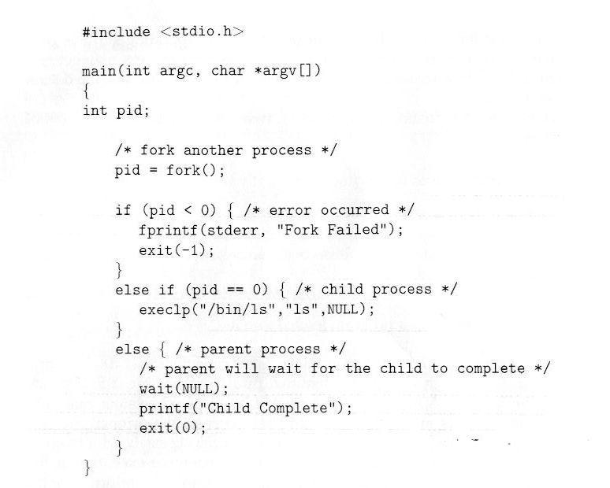
C Program Forking Process

Slide 102
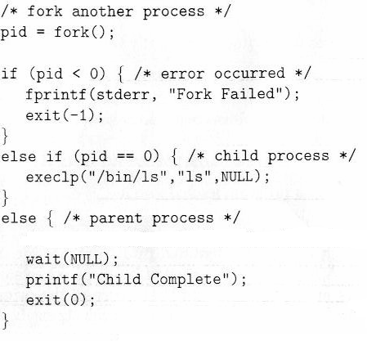
pid=153
memory
parent’ code
pid=0
ls
child’ code

Slide 103
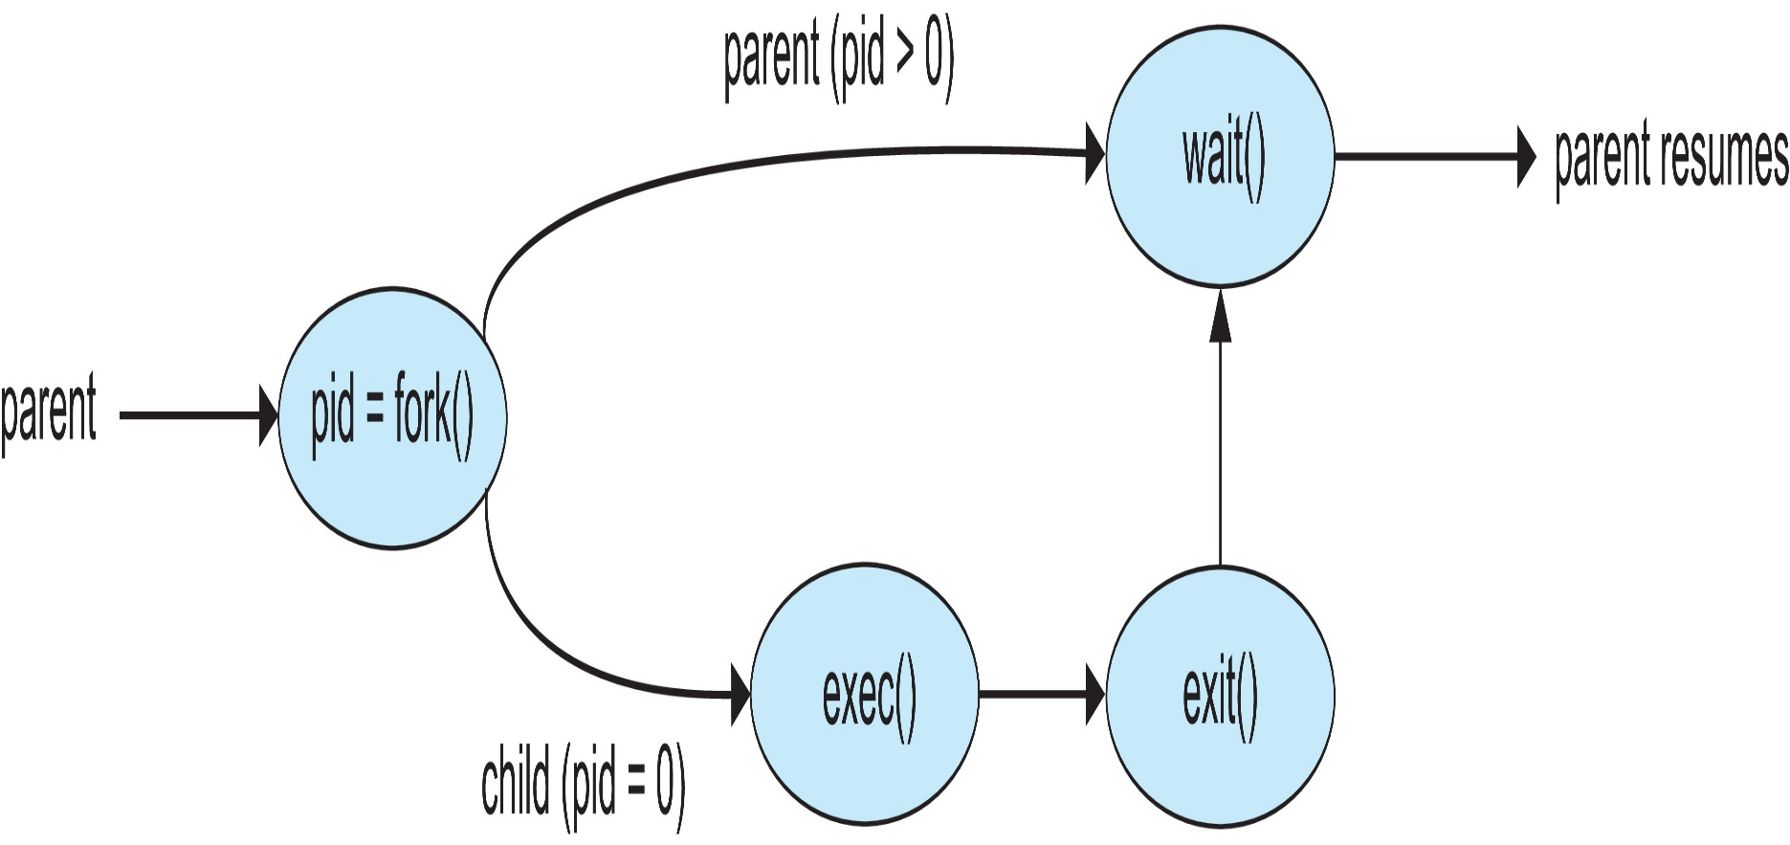
Flow Diagram in above Program

Slide 104
所以, 我們有以下的整理~

Slide 105
Process Creation (Cont.)
當parent create一個child process之後, parent有兩個選擇
Parent and children execute concurrently
Parent waits until children terminate
wait() system call in Linux

Slide 106
Process Creation (Cont.)
當child被創建出來後, 也有兩個選擇
Child duplicate of parent
i.e., child has the same program and data as the parent
fork() system call creates a new process in Linux
Child has a new program loaded into it
exec() system call replaces the process’ memory space with a new program in Linux

Slide 107
在之前的例子中, parent和child的選擇是什麼呢?
Ans: see the following two slides

Slide 108
Process Creation (Cont.)
當parent create一個child process之後, parent有兩個選擇
Parent and children execute concurrently, or
Parent waits until children terminate
wait() system call in Linux

Slide 109
Process Creation (Cont.)
當child被創建出來後, 也有兩個選擇
Child duplicate of parent, or
i.e., child has the same program and data as the parent
fork() system call creates a new process in Linux
Child has a new program loaded into it
exec() system call replaces the process’ memory space with a new program in Linux

Slide 110
注意: 不同的程式可能會有不同的選擇~
端看程式的需求

Slide 111
Outline
Process Concept
Process Scheduling
Operations on Processes
Process creation
Process termination
Interprocess Communication
IPC in Shared-Memory Systems
Examples of IPC Systems
Communication in Client-Server Systems

Slide 112
類似fork(), OS會提供system call (exit()), 讓應用程式呼叫結束執行

Slide 113
Process Termination
Process invokes exit() system call
Return a status value with its process identifier to parent
Parent obtains the status value and the process identifier of the child via the wait() system call
Then, process’ resources are deallocated by OS
#include <sys/wait.h>
pid_t pid;
int status;
pid_t wait(int *stat_loc);
#include <stdlib.h>
void exit(int status);

Slide 114
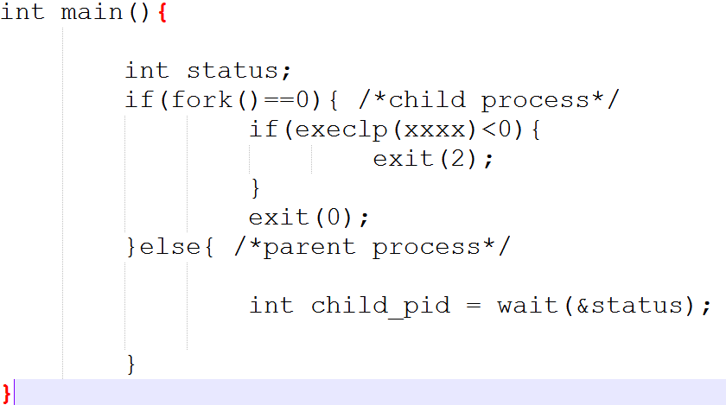

Slide 115
Q: 如果child先結束執行(呼叫exit()), 但是parent還沒有呼叫wait(), 會發生什麼問題呢?

Slide 116
Zombie Process
When a process terminates before parent calls wait()
The terminated process becomes a zombie(殭屍) process
Since its process control block (PCB) still exists for storing the exit status value
See the following two slides

Slide 117
Zombie Process
wait()
fork()
parent
exit status value
child
exit()
zombie

Slide 118
Zombie Process
A = A +1;
…
wait();
CPU
…
exit(1);
OS
P1 PCB
P2 PCB
Zombie Process
P2 PCB
exit status = 1
OS

Slide 119
Q: 如果parent比child先結束執行, 會發生什麼問題呢?
Ans: If parent terminates before child calls exit(), the child process becomes as orphans

Slide 120
Orphans Process
exit()
?
fork()
parent
exit status value
child
exit()
orphan

Slide 121
Q: 怎麼辦呢? Who calls wait()?

Slide 122
Orphans Process
Sol.: Linux set the child’s parent to the init
init process periodically calls wait() to collect children’s exit status value
See the following two slides

Slide 123
Orphans Process
init
exit()
fork()
parent
child
exec()
a=a+1;
b=b-1;
…
orphan

Slide 124
複習: A Tree of Processes in Linux
OS identify processes according to a unique process identifier (or pid)

Slide 125
作業系統實驗會有一個Linux Process Control的實驗

Slide 126
Outline
Process Concept
Process Scheduling
Operations on Processes
Interprocess Communication
IPC in Shared-Memory Systems
Examples of IPC Systems
Communication in Client-Server Systems

Slide 127
YouTube會產生兩個processes: 一個負責前端以及畫面撥放, 另一個負責聲音的產生
Q: 當使用者按下暫停, 前端的process如何通知音訊process暫時停止?

Slide 128
Interprocess Communication (IPC)
Processes 之間有時需要 interprocess communication (IPC)
例如YouTube的兩個processes
Two common models
Message passing
Shared memory

Slide 129
IPC Models
(a) Message passing. (b) Shared memory

Slide 130
問題：如何實現Message Passing?

Slide 131
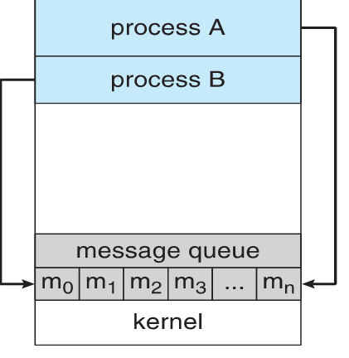
Message Passing
receive()
Process A
send_msg()
send()
Process B
memory copy
memory copy

Slide 132
Message-Passing Systems
Message-passing provides two operations:
send(message)
receive(message)

Slide 133
Blocking and Nonblocking
Message passing may be either blocking or non-blocking
Blocking - process suspended until I/O completed
Easy to use but insufficient for some needs
Nonblocking - I/O call returns immediately with as much as data available (maybe zero)

Slide 134
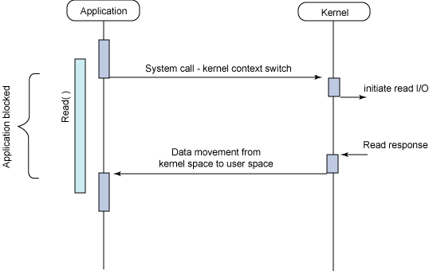
Blocking I/O

Slide 135
Blocking I/O-based Message Passing
receive()
Process A
blocked
send_msg()
send()
Process B
memory copy
memory copy
Queue is empty

Slide 136
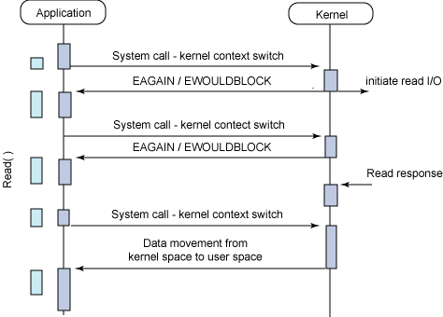
Non-Blocking I/O
https://medium.com/@clu1022/%E6%B7%BA%E8%AB%87i-o-model-32da09c619e6

Slide 137
Non-Blocking I/O-based Message Passing
receive()
receive()
…
Process A
send_msg()
Process B
EAGAIN
Queue is empty

Slide 138
問題：如何實現Shared Memory?

Slide 139
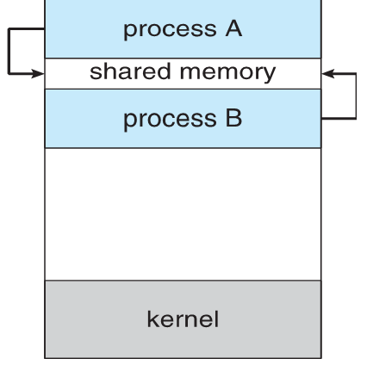
Shared Memory

Slide 140
Interprocess Communication (IPC) (Cont.)
Comparisons
Message passing
Useful for exchanging smaller amounts of data
Easier to implement
Slower: requires system calls for sending/receiving messages (via memory copying)
No conflict need to be avoided (introduced in Chapter 6)
Shared memory
Faster: requires no system calls when reading/writing data
But need protection and synchronization (introduced in Chapter 6)

Slide 141
複習：Microkernel

Slide 142
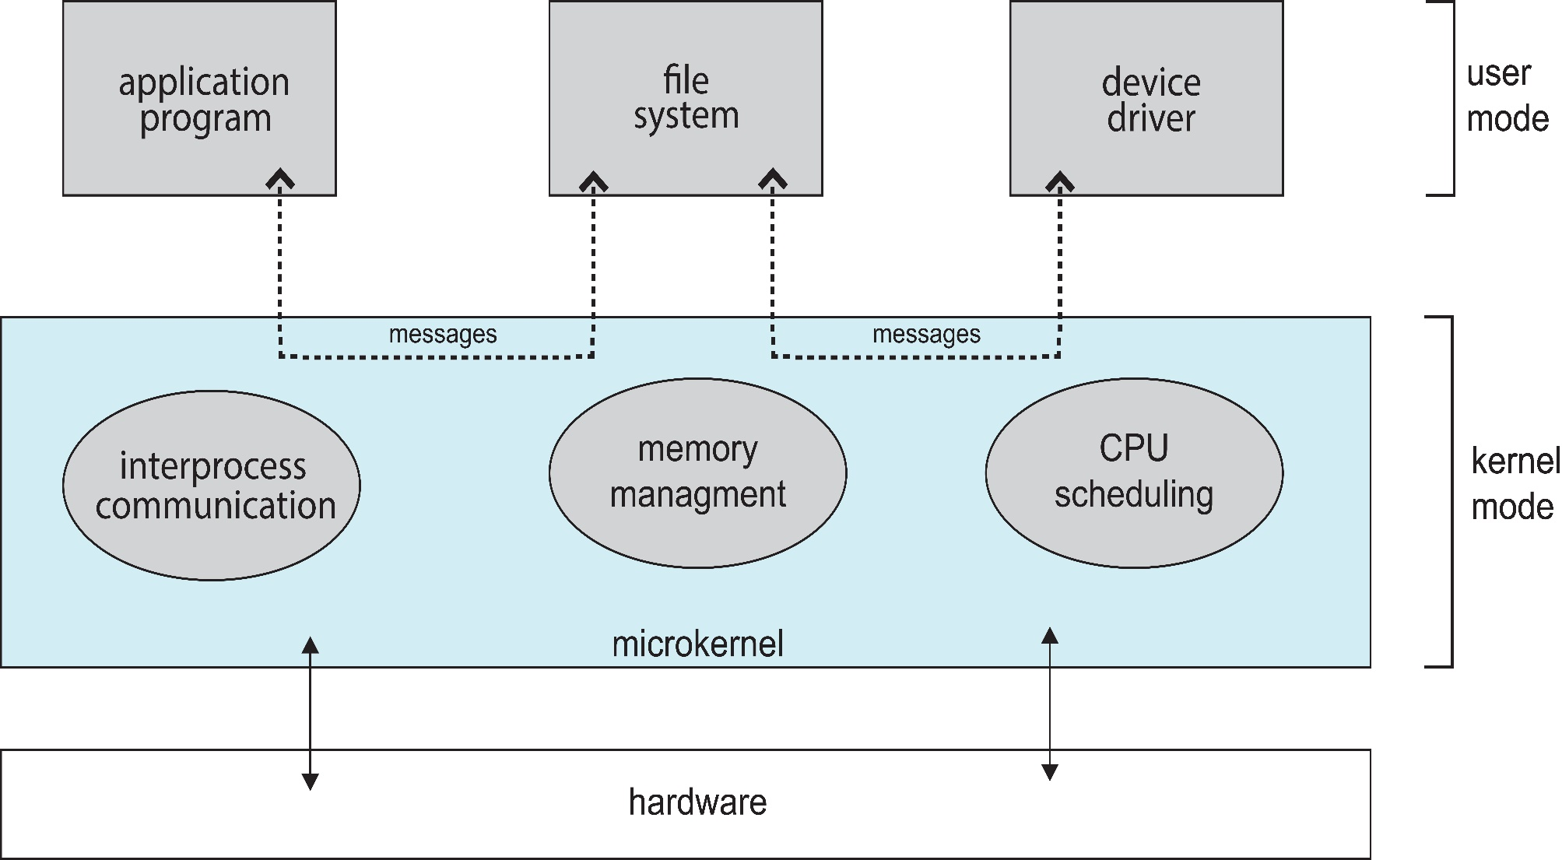
Microkernel System Structure

Slide 143
問題：為何Microkernel效能不好？

Slide 144
Microkernel (Cont.)
Advantages:
Easier to extend the OS
By adding new services and do not require kernel modification
Easier to port the OS to new architectures
The kernel is small and the changes tend to be fewer
More reliable and more secure
Most services are running as user processes
If a service failed, the rest of the OS remains untouched
Disadvantages:
Performance overhead by message passing between services
Window NT: microkernel, Windows XP: a monolithic kernel

Slide 145
複習結束：Microkernel

Slide 146
作業系統實驗會有一個Linux IPC的實驗

Slide 147
事實上, 除了Message Passing和Shared Memory, 還有許多可以使用在單一電腦或是不同電腦之間的IPC機制

Slide 148
Other IPC Schemes
Communication between processes (maybe in different computers) (Skip!)
Sockets
Remote Procedure Calls (RPC)
pipe()

Slide 149
作業系統實驗會有一個Socket的實驗

