Slide 1
Operating Systems

Slide 2
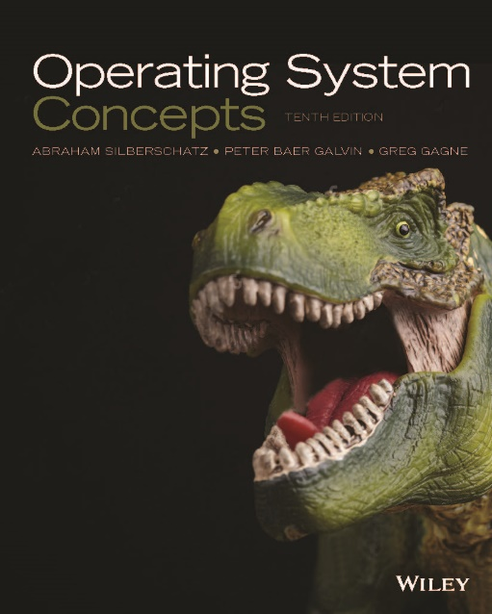
Course Syllabus
Text Book:
Abraham Silberscharz, Peter Baer Galvin, and Greg Gagne, “Operating System Concepts,” 10th Edition
新月圖書，東華書局代理
Instructor
張軒彬, hpchang@cs.nchu.edu.tw, Office Number: 808

Slide 3
Course Syllabus
TA: Office Number: 1001A
陳柏彥, b10900032@gemail.yuntech.edu.tw
張家展, aa1247852@gmail.com
陳立崴, wwiillllyy0207@gmail.com
吳宥德, wuyodi@gmail.com
侯佳旻, acs109113@gm.ntcu.edu.tw
陳威碩, tavhadia@gmail.com
倪偉軒, niweixuan0418@gmail.com

Slide 4
Course Syllabus (Cont.)
All slides are available in i-learning
Videos are available in YouTube
https://www.youtube.com/channel/UCh1ctBhUGQ7mOh5rfq-Ydiw/playlists
But may be obsolete~(來上課比較安全)
Requirements
期中考
期末考
Programming homework (3~5)

Slide 5
Course Syllabus (Cont.)
電資學士班、資工系碩士班、資工系博士班欲加選的同學請到資工系辦找嘉儷加選
外系欲加選的同學請詢問資工系辦嘉儷, 如果還有空缺即可加選
電資學士班、資工系碩士班、資工系博士班、外系的學生可以自行決定是否選修作業系統實驗
資工系為必修課！
建議先修課程
程式設計(C語言)
組合語言與系統程式

Slide 6
Outline
PART ONE: Overview
Chapter 1: Introduction
Chapter 2: Operating-System Structures
PART TWO: Process Management
Chapter 3: Process
Chapter 4: Thread & Concurrency
Chapter 5: CPU Scheduling

Slide 7
Outline (Cont.)
PART THREE: Process Synchronization
Chapter 6: Synchronization Tools
Chapter 7: Synchronization Examples
Chapter 8: Deadlocks
PART FOUR: Memory Management
Chapter 9: Main Memory
Chapter 10: Virtual Memory

Slide 8
Outline (Cont.)
PART FIVE: Storage Management
Chapter 11: Mass-Storage Structure
Chapter 12: I/O Systems
PART FIVE: File System
Chapter 13: File-System Interface
Chapter 14: File-System Implementation
Chapter 15: File-System Internals

Slide 9
Another Course: Operating System Lab
Programming Labs
Operating System Experiment
Help you to learn the OS and to write advanced programs

Slide 10
Some Tips
Study Tips: 好奇心
明白名詞的意義
訓練對於英文單字的敏銳度
思考理解電腦(包含應用程式、OS、硬體)的整體運作
嘗試思考如何畫圖表示甚至動畫表示(加上時間軸 t=1, 2, 3,…)
Answer Tips: 考試答題
講清楚、說明白 : an important skill for you

