Slide 1
Finding Prime Numbers in Parallel
FIT3143 Lab #1 · POSIX Threads and OpenMP
[Student 1 name] · [ID] · [name@student.monash.edu]
[Student 2 name] · [ID] · [name@student.monash.edu]
All measurements: AMD Ryzen 5 7535HS · 4 physical cores / 8 logical (SMT) · Docker, GCC -O2
Notes:
7 minutes total. Task 1 about 1 min, Task 2 about 3 min, Task 3 about 2 min, conclusion about 1 min.

Slide 2
1
Serial implementation
task1.c · the baseline every speed-up is measured against
Trial division, but stop at √k — if k = m×n with m > √k then n < √k, so a composite always has a factor at or below √k
Reject even k up front, then test only odd divisors — halves the division count again
Buffer sized from the prime number theorem (1.2n / ln n) and grown with realloc, instead of the 8n bytes a worst-case allocation would reserve
Primes are found in ascending order of k, so the list is sorted by construction — no sorting step
$ ./task1 30
Prime numbers less than 30 (10 found):
2, 3, 5, 7, 11, 13, 17, 19, 23, 29
n = 30 | primes = 10 | time = 0.000004 s
$ ./task1 10000000
664579 primes written to primes_output.txt
n = 10000000 | primes found = 664579
| time taken = 2.596699 seconds
Small n prints to standard output; n ≥ 100 goes to a text file. All three programs share a byte-for-byte identical is_prime, so every later comparison isolates parallelisation rather than a difference in the work being done.
Notes:
Keep this to about 30 seconds. The sqrt cutoff and the odd-divisor skip are the two optimisations measured on the next slide.

Slide 3
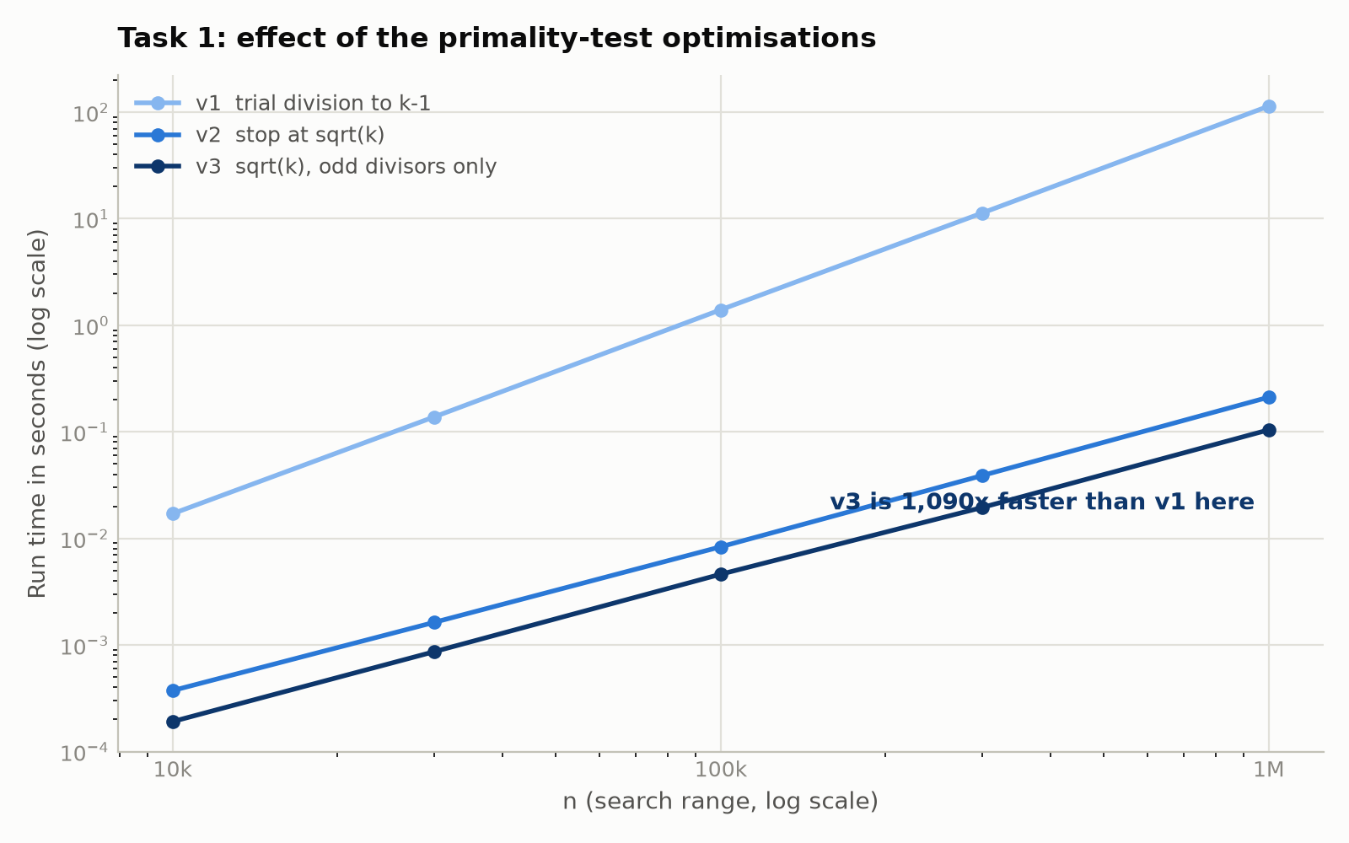
1
Optimising the primality test
Three versions behind one identical timing harness — only is_prime differs
1,090×
2.0×
v1 → v3 at n = 10⁶
odd-divisor skip alone, at every n
Measured log-log slopes: 1.9 for v1, 1.37 for v2 and v3 — the complexity difference, observed rather than asserted
The gap widens with n: 89× at n = 10⁴, 1,090× at n = 10⁶
At n = 10⁶ the naive version needs 113.8 s. Parallelised perfectly over 8 threads it would still take about 38 s — the optimised serial version finishes in 0.10 s.
Notes:
The punch line: algorithmic optimisation bought three orders of magnitude; parallelisation buys five times. Optimise before you parallelise.

Slide 4
2
Parallel partitioning scheme
task2.c · POSIX Threads · how the workload is distributed
Contiguous blocks — one range per thread
Thread t takes k = 3 + 2t and strides by 2 × num_threads
Even numbers are skipped entirely; k = 2 is handled once in main
No lock is needed: results[k] is indexed by the value being tested, so two threads can never write to the same slot
One sequential pass then compacts results[] into the sorted list
thread 3 owns the whole expensive end, finishes last, and everyone waits
Cyclic — interleaved, one value at a time
every thread gets the same mix of cheap and expensive values
cost of is_prime(k) grows with √k
task3.c uses schedule(static, 1), which is the same cyclic assignment. Both parallel versions therefore share one partitioning strategy, so the POSIX Threads versus OpenMP comparison isolates the API instead of confounding it with the work distribution.
Notes:
This is the central design decision of Task 2. Spend about 45 seconds here.

Slide 5
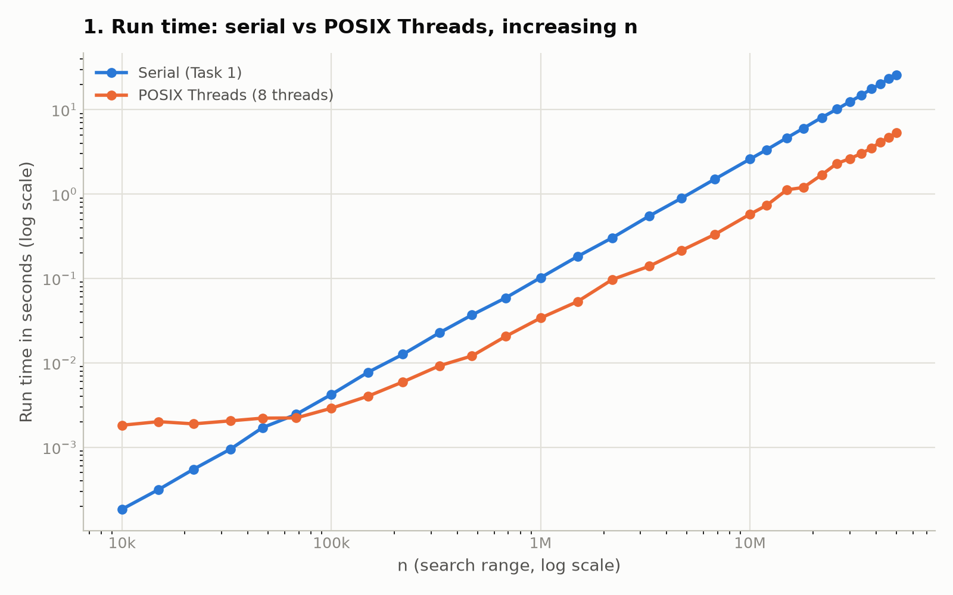
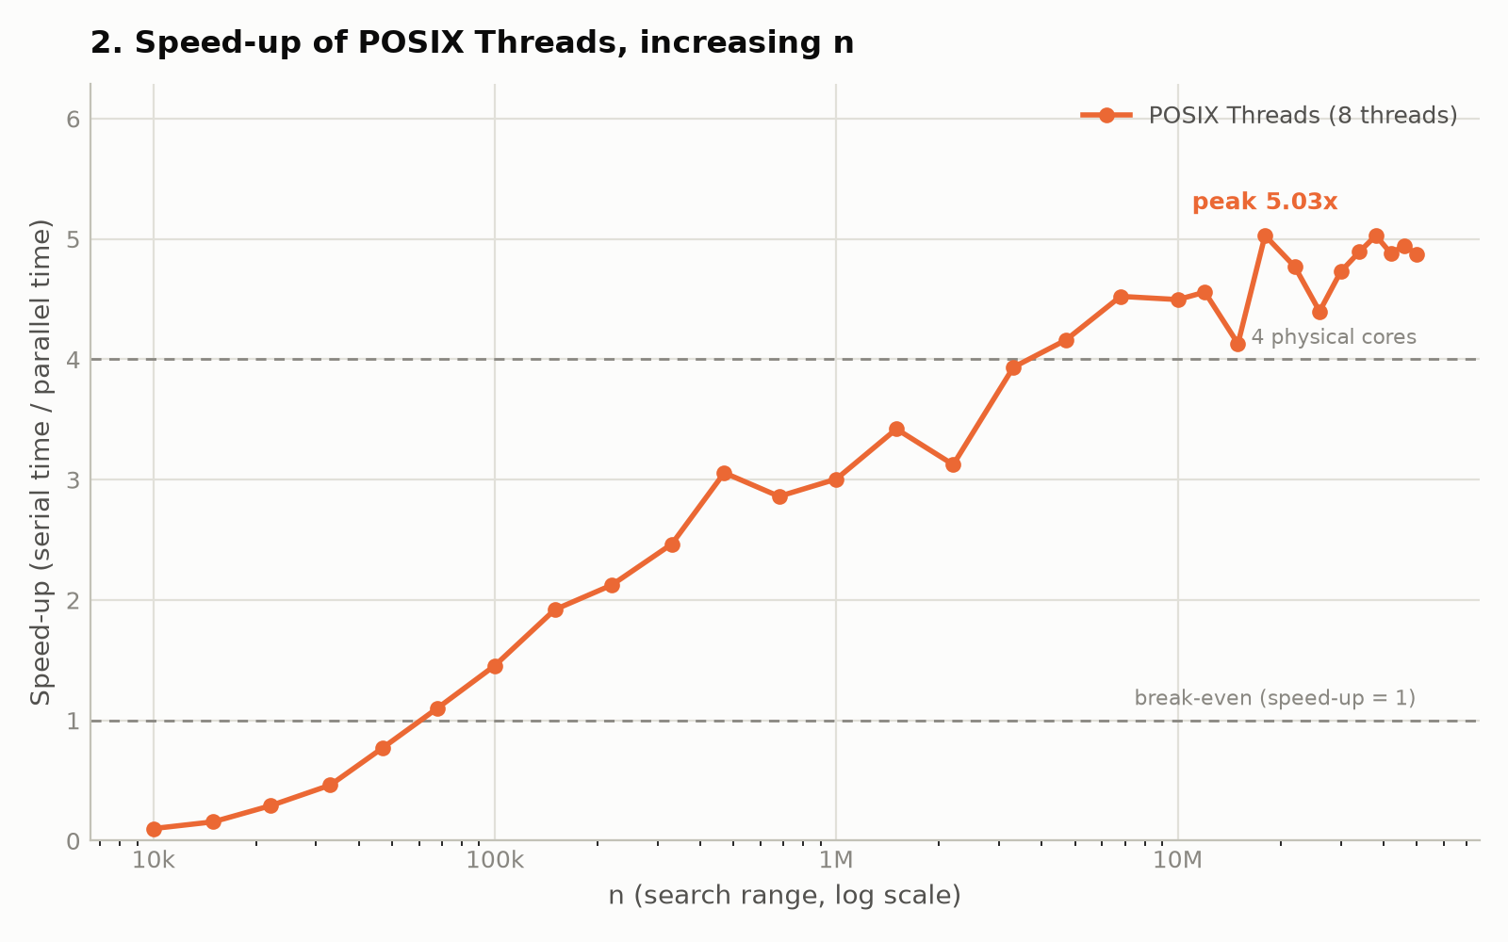
2
POSIX Threads against the serial baseline
Graphs 1 and 2 · increasing problem size, 8 threads
Speed-up is below 1 for small n — thread creation and the sequential compaction cost more than they save. Break-even falls at n ≈ 68,000; the curve then climbs to a peak of 5.03×, which exceeds the four physical cores because SMT contributes roughly a further 20%.
Notes:
Point at the break-even crossing, then at the peak above the four-core reference line.

Slide 6
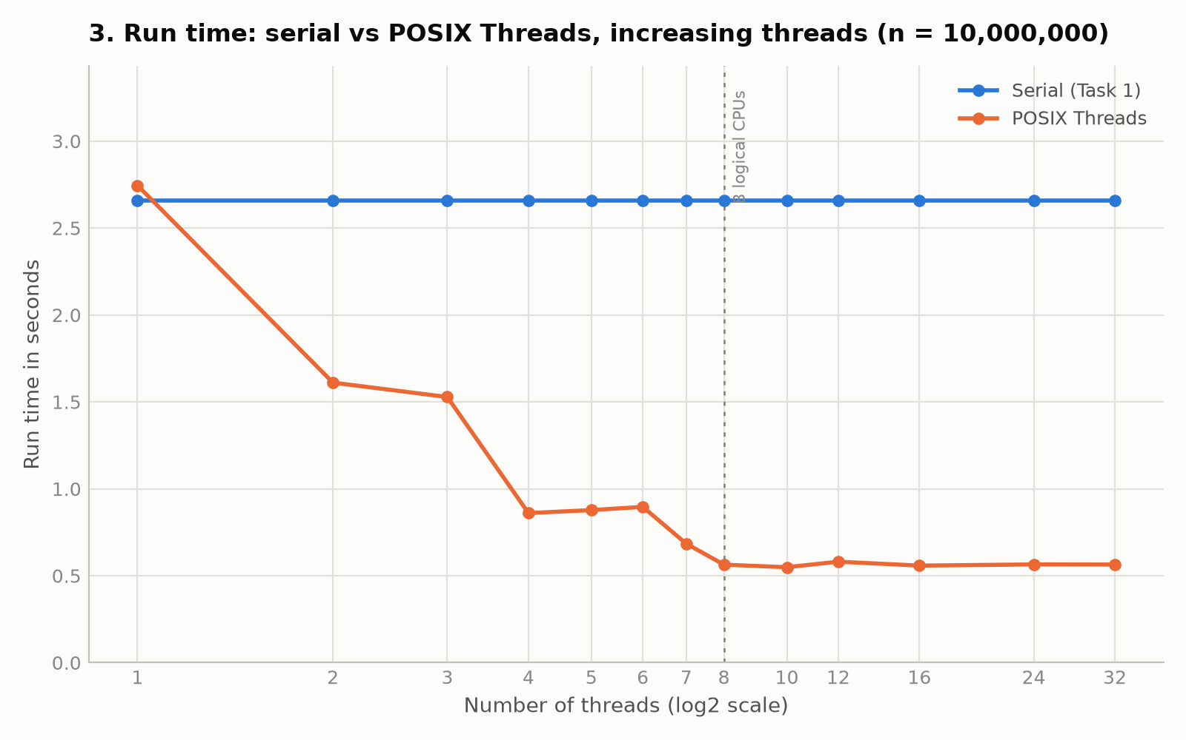
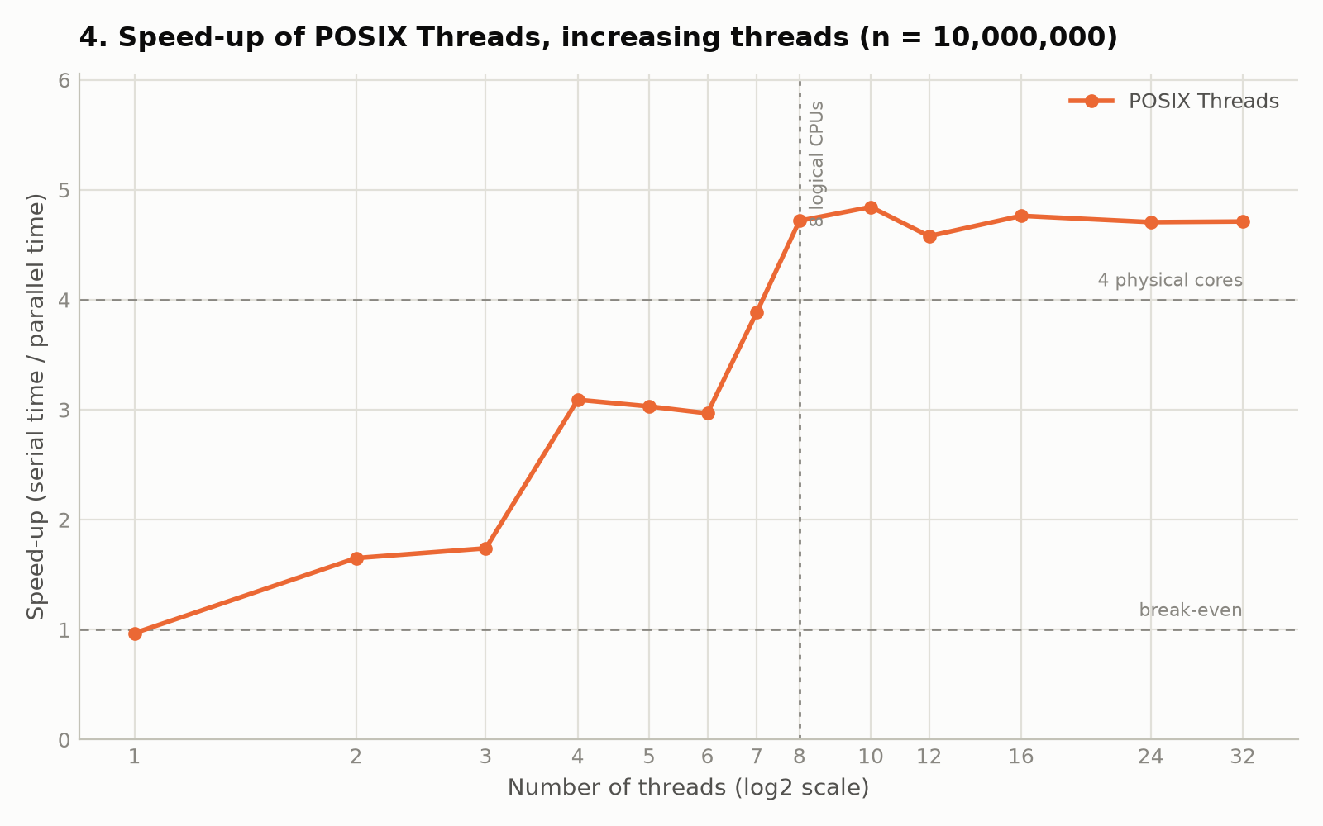
2
Scaling with thread count
Graphs 3 and 4 · n fixed at 10,000,000
The curve is a staircase rather than a smooth ramp: it jumps at 3→4 and 6→7 but stalls between 4 and 6. Past 8 threads every logical CPU is in use and the curve flattens — oversubscription as far as 32 threads costs almost nothing, because the workload is compute-bound.
Notes:
The staircase is not noise. The next slide shows what causes it.

Slide 7
2
What the partitioning change bought
Same code, same machine — only the workload distribution differs
n | contiguous | cyclic | gain
6,800,000 | 3.83× | 4.52× | +18.1%
22,000,000 | 3.89× | 4.77× | +22.8%
38,000,000 | 4.17× | 5.03× | +20.7%
50,000,000 | 4.04× | 4.88× | +20.8%
Why the staircase: thread placement
The OS does not guarantee that threads land on distinct physical cores
Pinned to 2 physical cores (SMT siblings): 1.210 s
Pinned to 4 physical cores: 1.069 s
The same four threads, 13.3% apart — SMT siblings share the core's execution units, above all the integer divider
Speed-up at 8 threads, best of three runs, measured across all 30 values of n
taskset -c 0,1,2,3 vs taskset -c 0,2,4,6
Both findings say the same thing from different directions: on this workload, which values a thread owns and where that thread runs matter more than anything else we changed. Sibling map on this CPU: logical 0-1 = core 0, 2-3 = core 1, 4-5 = core 2, 6-7 = core 3.
Notes:
Say plainly: our first implementation used contiguous blocks, we measured the imbalance, then fixed it.

Slide 8
3
OpenMP implementation
task3.c · the same partitioning, expressed as one directive
#pragma omp parallel for schedule(static, 1)
schedule | median | vs static,1
static (default chunk) | 0.6475 s | 11.5% slower
static, 1 | 0.5809 s | chosen
dynamic, 1000 | 0.5708 s | 1.7% faster
guided | 0.5739 s | 1.2% faster
replaces about 25 lines of pthread_create, join and argument marshalling
Chunk size 1 makes the static assignment cyclic — identical to the task2 scheme
static is computed by formula, so there is no runtime scheduling overhead at all
We evaluated four schedules using schedule(runtime), five runs each
n = 10⁷, 8 threads, median of five runs
Only schedule(static) is meaningfully slower, and it is the contiguous assignment again — the same effect Task 2 measured by hand. The other three sit inside the 12–18% run-to-run variability, so they are indistinguishable. We kept static,1 because it matches the best measured time with zero scheduling overhead, while dynamic and guided coordinate through a shared counter at runtime.
Notes:
A single run first suggested guided was 9.7% faster. Repeating it five times made the difference vanish. Mention this if asked about methodology.

Slide 9
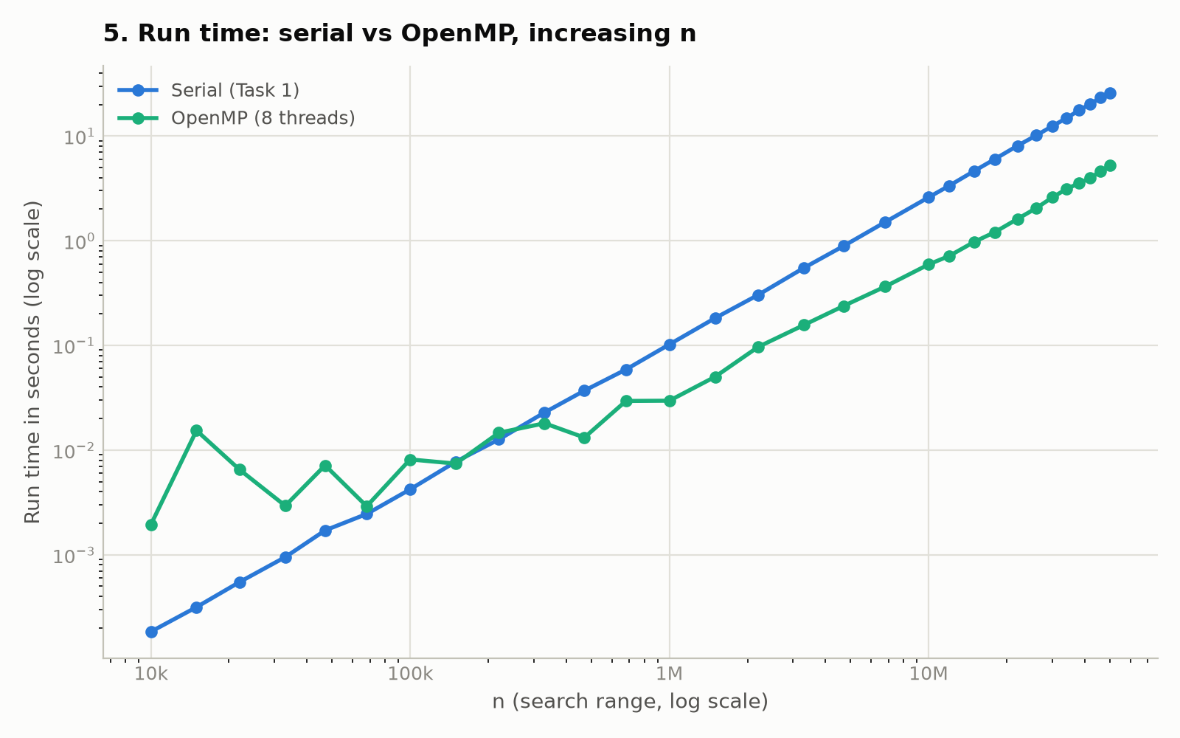
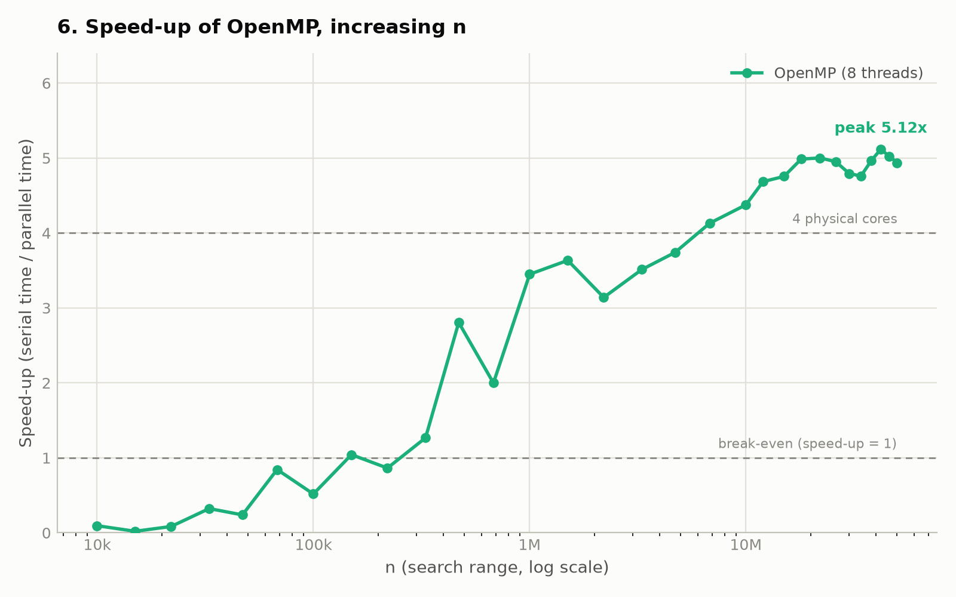
3
OpenMP against the serial baseline
Graphs 5 and 6 · increasing problem size, 8 threads
The same shape as POSIX Threads, but break-even arrives later — around n ≈ 150,000 rather than 68,000. Below that the libgomp runtime has to build its thread pool, which is pure overhead for a program that enters one parallel region and then exits. Peak speed-up is 5.12×.
Notes:
Contrast with slide 5: OpenMP pays a larger fixed start-up cost.

Slide 10
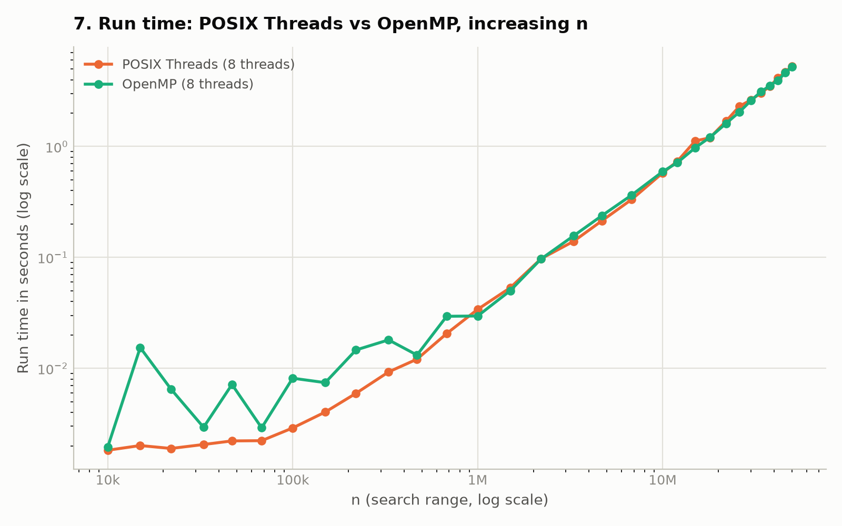
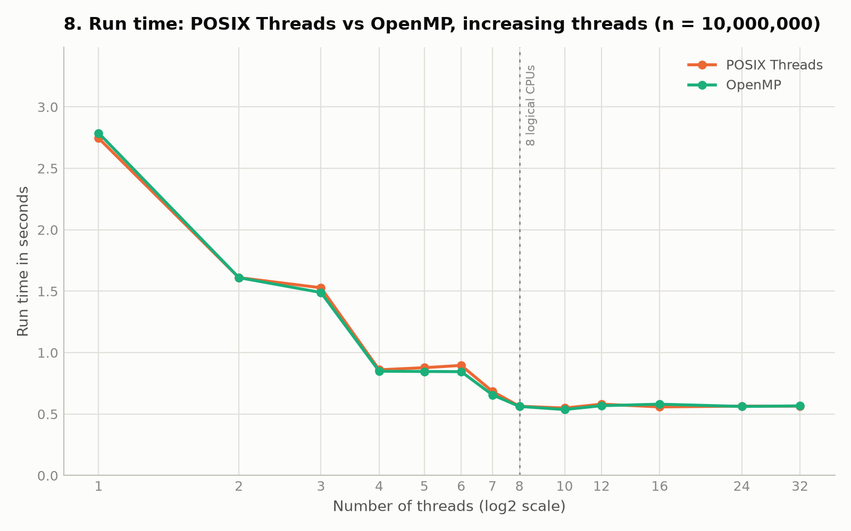
3
POSIX Threads against OpenMP
Graphs 7 and 8 · the direct comparison
Above n ≈ 1,000,000 the two lines lie on top of each other — 4.88× against 4.94× at n = 5×10⁷, well inside measurement noise. Before we corrected the partitioning, OpenMP appeared to be 20% faster; that entire gap was the scheme, not the API. Below n ≈ 500,000 OpenMP is erratic and slower, which is its runtime start-up cost.
Notes:
This slide answers 'would you recommend OpenMP'. Performance is a tie; the difference is development effort and start-up cost.

Slide 11
∑
Why the speed-up is 4.7× and not 8×
Three effects, each measured rather than assumed
1
Only four physical cores
The other four logical CPUs are SMT siblings sharing one core's execution units — above all the integer divider that is_prime hammers. SMT adds roughly 20% on top of 4×, not another 4×.
2
A sequential portion remains
Amdahl's law. The shared results[] array is allocated and compacted into the sorted list by a single thread — an O(n) pass that does not shrink as threads are added. It is also why one thread is slower than the serial program, at 0.97×.
3
Thread creation and placement
pthread_create and join sit inside the timed region, and the scheduler does not spread threads across distinct physical cores — measured at 13.3%.
Notes:
This is the answer to the standard Q&A question. Give reasons 1 and 2 at minimum.

Slide 12
Conclusion
What we found
Limitations
Future work
Optimising the algorithm bought 1,090×; parallelising it bought a further 5×
Cyclic partitioning beat contiguous blocks by 18–23% at large n
POSIX Threads and OpenMP are equal once the partitioning is equal
The shared results[] array forces an O(n) sequential compaction that caps the speed-up
One machine, one architecture — a homogeneous 4-core CPU with SMT
Parallel runs vary by up to 22% between repetitions
Per-thread buffers merged at the end would cut the sequential pass to O(π(n))
Pin threads to physical cores and re-measure the staircase
Repeat on a hybrid CPU, where dynamic scheduling should finally pay for itself
Optimise before you parallelise — a perfectly parallelised naive implementation would still have been 360× slower than the optimised serial one.
Notes:
Land on the last line. It is the single sentence worth remembering.

Slide 13
Questions
Code, measurement data and all nine graphs: github.com/Haruto03/fit3143-lab1
Notes:
Appendix slides follow: methodology and the AI declaration.

Slide 14
A
Appendix — how the measurements were made
Not presented; included for reference
benchmark.sh runs about 350 measurements automatically and records every one to results.csv
Experiment A: 30 values of n from 10,000 to 50,000,000, all three programs, 8 threads, three repetitions each
Experiment B: n fixed at 10,000,000, thread counts 1 to 8, then 10, 12, 16, 24 and 32, three repetitions each
summarize.sh reports the best of the repetitions. Parallel runs vary by up to 22% between repetitions, against 4% for the serial run, because thread placement is decided afresh each time — the mean produced visible artefacts in the speed-up curve
Correctness: every run records how many primes it found, and the script checks that all three programs agree at every n. They do. Output files were also compared directly with diff against the serial version
All three programs share a byte-for-byte identical is_prime, so the comparisons isolate parallelisation
Notes:
Reference only.

Slide 15
A
Appendix — declaration of AI use
Required by the assessment specification
Generative AI was used during the preparation period only. It was not used during the presentation or the Q&A session.
[Describe what it was used for — for example: reviewing the partitioning scheme, drafting the benchmark and plotting scripts, and checking the interpretation of the measurements.]
[State which tool and which version.]
All measurements reported in these slides were produced by running our own code on our own machine. Every number is reproducible from the repository.
The full prompt records are submitted separately as a PDF, as required by the specification.
Complete the bracketed items before submitting, and attach the prompt-record PDF.
Notes:
Fill in the brackets before submission.

