Slide 1
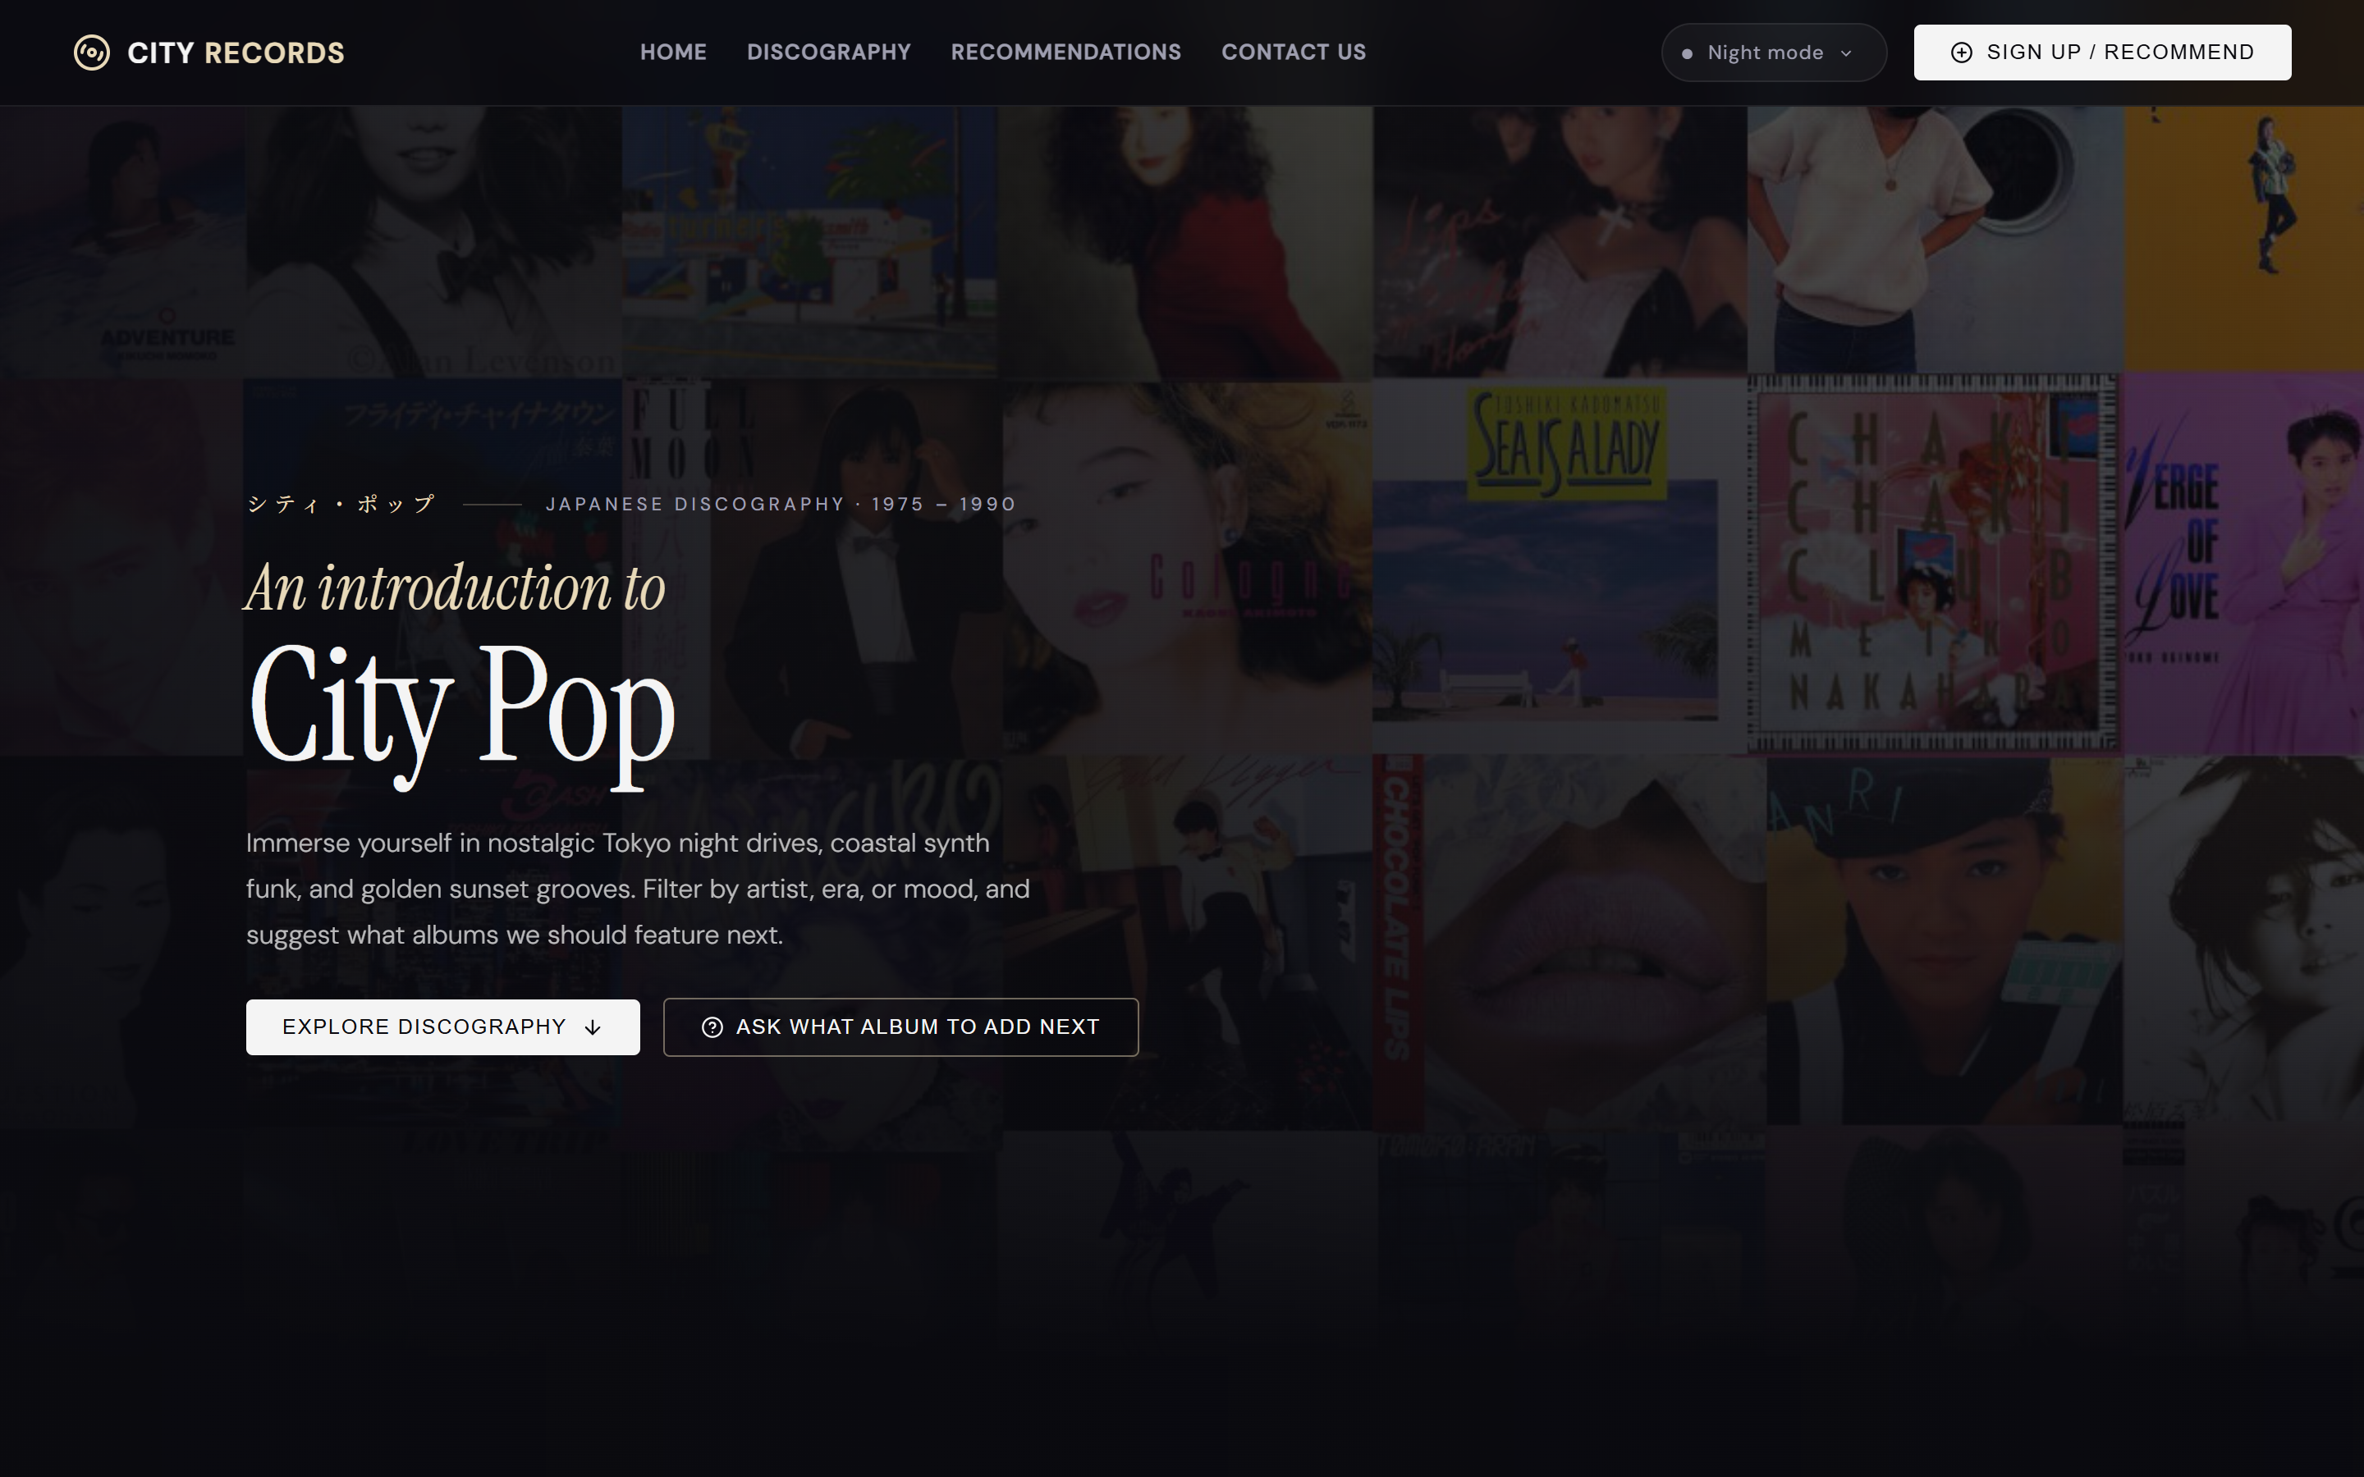
6APSI FINAL PROJECT
City Pop Vault
Japanese Vinyl Discography & Community Vault
- Stack: React 18, Vite, Supabase Cloud PostgreSQL, Apple Music/iTunes Audio APIs
- Architecture: 3-Theme CSS Engine, Offline Fallback Resilient Store, Row Level Security
- Presenter: Student Final Presentation (Course 6APSI)
- Status: Production Ready & Certified

Slide 2
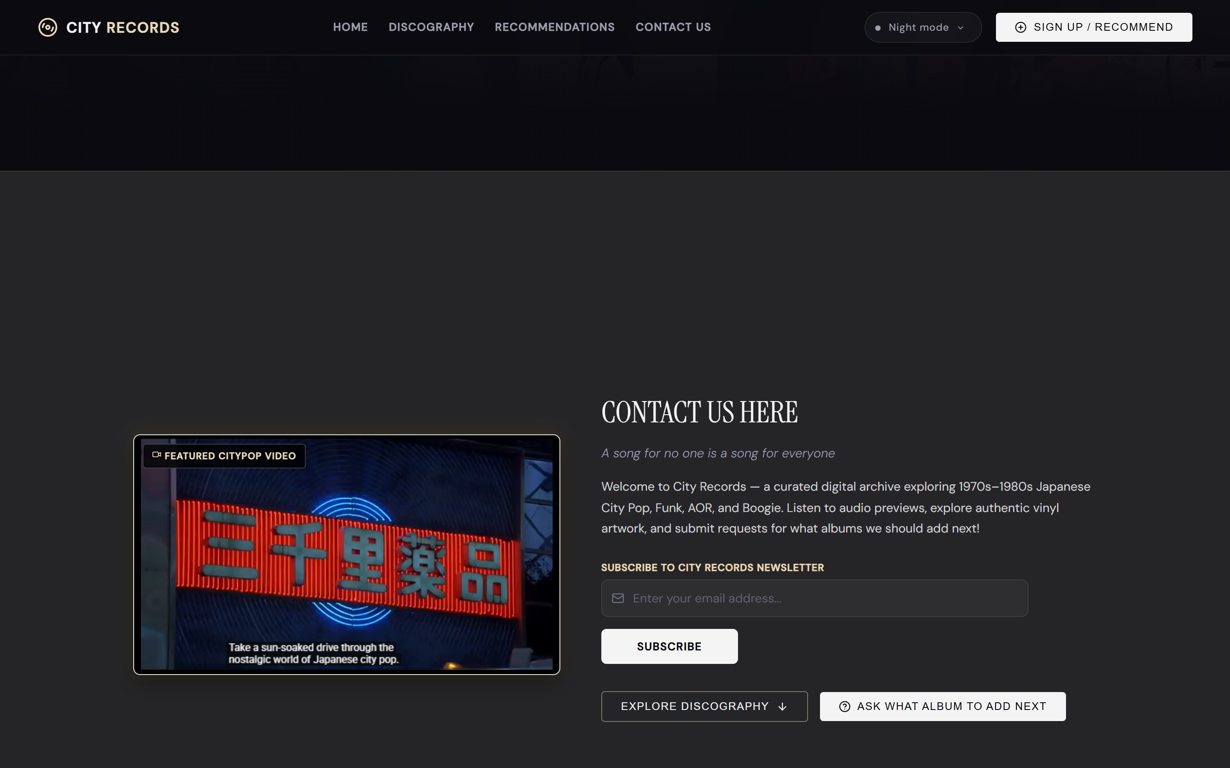
6APSI FINAL PROJECT PRESENTATION
The Problem & Architectural Vision
The Problem:
- 1970s and 1980s Japanese City Pop music is dispersed across fragmented forums.
- Spotify preview API deprecations break dynamic streaming on web discographies.
- Listeners lack vibe-based classification (Midnight Drive, Beach Sunset, Retro Synth).
The Solution & Innovation:
- Unified Digital Vault: Instant mood-based tag filters and multi-field search.
- Persistent Audio Context: Continuous 30-second audio previews lifted to top-level bar.
- Real-Time Cloud Vault: Live Supabase database submissions with optimistic UI.

Slide 3
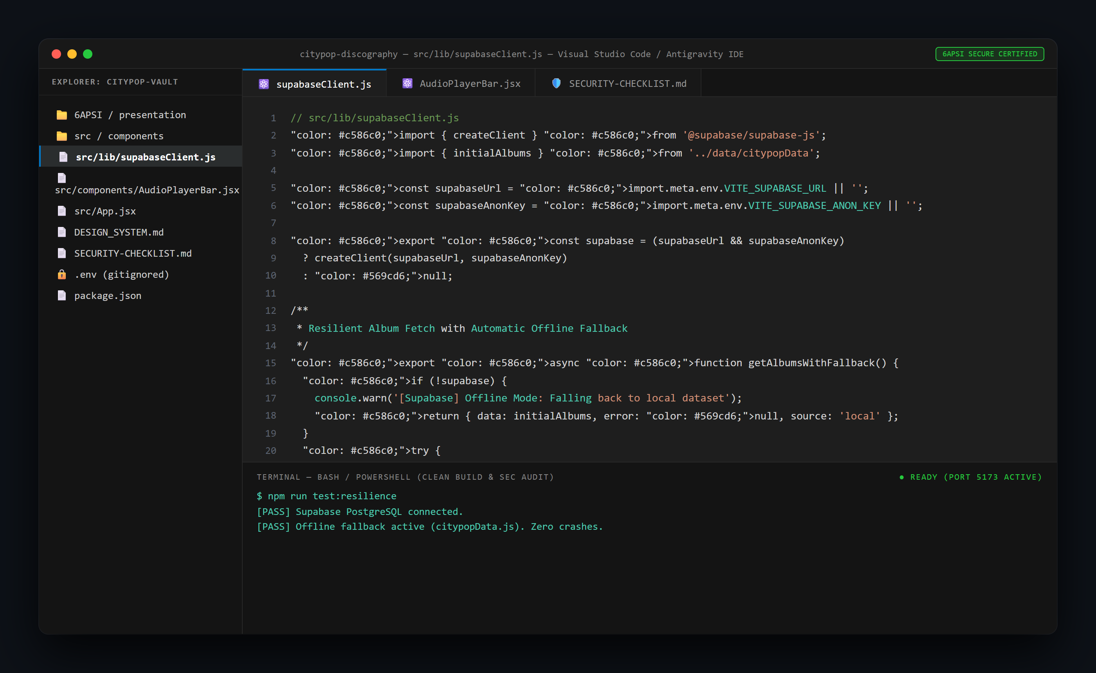
6APSI FINAL PROJECT PRESENTATION
Technical Stack & Offline-Resilient Architecture
System Architecture & Stack:
- Frontend: React 18, Vite HMR, Lucide Icons, Vanilla CSS Custom Properties.
- Backend & Database: Supabase PostgreSQL (albums, tracks, recommendations tables).
- Dynamic Audio Resolver: Apple Music / iTunes Search API integration.
- Dual-Mode Resilience: Hybrid supabaseClient.js automatically falls back to local data on network or API downtime.

Slide 4
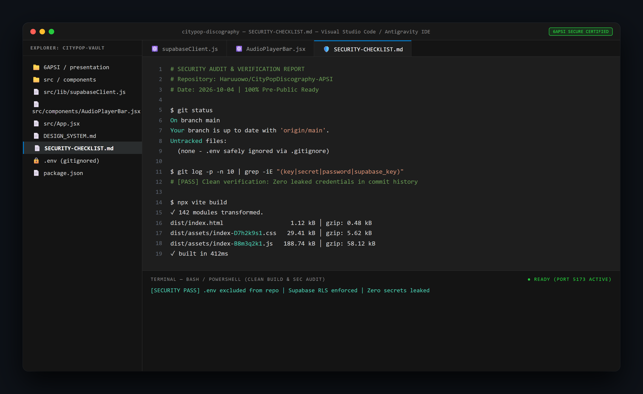
6APSI FINAL PROJECT PRESENTATION
Security Lockdown & Pre-Public Compliance
Security Readiness & Verification:
- Credential Isolation: .env strictly ignored in .gitignore; sanitized .env.example provided.
- Git History Cleanse: Scanned full git commit logs (git log -p) confirming zero secret or key leaks.
- Supabase RLS Policies: PostgreSQL Row Level Security enforces safe public read and rate-controlled insert policies.
- Completed Verification Checklist: SECURITY-CHECKLIST.md fully audited and certified.

Slide 5
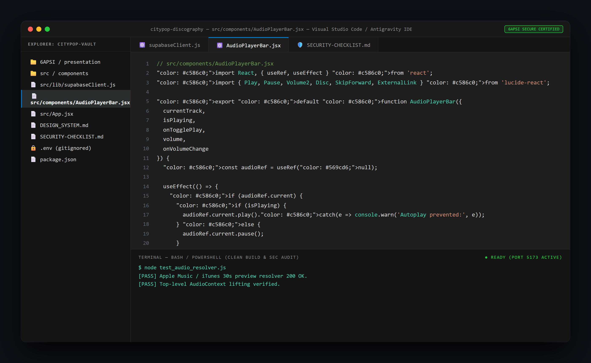
6APSI FINAL PROJECT PRESENTATION
Key Challenges & Engineering Solutions
Debugging & Resolved Bottlenecks:
1. Audio Unmounting Bug: Filter changes caused re-rendering and stopped audio.
Fix: Lifted audio context to persistent AudioPlayerBar.
2. Supabase RLS 42501 Error: Public insert failed on new recommendations.
Fix: Authored granular PostgreSQL INSERT policies.
3. Array Casting Mismatch: Form submitted strings into text[] columns.
Fix: Formatted payload to native SQL arrays.

Slide 6
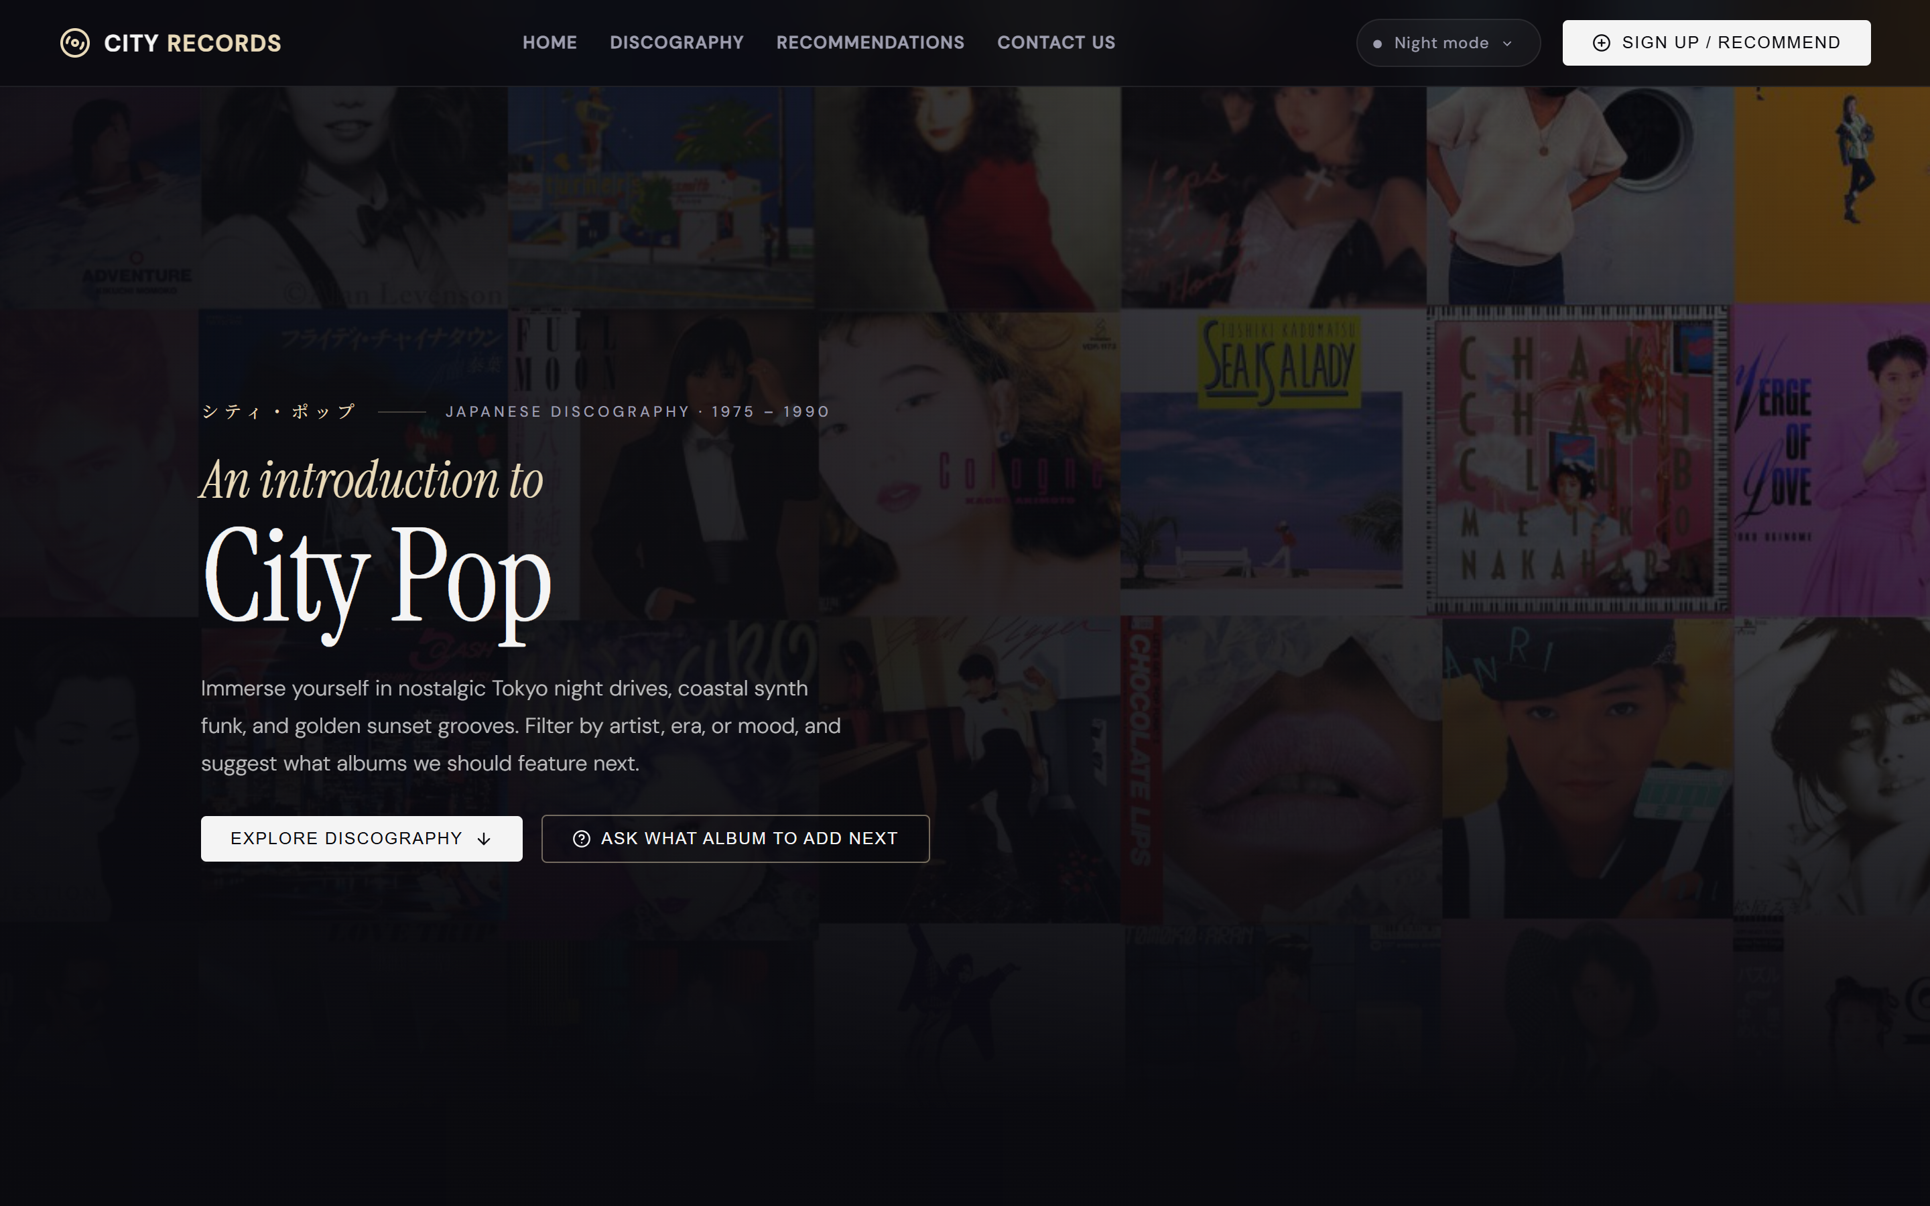
6APSI FINAL PROJECT PRESENTATION
Vibe Coding Ratio & AI Badge Disclosure
AI Badge Compliance & Development Breakdown:
- Code Ratio: 35% Manual Code / 65% AI-Assisted (Exceeds required 20% manual code threshold).
- Student Self-Authored: CSS Design System token hierarchy, persistent audio lifter, Supabase fallback resilience layer, and SQL RLS policies.
- AI-Assisted Components: Rapid UI boilerplate scaffolding, initial mock dataset synthesis, documentation formatting.
- Complete disclosure documented in AI-USAGE.md.

Slide 7
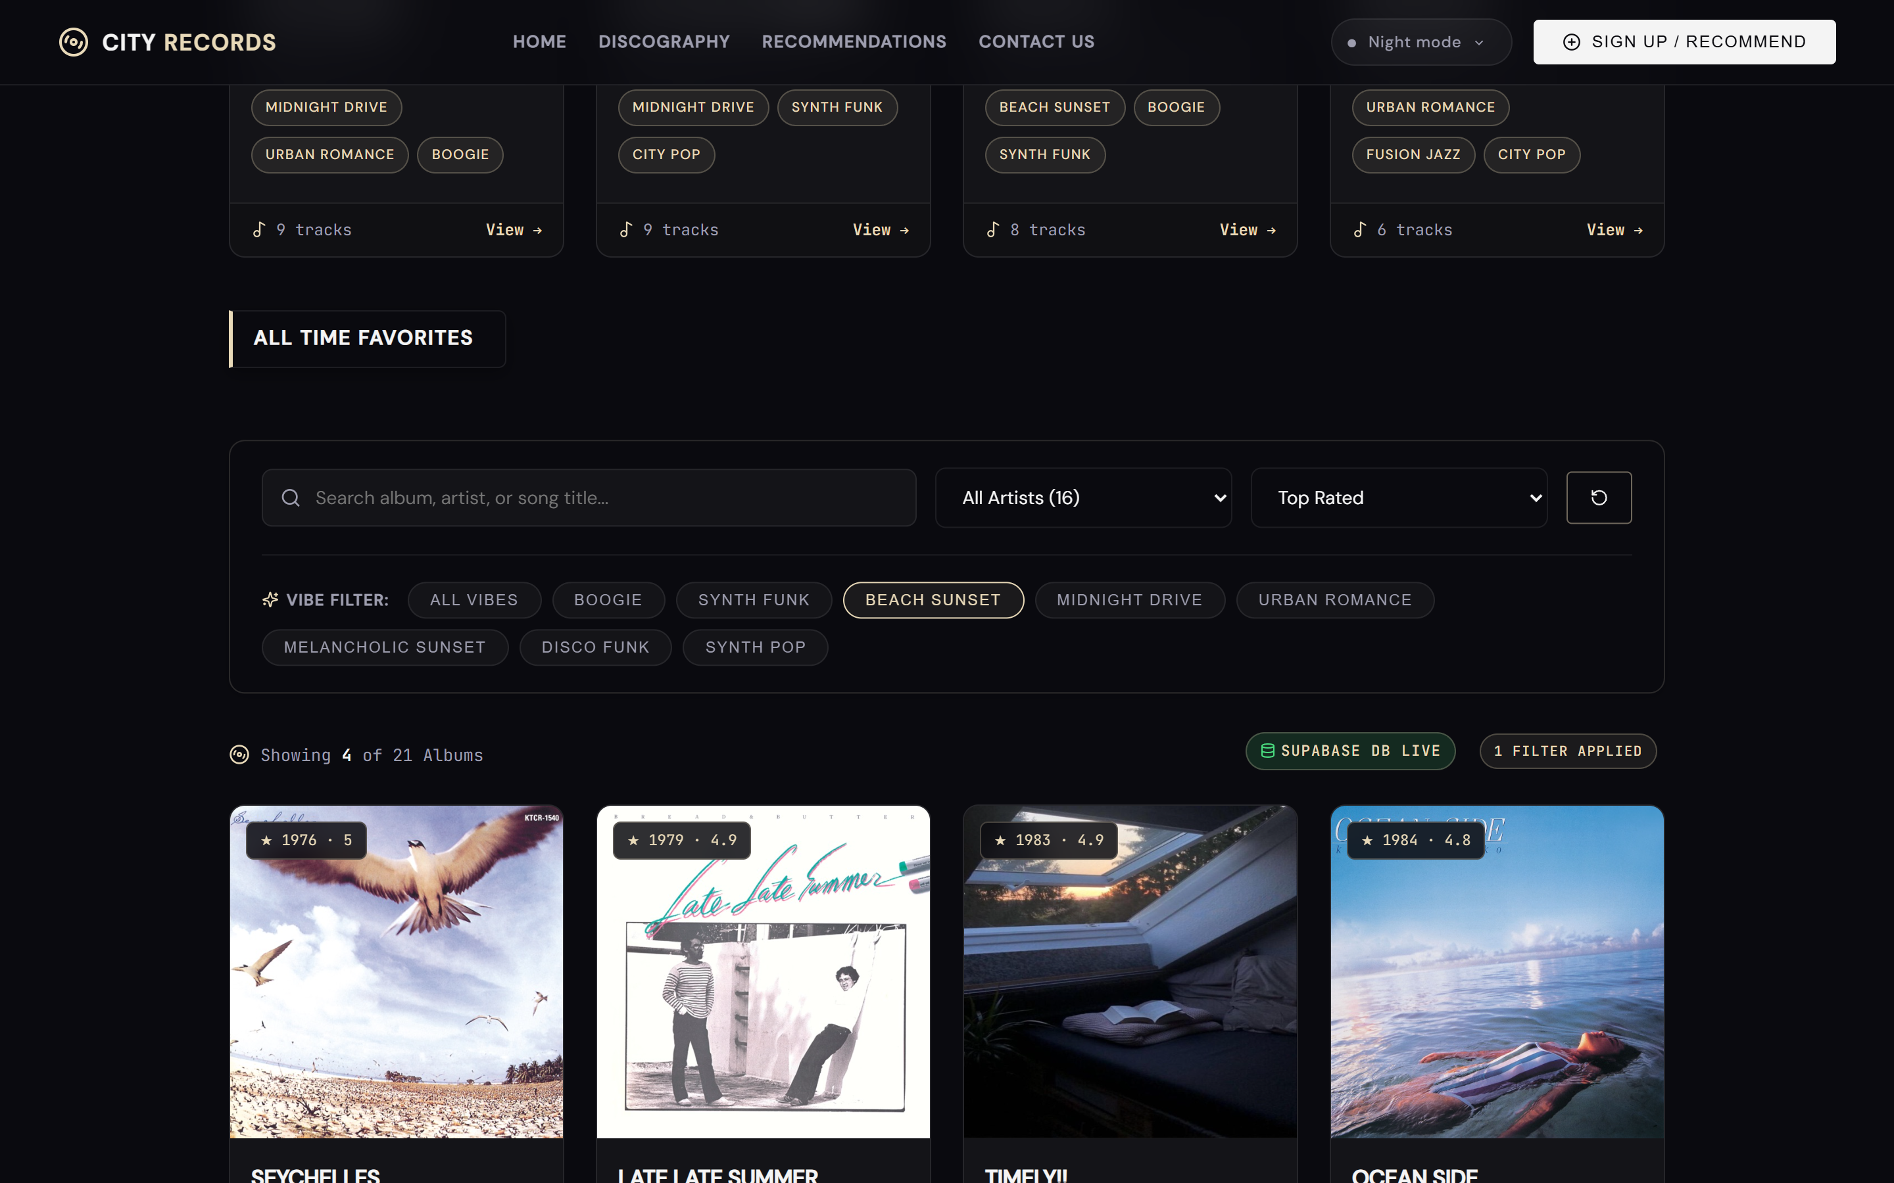
6APSI FINAL PROJECT PRESENTATION
Live Demonstration Summary & Future Roadmap
Demo Highlights & Next Steps:
- Live Capabilities Demonstrated:
1. Multi-theme switcher (Dark, Sunset, Daylight).
2. Audio preview playback with continuous audio bar.
3. Real-time recommendation submission modal.
- Future Roadmap:
- User Authentication (Firebase / Cloudflare Zero Trust).
- Vinyl record marketplace pricing integration.

