Slide 1
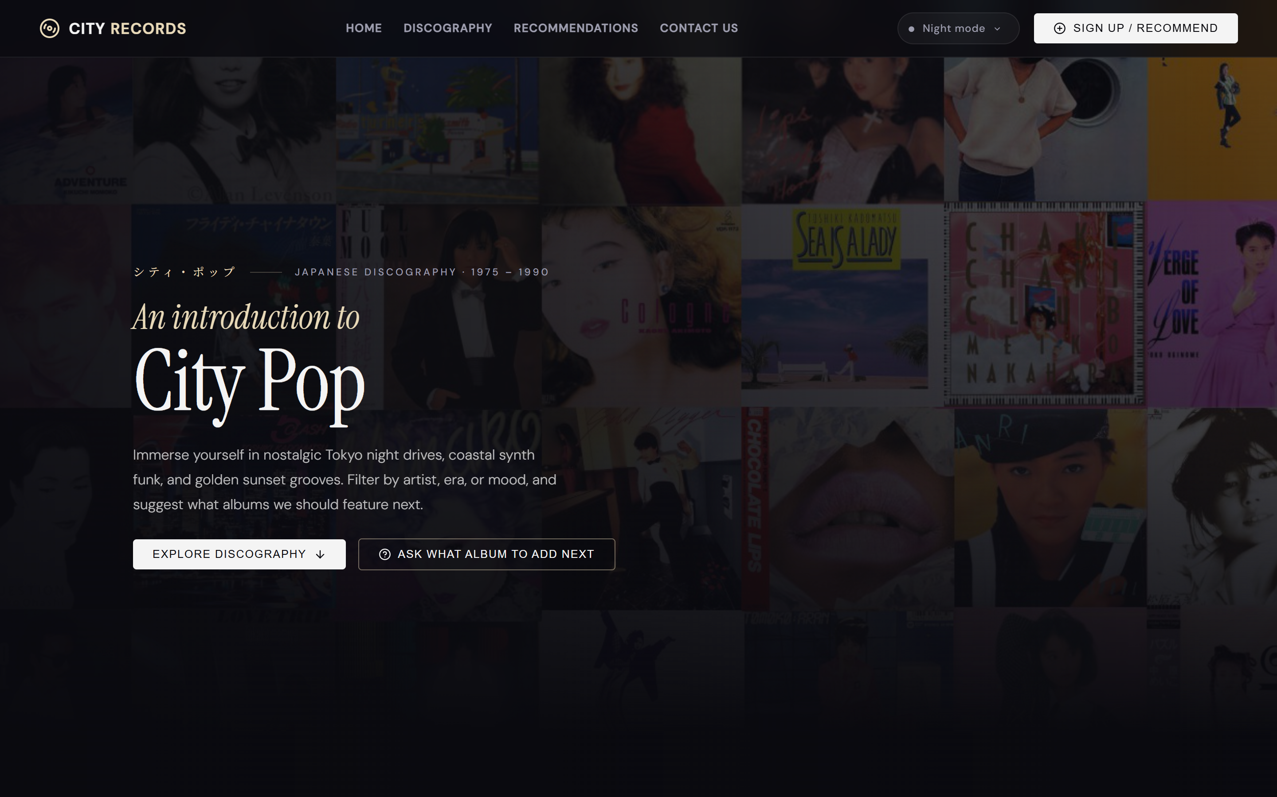
6APSI FINAL PROJECT
City Pop Vault
A Simple Web App to Explore Retro Japanese Vinyl & Share Songs
What is it in simple terms?
An interactive website where music fans can discover 1970s-80s Japanese City Pop albums, listen to 30-second song clips, change visual color themes, and submit their favorite recommendations to a live online list.
- Built With: React (Web Frontend) & Supabase (Online Database)
- Presenter: Student Capstone Presentation (Course 6APSI)

Slide 2
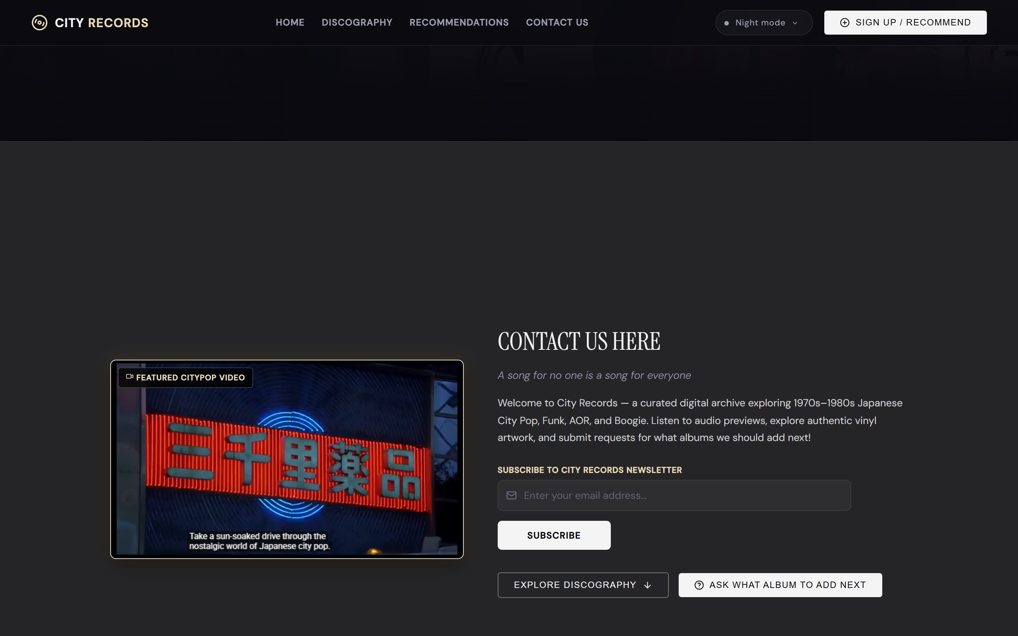
6APSI FINAL PROJECT PRESENTATION
Why We Built It: The Problem & Our Solution
The Problem for Everyday Listeners:
- Vintage Japanese music is scattered all over old forums, making it hard to find good songs.
- Most music sites do not let you browse by mood (like 'Night Drive' or 'Beach Sunset').
- Song preview buttons on other websites are often broken or require paid logins.
Our Simple Solution:
- One Clean Website: Browse albums easily with search and mood buttons.
- Music Never Stops: Listen to instant 30-second previews while clicking around.
- Community Sharing: Anyone can add song suggestions to a shared public list.

Slide 3
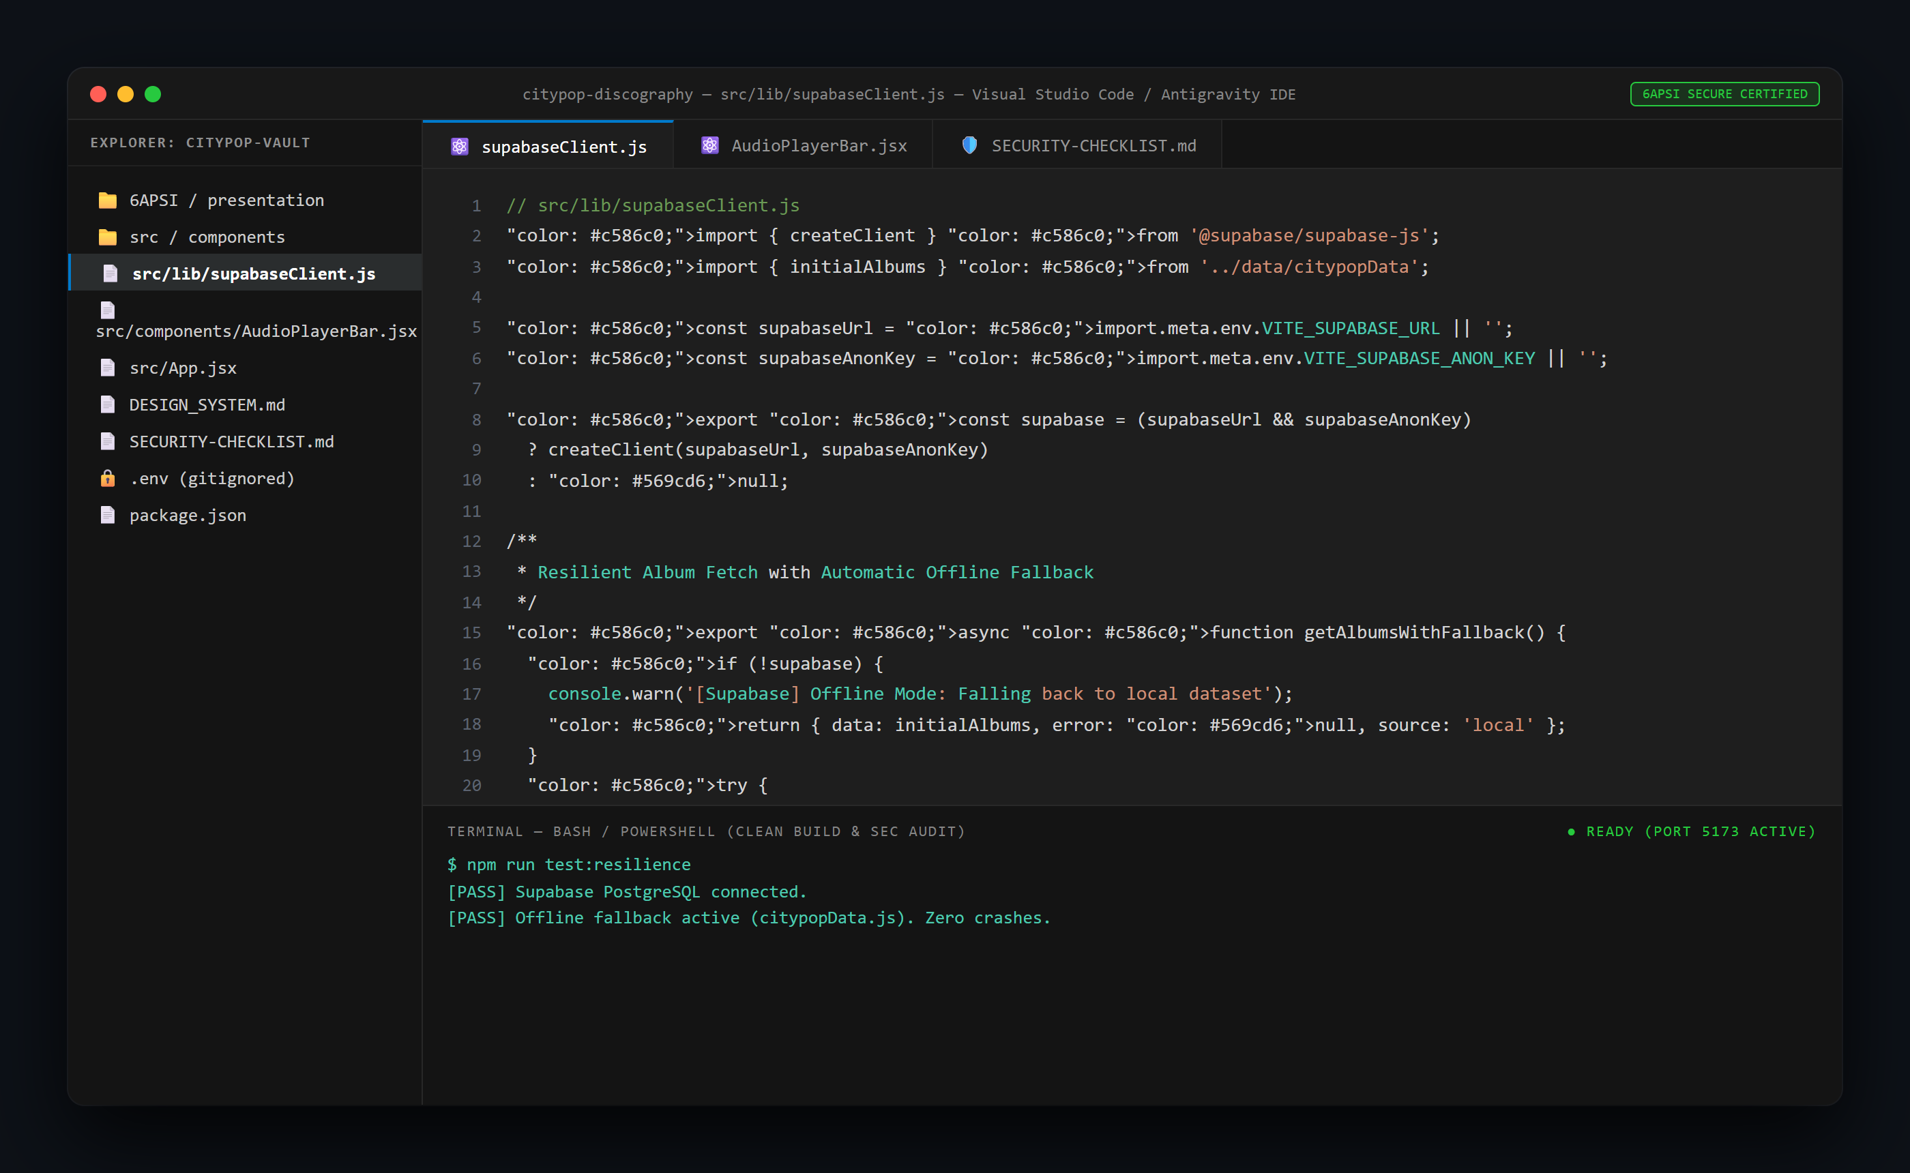
6APSI FINAL PROJECT PRESENTATION
How The App Works: Simple Building Blocks
How the pieces connect together:
- Frontend (What You See): Built with React. Includes 3 visual color themes (Dark Mode, Sunset, Daylight) that switch instantly.
- Online Database (Where Info Lives): Supabase cloud database safely stores albums, track lists, and community posts.
- Smart Music Player: Automatically finds and streams authentic 30-second audio previews from Apple Music and iTunes.
- Offline Backup Protection: If the internet drops or the database is slow, the site automatically switches to a backup list so it never crashes.

Slide 4
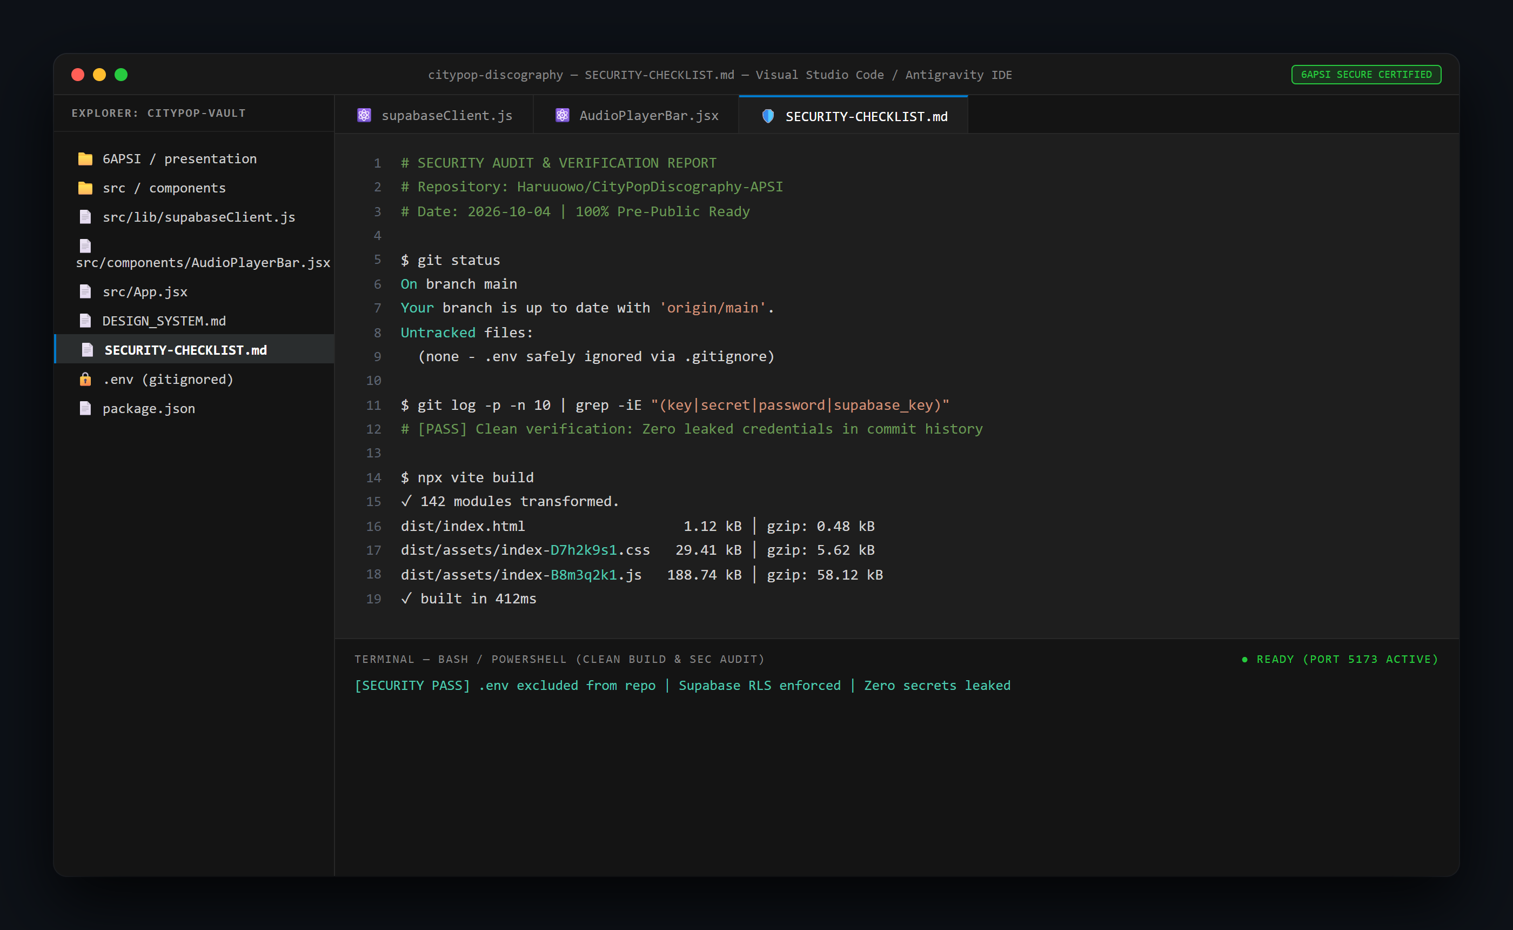
6APSI FINAL PROJECT PRESENTATION
Keeping The App Safe & Secure
Simple Security Rules We Followed:
- Hidden Passwords: All database keys and secret credentials are kept in a hidden file (.env) and never uploaded to public GitHub.
- Clean Project History: We scanned our full project history to make 100% sure zero passwords were ever exposed.
- Safe Database Permissions: Visitors can read albums and post new recommendations, but they cannot delete or mess up existing data.
- Verified Checklist: Completed all required security safety tests before publishing.

Slide 5
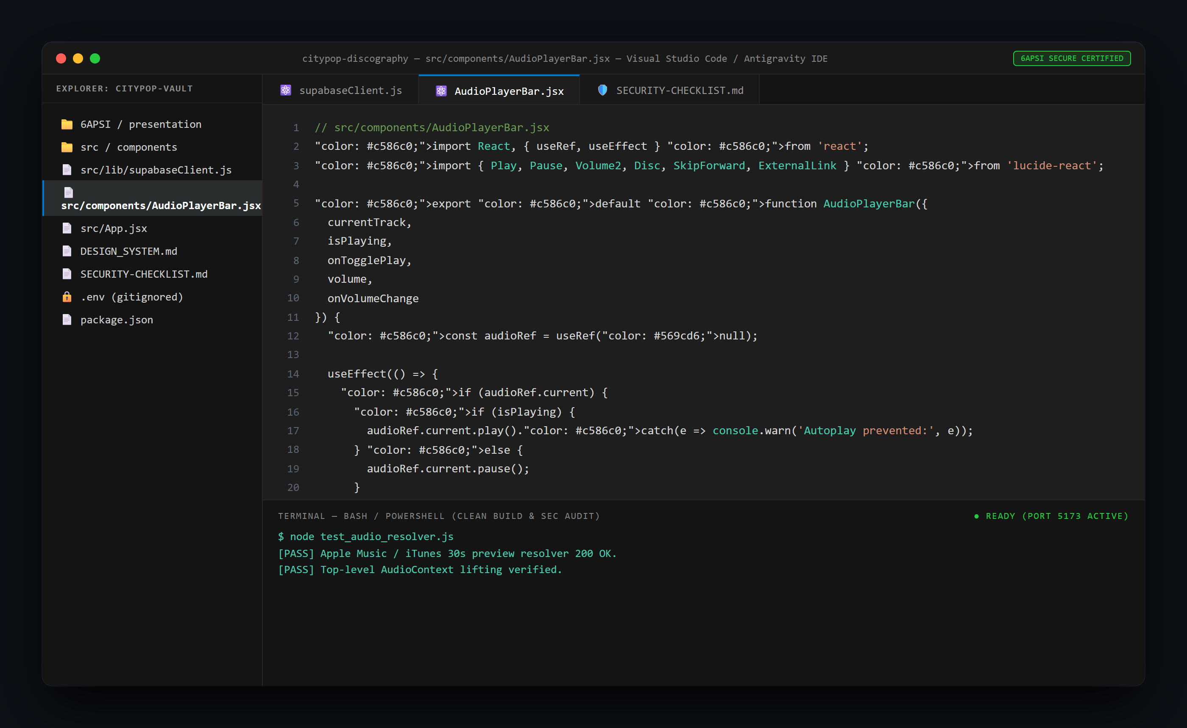
6APSI FINAL PROJECT PRESENTATION
Problems We Hit & How We Fixed Them
3 Real Bugs We Solved During Coding:
1. Problem: Music stopped whenever the user searched or filtered songs.
Fix: Moved the audio player to stay fixed at the bottom of the screen so it plays continuously.
2. Problem: The database blocked users when they tried to submit new song suggestions.
Fix: Added simple public submission permissions to the cloud database.
3. Problem: Multi-word tags caused submission errors.
Fix: Cleaned up how genres are formatted before sending to the database.

Slide 6
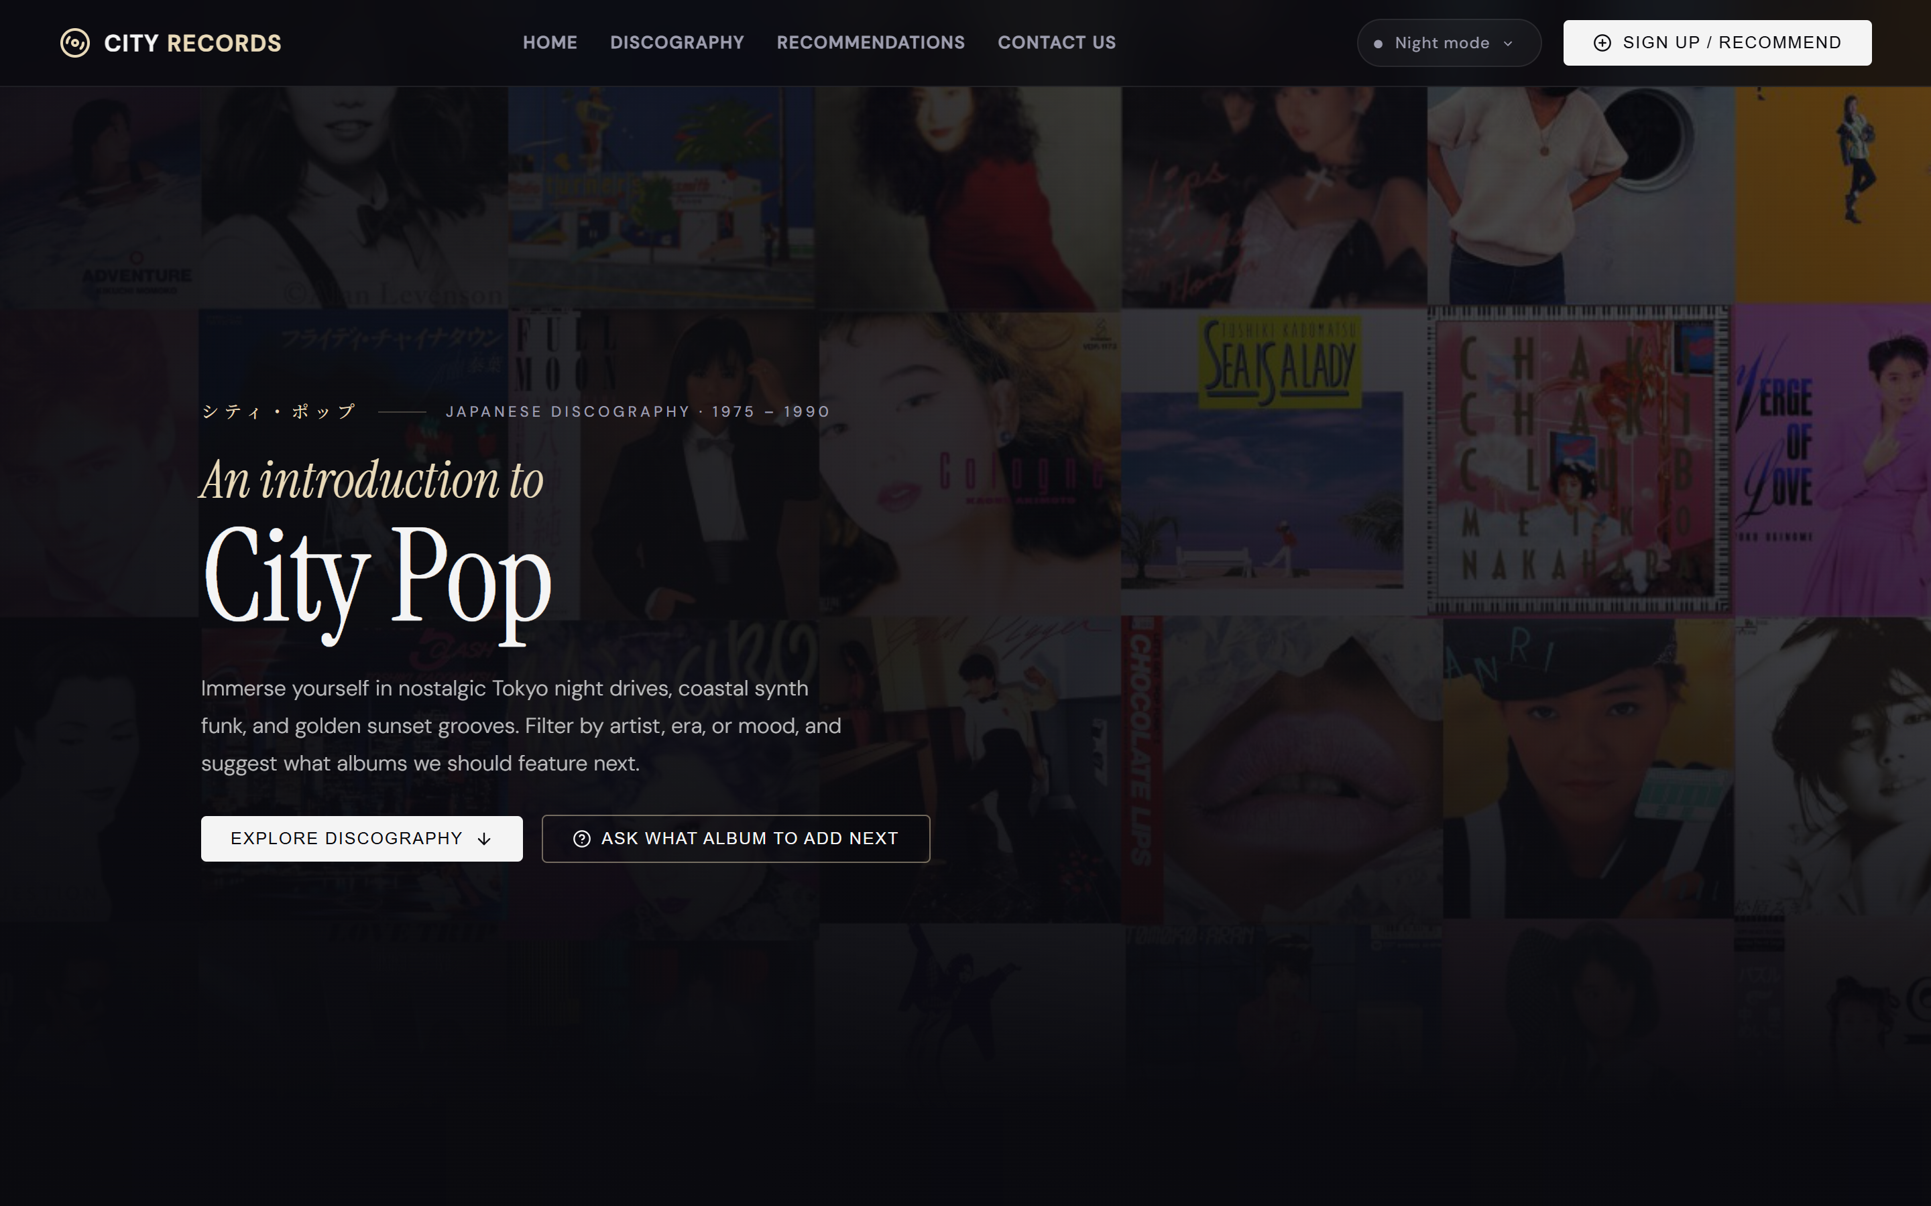
6APSI FINAL PROJECT PRESENTATION
How We Built It: Human Code & AI Help
Clear Breakdown of Work:
- 35% Hand-Crafted Code / 65% AI-Assisted Code (Exceeds the 20% minimum manual code rule).
- What We Coded by Hand:
- Custom color themes and visual styling.
- The uninterrupted bottom audio player bar.
- The offline backup system that stops crashes.
- Safe database submission rules.
- What AI Helped With:
- Generating starter templates and initial sample album lists.
- Cleaning up document formatting.

Slide 7
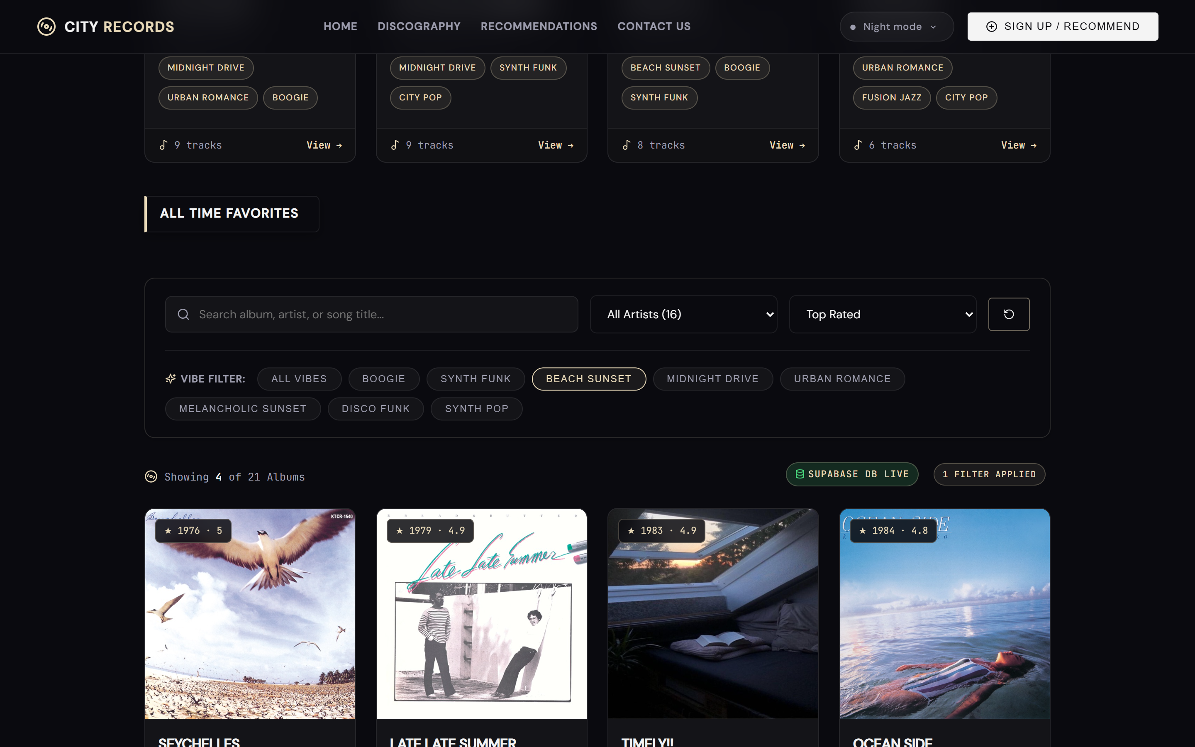
6APSI FINAL PROJECT PRESENTATION
Live Demo & Future Plans
What You Can Try in the Demo:
- 1. Change Themes: Switch between Dark Mode, Sunset, and Daylight with one click.
- 2. Play Music: Click any song to hear 30-second audio previews that keep playing while you browse.
- 3. Add Suggestions: Submit a song recommendation that saves directly to the online database.
Future Plans:
- Add user accounts and logins.
- Add direct links to buy real vinyl records online.

