Slide 1
CSE 182: Section 1
Probability RevieW

Slide 10
A Probabilistic Analysis of Darts

Slide 11
A Probabilistic Analysis of Darts
Y
Lets assume that I am decent bad at darts and therefore I throw darts randomly towards the board, what is the likelihood that the dart lands in any location on the board?
6
5
4
3
2
1
0
X
0
1
2
3
4
5
6

Slide 12
A Probabilistic Analysis of Darts
Y
Lets assume that I am decent bad at darts and therefore I throw darts randomly towards the board, what is the likelihood that the dart lands in any location on the board?
Well if it is truly random it is equally likely that it could land anywhere on the board!
6
5
4
3
2
1
0
X
0
1
2
3
4
5
6

Slide 13
A Probabilistic Analysis of Darts
Y
Lets assume that I am decent bad at darts and therefore I throw darts randomly towards the board, what is the likelihood that the dart lands in any location on the board?
Well if it is truly random it is equally likely that it could land anywhere on the board!
Given that, what would the probability density function (PDF) be? Is there a canonical name for this function?
6
5
4
3
2
1
0
X
0
1
2
3
4
5
6

Slide 14
A Probabilistic Analysis of Darts
Y
Lets assume that I am decent bad at darts and therefore I throw darts randomly towards the board, what is the likelihood that the dart lands in any location on the board?
Well if it is truly random it is equally likely that it could land anywhere on the board!
Given that, what would the probability density function (PDF) be? Is there a canonical name for this function?
It’s the uniform distribution over the area since there is a uniform (equal) chance at every location.
6
5
4
3
2
1
0
X
0
1
2
3
4
5
6

Slide 15
A Probabilistic Analysis of Darts
Y
To make things simpler let’s consider a discrete approximation of this problem.
6
5
4
3
2
1
0
X
0
1
2
3
4
5
6

Slide 16
A Probabilistic Analysis of Darts
Y
To make things simpler let’s consider a discrete approximation of this problem.
The uniform distribution over a 6 by 6 grid should result in what probability in each box?
6
5
4
3
2
1
0
X
0
1
2
3
4
5
6

Slide 17
A Probabilistic Analysis of Darts
Y
To make things simpler let’s consider a discrete approximation of this problem.
The uniform distribution over a 6 by 6 grid should result in what probability in each box?
6
1/36 | 1/36 | 1/36 | 1/36 | 1/36 | 1/36
1/36 | 1/36 | 1/36 | 1/36 | 1/36 | 1/36
1/36 | 1/36 | 1/36 | 1/36 | 1/36 | 1/36
1/36 | 1/36 | 1/36 | 1/36 | 1/36 | 1/36
1/36 | 1/36 | 1/36 | 1/36 | 1/36 | 1/36
1/36 | 1/36 | 1/36 | 1/36 | 1/36 | 1/36
5
4
3
2
1
0
X
0
1
2
3
4
5
6

Slide 18
A Probabilistic Analysis of Darts
Y
To make things simpler let’s consider a discrete approximation of this problem.
The uniform distribution over a 6 by 6 grid should result in what probability in each box?
Lets create two random variables: (X, Y) which define the x and y position of a dart in the grid respectively.
6
1/36 | 1/36 | 1/36 | 1/36 | 1/36 | 1/36
1/36 | 1/36 | 1/36 | 1/36 | 1/36 | 1/36
1/36 | 1/36 | 1/36 | 1/36 | 1/36 | 1/36
1/36 | 1/36 | 1/36 | 1/36 | 1/36 | 1/36
1/36 | 1/36 | 1/36 | 1/36 | 1/36 | 1/36
1/36 | 1/36 | 1/36 | 1/36 | 1/36 | 1/36
5
4
3
2
1
0
X
0
1
2
3
4
5
6

Slide 19
A Probabilistic Analysis of Darts
Y
To make things simpler let’s consider a discrete approximation of this problem.
The uniform distribution over a 6 by 6 grid should result in what probability in each box?
Lets create two random variables: (X, Y) which define the x and y position of a dart in the grid respectively.
The 1/36 probability of each (X, Y) pair is known as the joint distribution aka p(X = x, Y = y)
6
1/36 | 1/36 | 1/36 | 1/36 | 1/36 | 1/36
1/36 | 1/36 | 1/36 | 1/36 | 1/36 | 1/36
1/36 | 1/36 | 1/36 | 1/36 | 1/36 | 1/36
1/36 | 1/36 | 1/36 | 1/36 | 1/36 | 1/36
1/36 | 1/36 | 1/36 | 1/36 | 1/36 | 1/36
1/36 | 1/36 | 1/36 | 1/36 | 1/36 | 1/36
5
4
3
2
1
0
X
0
1
2
3
4
5
6

Slide 20
A Probabilistic Analysis of Darts
Y
6
1/36 | 1/36 | 1/36 | 1/36 | 1/36 | 1/36
1/36 | 1/36 | 1/36 | 1/36 | 1/36 | 1/36
1/36 | 1/36 | 1/36 | 1/36 | 1/36 | 1/36
1/36 | 1/36 | 1/36 | 1/36 | 1/36 | 1/36
1/36 | 1/36 | 1/36 | 1/36 | 1/36 | 1/36
1/36 | 1/36 | 1/36 | 1/36 | 1/36 | 1/36
What if we just wanted the p(Y = y)? What is this called?
5
4
3
2
1
0
X
0
1
2
3
4
5
6

Slide 21






A Probabilistic Analysis of Darts
Y
6
1/36 | 1/36 | 1/36 | 1/36 | 1/36 | 1/36
1/36 | 1/36 | 1/36 | 1/36 | 1/36 | 1/36
1/36 | 1/36 | 1/36 | 1/36 | 1/36 | 1/36
1/36 | 1/36 | 1/36 | 1/36 | 1/36 | 1/36
1/36 | 1/36 | 1/36 | 1/36 | 1/36 | 1/36
1/36 | 1/36 | 1/36 | 1/36 | 1/36 | 1/36
What if we just wanted the p(Y = y)? What is this called?
The p(Y = y) is called the marginal distribution and can be found be summing the joint distribution over all possible X values for each Y value (which simply means sum to each margin!)
Note: the same can be done for p(X = x)
$$=1/6$$
5
$$=1/6$$
4
$$=1/6$$
3
$$=1/6$$
2
$$=1/6$$
1
$$=1/6$$
0
X
0
1
2
3
4
5
6

Slide 22
A Probabilistic Analysis of Darts
So now we know that:
P(X = x, Y = y) = 1/36 if in the grid else 0
P(Y = y) = 1/6 if in the grid else 0
P(X = x) = 1/6 if in the grid else 0
In this case, are X and Y independent? How can we tell?
1/36 | 1/36 | 1/36 | 1/36 | 1/36 | 1/36
1/36 | 1/36 | 1/36 | 1/36 | 1/36 | 1/36
1/36 | 1/36 | 1/36 | 1/36 | 1/36 | 1/36
1/36 | 1/36 | 1/36 | 1/36 | 1/36 | 1/36
1/36 | 1/36 | 1/36 | 1/36 | 1/36 | 1/36
1/36 | 1/36 | 1/36 | 1/36 | 1/36 | 1/36

Slide 23
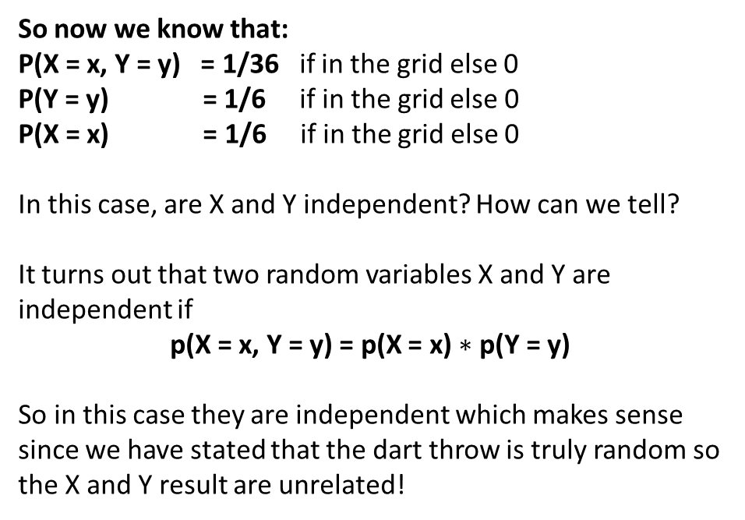
A Probabilistic Analysis of Darts
So now we know that:
P(X = x, Y = y) = 1/36 if in the grid else 0
P(Y = y) = 1/6 if in the grid else 0
P(X = x) = 1/6 if in the grid else 0
In this case, are X and Y independent? How can we tell?
It turns out that two random variables X and Y are independent if
p(X = x, Y = y) = p(X = x) $∗$ p(Y = y)
So in this case they are independent which makes sense since we have stated that the dart throw is truly random so the X and Y result are unrelated!
1/36 | 1/36 | 1/36 | 1/36 | 1/36 | 1/36
1/36 | 1/36 | 1/36 | 1/36 | 1/36 | 1/36
1/36 | 1/36 | 1/36 | 1/36 | 1/36 | 1/36
1/36 | 1/36 | 1/36 | 1/36 | 1/36 | 1/36
1/36 | 1/36 | 1/36 | 1/36 | 1/36 | 1/36
1/36 | 1/36 | 1/36 | 1/36 | 1/36 | 1/36

Slide 24
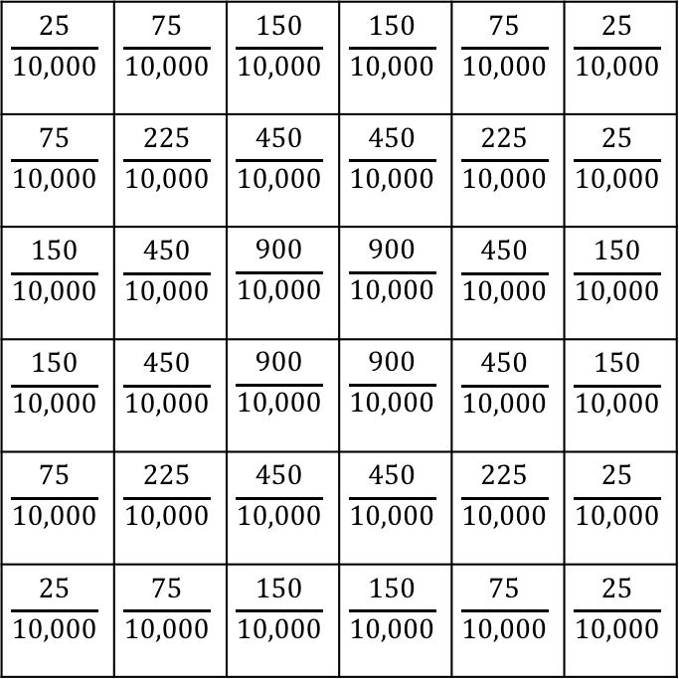
A Probabilistic Analysis of Darts
This is another possible joint distribution for discrete X and Y in the case of throwing the dart at the dartboard. Here we are no longer in a uniform distribution as I have been practicing and am now good below average at darts.
What are the marginal distributions for discrete X and Y?
In this case, are X and Y independent?
$$\frac{25}{10,000}$$ | $$\frac{75}{10,000}$$ | $$\frac{150}{10,000}$$ | $$\frac{150}{10,000}$$ | $$\frac{75}{10,000}$$ | $$\frac{25}{10,000}$$
$$\frac{75}{10,000}$$ | $$\frac{225}{10,000}$$ | $$\frac{450}{10,000}$$ | $$\frac{450}{10,000}$$ | $$\frac{225}{10,000}$$ | $$\frac{25}{10,000}$$
$$\frac{150}{10,000}$$ | $$\frac{450}{10,000}$$ | $$\frac{900}{10,000}$$ | $$\frac{900}{10,000}$$ | $$\frac{450}{10,000}$$ | $$\frac{150}{10,000}$$
$$\frac{150}{10,000}$$ | $$\frac{450}{10,000}$$ | $$\frac{900}{10,000}$$ | $$\frac{900}{10,000}$$ | $$\frac{450}{10,000}$$ | $$\frac{150}{10,000}$$
$$\frac{75}{10,000}$$ | $$\frac{225}{10,000}$$ | $$\frac{450}{10,000}$$ | $$\frac{450}{10,000}$$ | $$\frac{225}{10,000}$$ | $$\frac{25}{10,000}$$
$$\frac{25}{10,000}$$ | $$\frac{75}{10,000}$$ | $$\frac{150}{10,000}$$ | $$\frac{150}{10,000}$$ | $$\frac{75}{10,000}$$ | $$\frac{25}{10,000}$$

Slide 25









A Probabilistic Analysis of Darts
$$0.05$$
$$0.15$$
$$0.30$$
$$0.30$$
$$0.15$$
$$0.05$$
This is another possible joint distribution for discrete X and Y in the case of throwing the dart at the dartboard. Here we are no longer in a uniform distribution as I have been practicing and am now good below average at darts.
What are the marginal distributions for discrete X and Y?
In this case, are X and Y independent? YES!
$$\frac{25}{10,000}$$ | $$\frac{75}{10,000}$$ | $$\frac{150}{10,000}$$ | $$\frac{150}{10,000}$$ | $$\frac{75}{10,000}$$ | $$\frac{25}{10,000}$$
$$\frac{75}{10,000}$$ | $$\frac{225}{10,000}$$ | $$\frac{450}{10,000}$$ | $$\frac{450}{10,000}$$ | $$\frac{225}{10,000}$$ | $$\frac{25}{10,000}$$
$$\frac{150}{10,000}$$ | $$\frac{450}{10,000}$$ | $$\frac{900}{10,000}$$ | $$\frac{900}{10,000}$$ | $$\frac{450}{10,000}$$ | $$\frac{150}{10,000}$$
$$\frac{150}{10,000}$$ | $$\frac{450}{10,000}$$ | $$\frac{900}{10,000}$$ | $$\frac{900}{10,000}$$ | $$\frac{450}{10,000}$$ | $$\frac{150}{10,000}$$
$$\frac{75}{10,000}$$ | $$\frac{225}{10,000}$$ | $$\frac{450}{10,000}$$ | $$\frac{450}{10,000}$$ | $$\frac{225}{10,000}$$ | $$\frac{25}{10,000}$$
$$\frac{25}{10,000}$$ | $$\frac{75}{10,000}$$ | $$\frac{150}{10,000}$$ | $$\frac{150}{10,000}$$ | $$\frac{75}{10,000}$$ | $$\frac{25}{10,000}$$
$$0.05$$
$$0.15$$
$$0.30$$
$$0.30$$
$$0.15$$
$$0.05$$

Slide 26
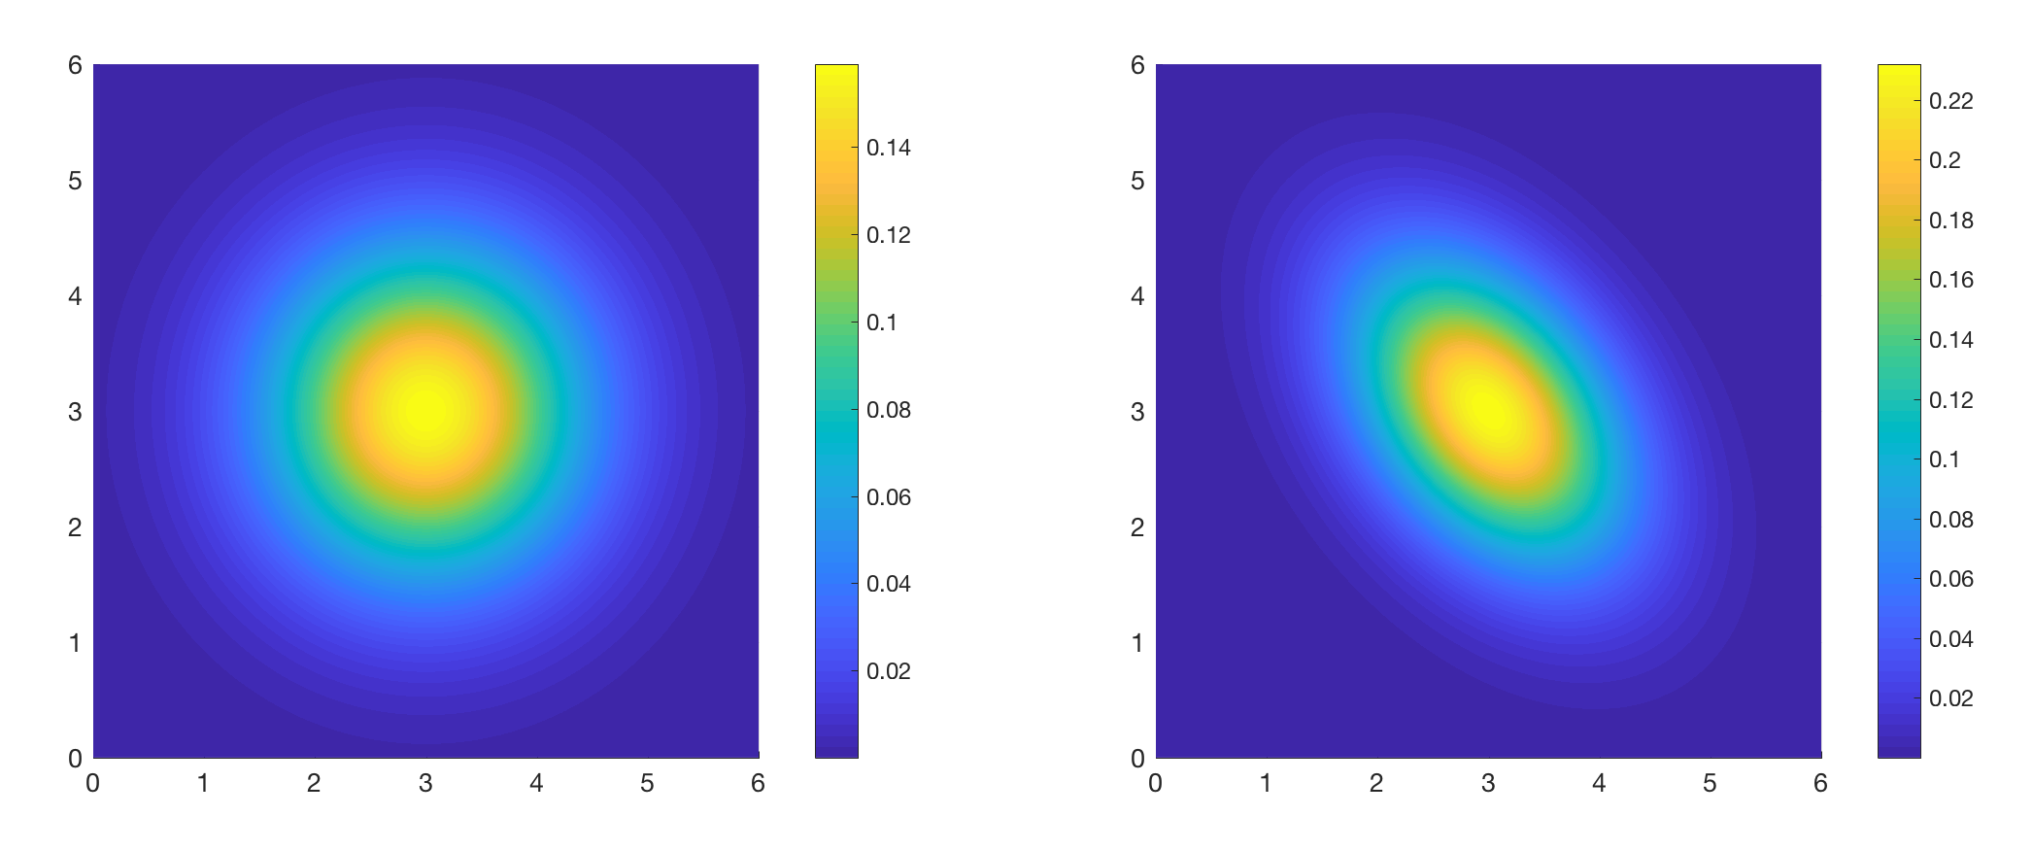
A Probabilistic Analysis of Darts
Can we bring this analysis back to continuous distributions?
For both of these distributions, sketch the marginal distributions for X and Y (don’t worry about the scale / numeric values, just think about the general shape!), and decide whether X and Y are independent.

Slide 27
A Probabilistic Analysis of Darts
Event: some set of outcomes of a probabilistic experiment.

Slide 28
A Probabilistic Analysis of Darts
Event: some set of outcomes of a probabilistic experiment.
Let’s introduce:
A – the event that a dart lands in the orange/green belt
A

Slide 29
A Probabilistic Analysis of Darts
Event: some set of outcomes of a probabilistic experiment.
Let’s introduce:
A – the event that a dart lands in the orange/green belt
B – the event that a dart lands inside the top right quadrant
B

Slide 30
A Probabilistic Analysis of Darts
Y
Event: some set of outcomes of a probabilistic experiment.
Let’s introduce:
A – the event that a dart lands in the orange/green belt
B – the event that a dart lands inside the top right quadrant
What is P(A)?
What is P(B)?
6
5
4
3
2
1
0
X
0
1
2
3
4
5
6

Slide 31


A Probabilistic Analysis of Darts
Y
Event: some set of outcomes of a probabilistic experiment.
Let’s introduce:
A – the event that a dart lands in the orange/green belt
B – the event that a dart lands inside the top right quadrant
What is P(A)?
What is P(B)?
6
5
4
$$P\left(A\right)= \frac{4π −π}{9π}=1/3$$
$$P\left(B\right)=1/4$$
3
2
1
0
X
0
1
2
3
4
5
6

Slide 32
A Probabilistic Analysis of Darts
Y
Event: some set of outcomes of a probabilistic experiment.
Let’s introduce:
A – the event that a dart lands in the orange/green belt
B – the event that a dart lands inside the top right quadrant
What is P(A)?
What is P(B)?
Now, suppose I throw a dart, and tell you that it lands in the orange/green belt. What is the probability that it is also in the top right quadrant?
Opposite case: suppose I throw a dart, and tell you that it lands in the top right quadrant. What is the probability that it is also in the orange/green belt?
6
5
4
$$P\left(A\right)= \frac{4π −π}{9π}=1/3$$
$$P\left(B\right)=1/4$$
3
2
1
0
X
0
1
2
3
4
5
6

Slide 33
A Probabilistic Analysis of Darts
Y
P([top right quadrant] | [orange/green belt]) = P(B | A) = 1/4
6
P([orange/green belt] | [top right quadrant]) = P(A | B) = 1/3
5
4
3
2
1
0
X
0
1
2
3
4
5
6

Slide 34

A Probabilistic Analysis of Darts
Y
P([top right quadrant] | [orange/green belt]) = P(B | A) = 1/4
6
P([orange/green belt] | [top right quadrant]) = P(A | B) = 1/3
5
Definition of conditional probability:
$$P\left(A \right|B)=\frac{P(A \& B)}{P(B)}$$
4
3
What is P(A | B) if A and B are independent? Are the A and B we defined for the dartboard problem independent?
2
1
0
X
0
1
2
3
4
5
6

Slide 35
A Probabilistic Analysis of Darts
Y
P([top right quadrant] | [orange/green belt]) = P(B | A) = 1/4
6
P([orange/green belt] | [top right quadrant]) = P(A | B) = 1/3
5
Definition of conditional probability:
$$P\left(A \right|B)=\frac{P(A \& B)}{P(B)}$$
4
3
What is P(A | B) if A and B are independent? Are the A and B we defined for the dartboard problem independent?
For independent events, P(A & B) = P(A) P(B), so P(A | B) = P(A).
2
1
0
X
0
1
2
3
4
5
6

Slide 36
A Probabilistic Analysis of Darts
Y
P([top right quadrant] | [orange/green belt]) = P(B | A) = 1/4
6
P([orange/green belt] | [top right quadrant]) = P(A | B) = 1/3
5
Definition of conditional probability:
$$P\left(A \right|B)=\frac{P(A \& B)}{P(B)}$$
4
3
What is P(A | B) if A and B are independent? Are the A and B we defined for the dartboard problem independent?
For independent events, P(A & B) = P(A) P(B), so P(A | B) = P(A).
In general, what is the relationship between P(A|B) and P(B|A) ?
2
1
0
X
0
1
2
3
4
5
6

Slide 37
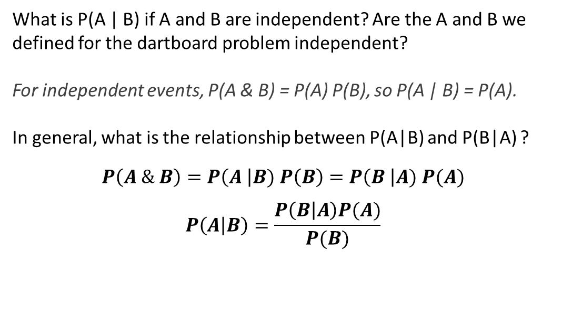
A Probabilistic Analysis of Darts
Y
P([top right quadrant] | [orange/green belt]) = P(B | A) = 1/4
6
P([orange/green belt] | [top right quadrant]) = P(A | B) = 1/3
5
Definition of conditional probability:
$$P\left(A \right|B)=\frac{P(A \& B)}{P(B)}$$
4
3
What is P(A | B) if A and B are independent? Are the A and B we defined for the dartboard problem independent?
For independent events, P(A & B) = P(A) P(B), so P(A | B) = P(A).
In general, what is the relationship between P(A|B) and P(B|A) ?
$$P\left(A \& B\right)=P\left(A \right|B) P\left(B\right)=P\left(B \right|A) P(A)$$
$$P\left(A | B\right)=\frac{P\left(B | A\right)P(A)}{P(B)}$$
2
1
0
X
0
1
2
3
4
5
6

Slide 38

A Probabilistic Analysis of Darts
Y
This is Bayes’ Law/Theorem/Rule!
$$P\left(A \right|B)=\frac{P\left(B \right|A) P(A)}{P(B)}$$
6
5
4
3
2
1
0
X
0
1
2
3
4
5
6

Slide 39
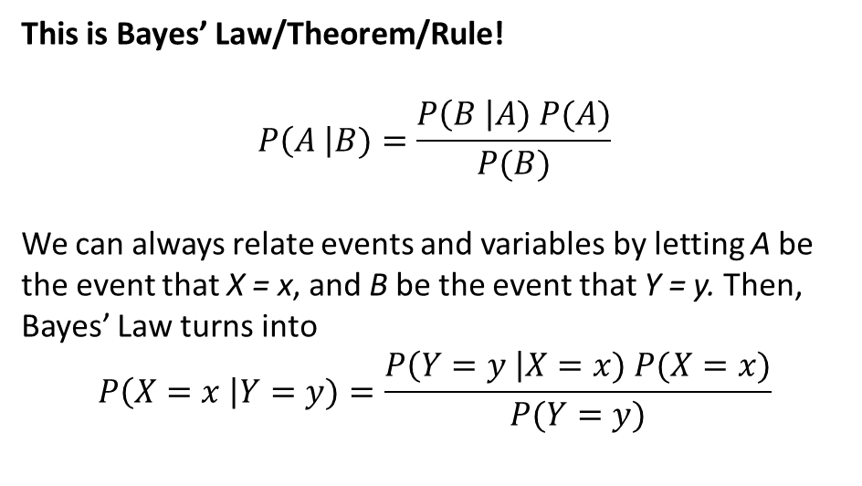
A Probabilistic Analysis of Darts
Y
This is Bayes’ Law/Theorem/Rule!
$$P\left(A \right|B)=\frac{P\left(B \right|A) P(A)}{P(B)}$$
We can always relate events and variables by letting A be the event that X = x, and B be the event that Y = y. Then, Bayes’ Law turns into
$$P\left(X=x \right|Y=y)=\frac{P\left(Y=y \right|X=x) P(X=x)}{P(Y=y)}$$
6
5
4
3
2
1
0
X
0
1
2
3
4
5
6

Slide 40
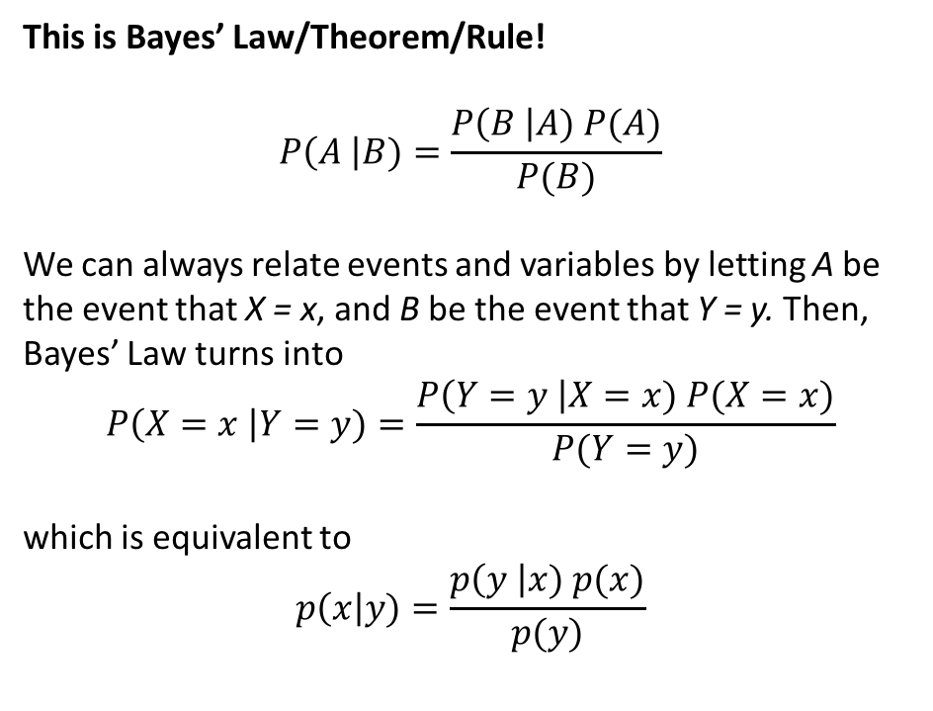
A Probabilistic Analysis of Darts
Y
This is Bayes’ Law/Theorem/Rule!
$$P\left(A \right|B)=\frac{P\left(B \right|A) P(A)}{P(B)}$$
We can always relate events and variables by letting A be the event that X = x, and B be the event that Y = y. Then, Bayes’ Law turns into
$$P\left(X=x \right|Y=y)=\frac{P\left(Y=y \right|X=x) P(X=x)}{P(Y=y)}$$
which is equivalent to
$$p\left(x\right|y)=\frac{p\left(y \right|x) p(x)}{p(y)}$$
6
5
4
3
2
1
0
X
0
1
2
3
4
5
6

Slide 41
A Probabilistic Analysis of Darts
Y
This is Bayes’ Law/Theorem/Rule!
$$P\left(A \right|B)=\frac{P\left(B \right|A) P(A)}{P(B)}$$
We can always relate events and variables by letting A be the event that X = x, and B be the event that Y = y. Then, Bayes’ Law turns into
$$P\left(X=x \right|Y=y)=\frac{P\left(Y=y \right|X=x) P(X=x)}{P(Y=y)}$$
which is equivalent to
$$p\left(x\right|y)=\frac{p\left(y \right|x) p(x)}{p(y)}$$
6
5
4
3
2
prior
1
posterior
0
X
0
1
2
3
4
5
6

