Slide 1
CSE 182: Section 2
SEARCH

Slide 2
What are the components of a search problem?

Slide 3
What are the components of a search problem?
set of states S
S₀
S₁
S₃
S₅
S₄
S₉
S₂
S₇
S₈
S₆

Slide 4
What are the components of a search problem?
set of states S
possible actions A
S₀
S₁
S₃
S₅
S₄
S₉
S₂
S₇
S₈
S₆

Slide 5
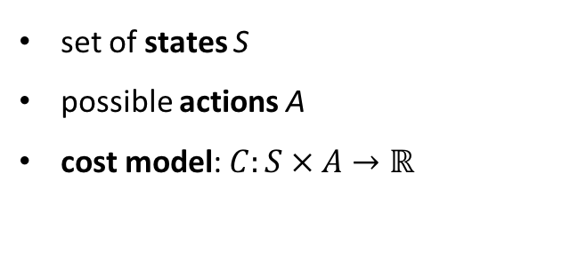
What are the components of a search problem?
set of states S
possible actions A
cost model: $C:S × A→ℝ$
S₀
4
S₁
5
S₃
6
4
2
S₅
4
S₄
1
2
S₉
S₂
3
4
3
3
2
S₇
S₈
S₆
5
4

Slide 6
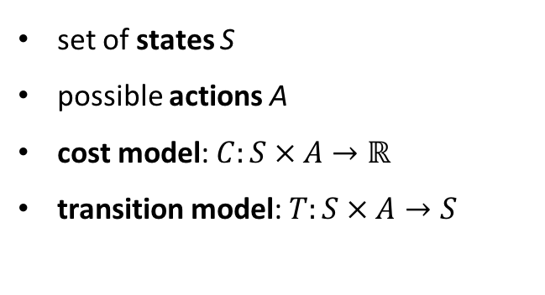
What are the components of a search problem?
set of states S
possible actions A
cost model: $C:S × A→ℝ$
transition model: $T:S × A→S$
What is the transition model?
State S₁ might have actions:
move towards S₂
move towards S₃
Then, assuming a deterministic system,
T(S_{1,} move towards S₂) = S₂
T(S_{1,} move towards S₃) = S₃
S₀
4
S₁
5
S₃
6
4
2
S₅
4
S₄
1
2
S₉
S₂
3
4
3
3
2
S₇
S₈
S₆
5
4

Slide 7
What are the components of a search problem?
set of states S
possible actions A
cost model: $C:S × A→ℝ$
transition model: $T:S × A→S$
What is the transition model?
State S₁ might have actions:
move towards S₂
move towards S₃
Then, assuming a deterministic system,
T(S_{1,} move towards S₂) = S₂
T(S_{1,} move towards S₃) = S₃
In the future, we might not assume a deterministic system, and the transition model may be something like:
T(S_{1,} move towards S₂) =
T(S_{1,} move towards S₃) =
S₀
4
S₁
5
S₃
6
4
2
S₅
4
S₄
1
2
S₉
S₂ with probability 0.8
S₃ with probability 0.2
S₂
3
4
3
S₂ with probability 0.2
S₃ with probability 0.8
3
2
S₇
S₈
S₆
5
4

Slide 8
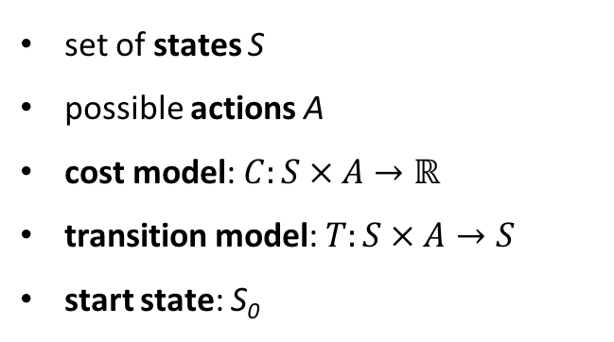
What are the components of a search problem?
set of states S
possible actions A
cost model: $C:S × A→ℝ$
transition model: $T:S × A→S$
start state: S₀
S₀
4
S₁
5
S₃
6
4
2
S₅
4
S₄
1
2
S₉
S₂
3
4
3
3
2
S₇
S₈
S₆
5
4

Slide 9
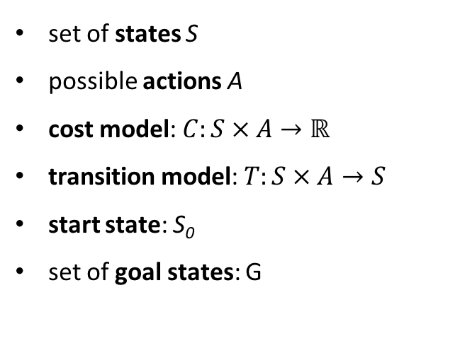
What are the components of a search problem?
set of states S
possible actions A
cost model: $C:S × A→ℝ$
transition model: $T:S × A→S$
start state: S₀
set of goal states: G
S₀
4
S₁
5
S₃
G
6
4
2
S₅
4
S₄
1
2
S₉
S₂
3
4
3
3
2
S₇
S₈
S₆
5
4

Slide 10
What are the components of a search problem?
(just for fun – any guesses of what these states represent?)

Slide 11
What are the components of a search problem?
(just for fun – any guesses of what these states represent?)
Museum of Science
Faneuil Hall
Chinatown Gate

Slide 12
What are the components of a search problem?
(just for fun – any guesses of what these states represent?)
Museum of Science
Boston Farmer’s Market
Faneuil Hall
New England Aquarium
Boston Massacre Site
Ducklings Statues
Boston Public Library
Tea Party Museum
Chinatown Gate

Slide 13

What are the components of a search problem?
(just for fun – any guesses of what these states represent?)
Bunker Hill Monument
Museum of Science
Boston Farmer’s Market
Faneuil Hall
New England Aquarium
Boston Massacre Site
Ducklings Statues
Boston Public Library
Tea Party Museum
Chinatown Gate

Slide 14
What are the components of a search problem?
(just for fun – any guesses of what these states represent?)
Bunker Hill Monument
Museum of Science
Boston Farmer’s Market
Faneuil Hall
New England Aquarium
Boston Massacre Site
Ducklings Statues
Built between 1825 and 1843 – you can take the stairs to the top for a lookout!
Boston Public Library
Tea Party Museum
Chinatown Gate

Slide 15
Search problem example: 8 queens puzzle
How can 8 queens be placed on a standard chessboard such that no two threaten each other?

Slide 16
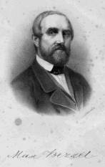
Search problem example: 8 queens puzzle
How can 8 queens be placed on a standard chessboard such that no two threaten each other?
This puzzle was first published by Max Bezzel in 1848.

Slide 17
Search problem example: 8 queens puzzle
How can 8 queens be placed on a standard chessboard such that no two threaten each other?
What are the states, and how big is the state space?
What are the actions?
What is the transition model?
What are the costs?
What is the start state?
What is the goal test?
This puzzle was first published by Max Bezzel in 1848.

Slide 18
Search problem example: 8 queens puzzle
How can 8 queens be placed on a standard chessboard such that no two threaten each other?
What are the states, and how big is the state space?
Any arrangement of 0-8 queens on a chessboard: 64! / (56!)(8!) …
What are the actions?
What is the transition model?
What are the costs?
What is the start state?
What is the goal test?
This puzzle was first published by Max Bezzel in 1848.

Slide 19
Search problem example: 8 queens puzzle
How can 8 queens be placed on a standard chessboard such that no two threaten each other?
What are the states, and how big is the state space?
Any arrangement of 0-8 queens on a chessboard: 64! / (56!)(8!) …
What are the actions?
Add a queen to an empty square.
What is the transition model?
What are the costs?
What is the start state?
What is the goal test?
This puzzle was first published by Max Bezzel in 1848.

Slide 20
Search problem example: 8 queens puzzle
How can 8 queens be placed on a standard chessboard such that no two threaten each other?
What are the states, and how big is the state space?
Any arrangement of 0-8 queens on a chessboard: 64! / (56!)(8!) …
What are the actions?
Add a queen to an empty square.
What is the transition model?
The transition model would return a chessboard with a queen added to the designated square.
What are the costs?
What is the start state?
What is the goal test?
This puzzle was first published by Max Bezzel in 1848.

Slide 21
Search problem example: 8 queens puzzle
How can 8 queens be placed on a standard chessboard such that no two threaten each other?
What are the states, and how big is the state space?
Any arrangement of 0-8 queens on a chessboard: 64! / (56!)(8!) …
What are the actions?
Add a queen to an empty square.
What is the transition model?
The transition model would return a chessboard with a queen added to the designated square.
What are the costs?
Every addition of a queen has the same cost (can say that the cost for each action is 1).
What is the start state?
What is the goal test?
This puzzle was first published by Max Bezzel in 1848.

Slide 22
Search problem example: 8 queens puzzle
How can 8 queens be placed on a standard chessboard such that no two threaten each other?
What are the states, and how big is the state space?
Any arrangement of 0-8 queens on a chessboard: 64! / (56!)(8!) …
What are the actions?
Add a queen to an empty square.
What is the transition model?
The transition model would return a chessboard with a queen added to the designated square.
What are the costs?
Every addition of a queen has the same cost (can say that the cost for each action is 1).
What is the start state?
An empty chessboard.
What is the goal test?
This puzzle was first published by Max Bezzel in 1848.

Slide 23
Search problem example: 8 queens puzzle
How can 8 queens be placed on a standard chessboard such that no two threaten each other?
What are the states, and how big is the state space?
Any arrangement of 0-8 queens on a chessboard: 64! / (56!)(8!) …
What are the actions?
Add a queen to an empty square.
What is the transition model?
The transition model would return a chessboard with a queen added to the designated square.
What are the costs?
Every addition of a queen has the same cost (can say that the cost for each action is 1).
What is the start state?
An empty chessboard.
What is the goal test?
This puzzle was first published by Max Bezzel in 1848.
Are there 8 queens on the board such that none are threatening each other?

Slide 24
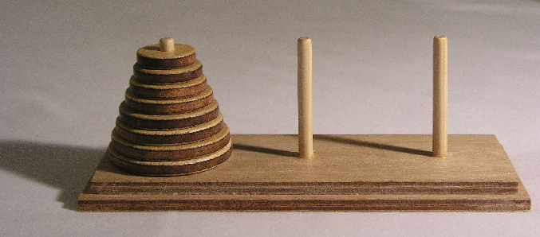
Search problem example: Tower of Hanoi
Moving one at a time, how can all of the N disks be moved from the leftmost peg to the rightmost peg, while maintaining the invariant that no disk may be placed on top of a smaller disk?
Notes:
The puzzle was invented by the French mathematician Édouard Lucas in 1883. There is a story about an Indian temple in Kashi Vishwanath which contains a large room with three time-worn posts in it, surrounded by 64 golden disks. Brahmin priests, acting out the command of an ancient prophecy, have been moving these disks in accordance with the immutable rules of Brahma since that time. The puzzle is therefore also known as the Tower of Brahma puzzle. According to the legend, when the last move of the puzzle is completed, the world will end.[2]
If the legend were true, and if the priests were able to move disks at a rate of one per second, using the smallest number of moves it would take them 264 − 1 seconds or roughly 585 billion years to finish,[3] which is about 42 times the current age of the Universe.
There are many variations on this legend. For instance, in some tellings the temple is a monastery, and the priests are monks. The temple or monastery may be said to be in different parts of the world — including Hanoi, Vietnam, — and may be associated with any religion. In some versions other elements are introduced, such as the fact that the tower was created at the beginning of the world, or that the priests or monks may make only one move per day.
Édouard Lucas devised methods for testing the primality of numbers. In 1857, at age 15, Lucas began testing the primality of 2¹²⁷ − 1 by hand, using Lucas sequences. In 1876, after 19 years of testing,^{[4]} he finally proved that 2¹²⁷ − 1 was prime; this would remain the largest known Mersenne prime for three-quarters of a century.

Slide 25
Search problem example: Tower of Hanoi
Moving one at a time, how can all of the N disks be moved from the leftmost peg to the rightmost peg, while maintaining the invariant that no disk may be placed on top of a smaller disk?
This puzzle was invented by Édouard Lucas in 1883. He also studied Fibonacci numbers and prime numbers.
Notes:
The puzzle was invented by the French mathematician Édouard Lucas in 1883. There is a story about an Indian temple in Kashi Vishwanath which contains a large room with three time-worn posts in it, surrounded by 64 golden disks. Brahmin priests, acting out the command of an ancient prophecy, have been moving these disks in accordance with the immutable rules of Brahma since that time. The puzzle is therefore also known as the Tower of Brahma puzzle. According to the legend, when the last move of the puzzle is completed, the world will end.[2]
If the legend were true, and if the priests were able to move disks at a rate of one per second, using the smallest number of moves it would take them 264 − 1 seconds or roughly 585 billion years to finish,[3] which is about 42 times the current age of the Universe.
There are many variations on this legend. For instance, in some tellings the temple is a monastery, and the priests are monks. The temple or monastery may be said to be in different parts of the world — including Hanoi, Vietnam, — and may be associated with any religion. In some versions other elements are introduced, such as the fact that the tower was created at the beginning of the world, or that the priests or monks may make only one move per day.
Édouard Lucas devised methods for testing the primality of numbers. In 1857, at age 15, Lucas began testing the primality of 2¹²⁷ − 1 by hand, using Lucas sequences. In 1876, after 19 years of testing,^{[4]} he finally proved that 2¹²⁷ − 1 was prime; this would remain the largest known Mersenne prime for three-quarters of a century.

Slide 26
Search problem example: Tower of Hanoi
Moving one at a time, how can all of the N disks be moved from the leftmost peg to the rightmost peg, while maintaining the invariant that no disk may be placed on top of a smaller disk?
What are the states, and how big is the state space?
What are the actions?
What is the transition model?
What are the costs?
This puzzle was invented by Édouard Lucas in 1883. He also studied Fibonacci numbers and prime numbers.
What is the start state?
What is the goal test?
Notes:
The puzzle was invented by the French mathematician Édouard Lucas in 1883. There is a story about an Indian temple in Kashi Vishwanath which contains a large room with three time-worn posts in it, surrounded by 64 golden disks. Brahmin priests, acting out the command of an ancient prophecy, have been moving these disks in accordance with the immutable rules of Brahma since that time. The puzzle is therefore also known as the Tower of Brahma puzzle. According to the legend, when the last move of the puzzle is completed, the world will end.[2]
If the legend were true, and if the priests were able to move disks at a rate of one per second, using the smallest number of moves it would take them 264 − 1 seconds or roughly 585 billion years to finish,[3] which is about 42 times the current age of the Universe.
There are many variations on this legend. For instance, in some tellings the temple is a monastery, and the priests are monks. The temple or monastery may be said to be in different parts of the world — including Hanoi, Vietnam, — and may be associated with any religion. In some versions other elements are introduced, such as the fact that the tower was created at the beginning of the world, or that the priests or monks may make only one move per day.
Édouard Lucas devised methods for testing the primality of numbers. In 1857, at age 15, Lucas began testing the primality of 2¹²⁷ − 1 by hand, using Lucas sequences. In 1876, after 19 years of testing,^{[4]} he finally proved that 2¹²⁷ − 1 was prime; this would remain the largest known Mersenne prime for three-quarters of a century.

Slide 27
Search problem example: Tower of Hanoi
Moving one at a time, how can all of the N disks be moved from the leftmost peg to the rightmost peg, while maintaining the invariant that no disk may be placed on top of a smaller disk?
What are the states, and how big is the state space?
The states are the arrays of possible peg locations of each disk (for instance, [1, 3, 2, 2, 1, …]). For N disks, there are 3^{N} possible such arrays.
What are the actions?
What is the transition model?
What are the costs?
This puzzle was invented by Édouard Lucas in 1883. He also studied Fibonacci numbers and prime numbers.
What is the start state?
What is the goal test?
Notes:
The puzzle was invented by the French mathematician Édouard Lucas in 1883. There is a story about an Indian temple in Kashi Vishwanath which contains a large room with three time-worn posts in it, surrounded by 64 golden disks. Brahmin priests, acting out the command of an ancient prophecy, have been moving these disks in accordance with the immutable rules of Brahma since that time. The puzzle is therefore also known as the Tower of Brahma puzzle. According to the legend, when the last move of the puzzle is completed, the world will end.[2]
If the legend were true, and if the priests were able to move disks at a rate of one per second, using the smallest number of moves it would take them 264 − 1 seconds or roughly 585 billion years to finish,[3] which is about 42 times the current age of the Universe.
There are many variations on this legend. For instance, in some tellings the temple is a monastery, and the priests are monks. The temple or monastery may be said to be in different parts of the world — including Hanoi, Vietnam, — and may be associated with any religion. In some versions other elements are introduced, such as the fact that the tower was created at the beginning of the world, or that the priests or monks may make only one move per day.
Édouard Lucas devised methods for testing the primality of numbers. In 1857, at age 15, Lucas began testing the primality of 2¹²⁷ − 1 by hand, using Lucas sequences. In 1876, after 19 years of testing,^{[4]} he finally proved that 2¹²⁷ − 1 was prime; this would remain the largest known Mersenne prime for three-quarters of a century.

Slide 28
Search problem example: Tower of Hanoi
Moving one at a time, how can all of the N disks be moved from the leftmost peg to the rightmost peg, while maintaining the invariant that no disk may be placed on top of a smaller disk?
What are the states, and how big is the state space?
The states are the arrays of possible peg locations of each disk (for instance, [1, 3, 2, 2, 1, …]). For N disks, there are 3^{N} possible such arrays.
What are the actions?
The legal actions are movement of any of the three top disks to another peg where all of the rings are (or equivalently, just the top ring is) larger than the one being moved.
What is the transition model?
What are the costs?
This puzzle was invented by Édouard Lucas in 1883. He also studied Fibonacci numbers and prime numbers.
What is the start state?
What is the goal test?
Notes:
The puzzle was invented by the French mathematician Édouard Lucas in 1883. There is a story about an Indian temple in Kashi Vishwanath which contains a large room with three time-worn posts in it, surrounded by 64 golden disks. Brahmin priests, acting out the command of an ancient prophecy, have been moving these disks in accordance with the immutable rules of Brahma since that time. The puzzle is therefore also known as the Tower of Brahma puzzle. According to the legend, when the last move of the puzzle is completed, the world will end.[2]
If the legend were true, and if the priests were able to move disks at a rate of one per second, using the smallest number of moves it would take them 264 − 1 seconds or roughly 585 billion years to finish,[3] which is about 42 times the current age of the Universe.
There are many variations on this legend. For instance, in some tellings the temple is a monastery, and the priests are monks. The temple or monastery may be said to be in different parts of the world — including Hanoi, Vietnam, — and may be associated with any religion. In some versions other elements are introduced, such as the fact that the tower was created at the beginning of the world, or that the priests or monks may make only one move per day.
Édouard Lucas devised methods for testing the primality of numbers. In 1857, at age 15, Lucas began testing the primality of 2¹²⁷ − 1 by hand, using Lucas sequences. In 1876, after 19 years of testing,^{[4]} he finally proved that 2¹²⁷ − 1 was prime; this would remain the largest known Mersenne prime for three-quarters of a century.

Slide 29
Search problem example: Tower of Hanoi
Moving one at a time, how can all of the N disks be moved from the leftmost peg to the rightmost peg, while maintaining the invariant that no disk may be placed on top of a smaller disk?
What are the states, and how big is the state space?
The states are the arrays of possible peg locations of each disk (for instance, [1, 3, 2, 2, 1, …]). For N disks, there are 3^{N} possible such arrays.
What are the actions?
The legal actions are movement of any of the three top disks to another peg where all of the rings are (or equivalently, just the top ring is) larger than the one being moved.
What is the transition model?
The transition model takes an initial state and action, and returns the new state with a ring moved to another peg.
What are the costs?
This puzzle was invented by Édouard Lucas in 1883. He also studied Fibonacci numbers and prime numbers.
What is the start state?
What is the goal test?
Notes:
The puzzle was invented by the French mathematician Édouard Lucas in 1883. There is a story about an Indian temple in Kashi Vishwanath which contains a large room with three time-worn posts in it, surrounded by 64 golden disks. Brahmin priests, acting out the command of an ancient prophecy, have been moving these disks in accordance with the immutable rules of Brahma since that time. The puzzle is therefore also known as the Tower of Brahma puzzle. According to the legend, when the last move of the puzzle is completed, the world will end.[2]
If the legend were true, and if the priests were able to move disks at a rate of one per second, using the smallest number of moves it would take them 264 − 1 seconds or roughly 585 billion years to finish,[3] which is about 42 times the current age of the Universe.
There are many variations on this legend. For instance, in some tellings the temple is a monastery, and the priests are monks. The temple or monastery may be said to be in different parts of the world — including Hanoi, Vietnam, — and may be associated with any religion. In some versions other elements are introduced, such as the fact that the tower was created at the beginning of the world, or that the priests or monks may make only one move per day.
Édouard Lucas devised methods for testing the primality of numbers. In 1857, at age 15, Lucas began testing the primality of 2¹²⁷ − 1 by hand, using Lucas sequences. In 1876, after 19 years of testing,^{[4]} he finally proved that 2¹²⁷ − 1 was prime; this would remain the largest known Mersenne prime for three-quarters of a century.

Slide 30
Search problem example: Tower of Hanoi
Moving one at a time, how can all of the N disks be moved from the leftmost peg to the rightmost peg, while maintaining the invariant that no disk may be placed on top of a smaller disk?
What are the states, and how big is the state space?
The states are the arrays of possible peg locations of each disk (for instance, [1, 3, 2, 2, 1, …]). For N disks, there are 3^{N} possible such arrays.
What are the actions?
The legal actions are movement of any of the three top disks to another peg where all of the rings are (or equivalently, just the top ring is) larger than the one being moved.
What is the transition model?
The transition model takes an initial state and action, and returns the new state with a ring moved to another peg.
What are the costs?
Each movement has the same cost (can say that each action has cost 1).
This puzzle was invented by Édouard Lucas in 1883. He also studied Fibonacci numbers and prime numbers.
What is the start state?
What is the goal test?
Notes:
The puzzle was invented by the French mathematician Édouard Lucas in 1883. There is a story about an Indian temple in Kashi Vishwanath which contains a large room with three time-worn posts in it, surrounded by 64 golden disks. Brahmin priests, acting out the command of an ancient prophecy, have been moving these disks in accordance with the immutable rules of Brahma since that time. The puzzle is therefore also known as the Tower of Brahma puzzle. According to the legend, when the last move of the puzzle is completed, the world will end.[2]
If the legend were true, and if the priests were able to move disks at a rate of one per second, using the smallest number of moves it would take them 264 − 1 seconds or roughly 585 billion years to finish,[3] which is about 42 times the current age of the Universe.
There are many variations on this legend. For instance, in some tellings the temple is a monastery, and the priests are monks. The temple or monastery may be said to be in different parts of the world — including Hanoi, Vietnam, — and may be associated with any religion. In some versions other elements are introduced, such as the fact that the tower was created at the beginning of the world, or that the priests or monks may make only one move per day.
Édouard Lucas devised methods for testing the primality of numbers. In 1857, at age 15, Lucas began testing the primality of 2¹²⁷ − 1 by hand, using Lucas sequences. In 1876, after 19 years of testing,^{[4]} he finally proved that 2¹²⁷ − 1 was prime; this would remain the largest known Mersenne prime for three-quarters of a century.

Slide 31
Search problem example: Tower of Hanoi
Moving one at a time, how can all of the N disks be moved from the leftmost peg to the rightmost peg, while maintaining the invariant that no disk may be placed on top of a smaller disk?
What are the states, and how big is the state space?
The states are the arrays of possible peg locations of each disk (for instance, [1, 3, 2, 2, 1, …]). For N disks, there are 3^{N} possible such arrays.
What are the actions?
The legal actions are movement of any of the three top disks to another peg where all of the rings are (or equivalently, just the top ring is) larger than the one being moved.
What is the transition model?
The transition model takes an initial state and action, and returns the new state with a ring moved to another peg.
What are the costs?
Each movement has the same cost (can say that each action has cost 1).
This puzzle was invented by Édouard Lucas in 1883. He also studied Fibonacci numbers and prime numbers.
What is the start state?
The starting state is the arrangement of N disks on the leftmost peg from smallest to largest.
What is the goal test?
Notes:
The puzzle was invented by the French mathematician Édouard Lucas in 1883. There is a story about an Indian temple in Kashi Vishwanath which contains a large room with three time-worn posts in it, surrounded by 64 golden disks. Brahmin priests, acting out the command of an ancient prophecy, have been moving these disks in accordance with the immutable rules of Brahma since that time. The puzzle is therefore also known as the Tower of Brahma puzzle. According to the legend, when the last move of the puzzle is completed, the world will end.[2]
If the legend were true, and if the priests were able to move disks at a rate of one per second, using the smallest number of moves it would take them 264 − 1 seconds or roughly 585 billion years to finish,[3] which is about 42 times the current age of the Universe.
There are many variations on this legend. For instance, in some tellings the temple is a monastery, and the priests are monks. The temple or monastery may be said to be in different parts of the world — including Hanoi, Vietnam, — and may be associated with any religion. In some versions other elements are introduced, such as the fact that the tower was created at the beginning of the world, or that the priests or monks may make only one move per day.
Édouard Lucas devised methods for testing the primality of numbers. In 1857, at age 15, Lucas began testing the primality of 2¹²⁷ − 1 by hand, using Lucas sequences. In 1876, after 19 years of testing,^{[4]} he finally proved that 2¹²⁷ − 1 was prime; this would remain the largest known Mersenne prime for three-quarters of a century.

Slide 32
Search problem example: Tower of Hanoi
Moving one at a time, how can all of the N disks be moved from the leftmost peg to the rightmost peg, while maintaining the invariant that no disk may be placed on top of a smaller disk?
What are the states, and how big is the state space?
The states are the arrays of possible peg locations of each disk (for instance, [1, 3, 2, 2, 1, …]). For N disks, there are 3^{N} possible such arrays.
What are the actions?
The legal actions are movement of any of the three top disks to another peg where all of the rings are (or equivalently, just the top ring is) larger than the one being moved.
What is the transition model?
The transition model takes an initial state and action, and returns the new state with a ring moved to another peg.
What are the costs?
Each movement has the same cost (can say that each action has cost 1).
This puzzle was invented by Édouard Lucas in 1883. He also studied Fibonacci numbers and prime numbers.
What is the start state?
The starting state is the arrangement of N disks on the leftmost peg from smallest to largest.
What is the goal test?
The goal test is whether the state is the arrangement of N disks on the rightmost peg from smallest to largest.
Notes:
The puzzle was invented by the French mathematician Édouard Lucas in 1883. There is a story about an Indian temple in Kashi Vishwanath which contains a large room with three time-worn posts in it, surrounded by 64 golden disks. Brahmin priests, acting out the command of an ancient prophecy, have been moving these disks in accordance with the immutable rules of Brahma since that time. The puzzle is therefore also known as the Tower of Brahma puzzle. According to the legend, when the last move of the puzzle is completed, the world will end.[2]
If the legend were true, and if the priests were able to move disks at a rate of one per second, using the smallest number of moves it would take them 264 − 1 seconds or roughly 585 billion years to finish,[3] which is about 42 times the current age of the Universe.
There are many variations on this legend. For instance, in some tellings the temple is a monastery, and the priests are monks. The temple or monastery may be said to be in different parts of the world — including Hanoi, Vietnam, — and may be associated with any religion. In some versions other elements are introduced, such as the fact that the tower was created at the beginning of the world, or that the priests or monks may make only one move per day.
Édouard Lucas devised methods for testing the primality of numbers. In 1857, at age 15, Lucas began testing the primality of 2¹²⁷ − 1 by hand, using Lucas sequences. In 1876, after 19 years of testing,^{[4]} he finally proved that 2¹²⁷ − 1 was prime; this would remain the largest known Mersenne prime for three-quarters of a century.

Slide 33
What search algorithms have we covered?

Slide 34
What search algorithms have we covered?
UCS (uniform cost search)
BFS (breadth-first search)
DFS (depth-first search)
Greedy search
DFS with iterative deepening
A* search

Slide 35
Tree search and Graph Search
Question: Are these tree search or graph search algorithms?

Slide 36
Tree search and Graph Search
Question: Are these tree search or graph search algorithms?
Graph in state space

Slide 37
Tree search and Graph Search
Question: Are these tree search or graph search algorithms?
Search tree corresponding to state space graph
Graph in state space

Slide 38
Tree search and Graph Search
Question: Are these tree search or graph search algorithms?
Search tree corresponding to state space graph
Graph in state space

Slide 39
Tree search and Graph Search
Question: Are these tree search or graph search algorithms?
Search tree corresponding to state space graph
Graph in state space

Slide 40
Tree search and Graph Search
Question: Are these tree search or graph search algorithms?
Search tree corresponding to state space graph
Graph in state space

Slide 41
Tree search and Graph Search
Question: Are these tree search or graph search algorithms?
Search tree corresponding to state space graph
Graph in state space
Answer: Sort of a trick question; they can all be used within tree search or graph search. Graph search is just an extension of tree search that keeps track of which nodes have been visited to avoid redundancy.

Slide 42
What differentiates these algorithms?

Slide 43
What differentiates these algorithms?
UCS (uniform cost search)
explores node with lowest running cost first
BFS (breadth-first search)
explores oldest added node first
DFS (depth-first search)
explores newest added node first
Greedy search
explores node with lowest heuristic first
DFS with iterative deepening
iteratively repeats DFS, with increasing maximum depths
A* search
explores node with lowest (heuristic + running cost) first

Slide 44
Heuristics

Slide 45
Heuristics
Let h*(s) be the optimal cost to reach the goal from every state s in the state space.
A heuristic h(s) is admissible if it never overestimates the cost of reaching the goal.
A heuristic h(s) is consistent if it never overestimates the estimated distance to the goal of a neighbor plus the cost of reaching the neighbor.
h(s) ≤ h*(s) for all states s
h(s) ≤ c(s, s’) + h(s’) for all states s, s’

Slide 46
Search algorithms example
Consider the state space graph shown at right, in which some of the states are missing a heuristic value.
Determine the possible range for each missing heuristic value so that the heuristic is admissible.
Additionally, for what range of each heuristic
value is the heuristic consistent?
(Berkeley CS 188, Spring 2015)
B
h = 2
5
2
A
h = ?
C
h = ?
3
Start
h = 9
1
4
3
D
h = 5
Goal
h = 0
2
1
6
E
h = 7
2
F
h = ?

Slide 47
Search algorithms example
Consider the state space graph shown at right, in which some of the states are missing a heuristic value.
Determine the possible range for each missing heuristic value so that the heuristic is admissible.
Additionally, for what range of each heuristic
value is the heuristic consistent?
(Berkeley CS 188, Spring 2015)
B
h = 2
5
2
A
h = ?
C
h = ?
3
Start
h = 9
1
4
3
D
h = 5
Goal
h = 0
2
1
6
E
h = 7
2
F
h = ?
Solutions
Admissibility:
h(A) ≤ 8
h(C) ≤ 3
h(F) ≤ 6
Consistency:
6 ≤ h(A) ≤ 6
1 ≤ h(C) ≤ 3
5 ≤ h(F) ≤ 6

Slide 48
Search algorithms example
Consider the state space graph shown at right, with missing heuristics filled in. What paths are returned by each of the following graph search algorithms?
BFS:
DFS:
UCS:
Greedy Search:
A* Search:
B
h = 2
5
2
A
h = 6
C
h = 2
3
Start
h = 9
1
4
3
D
h = 5
Goal
h = 0
2
1
6
E
h = 7
2
F
h = 5

