Slide 1
Advanced Section #5: Generalized Linear Models: Logistic Regression and Beyond
Nick Stern
Notes:
Credit Chris Tanner

Slide 2
Outline
Motivation
Limitations of linear regression
Anatomy
Exponential Dispersion Family (EDF)
Link function
Maximum Likelihood Estimation for GLM’s
Fischer Scoring

Slide 3
Motivation

Slide 4
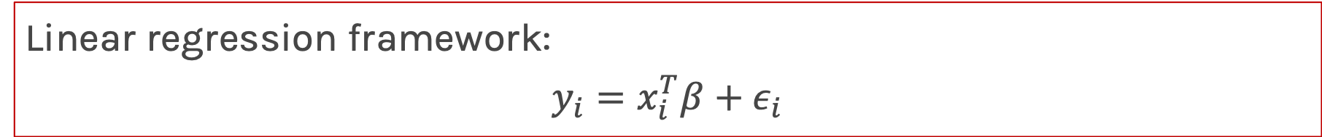
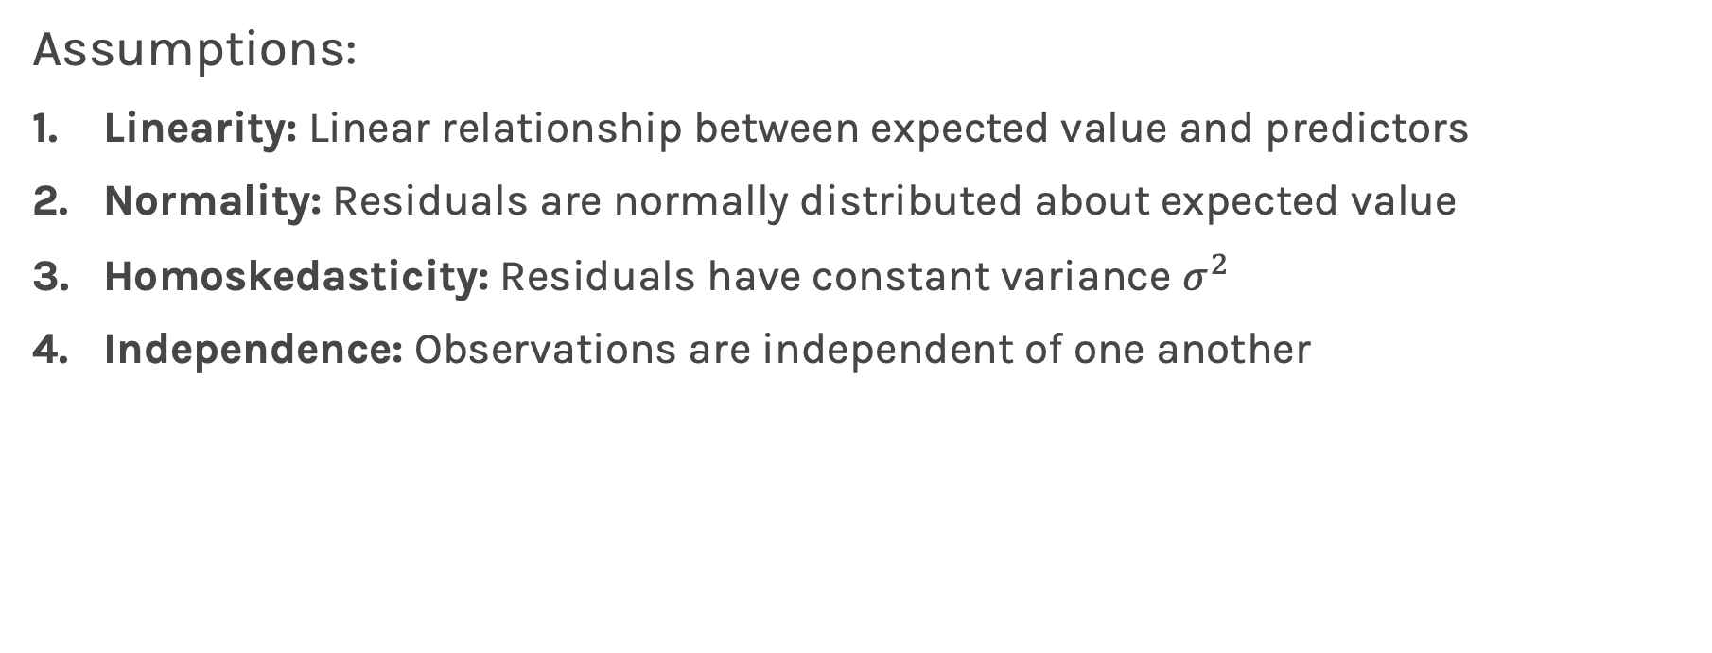
Motivation
Linear regression framework:
$$y_{i}=x_{i}^{T}β+ε_{i}$$
Assumptions:
Linearity: Linear relationship between expected value and predictors
Normality: Residuals are normally distributed about expected value
Homoskedasticity: Residuals have constant variance $σ^{2}$
Independence: Observations are independent of one another

Slide 5
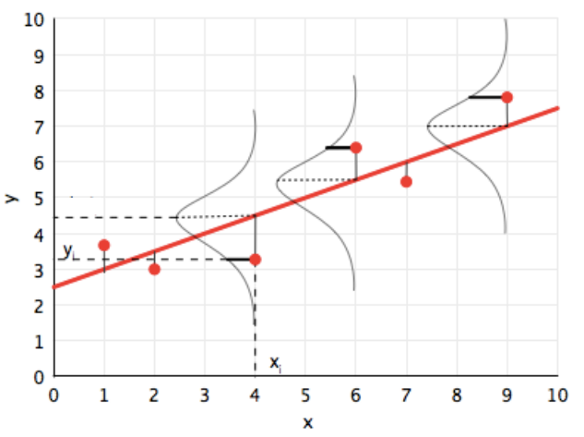
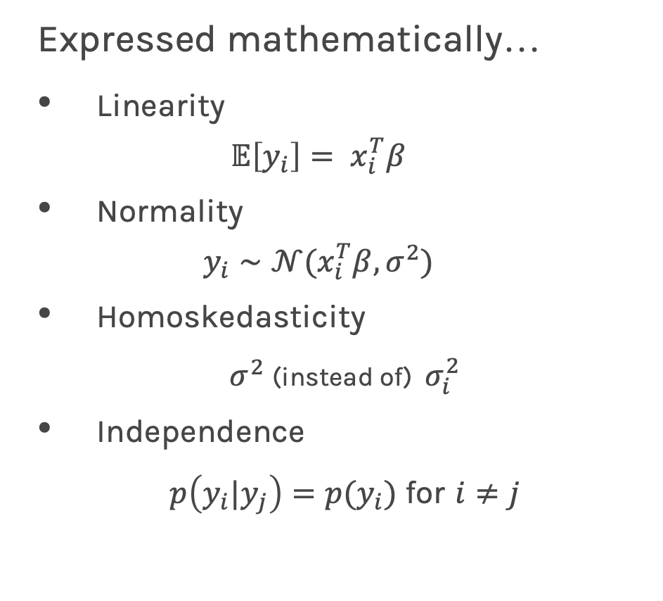
Motivation
Expressed mathematically…
Linearity
$$𝔼\left[y_{i}\right]= x_{i}^{T}β$$
Normality
$$y_{i}∼𝒩(x_{i}^{T}β, σ^{2})$$
Homoskedasticity
$σ^{2}$(instead of) $σ_{i}^{2}$
Independence
$p\left(y_{i}|y_{j}\right)=p(y_{i})$ for $i≠j$

Slide 6


Motivation
What happens when our assumptions break down?

Slide 7
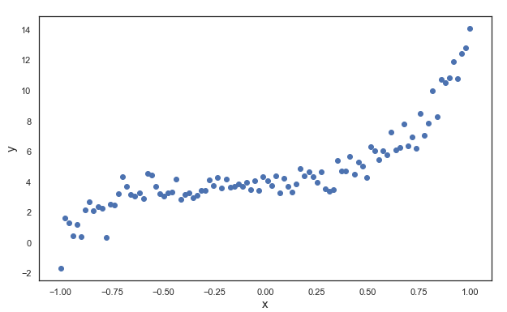
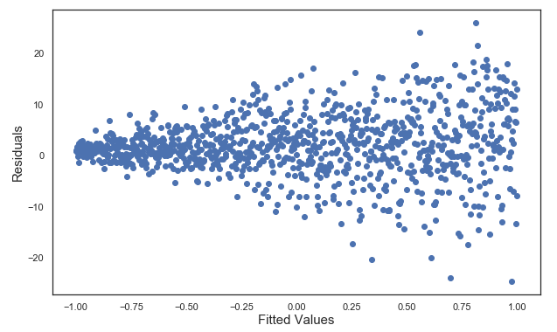
Motivation
We have options within the framework of linear regression
Nonlinearity
Heteroskedasticity
Transform X or Y
(Polynomial Regression)
Weight observations
(WLS Regression)

Slide 8
Motivation
But assuming Normality can be pretty limiting…
Consider modeling the following random variables:
Whether a coin flip is heads or tails (Bernoulli)
Counts of species in a given area (Poisson)
Time between stochastic events that occur w/ constant rate (gamma)
Vote counts for multiple candidates in a poll (multinomial)

Slide 9
Motivation
We can extend the framework for linear regression.
Enter:
Generalized Linear Models
Relaxes:
Normality assumption
Homoskedasticity assumption

Slide 10

Motivation

Slide 11
Anatomy

Slide 12
Anatomy
Two adjustments must be made to turn LM into GLM
Assume response variable comes from a family of distributions called the exponential dispersion family (EDF).
The relationship between expected value and predictors is expressed through a link function.

Slide 13
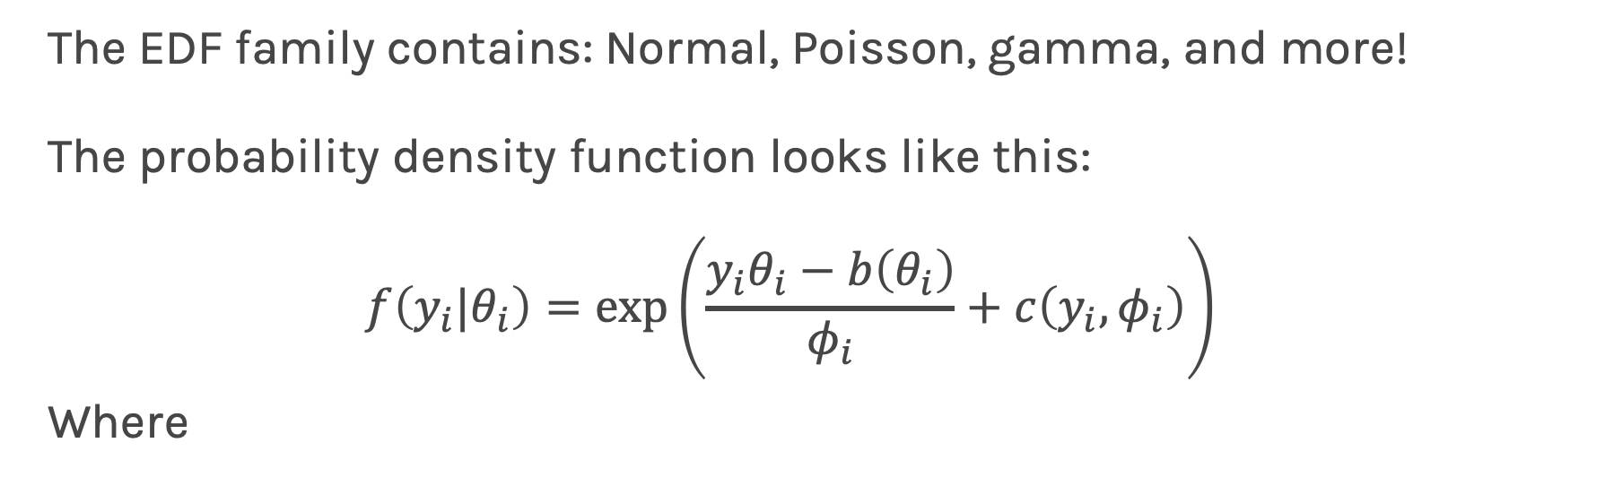
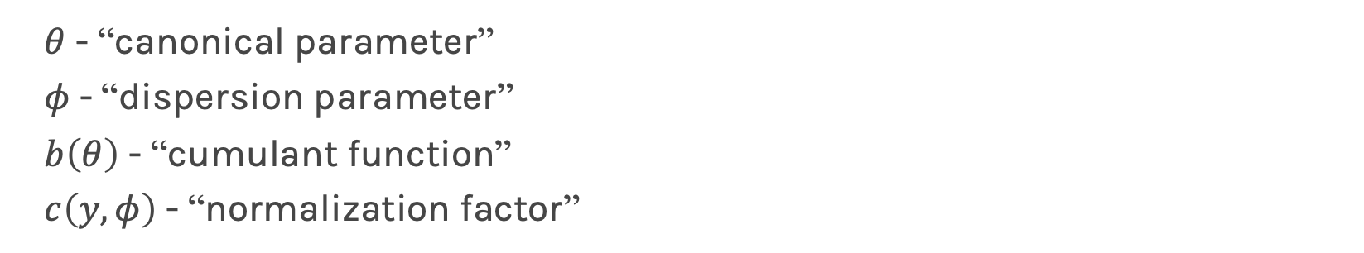
Anatomy – EDF Family
The EDF family contains: Normal, Poisson, gamma, and more!
The probability density function looks like this:
$$f\left(y_{i}|θ_{i}\right)=\exp\left(\frac{y_{i}θ_{i}−b\left(θ_{i}\right)}{φ_{i}}+c\left(y_{i}, φ_{i}\right)\right)$$
Where
$θ$ - “canonical parameter”
$φ$ - “dispersion parameter”
$b\left(θ\right)$ - “cumulant function”
$c\left(y, φ\right)$ - “normalization factor”

Slide 14
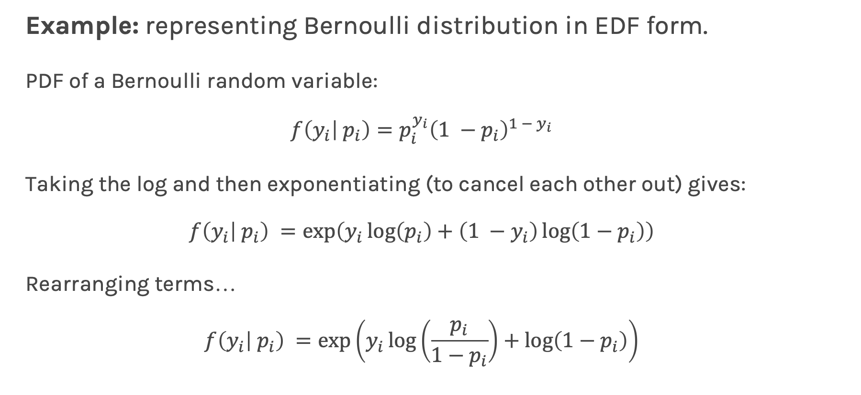
Anatomy – EDF Family
Example: representing Bernoulli distribution in EDF form.
PDF of a Bernoulli random variable:
$$f\left(y_{i} | p_{i}\right)=p_{i}^{y_{i}}{\left(1 −p_{i}\right)}^{{1 − y}_{i}}$$
Taking the log and then exponentiating (to cancel each other out) gives:
$$f\left(y_{i} | p_{i}\right) =\exp\left(y_{i}\log\left(p_{i}\right)+\left(1 −y_{i}\right)\log\left(1−p_{i}\right)\right)$$
Rearranging terms…
$$f\left(y_{i} | p_{i}\right) =\exp\left(y_{i}\log\left(\frac{p_{i}}{1−p_{i}}\right)+\log\left(1−p_{i}\right)\right)$$

Slide 15
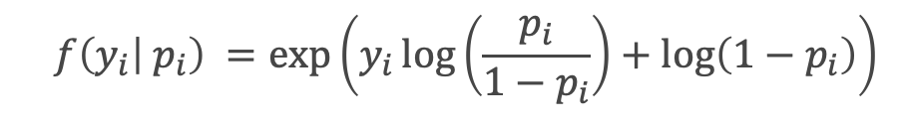

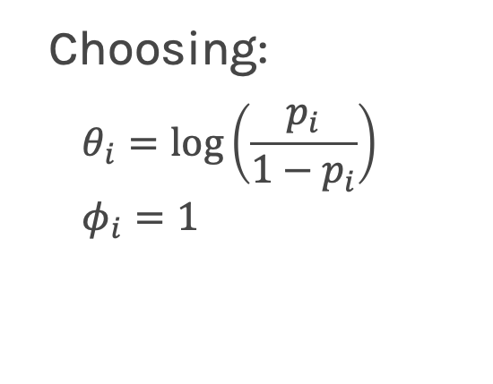
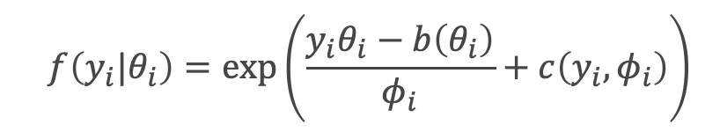
Anatomy – EDF Family
Comparing:
vs.
$$f\left(y_{i}|θ_{i}\right)=\exp\left(\frac{y_{i}θ_{i}−b\left(θ_{i}\right)}{φ_{i}}+c\left(y_{i}, φ_{i}\right)\right)$$
$$f\left(y_{i} | p_{i}\right) =\exp\left(y_{i}\log\left(\frac{p_{i}}{1−p_{i}}\right)+\log\left(1−p_{i}\right)\right)$$
Choosing:
$$θ_{i}=\log\left(\frac{p_{i}}{1−p_{i}}\right)$$
$$φ_{i}=1$$
$$b(θ_{i})=\log\left(1+e^{θ_{i}}\right)$$
$$c(y_{i}, φ_{i})=0$$
And we recover the EDF form of the Bernoulli distribution

Slide 16
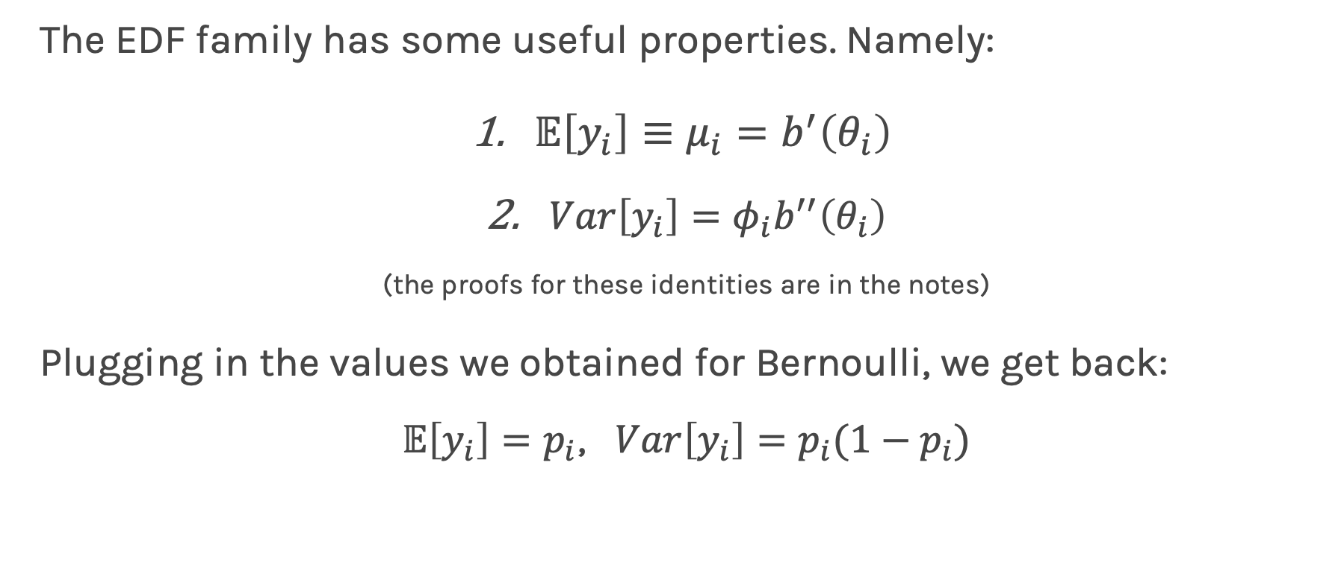
Anatomy – EDF Family
The EDF family has some useful properties. Namely:
$𝔼\left[y_{i}\right]≡μ_{i}=b^{′}\left(θ_{i}\right)$
$Var\left[y_{i}\right]=φ_{i}b^{′′}\left(θ_{i}\right)$
(the proofs for these identities are in the notes)
Plugging in the values we obtained for Bernoulli, we get back:
$𝔼\left[y_{i}\right]=p_{i}$, $Var\left[y_{i}\right]=p_{i}(1−p_{i})$

Slide 17

Anatomy – Link Function
Time to talk about the link function

Slide 18
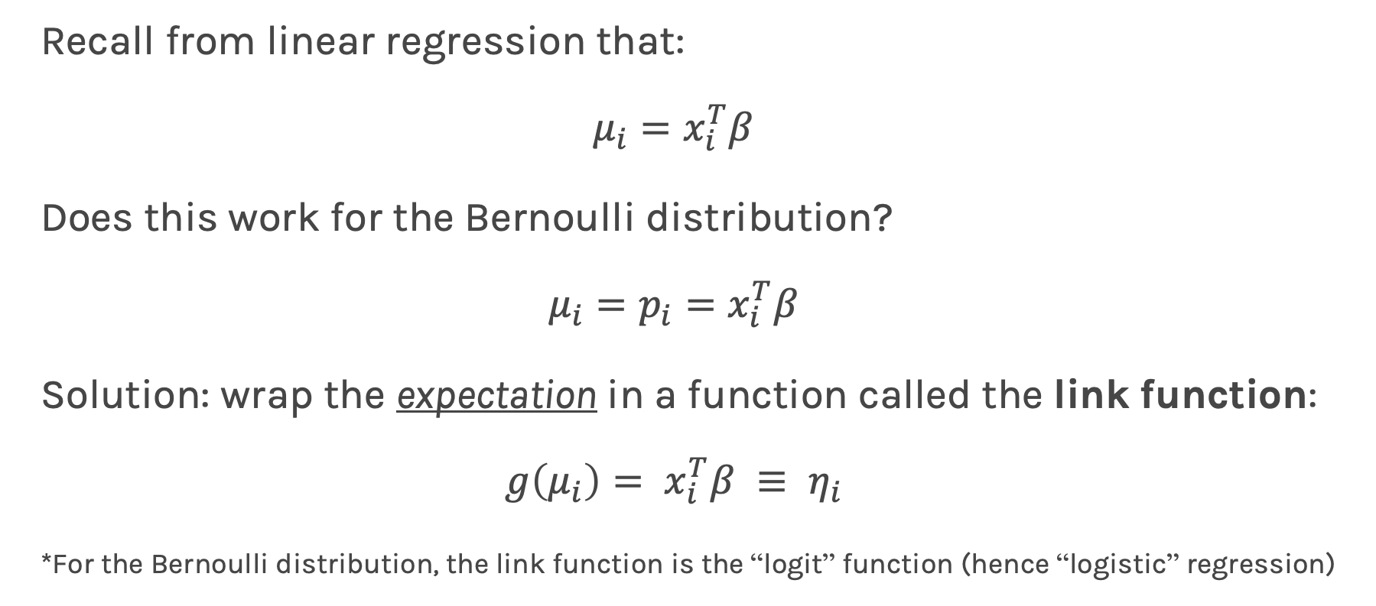
Anatomy – Link Function
Recall from linear regression that:
$$μ_{i}=x_{i}^{T}β$$
Does this work for the Bernoulli distribution?
$$μ_{i}=p_{i}=x_{i}^{T}β$$
Solution: wrap the expectation in a function called the link function:
$$g\left(μ_{i}\right)= x_{i}^{T}β ≡ η_{i}$$
*For the Bernoulli distribution, the link function is the “logit” function (hence “logistic” regression)

Slide 19
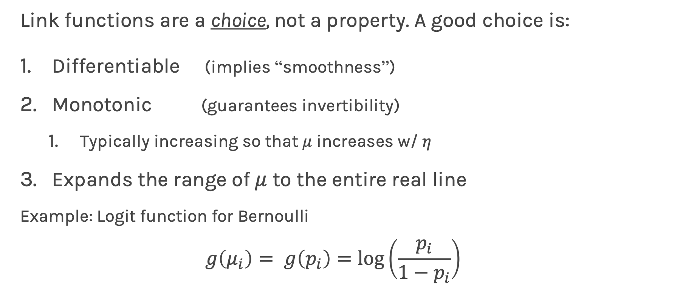
Anatomy – Link Function
Link functions are a choice, not a property. A good choice is:
Differentiable (implies “smoothness”)
Monotonic (guarantees invertibility)
Typically increasing so that $μ$ increases w/ $η$
Expands the range of $μ$ to the entire real line
Example: Logit function for Bernoulli
$$g\left(μ_{i}\right)= g\left(p_{i}\right)=\log\left(\frac{p_{i}}{1−p_{i}}\right)$$

Slide 20
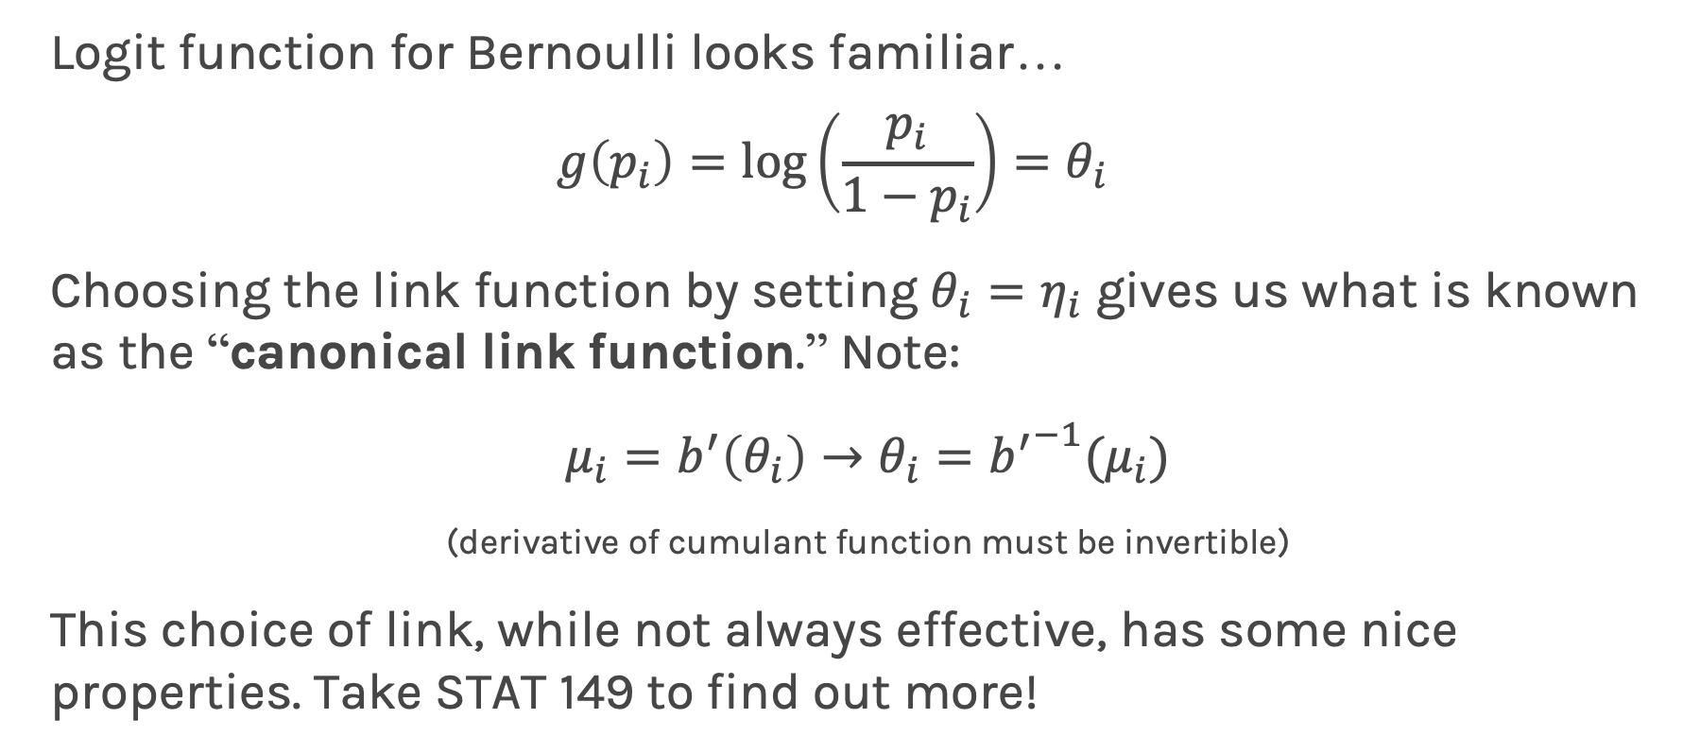
Anatomy – Link Function
Logit function for Bernoulli looks familiar…
$$g\left(p_{i}\right)=\log\left(\frac{p_{i}}{1−p_{i}}\right)=θ_{i}$$
Choosing the link function by setting $θ_{i}=η_{i}$ gives us what is known as the “canonical link function.” Note:
$μ_{i}=b^{′}\left(θ_{i}\right)→θ_{i}={b^{′}}^{−1}(μ_{i})$
(derivative of cumulant function must be invertible)
This choice of link, while not always effective, has some nice properties. Take STAT 149 to find out more!

Slide 21
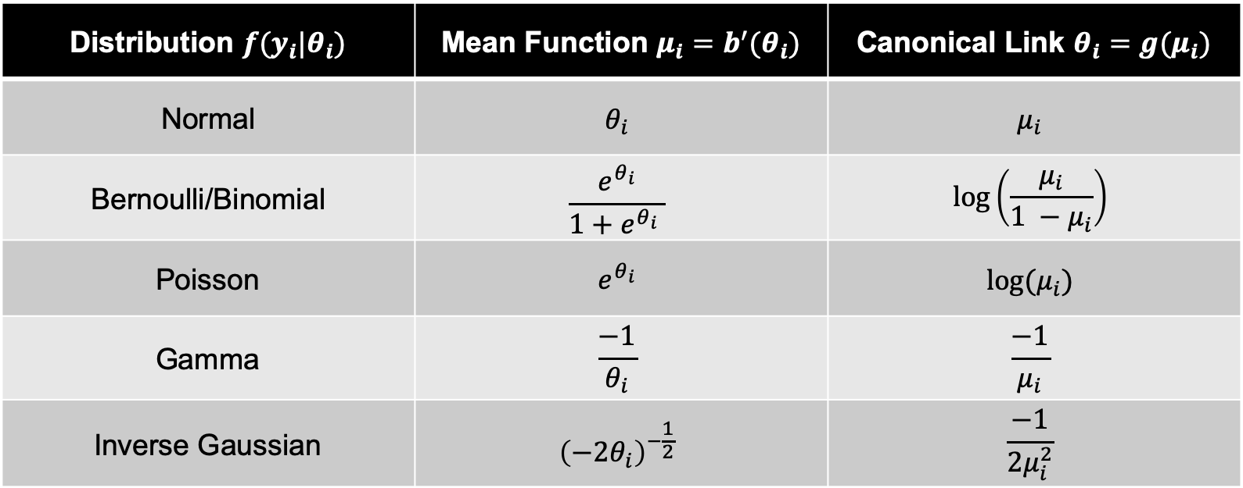
Anatomy – Link Function
Here are some more examples (fun exercises at home)
Distribution $f(y_{i}|θ_{i})$ | Mean Function $μ_{i}=b^{′}(θ_{i})$ | Canonical Link $θ_{i}=g(μ_{i})$
Normal | $$θ_{i}$$ | $$μ_{i}$$
Bernoulli/Binomial | $$\frac{e^{θ_{i}}}{1+e^{θ_{i}} }$$ | $$\log\left(\frac{μ_{i}}{1 −μ_{i}}\right)$$
Poisson | $$e^{θ_{i}}$$ | $$log⁡(μ_{i})$$
Gamma | $$\frac{−1}{θ_{i}}$$ | $$\frac{−1}{μ_{i}}$$
Inverse Gaussian | $${\left(−2θ_{i}\right)}^{−\frac{1}{2}}$$ | $$\frac{−1}{2μ_{i}^{2}}$$

Slide 22
Maximum Likelihood Estimation

Slide 23
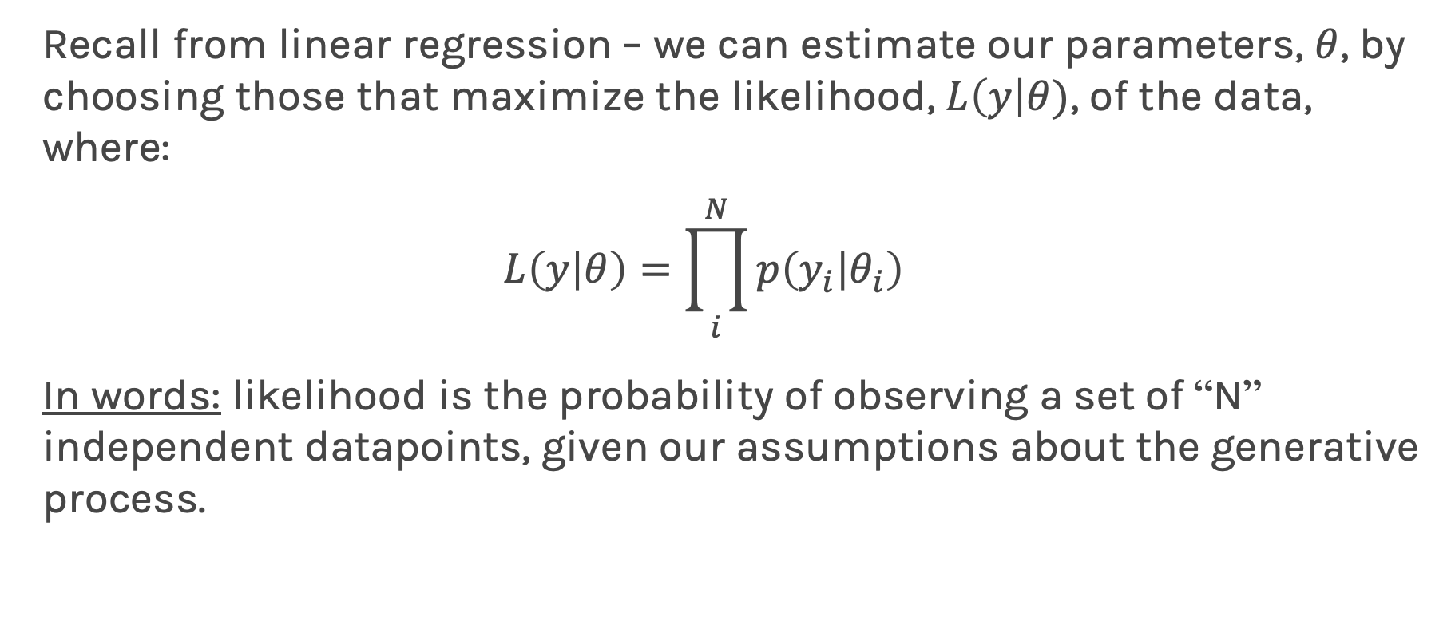
Maximum Likelihood Estimation
Recall from linear regression – we can estimate our parameters, $θ$, by choosing those that maximize the likelihood, $L\left(y\right|θ)$, of the data, where:
$$L\left(y | θ\right)=\prod_{i}^{N}{p\left(y_{i} | θ_{i}\right)}$$
In words: likelihood is the probability of observing a set of “N” independent datapoints, given our assumptions about the generative process.

Slide 24
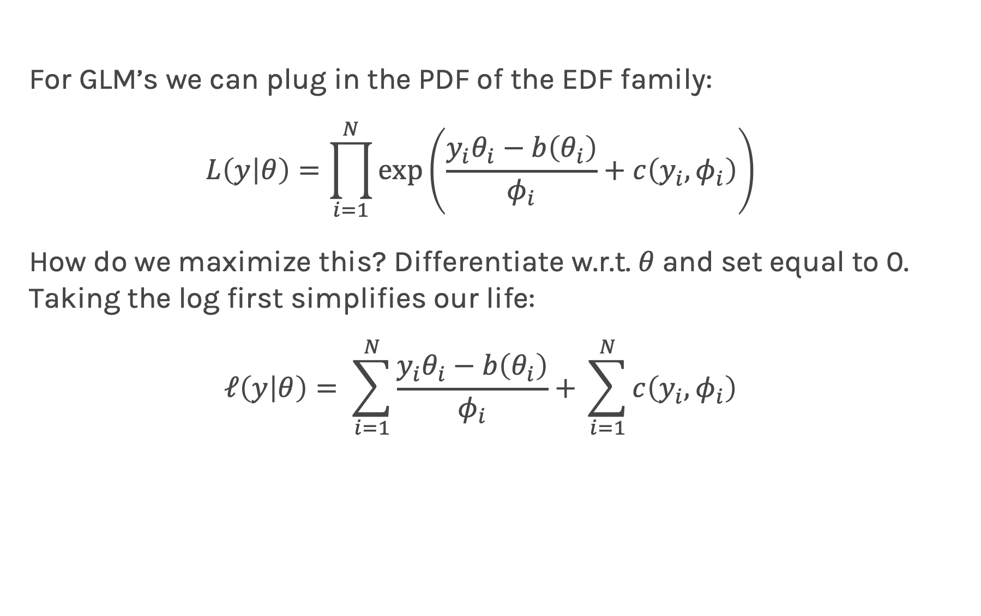
Maximum Likelihood Estimation
For GLM’s we can plug in the PDF of the EDF family:
$$L\left(y | θ\right)=\prod_{i=1}^{N}{\exp\left(\frac{y_{i}θ_{i}−b\left(θ_{i}\right)}{φ_{i}}+c\left(y_{i}, φ_{i}\right)\right)}$$
How do we maximize this? Differentiate w.r.t. $θ$and set equal to 0. Taking the log first simplifies our life:
$$ℓ\left(y | θ\right)= \sum_{i=1}^{N}{\frac{y_{i}θ_{i}−b\left(θ_{i}\right)}{φ_{i}}+ }\sum_{i=1}^{N}{c\left(y_{i}, φ_{i}\right)}$$

Slide 25
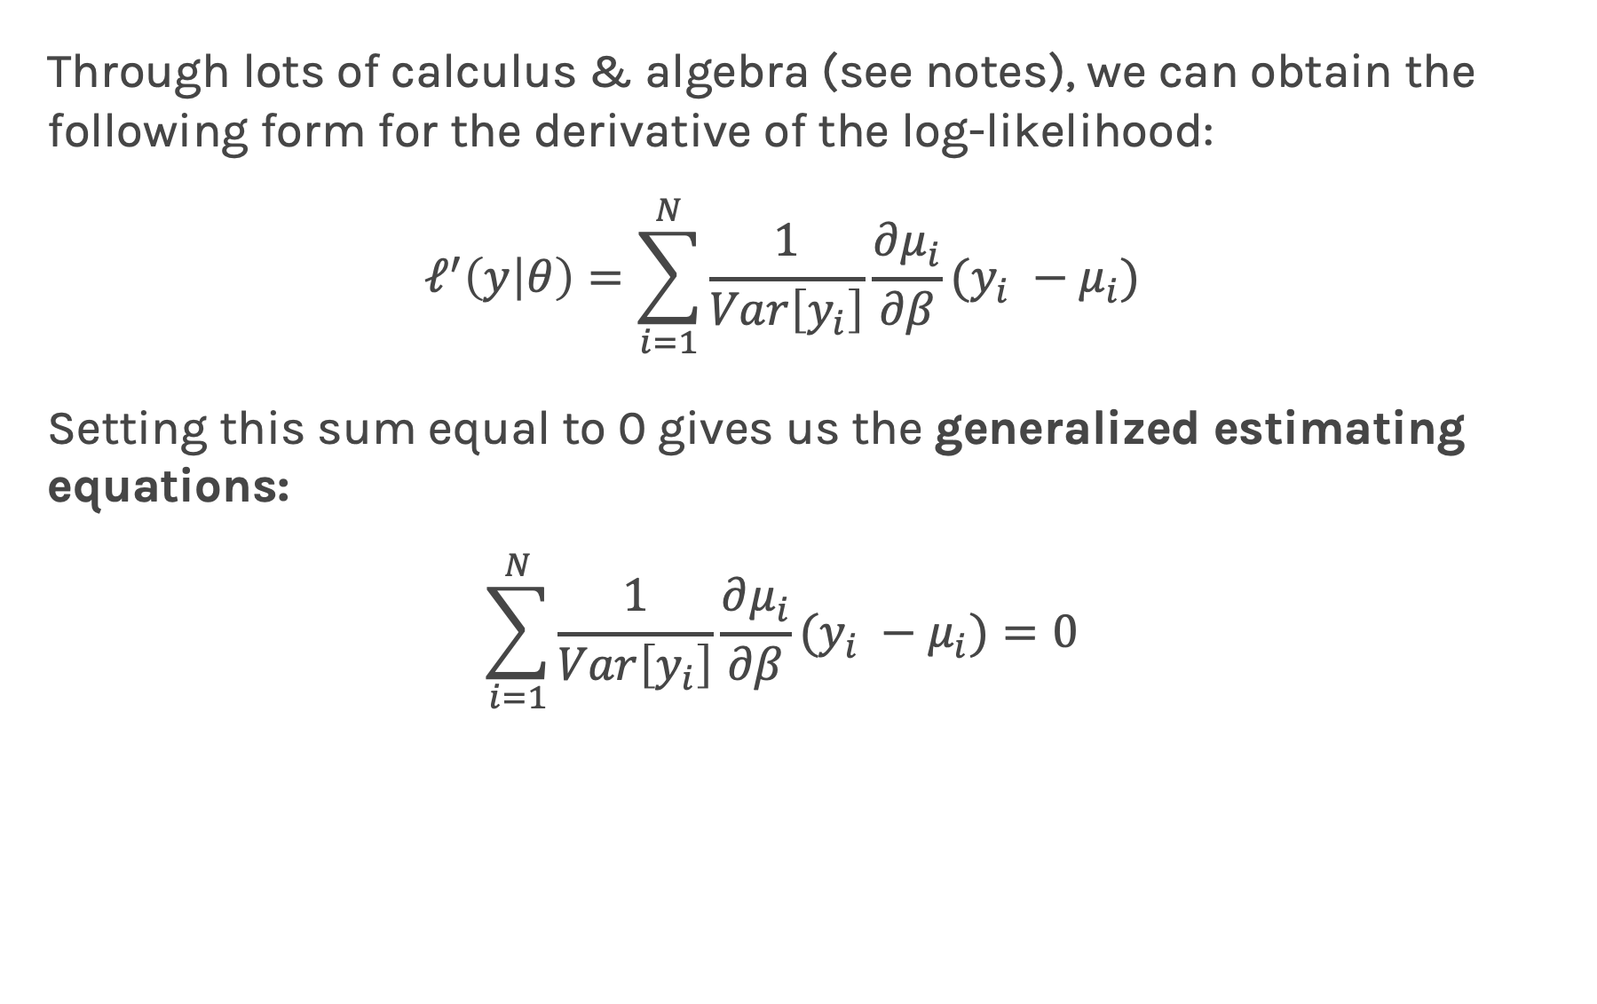
Maximum Likelihood Estimation
Through lots of calculus & algebra (see notes), we can obtain the following form for the derivative of the log-likelihood:
$$ℓ^{′}\left(y | θ\right)=\sum_{i=1}^{N}{\frac{1}{Var\left[y_{i}\right]}\frac{∂μ_{i}}{∂β}(y_{i} −μ_{i})}$$
Setting this sum equal to 0 gives us the generalized estimating equations:
$$\sum_{i=1}^{N}{\frac{1}{Var\left[y_{i}\right]}\frac{∂μ_{i}}{∂β}(y_{i} −μ_{i})}=0$$

Slide 26
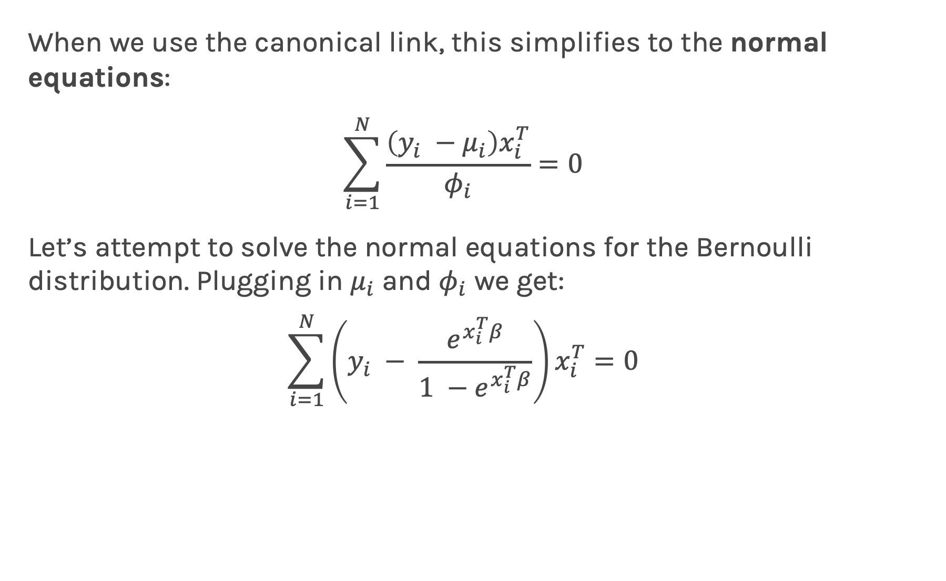
Maximum Likelihood Estimation
When we use the canonical link, this simplifies to the normal equations:
$$\sum_{i=1}^{N}{\frac{\left(y_{i} −μ_{i}\right)x_{i}^{T}}{φ_{i}}}=0$$
Let’s attempt to solve the normal equations for the Bernoulli distribution. Plugging in $μ_{i}$ and $φ_{i}$ we get:
$$\sum_{i=1}^{N}{\left(y_{i} − \frac{e^{x_{i}^{T}β}}{1 −e^{x_{i}^{T}β}}\right)x_{i}^{T}=0}$$

Slide 27

Maximum Likelihood Estimation
Sad news: we can’t isolate $β$ analytically.

Slide 28
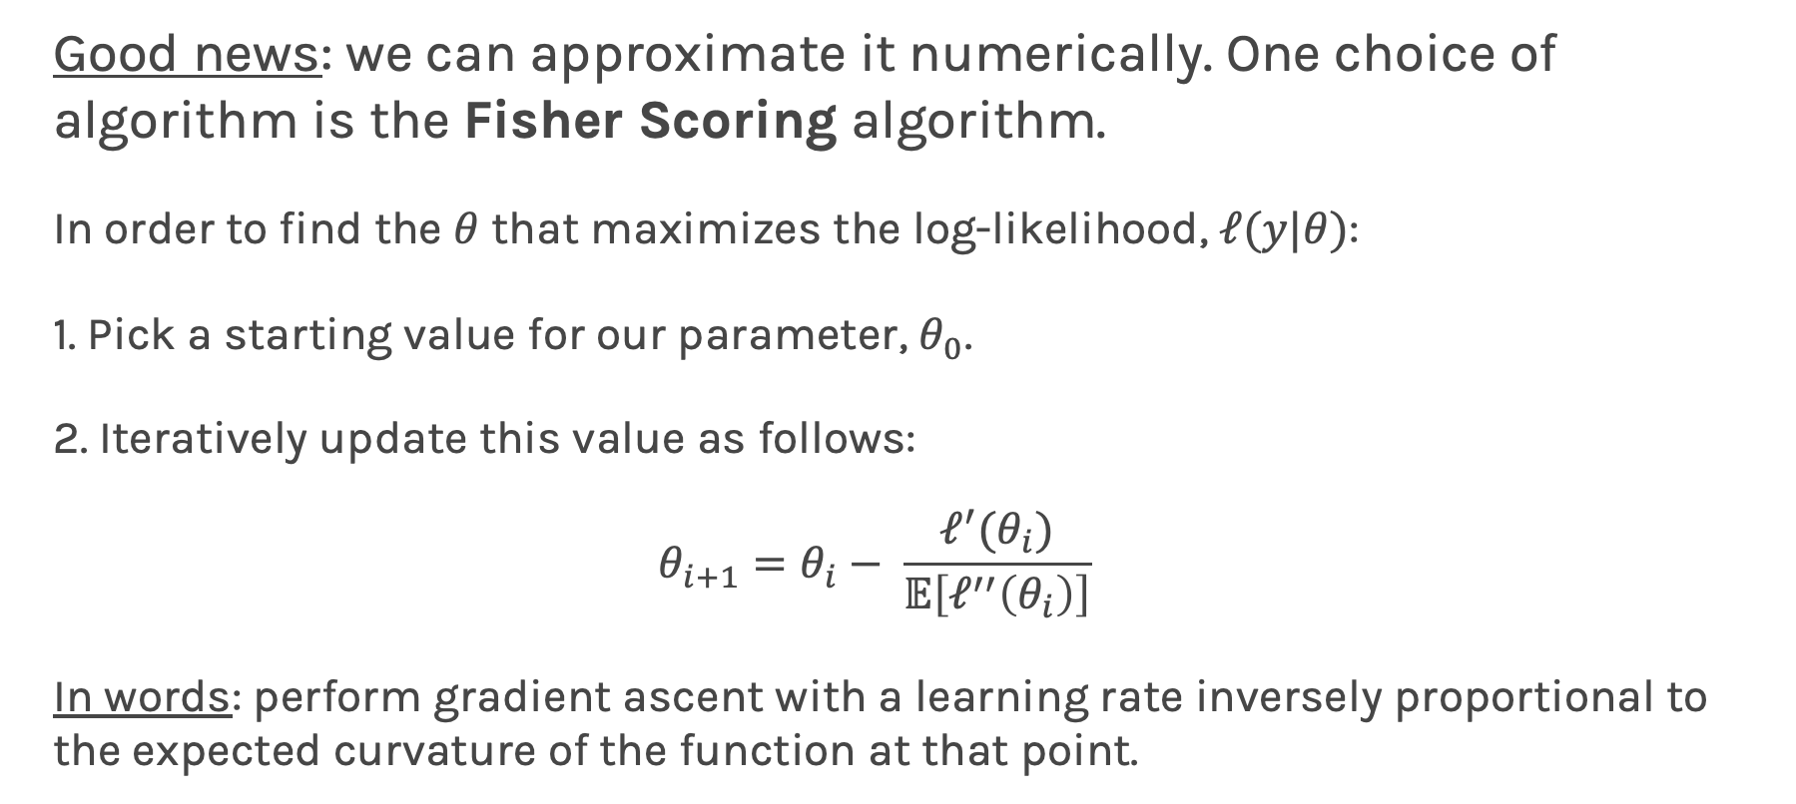
Maximum Likelihood Estimation
Good news: we can approximate it numerically. One choice of algorithm is the Fisher Scoring algorithm.
In order to find the $θ$ that maximizes the log-likelihood, $ℓ(y|θ)$:
1. Pick a starting value for our parameter, $θ_{0}$.
2. Iteratively update this value as follows:
$$θ_{i+1}=θ_{i}− \frac{ℓ^{′}(θ_{i})}{𝔼\left[ℓ^{′′}\left(θ_{i}\right)\right]}$$
In words: perform gradient ascent with a learning rate inversely proportional to the expected curvature of the function at that point.

Slide 29
Maximum Likelihood Estimation
Here are the results of implementing the Fisher Scoring algorithm for simple logistic regression in python:
DEMO

Slide 30
Questions?

